Slide 1
Ray:
A Distributed Framework for Emerging AI Applications
Dynamic Control Flow
in Large-Scale Machine Learning
Philipp Moritz, Robert Nishihara, Stephanie Wang, Alexey Tumanov, Richard Liaw,
Eric Liang, Melih Elibol, Zongheng Yang, William Paul, Michael I. Jordan, Ion Stoica
Yuan Yu, Martin Abadi, Paul Barham, Eugene Brevdo, Mike Burrows, Andy Davis, Jeff Dean, Sanjay Ghemawat, Tim Harley, Peter Hawkins, Michael Isard, Manjunath Kudlur, Rajat Monga, Derek Murray, Xiaoqiang Zheng
Presenter: Hengjia Zhang, Jiaqing Ni, Yide Gu

Slide 2
Ray
A Distributed Framework for Emerging AI Applications

Slide 3
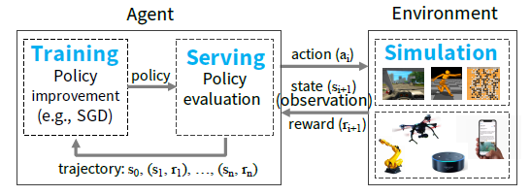
Motivation and Background
Reinforcement Learning
Learn to operate continuously within an uncertain environment based on delayed and limit feedback
Notes:
chess board, self-driving car, piloting drone, inverted pendulum

Slide 4
Motivation and Background
Goal of RL: Learn policy
a mapping from the state of the environment to a choice of action
3 main capabilities for finding policies in large-scale applications
Simulation to evaluate policies
Distributed training
Serving the policy in interactive closed/open-loop scenarios
Notes:
choice of action sequences, long-term consequences of those choices.
Policy generating.
Improve policy based on data generated through si ulations of interactions with environments. Serve policy in a control problem scenarios.

Slide 5
Motivation and Background
Existing frameworks | Simulation | Training | Serving
Batch Dataflow System (MapReduce/Spark/Dryad) | ✖ |  | ✖
Task-parallel System (CIEL/Dask) |  | ✖ | ✖
Streaming System (Naiad/Storm) |  | ✖ | ✖
Deep-Learning Framework (TensorFlow/MXNet) | ✖ |  | ✖
Model-Serving System (TensorFlow Serving/Clipper) | ✖ | ✖

Slide 6
Motivation and Background
People doing ML are building new system from scratch
AlphaGo (DeepMind), DotA (OpenAI)
Ray: a general-purpose cluster-computing framework that enables
Simulation
Training
Serving
Notes:
Interacts repeatedly with the environment. Maximize the reward.
User requirements to system requirements.

Slide 7
Requirement to satisfy
Fine-grained, heterogeneous computations
Duration range from milliseconds to hours
Flexible computation model
For both stateless and stateful computations
Dynamic execution
The order in which computations finish is not always known in advance
Result of a computation can determine future computations
Notes:
Dynamic computation framework handles millions of heterogeneous tasks millisecond-level latencies
stateless: easy for load balancing and movement of computation to data, good for fine-grained simulation and data processing, extracting features from images or videos.
stateful: good for implementing parameter servers, perform repeated computation GPU training process.

Slide 8
Programming Model
Tasks:
The execution of a remote function on a stateless worker
Actors:
Represent stateful computations and instantiate class as a remote actor
Tasks (stateless) | Actors (stateful)
Fine-grained load balancing | Coarse-grained load balancing
Support for object locality | Poor locality support
High overhead for small updates | Low overhead for small updates
Efficient failure handling | Overhead from checkpointing
Notes:
Tasks: Immutable objects, output depends solely on inputs, no side-effect. Simplify fault tolerance through function re-execution on failure.
Actor methods invoked remotely and executed serially. Also returns a future. Handle is used to pass actor to other actors or tasks.
Actor implement parameter servers and GPU-based iterative computation (training)

Slide 9
Computation Model
Ray employs a dynamic task graph computation model.
Nodes Types:
Data objects
Tasks (Remote function invocations)
Actor method invocations
Edges Types:
Data Edges: dependencies between data objects and tasks/methods
Control Edges: Computation dependencies between tasks
Stateful Edges: State dependencies between method invocations on the same actor
Notes:
Actor method invocation identitcal to tasks with one key difference. The stateful edges.

Slide 10
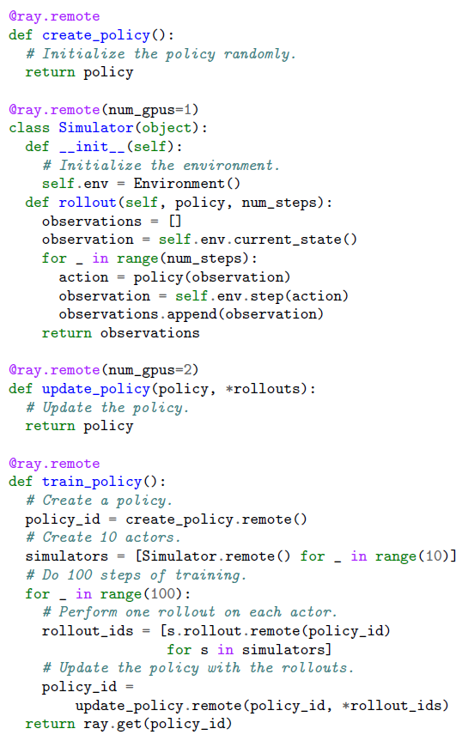
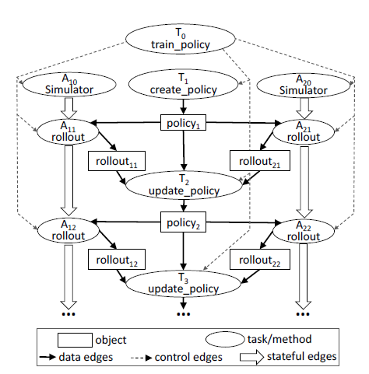
Computation Model

Slide 11
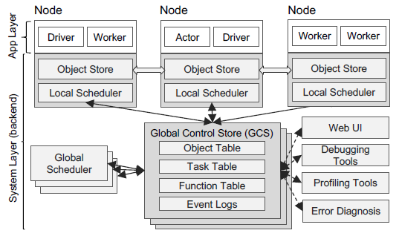
Architecture
Ray’s architecture comprises
An application layer implementing the API
A system layer providing high scalability and fault tolerance
Notes:
Workers are started automatically and assigned tasks by the system layer. No local state

Slide 12
Application Layer
Driver: A process executing the user program
Worker: A stateless process that executes tasks
Actor: A stateful process that executes the methods it exposes
Notes:
Workers are started automatically and assigned tasks by the system layer. Function is published to all workers.
Unlike a worker, an actor is explicitly instantiated by a worker or a driver.

Slide 13
System Layer
Global Control Store (GCS)
Key-value store with pub-sub functionality
Maintains the entire control state of the system
Decouple task dispatch from task scheduling
Notes:
Current dataflow system couple task dispatch and task scheduling by storing object locations and sizes in a centralized scheduler, which may be very expensive when communications are intense.
Therefore, global control store decouples task dispatch from task scheduling, so that the system may have low latency

Slide 14
System Layer
Bottom-Up Distributed Scheduler
Dynamically schedule millions of tasks per second
two-level hierarchical scheduler consisting of a global scheduler and per-node local schedulers
Notes:
Current dataflow system are using centralized scheduler which a large latency.
To avoid overloading the global scheduler, the tasks created at a node are submitted first to the node’s local scheduler
local scheduler schedules tasks locally unless the node is overloaded or can’t satisfied a task’s requirements
If a local scheduler decides not to schedule a task locally, it forwards it to the global scheduler

Slide 15
System Layer
In-memory Distributed Object Store
Store the inputs and outputs of every task/stateless computation
Inputs are replicated if not local
Task writes its outputs to the local object store
Notes:
On each node, the object stores are implemented via shared memory

Slide 16
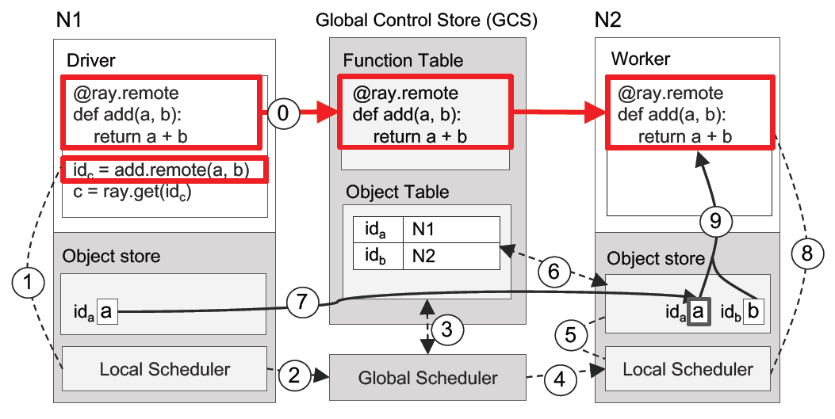
Executing a task remotely

Slide 17
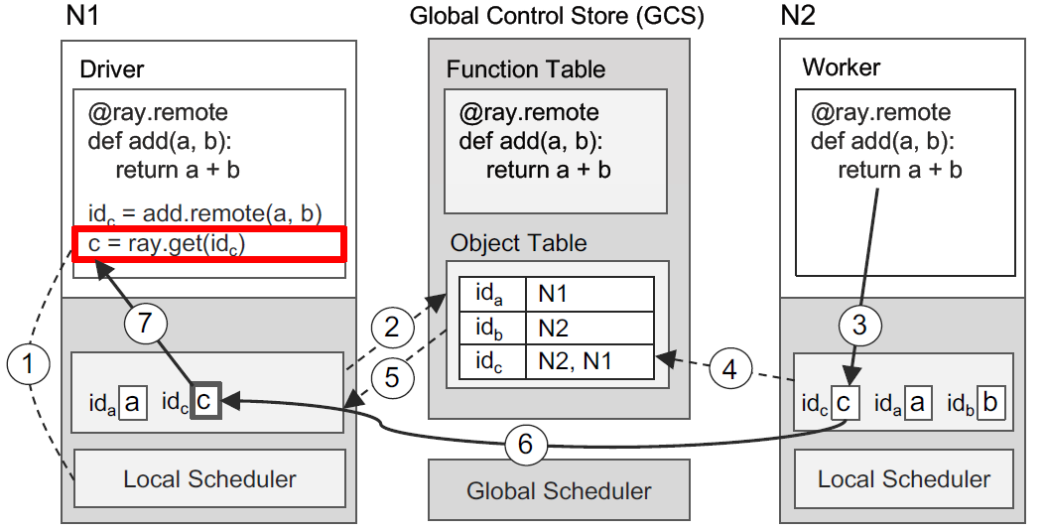
Returning the result of a remote task

Slide 18
Differences with the related work
Dynamic task graphs (CIEL, Dask):
Ray extends the task model with an actor abstraction
Ray employs as fully distributed and decoupled control plane and scheduler
Dataflow systems (MapReduce, Spark, Dryad):
They are too restrictive for fine-grained and dynamic simulation workload
No Actor abstraction/distributed scalable control pane and scheduler
Machine Learning frameworks (TensorFlow, MXNet):
Limited support for coupling training with simulations and embedded serving

Slide 19
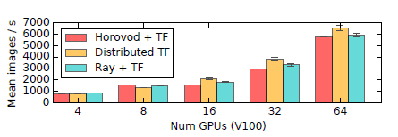


Evaluation
Training:
Ray Parameter-server SGD implementation
Serving:
The server throughput achieved using a Ray actor to serve policy
Simulation:
Ray program that issues tasks as simulations while concurrently gathering results back to driver.
Notes:
In training, the paper only compare against TensorFlow-based systems to accurately measure the overhead imposed by Ray, rather than differences between the deep learning frameworks themselves.
Training is good: Ray is able to express the same application-level optimizations found in these specialized systems in Ray’s general-purpose API
Serving is good: since Ray has low-overhead serialization and shared memory abstraction
Simulation is good: fine-grained simulation tasks

Slide 20
Dynamic Control Flow
in Large-Scale Machine Learning

Slide 21
Motivation and Background
Advances in machine learning conflicts design objectives for the underlying systems
They should be scalable
They should be expressive and flexible to support both production and research

Slide 22
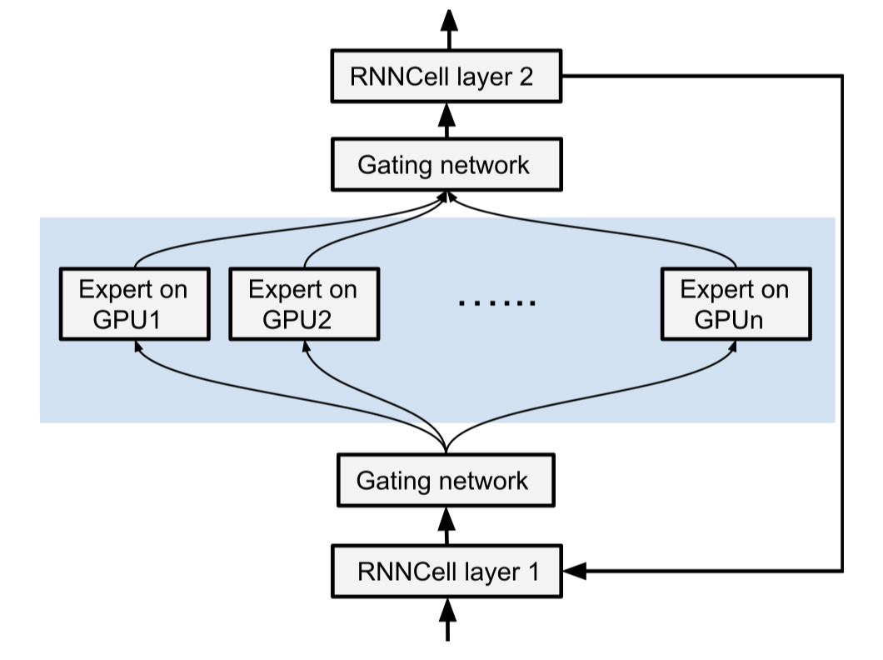
Motivation and Background
Some architectures make essential use of dynamic control flow.

Slide 23
Motivation and Background
Machine learning systems should provide general facilities for dynamic control flow
in-graph
Encode control-flow decisions as operations in the dataflow graph
out-of-graph
Implement control flow decisions in the client process, using control-flow primitives of a host language
Notes:
In-graph approach: encodes control-flow decisions as oper

Slide 24
Motivation and Background
TensorFlow is using in-graph dynamic control flow:
process a single unified dataflow graph
perform whole-program optimization
allow the entire computation to stay inside the system runtime during execution.
can be arbitrarily partitioned
support Automatic Differentiation

Slide 25
Programming Interface
cond(pred, true_fn, false_fn) (Conditional)
pred is a boolean tensor
true_fn and false_fn are functions that construct the subgraphs for the respective branches.
the result of cond is a tuple of tensors, representing the result of the branch that executes.
while_loop(pred, body, inits) (Iterative)
pred and body are functions that construct the subgraphs for the loop termination condition and the loop body
inits is a tuple of tensors that specifies the initial values of the loop variables

Slide 26
Control Flow in Machine Learning
Recurrent Neural Network
Apply a cell function to every element of a sequence
Neural Machine Translation (NMT)
an encoder and a decoder
TensorFlow implements the dynamic_rnn operator using while-loops
Reinforcement Learning
An agent interacts with its environment by performing a sequence of actions according to some learned policy and receives rewards
Actions and rewards need not be deterministic or differentiable
Additional training techniques are required
Notes:
Both of the encoder and decoder canbe conveniently expressed as while-loops on variable-length sentences.
Not deterministic or idfferentiable: traditional backpropagation is insufficient and additional techniques are required
These training techiniques generally benefit from dynamic control flow

Slide 27
System Architecture
Central Coordinator
Distributed execution
Central coordinator: partitions the graph into a set of subgraphs
Partitioning would cut an edge between two devices
Send(t, k) and Recv(k) to replace the edge with a pair of communication operations, share a rendezvous key
Problem with the rendezvous key
Without control flow, each operation in the graph executes exactly once
With control flow, an operation in a loop can execute zero or more times
Op1
Send
Recv
Op2
Notes:
To execute data-flow graph in heterogeneous environment, we hire a central coordinator
Maps nodes in the graph to devices and partition the graph into sets of subgraphs
For tensors to be sent between devices, we also introduce communication operation
… use shared rendezvous key and it works perfect for static data-flow graphs.
Move on to dynamic control flow, there is a chance a single operation (in loop for example) executes multiple times
We have to generate unique names and rendezvous keys dynamically to distinguish multiple invocations of the same operations

Slide 28
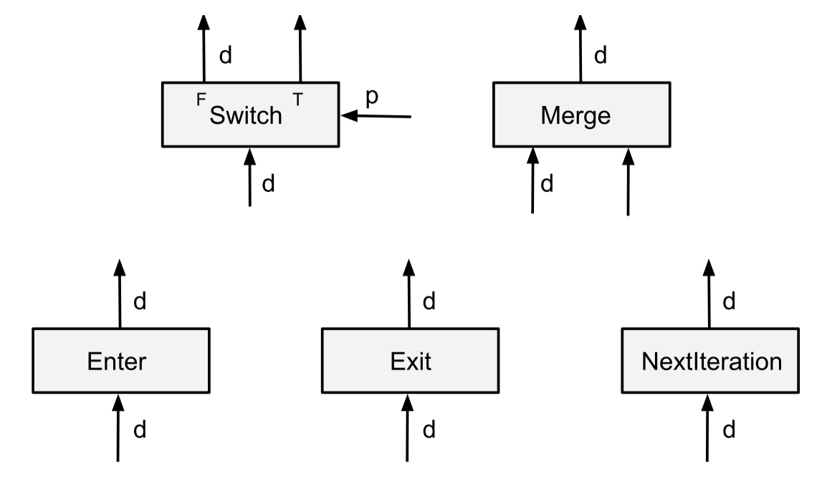
Control-Flow Primitives
Every execution of an operation takes place within a “frame”
Each operation executes at most once per frame.
Notes:
predicate
Enter: forward input to a child frame asynchronously, which is created when first Enter executes
Exit: symmetrical, forwards result to parent frame.
NextIteration: forwards input to the next iteration frame.
Frame: dynamically allocated execution contexts associated with each iteration of a loop.
Each operation executed at most once per frame in control flow graph.

Slide 29
Compilation of Control-Flow Constructs
Conditional Statement cond(p, true_fn, false_fn)
Use Switch(demultiplexer) and Merge(multiplexer)
Output 0
Data Input
Switch
Merge
Output 0
Output 1 (Dead)
Control Input
Notes:
Merge: enabled for execution when ANY input becomes available

Slide 30
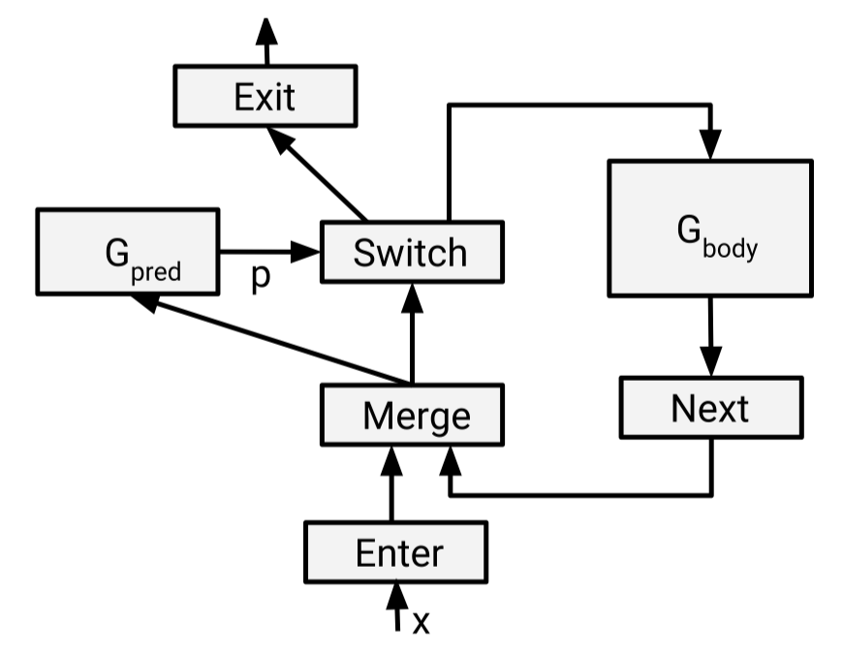
Compilation of Control-Flow Constructs
Single While-loop
The loop predicate and the loop body are represented by the subgraphs G_pred and G_body
Notes:
Example while loop with a single loop variable x
Input tensor is forwarded to Predicate operation and controls Switch behavior.
Then, forward tensor either to Exit current frame (scope of the loop) or to loop body operation.
The cyclic data-flow allows result tensor to be sent back to Merge for next iteration.
**(For multiple loop variables, additional sets of Enter-Merge-Switch-Next-Exit enables multiple iterations in parallel.)
Supports nested loop & conditions, e.g. Loop body can contain a condition.

Slide 31
Local Execution
Local Executor starts from the source nodes and repeatedly executes the nodes that become ready.
Graph without Dynamic Control Flow
every node is executed exactly once
the execution ends when all nodes have been executed
Graph with Dynamic Control Flow
An operation now can be executed any number of times
The executor manages the (possibly concurrent) execution of multiple instances of the same operation, and to determine the completion of the entire execution.
Notes:
Local Execution and usage in distributed system and how eventually it works for dynamic control flow
A local Executor in charge of its subgraph part.
Starting from any source nodes (usually Enter or Recv), execution propagates to the next node that becomes ready.
Exception is Merge: any input available
Straightforward with static control flow
Troublesome with dynamic control flow
All Recv nodes in a subgraph are regarded as source nodes.

Slide 32
Local Execution
Each tensor is represented as a tuple (value, is_dead, tag)
value: tensor value
is_dead: a boolean that indicates whether the tensor is on an untaken branch of a Switch
tag: globally unique identifier for the tensor
Define a “Frame”
Tag is used to distinguish the tensors generated by different iterations
Used as the rendezvous keys
Notes:
the tag is used to distinguish the tensors generated by different iterations
This distinction is critical for the correct rendezvous of Send and Recv operations, since tags are used as the rendezvous keys.

Slide 33
Distributed Execution
What if the subgraph of a conditional branch or loop body is partitioned across devices?
allows the executors of the partitions to make progress independently
The local executors communicate only via Send and Recv operations
A centralized coordinator is involved only in the event of completion or failure
Notes:
Major challenge: partitioned conditional branch or loop
Bypass central coordinator for parallelism (for sake of performance), except when the task completes or a device fails.

Slide 34
Distributed Execution (Conditional)
Device A
Device B
Send
Recv
Data Input
Switch
Merge
Output 0
Send
Recv
Control Input
Noticed that transmits an is_dead signal only once to the destination device and, there, broadcasts it to all Recv operations.
Notes:
Issue: Recv is always ready, blocking resource on the untaken branch (where Send never executes)
Propagate is_dead across devices and as far as needed.
To avoid slowing down performance when there are too many pairs of Send-Recv …
Supports nested conditionals and distributed execution of loops

Slide 35
Distributed Execution (Iterative)

Slide 36
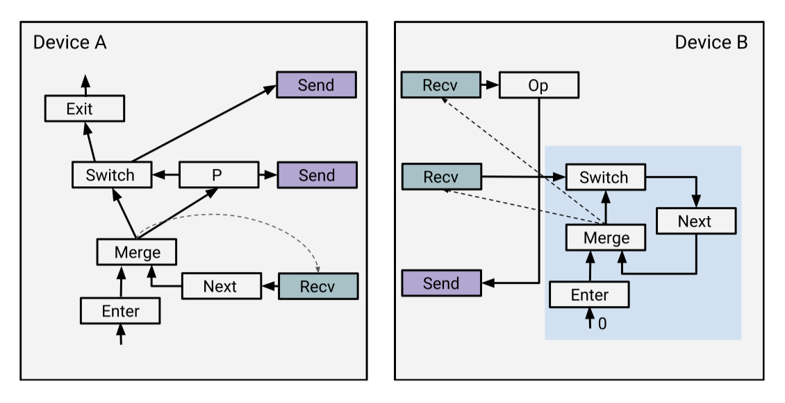
Distributed Execution (Iterative)
Notes:
Simple while loop partitioned into two devices.
Add a control-loop state machine on Recv operations on the loop body hand
The Merge provides control flow for the receivers. In this graph dotted line: control edge, impose an order on operations

Slide 37
Distributed Execution (Iterative)
On A, Recv awaits a value from B
Notes:
On A, Recv awaits a value from B

Slide 38
Distributed Execution (Iterative)
A sends P to B, so B knows the decision on iteration i
Notes:
A sends P to B, so B knows the decision on iteration i

Slide 39
Distributed Execution (Iterative)
Depending on whether P is true, A sends either the input tensor for Op or dead signal to B
Notes:
If predicate P evaluates True, A sends input tensor for Op
Otherwise A sends is_dead signal to destination device (B)

Slide 40
Distributed Execution (Iterative)
If Recv for Op gets a real tensor from A, B executes Op and sends back, otherwise, B propagates the signal and sends an is_dead to A
Notes:
if Recv for Op gets a real tensor from A, B executes Op and sends back a real tensor
Otherwise, if the Recv gets an is_dead signal, B propagates the signal through Op and sends an is_dead signal back to A

Slide 41
Distributed Execution (Iterative)
If Recv for Switch gets true, the control-loop state machine further enables Recvs for the next iteration
Notes:
Recv for Switch gets true
the control-loop state machine further enables Recvs for the next iteration

Slide 42
Distributed Execution (Iterative)
Back on A, if Recv gets a real tensor, the next iteration is started. Otherwise, execution terminates.
Notes:
Back on A, if Recv gets a real tensor, the next iteration is started. Otherwise, execution terminates.

Slide 43
Backpropagation with Control Flow
TensorFlow includes a reverse-mode automatic differentiation (autodiff) library that implements the well-known backpropagation algorithm
Notes:
Discussed as support for potentially nested conditional and loops

Slide 44
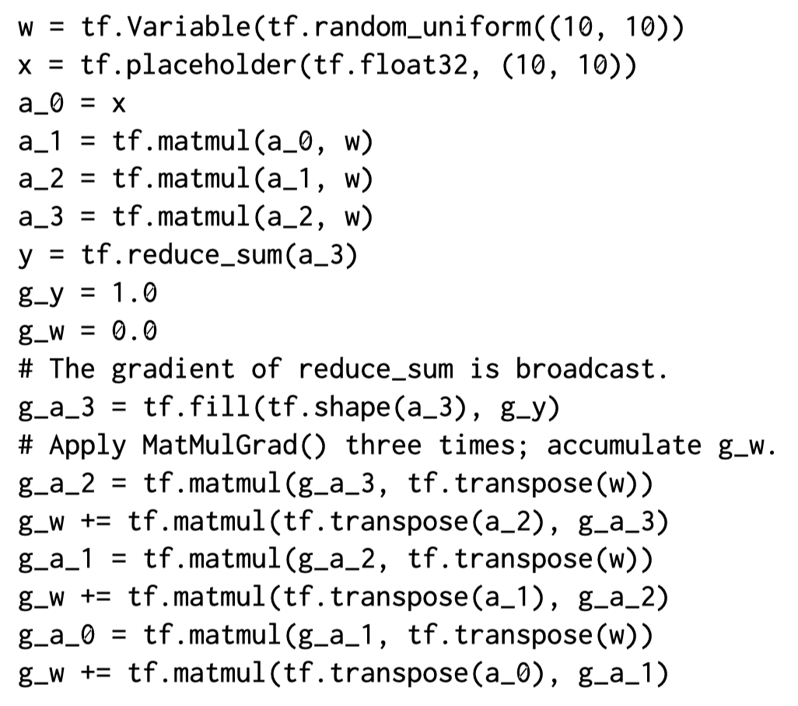
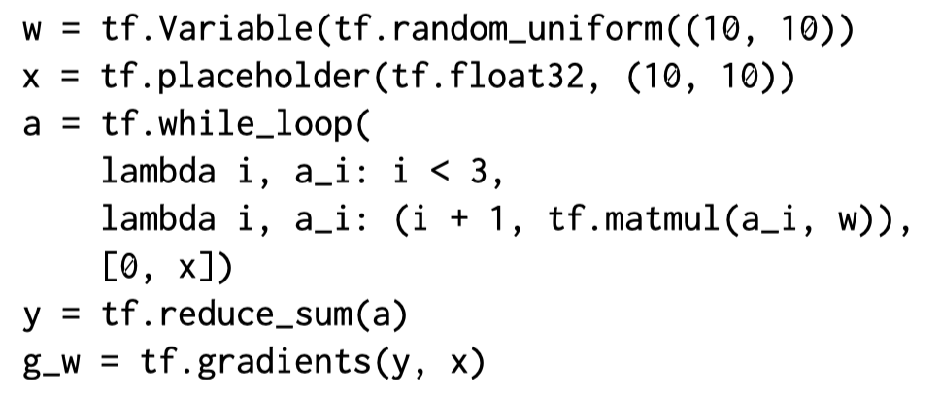
Backpropagation with Control Flow (Iterative)
Unrolling

Slide 45
Backpropagation with Control Flow (Iterative)
The gradient of a tf.while_loop() is another loop
executes the gradient of the loop body for the same # of iterations
The gradient of each differentiable loop variable becomes a loop variable in the gradient loop
Initial value is the gradient w.r.t. the corresponding loop output
The gradient of each differentiable tensor that is constant in the loop is the sum of the gradients for that tensor at each iteration
Notes:
1. The gradient of a loop features the same number of iterations

Slide 46
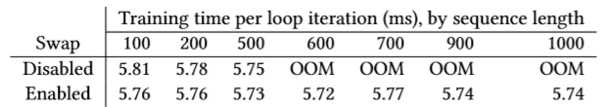
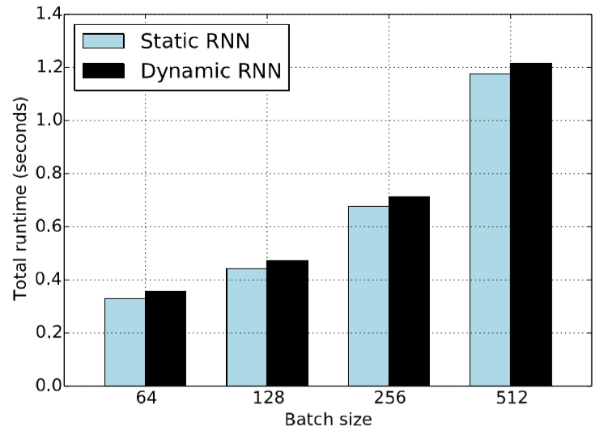
Evaluation
Memory swapping performance
Dynamic control vs. static unrolling
Notes:
One of the techniques that is used to alleviate the memory scarcity in GPUs is memory swapping.
Multiple iterations can run in parallel; forward computation can run ahead; I/O operation in gradient computation as well
Separate GPU streams for I/O and computation to improve the overlap

Slide 47
Differences with the related work
Naiad system: timely dataflow model
Supports: distributed execution, incremental computations
Does not support: heterogeneous devices, auto diff
Theano: programmer create computation graph
Does not support: nested loops, parallel/distributed execution
Other: inefficient auto diff

Slide 48
Discussion
Ray:
Why no other systems seperate object locations and scheduler?
Distributed computational graph?
Dynamic Control Flow

Slide 49
Evaluation

