Slide 1
Prediction Serving Systems
Pretzel: Opening the Black Box of Machine Learning Prediction Serving Systems
Parity Models: Erasure-Coded Resilience for Prediction Serving Systems
Presented by: Xiangfeng Zhu, Jiachen Liu, Chris Chen

Slide 2
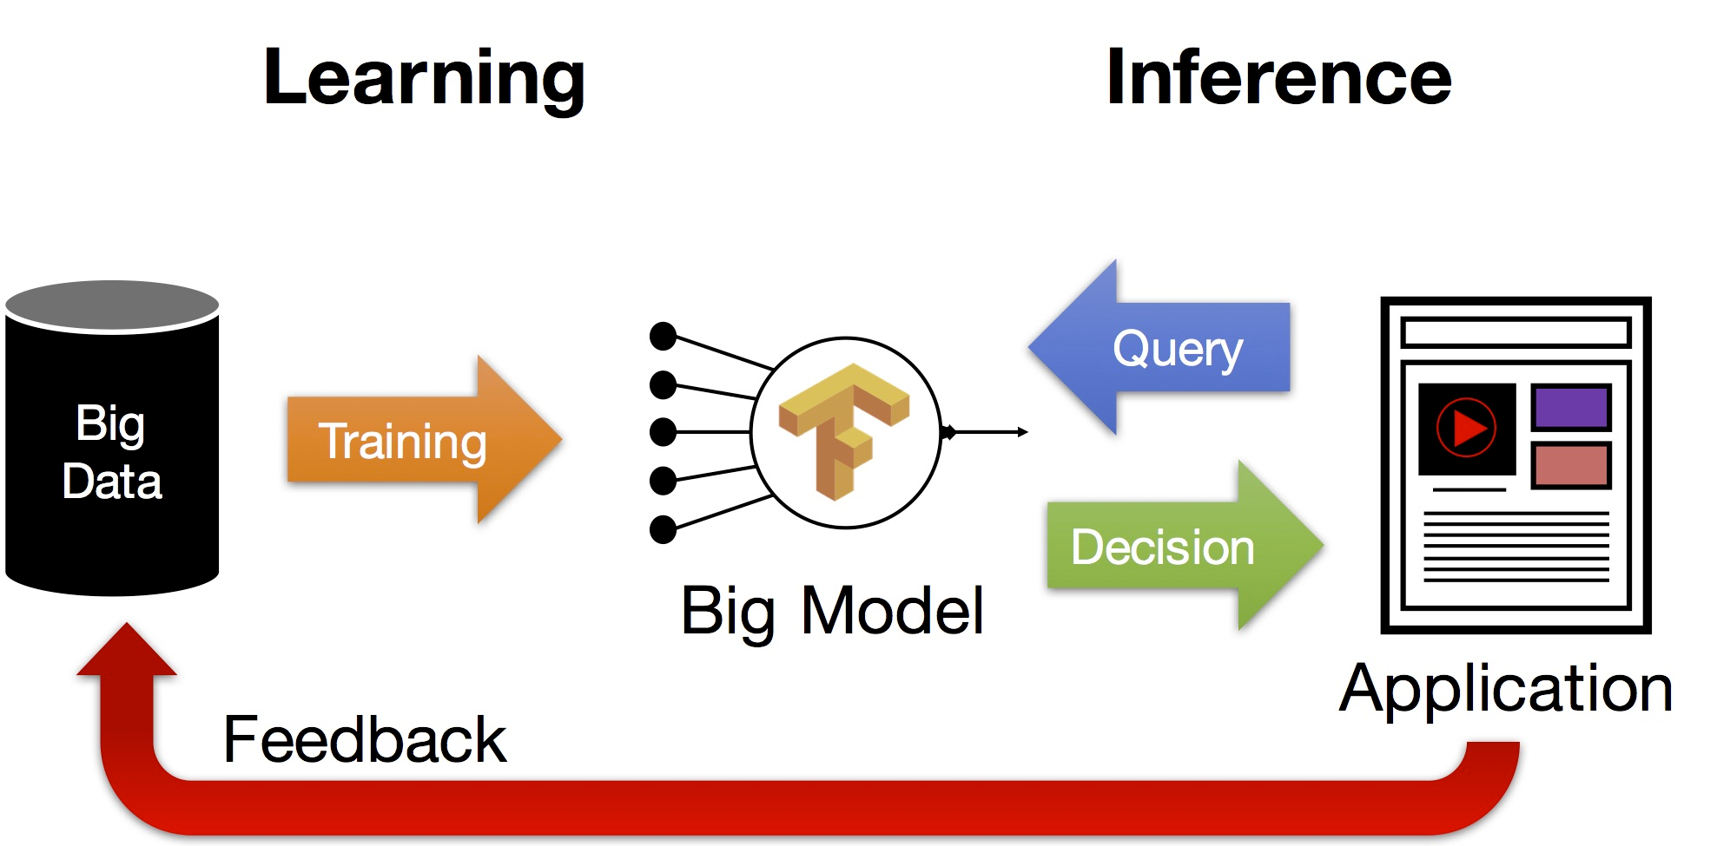
Machine Learning Lifecycle
Credit: Joseph E. Gonzalez

Slide 3
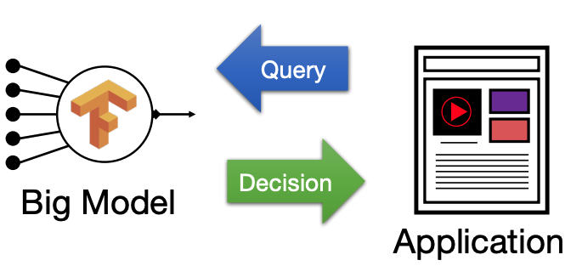
Challenge
Performance Goal:
Low latency
High throughput
Minimal resource usage

Slide 4
Two optimization on Inferencing
Offline: Pre-Materialize Predictions
Online: Compute Predictions on the fly
Notes:
during inference pipelines are often surfaced for direct users’ servicing and therefore require low latency, high throughput, and graceful degradation of performance in case of load spikes.

Slide 5

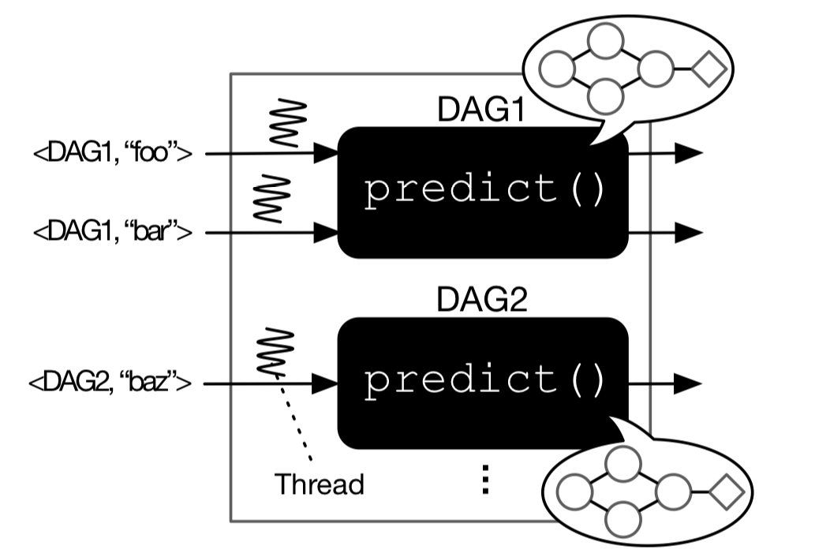
State-of-art Prediction Serving Systems:
Problem : Assume models are black box

Slide 6
State-of-art Prediction Serving Systems:
Problem : Assume models are black box
Re-use the same code in training phase
Encapsulate all operations into a function call
Apply external optimizations (caching, batching and model selection)

Slide 7
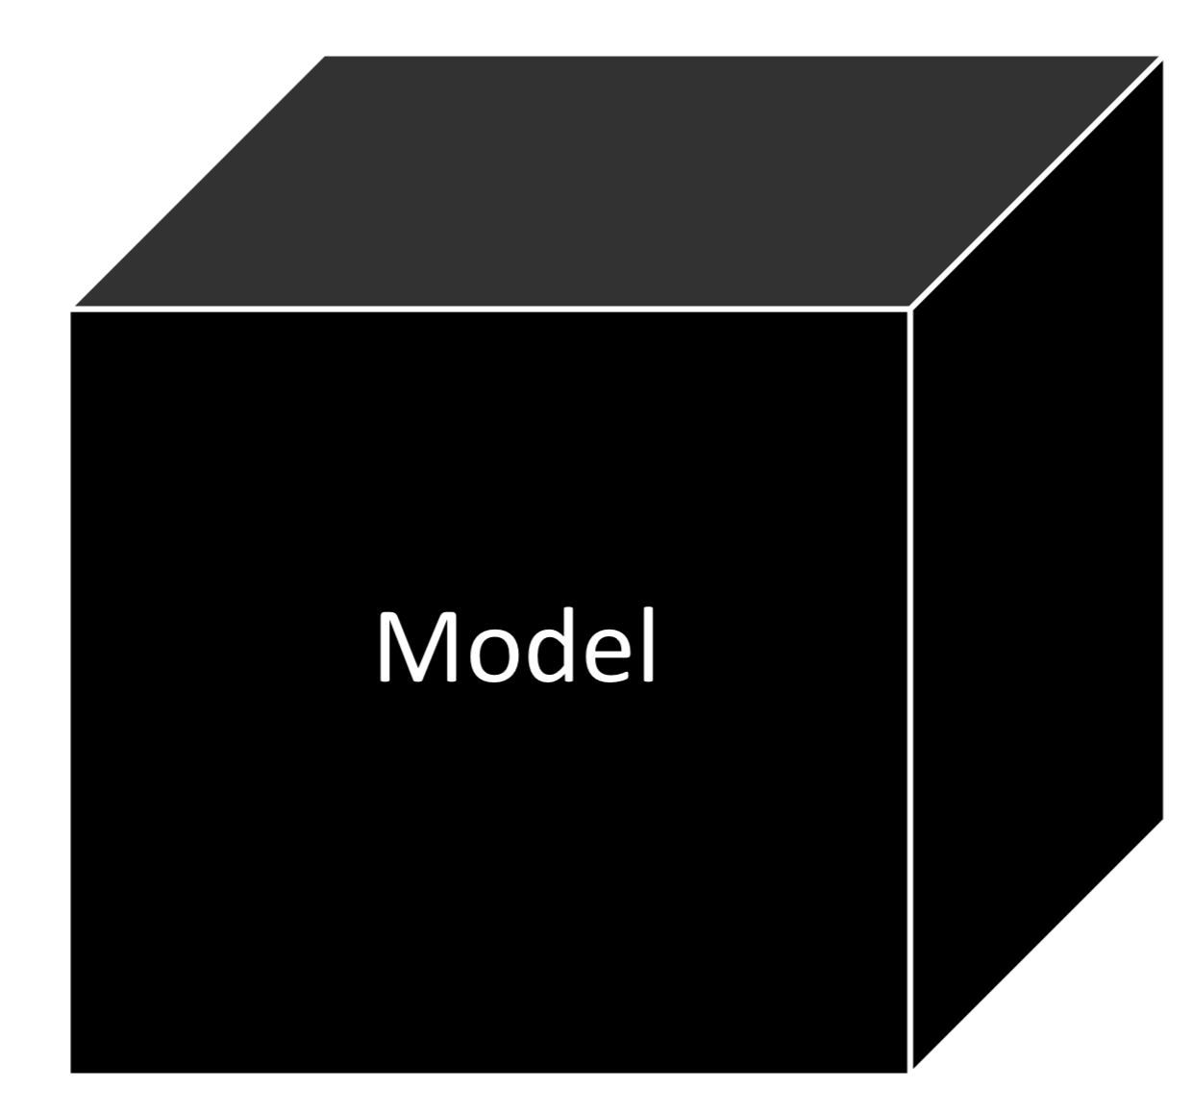
How do they work with Black Boxes?
Bubble Tea is tasty
(Text)
Positive
VS.
Negative
Example: Sentiment Analysis

Slide 8
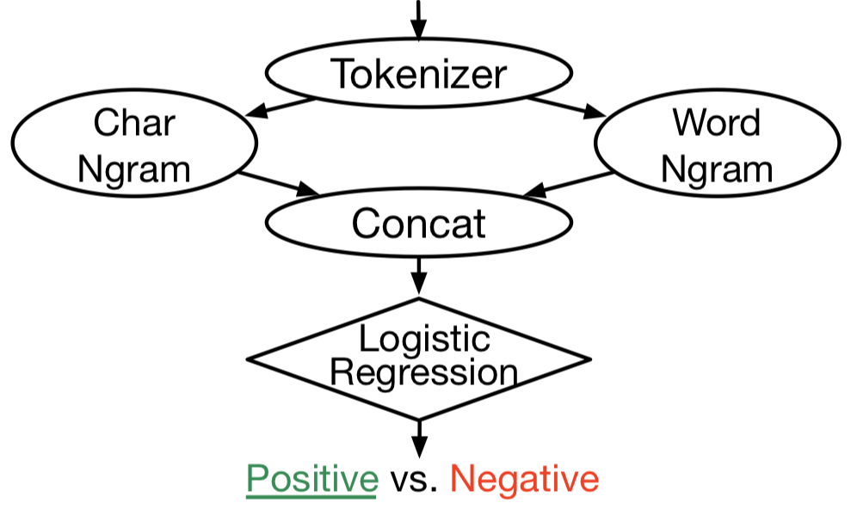
Inside ML Black Boxes:
“Bubble Tea is tasty”

Slide 9
Inside ML Black Boxes:
“Bubble Tea is tasty”
Split text into tokens
Extract N-grams
Merge vectors
Compute final score
Notes:
Can be complex DAG of operators

Slide 10
Many Models Have Similar Structures
• Many part of a model can be re-used in other models
• Identical set of operators with different parameters
Application : Customer personalization, Templates, Transfer Learning

Slide 11
Limitations of Black Box 1
Resource Waste:
Resources are isolated across Black boxes

Slide 12
Limitations of Black Box 1
Resource Waste:
Resources are isolated across Black boxes
1. Unable to share memory space
Waste memory to maintain duplicate objects
2. No coordination for CPU resources between boxes
Serving many models can use too many threads

Slide 13
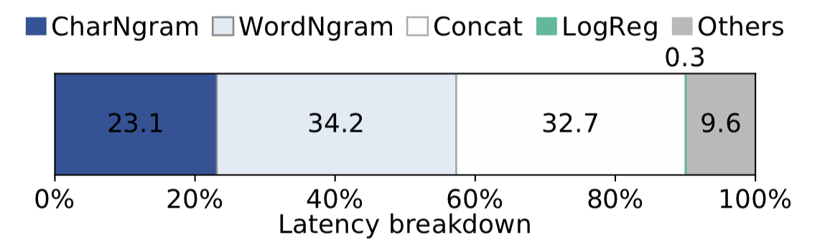
Limitations of Black Box 2
Inconsideration for Ops’ Characteristics
1. Operators have different performance characteristics
2. Re-use the existing vectors

Slide 14
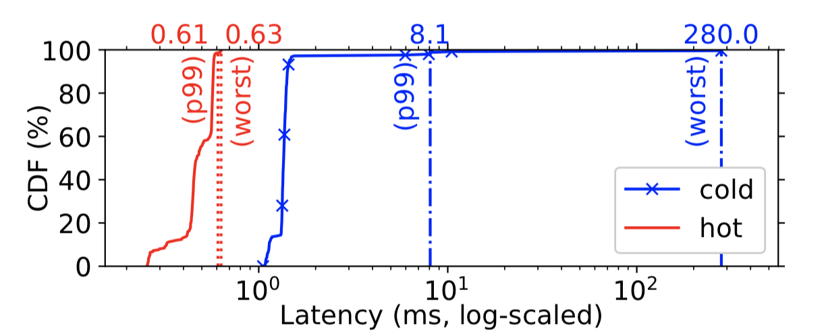
Limitations of Black Box 3
Prediction initialization
1. ML.Net initializes code and memory lazily
(efficient in training phase)
Run 250 Sentiment Analysis models 100 times
cold: first execution / hot: average of the rest 99

Slide 15
Pretzel Contribution
White-box Prediction Serving
Pretzel analyzes models to optimize the internal execution
Pretzel lets models co-exist on the same runtime, sharing computation and memory resources
Pretzel optimizes models in two directions:
End-to-end optimizations
Multi-model optimizations

Slide 16
End-to-end optimizations
Inference: a model has a defined structure and its operators are fixed
Ahead-of-time Compilation
Compile operators’ code in advance
Vector pooling
Pre-allocate data structures

Slide 17
Multi-model Optimizations：
Share computation and memory across models
Object Store
Share Operators parameters/weights
Sub-plan Materialization
Reuse intermediate results computed by other models

Slide 18
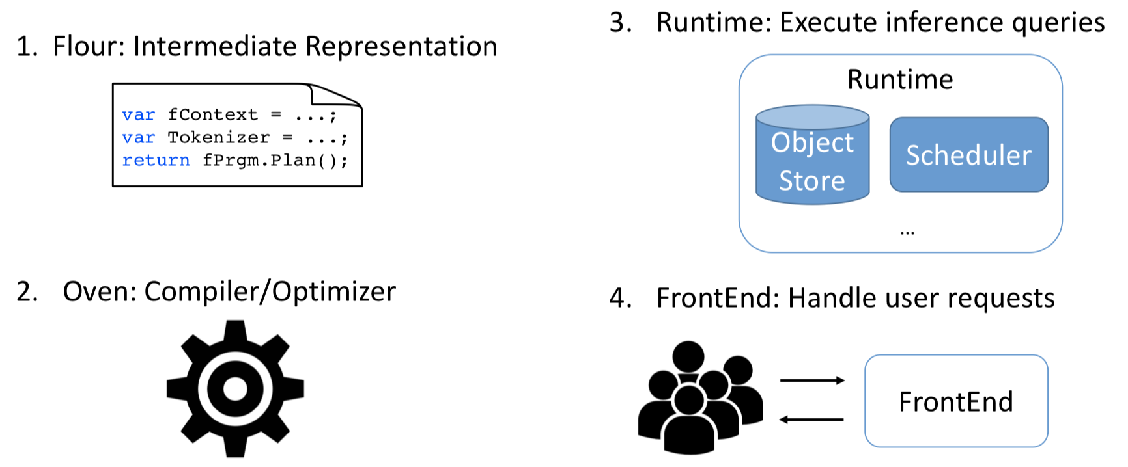
Pretzel System components

Slide 19
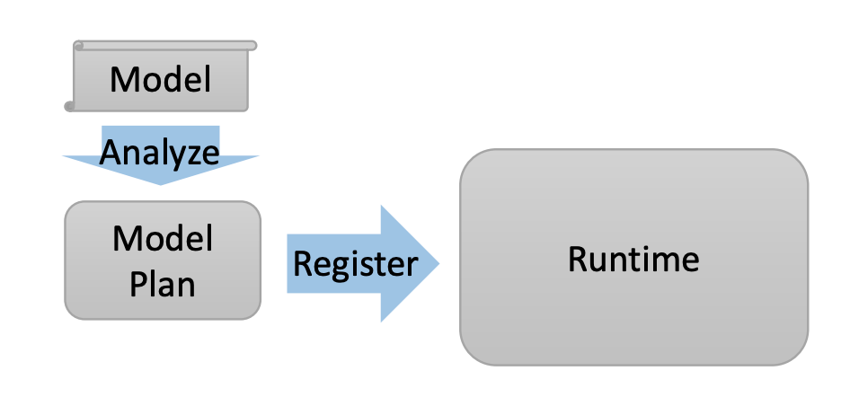
Prediction Serving with Pretzel
A two-phase process for deployment and serving.
Offline phase
Analyze structural information of models
Build Model Plan for optimal execution
Register ModelPlan to Runtime
Online phase
Handle prediction requests
Coordinate CPU & memory resources

Slide 20
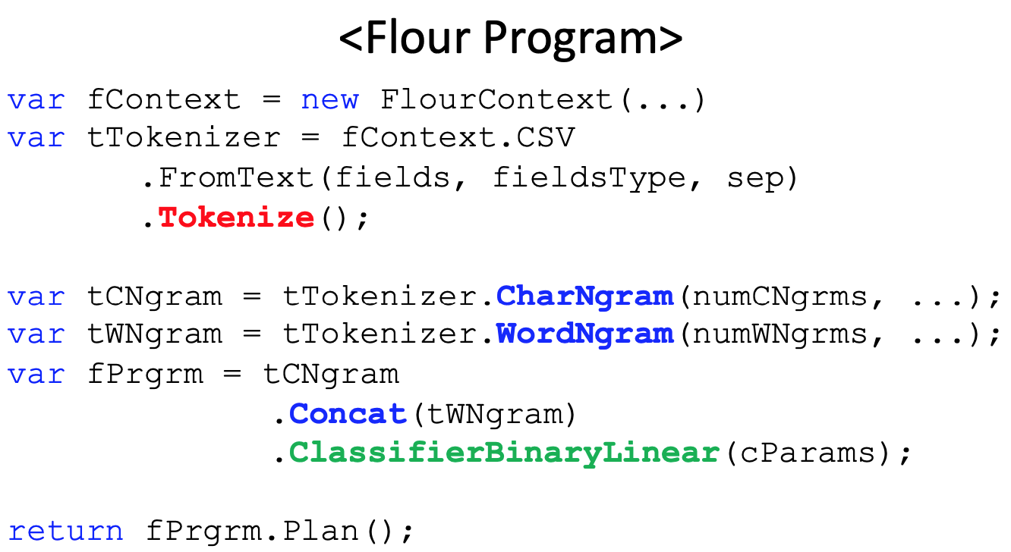
Offline Phase - 1
Translate model into Flour program
Intermediate representation

Slide 21
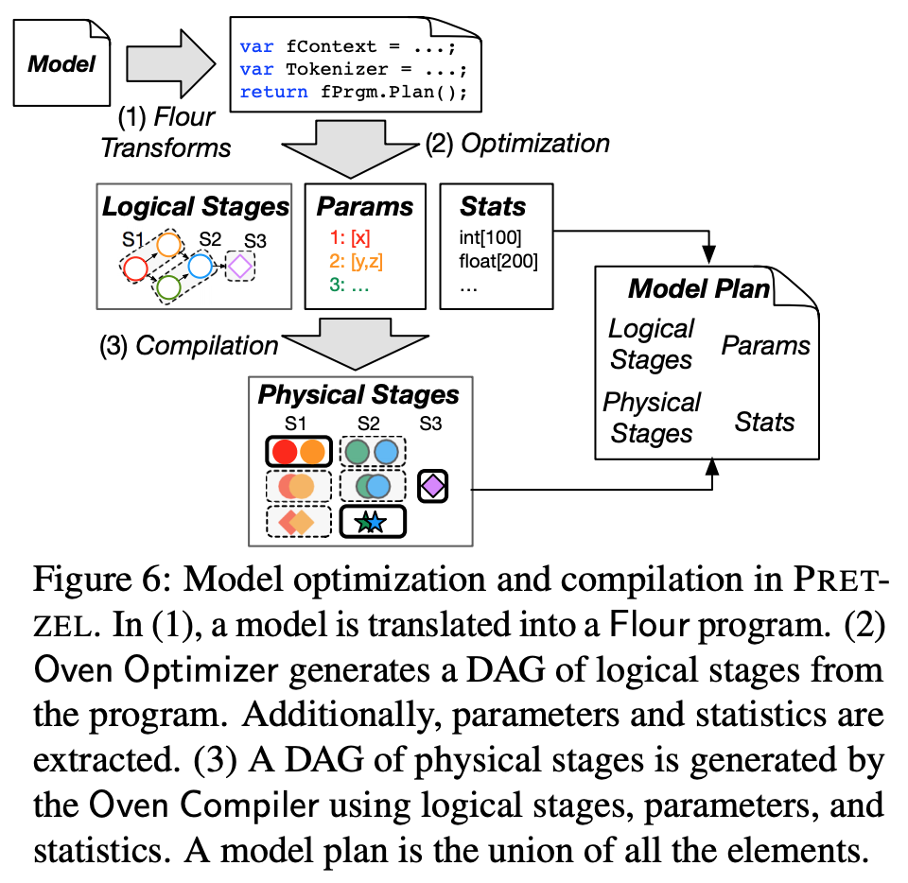
Offline Phase - 2
Build Model Plan with Oven optimizer
and compiler

Slide 22
Offline Phase - Object Store
Object Store saves common parameters used by many models.
e.g. language dictionaries in the context of different NLP models
Object Store is populated offline by Model Plan Compiler

Slide 23
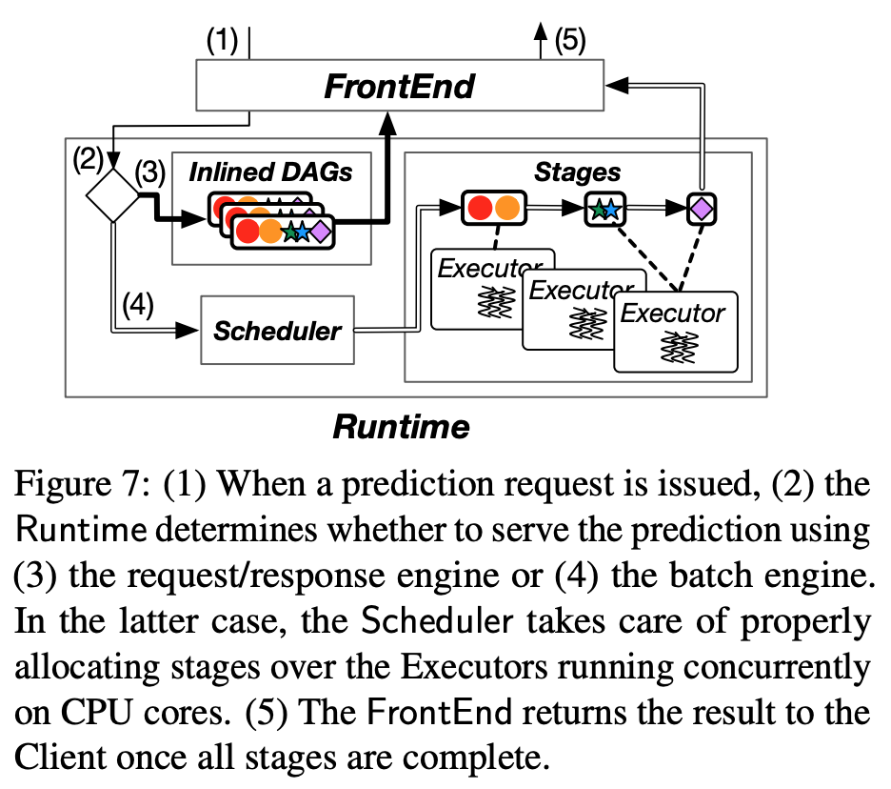
Online Phase - Overview

Slide 24
Online Phase - Initialization
Model plans are registered in the PRETZEL Runtime
Unique pipeline ID
Physical stages loaded into a system catalog; each stage only loaded once
A set of vectors and long-running thread pools (executors)
Executors are managed by the Scheduler

Slide 25
Online Phase - Execution
Inference requests: pipeline ID + input records
Request-response engine
single predictions → latency is the major concern → context-switching and scheduling overheads can be costly
Inlined execution: the pipeline physical plan is JIT-compiled into a unique function call
Batch engine
A batch of records or predictions where the prediction time >> scheduling overheads
Requests forwarded to the Scheduler: allocate physical stages by current runtime and resource status
Choice of engine by a config parameter passed during registration

Slide 26
Online Phase - Scheduler
Late-binding event-based scheduling
Each core runs an Executor instance
All Executors pull work from a shared pair of queues
low priority queue for newly submitted plans
high priority queue for already started stages
Reservation-based scheduling
Option to reserve memory or computation resources for exclusive use
Reserved resources are pipeline-specific and not shared among plans
Parameters and physical stage objects are shared nonetheless

Slide 27
Evaluation
Memory
Latency
Throughput

Slide 28
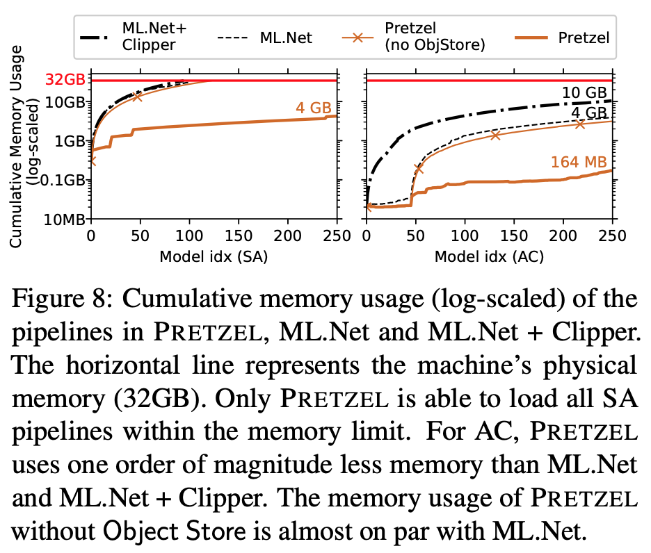
Evaluation - Memory

Slide 29
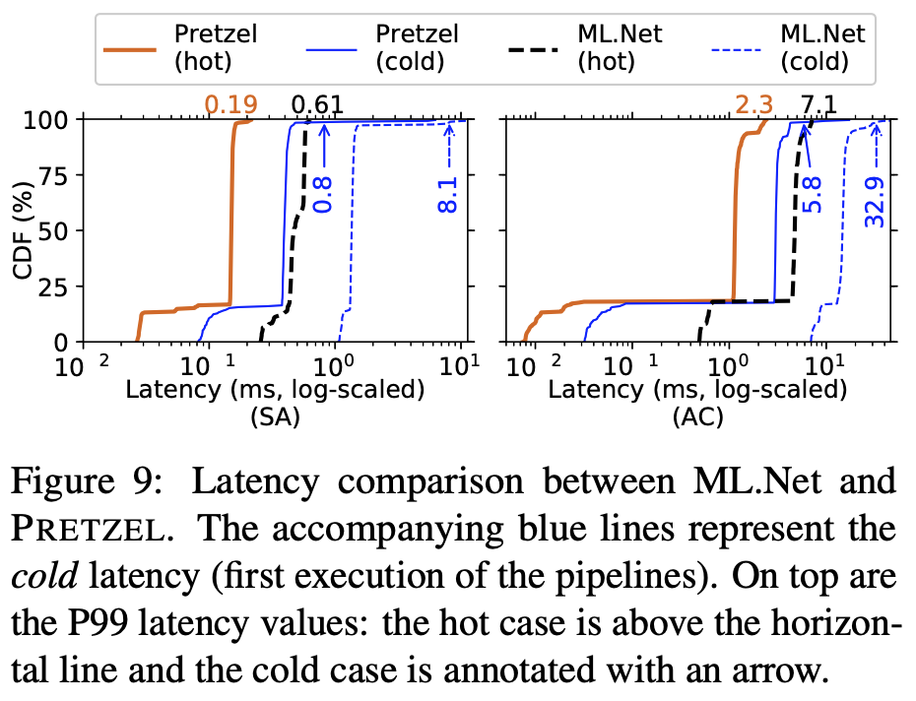
Evaluation - Latency (micro-benchmark)

Slide 30
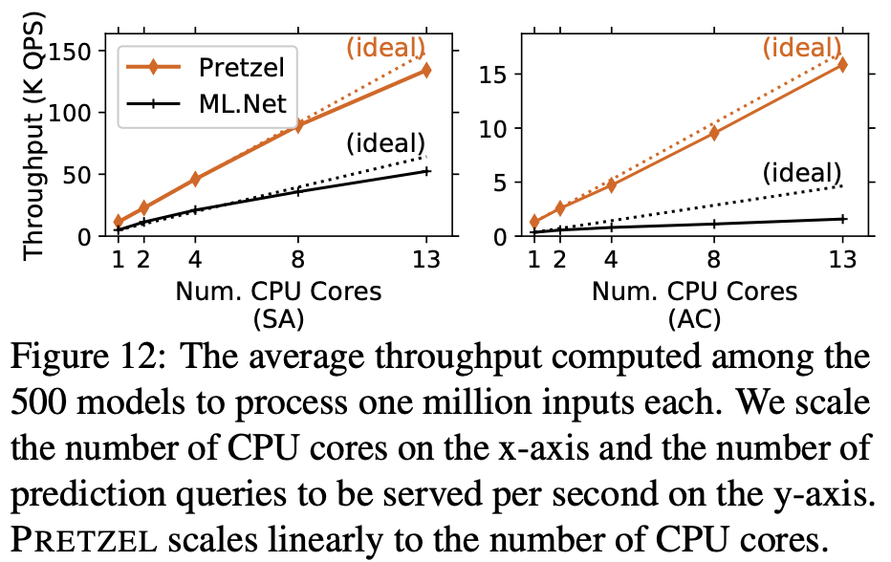
Evaluation - Throughput

Slide 31
Acknowledgement
Some slides are adapted from https://www.usenix.org/sites/default/files/conference/protected-files/osdi18_slides_lee.pdf

Slide 32
Discussion
PRETZEL for deep learning models
Featurizers are no longer the bottleneck
Operator-specific optimization?
Adaptive switching b/w request-response engine and batch engine
Challenges and solutions?
Support for other ML frameworks (e.g. TensorFlow)
Provide framework-specific Flour? Other methods?

Slide 33
Parity Models: Erasure-Coded Resilience for Prediction Serving Systems
Presented by: Xiangfeng Zhu, Jiachen Liu, Chris Chen

Slide 34
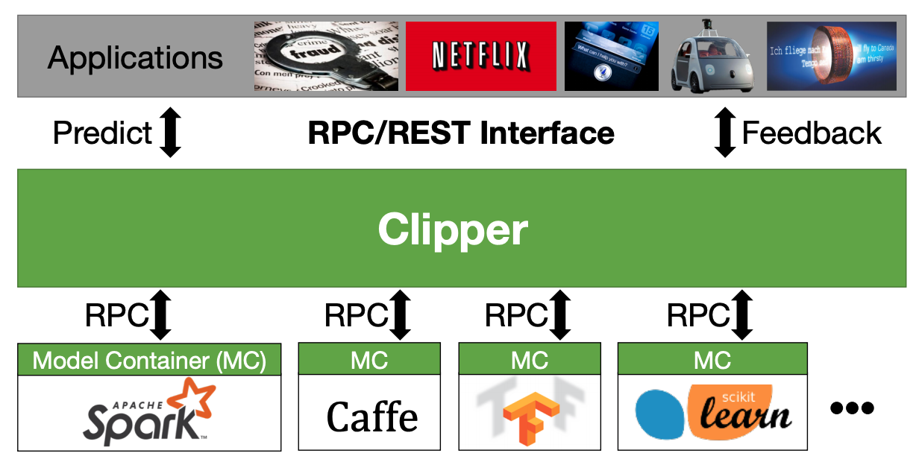
Clipper
Simplifies deployment through layered architecture
Serves many models across ML frameworks concurrently
Employs caching, adaptive batching, container scale-out to meet interactive serving workload demand
Clipper: A Low-Latency Online Prediction Serving System by Crankshaw et al. (2017)
Clipper: A Low-Latency Online Prediction Serving System by Crankshaw et al. (2017)

Slide 35
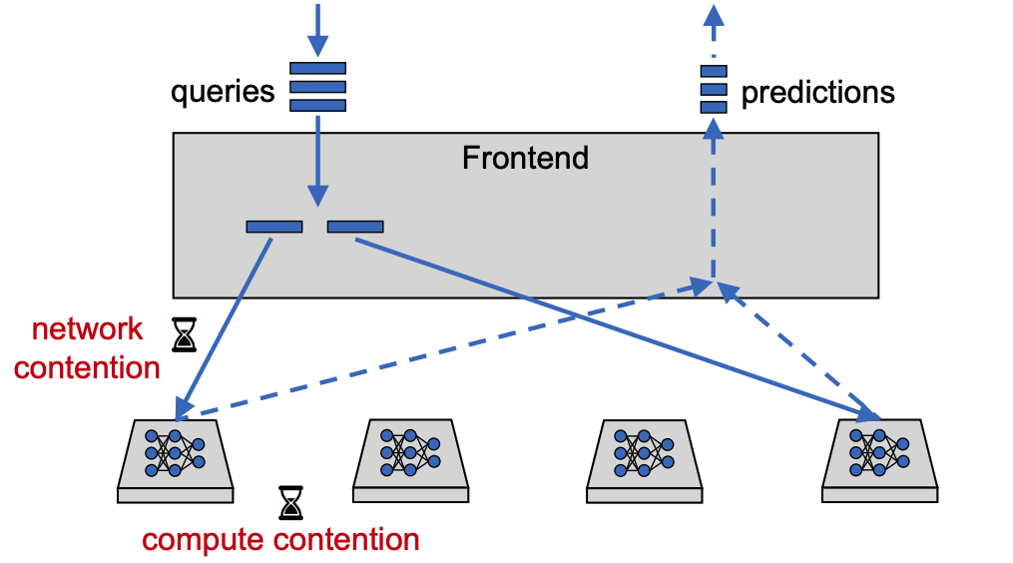
Slowdowns and failure

Slide 36
Solution 1: Reactive
Send to one server
Wait, retry request
Problem: delayed mitigation

Slide 37
Solution 2: Replicative
Proactively issue redundant queries
Wait for first response
Problem: requires at least 2x resources

Slide 38

Erasure coding
Goal: Add resilience against disk failures
Simplest approach: replication
D1

Slide 39
Erasure coding
Goal: Add resilience against disk failures
Simplest approach: replication
D1
D1

Slide 40
Erasure coding
Goal: Add resilience against disk failures
Simplest approach: replication
D1
D1

Slide 41
Erasure coding
Goal: Add resilience against disk failures
Simplest approach: replication
D1
D1
Problem: at least 50% resource overheads

Slide 42
Erasure coding
Goal: Add resilience against disk failures
Redundancy via erasure coding
Encode data into parties
D1
D2
P = D1 + D2

Slide 43
Erasure coding
Goal: Add resilience against disk failures
Redundancy via erasure coding
Encode data into parties
D1
D2
P = D1 + D2

Slide 44
Erasure coding
Goal: Add resilience against disk failures
Redundancy via erasure coding
Encode data into parties
D1
D2
P = D1 + D2
D2 = P - D1

Slide 45
Erasure coding
Goal: Add resilience against disk failures
Redundancy via erasure coding
Encode data into parties
D1
D2
P = D1 + D2
Much lower resource overhead!

Slide 46
Erasure coding
Goal: Add resilience against disk failures
Redundancy via erasure coding
Encode k data units to produce r redundant parity units
Any k of the total (k + r) is sufficient
Resource overhead: (k + r)/k
Much lower resource overhead!

Slide 47

Coded Computation
Multiple copies of a function F computed on different nodes
X1
X2
Encoder
F(X1)
F(X2)
F(P)

Slide 48
Coded Computation
Multiple copies of a function F computed on different nodes
X1
X2
Encoder
F(X2)
F(X1)
F(P)
Decoder
F(X2)

Slide 49
Codes for storage
Codes for computation
D1
D2
X1
X2
Encoder
Encoder
F(Y)
D1
P
F(X1)
F(P)
Decoder
Decoder
D2
F(X2)
Protect data
Protect function outputs

Slide 50

Example 1
P = X1 + X2
X1
X2
F(Y)
F(X) = 4X
F(P) - F($X_{1}$) = 2($X_{1}+X_{2}$) - 2${ X}_{1}$ = 2 $X_{2}$
Correct!
F(X1)
F(P)
Decoder
F(X2)

Slide 51

Example 2
P = X1 + X2
X1
X2
F(Y)
F(X) = $2^{X}$
F(P) - F($X_{1}$) = $2^{(X_{1}+X_{2})}$ - $2^{X_{1}}$
Incorrect!
F(X1)
F(P)
Decoder
F(X2)

Slide 52
Example 2
P = X1 + X2
X1
X2
F(Y)
F(X) = $2^{X}$
F(P) - F($X_{1}$) = $2^{(X_{1}+X_{2})}$ - $2^{X_{1}}$
Incorrect!
F(X1)
F(P)
Decoder
F(X2)
Existing coded computation schemes applicable only to limited class of functions: Linear functions and polynomials

Slide 53
Parity Model
Erasure codes for resilient ML inference
overcome challenges of coded-computation by taking a learning-based approach

Slide 54
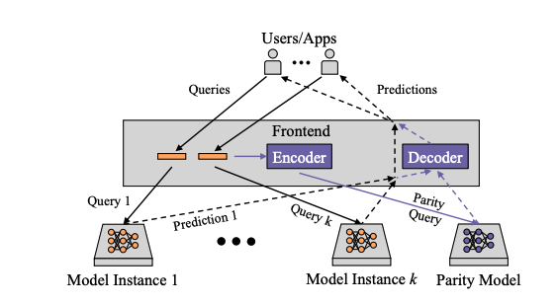
Architecture

Slide 55

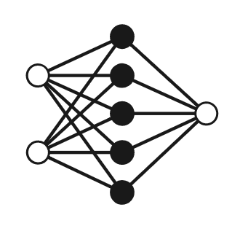
Attempt 1:
Replace the simple decoder and encoder with complex neural network
X1
X2
F(X2)

Slide 56
Attempt 1:
Replace the simple decoder and encoder with complex neural network
X1
X2
F(X2)
Accurate but expensive encode/decode

Slide 57

Parity Model($F_{p})$
Use simple encoder and encoder
Use neural network for “parities”
X1
X2
Encoder
F(Y)
Parity Model
Decoder
F(X2)

Slide 58

Parity Model($F_{p})$
X1
X2
P = X1 + X2
F(Y)
Parity Model
$F$(X2) = $F_{p}$(P) – $F$(X1)

Slide 59
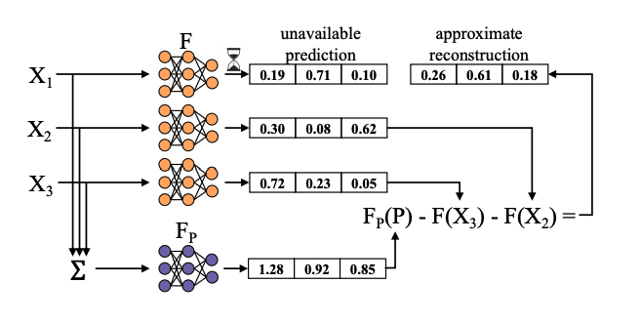
Parity Model($F_{p})$

Slide 60
How to train a parity model?
Training dataset same as the original mode
Mimic stragglers/failures by artificially erasing outputs from the model instances

Slide 61
How to train a parity model?
Sample inputs and encode
Perform inference with parity model
Compute loss
Backpropagate loss
Repeat

Slide 62
Implementation
Built on top of Clipper
Encoder and decoder in Clipper’s frontend
Original and parity models
Pytorch models in Docker containers

Slide 63
One caveat
Predictions with parity model are approximations
However, inaccuracy only at play when original computations are slow/failed
Late prediction is worse than inaccurate prediction

Slide 64
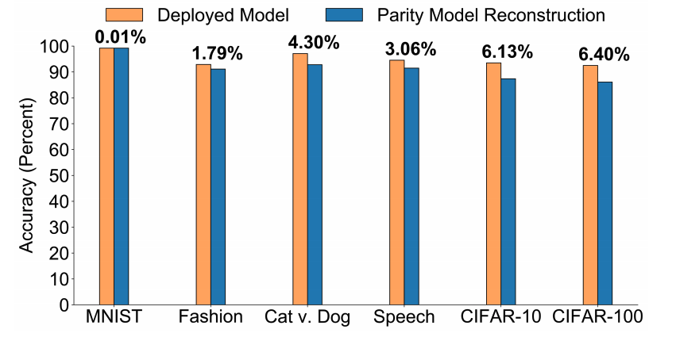
Evaluation of Accuracy
Notes:
Parity model degraded mode accuracy is no more than 6.5% lower than the desired output.

Slide 65
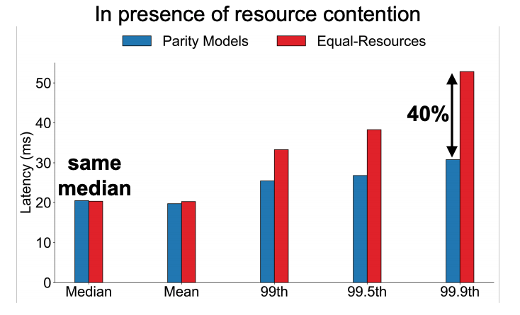
Tail latency reduction
Notes:
But it can achieve at most 40% reduction in tail latency

Slide 66
Limitations
Accuracy is important to mission critical tasks
More efficient encoder/decoder
Generic or task-specific

Slide 67
Additional Readings
Clipper: A Low-Latency Online Prediction Serving System by Crankshaw et al (NSDI’ 17)
TensorFlow-Serving: Flexible, High-Performance ML Serving by Olston et al (NIPS’ 17)
NoScope: Optimizing Neural Network Queries Over Video at Scale by Kang et al (VLDB’ 17)
Focus: Querying Large Video Datasets with Low Latency and Low Cost by Hsieh et al (OSDI’ 18)
Machine Learning at Facebook: Understanding Inference at the Edge by Wu et al (HPCA’ 18)

