Slide 1
GRNN: Low-Latency and Scalable RNN Inference on GPU’s
Presented by Adam Stautberg and Mihir Patil

Slide 2
Base Motivation
RNN’s are not well optimized for inference on GPU’s. They should be.

Slide 3
What’s so special about RNN’s?
An RNN is a recurrent neural network.
Useful in natural language processing, and similar problems where the sequence of input contextualizes the problem
Can process input sequences of varying length.
Not strictly feed forward.
Many more interconnections and dependencies between nodes than something like a CNN

Slide 4
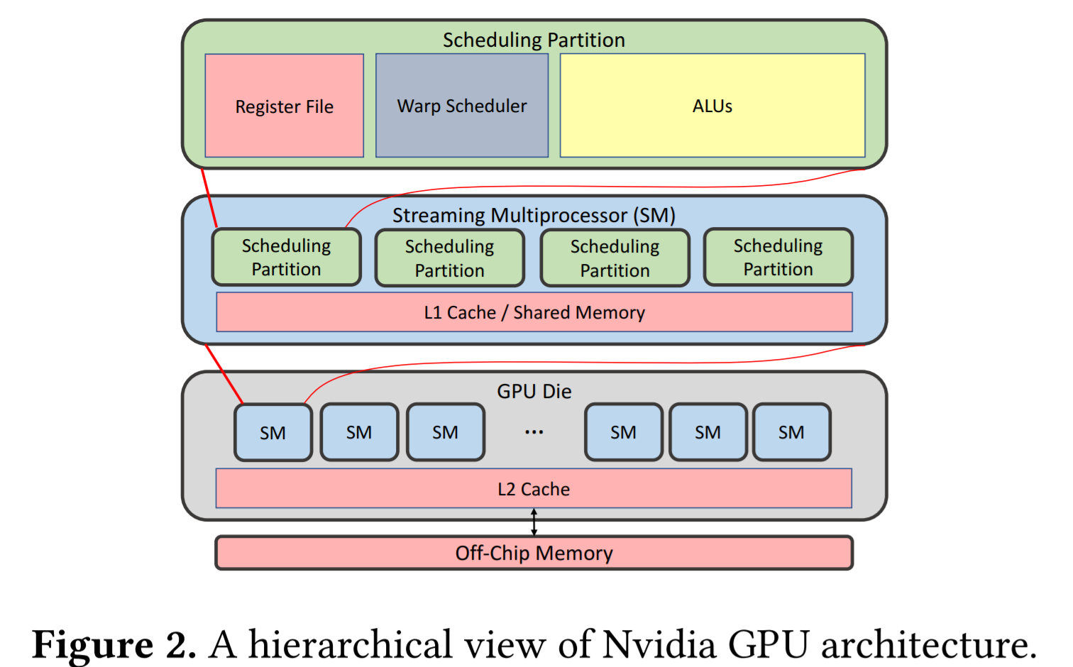
Background: Nvidia Volta architecture peek
Eventually our tiles/submatrices are going to be split across SM’s
We want to minimize inter-SM communication
Or maximize memory reuse in L1 Cache and Register File
32 threads per Warp Scheduler

Slide 5
Competitors/foils
DeepCPU - current best option but uses only CPU, doesn’t scale with model size
cuDNN - works but doesn’t scale with batch size
Tensorflow - very high latency, repeatedly loads model weights
TensorRT - good operator optimizations, very high latency

Slide 6
Introducing GRNN
GRNN is a GPU based library for serving RNN models which utilizes a persistent threading technique to minimize memory overhead
Main targets of innovation:
Novel output based tiling technique to reduce global synchronization costs
A flexible thread-to-computation mapping strategy to maximize chip utilization
A model configuration optimizer

Slide 7
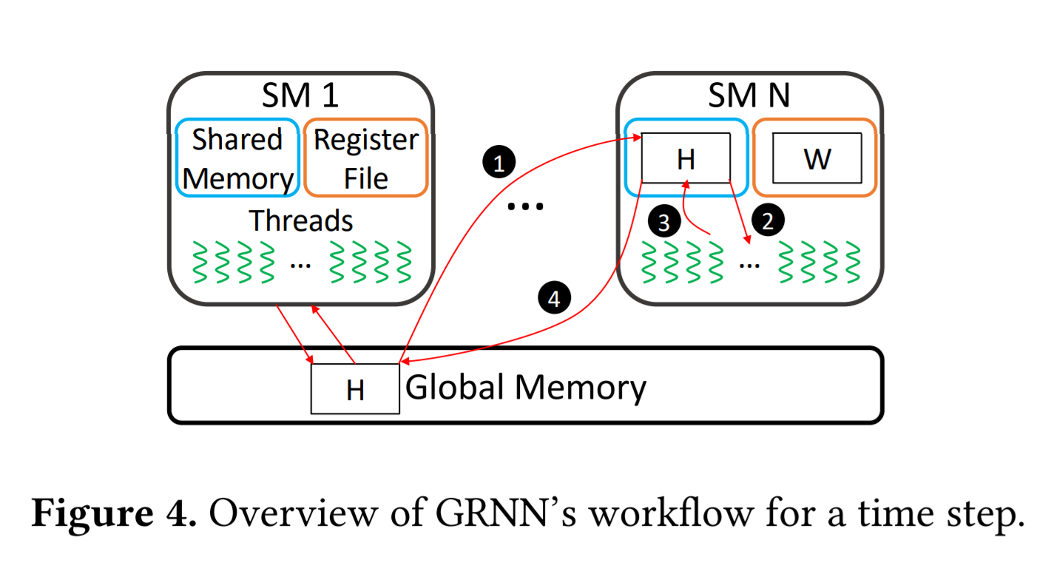
Basic sketch of GRNN flow
Hidden state H is replicated in each SM’s shared memory
Threads are mapped to the weight matrix and state
Optimized operators are applied to locally update H
Local slices of H are merged into global H

Slide 8
Tiling based persistent kernel
The persistent thread approach is established and allows for data to persist in register files
Matrices/operators are split across streaming multiprocessors
Instead of splitting across the input tensors, GRNN first splits the output, identifies the relevant weights needed to produce said split, and then groups those weights into a tile on a single SM
This allows the SM to perform all elementwise operations without any inter-SM communication until the next timestep/Global sync

Slide 9
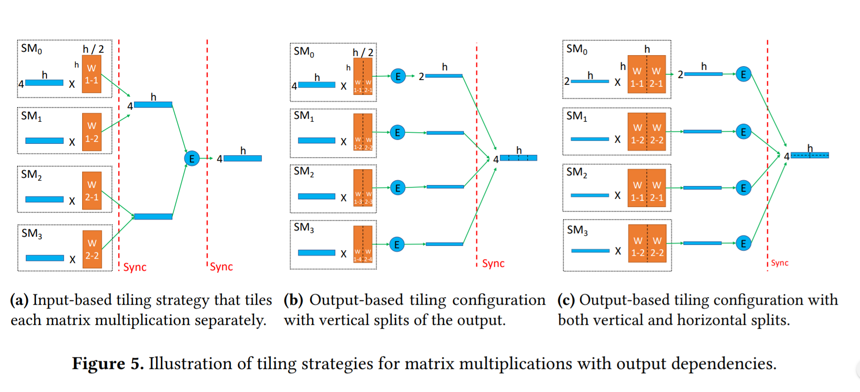
Tiling based persistent kernel

Slide 10
Flexible thread mapping for balancing Streaming Multiprocessor usage
Hierarchical GPU threading system
Thread block contains many warps
Each warp contains several threads
Can map threads to optimize for computation or communication overhead
Authors unfortunately omitted details of this part

Slide 11
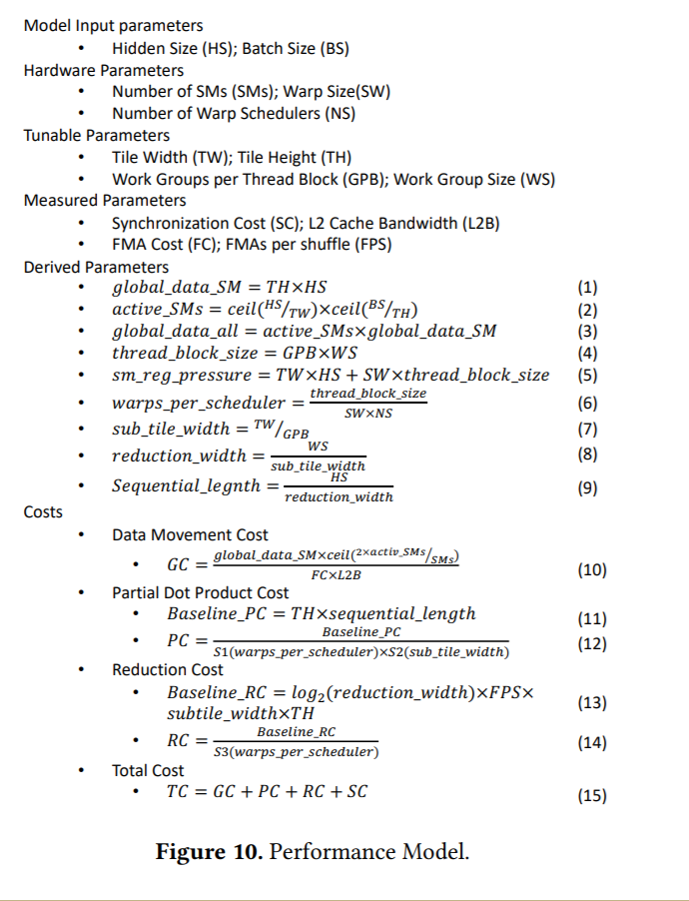
Performance model and config selection
Estimate cost of single time step (communication + computation)
Communication cost estimated by analytical model
Communication happens once every timestep to sync global H
Microbenchmarks are designed to estimate computation costs
Begin with a full config set and prune to top K set according to cost estimate

Slide 12
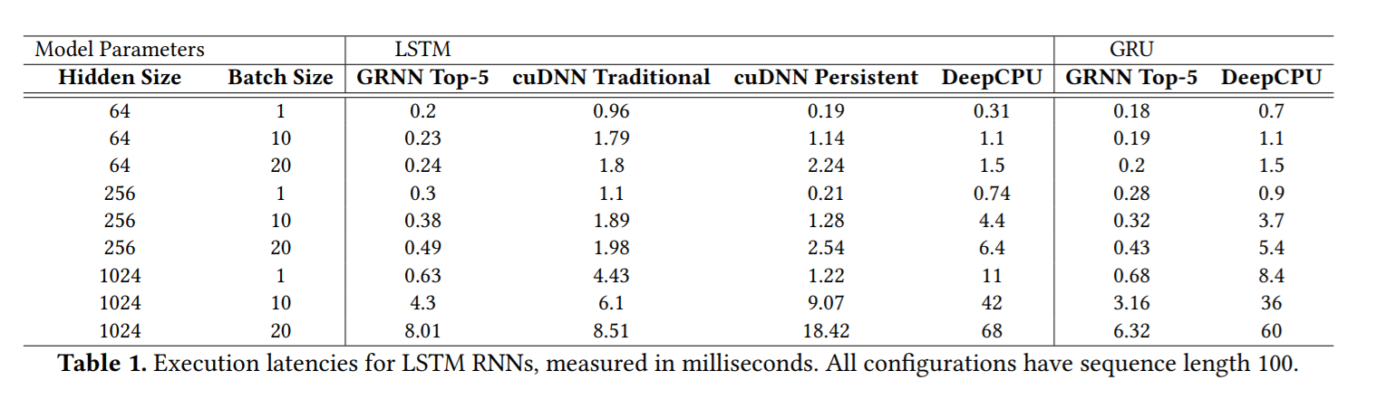
Evaluation
-GRNN latency scales much better with batch size than cuDNN persistent
-cuDNN traditional comes close to GRNN Top-5 for large models with larger batches
-DeepCPU is outgunned

Slide 13
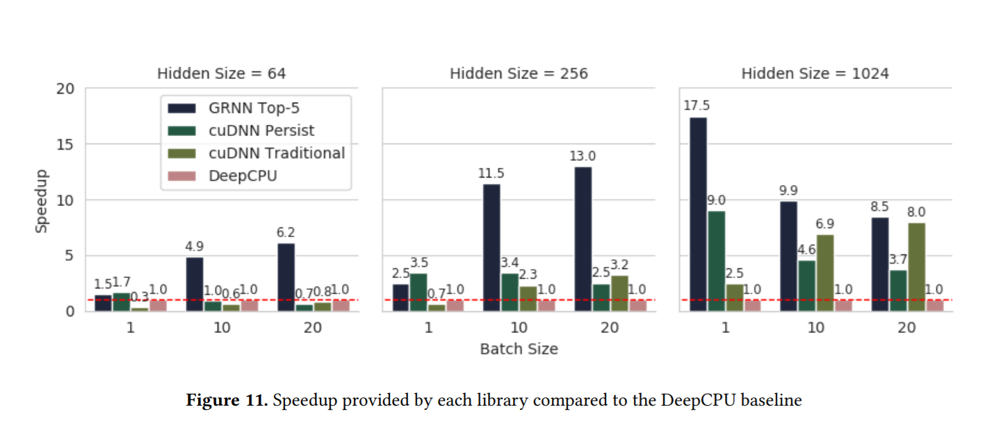
Evaluation
Clearly GRNN is much faster than the alternatives in most situations.
cuDNN traditional approaches its speed when tasked with a larger model.

Slide 14
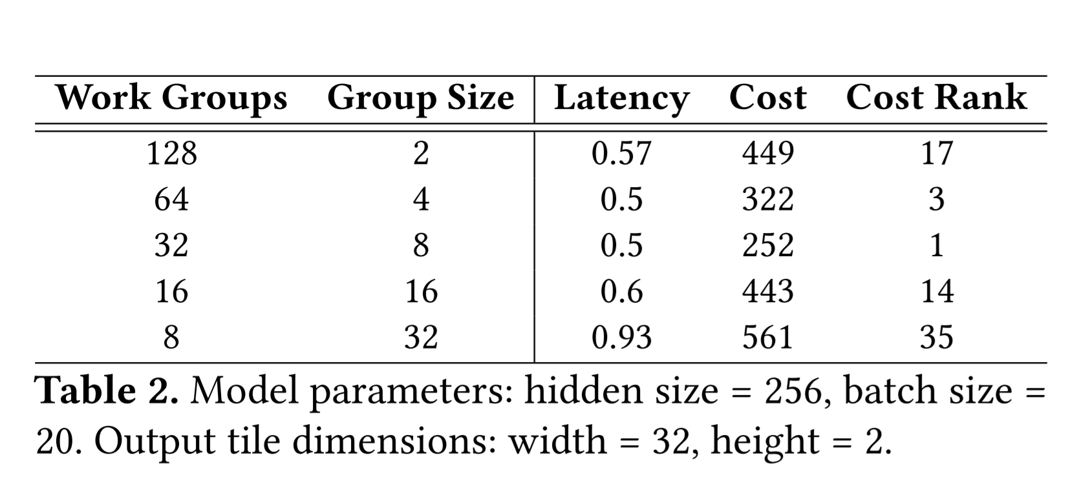
Assessing configuration accuracy
This seemed to be one of the weakest parts of the paper. The third model was selected as the best which is good. But the result sounds anecdotal.

Slide 15
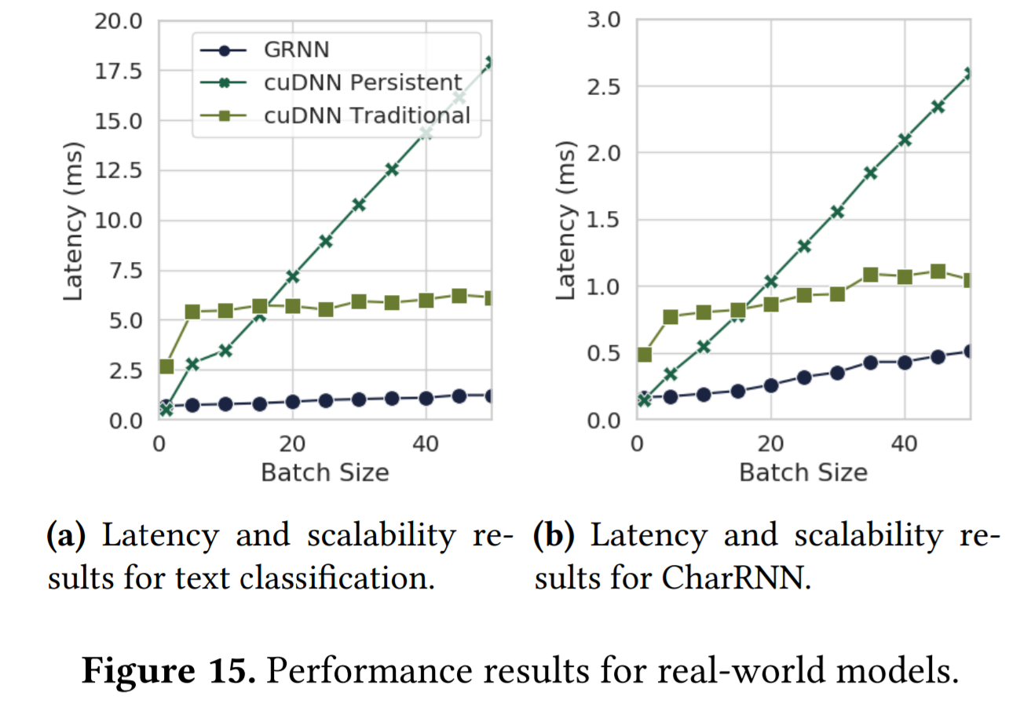
Eval: Real world models
Hidden size: 256
Alternatives have issues with scalability of latency
Latency for cuDNN traditional doesn’t increase much with model size
Larger models incur significant synchronization costs for GRNN
This is where cuDNN catches up

Slide 16
Related works
Multiple full-fledged deep learning systems like Tensorflow, Caffe, Pytorch, MXNet, Theano etc, are optimized for model declaration and training, not necessarily inference.
Their default implementations fail to exploit the inherent data reutilization opportunities in RNN’s
TensorFlowServing is specialized for inference, but it uses the same operators as TensorFlow so it inherits the same limitations. Much like BatchMaker with MXNet.
The TVM and XLA compilers DO produce high performance inference optimizations which could be incorporated into GRNN in the future

Slide 17
Discussion
Transformer models and attention?
Paper was limited to LSTM and GRU cells within RNN’s
Even then multiple implementation details were omitted
That being said the three-pronged approach seemed robust and should be applicable to other cell structures
Implementation details of “flexible thread mapping technique” were omitted
Why are RNN’s so underserved?

Slide 18
Nexus: A GPU Cluster Engine for Accelerating DNN-Based Video Analysis
Presented by Adam Stautberg and Mihir Patil

Slide 19
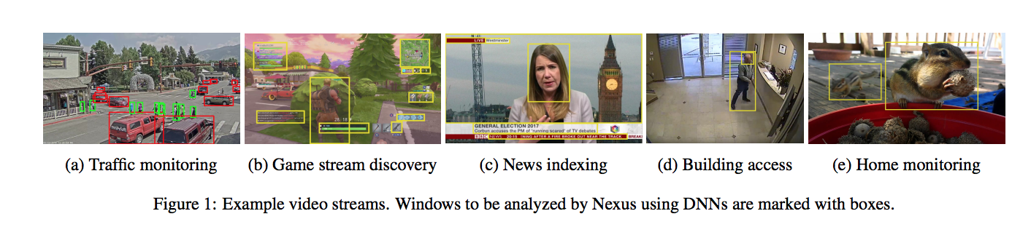
Motivation
Cloud-scale video analysis service using DNNs with GPU accelerators
CPU-based code selects frames from the stream for processing, identifies what parts of the image need deeper analysis, applies a DNN query to these windows, and aggregates the result

Slide 20
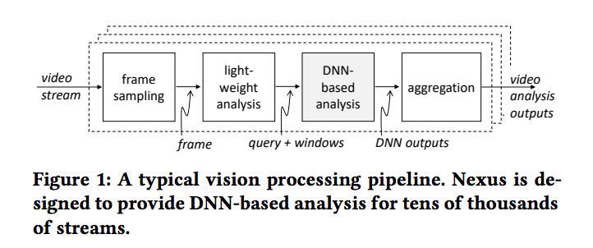
Motivation Continued
“A fundamental problem, therefore, is to distribute the large incoming workload onto a cluster of accelerators at high accelerator utilization and acceptable latency”
“The primary goal of Nexus is to attain high execution efficiency on GPU clusters while serving video analysis requests within a specified latency SLO”

Slide 21
Conceptual Overview
Nexus: A GPU Cluster Engine for Accelerating DNN-Based Video Analysis. Conceptually, Nexus works by sharding inputs via a distributed frontend onto DNNs on backend GPUs.
Factors Nexus addresses:
Scheduling different types of networks on the same GPU
Specifying groups of DNNs and scheduling execution to maximize performance
Batching together inputs for more efficient DNN execution
Increase use of transfer learning means models are not fully identical which makes batching more difficult

Slide 22
Main Techniques
Utilizes a Batching-aware scheduler
Allows groups of related DNN invocations to be written as queries and provides automated query optimization to assign optimal batch sizes to the components of the query
Allows batching of parts of networks with different batch sizes

Slide 23
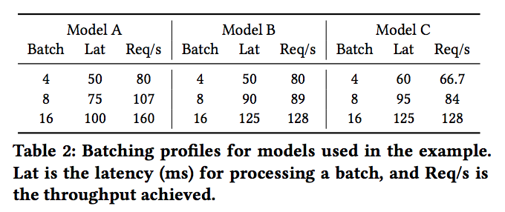
Squishy Bin Packing
The processing cost of an input is “squishy”, i.e., it varies with the size of the batch within which that input is processed. Further, the latency of execution also depends on the batch size.

Slide 24
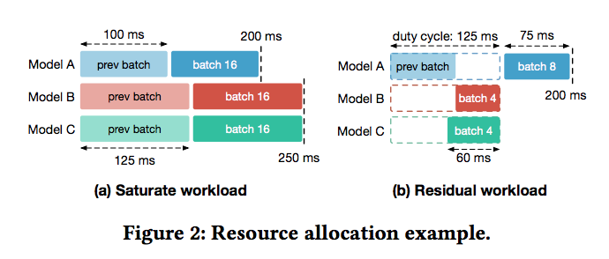
Squishy Bin Packing Example
Models requiring less than one GPU each.
Combine models as long as they can fit in the same duty cycle

Slide 25
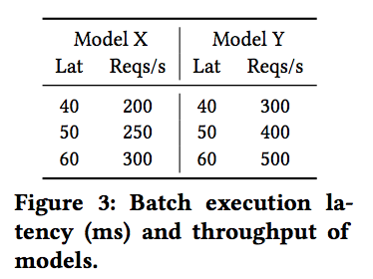
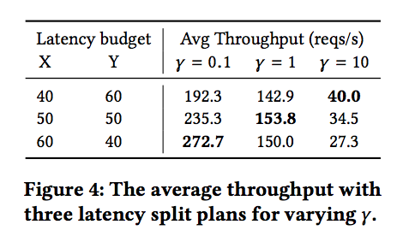
Complex Query Scheduling
Latency SLO specified for entire query which then has to be split into steps.
p and q = #GPUs for X and Y T_{X} and T_{Y} = throughput γ · p · T_{X} = q · T_{Y} γ = #outputs for an invocation of X

Slide 26
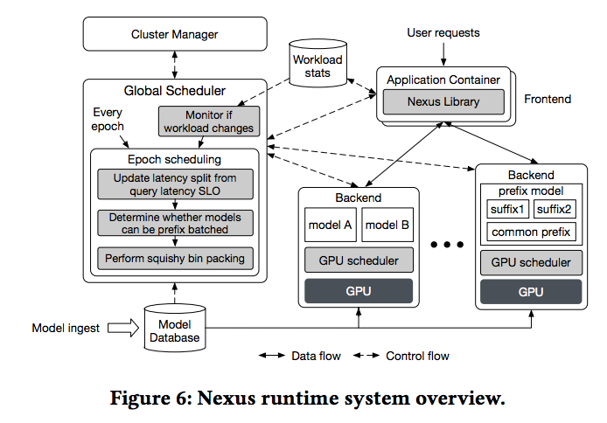
Nexus Architecture

Slide 27
Epoch Steps
Allocation, scheduling, and routing updates happen at the granularity of an epoch, typically 30-60s.
Produce an updated split of the latency SLO for the individual models inside a query.
Combine two or more models that share a prefix and latency SLO into a new prefix-batched model.
Perform profile-guided squishy bin packing to allocate the GPU resources for each model.

Slide 28
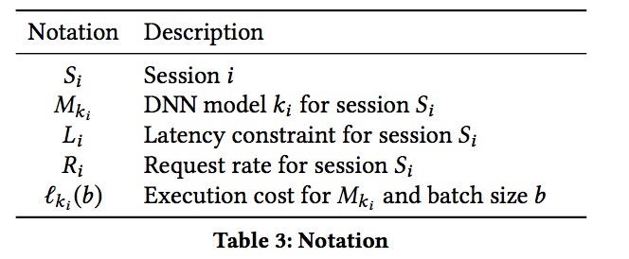
Batch-aware Scheduling
Batch size B_{i} is the maximum value for b that meets the constraint 2ℓ_{ki} (b) ≤ L_{i} Max throughput T_{i} , for session S_{i} on a single GPU is B_{i} /ℓ_{ki}(B_{i}) # of GPU nodes we allocate to execute S_{i} requests is n = ⌊R_{i} /T_{i}⌋

Slide 29
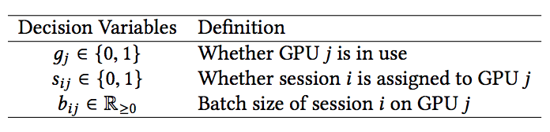
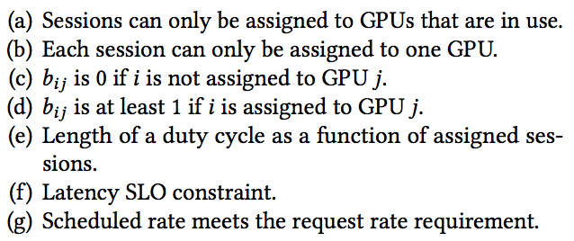
Scheduling Residual Workloads
Satisfying constraints is NP-Hard
Greedy scheduling algorithm
Choose largest batch size

Slide 30
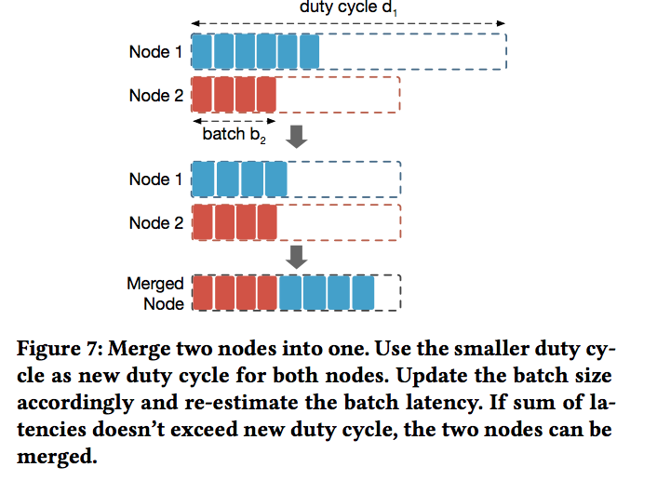
Scheduling Residual Workloads

Slide 31
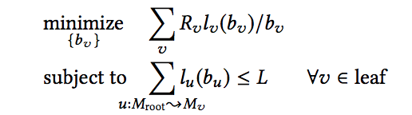
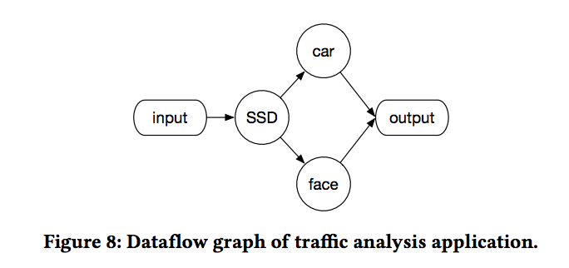
Scheduling Complex Queries
Nexus uses Dynamic Programming to solve this optimization problem

Slide 32
Batch-aware Dispatch
Overlapping CPU and GPU computation
Overlap pre and post processing in CPU with GPU DNN runs
GPU Multiplexing
Nexus runtime manages execution of models on GPUs to prevent random interleaving
Prefix Batching
Batched at the sub-tree level for similar models
Adaptive Batching
Uses early drop instead of lazy drop

Slide 33
Related Work
Clipper – prediction serving system. Given a request to serve a machine learning task, Clipper selects the type of model to serve it, batches requests, and forwards the batched requests to a backend container
TensorFlow Serving – can be seen as a variant of Clipper that does not provide approximation and caching, but also has additional machinery for versioning models
MCDNN, Mainstream - exploited shared model prefixes resulting from specialization on mobile cpus. (operating on same input)
Sparrow, Slicer – service for dividing back ends into shards and load balancing across them, lack query processing, task allocation, and sub task scheduling functionality

Slide 34
Evaluation
Does using Nexus result in better cluster utilization while meeting SLOs with respect to existing systems?
Does high performance persist when Nexus is used at a large scale?
How do the new techniques in Nexus contribute to its performance?
What determines how well each of these techniques work?
Implemented in 10k lines of code. Measures throughput as the maximum rate of queries that Nexus can process such that 99% of them are served within their latency SLOs.

Slide 35
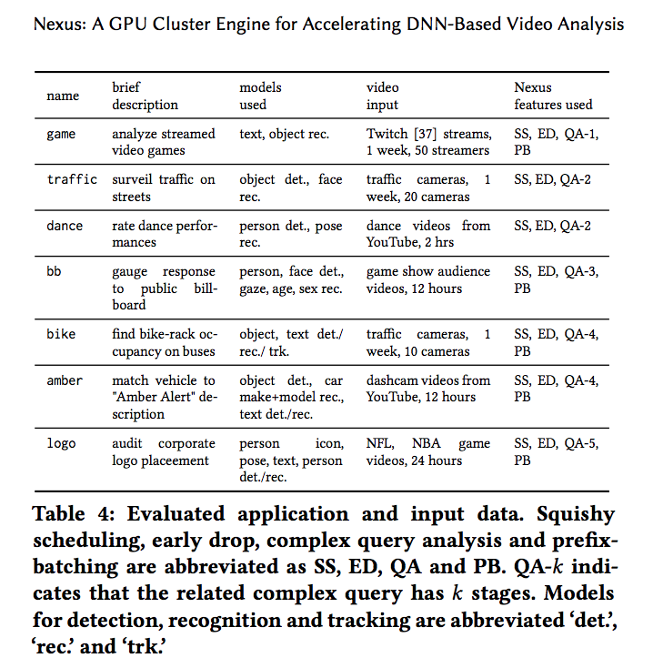
Evaluation Methods
Run on small (16 GPU) and Large (100 GPU) clusters.
Uses Clipper and Tensorflow as baselines

Slide 36
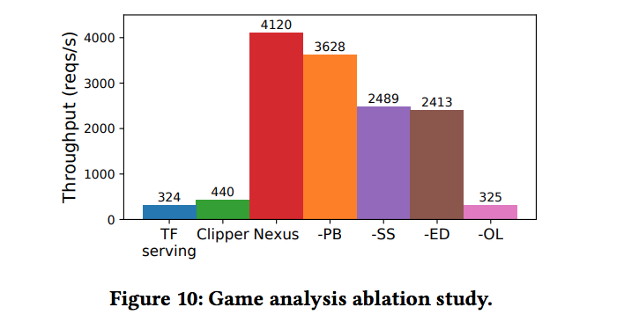
Evaluation Results (Game)

Slide 37
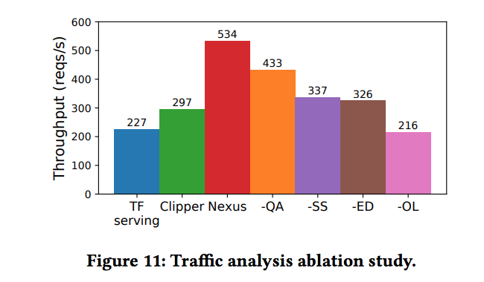
Evaluation Results (Traffic)

Slide 38
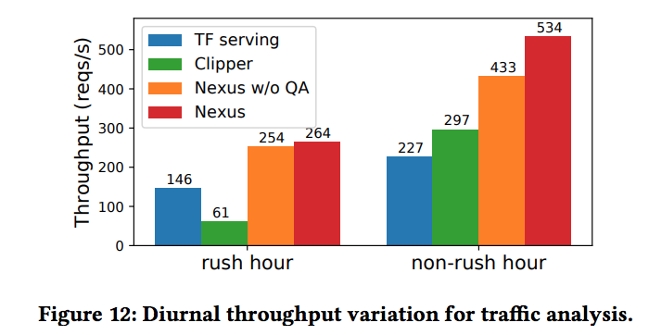
Evaluation Results (Traffic)

Slide 39
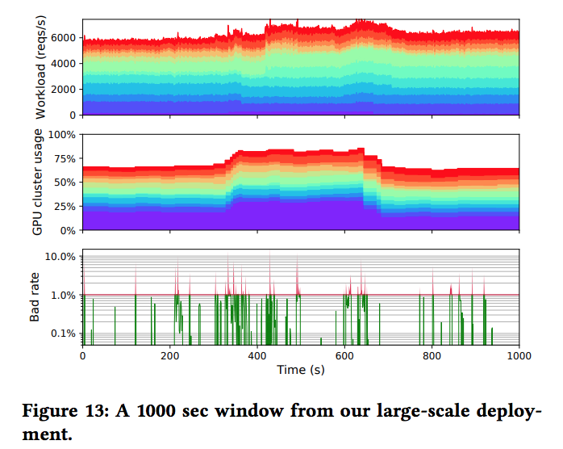
Long-running Multi-application Evaluation
Nexus was run on cluster ranging from 16 to 100 GPUs on a commercial cloud, running all applications from Table 4 simultaneously for a period of several hours.

Slide 40
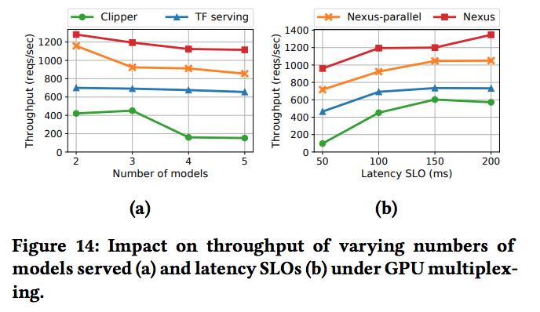
Feature Evaluation (GPU Multiplexing)

Slide 41
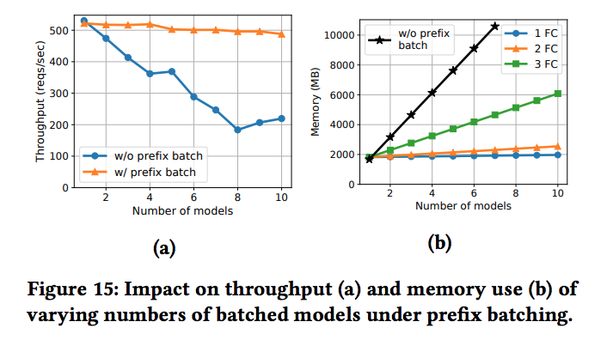
Feature Evaluation (Prefix Batching)

Slide 42
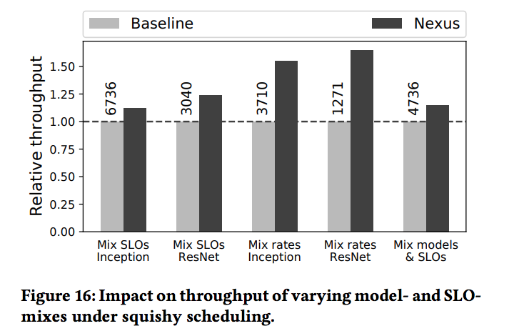
Feature Evaluation (Squishy Scheduling)

Slide 43
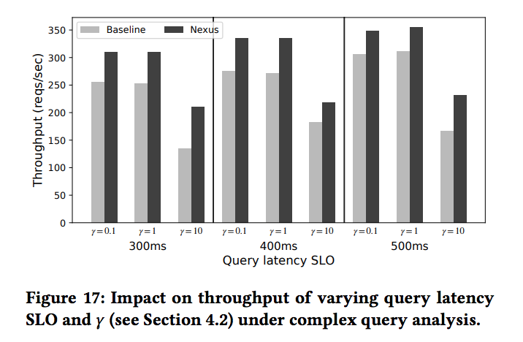
Feature Evaluation (Complex Query Analysis)

Slide 44
Conclusion
“Nexus can achieve 1.8-12.7× more throughput relative to state-of-the-art baselines while staying within latency constraints (achieving a “good rate”) over 99% of the time”

Slide 45
Discussion/Questions?
No downsides mentioned in the paper
What if we changed the 99% SLO limit?
Could early drop lead to starvation?
How does Nexus handle failures?

