Slide 1
FaRM: Fast Remote Memory
Aleksandar Dragojevic ́, Dushyanth Narayanan, Orion Hodson, Miguel Castro
Microsoft Research
Presenters: Qiyang Lin, Ruying Sun
Notes:
Two papers about farm
The firstone will give you an overall introduction to it, while the other one focus on the transaction.

Slide 2
Background
Decreasing DRAM prices have made it cost effective to build commodity servers with hundreds of gigabytes of DRAM
With 128GB of memory per machine, 32 machines can store 4TB of data in RAM
Frequently, a modest sized cluster can fit the entire working set of an application in memory
Notes:
FaRM is motivated by the low cost of memory.
We know memory increase the speed a lot when we access data rather than using disk
And 足够 for applications at least
TCP becomes the bottlenecked

Slide 3
FaRM
A new main memory distributed computing platform that exploits RDMA to improve performance
Two mechanisms: Lock-free reads over RDMA; Collocating objects
Provide distributed transactions with strict serializability.
Duality and efficient fault tolerance during transaction
Notes:
FaRM uses the concept of key value store but is more general. 读

Slide 4
FaRM
RDMA is 23x slower than local memory
Locality first, then RDMA
Notes:
We can also seem FaRM as a concept or philosophy. Try to make the work as fast as posible. It use many ideas from the other places like the RDMA, ACID transaction, lock

Slide 5
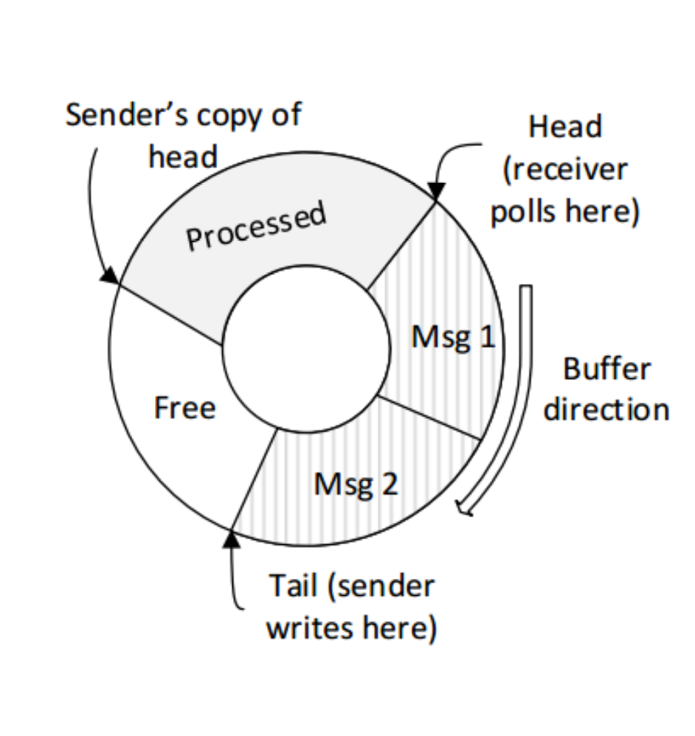
Communication primitives
One-sided RDMA reads & RDMA writes
Circular buffer on the receiver
Polls message at the head
Writes message at the tail
The receiver makes the processed space available lazily by sender’s copy of head.
Notes:
In order to improve the performance we use one buffer each machine.(polling overhead increases with number of channel)
There are many portions in the buffer. It is a FIFO (first in first out) process
Polls periodically, ……. Advance the head each time
Write and advance the tail pointer
Both the free and processed part are unused. The sender copy the head, and it will be updated after processing at least half of the buffer.
The processed portion guarantees not to overwrite unprocessed messages .
The sender firstly inform length of the message.

Slide 6
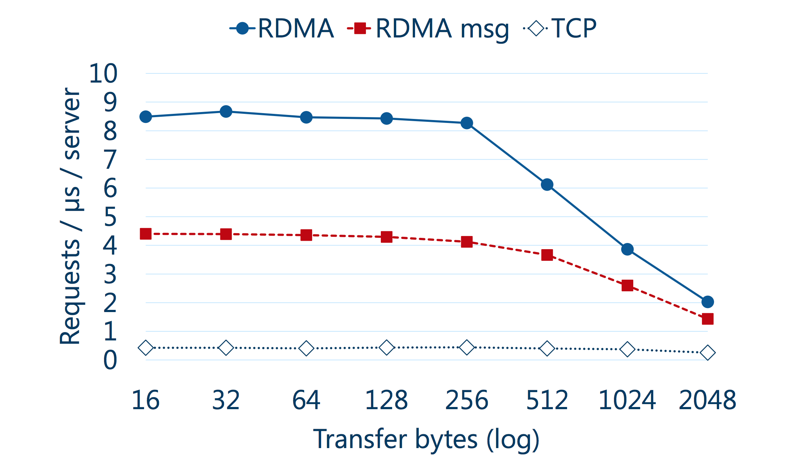
Notes:
Line in the botton is the performance of TCP
….
RDMA messaging use RPC, two-sided send and receive pair and RDMA is one-sided so it is two times better than RDMA messaging
Towards the left of the graph, FaRM’s communication primitives are bottlenecked on packet rate and, towards the right, on bit rate.
[because of the bandwidth, fixed amount of work must be done for each packet. ||there is a maximum limit on how many packets one can send (left side). As packets become larger, i.e., they have more data, total bandwidth becomes the bottleneck (right side).

Slide 7
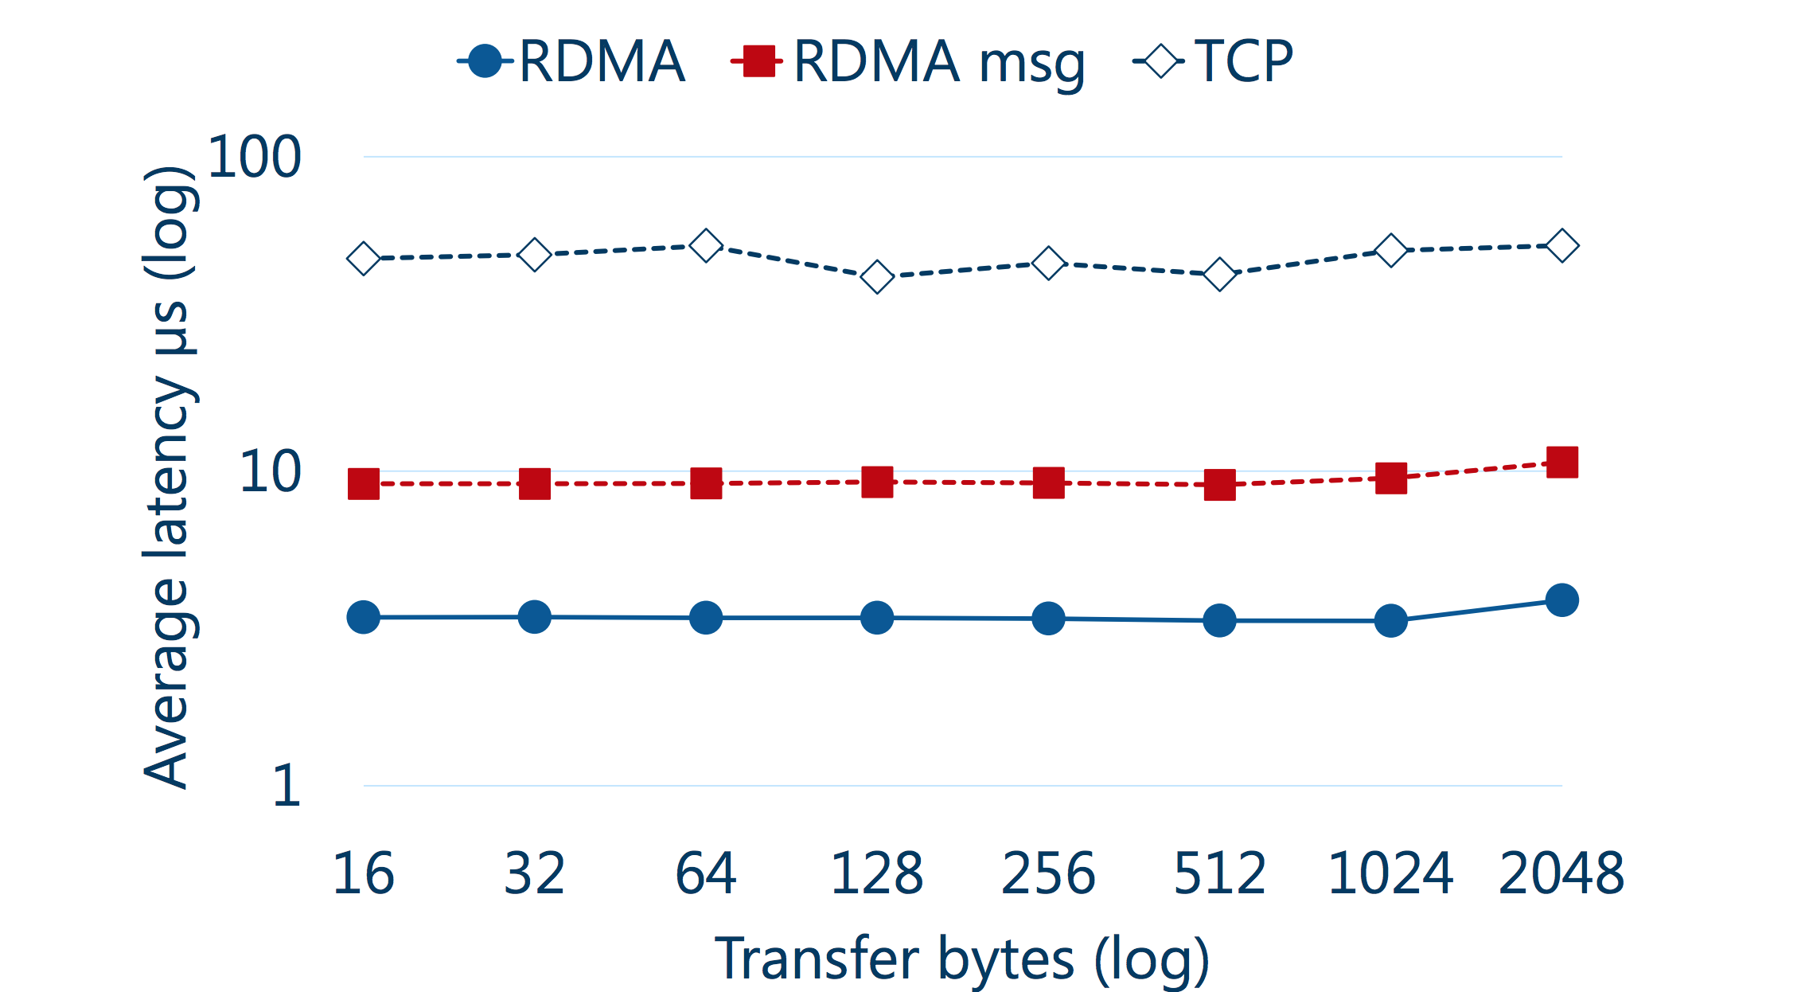
Notes:
About the latency, most is the same

Slide 8
More optimization
NIC page table is too small to store large number of page
—— larger page by Phyco (2GB)
NIC can’t cache message queues
—— using a single connection between a thread and each remote machine
Notes:
Instead of between a thread and a thread
…..[读
And also we introduced queue pair sharing among q threads
【PhyCo, a kernel driver that allocates a large number of physically-contiguous and naturally-aligned 2 GB memory regions at boot time (2 GB is the max- imum page size supported by our NICs

Slide 9
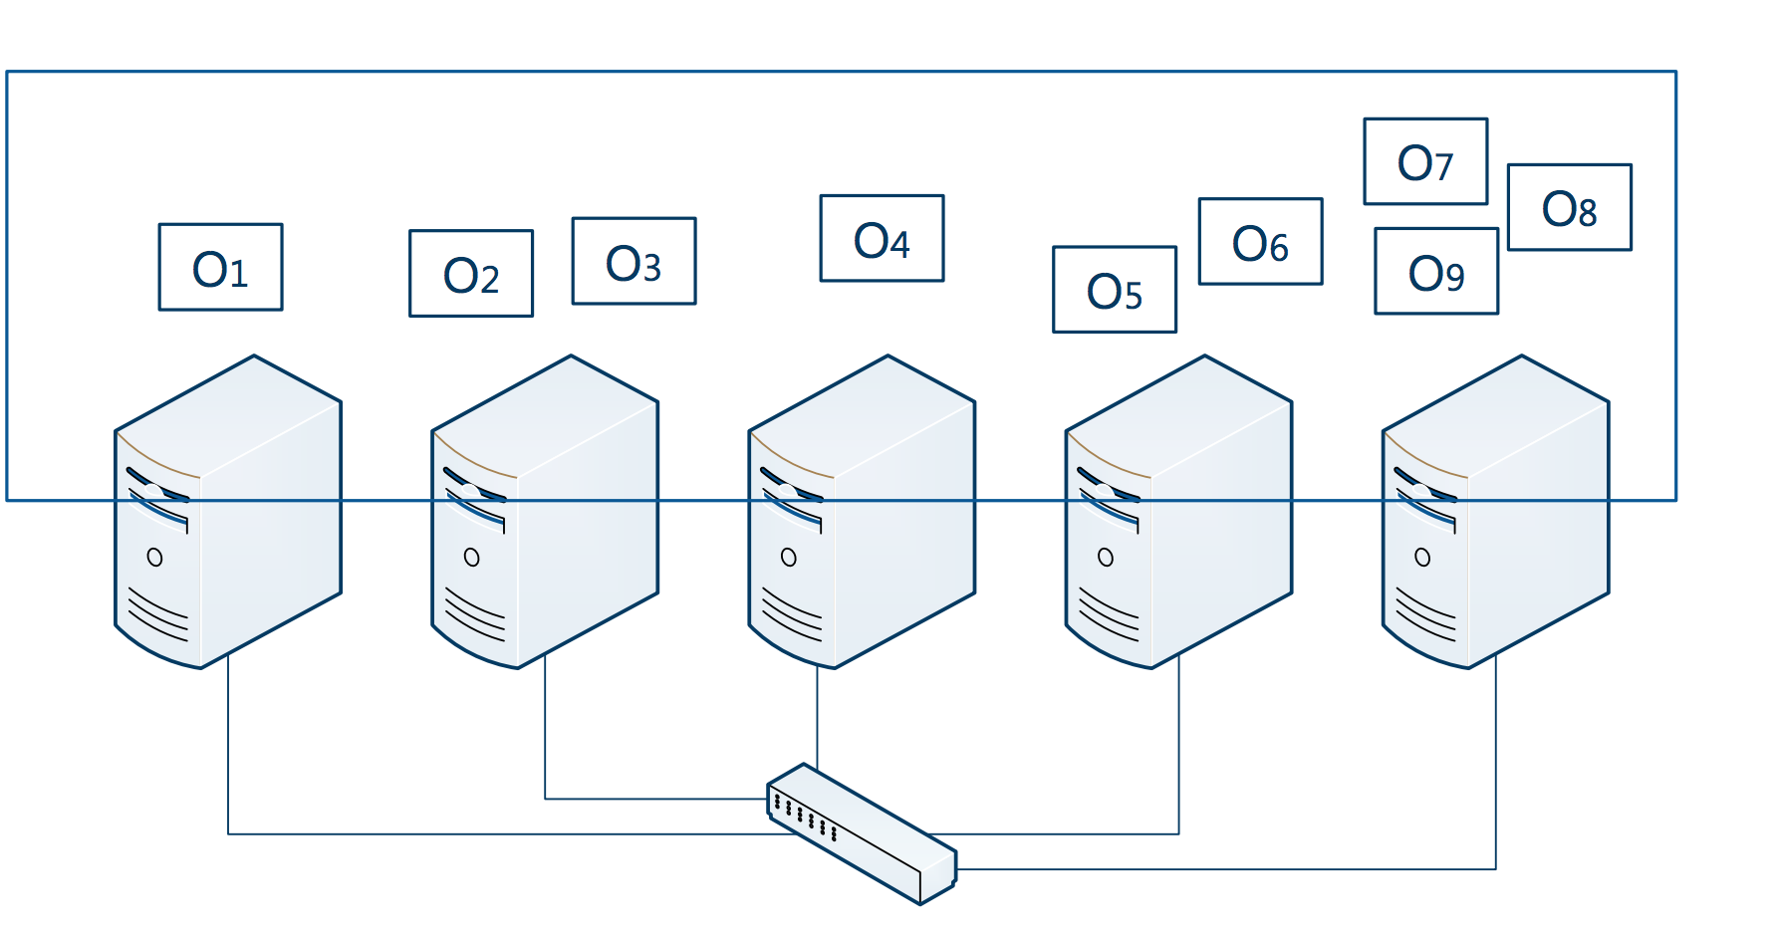
Distributed Memory Management
Shared address space
Notes:
Each machine both store data and execute application which is a little different from the traditional. So in this way we can access the local memory more faster. RDMA donot use CPU so they are idle, so we can make use of it.
------
Farm has a shared address space. Manipulate the object in the sharred space. This is also for the direct RDMA. The size of the transfer.
We perform transaction on this shared space. Such as read, write, allocate the object, free the object

Slide 10
Distributed Memory Management
Objects are stored in 2GB regions, distributed across cluster
High bits are region ID and low bits are offset
Regions are located using a consistent hashing scheme for remote objects.
Notes:
The format of the address
. If the region is stored locally, FaRM uses local memory accesses
[选择性
Otherwise, FaRM contacts the remote machine to obtain a capability for the region, and then uses the capability, the offset in the address and the object size to build an RDMA request.

Slide 11
Consistent Hashing
Allow multiple regions to be recovered in parallel
Improve load balancing
Notes:
To access an object, FaRM uses a form of consistent hashing
I will introduce consistent hashing use an example

Slide 12
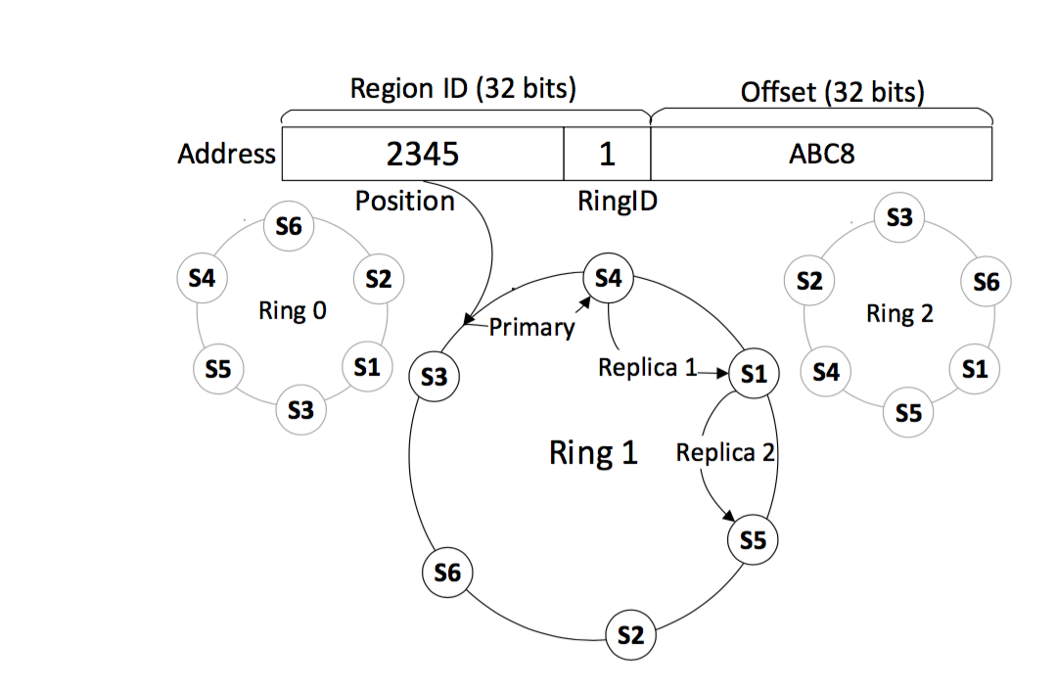
Consistent Hashing
Notes:
shows a simple example with k = 3 and r = 3.
We can see the address of an object in the shared address space consists of the 32-bit region identifier and the 32-bit offset.
Each machine is mapped into k virtual rings by hashing its IP address with k hash func- tions.
In the regionID, there is one bit which is used to identify the ring
自由发挥
【replicas

Slide 13
Memory Allocation
Three level allocation
Region
Block
Slab
Supply a location hint: collocating the objects.
Notes:
This is just for store efficiency
Block is the machine-wide. Region is the cluster wide
[block allocator It splits the regions into blocks whose size is a multiple of 1 MB
slab是Linux操作系统的一种内存分配机制，slab分配算法采用cache 存储内核对象
allocate small objects from large blocks. ]
A location hint, which is the address of an existing object
: in the same block as the hint, in the same region, or in a region with a nearb

Slide 14
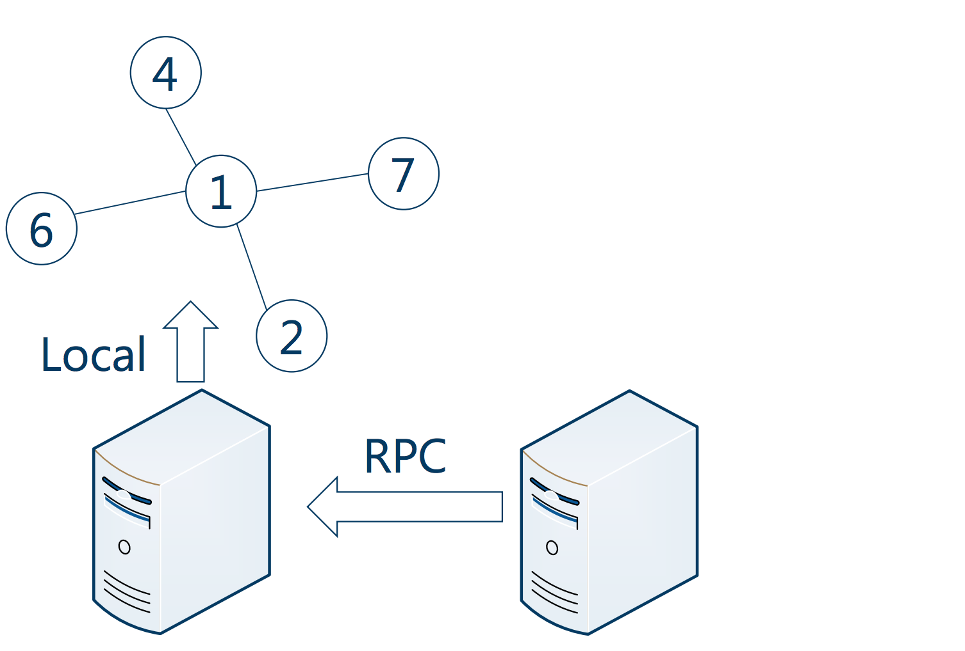
Notes:
Allocated the related object at the same machine, then we can shiping the computation to that machine
Do the single-machine transaction
Send rpc to that machine, and
flat combining one node acts as the combiner to combine all the transactions issued by the other nodes. It is done by combining the request records published by other threads.
首先了解什么叫RPC,为什么要RPC,RPC(Remote Procedure Call）是指远程过程调用,也就是说两台服务器A,B,一个应用部署在A服务器上,想要调用B服务器上应用提供的函数

Slide 15
Transactions
Two-phase commit
Single machine transaction
Lock-free read-only operations

Slide 16
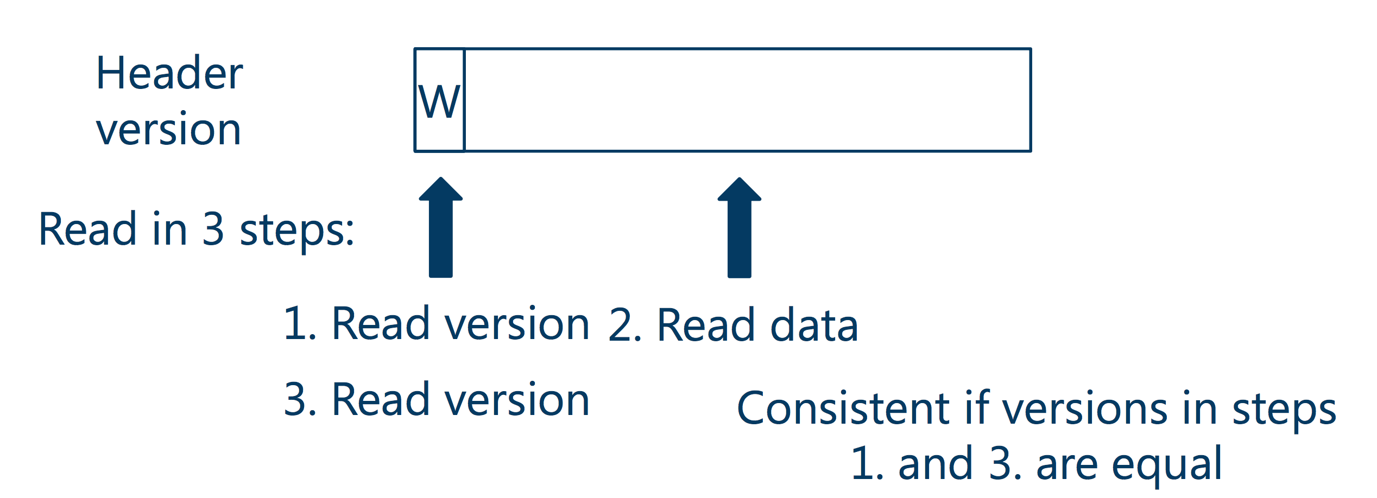
Lock-free Operations
Notes:
Traditionally, in order to ensure consistency, we put a version in the header. If there is write, it will first lock the object, update the object and unlock it and increase the version number
读
Otherwise restart the read
But in this way we need three times for read, which means three times network accesses
【objects are first locked in a mode that allows lock-free reads and the primary locks objects in exclusive mode just before updat- ing them (after the commit messages are delivered to the replicas

Slide 17
Lock-free Operations
FaRM provides lock-free reads that are serializable with transactions and are performed using a single RDMA
A lockFreeRead reads the object with RDMA and checks if the header version is unlocked and matches all the cache line versions.
Notes:
Read at the same time when other disrtributed transactions are executed
reducing the number of messages and by further reducing delays due to locks.

Slide 18
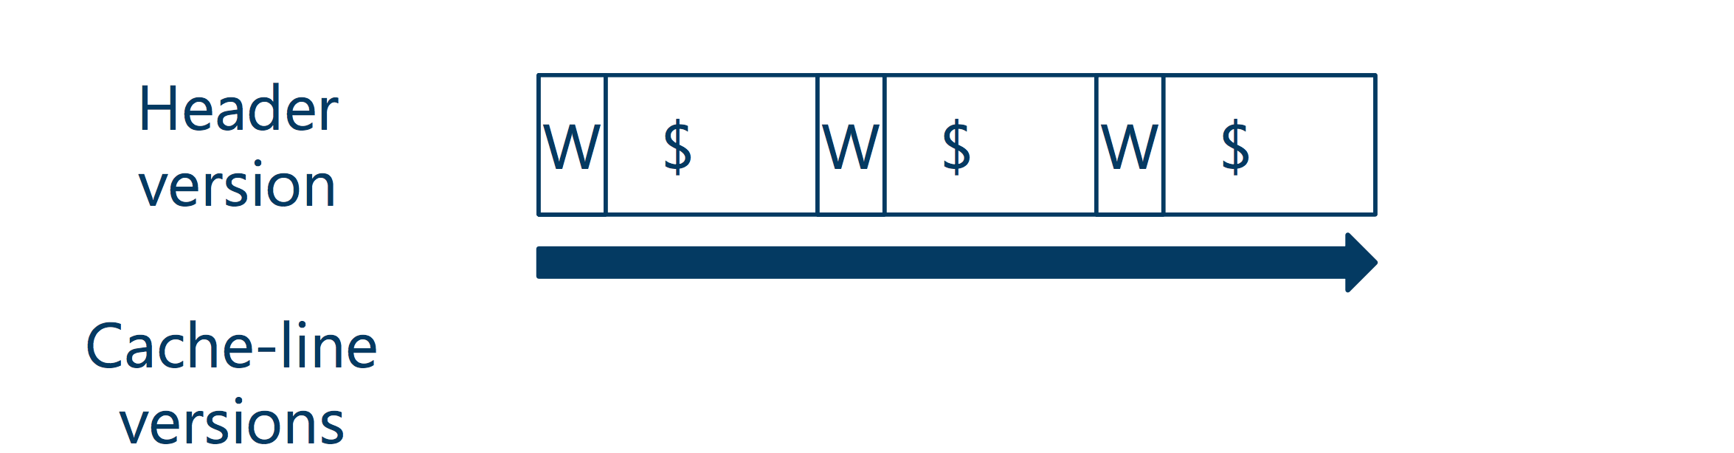
Lock-free Operations
Notes:
In farm, the object is stored in several cache lines, we assume it is cache coherent DMA
We also put a version in the object header, but furthermore we put a version into the header of each cache lines. During the update we first update the version of the cacheline, then the version of the object header. The order these cache lines got updated might be different. So in the read we can check if the version of the object match the version of cache lines.
Now we only need one RDMA read, it is efficient.
【I thought the DMA read will observe memory in all cache lines in the order. only observe memory writes within a single cache line
[coherent: For example, when a DMA read arrives, hardware will somehow flush the content of the cache to main memory to ensure that the DMA does not get the stale data. As the author points out in the paper, they are using x86 processors where DMA operations are indeed cache coherent.

Slide 19
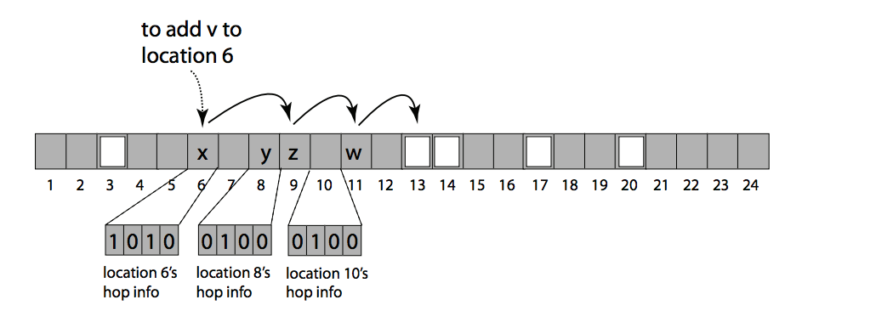
Hash Table
Chained hopscotch hashing: achieves a good balance between space efficiency and the size and number of RDMAs
Notes:
FaRM implemented as a hashtable on top of the shared address space. The hashtable is sharded across the machines in the cluster.
Because a small contiguous region of memory that may be read with a single RDMA. Hopscotch hashing is used for space efficiency.
In this hashing method, item will always be inserted-into and found-in the neighborhood of its hashed bucket. if there is a collision, first linear probe forward and find the empty entry. If it is too far. For example, H is 4. Then we exchange this empty entry with the H closest entry to it. And then continously repeat.
【然后再说例子
[We use consistent hashing to partition hash values across shards to enable elasticity.

Slide 20
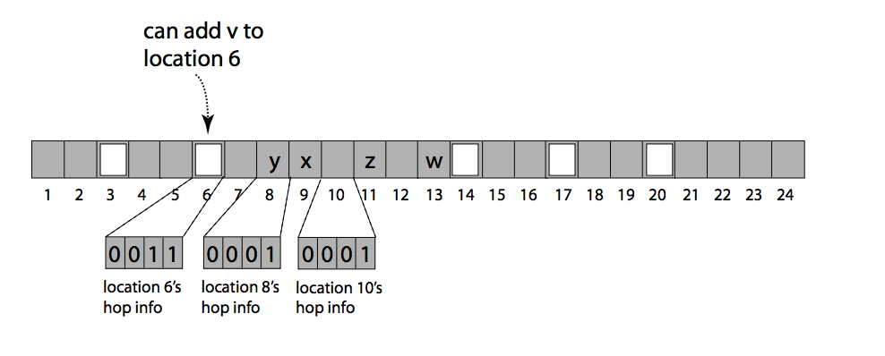
Hash Table
Chained hopscotch hashing
Notes:
And chaining in this part is used to replace resizing when we fail to insert entry in the H-1 neighbourhood. also lets us limit the length of linear probing during inserts .
Like normal chain hash we add chain list of entry. During lookups, we first search the neighbourhood bucket, then search through the chain
【用集中H个，不是为了减少次数，而是减少了每次rmda read的size】

Slide 21
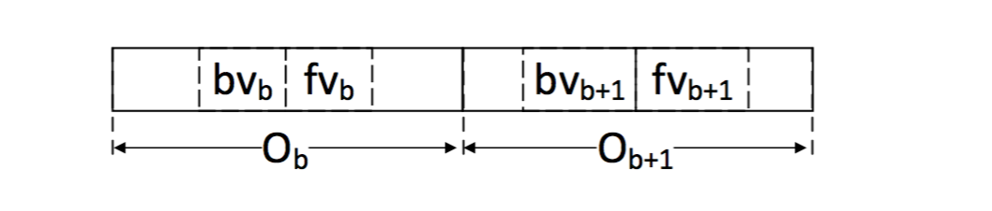
Hash Table
Associativity: Each bucket is a FaRM object with H/2 slots. It amortize the space overhead of chaining
Notes:
For example, H=4,we only need to read 2 bucket.
Also we need to ganrantee the version of two buckets are the same to ensure the consistency.
And we use joint versions, the forward version pf the first bucket fvb should be the same as the backward version of the second bucket bv+1

Slide 22
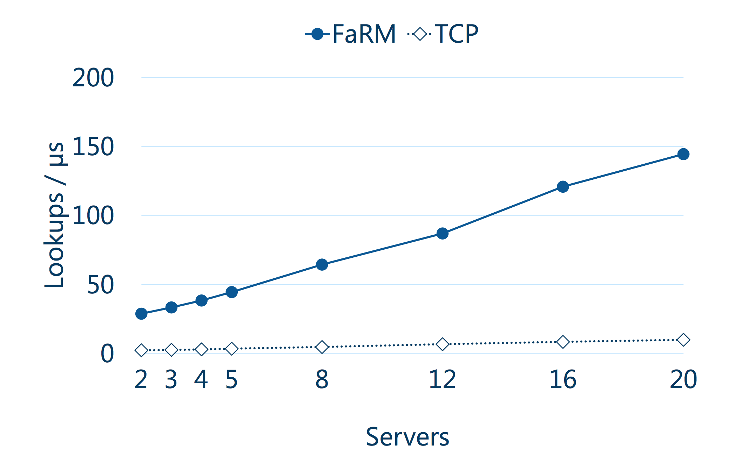
Evaluation
Notes:
{We use a technique inspired by flat combining [20] to combine concurrent inserts and updates to the same key into a sin- gle transaction.
Traditional key-value store look ups over TCP
Throughput of FaRM is very huge. Near 150 million operations per second.
A factor of 15 better than TCP

Slide 23
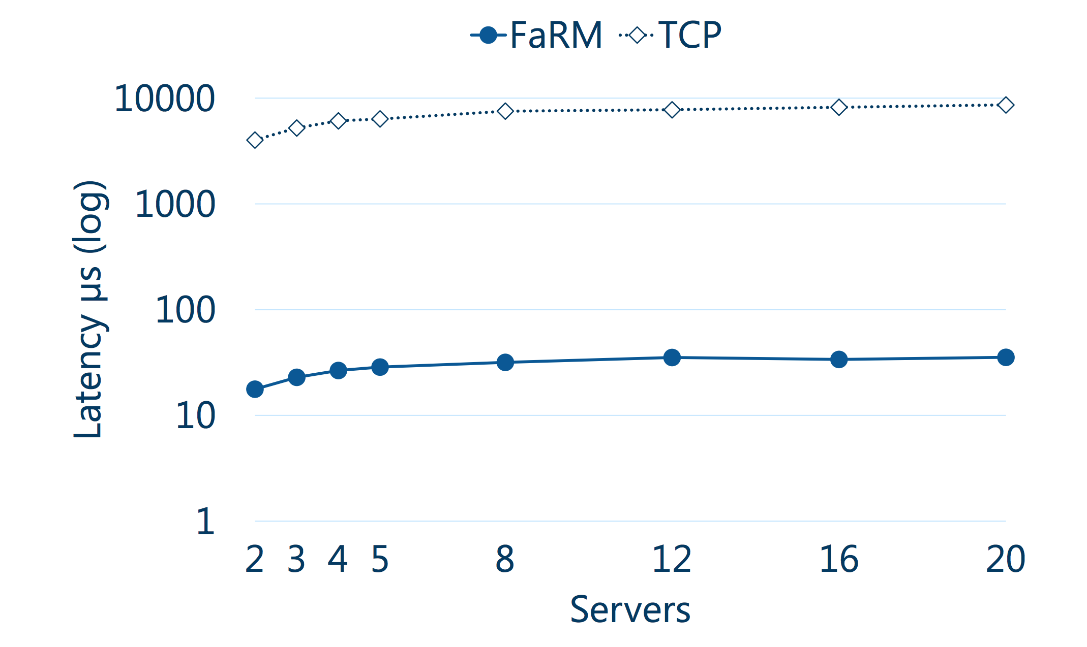
Notes:
TCP need to sacrifice the latency to improve the throughput
But farm accomplish this in the same time

Slide 24
No compromises: distributed transactions with consistency, availability, and performance
Aleksandar Dragojevi´c, Dushyanth Narayanan, Edmund B. Nightingale,
Matthew Renzelmann, Alex Shamis, Anirudh Badam, Miguel Castro
Microsoft Research
Presenters: Qiyang Lin, Ruying Sun
Notes:
Transactions with strong consistency and high availability simplify building and reasoning about distributed systems.
However, previous implementations performed poorly. So many systems avoid them or weaken their consistency to
improve availability and performance. FaRM can provide distributed transactions with strict serializability, high performance, and high availability

Slide 25
Goal
Strictly serializable transactions
High throughput
Low latency
High availability
New protocols in transaction, replication, and recovery phases.
Notes:
Key to achieving this are new transaction, replication, and recovery protocols designed from first principles to leverage commodity networks with RDMA and a new, inexpensive approach to providing non-volatile DRAM.

Slide 26
High performance
One-sided operations
Read objects
Log updates
Reduce message counts
Primary-backup replication
Optimistic concurrency control
Access objects only on primaries
Notes:
Goal : achieve high performance
FaRM uses one-sided operations that have already mentioned to read objects and update logs.
It also design protocols to reduce message counts. Because issuing and processing messages takes up CPU. Sending fewer messages reduce CPU over head.
Use primary-backup replication because this requires sending replications messages with fewer backups.
Read without requiring locks because you do not need to send messages to acquire and release locks later.
Because we do not need lock objects on the backup which also reduces.

Slide 27
Two phase commit
Prepare
Commit
C
P1
B1
P2
B2
Notes:
Let’s have a look at how FaRM achieve high performance in transactions.
Once all the operations are performed by transactions, it enter the commit protocol and then commit the transactions.
Each transaction is executed by a single thread which is coordinator thread which is letter C. (communicate with primary & backups)
How does FaRM commit transactions? One possible options is to use two phase commit.
Where the coordinator will send the messages to the primaries. And they will send to the backups and the messages will then go back all the way to coordinator. This would work and will be able to commit the transactions only two round trips. But this uses quite a lot messages and all the messages need to be processes by the CPU.

Slide 28
FaRM commit
Lock
Validate
Replicate
Update and unlock
C
P1
B1
P2
B2
Notes:
So FaRM design a new protocol that minimize the number of the messages and cpu processing.
1.The first step in the protocol is for the coordinator to temp to acquire the lock for the objects that have been written in the transactions. This is done by sending messages to the primaries of these objects. The messages contains new content of the objects. The primary temp to acquire the lock. If all the locks are acquired , then coordinator proceeds to validate the read set.
2. Validate the read sets means reading the version of the objects that have been read but not written in the transactions. This is to needed to ensure that the objects haven’t change since there are read during the transactions. It uses one-side RDMA read. If the validation succeed , that is none of the versions have changed ,then the transaction can proceed to replicate the log.
3. Replicate: This is done by issuing one-side RDMA write to do back-ups of the objects that updated by transactions, and the coordinator do not need to wait for these messages to be processed by CPU. It can proceed as soon as they receive the hardware ack.
4. The final step after replication is update the objects on primary. This is done by writing commit log entries into the logs on the primaries. Again, the coordinator does not need to wait for the message that actually be processed. As soon as it receives hardware acks , it can report the transaction to be committed to the client.
there are 4 phase, but only the lock phase we need to wait for the CPU to perform many actions which will actually cost the most latency. In other cases, the system only wait for the hardware acks and proceed immediately. It will reduce the latency..

Slide 29
One-sided operations
Complicate recovery
CPU does not process remote accesses
Cannot rely on CPU rejecting messages
Changes:
Configuration change: Precise membership
Recovery: Drain logs before recovering
Notes:
Then let’s talk about failure recovery. We use one-side operations to improve performance, it has some downside. It complicate recovery. The main reason is that with one-side operation, we do not have cpu on the remote end to process the messages.
Because there are some of the messages that haven’t been processed yet by the primary and backups , but the transactions have already commited to the client.
It have been proved that uses these methods will achieve strict serializability. <I’d like to give an outline of how recovery works and how to achieve high availibility>
<presice membership>After a failure, all machines in a new configuration must agree on its membership before allowing object mutations. Machines in the configuration do not issue RDMA requests to machines that are not in it, and replies to RDMA reads and acks for RDMA writes from machines no longer in the configuration are ignored.

Slide 30
Failure recovery steps
Detect failure
Change configuration
Recover transactions
Recover data
Notes:
Recovery . On high level it looks like recovery in other systems.
Want to achieve high availability.
Use primary-backup system, that you are going to have some down times when machine fails , the cluster agree with new membership. But we would like to keep this down time as short as possible.
Have very short failure detection time:
remove interference like pre-allocate all memory
2. Use parallelism as much as they can
Do not block new transactions in recovery as much as they can
Recovery transactions in parallel
Recovery data in parallel.

Slide 31
Transaction recovery
Use parallelism
All message logs in parallel (Draining)
All regions in parallel (Find recovery transactions, Lock, Replicate log)
All recovering transactions in parallel (Vote and Decide)
Notes:
This involves recovering the state both at the replicas of objects modified by the transaction and at the coordinator to decide on the outcome of the transaction.
1.First need to drain the message log. It means process all the messages that are there. Reject the records from old configuration.
2. When lock recovery is complete for a region, the region is active and local and remote coordinators can read objects and commit updates to this region in parallel with subsequent recovery steps.

Slide 32
Data recovery
Parallelize data replication
Done in background
Notes:
Recreate backups for the regions that lost backups
Done in background:
paced into background to reduce impact on foreground traffic.

