Slide 1
Supporting Very Large Models using Automatic Dataflow Graph Partitioning
PipeDream: Generalized Pipeline Parallelism for DNN Training
Deepak Narayanan‡ ∗, Aaron Harlap† ∗, Amar Phanishayee, Vivek Seshadri, Nikhil R. Devanur, Gregory R. Ganger†, Phillip B. Gibbons†, Matei Zaharia‡ Microsoft Research †Carnegie Mellon University ‡Stanford University
Minjie Wang New York University Chien-chin Huang New York University Jinyang Li New York University
Wenyi Wu, Alexandra Spence

Slide 2
PipeDream: Generalized Pipeline Parallelism for DNN Training

Slide 3
Overview
Background and Related Work
Pipeline Parallelism
Implementation
Evaluation

Slide 4
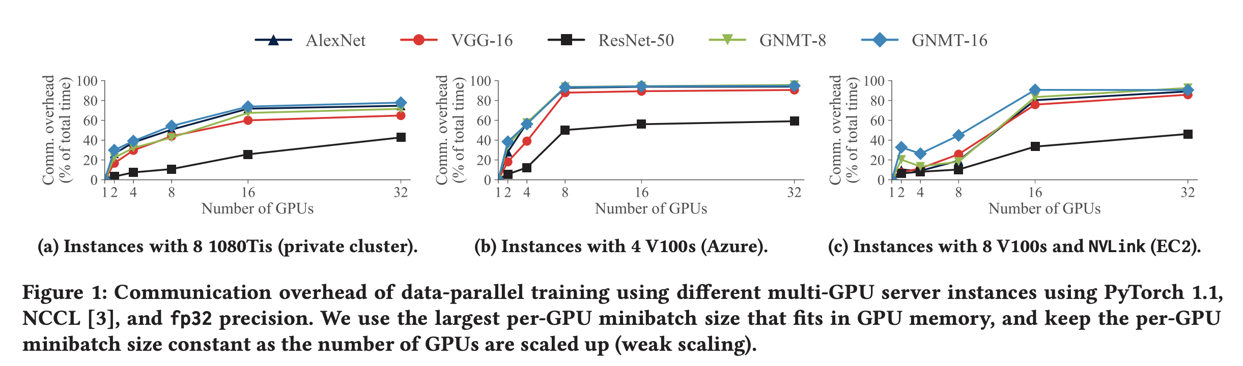
Background - Data parallelism
Partitions the input data
Periodically synchronizing weights with other workers
The amount of data communicated is proportional to the number of model weights and the number of workers participating in training

Slide 5
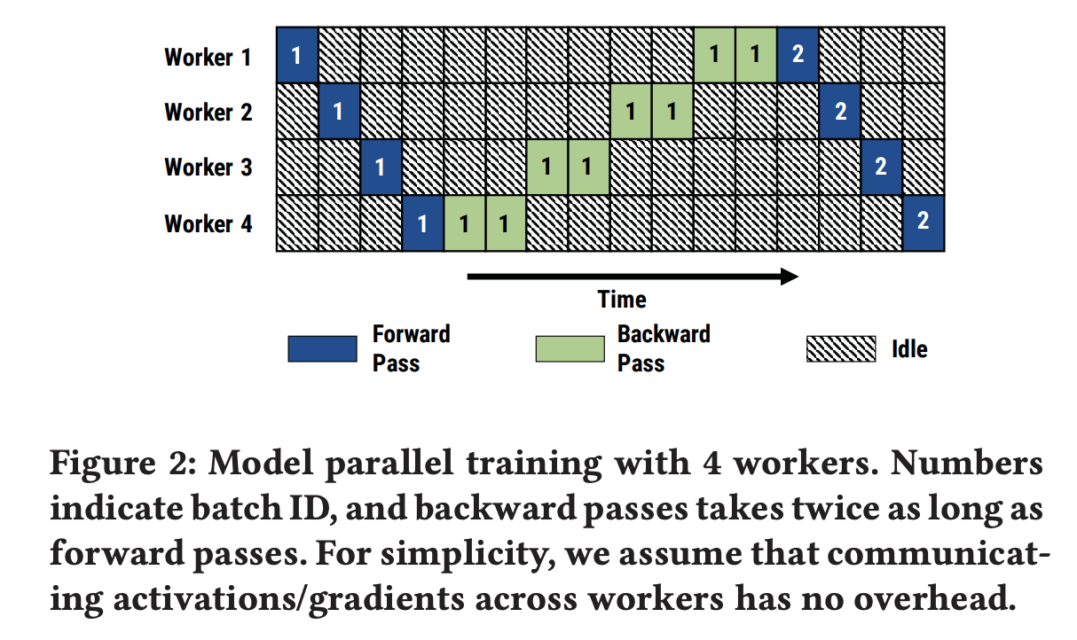
Background Vanilla Model parallelism
Partitions operators
Each worker updates a subset of parameters for all inputs
The amount of data communicated is the size of intermediate outputs (and corresponding gradients) that need to be sent across workers

Slide 6
Background - Hybrid parallelism
OWT (One Weird Trick)
Splits by hand, using data parallelism for convolutional layers but not fully connected layers
FlexFlow
Splits a single iteration along samples, operators, attributes, and parameters

Slide 7
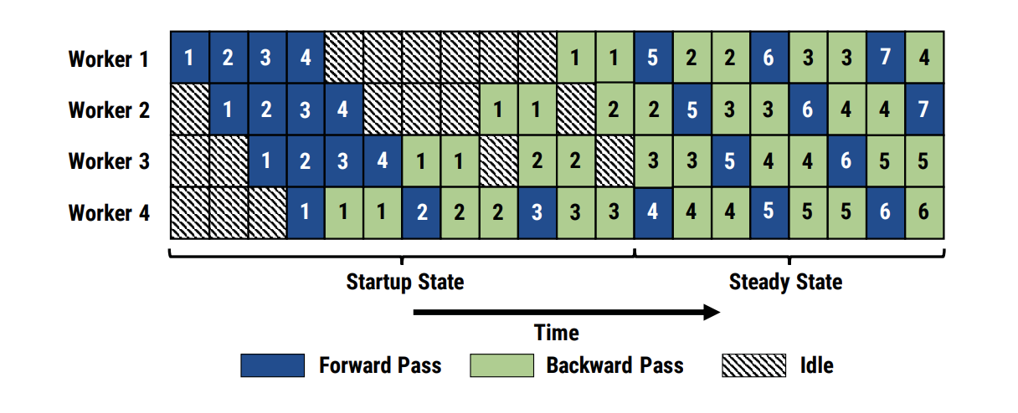
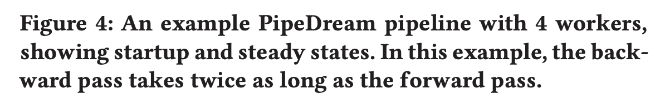
Pipeline Parallelism
Combining intra-batch parallelism with inter-batch parallelization
Assigns groups of consecutive layers to available workers
Overlaps the computation and communication of different inputs in a pipelined fashion
Notes:
This process can greatly reduce inter-worker communication because it limits the communication to layer inputs and outputs (activations in the forward pass and gradients in the backward pass) solely across consecutive layers assigned to different workers, which for many models are much smaller than the size of the entire model

Slide 8
Pipeline Parallelism - Advantages
Each worker has to communicate only subsets of the gradients and output activations, to only a single other worker.
Large reductions in communication for some models (e.g., >85% reduction for VGG-16, AWD LM)
Significant overlap of communication with the computation of a subsequent minibatch
Notes:
DP has to aggregate gradients for all parameters and send the result to all workers

Slide 9
Pipeline Parallelism - Work Partitioning
Profiler (Run of 1000 minibatches on a single GPU)
T_l, the total computation time across the forward and backward passes for layer l on the target GPU
a_l, the size of the output activations of layer l (and the size of input gradients in the backward pass) in bytes
w_l, the size of weight parameters for layer l in bytes
Notes:
Slow stages result in resource under utilization
Excessive communication lower the throughput
Partitioning may need to be model- and resource- aware

Slide 10






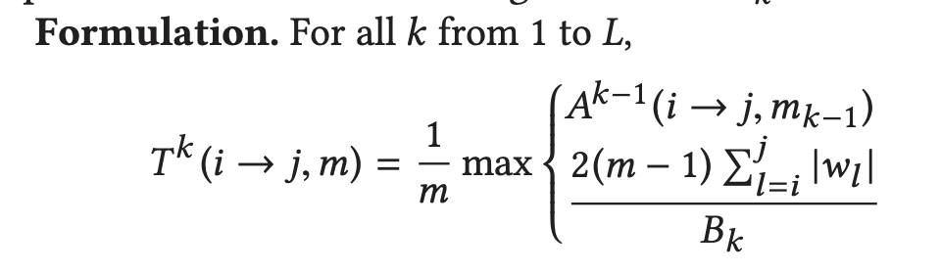
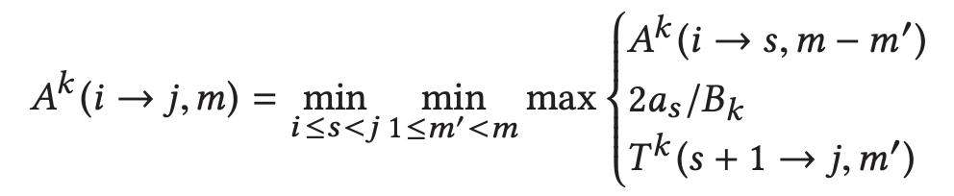
Pipeline Parallelism - Work Partitioning
: time taken by the slowest stage in the optimal pipeline between layers i and j using m workers at level k (computation)
Find , and the corresponding partitioning, where L is the highest level and N is the total number of layers in the model.
: the total time taken by a single stage spanning layers i through j for both forward and backward passes, replicated over m workers using bandwidth Bk (communication)
Notes:
For a given level k, the total number of sub-problems is O(N2mk ). Time complexity per sub-problem is O(Nmk ), leading to a total time complexity of O(N3m2 k ) for level k. Total time complexity is L k=1 O(N3m2 k ). In our experiments, the running time is under 8 seconds.

Slide 11
Pipeline Parallelism - Work Scheduling
Each worker could be:
Performing its stage’s forward pass for a minibatch, pushing the minibatch to downstream workers
Performing its stage’s backward pass for a different minibatch, pushing the minibatch to upstream workers

Slide 12
Pipeline Parallelism - Work Scheduling
One-forward-one-backward (1F1B)
NUM_OPT_ACTIVE_MINIBATCHES (NOAM) = (# workers) / (# of replicas in the input stage)
In steady state, each stage alternates between performing its forward pass for a minibatch and its backward pass for an earlier minibatch
One-forward-one-backward-round-robin (1F1B-RR)
Ensures that each minibatch is routed to the same worker for both the forward and backward passes of the stage
Notes:
In the startup phase, the input stage admits enough minibatches to keep the pipeline full in steady state

Slide 13
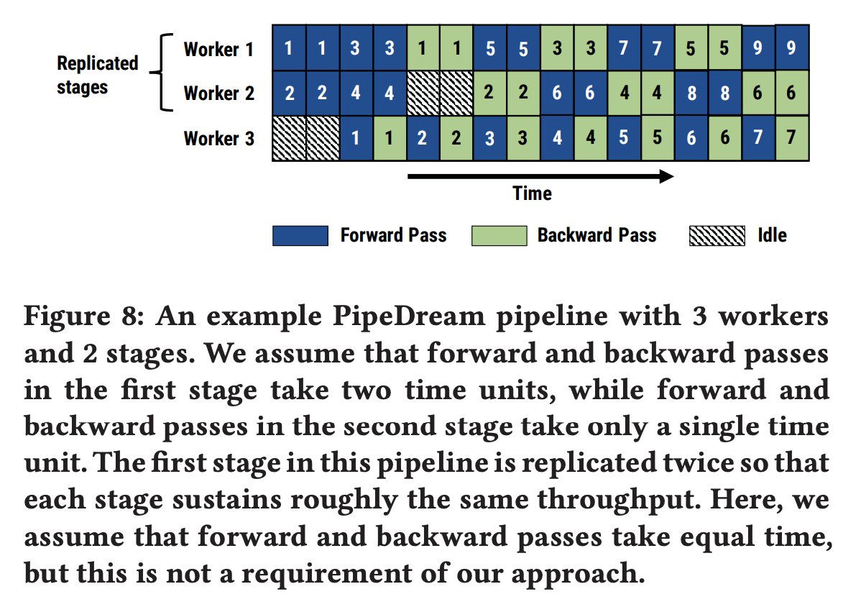
Pipeline Parallelism - Work Scheduling
Notes:
Figure 8 shows this mechanism in action for a simple 2-1 configuration, with the first stage replicated twice, and the second stage un-replicated. In the first stage, all inputs with even minibatch IDs are processed by worker 1, while inputs with odd minibatch IDs are processed by worker 2. Worker 3 in the second stage processes all inputs. All workers perform a forward pass followed by a backward pass on a different input minibatch.
For 1F1B-RR to be effective, it is not necessary for the forward pass to take as long as the backward pass. In fact, we observe that the backward pass is always larger than the forward pass in practice. 1F1B-RR remains an effective scheduling mechanism, as highlighted in Figure 4

Slide 14
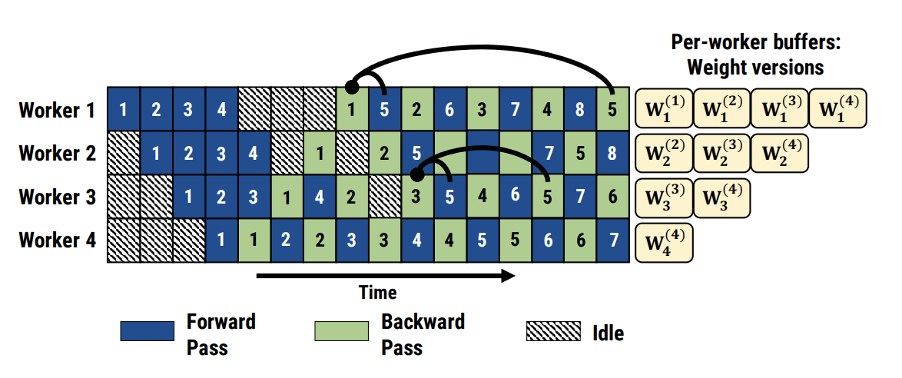
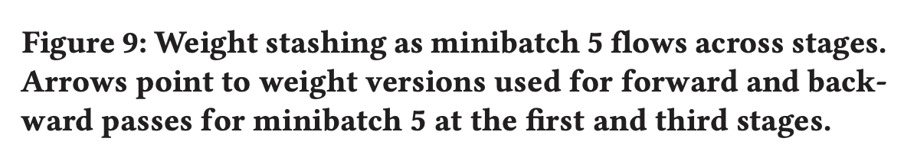
Pipeline Parallelism - Effective Learning
Weight stashing
Use the latest version of weights available in the forward pass
Same weight version is then used in the minibatch’s backward pass

Slide 15
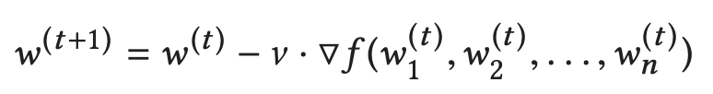
Pipeline Parallelism
Vertical sync (optional)
Each minibatch (bi) that enters the pipeline is associated with the latest weight version (w(i−x)) seen at the input stage
Across all stages, the forward pass for bi uses the stashed weights w(i−x)
Staleness
Vanilla SGD:
With weight stashing:
With vertical sync:
Memory overhead
Does not significantly increase per worker memory usage relative to data parallelism

Slide 16
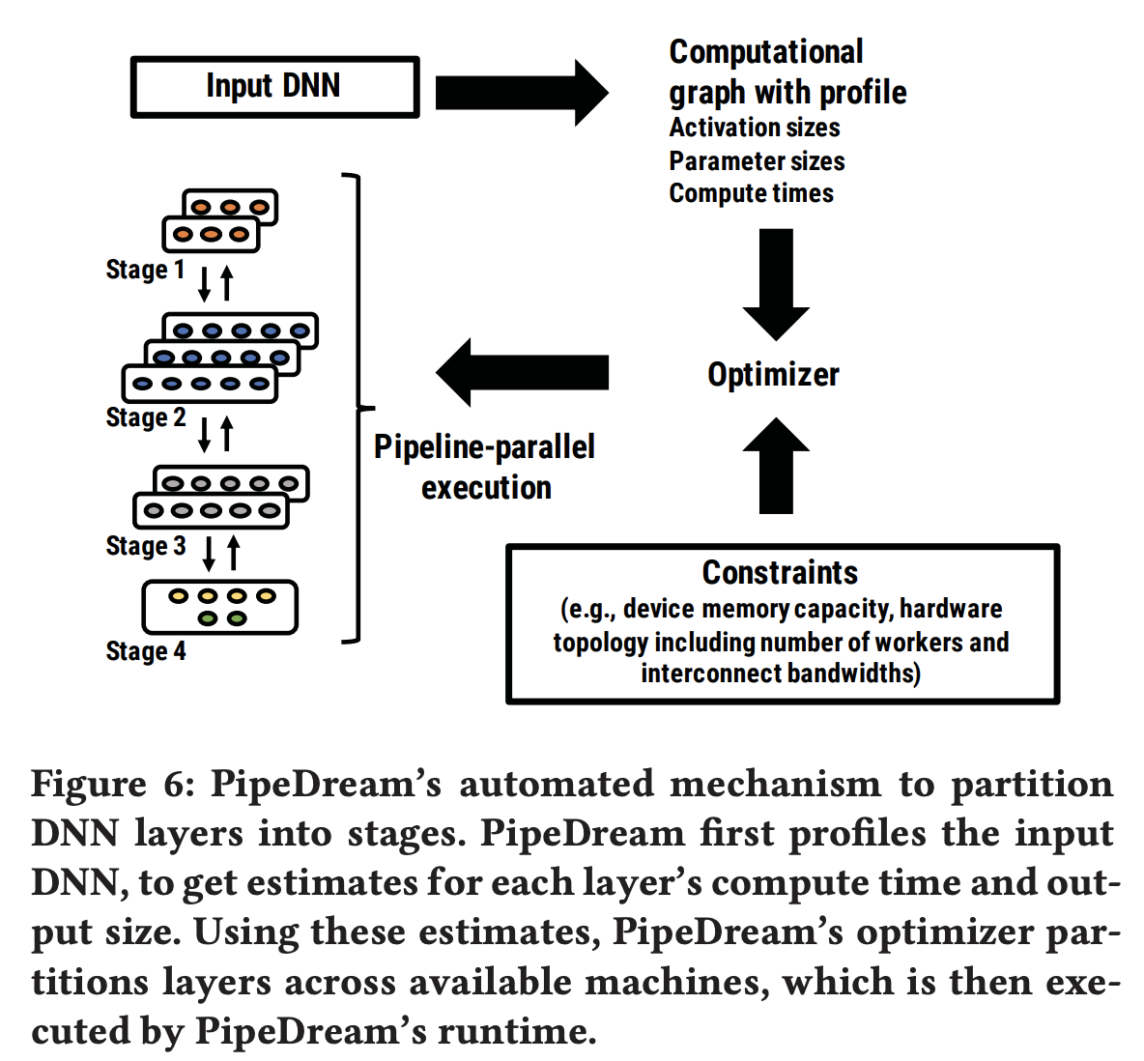
Implementation
Profiles the model
Partition the model into stages
Optimizer returns an annotated operator graph
Each stage as a separate torch.nn.Module
Assigns each stage according to its 1F1B-RR schedule
Notes:
Profiles the model on a single GPU with a subset of inputs from the training dataset
BFS traversal of this graph and generates code for each stage as a separate torch.nn.Module

Slide 17
Implementation - Parameter State
Maintains all parameters associated with the layers assigned to the stage directly in GPU memory
Weight updates are synchronized across replicas prior to being applied if the stage is replicated
Parameters are discarded only once a backward pass that uses fresher parameters is performed

Slide 18
Implementation - Intermediate State
Each stage’s input and output data is assigned a unique blob ID
Intermediate data from the forward pass is not discarded until the associated minibatch completes that stage’s backward pass
Intermediate data from the backward pass is freed as soon as the worker finishes using it, and if necessary, after it is sent to the next stage

Slide 19
Implementation - State Replication
Uses PyTorch’s Distributed Data Parallel library to synchronize parameters for layers of data-parallel stages
Data-parallel baselines
The NCCL communication backend for the large tensors
Gloo for small tensors, such as activations and gradients
Gloo is the default for inter-GPU communication when performing pipeline-parallel training

Slide 20
Implementation - Checkpointing
Default checkpoints across stages at the end of every epoch
Each stage dumps its model parameters locally when it performs the backward pass for the last minibatch in an epoch
Restarting a run due to failures entails starting from the last successfully created checkpoint for all stages

Slide 21
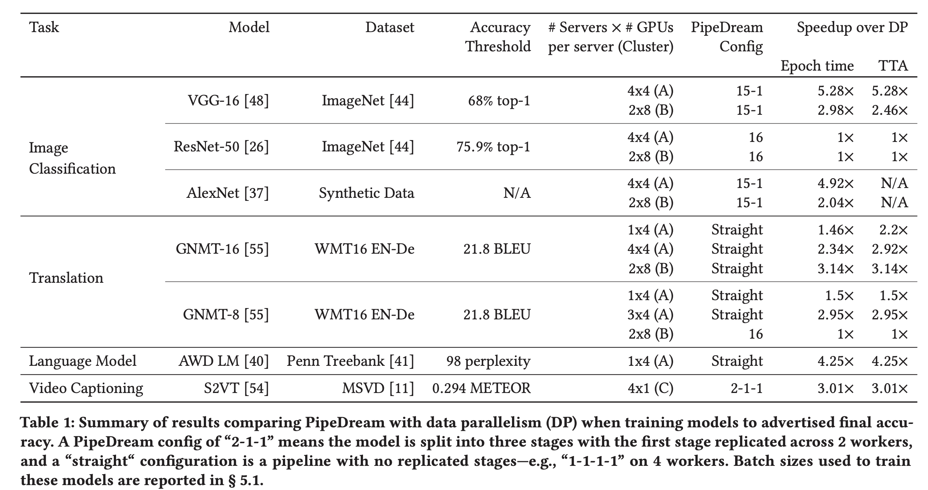
Evaluation - Compare with Data Parallelism

Slide 22
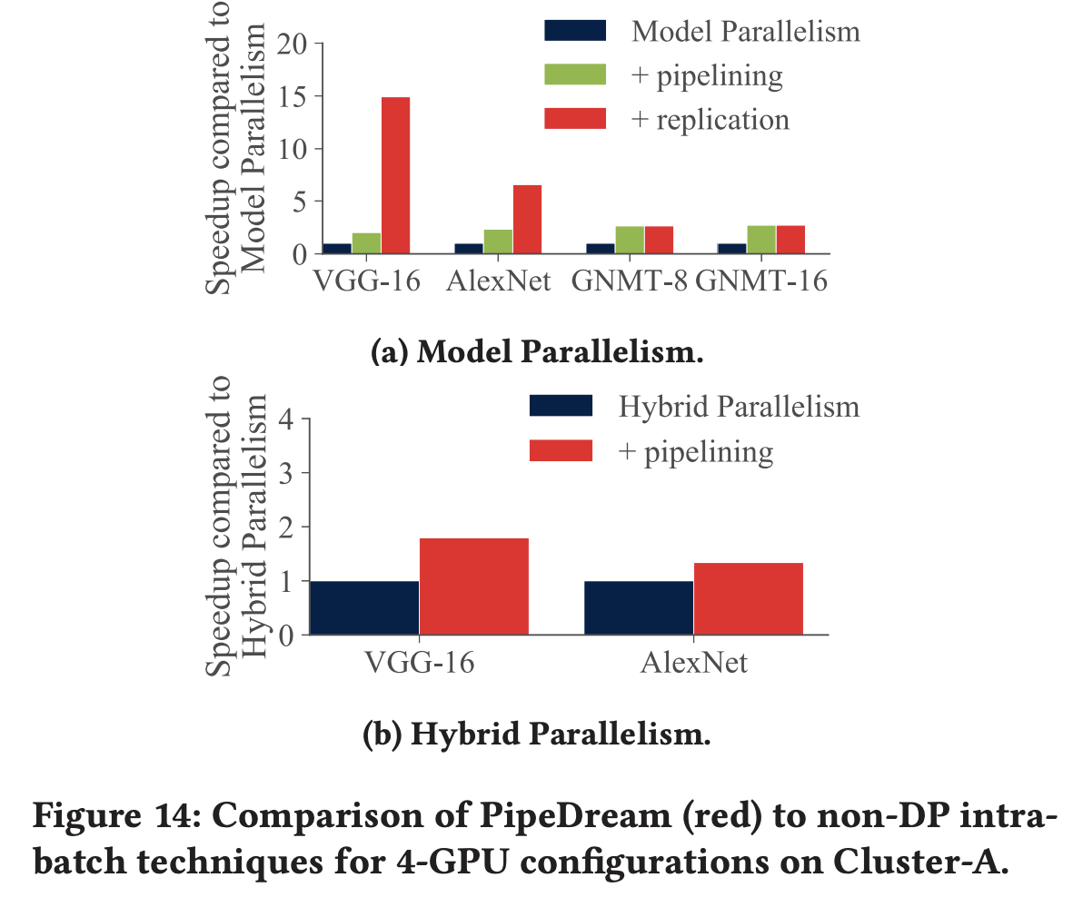
Evaluation - Compare with Model/Hybrid Parallelism
Notes:
14a For all four models, pipelining alone increases throughput by 2× or more
For VGG-16 and AlexNet, PipeDream replicates the first stage, leading to speedups of 14.9× and 6.5× compared to model parallelism
14b PipeDream is 1.9× faster

Slide 23
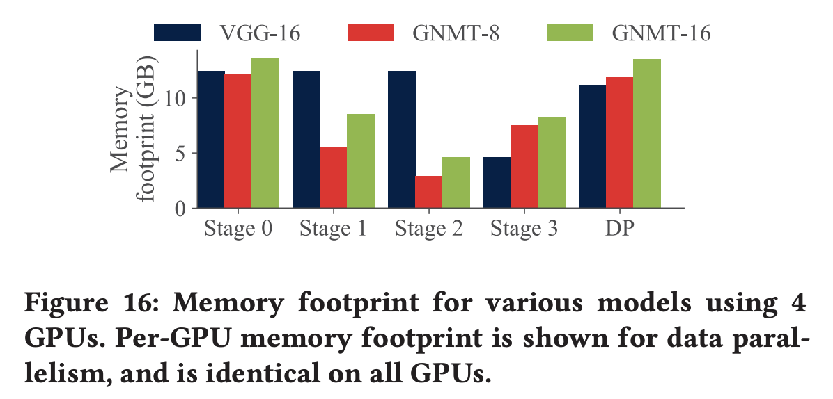
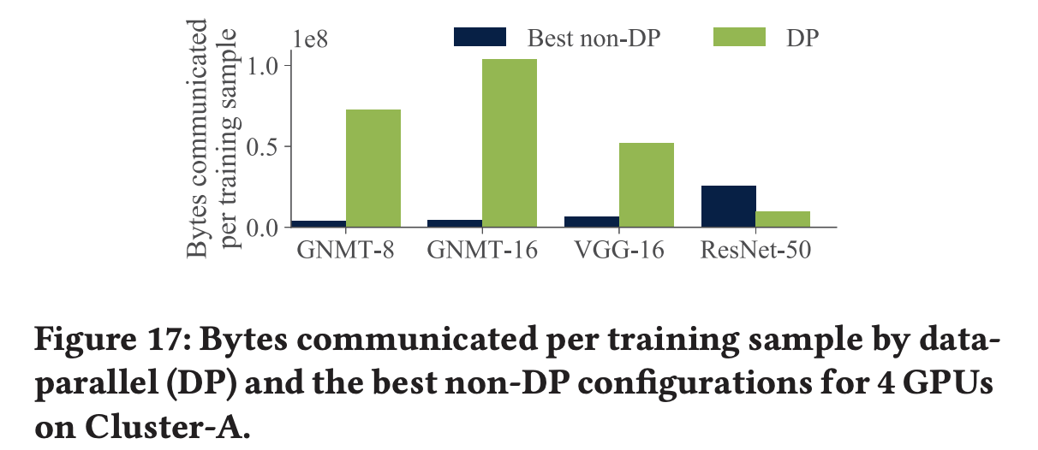
Evaluation - Memory and Communication Overhead

Slide 24
Conclusion
Pipeline-parallel DNN training helps reduce the communication overheads that can bottleneck intra-batch parallelism
Combining inter-batch pipelining with intra-batch parallelism to better overlap computation with communication
Up to 5.3× faster across a range of DNNs and hardware configurations

Slide 25
Supporting Very Large Models using Automatic Dataflow Graph Partitioning (Tofu)

Slide 26
Background and Motivation
The number of parameters in neural networks has been doubling every 2.4 years
Hardware improvements and the availability of large datasets allows this
The size of DNN models is constrained by limited GPU device memory
Partitioning tensors across devices can lower per-GPU memory
It also allows performance speedup due to parallel execution
Goal: automatically partition tensors and parallelize operators for training of large DNN models

Slide 27
Challenges
How to partition input/output tensors and parallelize execution of an individual operator?
How to optimize the partitioning of different operators for the overall graph?

Slide 28
How to partition a single operator?
Restricted parallelization pattern called “partition-n-reduce”
Operators are parallelized in one of two ways:
1) Output tensor O is obtained from concatenation of O₁ and O₂ (output from two workers)
2) O is the element-wise reduction of O₁ and O₂
“Partition-n-reduce” is not universally applicable nor optimal, but most operators can be parallelized using this method with good performance
Can achieve more efficient communication with specialized parallel algorithms
Because tensors have many dimensions, there are many ways to parallelize operators
Notes:
Cholesky decomposition is an example that it does not work
Specialized algorithms (Cannon’s algorithm for matrix multiplication) more efficient

Slide 29
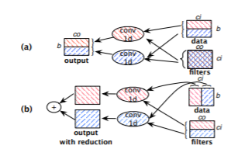
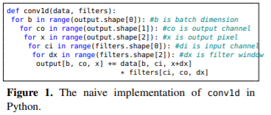
Partition Example
Notes:
In (a), the output is done using a concatenation of the output of two workers along the b dimension
In (b) the output is a reduction (sum) of the output of two workers

Slide 30
Tofu’s Approach to Partition
Tofu uses access patterns of operators to determine all viable partition strategies
This requires the use of Tensor Description Language (TDL)
TDL gives a description of what each operator computes and must be provided by the developer
The TDL description is statically analyzed to determine how to partition

Slide 31
How to optimize partitioning for a graph?
NP-hard to partition general dataflow graph
Existing proposals use greedy or dynamic programming algorithms for mostly linear graphs and stochastic searches for general graphs
Running time of greedy/dynamic approach is proportional to number of ways an operator can be partitioned
Notes:
Suspected that cannot be solved in polynomial time

Slide 32
Tofu’s Approach to Graph Partition
Tofu uses a modified version of an existing dynamic programming algorithm
Modifications include grouping forward and backward operations and applying the basic search recursively

Slide 33
Tensor Description Language
Inspired by Halide
Programming language designed to make it easier to write image and array processing code
“Tensor-as-a-lambda”
Represent tensors as lambda functions
TDL expressions include:
Index variables (arguments of the lambda function)
Tensor elements
Arithmetic operations involving constants, index variables, tensor elements, or TDL expressions
Reduction over a tensor along one or more dimensions
Built in reducers are Sum, Max, Min, and Prod
Programmers could define custom reducers, but as of the paper were not needed

Slide 34
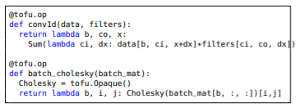
Example of TDL

Slide 35
Partitioning the Dataflow Graph
Optimization goal:
Ideal: consider end-to-end execution time and per-worker memory consumption
Neither can be optimized perfectly
Prior work optimizes approximate end-to-end execution time
Tofu minimizes total communication cost
DNN models process large tensors so any dimension tends to have similar execution time
Memory consumed at each GPU is used for storing worker’s tensor data (always the same) and buffering data communication between GPUs (proportional to amount of communication)

Slide 36
Graph Coarsening
Dataflow graphs are normally non-linear
“Coarsen” dataflow graphs into a linear one by grouping multiple operators or tensors
Group forward operators (introduced by user) with auto-generated backward operators
Group forward tensor (weight or intermediate tensors) and its gradient tensor
If there are multiple gradients, sum them up and add summation operator to group
Coalesce operators that share the same partition strategy
Merge consecutive element-wise operators
Merge unrolled timestamps
RNN: different time steps share the same computation logic and weight tensors
Notes:
Layer-wise parallelism

Slide 37
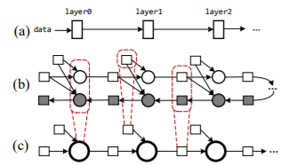
Graph Coarsening Example
Notes:
(a) shows a layer graph for an MLP model
(b) shows a dataflow graph including forward and backward computation
(c) shows the coarsened version of (b)
one operator group, one group for activation tensors and one group for weight tensor

Slide 38
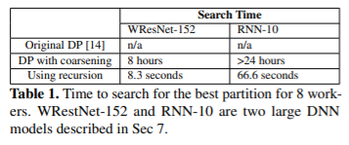
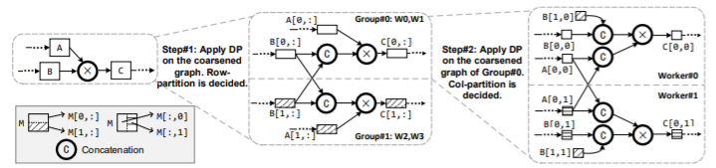
Recursive Partitioning Example
Notes:
Step 1 partitions the matrices by row
Step 2 partitions the matrices by column
Each worker computes one block of the resulting 2x2 grid

Slide 39
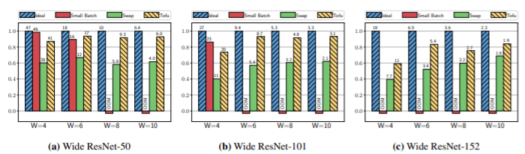
Evaluation - WResNet Performance
Notes:
W is the widening scaler (widened by 8 times)
The number is the number of layers

Slide 40
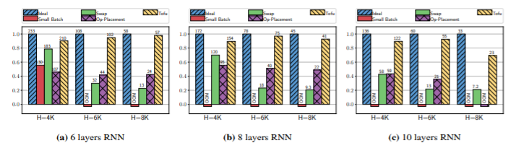
Evaluation - RNN Performance
Notes:
6 to 10 layers
4k 6k 8k hidden sizes

Slide 41
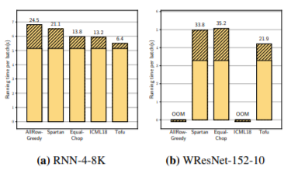
Evaluation - Comparison of Partition Algorithms
Notes:
Allrow-Greedy: partition largest tensor first then second largest
Spartan: equivalent proposal
EqualChop:: chop each tensor equally along only one dimension
ICML18: does not consider aggregating output tensors (output-reduction)
Striped parts are overhead due to communication

Slide 42
Related Work Comparisons
Parallel DNN training
Data parallelism cannot be used for very large models because parameters are replicated to each device
Model parallelism spreads out model parameters, so is suitable for training large models
Minerva and Strads require users to implement extra interfaces to partition model parameters
Out-of-core DNN training
Includes recomputation on demand and swapping and prefetching from host memory
Recomputation not viable for large weight tensors
Swapping scales poorly with multiple GPUs
Tofu can be combined with these techniques

Slide 43
Related Work Comparisons (cont.)
Model compression
Network pruning, quantization, and reduced precision
Speed up inference but affect model accuracy
Tofu does not change model behavior
Parallel tensor computing
Libraries with efficient matrix algorithms and tensor operations exist, but have limited programmability support
Many approaches to automatically parallelize tensors exist but none work well for sequential DNN computation
Data layout optimization
Generally heuristics are used since optimizing communication is NP-complete
Tofu analyzes simpler operator description language instead of source code

Slide 44
Limitations and Future Work
Fundamental Limitations
Partition-n-reduce restricts each worker to perform a task identical to the original computation
Partition-n-reduce does not necessarily minimize communication or use underlying interconnect topology
Limitations of TDL
TDL does not have control flow primitives or data-dependent indexing
Tofu does not support sparse tensor operations due to load-imbalance even though they can be described in TDL
Tofu does not verify that operator implementation matches its TDL description
Partition flexibility and hardware heterogeneity
Tofu always partitions every operator and tensor across all workers
This can leave GPUs unsaturated
Tofu has no support for non-uniform partitioning for GPUs with different computing and memory capacity
Tofu’s recursive search cannot be extended to address these limitations

Slide 45
Discussion
PipeDream
What are the main limitations? When does it fail to perform well?
Performance comparison to other tools that use pipeline such as GPipe
Can features of both be combined for improvements?
Tofu
Extending Tofu to other frameworks-is it worth it?
How to implement non-uniform partitioning?

Slide 46
TDL Properties
TDL is not Turing-complete
It does not support loops or recursion
Instead use opaque function for sophisticated computation
TDL can describe 134/139 MXNet v0.11 operators
77 simple element-wise operators, 2 use the opaque function, and 11 have output reductions
Most need fewer than three lines of code
Tofu does not have a prototype for TensorFlow, but can describe 257/341 TensorFlow operators
140 element-wise operators and 22 use the opaque function
Three categories that TDL cannot describe:
Sparse tensor manipulations
Operators with dynamic output shapes (none in MXNet)
Operators requiring data-dependent indexing (none in MXNet)
Notes:
Function that compiler has no prior information about

Slide 47
Analyzing TDL Descriptions
Basic partition strategy only uses 2 workers
Partition strategy specified by describing input tensor regions required by each worker
Using concrete ranges in inefficient, so use symbolic interval analysis on abstract domain
Symbolic interval analysis uses a symbolic interval as an affine transformation of symbolic upper bounds
Affine transformation maps an affine space onto itself that preserves dimensions and ratios of lengths
As of the paper, they did not encounter non-affine operations among MXNet operators
Two cases for input regions
Case 1: partition-n-reduce without the reduction step
Each partition calculates input regions needed to compute half the output tensor
In (a) from earlier example, each worker reads half the data and the entire filter tensor
Case 2: partition-n-reduce with the reduction step
Partition along a reduction dimension
In (b) from earlier example, each tensor reads half the data and half the filter

Slide 48
Recursive Partitioning
Steps for recursive optimization algorithm with 2^{m} GPUs:
1. Run DP algorithm with coarsening to partition G for two worker groups of 2^{m-1} workers, with each tensor only partitioned along one dimension
2. Consider partitioned dataflow graph as two halves, G₀ and G₁, where each half also contains data from the other group as extra input tensors
3. Repeat step 1 on G₀ and apply partition result to G₁until there is only one worker per group
Search time significantly decreased with recursion due to partitioning along only dimension at each step
Notes:
Partition plan is commutative-choosing P then P’ is the same total cost as P’ then P, so if sequence is non-optimal there must be a different sequence with smaller total cost which means could have chosen a better partition plan
there must be two consecutive steps k−1 and k, such that δk−1 ≤ δ ′ k−1 and δ ′ k < δk . We can show that, by choosing P ′ k instead of Pk at step k, the search could have produced a better partition plan
s. For each 4D tensor used in 2D-convolution, there are in total 20 different ways to partition it evenly across 8 workers. Hence, the number of possible configurations of 2D-convolution’s operator group is 206 = 6.4 × 10
For example, the number of configurations to be enumerated at each step for a 2D-convolution operator group is only 4 6 = 4096

Slide 49

Optimizations in Generating Partitioned Graph
Leveraging the existing memory planner
Operators can reuse memory buffers when they have a dependency
Naïve graph generation may remove direct dependencies
To fix, Tofu maintains original operator dependencies by generating extra control dependencies (red dashed lines)
Fusing operators for remote data fetch
Naïve graphs use split to extract input regions from other workers and copy data to local workers
Tofu uses custom GPU kernel called MultiFetch to retrieve remote data and assemble input region in-place using CUDA Unified Virtual Addressing (UVA)
CUDA UVA allows kernels on one GPU to directly access memory on another
Spread out reduction workload to all GPUs (all-reduce) for output reduction
Delay execution of remote fetch operator since MXNet scheduler may execute much earlier than required
Notes:
CUDA UVA allows all GPUs to access pointers to input data on other GPUs

Slide 50
Evaluation
Evaluated on WResNet and RNN since they are very large models
Not evaluated on DNNs that fit into single GPU’s memory
Benchmarks tested with a full training iteration including forward/backward propagation and weight update
Baseline and alternatives
Ideal: hypothetical baseline assuming each GPU has infinite memory
Simulated by modifying MXNet’s memory allocator to always return the same memory block
SmallBatch: reduce mini-batch size to try to fit model into single GPU
Swapping: swaps GPU memory blocks to CPU
Operator Placement: assigns operators to different devices to spread out memory usage-does not perform well for CNN so left out for WResNet
Notes:
-ideal and smallbatch: measure single GPU throughput and multiply by 8, so do not consider communication costs

Slide 51
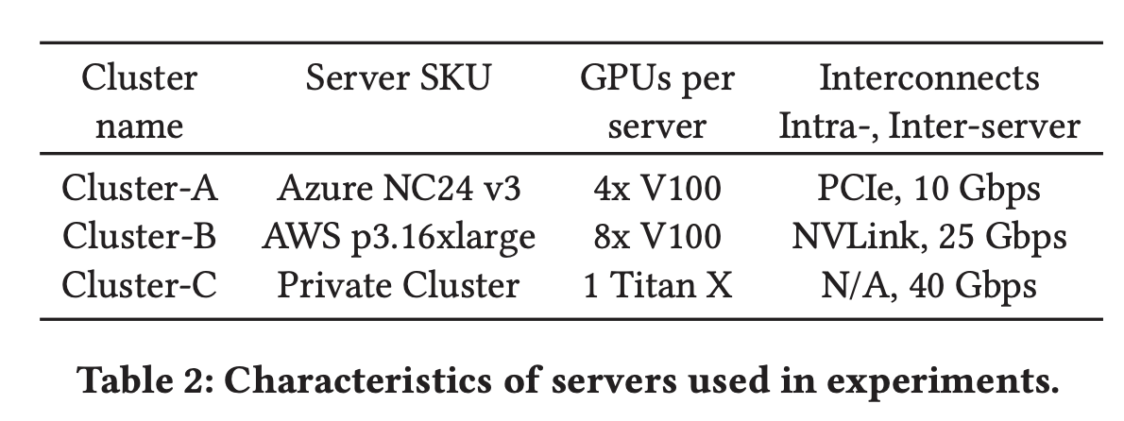
Evaluation - Setup
Tasks and Datasets
Image Classification, using the ImageNet-1K (ILSVRC12) dataset
Translation, using the WMT16 English to German dataset for training, and the “newstest2014” dataset for validation
Language Modeling, using the Penn Treebank (PTB) dataset
Video Captioning (S2VT), using the Microsoft Video description corpus (MSVD)
Servers

Slide 52
Evaluation - Setup Cont.
Models
1) VGG-16, 2) ResNet-50, 3) AlexNet, 4) Google Neural server Translation (GNMT) with 8 LSTM layers, 5) GNMT with 16 LSTM layers, 6) AWD Language Model (LM), and 7) the S2VT sequence-to-sequence model for video transcriptionServers
Batch Sizes and Training Methodology
Per-GPU minibatch size of 64 per GPU for VGG-16, 256 for AlexNet, 128 for ResNet-50 (e.g., BS = 1024 for 8 GPUs), 64 for GNMT, 80 for S2VT, and batch size of 80 for LM
Notes:
Uses the largest perGPU minibatch that fits in one GPU’s memory
ensures that we hit peak achievable FLOPs on a single device
We report per-GPU minibatch sizes (G); for data-parallel runs with n workers, the global minibatch size (BS) is n×G

Slide 53
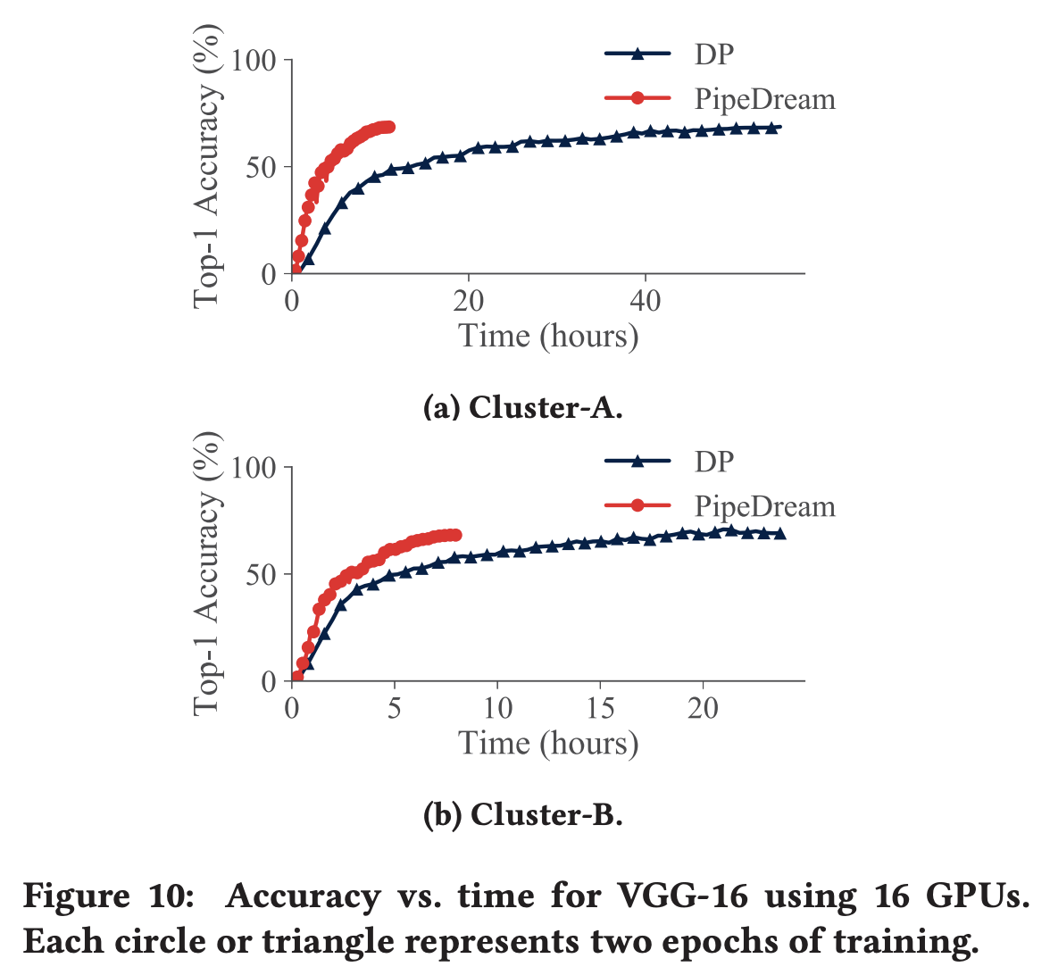
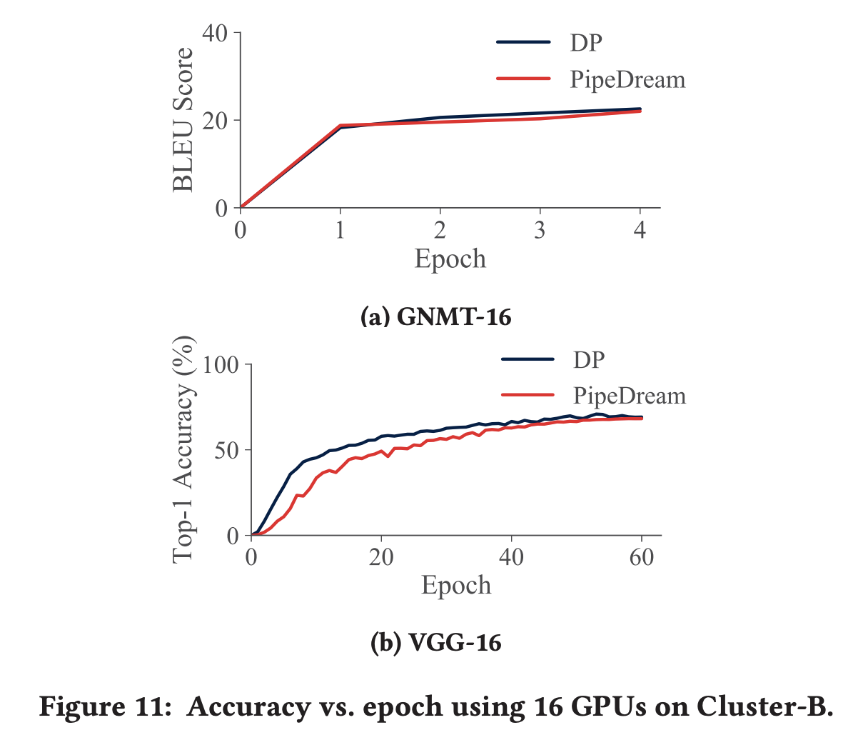
Evaluation - Compare with Data Parallelism
Notes:
Cluster A – 4 GPU * 4 servers, 5.28x speedup on a single server due to reduction of inter-GPU communication
Cluster B – 8 GPU * 2 servers, 2.98x speedup on a single server due to reduction of inter-GPU communication (generally faster than cluster A

Slide 54
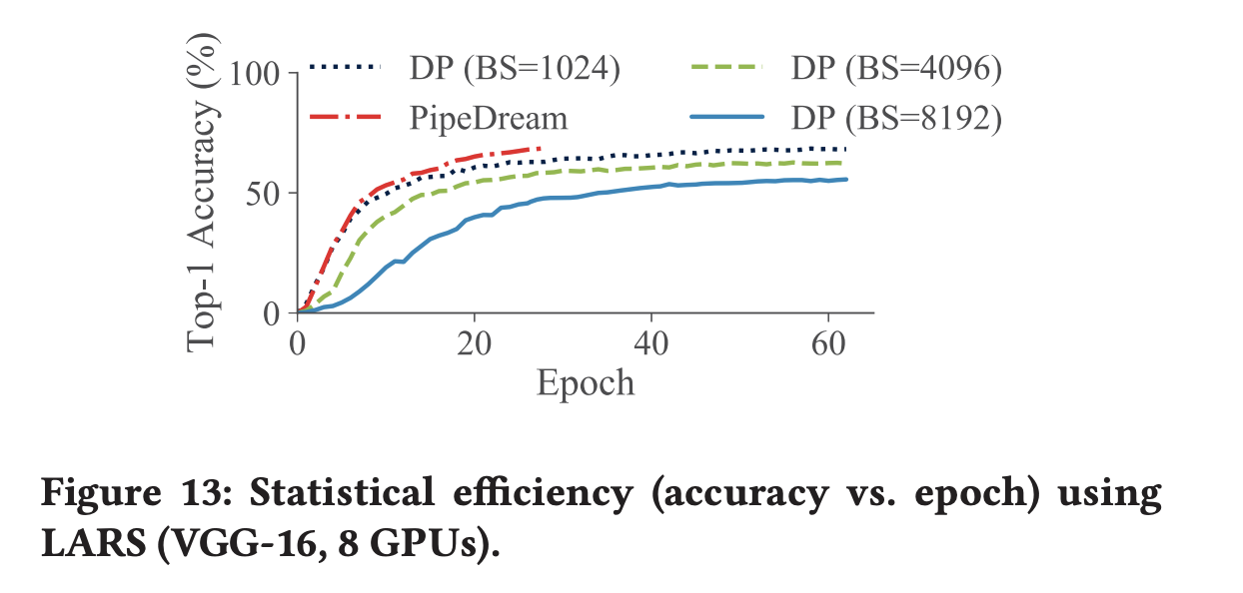
Evaluation - Compare with Data Parallelism
Notes:
Layer-wise Adaptive Rate Scaling (LARS) LARS uses different learning rates for each layer based on the ratio of the weight norm to the gradient norm
2.4x speed up than the fastest (1024)

