Slide 1
Naiad: A Timely Dataflow System
Presenter: Shaowen Wei, Chi Zhang, Die Hu
Some slides adapted from Derek G. Murray, SOSP 2013’ Talk
EECS 598 – F17
Notes:
Naida is a distributed system used for large scale computation. It is built on a timely dataflow model.

Slide 2
Batch processing
Stream processing
Graph processing
Timely DataFlow
EECS 598 – F17
Notes:
Why is Niaid useful?
Batch processing framework such as dryad, mapreduce, spark which is stateless and synchronous task execution model. Stream system using asynchronous model. Graph processing use a vertex oriented execution model, usually involve iterations.
If you want to have a system which can deal with both three tasks together, you have to use the lowest common denominator which is batch processing which need coordination.
Raise the common denominator

Slide 3
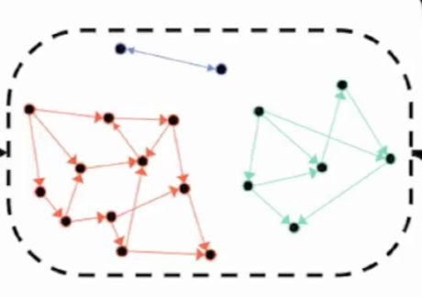
#
ln
@
join
max
join
?
join
Notes:
Let’s start with a iterative graph algorithm, suppose if you want to find all connected components of a graph in an iterative manner, derive this graph from a stream of twitter message. Update graph in real time, maintain a sliding window. Extract the hashtag join with the connected components. Interact query for username to find most popular hashtag for that user’s component.
We can use distributed system to solve this problem. For graph you can use a graph iterative algorithm. For real time data, you need a streaming processing model. For max and join those aggregation execution you need batch.
How to develop a system which can combine those three system together with a low latency? Think about we have a time requirements.

Slide 4
Dataflow
connector
A
E
stage
EECS 598 – F17
Notes:
Popular because it’s easy to paralyze, each stage has vertex and connector can be pipeline or data exchanges
Map
reduce

Slide 5
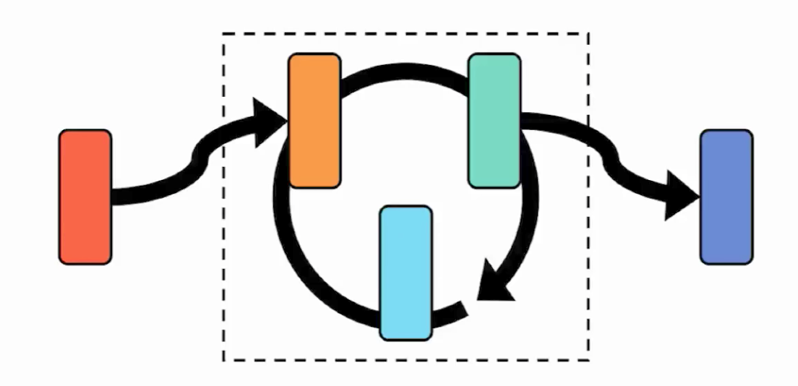
Dataflow: iteration
EECS 598 – F17
Notes:
Sometimes you don’t know how many iteration you need. Thinks about graph processing where the steps to finish a task is not known ahead of real computation

Slide 6
Batching vs. Streaming
(synchronous)
(asynchronous)
Require coordination
No coordination needed
Support aggregation
Aggregation is difficult
Notes:
What if you need these two system together. We can use batch framework to execute. But is not always efficient. What niaid do is simulate batch processing in a data streaming model to get rid of the coordination and support aggregation.

Slide 7
How to achieve low latency
Programming model
Distributed progress tracking protocol
System performance engineering
EECS 598 – F17
Notes:
How does naiad achieve this. We start with the programming model

Slide 8
Programming model
SendBy(e, m, t)
NotifyAt(t)
B.Operation(x, y, z)
x2
A
B
C
B.OnCallback(u, v)
x2
OnReceive(e, m, t)
OnNotify(t)
EECS 598 – F17
Notes:
All executions of a vertex happens in callback and vertex interact with outside world by operations

Slide 9
Messages
A.SendBy (edge, message, time)
A
B
C
B.OnReceive (edge, message, time)
Message are delivered asynchronously
Notes:
Asynchronous primitives are for message exchange. Every message is sent asynchronously (without reorder at receiver).
Time identify record that is associated with same batch of data. Just like a sequence number.

Slide 10
Notifications
A.SendBy(edge, message, time)
C.NotifyAt (t)
A
B
C
C.OnNotify (t)
Only be invoked when on further C.OnReceive(t’) t’<=t
Notification support batching
Notes:
Sometime you need synchronization, so we have notifications. They are delivered in a certain order so we can simulate batch execution.
C can request for notification and specify the time. It doesn’t block the messages.

Slide 11
How to achieve low latency
Programming model
Asynchronous and fined-grained synchronous execution
Distributed progress tracking protocol
System performance engineering
EECS 598 – F17
Notes:
Progress tracking used to make sure notification are sent at correct time

Slide 12
Progress tracking
C.SendBy(_,_,t’)
t’ >= t
E.NotifyAt(T)
Epoch T is complete
A
B
C
D
E
C.OnReceive(_,_,t)
EECS 598 – F17
Notes:
2 constraints
external source assign an integer Epoch to input data, and sometime confirm is complete
Make sure messages are not sent “backwards in time”,
Using exist technique like virtual time, like punctuation in streaming to fire notification
Make sure notifications get delivered at correct time in a prompt manner

Slide 13
Progress tracking
C.NotifyAt(time)
B
C
A
E
F
D
Advance timestamp
Problem: C depends on it’s own output
Notes:
Notification may never fire up. We have a cyclic dependency to resolve
Disallow notifications in the loop
Execute each iteration synchronously
Add structure to timestamp

Slide 14
(timestamp, counter) - pointstamp
B.SendBy (1, _, (1, 6))
B.SendBy (_, _, (1, 7))
C.NotifyAt ((1, 6))
C.NotifyAt (1)
A.SendBy (_, _, 1)
E.NotifyAt (1)
B
C
A
E
F
D
Advance loop counter
D.SendBy ((1, 6))
EECS 598 – F17
Notes:
Every back edge in the loop must have a feedback vertex
But we can not just simply increase the timestamp, because timestamp hold the relationship between input and output
Message inside the loop receive a second parameter work as the loop counter
By doing this, E will actually see all data correspond to a Epoch

Slide 15
How to achieve low latency
Programming model
Asynchronous and fined-grained synchronous execution
Distributed progress tracking protocol
Make sure notification is sent at correct time
System performance engineering
EECS 598 – F17

Slide 16
Implementation
Partitioning function
connector
H(m)
stage
routing
Stages are actually a set of vertices in physical structure.
Connectors are composed of multiple edges between vertices.
EECS 598 – F17
Notes:
How Naiad implement it in a distributed system.
Stages are actually a set of vertices in physical structure. And connectors are composed of multiple edges between vertices. Messages such as notifications are delivered through the edges. Some aggregation computation are achieved by partitioning function in the logical graph. The logical graph seems much more simpler than the physical connections, especially in the real implementation where vertices are spread across multiple workers with in multiple processes.

Slide 17
Implementation: Distributed
woker1
woker2
woker3
woker4
A1
A2
A3
A4
B1
B2
network
B3
B4
C1
C2
C3
C4
scheduler
scheduler
scheduler
scheduler
Progress tracker
Progress tracker
Notes:
Vertices within these workers communicate locally or through Internet. To deliver messages and notifications, each worker maintains a local scheduler for its vertices. Each scheduler maintains a queue. (it also maintains the local approximation of the frontier).

Slide 18
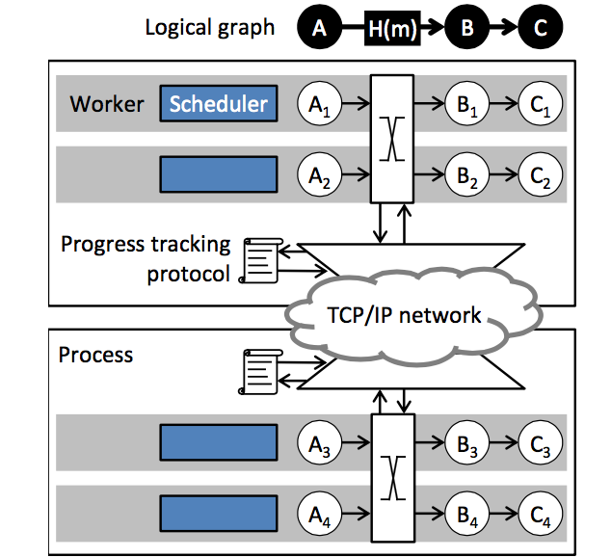
Implementation: Distributed
Graph distributed across workers
Application level: logical graph
Execution level: physical graph
Pointstamp projection
Physical p → Logical p
^
Compute could-result-in relation on projected pointstamp
Data structure only depends only on logical graph
Reduce amount of communication
EECS 598 – F17
Notes:
Physical graph in real implementation is really complex due to the distributed feature. But the relation is clear in the logical graph.
So the logical graph is needed at the application level for programming, while physical graph is for real implementation of message delivering on execution level.
Then we need a conversion between the two graphs. Pointstamp projection is introduced for doing computations in logical graph. It simplifies the graph structure and makes it possible to compute the could-result-in relation on projected pointstamps.
It’s a good solution since data structure only depends on the logical graph. And it also reduces the amount of communication.

Slide 19
Implementation: Distributed
1. Msgs from other workers
2. Re-entrancy calls
Queue
waiting...
EECS 598 – F17
Notes:
Then how does Naiad achieve good performance with this graph structure?
First, workers maintaining a queue to deal with messages and notifications. It only adds messages from other workers and some re-entrancy calls. And messages within a local worker is delivered directly to the corresponding vertex. So the queue is often shallow for Naiad.

Slide 20
Distributed progress tracking
Broadcast in Naiad:
Each worker maintains a local occurrence count.
Track stages and connectors instead of vertices and edges.
Do accumulation locally. ( Don’t broadcast on receiving new notifications.)
The protocol ensures that no local frontier moves ahead of global frontier.→ safety
EECS 598 – F17
Notes:
Progress tracking protocol is used.
Before delivering notifications, a Naiad worker must know that there are no outstanding events at any workers in the system with a pointstamp that could-result-in the pointstamp of the notification.So Naiad used the approach for maintaining a local frontier for each of the workers and do broadcasting to all other workers. And they are updated through broadcasting. But broadcasting introduce extra latency. So Naiad make two optimizations considering broadcasting.
One is to track the stages and connectors instead of vertices and edges, just as in the logical point of view.
And the second is by doing accumulations in a local buffer instead of broadcasting the notifications immediately. And it reduces the total number of messages being broadcasted.

Slide 21
Fault tolerance
Checkpoint mechanism to recover from failure.
Favors performance when there is no failure at the expense of availability of a failure.
Due to asynchronous features, there’s a limitation for achieving fault tolerance.
A tradeoff between low latency and concurrency.
EECS 598 – F17
Notes:
For Naiad, it favors performance assuming no failure occurs at the expense of availability. Due to the asynchronous features, there is a limitation for achieving fault tolerance with checkpointing method.

Slide 22
Scalability
Support Scale-up/ Scale-out
One program can be run on multiple core boxes as well as on a distributed cluster.
Obstacle: micro-stragglers (occurs more as cluster grows larger)
Packet loss
Contention on concurrent data structures
Garbage collections
Increase latency
Solution: try to avoid stragglers
Packet loss → Avoid TCP-related timers
Data Structure contention→ Backoff
Garbage Collection
EECS 598 – F17
Notes:
Scalability can be achieved both by scale-up and scale-out. One program of Naiad can be run on multiple core boxes as well as on a distributed cluster.
Probability of micro-stragglers increase as the cluster size increases. This adds significantly large delay for the system when the cluster is too large. Some batch systems solve this problem by scheduling duplicate work. But this method can’t be applied to Naiad since Naiad is a stateful system.
Instead of dealing with stragglers, Naiad make some efforts to try to avoid the latency effects of stragglers.

Slide 23
Preventing micro-stragglers
Networking
TCP
Disable Nagle’s algorithm
Change default TCP timers
RDMA(low latency/ no OS timers)
Data structure contention
.NET concurrent queue + spinlocks
Back-off
Decrease clock granularity to 1ms (default 15.6ms in Windows)
Garbage collections
Trigger .NET GC less frequently
Shorten pauses due to GC

Slide 24
Parallel
Data-parallel
applies to unstructured data
supports complex workflows
poor iteration support
Graph-parallel
specialized for graph data
single vertex program
supports rapid iteration
PPregel, Giraph, Graphlab, GraphChi, GraphX
Most Graph-parallel systems are too specialized for graph-data. Naiad can support complex workflows.
.
Notes:
Naiad takes advantages of both data-parallel and graph-parallel.

Slide 25
Naiad API-- high flexibility
Support high-level interfaces
LINQ, Pregel, MapReduce, SQL
Support custom vertices
Create own patterns without access to private APIs
Defining dataflow vertices’ behaviour
Defining dataflow topology
Decouple libraries from underlying system
Different from DryadLINQ, RDD , GraphLab that requires a single high-level model
Notes:
The Naiad API is of high flexibility. It supports high-level interfaces such as LINQ, Pregel, MapREduce, SQL and so on. And users can custom vertices on top of these interfaces. And we can also create own patterns without access to private APIs. Since it decouples the implementations of libraries, custom designs and system codes, it provides a very flexible framework for programming.

Slide 26
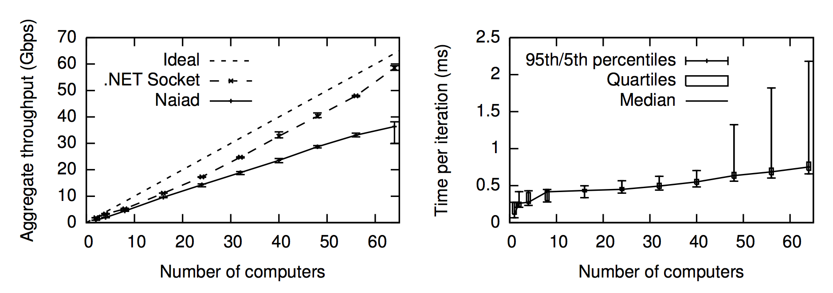
Performance Evaluation
Throughput
Latency
EECS 598 – F17
Notes:
Left graph: The top line is ideal, middle one .net socket, last naiad
The naiad line is nearly linear
Opportunity exist to improve its absolute performance
Right graph: evaluates the minimal time required for global coordination
For real case, the subset of vertices could be relatively small, not a problem

Slide 27
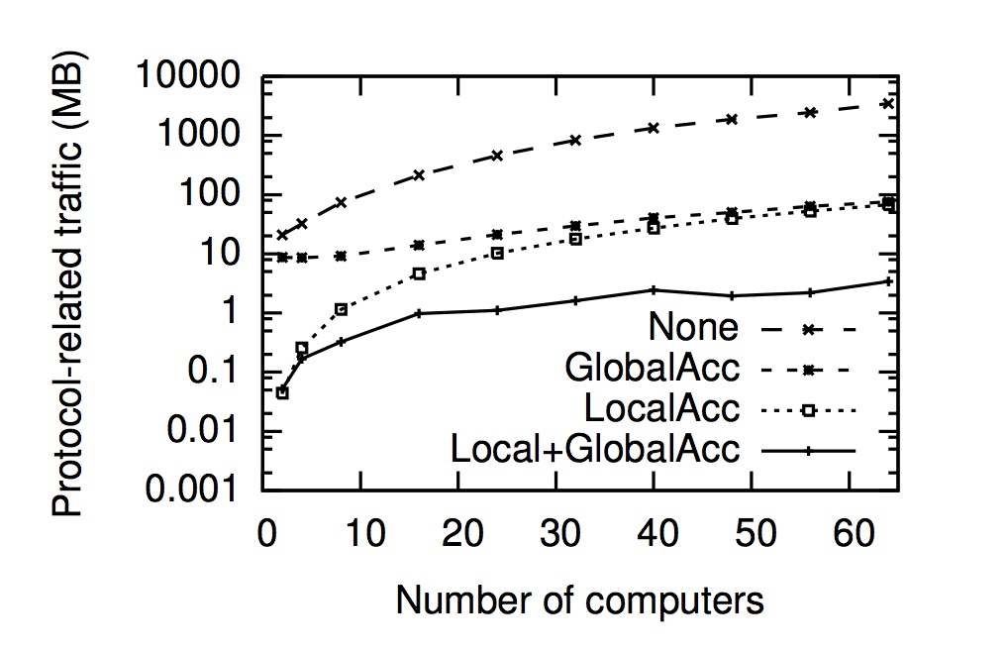
Performance Evaluation
Protocol Optimization
EECS 598 – F17
Notes:
Run a weakly connected components computation on a random graph
=> the current protocol may limit scalability

Slide 28
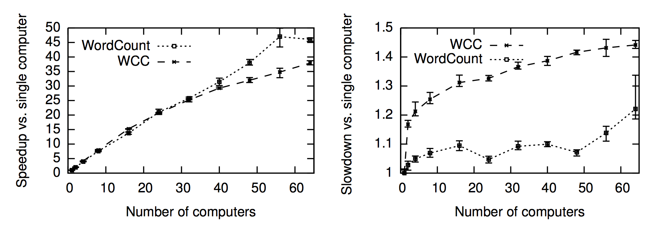
Performance Evaluation
Strong Scaling
Weak Scaling
EECS 598 – F17
Notes:
To evaluate strong scaling, we add computed resources while keeping the size of the input fixed
Weak scaling: measure the effect of increasing both the size of computers and the size of the input

Slide 29
Real Word Application - Batch Iterative Graph Computation:
Compare Naiad with:
PDW: Parallel Data Warehouse
DryadLINQ: Batch processor
SHS: A purpose-built distributed graph store
Measure their performance number of standard graph analyses
over datasets, compared to Naiad.
EECS 598 – F17

Slide 30
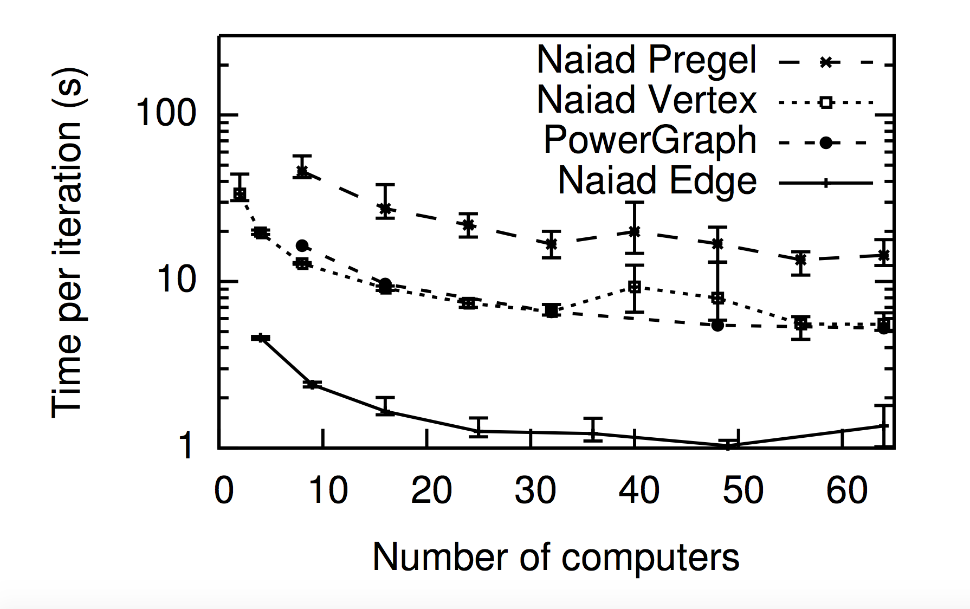
Real Word Application - Batch Iterative Graph Computation:
PageRank on Twitter Follower Graph
EECS 598 – F17
Notes:
Several systems for iterative computation have used the pagerank on a twitter follower graph as a standard benchmark

Slide 31
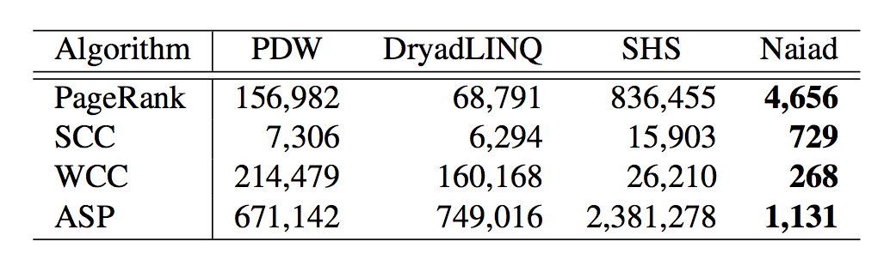
Real Word Application - Batch Iterative Graph Computation:
Batch Iterative Graph Computation
EECS 598 – F17
Notes:
Naiad eliminates this per-iteration cost, it can also use algorithms that perform more and sparser iterations. For most developers, we would seek simplicity, like building on high-level library, while crucial vertices could be implemented using lower API, it is a strenghth of Naiad

Slide 32
Real Word Application - Batch Iterative Machine Learning:
Experiment with Vowpal Wabbit(an open-source distributed machine learning library) show:
Naiad is competitive with a state-of-the-art custom implementation for distributed machine learning.
It is straightforward to build communication libraries for existing applications using Naiad’s API.
EECS 598 – F17
Notes:
Naiad’s performance show that timely dataflow if a powerful low-level programming method for iterative computation

Slide 33
References
Derek G. Murray, SOSP 2013’ Talk:
https://www.youtube.com/watch?v=yyhMI9r0A9E&t=1467s

Slide 34
Thank you.
EECS 598 – F17

