Slide 1
Dominant Resource Fairness: Fair Allocation of Multiple Resource Types
Ali Ghodsi, Matei Zaharia, Benjamin Hindman, Andy Konwinski, Scott Shenker, Ion Stoica
University of California, Berkeley
(NSDI’11)
Presented by Fan Lai, Henry Singer, and Hasan Al Maruf
EECS 598 – F17

Slide 2
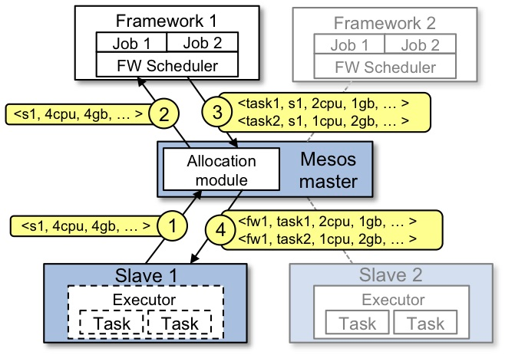
Background
Resource allocation
Resources: CPU, memory, disk, etc.
Schedulers for OS, networking
Resource sharing
Frameworks are greedy
Performance isolation
Get fair share irrespective of others
Fair sharing
image source: http://mesos.apache.org/documentation/latest/architecture/

Slide 3
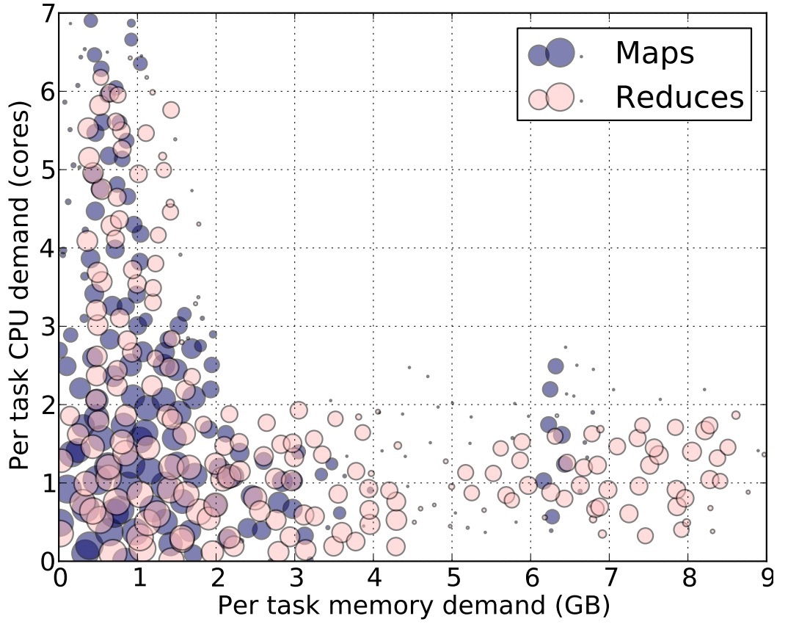
Background
Heterogeneous demand
Different types of resources
Different demands of the same resource
Existing solutions
Most for single resource (FCFS, round-bin)
Fair sharing in Hadoop
Slot-based leads poor match
CPU‐intensive tasks
Most need ~<2 CPU, 2 GB RAM>
Memory-intensive tasks
2000‐node Hadoop Cluster at Facebook
Notes:
But in today’s computing environment, there are multiple types of resources to allocate together, and different tasks may have different demands for different types of resources, this figure shows the demand distribution for tasks in a 2000-node hadoop cluster at facebook, we can see that even if most tasks require 2 CPUs and 2 GB memory, there are also some tasks that’s CPU-heavy or memory-heavy, in this case, the traditional max-min fairness may become not applicable. Existing solutions actually ignore this heterogeneity of demands, like Quincy, Hadoop Fair Scheduler, they allocate resources based on the granularity of slots, where a slot is a fixed fraction of the node. However, a slot may lead to a poor match for the task demands, and the figure below is the result from the same cluster, showing that most of the tasks either under-utilize or over-utilize some of their slot resources.

Slide 4
Allocation properties
Sharing incentive
Strategy-proofness
Each user gets at least 1/n of the resource
desirable
Envy-freeness
not better off by asking for more than they need
Pareto efficiency
Not prefer the allocation of others
Increasing the allocation of a user will decrease the allocation of others
Single resource fairness
Reduce to max-min fairness for single resource
Bottleneck fairness
nice-to-have
Population monotonicity
Reduce to max-min fairness when a resource is demanded most of by everyone
Resource monotonicity
Allocations of remaining users won’t decrease if someone leaves
Allocations of existing users won’t decrease when more resources are added

Slide 5
Dominant Resource Fairness
Dominant resource: resource a user has the largest share of
Dominant share: fraction of the dominant resource a user is allocated
Example
Total resource: <10 CPU, 4 GB>
User demand: <2 CPU, 1 GB>
Dominant resource is memory for 1/4>2/10
Dominant share is 1/4

Slide 6
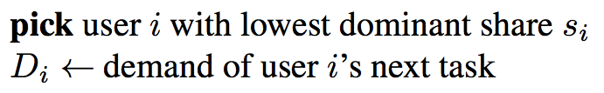
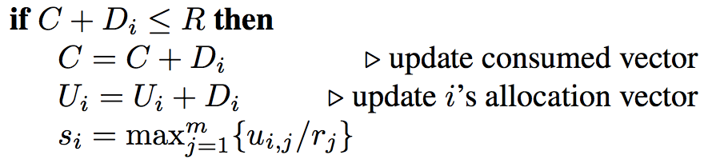
Dominant Resource Fairness
Apply max-min fairness to dominant shares
Equalize the dominant share of the users (sharing incentive)
Select user with lowest dominant share
Strategy-proofness
Resource allocation
Scheduling whenever resource and tasks available
Pareto efficiency
O(log n) time per decision using binary heaps

Slide 7

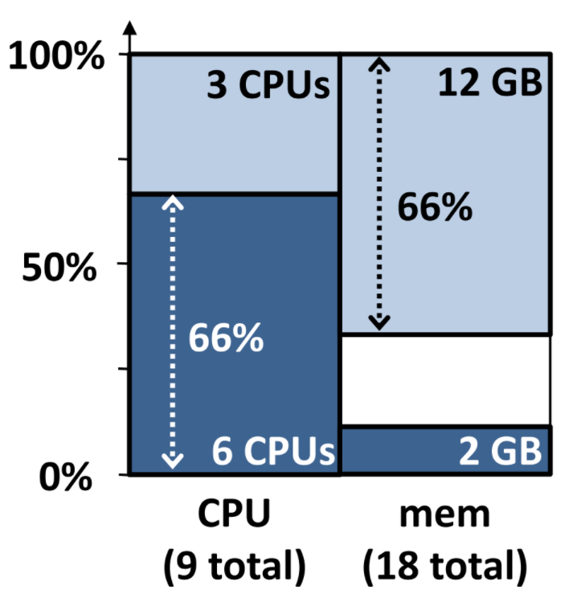
DRF example
System resource for tasks: <9 CPUs, 18 GB>
User A’s demand per task: <1 CPU, 4 GB> (dom res is mem)
User B’s demand per task: <3 CPUs, 1GB> (dom res is CPU)
What if we choose A the first?
Solution
Notes:
Take a two-user case as an example. Given the system resource constraint and users’ demand per task, let’s start the DRF steps we just introduced, first all users’ dominant share are initialized to zero, so the system will randomly choose a user for allocation, here we choose B, and if we choose A we will still get the same result. Then user B get scheduled and his dominant share is updated, so now user A’s dominant share is less than user B, and he should be chosen for next schedule turn, then update, but this time his dominant share is still less than B, so choose him again, now this time his dom share becomes larger than B, so the allocation goes back to B, and then A, until the cluster is full. And we can see that finally A and B have an equal share of 66% of their dominant resource, which is what we expect.

Slide 8
Alternative: Asset Fairness
Equalize the aggregate resources allocated
Example:
Total resources: <30 CPU, 45 GB> ~ <1.5 $, 1 $>
Demand:
User A: <1CPU, 1GB> ~ 2.5$ /tasks
User B: <4CPU, 3GB> ~ 9 $ /tasks
Sol: find max(x,y) such that 2.5x = 9y
<x,y> = <14.1, 3.9>
100%
50%
CPU
Mem
Violate sharing incentive

Slide 9
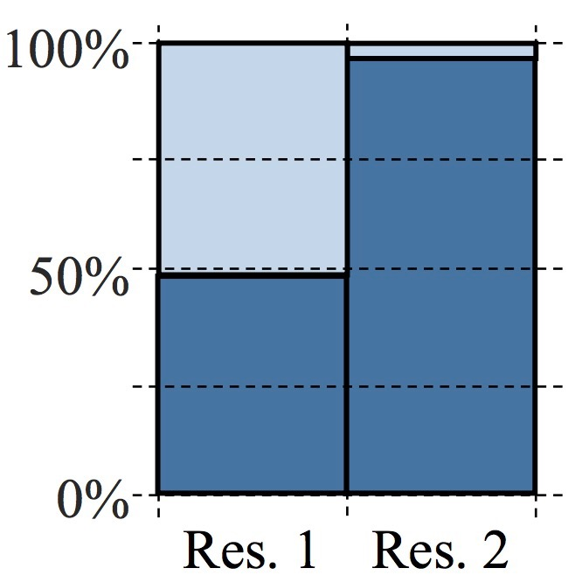
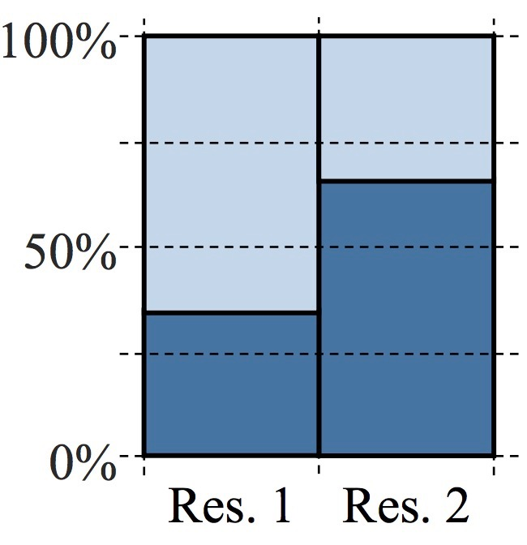
Alternative: CEEI
Competitive Equilibrium from Equal Incomes
Give each user 1/N of every resource
Users trade in perfectly competitive market
Example:
Total resources: <100 CPU, 100 GB>
Demand:
User A: <16 CPU, 1 GB>
User B: <1 CPU, 2 GB>
Sol: find max(x • y)
Violate strategy-proofness
A:<16 CPU, 1 GB>
A:<16 CPU, 8 GB>

Slide 10
Comparison Between Three Allocation
 | Objective | Particular Constraint | Comment
DRF | max(x, y) | (2x/9) = (y/3) | Equalize dominant shares
Asset Fairnes | max(x, y) | 6x = 7y | Equalize sum of resource shares
CEEI | max(x • y) | N/A | Every resource is allocated

Slide 11
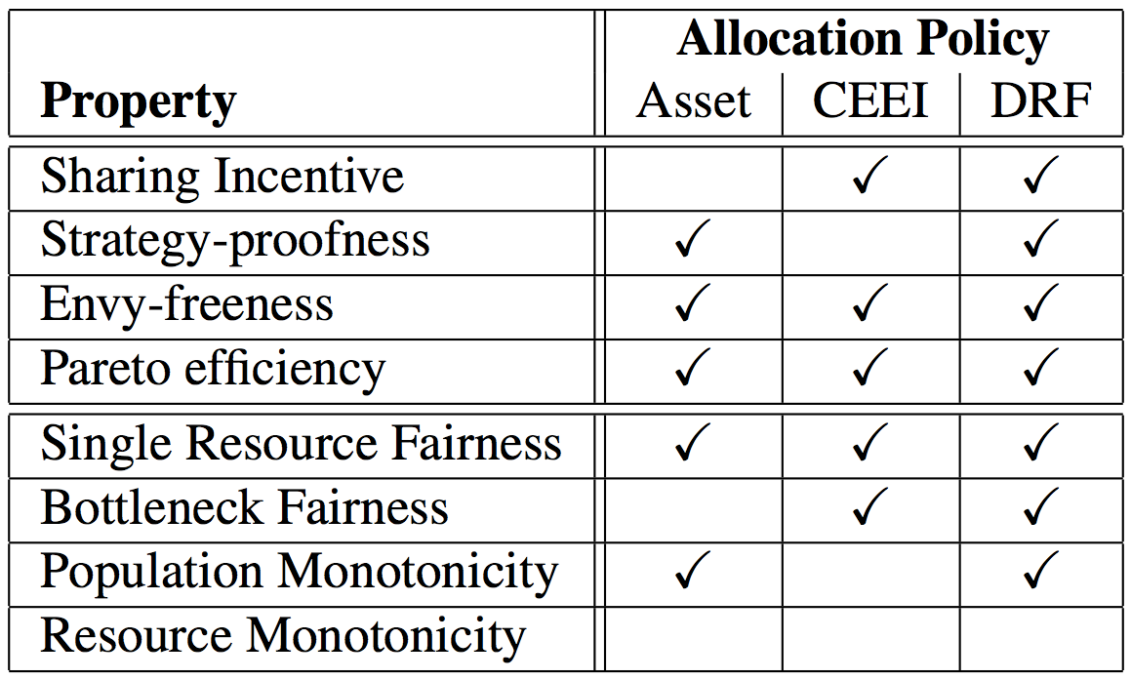
Comparison
DRF is the only one satisfying four required properties
Impossible to achieve resource monotonicity when sharing incentive and Pareto efficiency are achieved
Not frequent to add more resources to a system
Adding more resource may change dominant resource and share

Slide 12
Experimental Results
Illustrate dynamic adjustment of shares of different resources
Compare against slot-level and CPU-only fair sharing in Mesos
Compare against Hadoop’s Fair Scheduler on Facebook traces

Slide 13
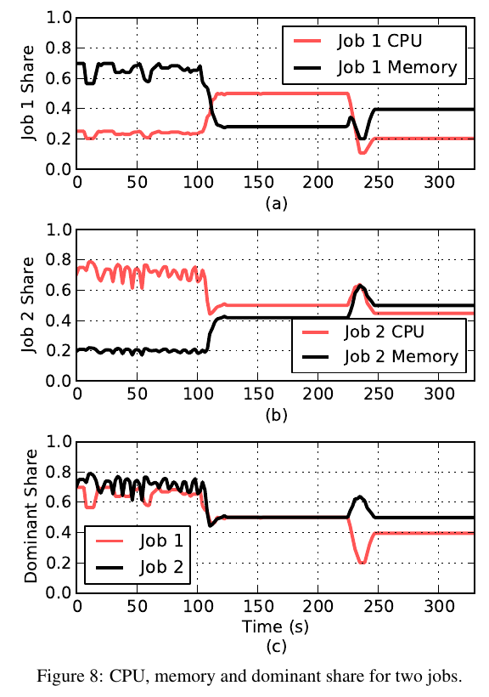
Dynamic Resource Sharing
Dominant shares are similar for both
Dynamically adapts to changes in dominant shares
Discrepancies due to grain of resource to be shared

Slide 14
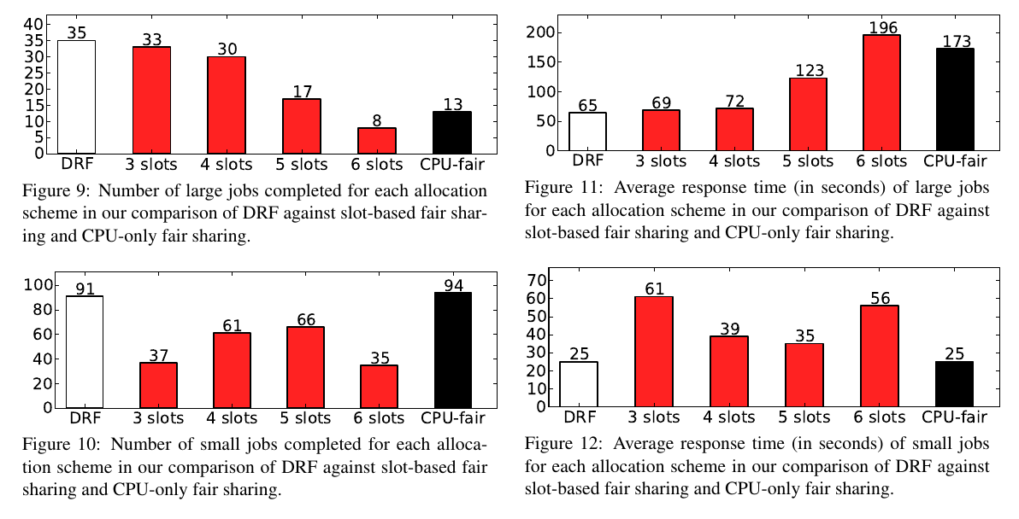
DRF vs. Alternatives

Slide 15
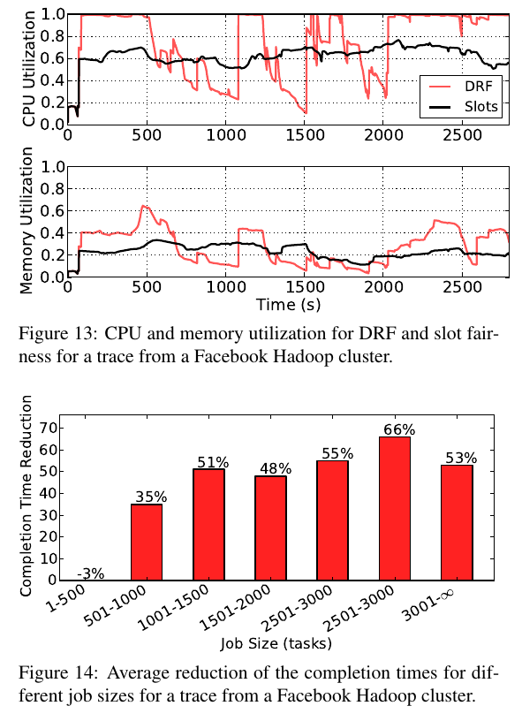
Facebook Traces
DRF has dramatically higher CPU and memory utilization
Small jobs only take one phase, dominated by longest task, thus difficult to improve
Large jobs experience dramatic improvement

Slide 16
Comments
Why no comparison with baselines for dynamic resource sharing?
What would be an ideal workload for DRF?
Experience a little improvement when workload is heavy on small jobs
Trade-off between fairness and efficiency/utilization.
Pareto efficiency != performance
Carbyne !

Slide 17
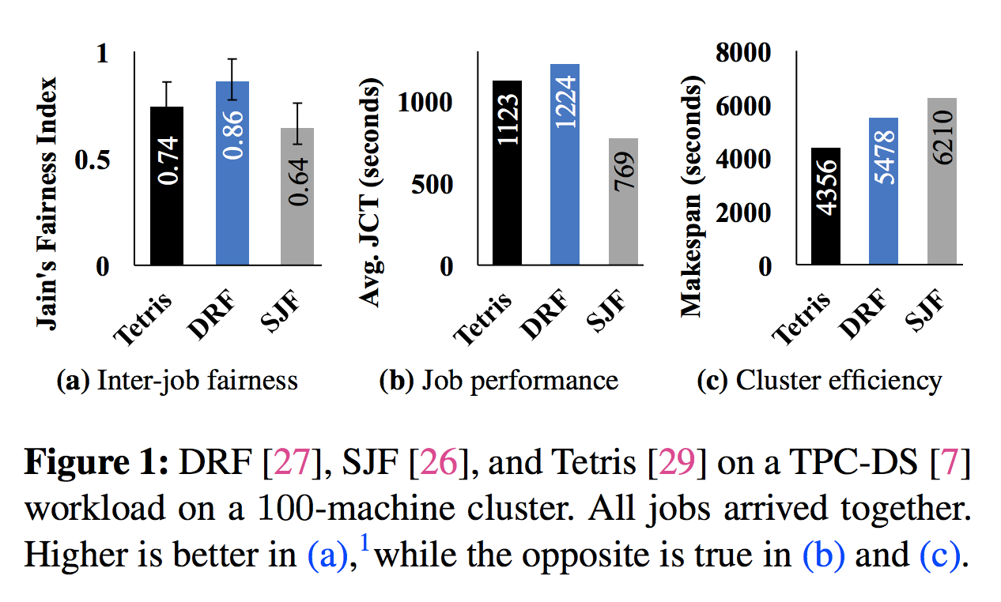
Introduction
Want high fairness, low JCT, and high utilization
Currently can optimize each, but not all

Slide 18
Introduction
Distributed data-parallel jobs are all-or-nothing, so greedily using all of fair share hurts JCT and utilization
Users only care about fairness at granularity of full job completion time
Answer: Altruism! Give up leftover resources that don’t affect JCT.

Slide 19
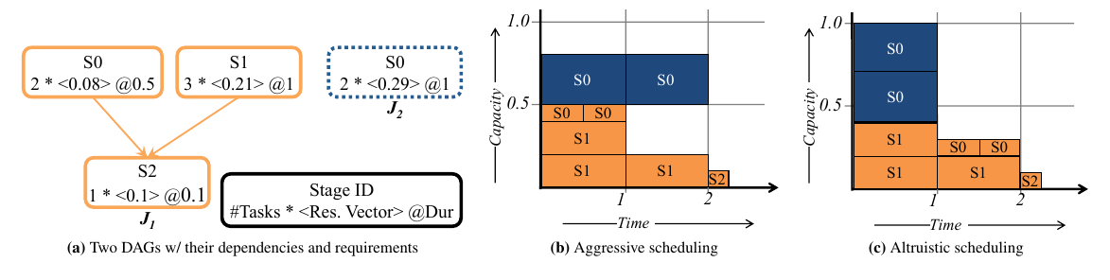
Altruism: An Example

Slide 20
Opportunities in Analytics DAGs
50% of the time, 20% of resources are available for altruistic sharing.
Disjoint paths and barriers result in more opportunities for altruistic sharing.

Slide 21
Objective
Information on individual tasks
Resource requirements
Duration
DAG dependencies
Schedule collection of jobs ensuring
Fairness
Job Performance
Cluster Efficiency

Slide 22
Components
Inter-job Scheduler
Maximizes the amount of leftover resources
Intra-job Scheduler
Determines the leftover contribution for each job
Leftover Scheduler
Re-distributes the leftover resources
Calculate fair resource share for jobs
Give up extra resources as leftover
Calculate job completion time under fair resource allocation
Calculate task start time in reversed DAG
Give up extra resources altruistically
Shortest remaining time jobs get priority
Pack as many tasks as possible

Slide 23
Other Features
Bounded altruism
Uniformly distributed probability P(Altruistic)
Resource estimation
from history of prior runs
Data locality
Altruistically delayed scheduling
Straggler mitigation
Leftover scheduling prioritizes speculative tasks
Handling task failure
Does not distinguish between new and restarted tasks

Slide 24
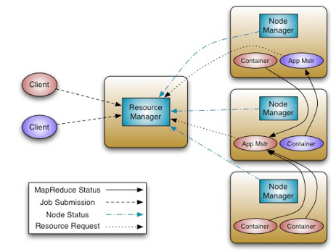
Implementation
Leftover Resource Management
Altruistic Resource Management
Altruistic Resource Management
Altruistic Resource Management
image source: https://hortonworks.com/blog/apache-hadoop-yarn-background-and-an-overview/

Slide 25
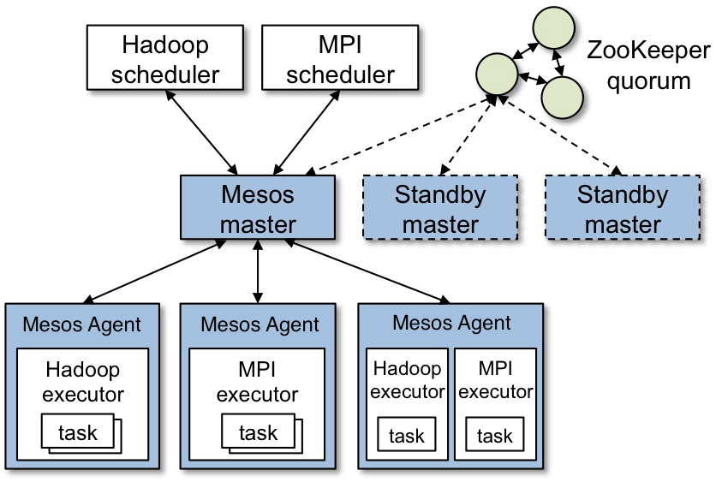
Implementation
Altruistic Resource Management
Leftover Resource Management
image source: http://mesos.apache.org/documentation/latest/architecture/

Slide 26
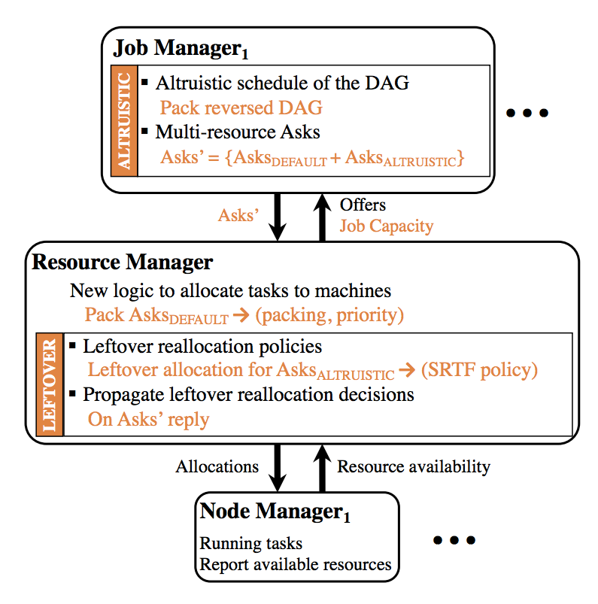
Implementation
image source: https://www.usenix.org/system/files/conference/osdi16/osdi16-grandl-altruistic.pdf

Slide 27
Evaluation
Implemented in YARN and TEZ
100 of servers (20 cores, 128 GB memory, 128 GB SSD, 10 Gbps NIC)
~2000 tasks in parallel
Replay Bing, Facebook traces & TPC-DS, TPC-H workloads
Compared against DRF, Tetris & SJF

Slide 28
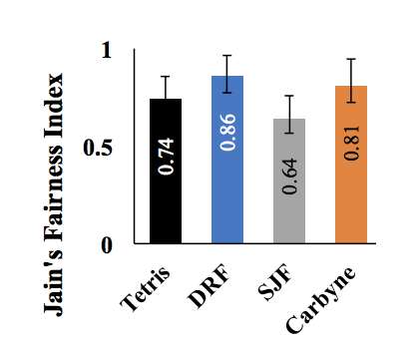
Fairness
Unfair on small time intervals
Leftover reallocation
Fluctuates from fare share
Altruism helps in long run

Slide 29
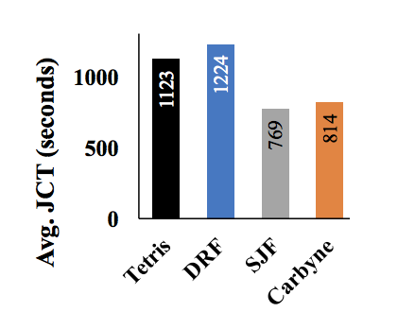
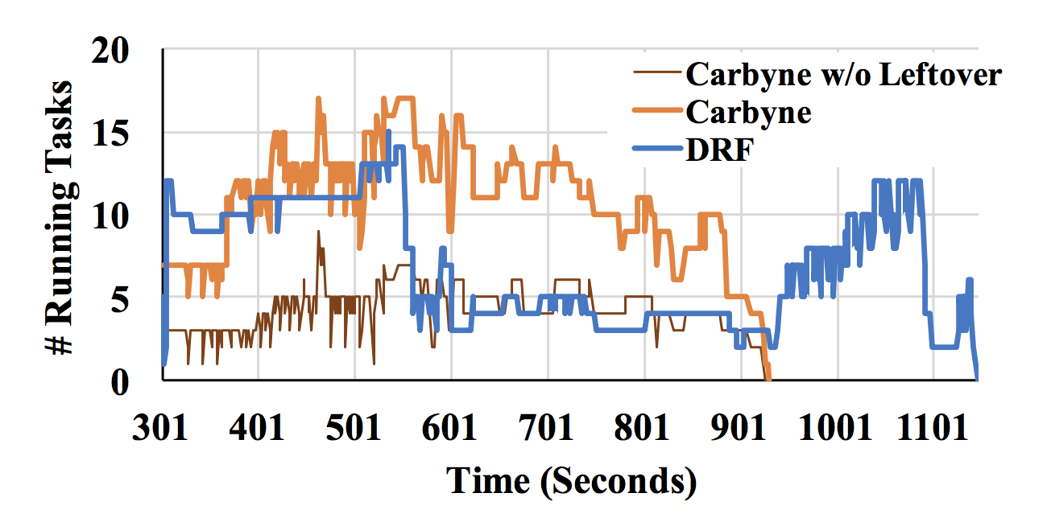
Job Performance
Greedy
Altruistic

Slide 30
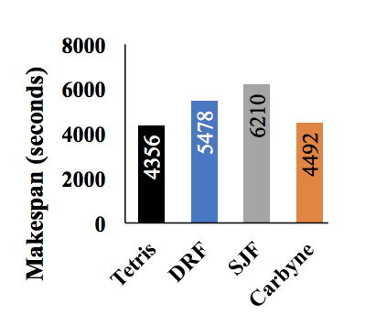
Cluster Efficiency
1.03x worse than Tetris
Bias to task from altruistic Jobs
Tetris treats each job equally
CARBYNE favours critical tasks during leftover allocation

Slide 31
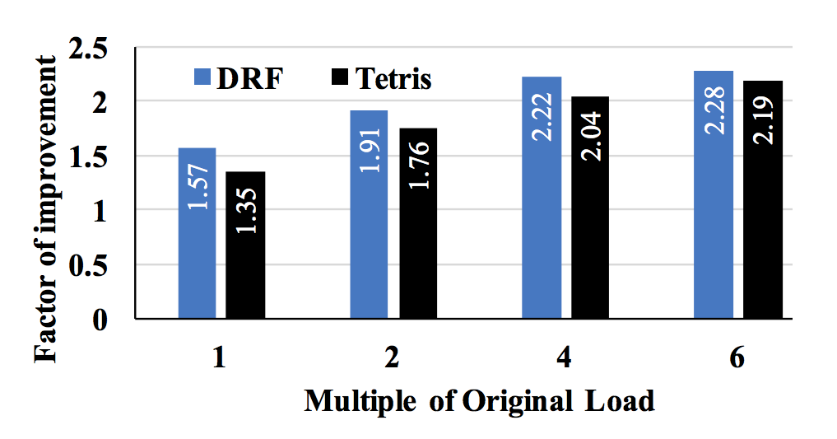
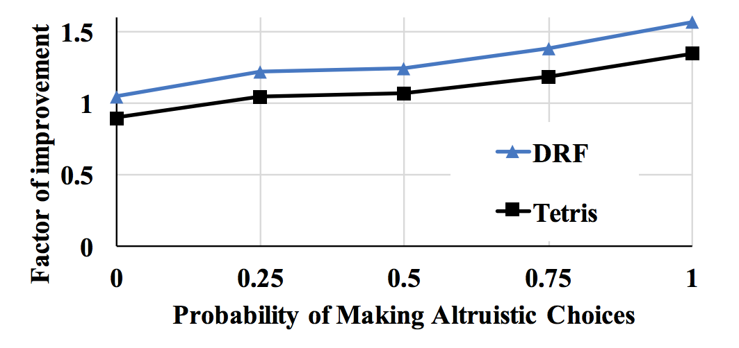
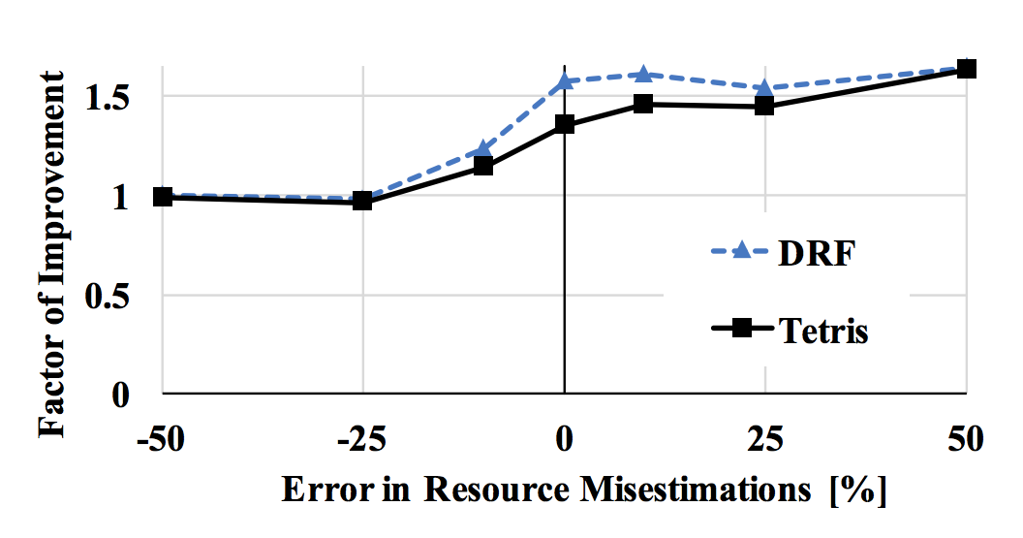
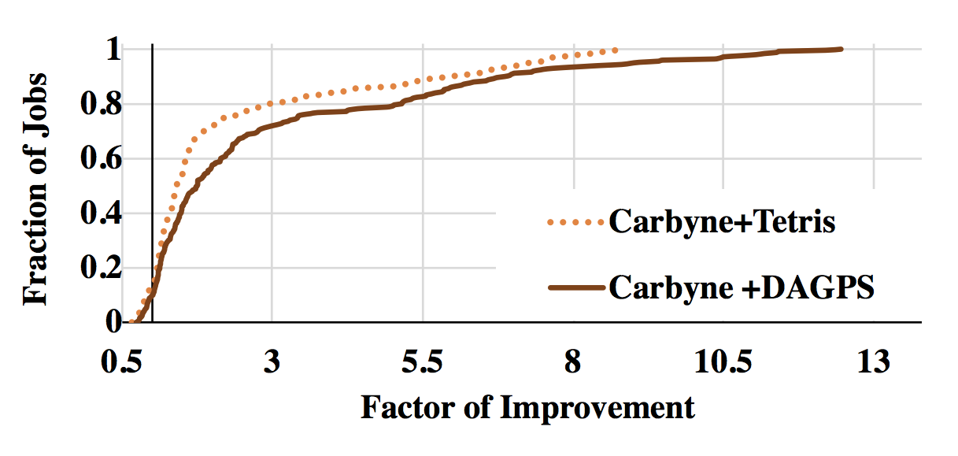
Impact of Contention
Impact of Altruistic Level
Impact of Misestimations
Impact of Better DAG Scheduler

Slide 32
Thank you for questions!

