Slide 1
Discretized Streams:
Fault-Tolerant Streaming Computation at Scale
Matei Zaharia, Tathagata Das, Haoyuan Li, Timothy Hunter, Scott Shenker, Ion Stoica
University of California, Berkeley
Presenters: Vandit Agarwal, Chun-Jung Chiu, Ting-Wei Cho

Slide 2
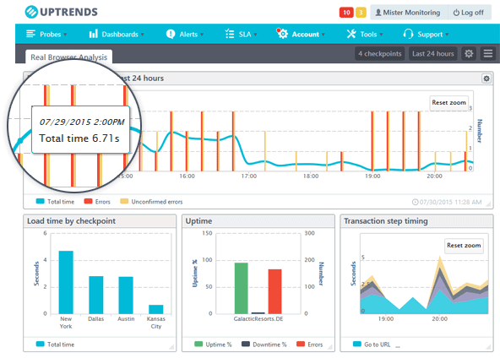


Why Streaming?
What are streams?
How are they different from batches?
A lot of real time systems in place
They are running big data applications for near-real time computation
Eg : web monitoring, fraud detection, ad monetization

Slide 3
Motivation
Common properties between such applications:
Large-scale distributed clusters reqd for the kind of scale we ingest data at
Req second-scale latencies
Fault-tolerance
Stragglers

Slide 4
Motivations
Failures and stragglers
Need to recover quickly and efficiently
Systems before this did not do both
Either replication or upstream backup
No way of handling stragglers

Slide 5
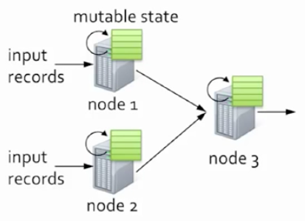
Previous Models
Continuous Operator Model (processing pipeline)
Each node runs a continuous operator
Produces an in-memory mutable state
For each new record, this state is updated
Records are sent to down-stream nodes
Problems?
If node fails, state is lost
Solution?
Replication
Upstream Backup
Credit: Tathagata Das, SOSP ‘13

Slide 6
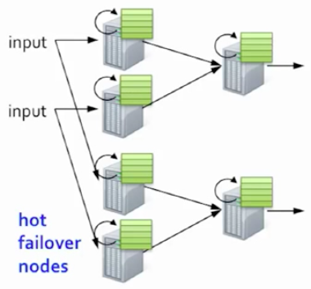

Previous Models: Fault-Tolerance
Replication
A twin hot-failover node for each node
Synchronization protocol to remain consistent
Fast recovery
Very expensive (twice in terms of h/w cost)
This assumption is very debatable in my opinion
Credit: Tathagata Das, SOSP ‘13

Slide 7
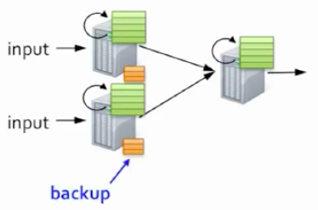
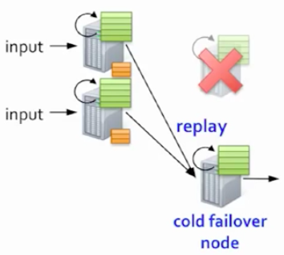
Previous Models: Fault-Tolerance
Upstream Backup
Node maintain copy of forwarded records until last checkpoint
Cold-failover node
If failure:
Replay the records serially to the failover node
Recreates the lost state
Cheap h/w wise
Very slow
Credit: Tathagata Das, SOSP ‘13

Slide 8
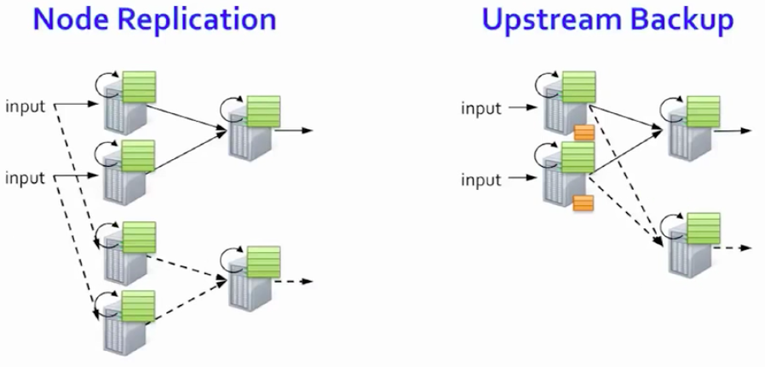

Previous Models: Fault-Tolerance
Neither handle stragglers
Credit: Tathagata Das, SOSP ‘13

Slide 9
Goals
Scalability
Minimal cost
Short latency (second scale)
Tolerate node failures and stragglers
Fast recovery from faults and stragglers
Minimal overhead beyond base processing

Slide 10
Separate Computation from State
Avoid the problems with traditional stream processing
Make state immutable
Break computation into a set of short, stateless, deterministic tasks
Reuse the batch system...

Slide 11
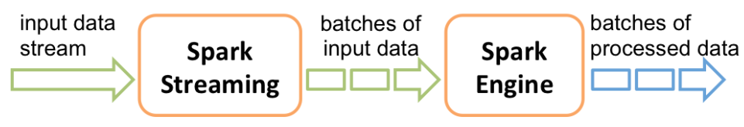
Spark
Break data into small partitions
Break jobs into short, stateless, deterministic tasks e.g. map/reduce

Slide 12
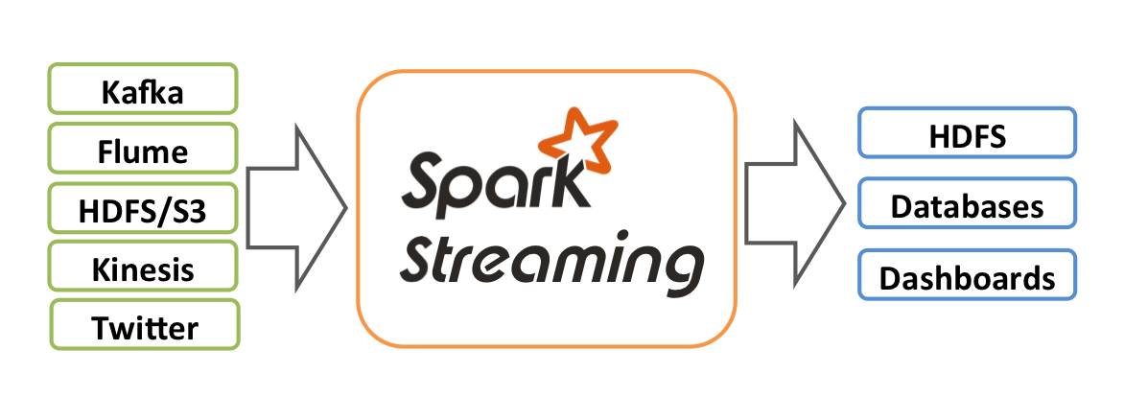
Spark Streaming
Receive data from data source e.g. HDFS
Batch data into D-Streams
Process D-Streams
Write data to databases or distributed file systems e.g. GFS, HDFS

Slide 13
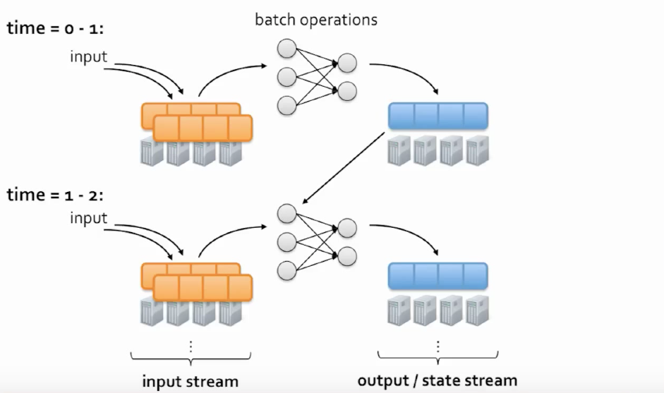
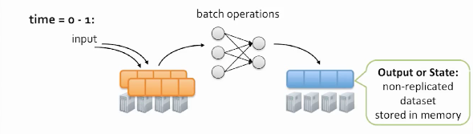
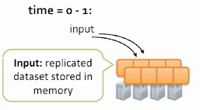
D-Streams: Computation Model
Slide Credit: Tathagata Das, SOSP ‘13

Slide 14
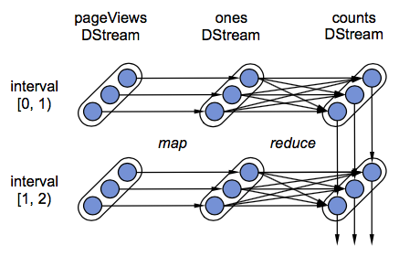
Data Recovery
Track lineage at level of partitions
Checkpoint state RDD partitions
Parallel recovery

Slide 15
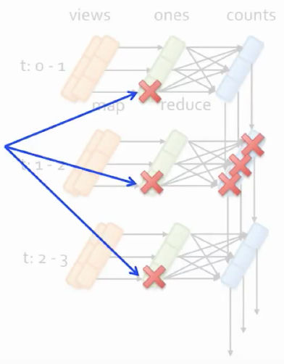
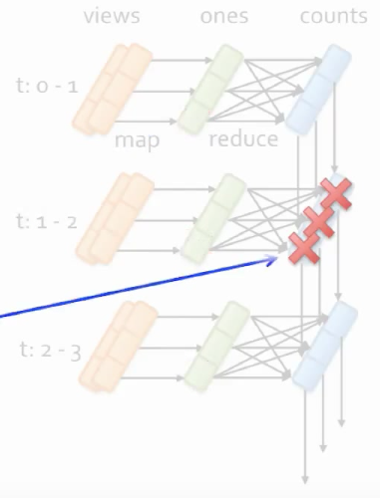
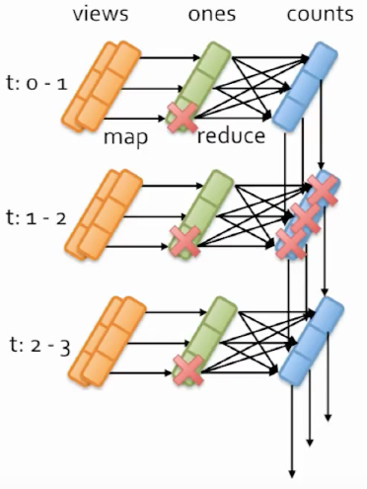
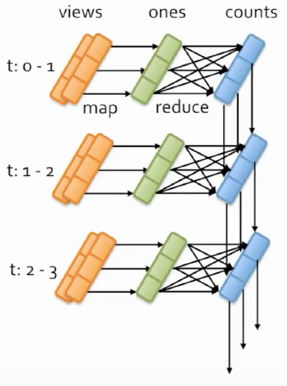
Parallel Recovery
Lineage can be used to recompute
lost partitions
Lost datasets on different time steps
can be recomputed in parallel
Partitions on the same time step can
also be computed in parallel
Slide Credit: Tathagata Das, SOSP ‘13
Slide Credit: Tathagata Das, SOSP ‘13

Slide 16
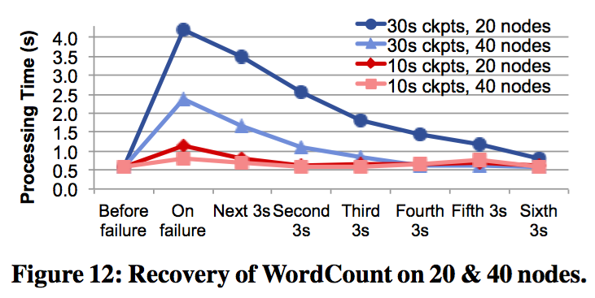
Fault Recovery

Slide 17
D-Streams: Timing Consideration
Batch incoming data:
By arrival time
If the application is at the same location as the streaming program
No delays in processing new incoming data
By external timestamp
If the application is at a different location than the streaming program
Wait for a “slack” time
Correct record time at the application level

Slide 18

D-Streams: Code Example

Slide 19

D-Streams: API
Stateless batch operations: map, reduce, groupBy, join

Slide 20
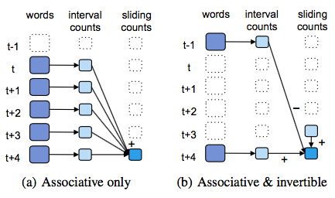
D-Streams: API
Stateful streaming operations: Windowing, Incremental aggregation, State tracking

Slide 21
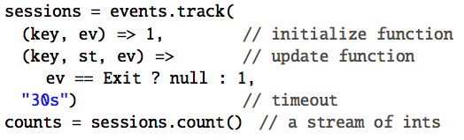
D-Streams: API
State tracking
Output operation
save
foreachRDD

Slide 22
D-Streams: Consistency Semantics
Continuous operator models:
Consistency across nodes can be a problem
Synchronize nodes
Discretized operator models:
Consistency is inherently taken care of
All computed results are free of stragglers and failures

Slide 23
D-Streams:
Unification with Batch and Interactive Processing
Seamless combination with batch systems
Same processing model, data structure, and fault tolerance mechanism as Spark
D-streams can be combined with static RDDs
New streaming report can be generated using old data in "batch mode"
Users can run ad-hoc queries interactively on D-Streams

Slide 24
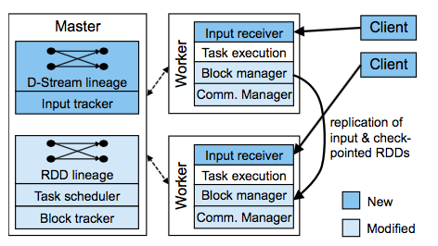
System Architecture
Master
Track D-Stream lineage
Schedule tasks
Worker
Receive data
Store input and computed RDDs
Execute tasks
Client
Send data into the system

Slide 25
Batch Scheduler Optimization
Pipeline operators that can be grouped together
Assign tasks based on data locality
Control partitioning of RDDs to minimize data shuffling over network

Slide 26
Data Management
Block store
Store and replicate input data
Master keeps track of block store locations with ID, and maximizes locality
Keep blocks in memory until there's not enough memory
Set maximum history timeout for RDDs after checkpointing
Forget lineage after checkpointing

Slide 27
Time Management
Clocks of nodes are synchronized via NTP
Nodes report list of blocks received to the master
The master launches tasks on nodes with the data. No further synchronization needed

Slide 28
Fault and Straggler Recovery

Slide 29
Fault and Straggler Recovery
The deterministic nature of D-Streams allows two powerful way to recover the worker state
Parallel recovery
Speculative execution
Also simplifies master recovery

Slide 30
Parallel Recovery
The system periodically checkpoints some of the state RDDs
Asynchronously replicates them to other worker nodes
When a node fails, the system detects all missing RDD partitions
Launches many tasks parallely to recompute them from the last checkpoint
In traditional systems, a single idle machine performed all of the recovery and then starts processing new records
In D-Streams, all of the machines partake in recovery, while processing new records

Slide 31
Straggler Mitigation
Slow tasks: when a task takes more than 1.4 times longer than the median task
Mitigate stragglers by running speculative copies of slow tasks
This becomes difficult in traditional systems:
Requires launching a new copy of the node, populating its state and overtaking the slow copy
Replication algorithms require synchronization
This would not allow for one copy to overtake the slow copy

Slide 32
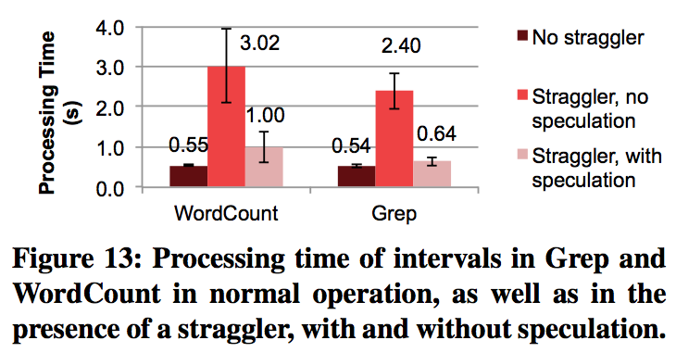
Straggler Speculation

Slide 33
Master Recovery
Master recovery is ensured by:
Writing the state of the computation reliably when starting each timestep
Having workers connect to the new Master and report their RDDs
Its okay if a given RDD is computed twice as the operations are deterministic
Its similar to recovering from a failure
Maintains the following state/metadata for recovery:
The graph of user’s D-Streams and Scala objects representing user code
The time of the last checkpoint
The IDs of RDDs for checkpointing

Slide 34
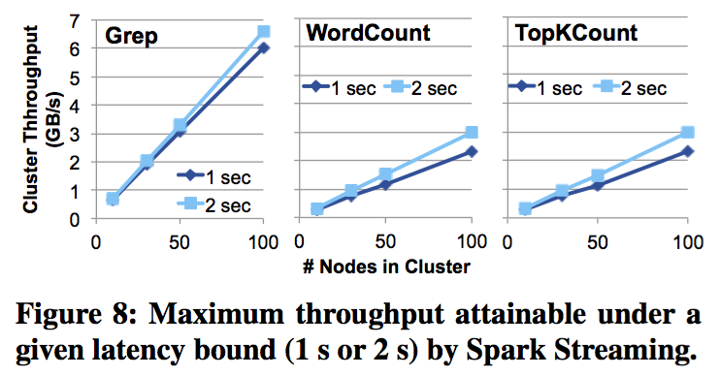
Scalability

Slide 35
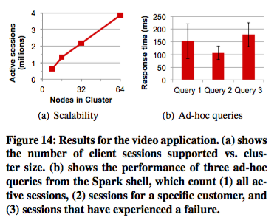
Video Distribution Monitoring
Combine two different systems:
A distributed streaming system
Hadoop/Hive for historical data
Spark streaming program:
Ad-hoc queries on the live stream

Slide 36
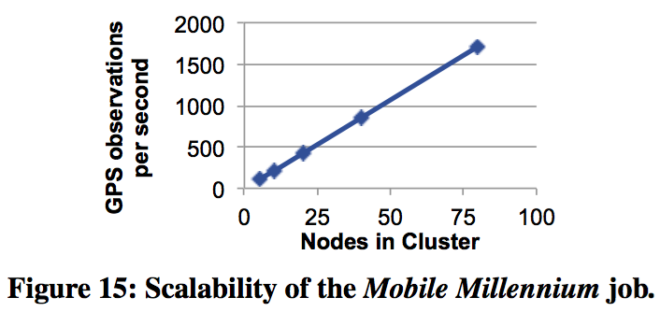
Crowdsourced Traffic Estimation
GPS data is noisy and sparse
Sparse data in every 5 seconds cause overfitting
D-Streams combines live data with historical data to resolve overfitting problem

Slide 37
Conclusion
Spark Streaming integrates streaming, batch, interactive computation in the same platform
More efficient recovery
1 - 2 seconds delay is enough for many applications
Higher memory usage than continuous operators

Slide 38
Storm @ Twitter
Ankit Toshniwal, Siddarth Taneja, Amit Shukla, Karthik Ramasamy, Jignesh M. Patel*, Sanjeev Kulkarni, Jason Jackson, Krishna Gade, Maosong Fu, Jake Donham, Nikunj Bhagat, Sailesh Mittal, Dmitriy Ryaboy
Twitter, Inc., *University of Wisconsin – Madison
Presenters: Vandit Agarwal, Chun-Jung Chiu, Ting-Wei Cho

Slide 39
Goals
Scalable
Resilient
Extensible
Efficient
Easy to Administer

Slide 40
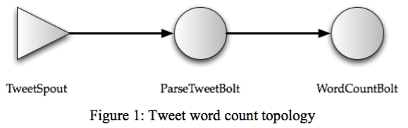
Data Model
Stream of tuples flow through topologies
Topology is a directed graph
Vertex: computation
Spouts: tuple sources
Bolts: process the incoming tuples
Edge: data flow

Slide 41
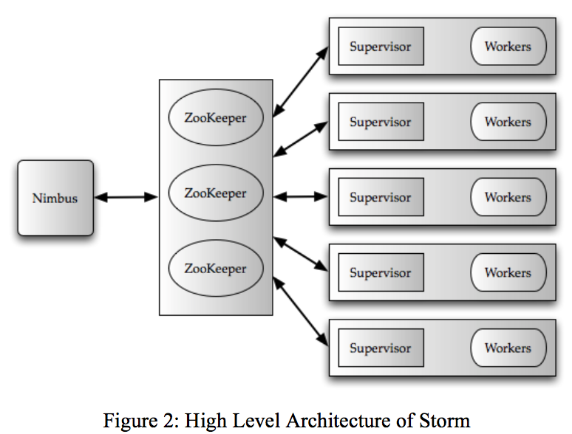
Overview
Clients submit topologies to the master node (Nimbus)
Nimbus distributes and coordinates execution of the topology
Execution takes place on the worker nodes:
Runs one or more processes
Each process runs one or more executors
Executors are made up of one or more tasks
Tasks do the actual work
Each node runs a supervisor that communicates with Nimbus
Cluster state maintained in Zookeeper

Slide 42
Nimbus and Zookeeper
To submit a job, the user sends the following to Nimbus:
topology
User code as a JAR
Nimbus uses a combination of local disk(s) and Zookeeper to store the state
Node supervisors send periodic heartbeats to Nimbus advertising:
The currently running topology
Any vacancies
Indicates liveness of the node
Zookeeper coordinates between Nimbus and Supervisors

Slide 43
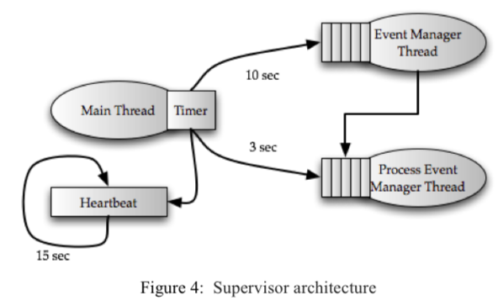
Supervisor
Runs on each node
Spawns workers on receiving assignment from Nimbus
Monitors the health of the workers and respawns them if necessary
Spawns 3 threads:
Heartbeat (15 sec): tells Nimbus that the supervisor is alive
Event manager thread (10 sec): manages changes in the current assignment
Process event manager thread (3 sec): manages worker processes that run on the same node as the supervisor

Slide 44
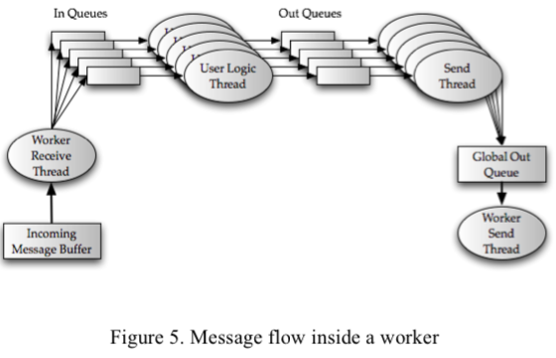
Workers and Executors
Processes -> Executors -> Tasks
Each process has two threads to handle the flow of tuples:
Worker receive thread:
point for incoming tuples
Examines tuple destination and queues them accordingly
Worker send thread
Examines each tuple in the global transfer queue and forwards it to the next downstream worker

Slide 45
Workers and Executors
Each executor has two threads:
User logic thread
Takes thread from the in queue and runs the actual task
Places the outgoing tuple in an out queue
Executor send thread
Puts the tuples from the out queue to the global transfer queue
Global transfer queue contains all outgoing tuples from several executors

Slide 46
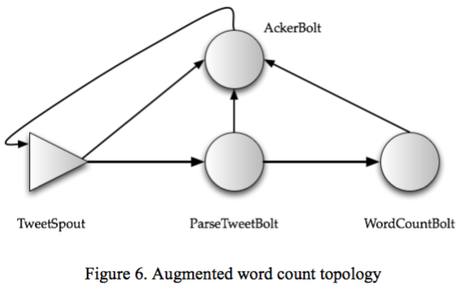
Processing Semantics
Provides two types of semantics:
At least once semantics: each input tuple will be processed at least once
Provided with the help of an “acker” bolt
The source spout holds the tuple until final ach received
At most once semantics: each input tuple will be processed either once or dropped
Provided when acking mechanism is disabled

Slide 47
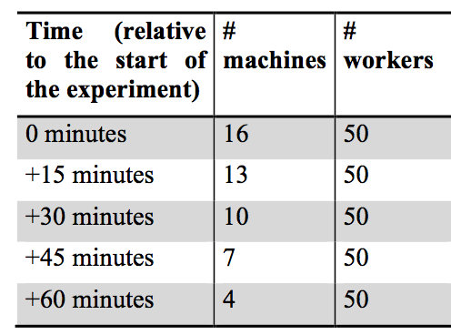
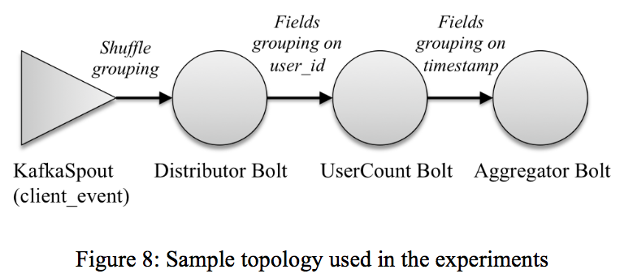
Empirical Evaluation

Slide 48
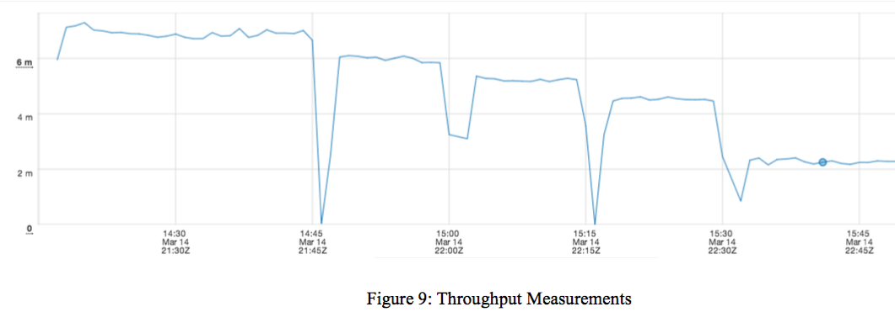
Empirical Evaluation
Resiliency
Number of tuples processed / minute

Slide 49
Spark Streaming vs Storm
 | Spark Streaming | Twitter Storm
Latency | Seconds | Milliseconds
Reliability | Exactly one | At Least One or At Most One
Fault Tolerance | Relied on RDD and its parallel recovery is much faster | Restart by Supervisor or Nimbus

Slide 50
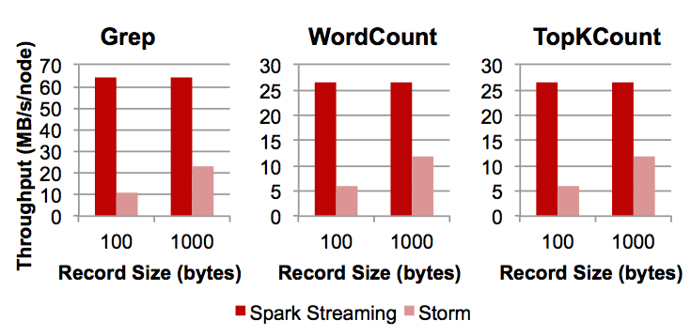
Spark Streaming vs Storm
Evaluation of three performance tests in D-Stream paper

Slide 51
Questions?

Slide 52
Spark vs Flink
Both very similar - meant for streaming
Spark built on top of a batch processing system, Flink built as a streaming system from grounds up
Flink does not distinguish between batch and streaming data
Memory management: Flink pages out to disk, whereas Spark fails the node in case memory becomes full
Flink supports windows based on various types of parameters: time, count, session, data
Flink is a windowed processing system vs spark which is a micro-batch processing system

Slide 53
Storm vs Flink
Storm does not have batch capabilities while Flink does
Flink offers a more high level API than Storm
Storm guarantees at least once semantics, Flink offers exactly once
Storm uses record-level ack, Flink uses a variation of the Chandy-Lamport Algorithm

