Slide 1
Dominant Resource Fairness: Fair Allocation of Multiple Resource Types
Ali Ghodsi, Matei Zaharia, Benjamin Hindman,
Andy Konwinski, Scott Shenker, Ion Stoica
Presenter: Che Yu Lin, Ke Yu Chen

Slide 2
Outlines
Introduction
Motivation
Dominant Resource Fairness (DRF)
Analysis
Experiment
Conclusion

Slide 3
What is fair sharing?
Every user gets equal share of resources.
Max-min fairness
Weighted max-min fairness
Can support other resource allocation policies including priority, reservation, and proportional sharing.

Slide 4
Properties of max-min fairness
Share guarantee
Each user can get at least 1/n of the resource
But will get less if her demand is less
Strategy-proof
Users are not better of by asking for more than they need
Users have no reason to lie

Slide 5
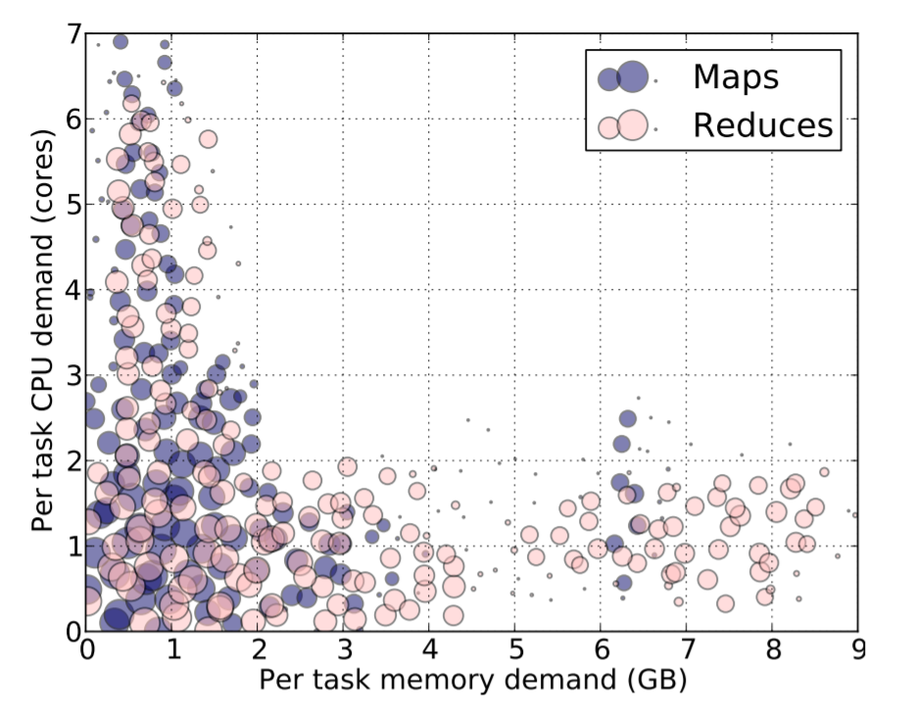
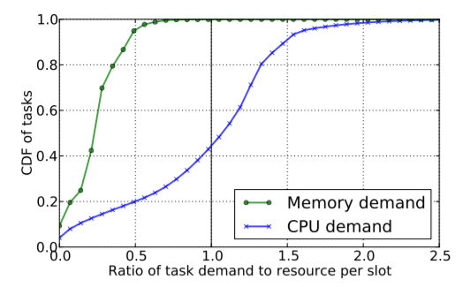
Is max-min fairness enough?
Increased need for allocation policies for environments with multiple resources and heterogeneous user demands.
2000-node Hadoop Cluster at Facebook (Oct 2010)

Slide 6
Consider the case
100%
Single resource example with only CPU
Total resource <12 CPU>
User 1 demands <2 CPU> per task
User 2 demands <3 CPU> per task
Multiple resources example with CPU and memory
Total resource <9 CPU, 18 GB RAM>
User 1 demands <1 CPU, 2 GB> per task
User 2 demands <3 CPU, 1 GB> per task
50%
0%
CPU
100%
? ?
50%
0%
CPU
RAM

Slide 7
What are some desired allocation properties?
Sharing incentive
Each user should be better of sharing the cluster, rather than exclusively using her own partition of the cluster.
Strategy-proof
User should not be able to benefit by lying about their resource demands.
Envy-freeness
A user should not prefer the allocation of another user.
Pareto efficiency
It should not be possible to increase the allocation of a user without decreasing the allocation of at least another user.

Slide 8
What are some desired allocation properties?
Single resource fairness
For a single resource, the solution should reduce to max-min fairness.
Bottleneck fairness
If there is one resource that is percent-wise demanded most of by every user, then the solution should reduce to max-min fairness for that resource.
Population monotonicity
When a user leaves the system and relinquishes her resources, none of the allocations of the remaining users should decrease.
Resource monotonicity
If more resources are added to the system, none of the allocations of the existing users should decrease.

Slide 9
Get back to our problem
How to share multiple resources fairly to users who have heterogeneous demand?

Slide 10
Dominant Resource Fairness (DRF)
An allocation policy for “multiple resources”.
It has the properties of
Sharing incentive
Strategy proof
Envy freeness
Pareto efficiency
Users have tasks according to demand vector
e.g. <1, 2, 3> user’s tasks need 1 R1, 2 R2, 3 R3.

Slide 11
Dominant Resource Fairness (DRF)
A user’s dominant share is the fraction of its allocated dominant resource.
A user’s dominant resource is the resource corresponding to the dominant share.
Example:
A system with <9 CPU, 18GB RAM>
User 1 requires <1 CPU, 4GB RAM>
1/9 (CPU) < 2/9 (RAM)
Dominant resource is RAM and dominant share is 2/9

Slide 12
Dominant Resource Fairness (DRF)
Apply max-min fairness to dominant share.
Aims to equalize the dominant share of the users

Slide 13
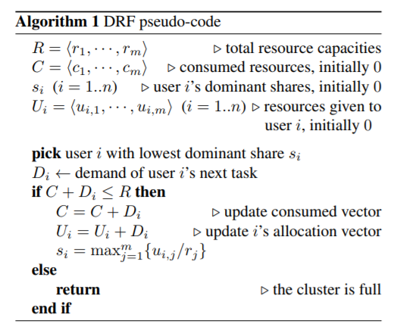
DRF pseudo-code

Slide 14
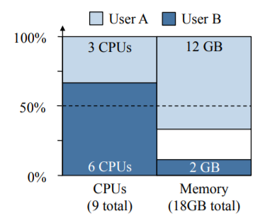
Dominant Resource Fairness (DRF)
Example:
Total resource <9 CPU, 18 GB>
User 1 runs task with demand <1 CPU, 4 GB>
User 2 runs task with demand <3 CPU, 1 GB>
Equalize the dominant share of each user.
User 1’s task <1/9, 2/9>
User 2’s task <1/3, 1/18>
Final allocation:
3 tasks for user 1
2 tasks for user 2
66%
66%

Slide 15
Online DRF Scheduler
Whenever there are available resources and tasks to run:
Schedule a task to user with smallest dominant share.

Slide 16
Are there alternate fair allocation policies ?

Slide 17
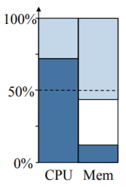
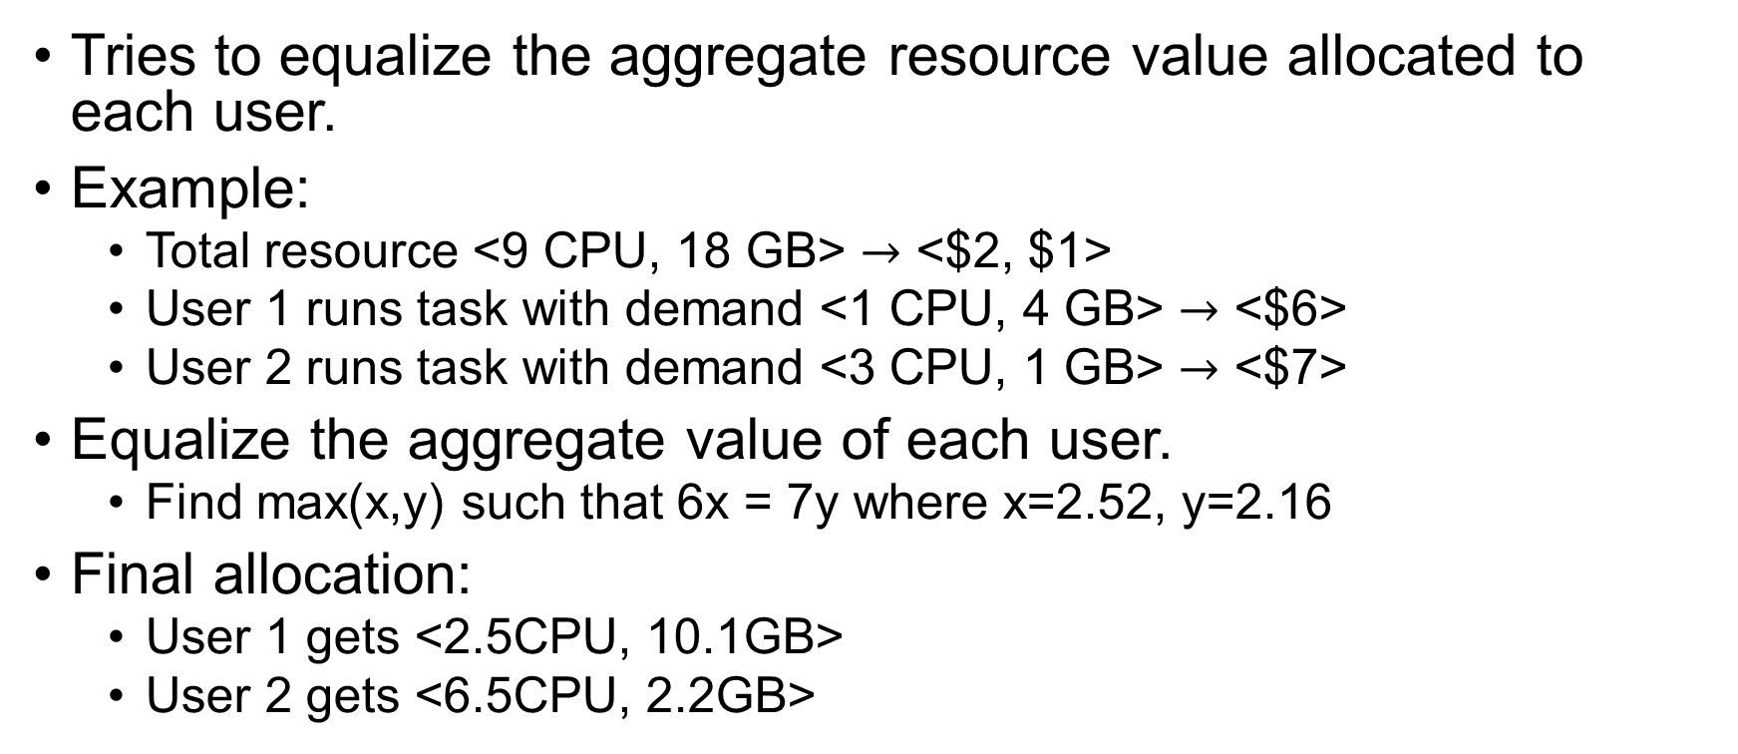
Asset Fairness
Tries to equalize the aggregate resource value allocated to each user.
Example:
Total resource <9 CPU, 18 GB> $→$ <$2, $1>
User 1 runs task with demand <1 CPU, 4 GB> $→$ <$6>
User 2 runs task with demand <3 CPU, 1 GB> $→$ <$7>
Equalize the aggregate value of each user.
Find max(x,y) such that 6x = 7y where x=2.52, y=2.16
Final allocation:
User 1 gets <2.5CPU, 10.1GB>
User 2 gets <6.5CPU, 2.2GB>
56%
72%

Slide 18
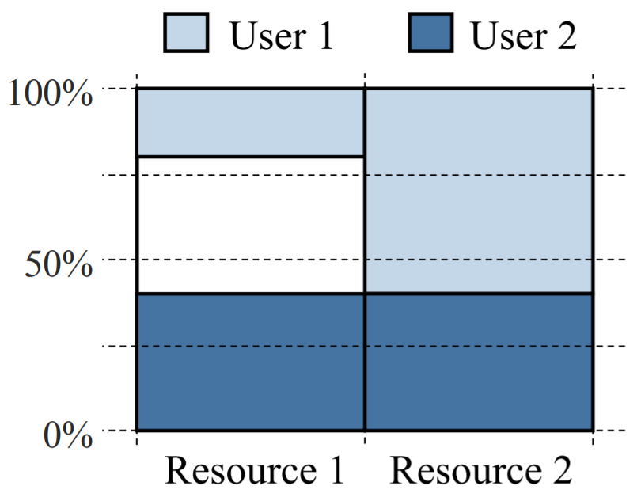
Asset Fairness
Violates the sharing incentive property.
Example:
Total resource <30 CPU, 30 GB>
User 1 runs task with demand <1 CPU, 3 GB>
User 2 runs task with demand <1 CPU, 1 GB>
Final allocation:
User 1 gets <6 CPU, 18 GB>
User 2 gets <12 CPU, 12 GB>

Slide 19
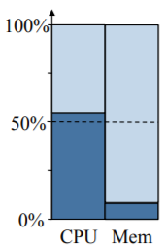
Competitive Equilibrium from Equal Incomes (CEEI)
An economic way to divide resource.
Each user receives initially 1/n of every resource.
Resources are trade in a perfect competitive market
between users.
Nash bargaining solution: Maximize the product of
dominant shares.
91%
55%

Slide 20
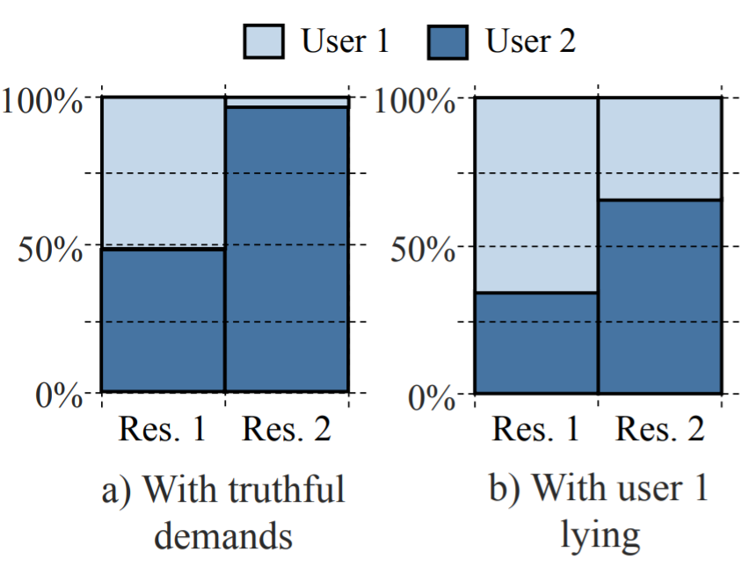
Competitive Equilibrium from Equal Incomes (CEEI)
CEEI is not strategy proof.
Example:
Total resource <100 CPU, 100 GB>
User 1 <16 CPU, 1 GB> -> <16 CPU, 8 GB>
User 2 <1 CPU, 2 GB>
Final allocation:
User 1 gets 3.2 tasks -> 4.2 tasks
User 2 gets 48.8 -> 33.3 tasks

Slide 21
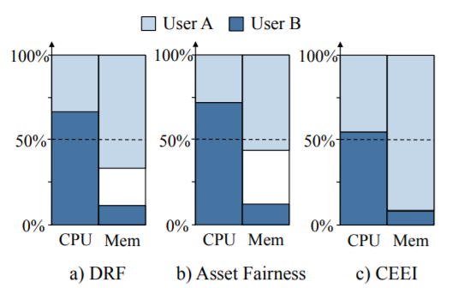
Comparison with DRF
DRF: equalizes the dominant share of the users.
Asset Fairness: equalizes the total fraction of resources.
CEEI: finds a solution satisfying market clearance.

Slide 22
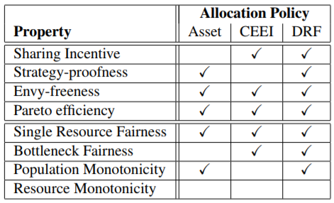
Comparison between three policies

Slide 23
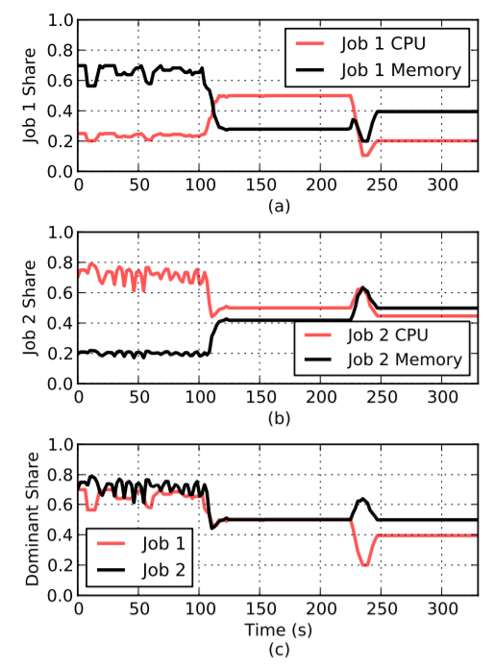
Experiment – Dynamic Resource Sharing
Run 2 jobs on a 48-node Mesos cluster on Amazon EC2 with 4 CPU cores and 14 GB RAM on each node.
Phase 1
Job 1 uses <1 CPU, 10 GB RAM> per task
Job 2 uses <1 CPU, 1 GB RAM> per task
Phase 2
Job 1 uses <2 CPU, 4 GB RAM> per task
Job 2 uses <1 CPU, 3 GB RAM> per task
Phase 3
Job 1 uses <1 CPU, 7 GB RAM> per task
Job 2 uses <1 CPU, 4 GB RAM> per task

Slide 24
Experiment – DRF vs. Slot-based fair scheduling
Run a 48-node Mesos cluster on Amazon EC2 with 8 CPU cores and 6 GB RAM on each node.
Two classes of users submitting
Small jobs with demands <1 CPU, 0.5GB> per task.
Large jobs with demands <2 CPU, 2GB> per task.
Comparison for number of jobs completed and average response time.

Slide 25
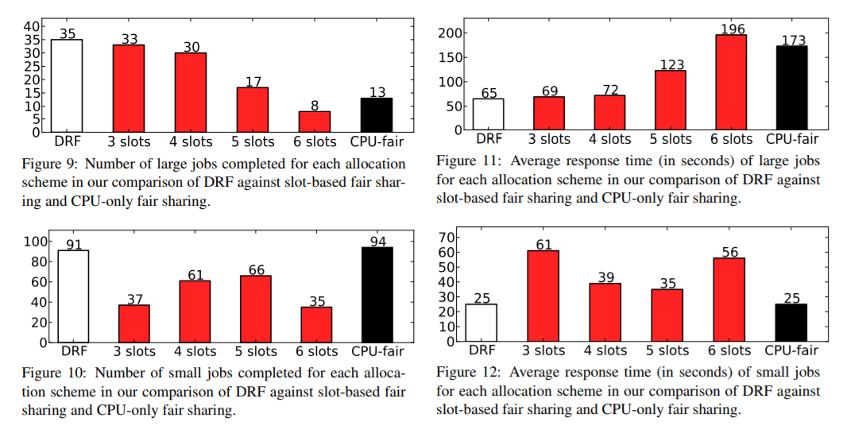
Experiment – DRF vs. Slot-based fair scheduling (k slots)
Notes:
Thrashing

Slide 26
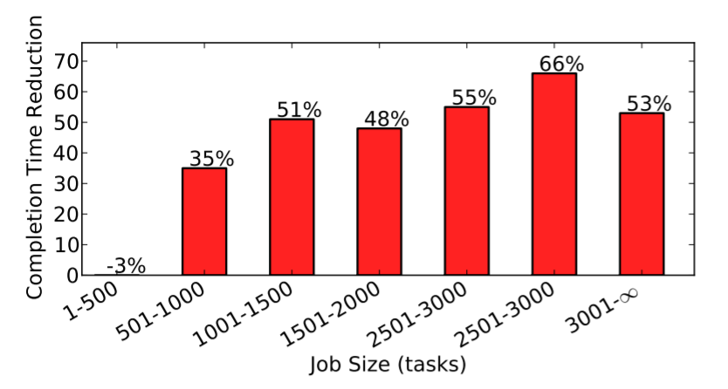
Reduction in Job Completion Time DRF vs slots
Simulation of 1-week Facebook traces.

Slide 27
Conclusion
DRF is a fair sharing model that generalizes max-min fairness to multiple resource types.
DRF is strategy-proof and sharing incentive.

Slide 28
Questions?

Slide 29
Altruistic Scheduling in Multi-Resource Clusters
Robert Grandl , Mosharaf Chowdhury , Aditya Akella , Ganesh Ananthanarayanan

Slide 30
Modern cluster schedulers
Multiple resources
Complex directed acyclic graph (DAG)
Provide fairness and ensure performance as well as efficiency

Slide 31
Three popular schedulers
Dominant resource fairness (DRF) – Multi-resource fairness
Shortest-job-first (SJF) – Minimize the average job completion time (JCT)
Tetris – Increase resource utilization

Slide 32
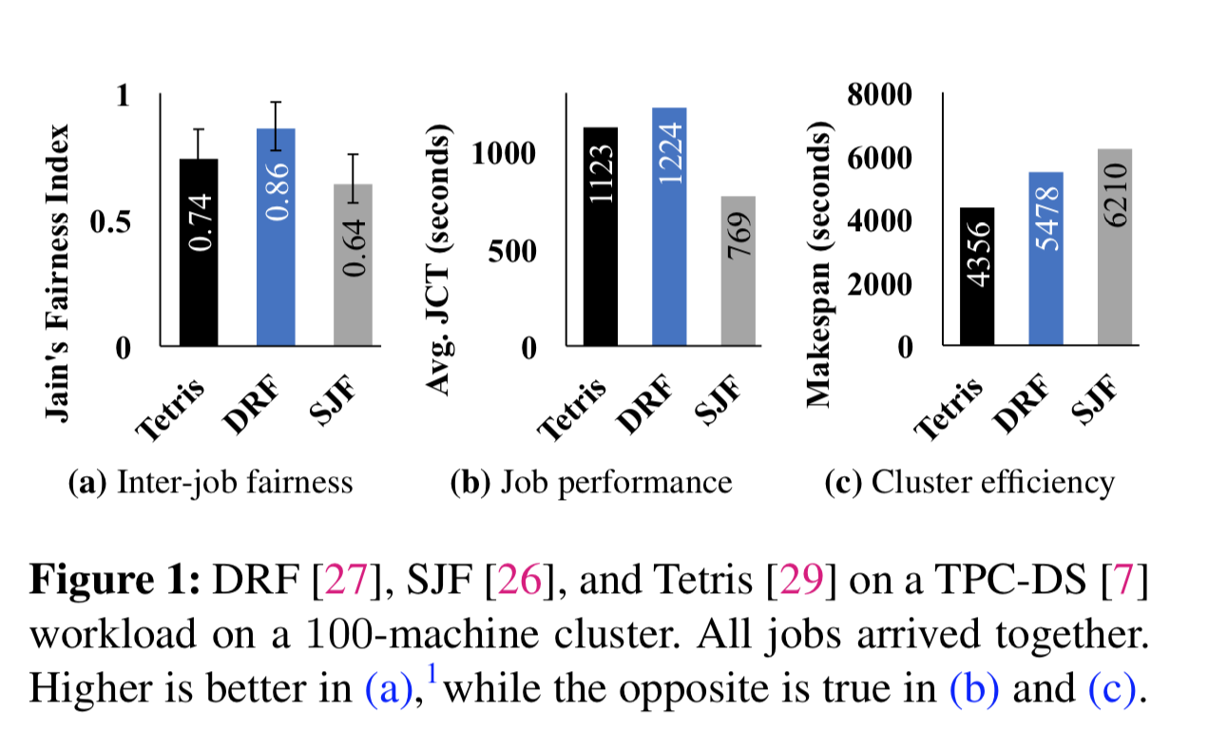

Slide 33
Two key characteristics
Distributed data-parallel jobs share an all-or-nothing characteristic
- A parallel job can’t complete until all its tasks have completed
User only observe the outcome of performance isolation when their jobs complete

Slide 34
A simple insight
Jobs yield fractions of their currently allocated resources (leftover resources) to be redistributed to further secondary objectives

Slide 35
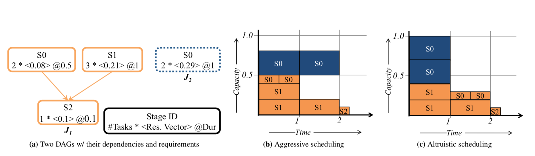
Illustration of Altruism
Average Completion Time: 2.05 time units 1.55 time units

Slide 36
Potential for Altruism
How much resources can be considered as leftover and used for altruistic scheduling ?
- Across thousands of scheduling events, at least 20% of the allocated resources can be used as leftover and rescheduled

Slide 37






Altruistic Multi-Resources Scheduling (Carbyne)
Problem Statement
Given a collection of jobs – along with information about individual tasks’ expected multi-resource requirements, durations, and DAG dependencies – we must schedule them such that each job receives a fair share of cluster resources, jobs complete as fast as possible, and the schedule is work-conserving.
DAG Jobs: Share:
Resources: Time:

Slide 38
Carbyne – Goals to satisfy
Fast completion: Each DAG should complete as fast as possible
Work conservation: Available resources should not remain unused
Starvation freedom: No DAG should starve for arbitrarily long periods

Slide 39
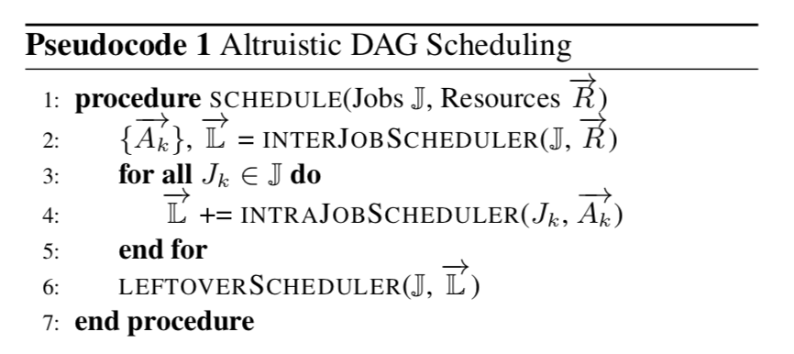
Carbyne – Scheduling

Slide 40
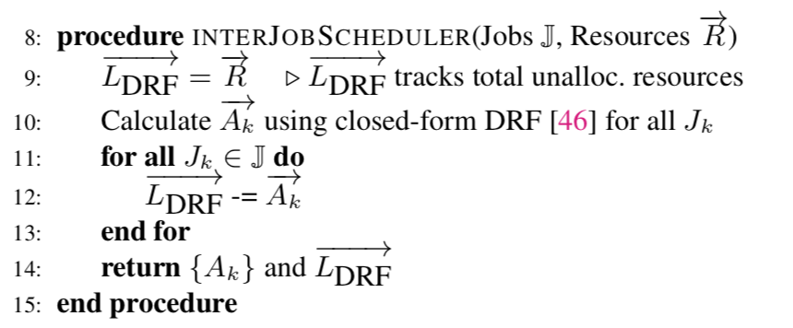
Step I – Increasing Leftover via Inter-Job Scheduling

Slide 41
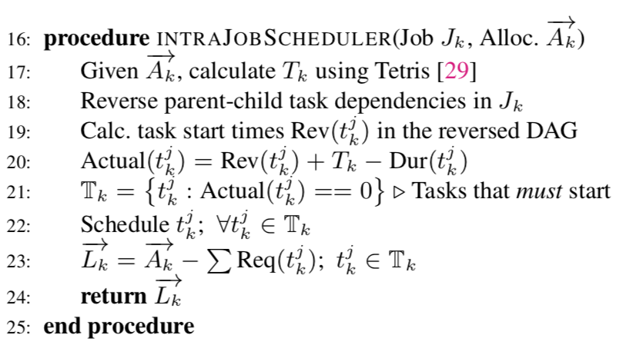
Step II – Determining Leftover for Individual Jobs

Slide 42
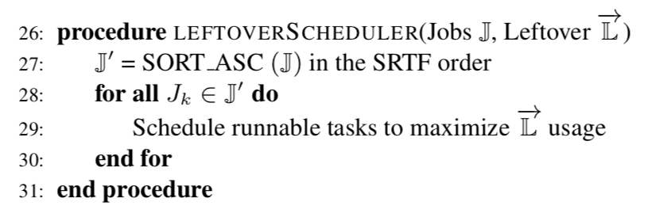
Step III – Redistribution via Leftover Scheduling

Slide 43
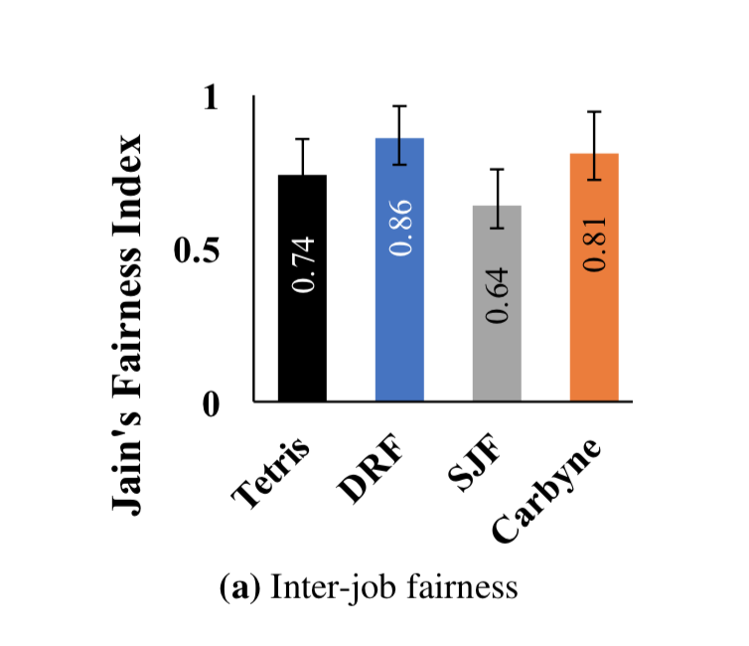
Carbyne – Performance in testbed experiments
Fairness
DRF is the most fair approach
Carbyne is only 0.05 units away
Carbyne is closest to DRF because of its long-term approach toward fairness

Slide 44
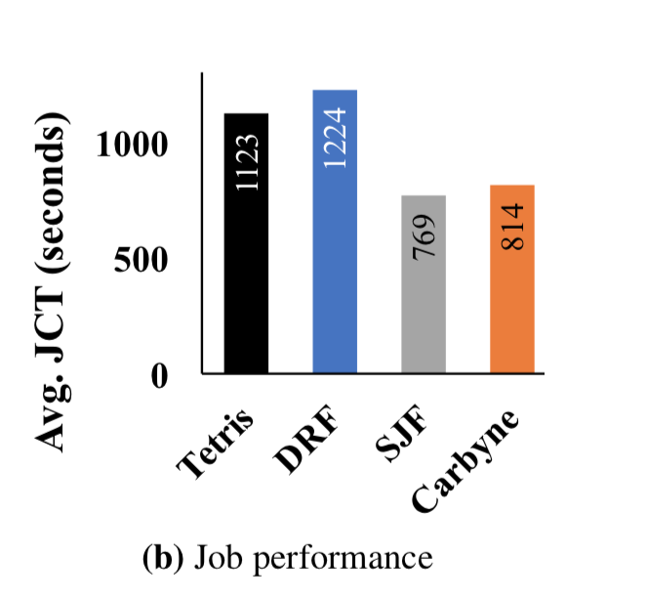
Carbyne – Performance in testbed experiments
Avg. JCT
SJF improves the most
Carbyne provides only 1.06x worse than SJF
Carbyne is slightly worse because it attempts not to delay any job beyond its fair-share-calculated completion time

Slide 45
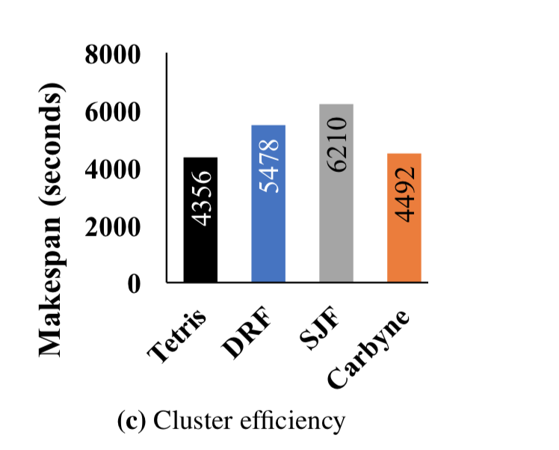
Carbyne – Performance in testbed experiments
Efficiency
Tetris provides the highest efficiency
Carbyne is the closest scheme with 1.03x worse than Tetris
This is because Carbyne favors tasks from altruistic jobs instead of treating all runnable tasks equally

Slide 46
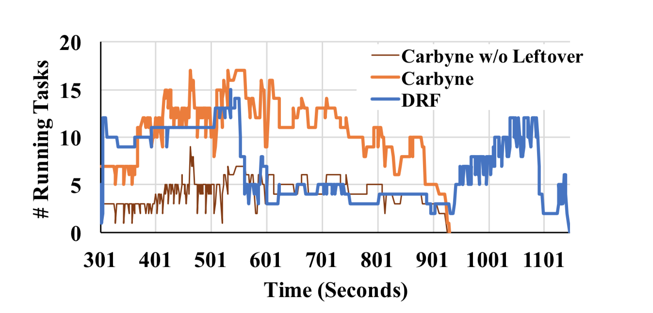
Carbyne – Source of Improvements
In DRF, the breadth-first intra-job scheduler is greedily scheduling tasks whenever it has containers allocated
Carbyne’s directive of being altruistic helps in the long run.

Slide 47
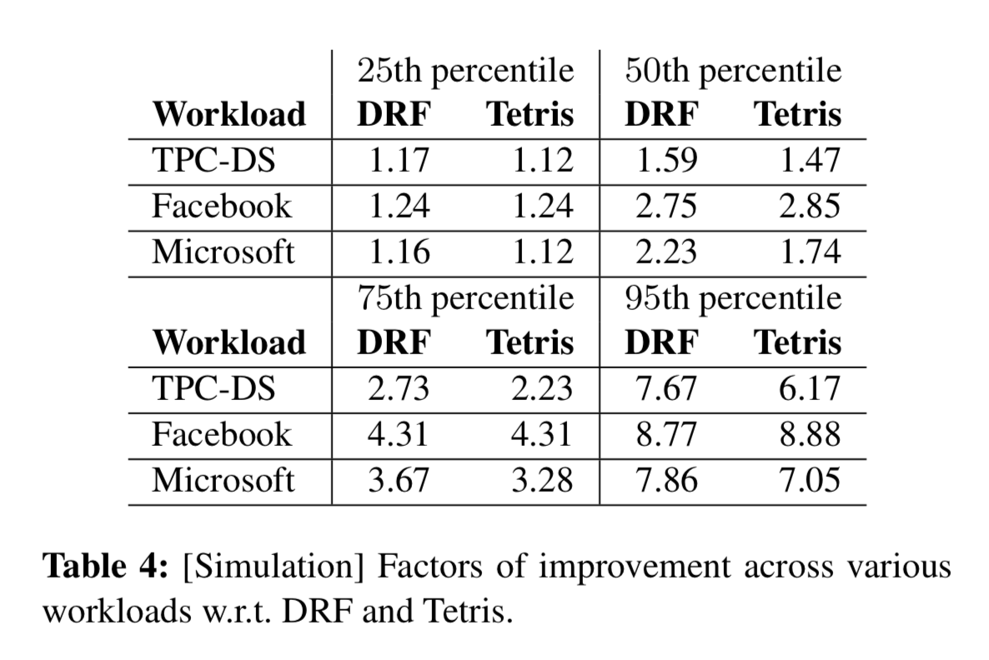
Carbyne – Performance in trace-driven simulations
Benchmark’s Performance in Simulations
Carbyne improves over the alternatives by up to 1.59x on average and 7.67x at the 95th percentile.

Slide 48
Carbyne – Performance in trace-driven simulations
Large-Scale Simulation on Production Trace
3000 machine Facebook and 10000 machine Microsoft production trace
Carbyne outperforms others by up to 2.85 for Facebook and 2.23 for Microsoft on average
Carbyne outperforms others by up to 8.88 for Facebook and 7.86 for Microsoft on 95th percentile

Slide 49
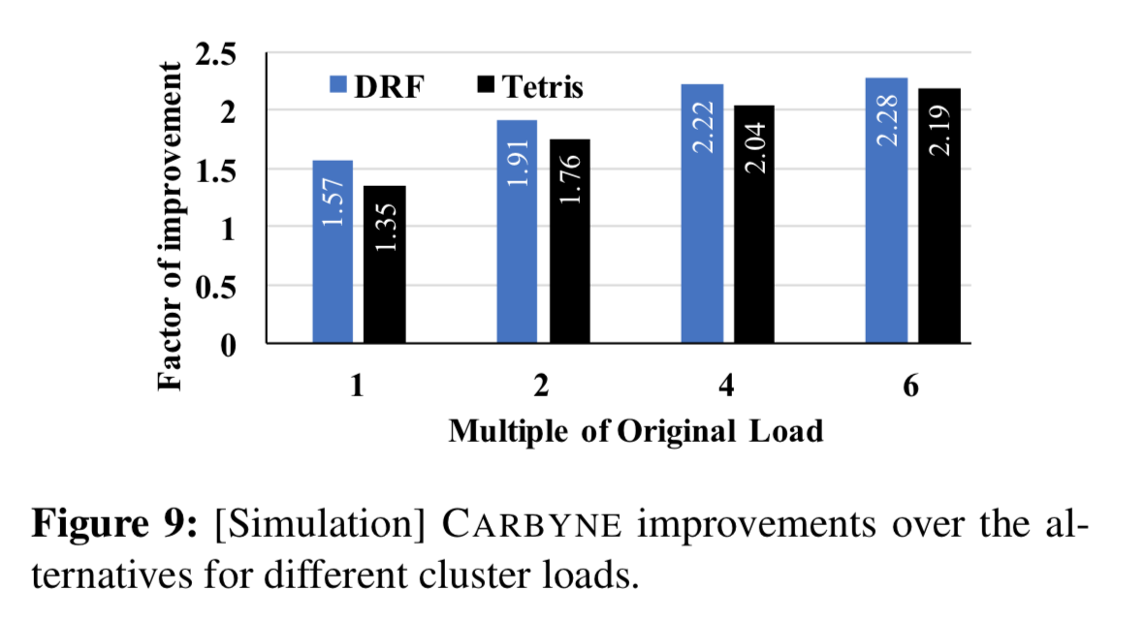
Carbyne – Sensitivity Analysis
Impact of Contention
As we increase resource contention, Carbyne’s gains keep increasing.
The more the contention, the better is Carbyne in carefully rearranging tasks over time.

Slide 50
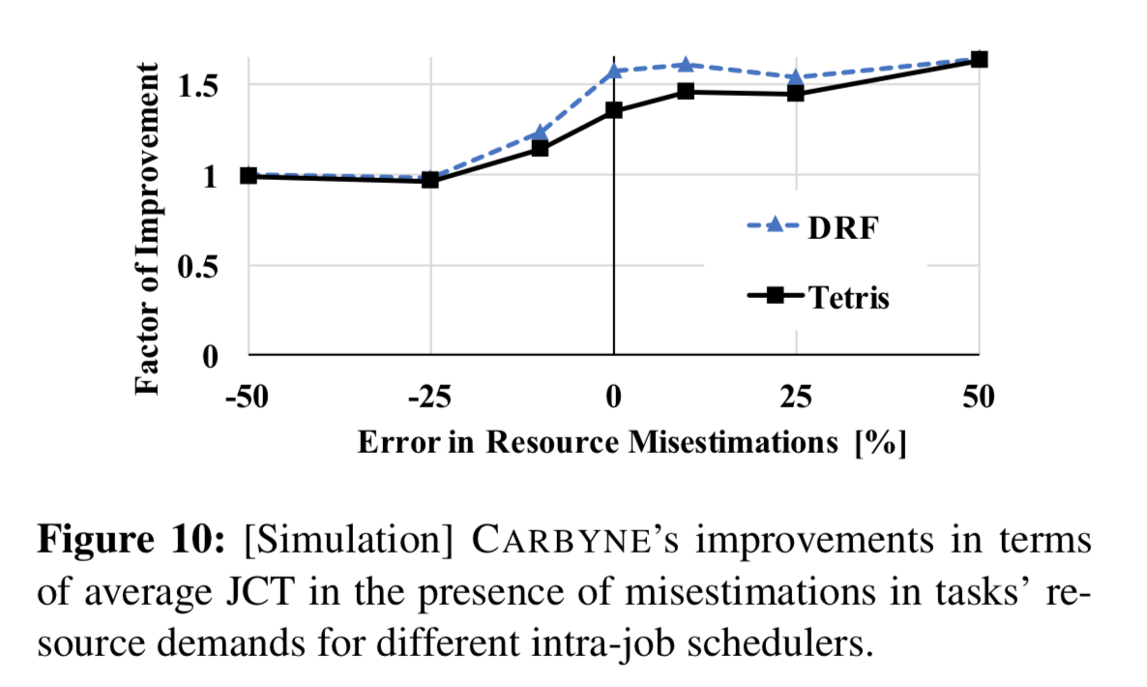
Carbyne – Sensitivity Analysis
Impact of Mis-estimations
Carbyne performs consistently better and becomes comparable when we underestimate.
Underestimations encourage higher parallelism (due to false sense of abundance).

Slide 51
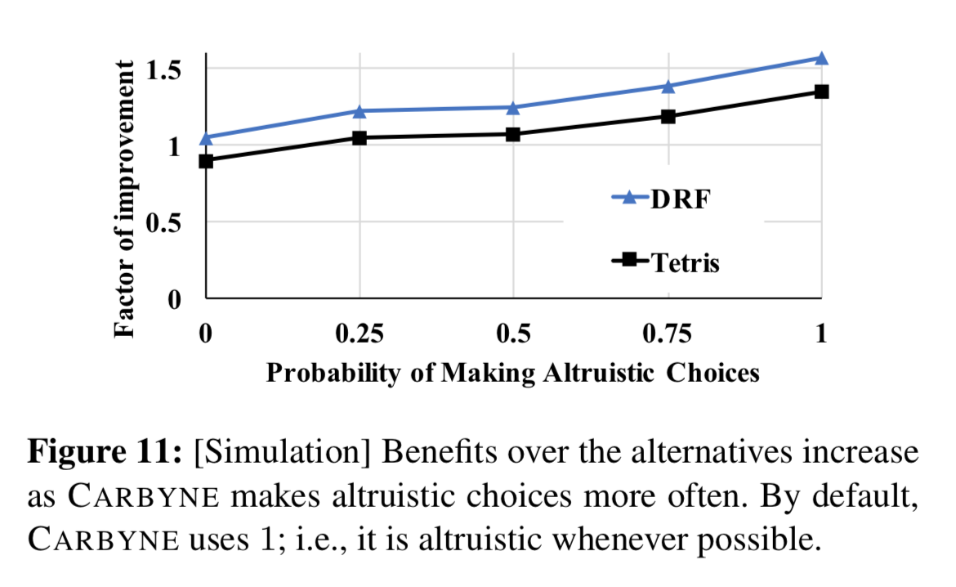
Carbyne – Sensitivity Analysis
Impact of Altruism Levels
Carbyne outperforms them by up to 1.24x at P(Altruism) = 0.5 and up to 1.56x at P(Altruism) = 1.
At P = 0, Carbyne is comparable to its alternatives, which means our mechanism is robust despite jobs being aggressive scheduling.

Slide 52
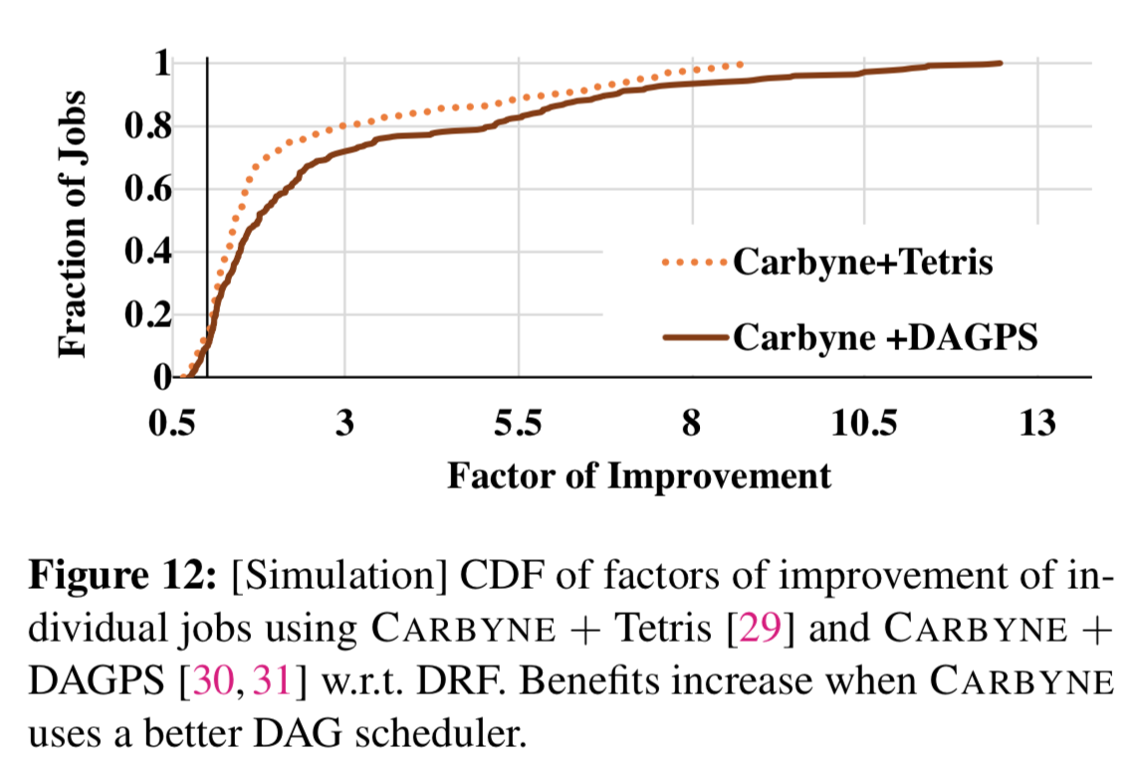
Carbyne – Sensitivity Analysis
Impact of a Better DAG Scheduler
For at least 50% of the jobs, Carbyne + DAGPS performs better than Carbyne + Tetris
For at least 25% of the jobs, factors of improvement increase from 2.36x to 3.41x

Slide 53
Conclusion
Modern cluster schedulers focus on performance isolation through instantaneous fairness and relegate performance and efficiency as secondary goals.
Carbyne combine and reschedule those leftover resources from collective altruisms and jobs yield fractions of their resources without inflating their completion times.
Deployments and large-scale simulations on benchmarks and production traces show that Carbyne closely approximates DRF in terms of performance isolation, while providing 1.26x better efficiency and 1.59x lower average completion time.

