Slide 1
TFX: A TensorFlow-Based Production-Scale Machine Learning Platform
Analysis of Large-Scale Multi-Tenant GPU Clusters for DNN Training Workloads
Myeongjae Jeon†*, Shivaram Venkataraman‡*, Amar Phanishayee*, Junjie Qian*, Wencong Xiao§*, and Fan Yang* †UNIST ‡University of Wisconsin §Beihang University *Microsoft Research
Denis Baylor, Eric Breck, Heng-Tze Cheng, Noah Fiedel, Chuan Yu Foo, Zakaria Haque, Salem Haykal, Mustafa Ispir, Vihan Jain, Levent Koc, Chiu Yuen Koo, Lukasz Lew, Clemens Mewald, Akshay Naresh Modi, Neoklis Polyzotis, Sukriti Ramesh, Sudip Roy, Steven Euijong Whang, Martin Wicke, Jarek Wilkiewicz, Xin Zhang, Martin Zinkevich Google Inc.∗
Wenyi Wu, Alexandra Spence

Slide 2
Analysis of Large-Scale Multi-Tenant GPU Clusters for DNN Training Workloads

Slide 3
Background and Motivation
Since model training requires many resources, many enterprises set up shared clusters
Deep learning creates new requirements for cluster management systems
Require GPUs instead of CPUs
Difficult to share resources across jobs
Tasks need to be scheduled at the same time (gang scheduling)
Require better locality for intra- and inter-machine communication
Goal: analyze how gang scheduling, locality requirements, and failures affect cluster utilization by studying jobs run on Philly

Slide 4
Philly: System Overview
Workloads:
Supervised machine learning
Any framework (TensorFlow, CNTK, Caffe, PyTorch)
Jobs rely on iterative optimization methods such as stochastic gradient descent
For large datasets, use distributed training with data parallelism, where each worker has a complete copy of the model in its memory
Cluster Architecture:
Within racks machines are connected via 100-Gbps RDMA (Infiniband) network
Cross-rack traffic uses Ethernet
Clusters use HDFS as distributed storage
Resource manager based off Apache YARN
Notes:
Remote direct memory access
Apache YARN split functionalities of resource management and job scheduling into separate daemons. Global resource manager and per-application application master

Slide 5
Philly: System Overview
Job Scheduling:
Users must specify number of GPUs required
Gang scheduling while locality aware-use the smallest number of servers within an RDMA domain
Locality constraints are relaxed after fixed number of retries
GPUs are not shared with other jobs
Three statuses: passed, killed, unsuccessful
Data Collection and Analysis:
2 server SKUs, one with 2 GPUs per server and one with 8 GPUs per server
Analysis pipeline combines three main log sources
YARN scheduler logs
Stdout and stderr logs
Ganglia monitoring system logs on hardware usage (CPU, memory, network, GPU utilizations)

Slide 6
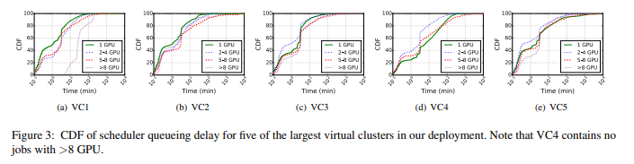
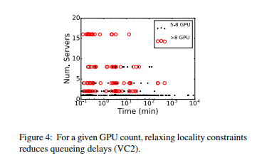
Queueing Delays vs Locality
Notes:
Most jobs have less than 10 minutes of delay, and in general the less GPUs used the smaller the delay
Jobs that need more than 4 GPUs tend to have a slightly longer tail in the distribution of queueing delays compared to their 1 GPU and 2-4 GPU counterparts. For example for VC2, 25% of jobs using >4 GPUs, which include both 5-8 GPU and >8 GPU, experience a queueing delay of at least 10 minutes; in comparison, only 10% of 1 GPU jobs experience a queueing delay of at least 10 minutes. But overall, queuing delays for jobs, irrespective of their GPU demand, are not markedly distinct
As expected, most of jobs with 5-8 GPU are scheduled with high locality, i.e., placed on one or two servers. On the other hand, we find that jobs with >8 GPU are spread across a wider range from 2 to 16 servers. Clearly, when jobs end up running on 16 servers, they start execution much sooner than running on 2 or 4 servers. This confirms how our scheduler works in practice to trade-off locality for lower scheduling delay

Slide 7
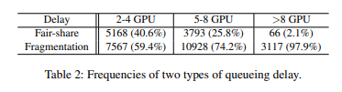
Types of Queueing Delay
Fair-share delay: queueing delay caused by fairness
Fragmentation delay: queueing delay caused by locality requirement and resource fragmentation
Notes:
Fair-share: equally distributed among system users or groups as opposed to among processes. We call queueing caused by the first factor as fair-share delay, as it happens when the virtual cluster uses up its assigned quota (i.e., number of GPUs).
However, it is possible that a job arrives within the quota but fails to be scheduled, mainly because resource fragmentation makes it hard to find enough GPUs with high locality. We call this queuing delay as fragmentation delay.
For jobs with 5-8 GPU, fragmentation delay is responsible for 74.2% of occurrences, and it dominates for larger jobs. In contrast, for smaller jobs, we see that the two causes are more balanced. Further, we also observe that across all jobs fragmentation delay is responsible for around 80% of the delay in terms of waiting time. This is because fair-share delays are easy to mitigate with preemption, but fragmentation delays are much harder to overcome in our current design.

Slide 8
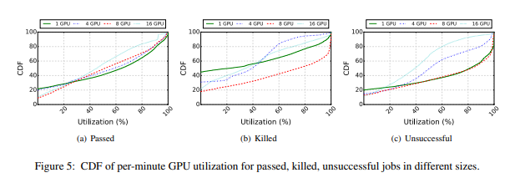
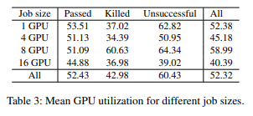
GPU Utilization
Notes:
Note that our current generation of GPUs only report coarse-grained utilization for processing cycles that can only be used to detect if any of the streaming multiprocessors (SMs) are being utilized [3]. They do not report what fraction of the SMs are being actually used within a single GPU. Therefore, our analysis presents an “upper bound” of actual effective SM utilization.
Surprisingly we find that around 47.7% of in-use GPUs’ cycles are wasted across all jobs, with jobs using 16 GPUs exhibiting the lowest utilization at 40.39%. Moreover, across job status in Figure 5, the median utilization for 16 GPU jobs is 45.00%, 34.24%, 39.54% for Passed, Killed, and Unsuccessful, respectively. These are 6.46%, 40.25%, and 42.63% lower than the 8 GPU jobs in the corresponding job status

Slide 9
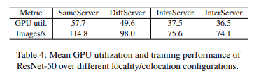
GPU Utilization: Impact of Distributed Learning
Jobs that use more than 8 GPUs must distribute training instances across multiple servers
Test relationship between distribution and efficiency of GPUs using ResNet-50
SameServer: job placed in single server
DiffServer: job placed in two servers connected with RDMA network
IntraServer: two SameServer jobs, one on each server as interference
InterServer: two DiffServer jobs
Notes:
2 GPU r50
Each server has four NVIDIA Tesla P100 GPUs 16 gb attached to a CPU socket. The table reports GPU utilization when processing a batch size of 32 images during training. First we observe that the training does not fully utilize GPUs even for single machine execution. In particular, SameServer achieves utilization of 57.7% for GPUs in use. It increases to 71.1% for twice the batch size but only increases marginally for larger batches.
To show this we set DiffServer as our baseline and measure changes in the efficiency while populating additional ResNet-50 jobs in the same servers. First, we measure GPU utilization when the colocated jobs do not use RDMA network at all: we place two SameServer jobs, one on each server in the same CPU socket as the job under Figure 6: GPU utilization when running 8 and 16 GPU jobs on dedicated servers. study. Thus, these jobs interfere with the job under study in the use of PCIe buses while reading training inputs, aggregating model updates, and so on. The observed efficiency is shown as IntraServer in Table 4, and we see that having such intra-server interference lowers the utilization by as much as 12.1%. We also study if such interference matters for the RDMA network in InterServer. For this setup we use two DiffServer jobs instead of two SameServer jobs as background traffic, so that all the jobs are distributed across two servers and share the RDMA network. In this case, we see a 13.1% decrease in utilization compared to the baseline.

Slide 10
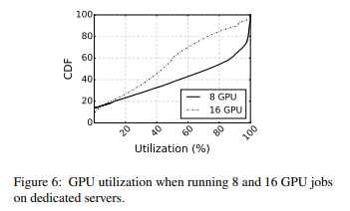
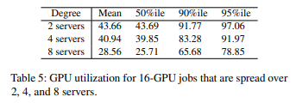
GPU Utilization: Across Servers
Notes:
In this case, the 8 GPU jobs uses all 8 GPUs in a single server while the 16 GPU jobs uses all the GPUs in two servers. The network over which the servers for these jobs are connected to each other is shared. Figure 6 shows the results of our comparison. Compared to the 8 GPU jobs, we see that 16 GPU jobs, which have the additional model aggregation step in distributed mode, have significantly lower utilization. Specifically, for 8 GPU jobs, GPU cycles are utilized 56.9% of time on average while this is only 34.3% for 16 GPU jobs. Furthermore, the median is 73.12% for 8 GPU jobs, which is 1.67x the median in the 16 GPU case.

Slide 11
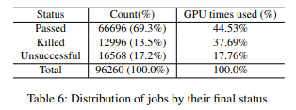
Training Progress
Notes:
Jobs in our system finish with one of three statuses: passed, killed or unsuccessful. Similar to iterative online computations [6, 16], our machine learning job utilizes cluster resources to improve the model over time. However as opposed to prior study on big data traces [30], we see a significant fraction of jobs (30.7% as shown in Table 6) are either terminated unsuccessfully or killed by users. They constitute around 55% of the total GPU time used during our trace collection period. Thus it is important to understand the reason behind these failures as fewer unsuccessful jobs would mean that more of the cluster resources can be used for successful jobs.

Slide 12
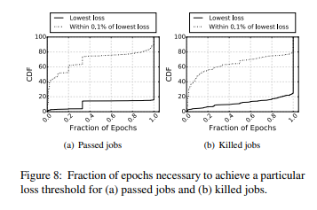
Training Iterations
Notes:
First, Figure 8(a) shows the fractions of epochs required to reach the lowest loss across all passed jobs. From the figure we see that around 80% of passed jobs require all the epochs executed to reach the lowest loss. We repeat this study for killed jobs and see a similar pattern as shown in Figure 8(b). However we also see that a majority of jobs improve the loss marginally using a large fraction of epochs. In particular, Figure 8(a) shows the fraction of epochs required to reach within 0.1% of the lowest loss across all passed jobs. Around 75% of jobs reach within 0.1% of the lowest loss using only 40% of the epochs. Again, a similar pattern is shown for killed jobs in Figure 8(b). While we do not present data from user surveys, this suggests that machine learning practitioners can early terminate jobs to save use of GPU times considerably when the loss change is less than a particular threshold in successive epochs. Essentially, we look into much resources are used to improve 0.1% of convergence accuracy in terms of the fraction of GPU times for each job. In our workload, this accounts for 62% and 56% on average for passed jobs and killed jobs, respectively

Slide 13
Job Failures: Types
Incorrect inputs: model files or input data cannot be read
Semantic error: errors due to library versions or other dependencies
Model checkpoint error: job unable to create successful model checkpoint
MPI runtime failure: failure of network connection to peer MPI process or internal failure of MPI daemon
Job preempted: YARN reclaims GPU currently in use to schedule another job
Invalid memory access: violating access on memory address space

Slide 14
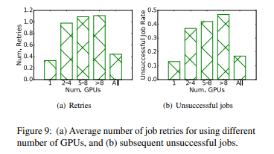
Job Failures

Slide 15
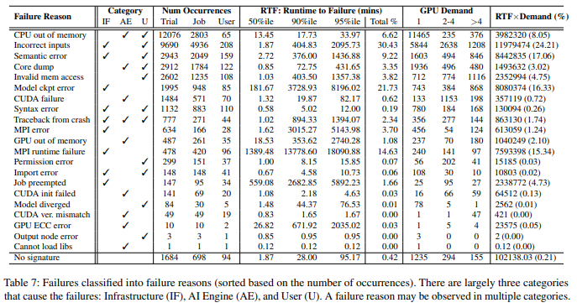
Job Failures: Frequency
Notes:
Failures incurred by user errors, such as configuration/syntax/semantic errors in program and script, are dominant. These failures are very prevalent across our top-8 failure reasons. As explained, CPU out of memory is the most frequent with its failures significantly concentrated on a few users. Other frequent failures such as incorrect inputs and semantic error are more spread out across different users.
Many failures of training jobs happen quickly, for example within 10 mins. This is mostly the case for failures driven by users in syntax, semantic, and configuration errors, which we can also infer from low 50P RTFs in the corresponding failure reasons. Note that most of those failures are deterministic and are caught when the runtime begins to execute the program. One of exceptions that is noteworthy is failure corresponding to inconsistent/corrupted input data. We can only detect this at the moment we actually read the erroneous data and attempt to parse it. This is the primary reason for having high 95P in incorrect inputs.
Infrastructure failures occur infrequently but have much longer runtime to failure (RTF).

Slide 16
Design Implications for Future Schedulers
Prioritizing locality
Current scheduler waits to see if locality can be achieved and if not relaxes constraints
Since jobs run for many hours, drops in efficiency can extend running time by hours
Better to wait longer for locality in some cases
Consider migrating jobs to machines with better locality during execution if resources become available
Mitigating interference
Consider placing small jobs on dedicated servers to reduce sharing/interference
Support for job migration to defragment the cluster will mitigate interference for small jobs and improve intra-job locality for large jobs

Slide 17
Design Implications cont.
Improving failure handling
Many user errors because languages are not strongly typed
Running the first iteration of training can capture some runtime failures
Set up a pool of cheaper VMs to pre-run jobs to catch errors and prevent wasted GPU cycles
Set up a well-defined schema for datasets and perform schema check to reduce data formatting errors
Develop a system to predictively mitigate failures by observing related failures
Classify error messages in real time from logs
Adapt scheduling parameters such as number of retries to reduce failure occurrences

Slide 18
Related Work
Failure analysis of data analytics jobs in shared clusters
Assume failures are common
Focus on framework support for fault-tolerance and reliable job execution
Many jobs fail within a few minutes, while some errors take days to detect such as failures due to data copy errors
Similar conclusions that coding errors cause a large amount of failures
Scheduler and runtime for efficient machine learning execution
SLAQ schedules based on quality improvement for resource usage
Optimus predicts job remaining time for dynamic resource scheduling and reduces average job completion time
Tiresias reduces job completion time using a trial-and-error exploration
Future schedulers may need to consider trade-off between reducing queueing time and job running time

Slide 19
Related Work cont.
GPU resource management for machine learning
Baymax explores GPU sharing to mitigate queueing delay
Prophet predicts performance of GPU workloads using an analytical model
Gandiva uses checkpointing for GPU time-sharing in shared GPU clusters
Future work would integrate these to improve cluster utilization
Some large networks do not fit in GPU memory with real-world data
Approximate data processing
Trade off accuracy for earlier completion times
Studied for SQL queries and batch processing
This work showed that trading a small amount of accuracy can significantly reduce GPU execution time

Slide 20
Conclusions
Importance of locality
Interference can cause lower GPU utilization
Based on their data, they have created guidelines for future research and development of machine learning schedulers
By publicly releasing the scheduler trace, they hope to encourage further research

Slide 21
Questions
How much failure handling should be done by the user and how much should be automated?
Most failures come from user error. Should it be the responsibility of the user to check for these errors, or is it more efficient to do automatic error checking?
The paper proposed the strategy of migrating a job to machines with better locality in order to increase resource usage. What effect would migrating a job have on the runtime and resource usage of the job?
For these types of jobs, all that would need to be transferred would generally be the loss. The training data is stored using HDFS, so it could be pulled from the nearest location instead of being migrated.
Section 4.1 showed that many jobs only need around 40% of their iterations to get within 0.1% of their lowest loss. Should jobs automatically terminate when their loss appears to be at a minimum, and what are some ways to identify when training is complete?
Currently number of iterations is set by the user, but they could consider setting a loss threshold instead or use a combination of the two

Slide 22
TFX: A TensorFlow-Based Production-Scale Machine Learning Platform

Slide 23
Overview
Platform Overview
Data Analysis, transformation, and validation
Model Training
Model Evaluation and Validation
Model Serving
Case Study

Slide 24
Platform Overview - Background
The learning algorithm is only one component of a machine learning platform that represents a small fraction of the code
Data and model parallelism require distributed systems and orchestration that exceed capabilities of many single-machine solutions
A machine learning pipeline also needs to be simple to set up, maybe even support automated pipeline construction
Ideally, the platform automatically surveys different machine learning techniques and suggests the best solution, allowing even non-experts access to machine learning

Slide 25
Platform Design and Anatomy
One machine learning platform for many learning tasks
Wide coverage of existing algorithms
Support sparse, dense, or sequence data
Support all kinds of inference types, including (among others) regression, classification, and sequences
Continuous training
Data visitation can be configured to be static or dynamic (over a rolling range of directories)
Warm-starting initializes a subset of model parameters from a previous state
Notes:
Data analysis, validation, and visualization tools need to support sparse, dense, or sequence data. Model validation, evaluation, and serving tools need to support all kinds of inference types, including (among others) regression, classification, and sequences.

Slide 26
Platform Design and Anatomy
Easy-to-use configuration and tools
Components share utilities that allow them to communicate and share assets
Production-level reliability and scalability
Model validation coupled with data validation in order to detect corrupted training data and thus prevent bad (yet, validated) models from reaching production
Use the distributed data processing model offered by Apache Beam for handling the large volume of data during training, model evaluation, and batch inference
Notes:
A TFX user is only exposed to one common configuration that is passed to all components and shared where necessary.
Utilities that are used by all components enable enforcement of global garbage collection policies, unified debugging and status signals, etc.
Model validation is critical, since it is difficult to predict whether a learning algorithm will behave reasonably on new data
To give an example, training data that accidentally includes the label will lead to a good quality model that passes validation, but would not perform well in production where the label is not available. Validating the serving infrastructure before pushing to the production environment is vital to the reliability and robustness of any machine learning platform. Our platform provides implementations of these components that encode best practices observed in many production pipelines

Slide 27
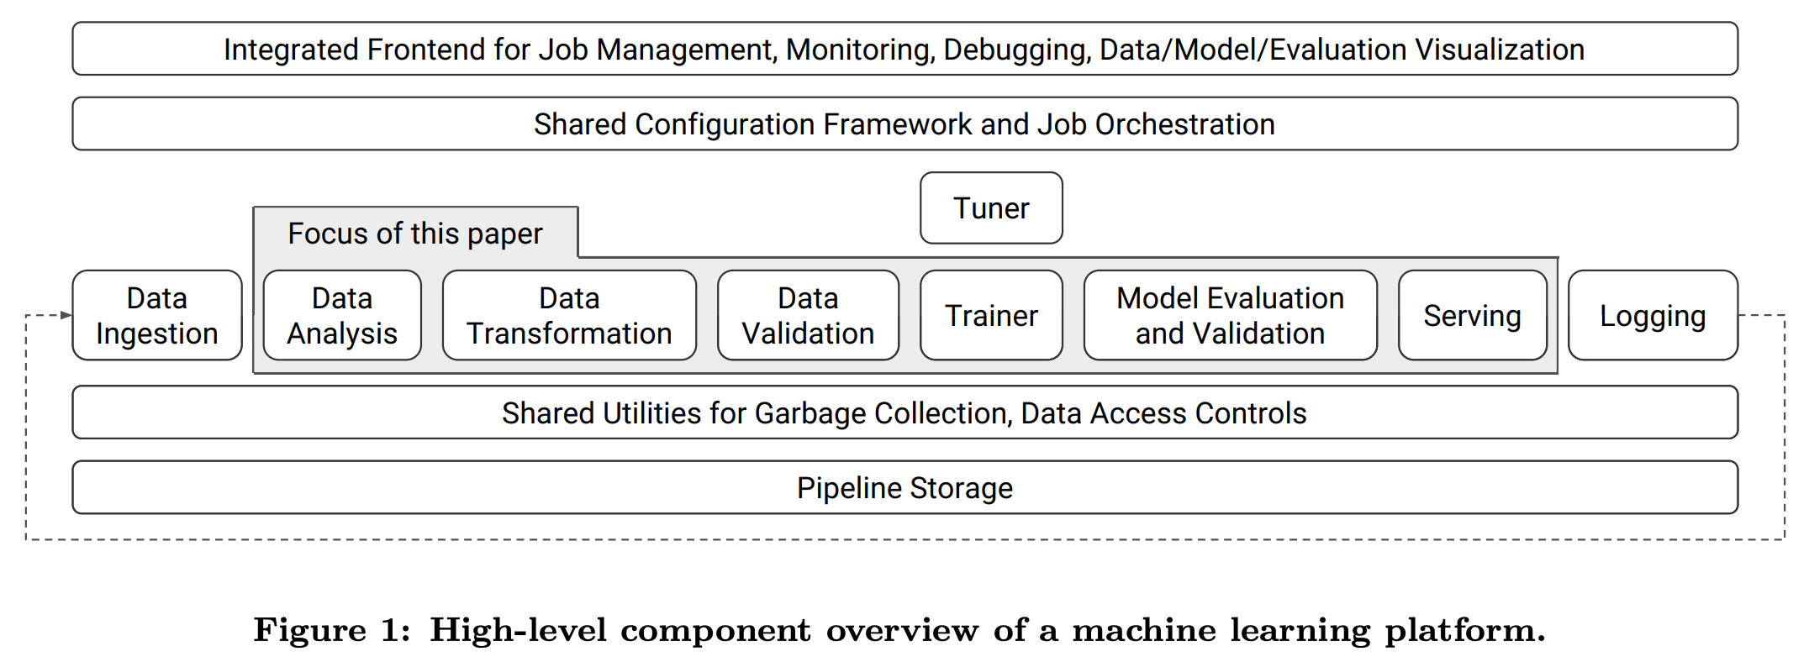
Platform Design and Anatomy
Notes:
In isolation, these components implement high-level functionality that is typical in machine-learning platforms.
However, it is worth pointing out two differentiations.
First, we built these components to adhere to the aforementioned principles, which introduced several technical difficulties.
Second, the integration of these components in a single platform, with shared configuration and utilities, enabled key improvements over existing alternatives.
To give an example, transformations applied in the trainer and at serving time may need statistics generated by the data analysis component.
Integrating these components ensures consistency across the pipeline and guarantees that the same transformations are applied at training and serving, which in turn prevents one form of training-serving skew (a common production headache in machine learning).
Although almost all of the components can be considered optional, TFX users find it beneficial to adopt the full stack in order to achieve more robust and reliable production systems and take advantage of all management and visualization tools in the integrated frontend.

Slide 28
Data Analysis, transformation, and validation
Often the data is generated by adhoc pipelines involving multiple products, systems, and usage logs
Reusable component that enables rigorous checks for data quality and promotes best practices for data management in the context of machine learning platforms is highly desired
Users tend to switch off data quality checks if they receive a large number of false-negative alerts or if the alerts are hard to understand

Slide 29
Data Analysis
Processes each dataset fed to the system and generates a set of descriptive statistics on the included features
E.g., the distribution of the number of values per example or the number of examples with and without the feature
Gathers statistics over feature values
Continuous features: the statistics include quantiles, equi-width histograms etc.
Discrete features: the top-K values by frequency, etc.
Supports statistics on configurable slices of the data and cross-feature statistics
On negative and positive examples in a binary classification problem
Correlation and covariance between features
Notes:
In a continuous training and serving environment, the above statistics must be computed efficiently at scale.
Unavailable feature statistics may result in missed opportunities to correct data anomalies, while outdated feature-to-integer mappings and feature value distributions may result in a drop in model quality.
On large training data, some of these statistics become difficult to compute exactly, and the component resorts to distributed streaming algorithms that give approximate results

Slide 30
Data Transformation
A suite of data transformations to allow feature wrangling for model training and serving
The generation of feature-to-integer mappings, also known as vocabularies
Both training and serving require mappings from string values of a sparse feature to integer IDs
Allow operations like looking up model weights or embeddings given a specific value
Saves memory and computation time
TFX exports any data transformations as part of the trained model, which in turn avoids problems with inconsistency

Slide 31
Data Validation
A schema that provides a versioned, succinct description of the expected properties of the data
Features present in the data; the expected type of each feature, etc.
Flag any deviations from the schema as potential anomalies
Provide actionable suggestions to fix the anomaly
Schemas should follow the following principles
The user should understand at a glance which anomalies are detected and their coverage over the data
Each anomaly should have a simple description
Allow updating schema corresponding to natural evolutions of the data
Allow anomalies to be filed just like any software bug
Notes:
• The expected presence of each feature, in terms of a minimum count and fraction of examples that must contain the feature.
• The expected valency of the feature in each example, i.e., minimum and maximum number of values.
• The expected domain of a feature, i.e., the small universe of values for a string feature, or range for an integer feature

Slide 32
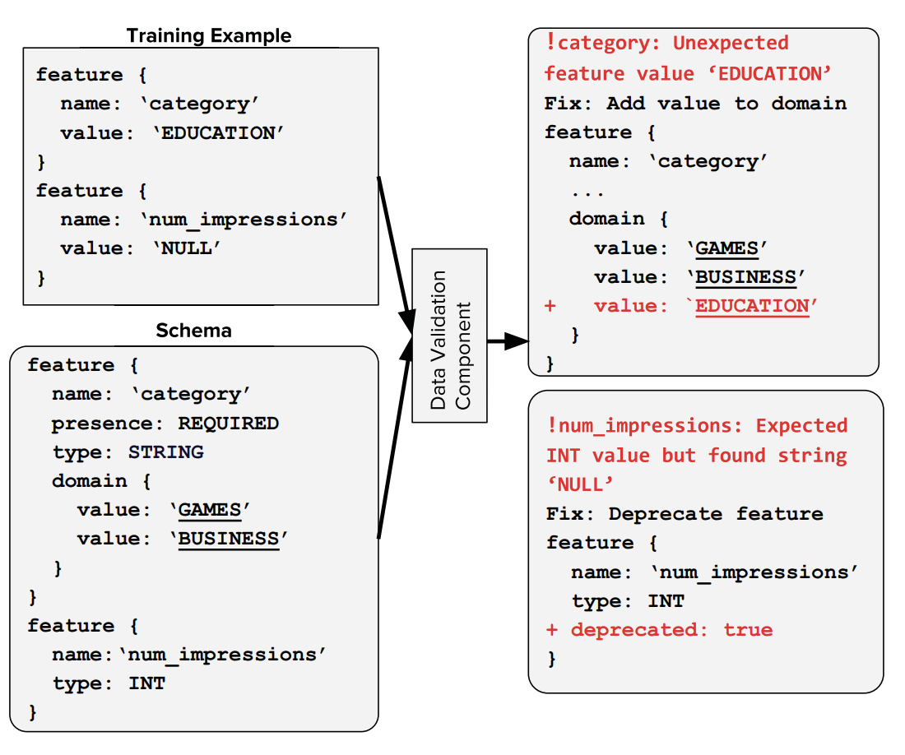
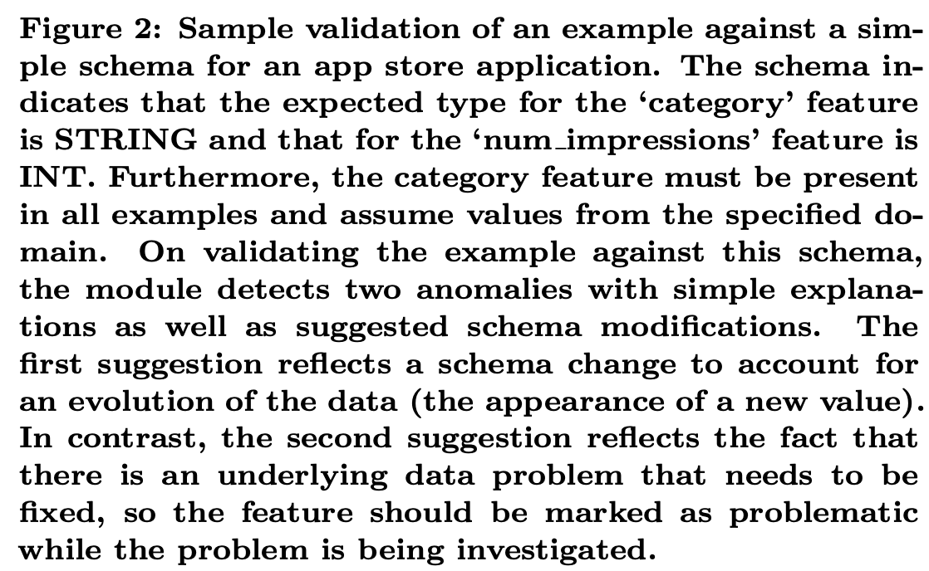
Data Validation

Slide 33
Model Training
Continuously training and exporting machine learning models is a common production use case
Both time and resource intensive to retrain these models

Slide 34
Warm Starting
For many production use cases, freshness of machine learning models is critical
Continuous training (inspired by transfer learning)
Identify a few general features of the network being trained (e.g., embeddings of sparse features)
Initialize (or warm-start) the parameters corresponding to these features from the previously trained version of the network
Fine tune them with the rest of the network

Slide 35
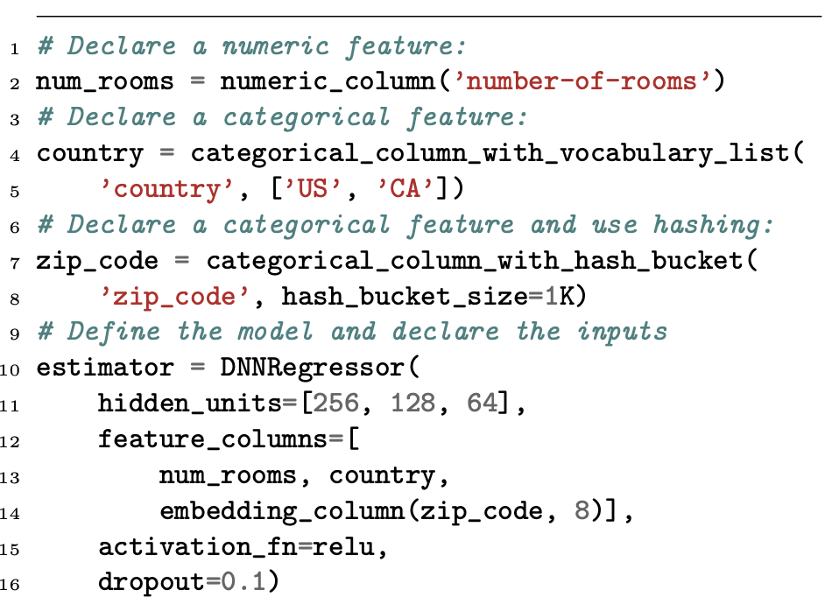
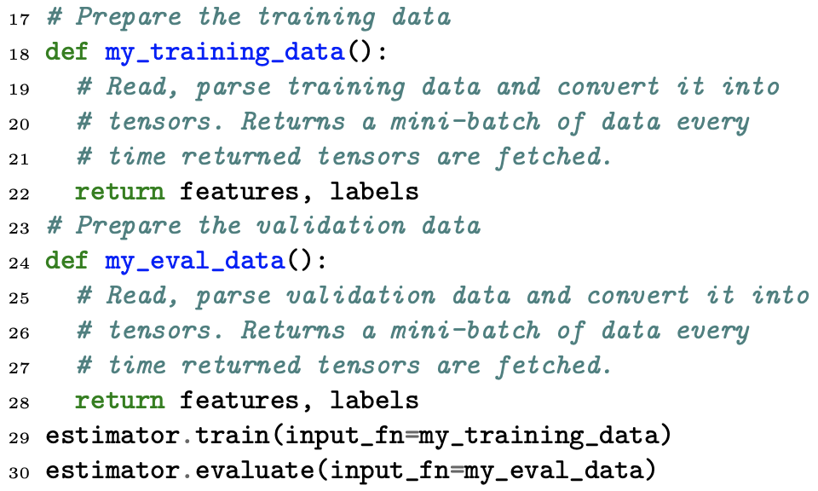
High-Level Model Specification API
FeatureColumns help users focus on which features to use
Estimator handles training and evaluation for a model

Slide 36
Model Evaluation and Validation
Machine-learned models are often parts of complex systems comprising a large number of data sources and interacting components
Bugs can grow and unexpected interactions can develop
Different components expecting different serialized model formats
Bugs in training or serving code causing binary crashes

Slide 37
Defining a “good” model
Safe to serve
Should not crash or cause errors in the serving system when being loaded
When sent bad or unexpected inputs, and the model shouldn’t use too many resources
Prediction quality
User satisfaction and product health
App install rate

Slide 38
Evaluation: human-facing metrics of model quality
It is costly and time-consuming to run A/B experiments on live traffic
The evaluation component provides proxy metrics such as AUC or cost-weighted error that approximate business metrics more closely than training loss, but are computable offline
Conduct product-specific A/B experiments after satisfied with the offline performance

Slide 39
Validation & Slicing
Once a model is launched to production and is continuously being updated, automated validation is used to ensure that the updated models are good
Evaluate prediction quality by comparing the model quality against a fixed threshold as well as against a baseline model
Offers the ability to compute metrics on slices of data
Metrics on the entire dataset can fail to reflect the performance on these small slices
Avoid serving models that sacrifice quality on these slices for better overall performance

Slide 40
Model Serving
Serving systems for production environments require low latency, high efficiency, horizontal scalability, reliability and robustness
The following slides elaborates on two specific system challenges: low latency and high efficiency

Slide 41
Multitenancy with Isolation
A single instance of the server to serve multiple machine-learned models concurrently
Latency peaks during the interval when the system was loading a new model or a new version of an existing model
To enhance isolation between these operations, we implemented a feature that allows the configuration of a separate dedicated threadpool for model-loading operations
Supports faster request processing consistently, trading off slower model-loads

Slide 42
Fast Training Data Deserialization
Non neural network (e.g., linear) models are often more data intensive than CPU intensive
Lazy parsing
A benchmarking suite to ensure that optimizing for one type of data distribution or configuration did not negatively impact performance for other types of data distributions or configurations
Speedup of 2-5 times on benchmarked datasets
Notes:
Lazy parsing was employed, including skipping complete parts of the input protocol buffer that the configuration specified as unnecessary

Slide 43
Case Study: Google Play
The data validation and analysis component helped in discovering a harmful training-serving feature skew
A few features that always missing from the logs, but always present in training
Improved the app install rate on the main landing page of the app store by 2%
Warm-starting helped improve model quality and freshness while reducing the time and resources spent on training over hundreds of billions of examples
Model validation helped in understanding and troubleshooting performance differences between the old and new models

Slide 44
Conclusions
Orchestrate reusable components (data analysis and transformation, data validation, model training, model evaluation and validation, and serving infrastructure) effectively and provide a simple unified configuration for users
Should be flexible and accommodate new innovations from the machine learning community

Slide 45
Questions
The title says “TFX” and this is Tensorflow based. Is this applicable to other machine learning frameworks?
I believe it is. There should be no obvious technical difficulties to apply this idea to other frameworks such as PyTorch.
In warm-starting it says “In this approach, we identify a few general features of the network being trained (e.g., embeddings of sparse features). When training a new version of the network, we initialize (or warm-start) the parameters corresponding to these features from the previously trained version of the network and fine tune them with the rest of the network. ” How much effort is needed to select proper features?
The paper says that it can use embeddings of sparse features but I'm not convinced that those features are good choices for warm-starting. Users should be responsible for selecting the properfeatures because they are the most familiar with the dataset and the problem. So I think some level of human expertise is stillrequired.

