Slide 1
EECS 598: Big Data Introduction
Mosharaf Chowdhury

Slide 2
Today’s Agenda
Administrivia
Topics we will and won’t cover
Assignments
Projects

Slide 3
About the Instructor
Mosharaf Chowdhury
Assistant Professor
Ph.D. from UC Berkeley in 2015
http://www.mosharaf.com/
Research interests span
Networked systems and networking in the context of big data applications and cloud computing infrastructure
The core tenet being “application-infrastructure symbiosis”
A quick overview of my recent work follows
Office hours:
Appointment-only

Slide 4
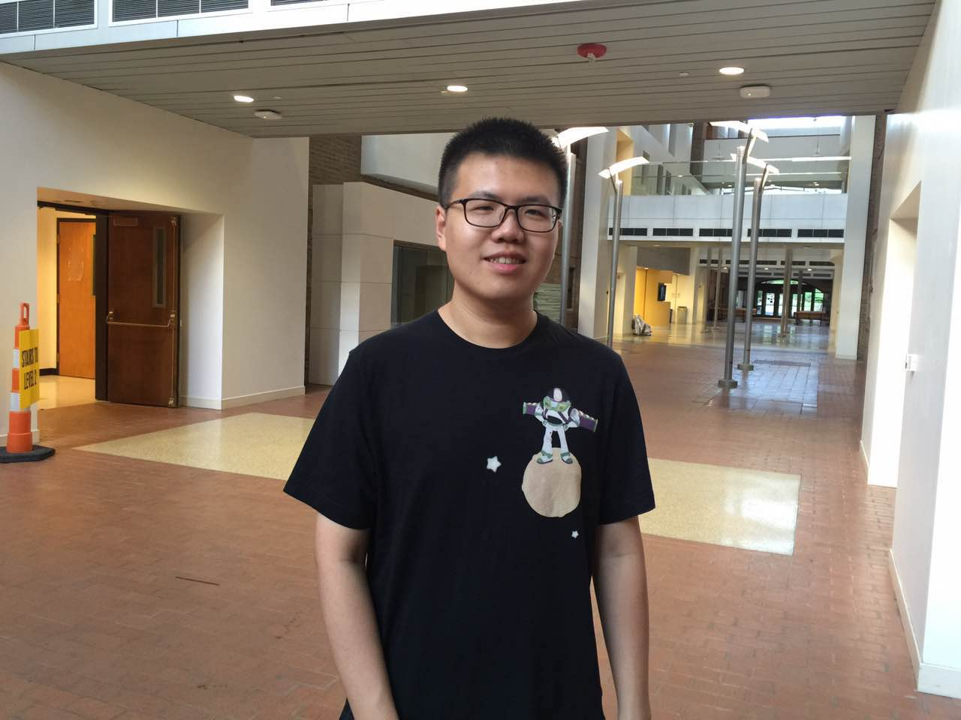
About Yiwen Zhang (GSI)
In charge of the Assignment Track
Office hours from Sep 15
BBB Learning Center, F 2:00 PM - 4:00 PM
No office hours this week
yiwenzhg@umich.edu

Slide 5





Big Data
The volume of data businesses want to make sense of is increasing
Increasing variety of sources
Web, mobile, wearables, vehicles, scientific, …
Cheaper disks, SSDs, and memory
Stalling processor speeds

Slide 6

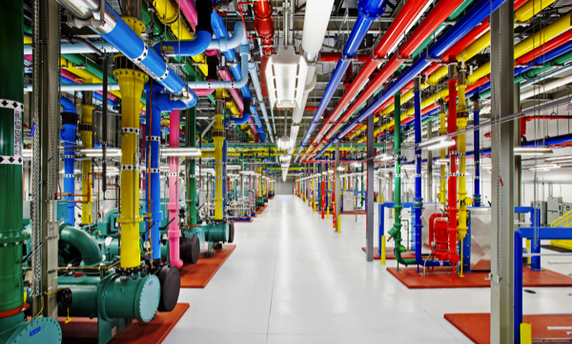
Big Datacenters for Massive Parallelism
BlinkDB
TensorFlow
Storm
Spark-Streaming
Pregel
GraphLab
GraphX
DryadLINQ
Spark
Dremel
MapReduce
Hadoop
Dryad
Hive
2005
2010
2015

Slide 7
1. Big Data Systems
Big data applications can be made faster if they are in-memory, but how do we make in-memory computations fault-tolerant?
Resilient Distributed Datasets: A Fault-Tolerant Abstraction for In-Memory Cluster Computing, NSDI’12 (Best Paper) – Apache Spark!
Memory disaggregation over RDMA to increase memory capacity
Efficient Memory Disaggregation with Infiniswap, NSDI’17
Storage and Caching
EC-Cache: Load-Balanced, Low-Latency Cluster Caching with Online Erasure Coding, OSDI’16
Geo-distributed analytics across multiple datacenters

Slide 8
2. Datacenter Networking
Big data applications transfer large volumes of data where
A communication stage cannot complete until all its parallel pieces complete
Coflow is a new networking abstraction to exploit this characteristic
CODA: Toward Automatically Identifying and Scheduling COflows in the Dark, SIGCOMM’16
Efficient Coflow Scheduling Without Prior Knowledge, SIGCOMM’15
Efficient Coflow Scheduling with Varys, SIGCOMM’14
Transport-aware datacenter load balancing
Resilient Datacenter Load Balancing in the Wild, SIGCOMM’17

Slide 9
3. Multi-Resource Allocation
How do we allocate resources between tenants to optimize fairness, to increase datacenter efficiency, and to improve performance?
Altruistic Scheduling in Multi-Resource Clusters, OSDI’16
HUG: Multi-Resource Fairness for Correlated and Elastic Demands, NSDI’16
FairCloud: Sharing the Network in Cloud Computing, SIGCOMM’12
How do we increase fault-tolerance of applications while meeting bandwidth demands?
Surviving Failures in Bandwidth-Constrained Datacenters, SIGCOMM’12

Slide 10
Waitlist Status
Course limit: 49 (18 groups)
As of today: 56 registered or w/ override, 47 on waitlist w/o override
Waitlist priority: CS PhD, CS Master’s, Other PhD, the rest
Others should check with the instructor
Typically, not advisable for undergrads
If you are not planning to take the class, drop ASAP
Existing overrides that have not converted will be dropped at midnight today

Slide 11
Course Schedule
Webpage: https://github.com/mosharaf/eecs598
Meetings
12PM – 1:30 PM at 2166 DOW (Mon/Wed for lectures and discussions)
12PM – 1:30PM at 1690 BEYSTER (Fri for makeups and projects)
Pay attention to the online announcements and schedule
On average, two meetings per week
Friday makeups will be added on a need-to-add basis (there are already a couple on schedule)

Slide 12
Prerequisites
EECS 482 / 484 / 489 / 491
Equivalent courses are acceptable as well
Good programming skills
Build substantial systems for course project
Raise hands if you
Have taken a grad-level systems (e.g., OS, networking) course before
Have worked on large systems-building project

Slide 13
Course Requirements
Paper Summary | 20%
Paper Presentation | 20%
Participation | 10%
Assignments OR Research Project | 50%

Slide 14
Course Requirements (Assignment Track)
Paper Summary | 20%
Paper Presentation | 20%
Participation | 10%
Assignment 1 | 15%
Assignment 2 | 15%
Assignment 3 | 20%

Slide 15
Course Requirements (Research Track)
Paper Summary | 20%
Paper Presentation | 20%
Participation | 10%
Proposal | 10%
Mid-Semester Checkpoint | 15%
Final Report + Presentation/Poster | 25%

Slide 16
Group-Based Work
ALL activities will be done in groups except for participation
Paper presentation
Paper summary
Assignments and Projects

Slide 17
Form Groups ASAP
Submit at https://goo.gl/qzMjq4
By September 11 the latest (it’ll be online from Friday at 5PM)
If you can’t find someone by the 11th, just put your name and preference and we’ll form groups
Track assignment is a preference and will be load-balanced if needed
Both tracks have roughly equivalent work

Slide 18
Readings (Both Tracks)
33 papers/articles across
Operating Systems venues like SOSP and OSDI
(Networked) Systems venues like NSDI and EuroSys
Networking venues like SIGCOMM
Database venues like SIGMOD and VLDB
Many of these papers are classics, test-of-time award winners, and best-paper award winners

Slide 19
Paper Summaries (Both Tracks)
This is a paper-reading course
Paper summaries account for 20% of the total grade
Roughly one summary per-group
Each summary must follow the template and address the following
What is the problem and why is it important?
What is the hypothesis of the work?
What is the proposed solution, and what key insight guides their solution?
What is one (or more) drawback or limitation of the proposal, and how will you improve it?
Summary must include the gist of class discussion

Slide 20
Paper Summaries (Both Tracks)
Reviews must be emailed to eecs598-bigdata-staff@umich.edu within 24 hours of class presentation
Delayed submission will receive NO CREDIT
There will be NO extensions
Read (if you haven’t already!)
How to Read a Paper by S. Keshav
Writing Reviews for Systems Conferences by Timothy Roscoe

Slide 21
Paper Presentation (Both Tracks)
This is a seminar-style course
Each group must present at least one paper along with the companion paper
Paper presentation account for 20% of the total grade
The entire class will be dedicated to the assigned paper(s)
Aim for 45-minute presentation without interruption
But there will be intermittent discussions
Lead the discussion
Go through the paper in details, along with its strengths and weaknesses
Include companion papers and other related papers
The rest of the class
PARTICIPATE

Slide 22
Paper Presentation
Email your slides to the instructor 24 hours before the class
Use the template on the course website
Prepare early
Practice a lot
Also, read
How to Give a Bad Talk, by David A. Patterson

Slide 23
Participation
Attend all lectures
Can miss at most two with legitimate reasons
Read all the papers and participate
Ask questions!

Slide 24
Before We Take a Break…
No extensions
Slides will be posted after the class
Everyone must come to class after reading the mandatory papers of the day
Lecture starts at Michigan time
We’ll take a short break somewhere in the middle

Slide 25
Break!

Slide 26
Today’s Agenda
Administrivia
Topics we will and won’t cover
Assignments
Projects

Slide 27
Topics
Datacenter Background and Core Systems (x5)
Resource Management (x5)
Execution Engines (x3)
Batch Processing Systems (x4)
Stream Processing Systems (x5)
Graph Processing Systems (x2)
Machine Learning Systems (x5)
Approximate Query Processing (x2)
RDMA-Enabled Systems (x2)

Slide 28
Today’s Agenda
Administrivia
Topics we will and won’t cover
Assignments
Projects

Slide 29
Assignments
There will be three assignments
Assignment 1: Apache Spark stack
Assignment 2: TensorFlow + X
Assignment 3: Small open-ended projects

Slide 30
Milestones
Date | Milestone | Details
ASAP | Form Group | Find 3 like-minded students
Soon | Assignment 1 Starts | Create CloudLab accounts
10/11/17 | Assignment 1 Due | Apache Spark + X
Soon After | Assignment 2 Starts
11/13/17 | Assignment 2 Due | TensorFlow +X
Soon After | Assignment 3 Starts
12/11/17 | Assignment 3 Due | Likely to be unique for each group

Slide 31
Today’s Agenda
Administrivia
Topics we will and won’t cover
Assignments
Projects

Slide 32
Projects
This is a research-oriented course!
The final project accounts for 50% of total grades
What can and cannot be a project?
Just surveys are not allowed. In fact, each project must include a survey of related work and background as part of the mid-semester checkpoint
An ideal project should answer the questions you asked during paper reviews and points you cared about for presentations
Measurements of new environments or of existing solutions on new environments are acceptable upon discussion

Slide 33
How to Approach it?
Find a problem and motivate why this is worth solving
Survey background and related work to get a sense of your (friendly!) competition
Might require you to go back to the first step
Form/update your hypothesis
Test your hypothesis
Go back to 3 until you are happy
Present your findings on poster and in writing
Discuss known limitations

Slide 34
Milestones
Date | Milestone | Details
ASAP | Form Group | Find 3 like-minded students
09/27/17 | Draft Proposal | Send your proposal by email
10/11/17 | Finalize Proposal | After a back-and-forth discussions with the instructor
11/13/17 11/15/17 | Mid-Semester Checkpoint | Define and motivate a problem, survey related work, and form initial hypothesis and idea
TBD | In-Class or Poster Presentations | Present your findings
12/15/17 | Research paper | Submit a report similar to the papers you read

Slide 35
Draft Proposal
Two pages including references that ideally includes
What is the problem?
Why is it important to solve?
Any initial thoughts on what you want to do?
How would you evaluate your solution?
Include team members
Meaning, form a group ASAP
Schedule via email a 15-minute meeting to discuss

Slide 36
Finalized Proposal
Two pages including references that must include
What is the problem?
Why is it important to solve?
Any initial thoughts on what you want to do?
How would you evaluate your solution?
Approved by the instructor and agreed upon by you
Forms the basis of expectation

Slide 37
Mid-Semester Checkpoint
Submit up to 4-page write-up on background, related work, current hypothesis, and progress
In-class short presentation over two days
This is to make sure you are making progress
Must include
What is the problem?
Why is it important?
What are the most related work?
What’s your hypothesis so far?
How are/will you evaluate it?

Slide 38
Final Presentation and Paper
Research paper
The key part
Should be written similar to the papers you’ve read
As if you’d submit it to a workshop with ~3 more months of work or to a conference after ~6 more months of work
How to Write a Great Research Paper by Simon Peyton Jones
Extended from the mid-semester checkpoint writeup

Slide 39
Rough Outline
Abstract
Introduction (Highlight the importance and give intuition of solution)
Motivation (Use data and simple examples)
Overview (Summarize your overall solution so that readers can follow later)
Core Idea (Main contribution w/ challenges and how you address them)
Implementation (Discuss non-obvious parts of your implementation)
Evaluation (Convince readers that it works and when it fails)
Related Work (Let readers know that you know your competition!)
Discussion (Know your limitations and possible workarounds)
Conclusion (Summarize and point out future work)

Slide 40
Next Class…
Read the assigned papers
Including today’s short reads mentioned in this presentation
Form groups of 3 and fill out https://goo.gl/qzMjq4 by Sep 11
This includes track and paper preference for your group
Try to decide if you’ll drop, before you fill it

