Slide 1
STREAMSCOPE: Continuous Reliable Distributed Processing of Big Data Streams
Wei Lin, Haochuan Fan, Zhengping Qian, Junwei Xu, Sen Yang
Jingren Zhou, Lidong Zhou
Presenters: Die Hu, Shaowen Wei, Chi Zhang

Slide 2
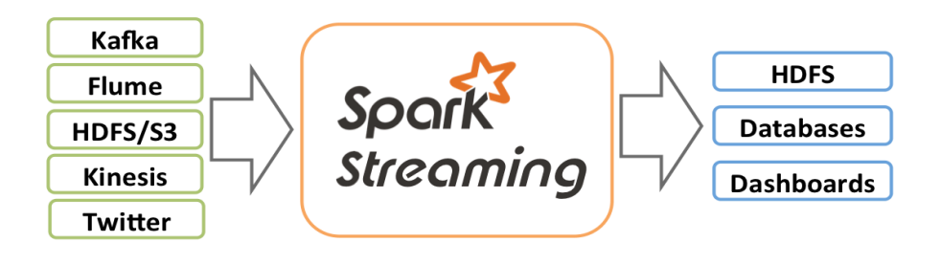
Other Streaming Systems - Overview
Spark Streaming
Spark Streaming integrates streaming, batch, interactive computation in the same platform
Notes:
Other streaming systems we have talked about so far.
Receive data from data source e.g. HDFS Batch data into D-Streams Process D-Streams Write data to databases or distributed file systems e.g. GFS, HDFS

Slide 3
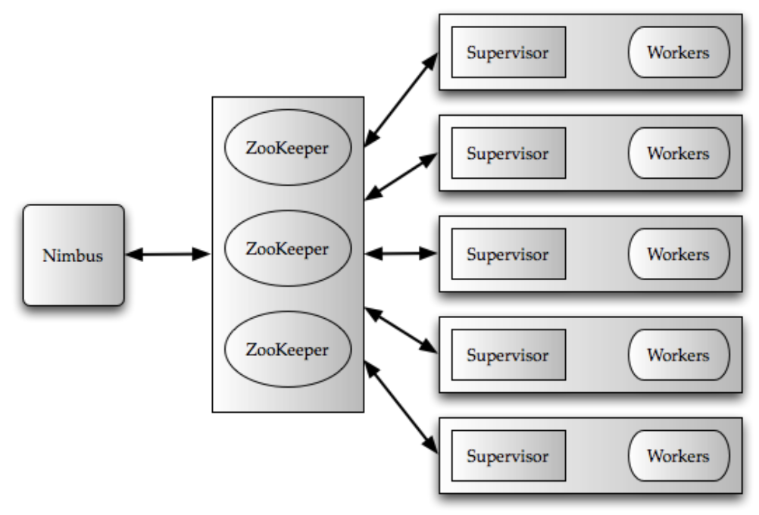
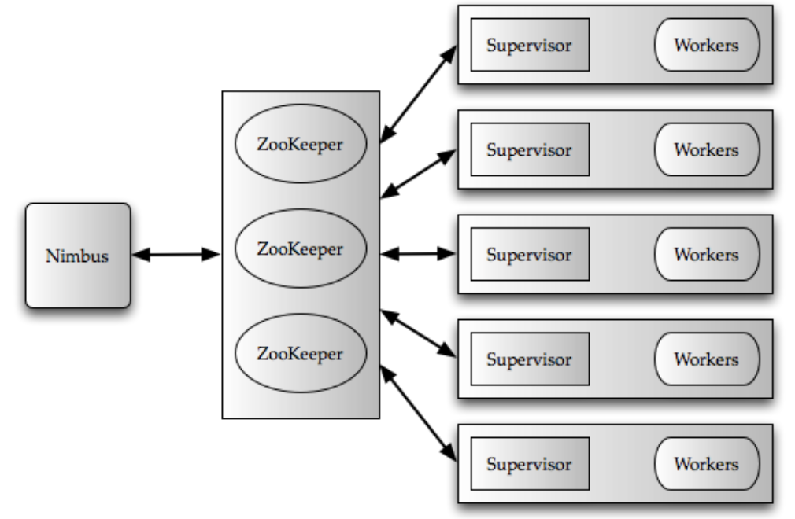
Other Streaming Systems - Overview
2. Storm @Twitter
A critical infrastructure at Twitter that powers many of the real-time data-driven decisions that are made at Twitter.
High Level Architecture of Storm
Notes:
We have compared spark storming and storm at twitter from latency (S)Seconds (T)Milliseconds
Reliability (S) Exactly one (T)At Least One or At Most One
Fault Tolerance (S)Relied on RDD and its parallel recovery is much faster
(T)Restart by Supervisor or Nimbus

Slide 4
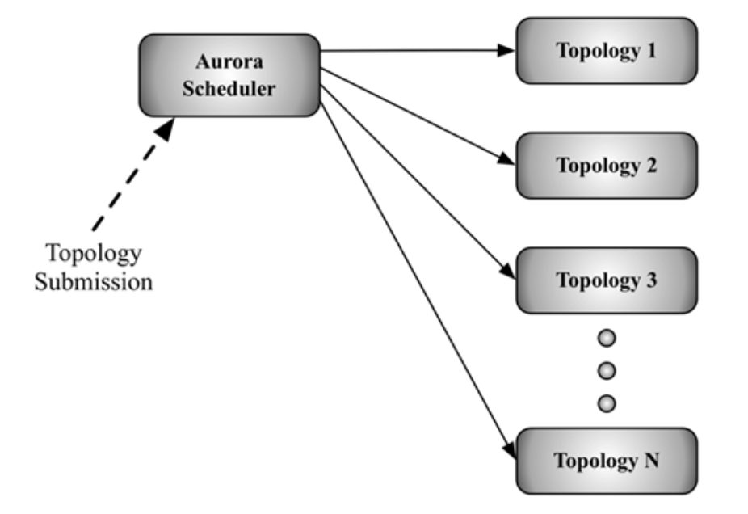
Other Streaming Systems - Overview
3. Twitter Heron
Scales better, has better debug-ability, has better performance, and is easier to manage – all while working in a shared cluster infrastructure.
Notes:
as the scale of data being processed in real- time at Twitter has increased, along with an increase in the diversity and the number of use cases, many limitations of Storm have become apparent. Users employ the Heron (spouts/bolts programming) API to create and deploy topologies to the Aurora scheduler, using a Heron command line tool. This design is a departure from Storm, where Nimbus (which is an integral component of Storm) was used for scheduling.

Slide 5
Introduction
StreamScope is
A cloud-scale reliable stream computation engine
STREAMS adopts a declarative language.
Notes:
1.….that has been deployed in shared production clusters, each containing over 20,000 commodity servers.
2…...that supports a continuous stream computation model, extended with the ability to allow user-defined functions to customize stream computation at each step.
It has been designed for business-critical stream applications, since they always require a strong guarantee, so that each event is processed exactly once though there might still be some server failures and message losses.

Slide 6
rVertex : models continuous computation on each vertex, introduces the notion of snapshots along the time dimension, and allows the computation to restart from a snapshot.
rStream: abstracts out the data and communication aspects of distributed stream computation, provides the illusion of reliable and asynchronous communication channels, and de- couples upstream and downstream vertices
Notes:
Failure recovery in cloud-scale stream computation could be particularly challenging. For one thing, there is dependency between upstream and downstream vertices, and the dependency is also introduced by vertex computation states. So An upstream vertex failure affects downstream vertices directly, while the recovery of a downstream vertex would depend on the output events from the upstream vertices. Failure recovery of a vertex would require rebuilding the state before the vertex can continue processing new events. So Streamscope introduces two abstraction…….so they two together could be well used to replay computation and to rewind streams, as needed during failure recovery.

Slide 7
Contributions
STREAMS shows that a cloud-scale distributed fault-tolerant stream engine can support a continuous stream computation model
STREAMS introduces two new abstractions, rVertex and rStream.
STREAMS is deployed in production and runs critical stream applications continuously on thousands of machines while coping well with failures and variations.
Notes:
….simplify cloud-scale stream computation engines through separation of concerns, making it easy to understand and reason about correctness despite failures. The abstractions are also effective in addressing challenges on debugging and de- ployment of stream applications in STREAMS. Support for debugging and deployment is critical in practice from our experiences, but has not received sufficient attention.

Slide 8
Programming Model
Continues Events Stream
STREAMS supports Current Time Increments (CTI) events that assert the completeness of event delivery up to start time Vs of the CTI event.
Notes:
In STREAMS, data is represented as event streams, each describing a potentially infinite collection of events that changes over time. Each event streams has a well-defined schema, and also a time interval to show that when the event is valid…….that is, there will be no events with a timestamp lower than Vs in the stream after this CTI event. Stream operators rely on CTI events to determine the current processing time in order to make progress and to retire obsolete state information.

Slide 9
Programming Model
Declarative Query Language
STREAMS supports a comprehensive set of relational operators
STREAMS supports several types of time-based windows, such as hopping, tumbling, and snapshot windows.
Notes:
….including projection, filters, grouping, and joins, adapted for temporal semantics.STREAMS provides a declarative language for users to program their application, while they do not need to worry about some distributed system details like scalability or fault tolerance…..For example, a temporal inner join is applied to events with overlapping time intervals only. Windowing is another key concept in stream processing. A window specification defines time windows and consequently defines a subset of events in a window, so that aggregations can be applied. ……..For example, hopping windows are windows (of size S) that “jump” forward in time by a fixed size H: a new window of size S is created for every H units of time.

Slide 10
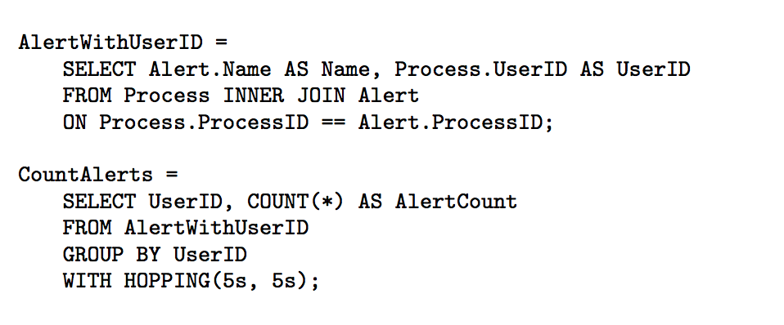
A Simplified Stream Program
Notes:
There is an example program. It performs continuous activity diagnosis on Process and Alert event streams. The program is made from a sequence of declarative queries that is operated on event streams. Process events record information about every process and its associated user. The Alert events record information about every alert, and also the process generated the alert. The front part of the program joins the streams to attach user information to alerts, and then the bottom part calculates for each user the number of alerts every 5 seconds using a hopping window.

Slide 11
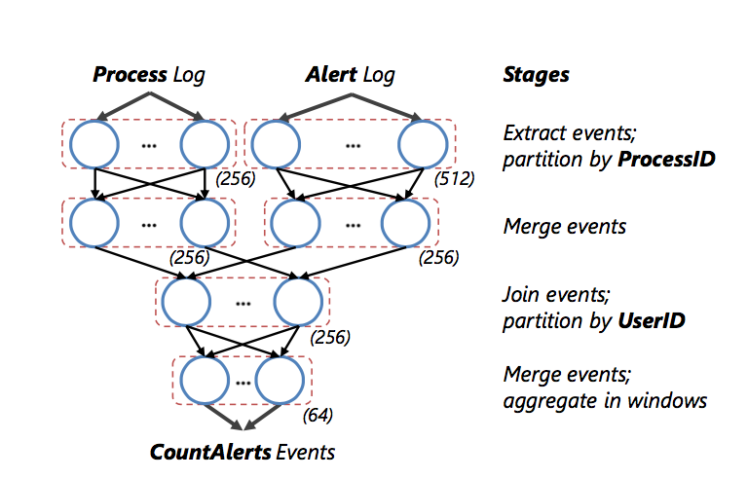
StreamS Abstractions
rVertex
rStream
Snapshot
Notes:
The execution of a STREAMS program can be modeled as a DAG, where each vertex (rVertex) performs local computation on input streams from its in-edges and produces output streams as its out-edges. A vertex can maintain a local state. Its execution starts with its initial state and proceeds in steps. In each step, the vertex consumes the next events from its input streams, updates its state, and possibly produces events to its output streams.
Each stream (rStream) is modeled as an infinite sequence of events, each with a continuously incremented sequence number.
The execution of a vertex is tracked through a series of snapshots, where each snapshot is a triplet containing the current sequence numbers of its input streams, the current sequence numbers of its output streams, and its current state.
Figure shows where each stage of computation is partitioned into multiple vertices to execute in parallel. STREAMS determines the degree of parallelism for each stage (marked in parentheses) based on data rate and computation cost.

Slide 12
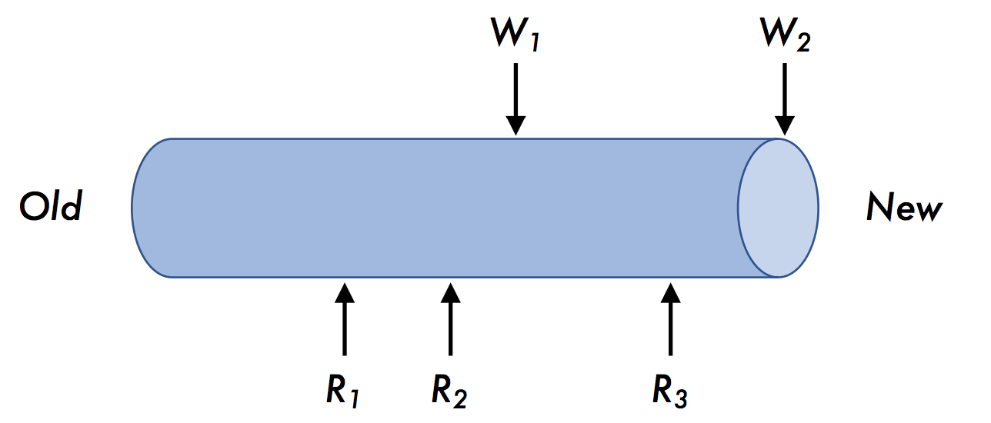
rStream Abstraction
1. Sequence of events
2. Support multiple writers/readers
3. Uniqueness
4. Validity
5. Reliability
Missing or duplicates
Notes:
What if some vertex fail -> the output result will be missing or have duplicate -> can not simply redo, because downstream vertex rely on upstream vertex ->In order to solve this -> rStream.
The rStream abstraction provides reliable channels that allow receivers to read from any written position. Introduce rStream to decouple upstream vertices and downstream vertices. It reliably maintain a continuous and monotonically increasing sequence numbers, supporting multiple writers (straggler, recovery) and readers. Three properties:
1) Uniqueness. There is a unique value associated with each sequence number. After the first write for each sequence number succeeds, any duplicate with this sequence number will be discarded. It ensures consistency for each sequence number.
2) Validity. If a ReadNext() returns an event e with sequence number seq, there must have been a Write(seq,e) that has returned successfully. Validity ensures correctness of the event value returned for each sequence number,
3) Reliability. If write(seq,e) succeeds, then, for any ReadNext() reaching position seq, eventually the read returns (seq, e). Reliability ensures that, all events written to the stream are always available to readers whenever requested.

Slide 13
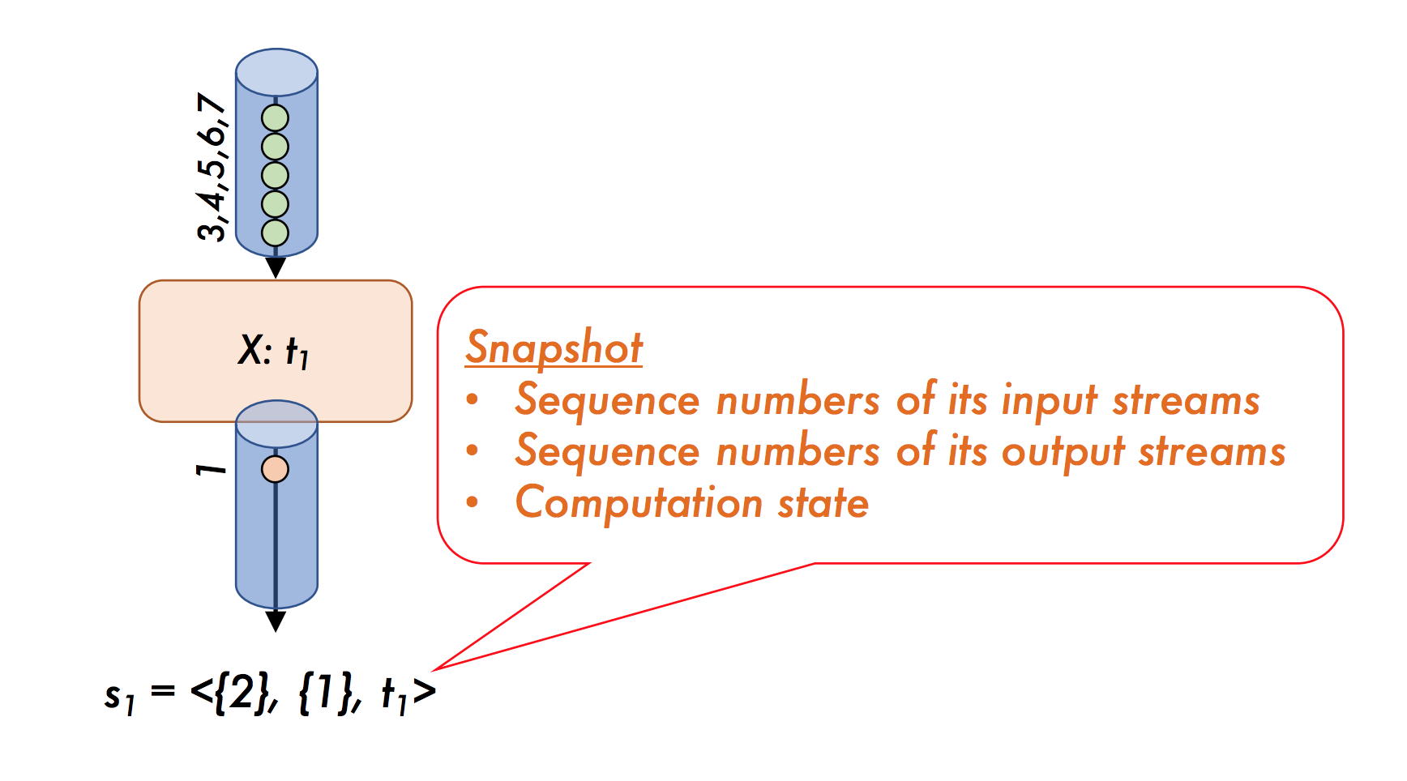
rVertex Abstraction
1. Running operations
2. Snapshot
3. Determinism
Notes:
The rVertex abstraction can execute a series of operations, which read the input events, update the state, and produce output events.
Snapshot consist of….. Used to recover from failure. At any point, one vertex can retrieve and save the snapshot.
Determinism. For a vertex with its given input streams, running the same operation on the same snapshot will always cause the vertex to transition into the same new snapshot and produce the same output events. Determinism ensures correctness when replaying an execution during failure recovery. It implies that:
(i) the order in which the execution takes the next event from multiple input streams is deterministic.
(ii) the execution of the processing logic is deterministic.
Determinism greatly simplifies the reasoning of correctness in STREAMS and makes streaming applications easier to develop and debug.

Slide 14
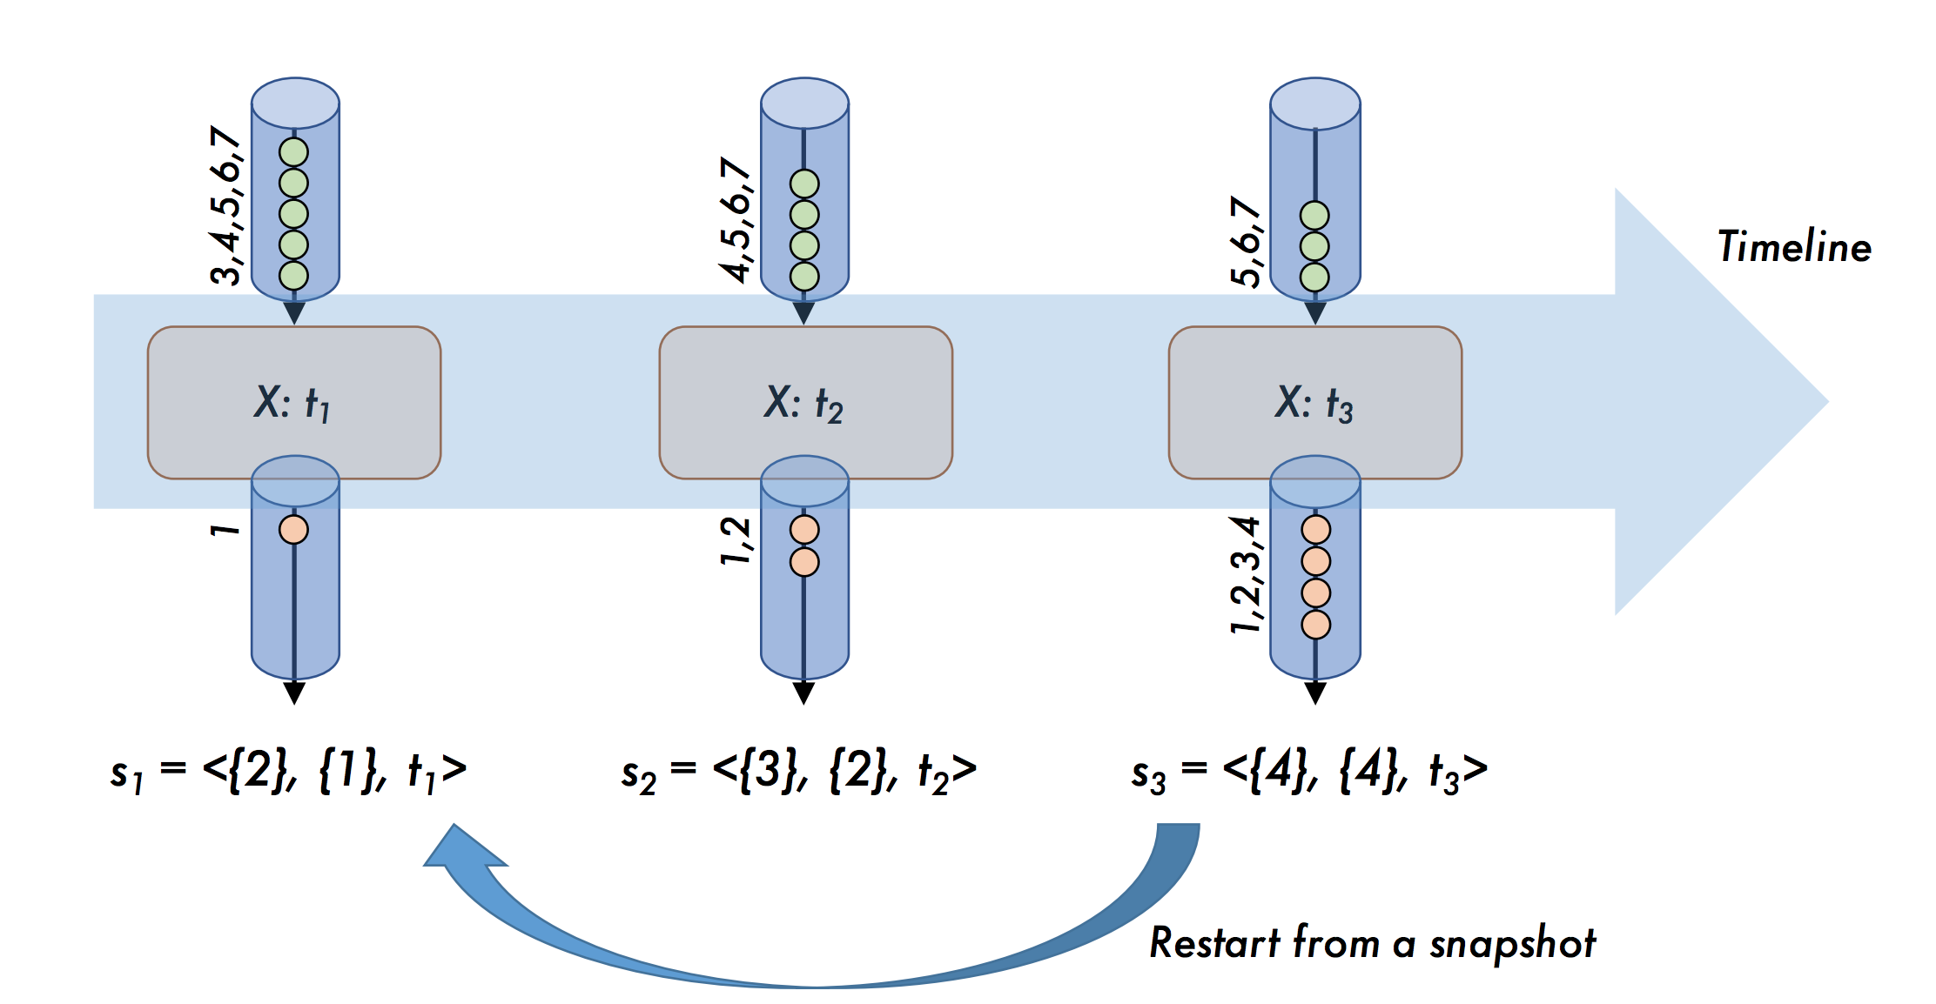
rVetex

Slide 15
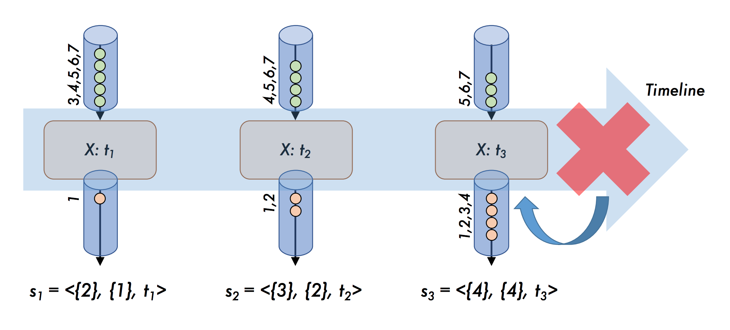
Failure Recovery
1. rStream decouples upstream and downstream vertices.
2. Vertex restart execution from most recent snapshot.
Notes:
The rStream abstraction decouples upstream and downstream vertices to allow individual vertices to recover from failures separately, ensures that the restarted vertex is able to reread the input streams.
When a vertex fails, we can simply restart its execution by going back to a most recently saved snapshot s to continue executing. The rVertex abstraction ensures that execution after recovery is the same as the continuation of the original execution as if no failures occurred.

Slide 16
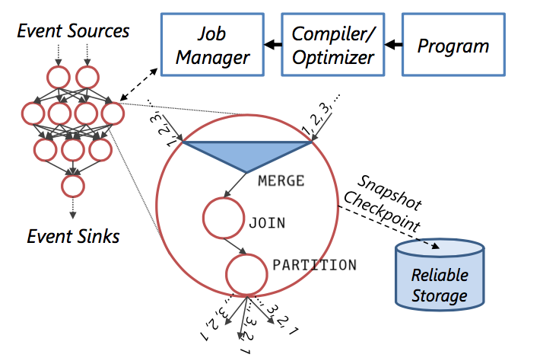
Architecture and Implementation
1. Compiler
2. Optimizer
3. Job Manager
Notes:
The program is compiled into a streaming DAG for distributed execution as shown in Figure. To generate such a DAG, the STREAMS compiler performs the following steps:
(1) the program is first converted into a logical plan (DAG) of STREAMS runtime operators, which include temporal joins, window aggregates, and user-defined functions;
(2) the STREAMS optimizer then evaluates various plans, choosing the one with the lowest estimated cost based on available resource, data statistics such as the incoming rate, and an internal cost model; and
(3) a physical plan (DAG) is finally created by mapping a logical vertex into an appropriate number of physical vertices for parallel execution and scaling, with code generated for each vertex to be deployed in a cluster and process input events continuously at runtime. We omit the details of these steps as they are similar to those for SCOPE.
The entire execution is orchestrated by a streaming job manager that is responsible for:
(1) scheduling vertices to and establishing channels (edges) in the DAG among different machines;
(2) monitoring progress and tracking snapshots;
(3) providing fault tolerance by detecting failures/stragglers and initiating recovery actions. Unlike a batch-oriented job manager that schedules vertices at different times on demand, a streaming job manager schedules all vertices in a DAG at the beginning of job execution. To provide fault tolerance and to cope with runtime dynamics, rVertex and rStream are used to implement vertices and channels in a streaming DAG, working in coordination with the job manager.

Slide 17
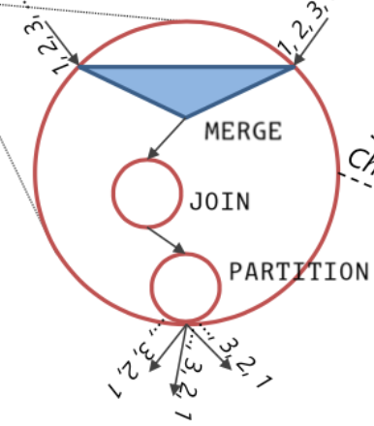
Implementing rVertex
1. Function determinism
2. Input determinism
3. ordering of events across multiple input streams
Notes:
The key to implementing rVertex is to ensure Determinism.
In STREAMS, all operators and user-defined functions must be deterministic. We also assume that the input streams for a job are deterministic, both in terms of order and event values.
The only remaining input-related non-determinism is the ordering of events across multiple input streams. Because STREAMS uses CTI events as markers, we insert a special MERGE operator at the beginning of a vertex that takes multiple input streams, which produces a deterministic order of events. It does so by waiting for the corresponding CTI events across input streams to show up, ordering them deterministically, and emitting them in that deterministic order.

Slide 18
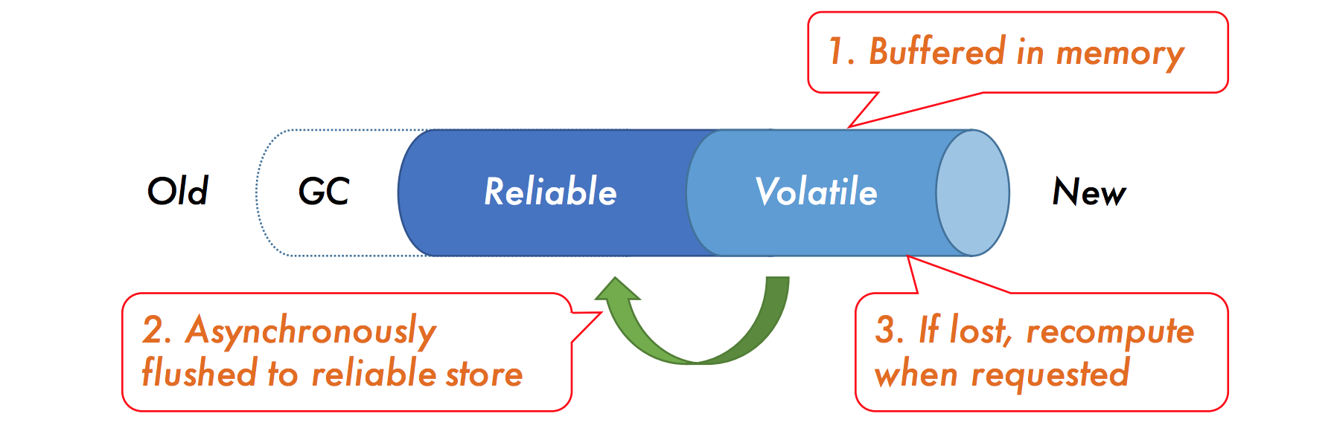
Implementing rStream
1. Reliable
2. Volatile
3. Garbage Collection
Notes:
rStream could simply be implemented by a reliable pub/sub system backed by reliable and persistent store. Synchronous write will introduce a high latency.
So STREAMS adopts a more efficient implementation that avoids paying the latency cost of going to persistent and reliable store in the critical path.
What they do is using a hybrid schema that moves writes out of the critical path while providing the illusion of reliable channels. So as we can see, they divide the whole stream into three parts. The first part is the obsolete part which will be garbage collected. And the second part is a reliable storage part and the last is a volatile part which is located in memory buffer. The in-memory buffer is asynchronously flushed to reliable storage part to survive server failures. Events that are only kept in memory might be lost on a failure, but can be recomputed when requested.

Slide 19
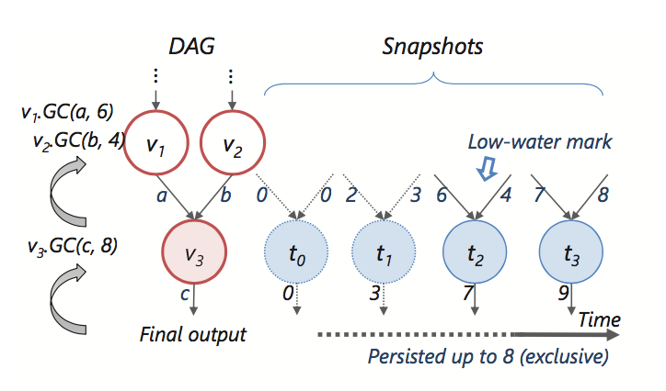
Garbage Collection
When the snapshots, streams and others info can be GC?
1. Low-water marks
2. GC(o, m)
Notes:
STREAMS persists checkpoints of snapshots, streams, and other tracking information reliably for failure recovery, and must determine when such information can be garbage collected.
STREAMS maintains low-water marks for vertices and streams during the execution of a streaming application. For a stream, the low-water mark points to the lowest sequence number of the events that are needed; for a vertex, the low-water mark points to the lowest snapshot of the vertex that are needed.
For each vertex, snapshots are totally ordered by the vector of sequence numbers of its input and output streams. Because snapshots capture the linear progress of deterministic vertex execution, all sequence numbers only move forward.
Intuitively, GC(o,m) figures out which information is no longer needed if the downstream vertex (connected to the output stream o) will not request any events with a sequence number lower than m. It is called when the final output events are persisted or consumed, or when any output events in a stream is persisted reliably.

Slide 20
Choices Discussion
Mini-batch Streaming with RDD Vs. Continuous Streaming
Problems: (discretized streaming)
breaking operators→ rebuilding state from previous batches needed
add unnecessary low-latency requirements
Non-determinism Vs. Determinism
Out-of-order Event Ordering
Notes:
Discretized streaming divides the continuous streaming task into multiple mini-batch streaming, which achieves streaming tasks utilizing batch systems.
1. Rebuilding state from previous batches are needed.
2. It adds unnecessary low-latency requirements even though there is no need for failure recovery.

Slide 21
Choices Discussion
Mini-batch Streaming with RDD Vs. Continuous Streaming
Non-determinism Vs. Determinism
Problems with non-determinism: inconsistency
expensive checkpointing needed to avoid inconsistency
Out-of-order Event Ordering
Notes:
The correctness of output from a recorded snapshot is always guaranteed.
And it also makes debugging easier.
non-determinism →inconsistency between two versions of downstream output events.
Although the inconsistency can be avoided, it’s at the expense of expensive checkpointing and checkpointing storage
And another approach is to log non-determinism decisions during execution for replay. (at a cost of identifying, logging and replaying all sources of non-determinism.)

Slide 22
Choices Discussion
Mini-batch Streaming with RDD Vs. Continuous Streaming
Non-determinism Vs. Determinism
Out-of-order Event Ordering
(Storm, MillWheel) Assign unordered ID to each event.
Track progress by responding ACKs to IDs. → performance overhead
(StreamScope) Use CTI events.
Assign sequence numbers. (Avoid using ACKs)
Notes:
For out-of-order event ordering, StreamScope also improves the performance by using different approaches from Storm and MillWheel. It tracks the sequence number stored in snapshot instead of assigning unordered unique IDs to each event. Thus there is no need for tracking responding ACKs to unique IDs. Thanks to the mechanism of using CTI events, it wisely avoids the using of ACKs and thus avoid the performance overhead introduced by ACKs.

Slide 23
Production Experience
Achieve streaming from batch systems
Developed from batch systems while maintaining low latency
Scaling and robustness to fluctuation
scaling achieved by new configurations with increased degrees of parallelism
robustness to fluctuation achieved by decoupling vertices in rStream. Input events queuing on vertex failure.
Distributed Streaming
rStream pass off-line datasets to on-line streams
Job manager provides off-line mode for debugging
Supporting time travel to the past
Maintains all past checkpoints in a global storage
Notes:
2.It uses a number of vertices in each stage execute in parallel to handle the peak load.
When the peak load increases over time, STREAMS will move to a new configuration with increased degrees of parallelism. Done by initiating new vertices with derived states from checkpoints in the current job, and retires the corresponding vertices when the new ones catch up. The flexibility of rStream makes it easy to support such transitions.
3. The distributed streaming: offline/online
4. Supporting time travel to the past. simply achieved by maintaining all past checkpoints in a global storage.

Slide 24
Production Experience
Stragglers handling
Examine machine health and only use healthy ones for running.
Tracking resulting CTI events for each vertex. Assign duplicate execution.
Alert mechanism is introduced. And it also filters out events consuming too much time
Continuous Operation
Similar approach with stragglers handling(schedule duplicate execution)
Notes:
Stragglers handling
tracks the resulting CTI events for each vertex and assign duplicate execution.
alert mechanism to alert users with different information consisting of some important statistics.
(determinism. create a checkpoint before filter is applied)
Continuous operation

Slide 25
Failure Recovery Strategies
Replication:
No influence on latency. But expensive. Used in dealing with stragglers and enable migration.
Checkpointing:
Small latency introduced. But introduce checkpointing cost. (75%) vertices used for fast-recovery
Replaying input event:
Comparable to checkpointing. (25%) vertices used to avoid high latency.
Notes:
1.replication strategy, which simply replicates the vertices and keep same vertices running potentially at the same time with same input stream and output stream. This does no harm to the latency. When one instance fails, it can get the snapshot from another instance directly to speed up the recovery process. And keep multiple replications running is easily achieved with the design of two abstractions with a determinism feature. However, the replication strategy is expensive.
2. checkpointing for snapshots and states as well as some other tracking information. Vertex can checkpoints for its snapshot within a reliable persistent store. small latency. But the overhead of checkpointing is inevitable.
3. replay-based recovery. No need for checkpointing. But often requires reloading a large window of input events after failure. So it’s not as fast as checkpointing.

Slide 26
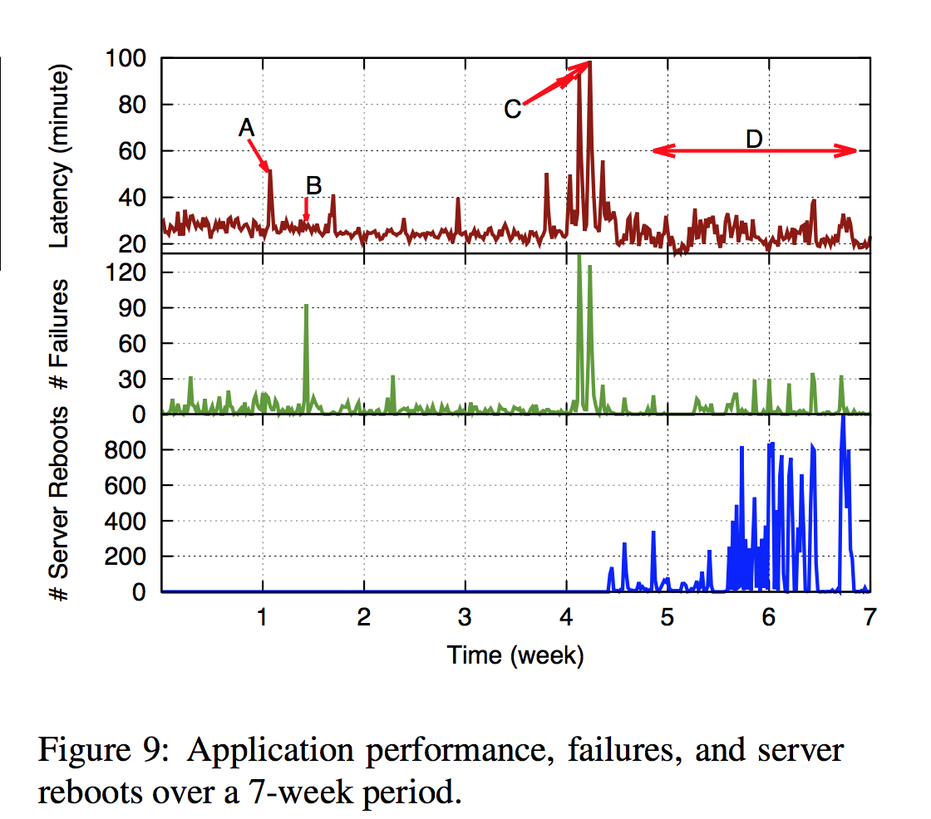
Performance and Failures
A: # of failures small, but takes long time for recovery→ influence latency
B: failures occurred mainly in vertex with small state. No big latency effects.
C: large number of machines reboot → unplanned mis-config → significant latency spike.
D: planned machine rebooting. successful migration.
Dominant latency factor: Windows aggregations
Notes:
The end-to-end latency in this testing is as high as 20 minutes on average. And the dominant latency affector is Windows aggregations.

Slide 27
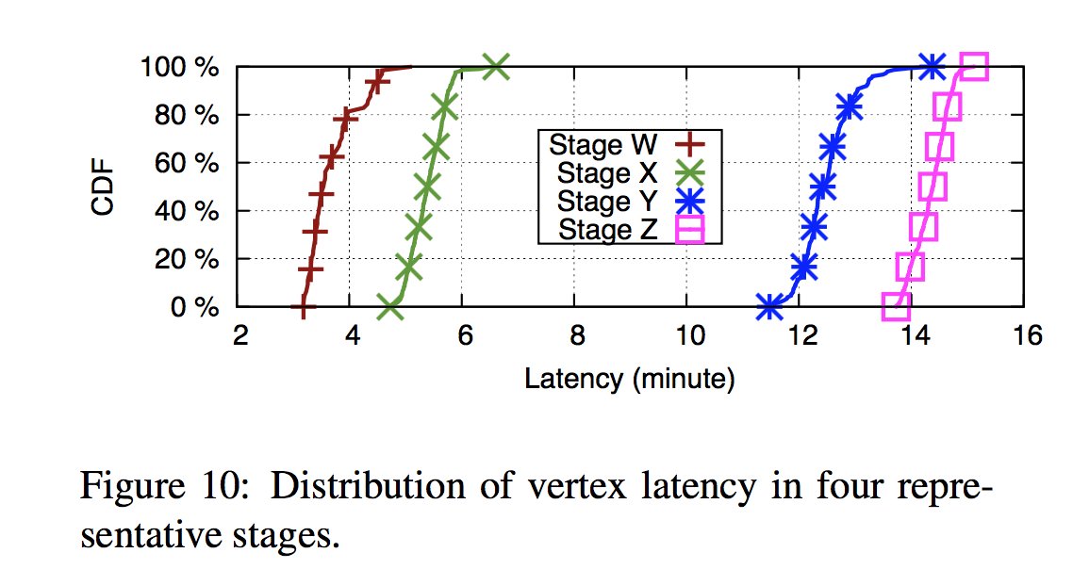
Performance: Variations
W: extracting input events from raw logs
X: window aggregations
Y: downstream stage
Z: final computation stage

Slide 28
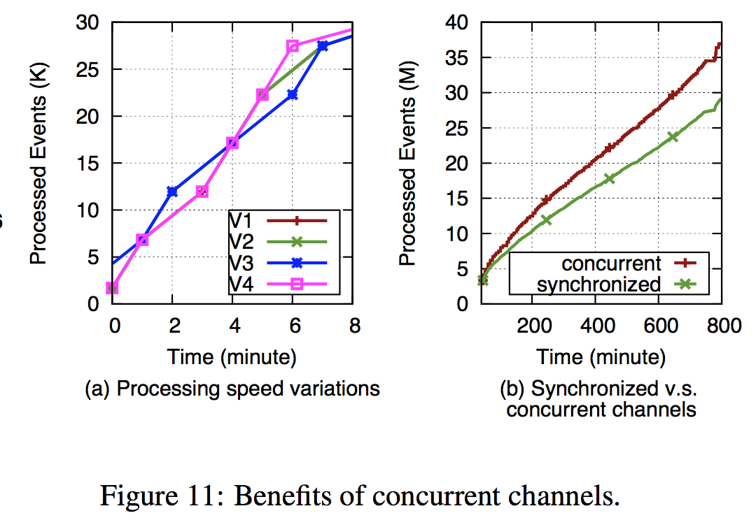
Performance: Concurrent Channels
Concurrent Vs. Synchronized
Advantage of concurrent design:
Speed varies with concurrent channels at different time. Concurrent design allows individual downstream vertices to advance at different speed.
Notes:
This figure illustrates the advantage of implementing concurrent design instead of using synchronized channels. Figure a, speed variations for the different four vertices in the same task and environment.
STREAMS employs a concurrent design, allowing individual downstream vertices to advance at different speeds.
Figure b compares the projected progress of synchronized design with the concurrent channel.
The performance of using concurrent channels outperforms that of using synchronized ones.

Slide 29
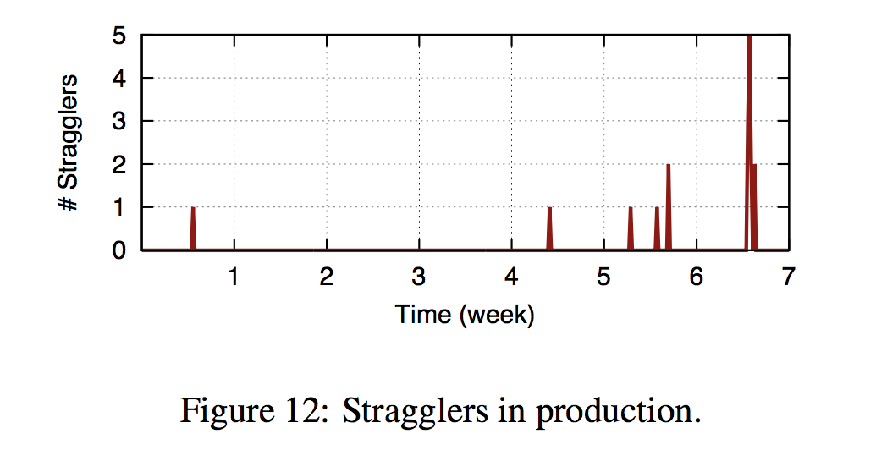
Performance: Stragglers
Recover by scheduling duplicate execution like batch systems.
Conservatively classifying vertex as stragglers
Notes:
Number of stragglers detected and successfully recovered.
And we should be conservative in classifying a vertex as a straggler because in most cases a vertex that falls behind temporarily can catch up by processing at large batches. The detected ones that are classified as stragglers should be those with persistent issues.

Slide 30
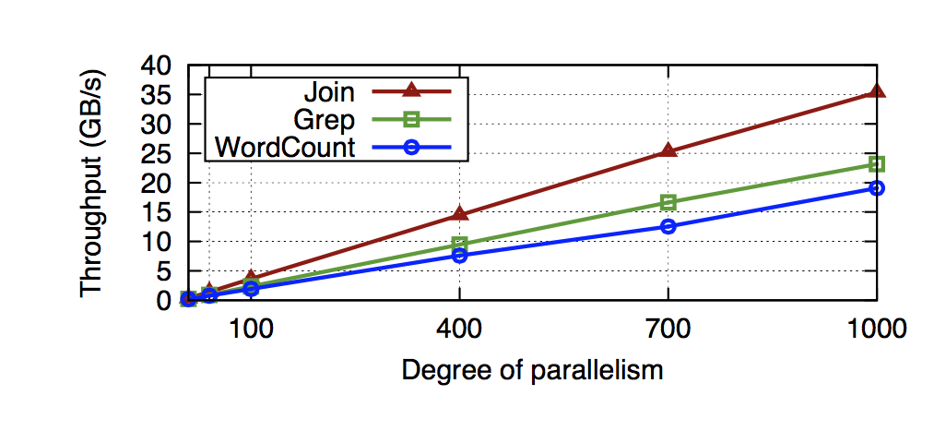
Scalability
Figure: Maximum throughput the application can maintain under 1sec latency bound
Notes:
This figure reports the maximum throughput that STREAMS can sustain under a 1- second latency bound for each application
STREAMS scales linearly to 1000 vertices, achieving a throughput of up to 35 GB/s.
STREAMS is able to saturate the network and the maximum throughput is bounded by network bandwidth.

Slide 31
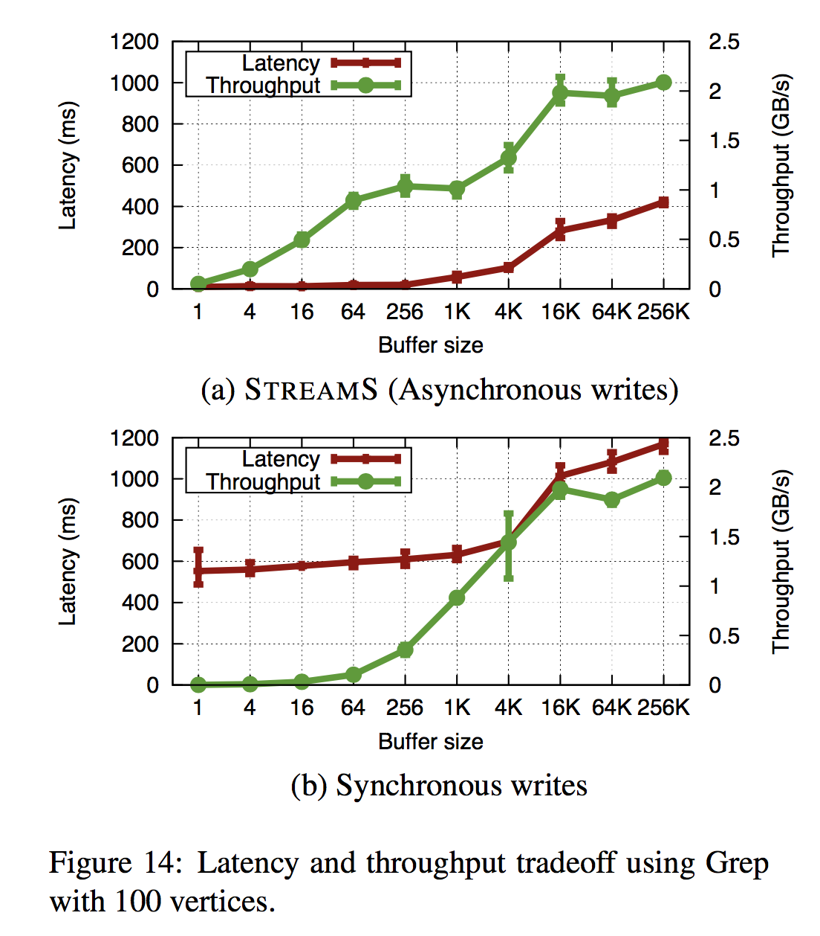
Latency Vs. Throughput
Trade-off between latency and throughput
Small buffer size:
low latency + low throughput
Large buffer size:
high latency + high throughput
Notes:
STREAMS achieves a latency around 10 msec using a small buffer size at the cost of lower throughput. As the buffer size grows, the throughput improves but the latency also increases.
STREAMS achieves a stable maximum throughput when buffering every 16K events, where the latency is around 280 msec.
In STREAMS, events are first buffered in memory before asynchronously flushed to a reliable persistent store. To compare, we repeat the same Grep experiment by synchronously storing every event persistently, as done in MillWheel. It shows a similar tradeoff.
But the latency is worse compared with asynchronous writes

Slide 32
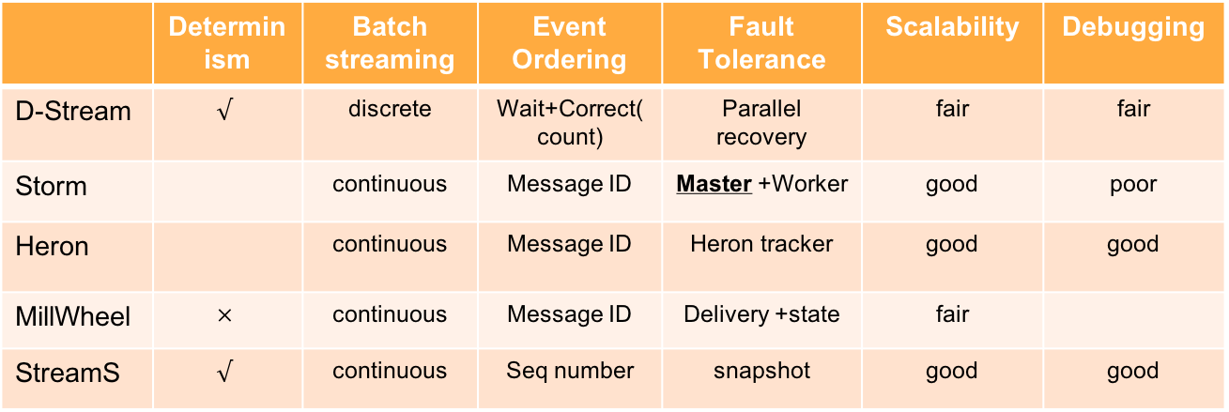
Comparison with Other Stream Processing Systems
 | Determinism | Batch streaming | Event Ordering | Fault Tolerance | Scalability | Debugging
D-Stream | $$√$$ | discrete | Wait+Correct(count) | Parallel recovery | fair | fair
Storm |  | continuous | Message ID | Master +Worker | good | poor
Heron |  | continuous | Message ID | Heron tracker | good | good
MillWheel | $$×$$ | continuous | Message ID | Delivery +state | fair
StreamS | $$√$$ | continuous | Seq number | snapshot | good | good

Slide 33
Conclusion
StreamScope provides a fault-tolerant cloud scale computation platform for performing continuous streaming tasks
Abstractions of rStream and rVertex contribute to achieve ideal performance goals
Implementation choices improves from both theoretical and engineering performance

Slide 34
Questions?

