Slide 1
Large scale cluster management at Google with Borg
Abhishek Verma, Luis Pedrosa, Madhukar Korupolu,
David Oppenheimer, Eric Tune, John Wilkes
Google
Presentation by Eric Newberry, University of Michigan

Slide 2
What is Borg?
Cluster manager used at Google
Verified in production use (for over 10+ years)
Many applications:
MapReduce, FlumeJava, Millwheel, Pregel, GFS, CFS (next-gen GFS), BigTable, MegaStore, …
Highly scalable
Clusters of “up to tens of thousands of machines” in production use
Combines different priority tasks on same cluster
Heterogeneous compute nodes
Fine-grained resource management
Resilient to controller failure

Slide 3
Previous Cluster Management Systems
Global Work Queue System (Google)
Borg’s predecessor [1]
Batch jobs only [1]
Mesos (Apache)
Multiple frameworks (Hadoop, Spark, …)
YARN (Apache)
No task priorities, preemption, …
[1] Software Engineering Daily, “Google Cluster Evolution with Brian Grant”, https://softwareengineeringdaily.com/2018/04/27/google-cluster-evolution-with-brian-grant/
Notes:
Selected list of cluster management systems preceding Borg
Not many details are publicly available about the Global Work Queue System, but it was Borg’s predecessor. However, unlike Borg, it was only intended to for batch jobs and production jobs were scheduled on separate clusters using another system.
Apache Mesos is notable because it attempts to split resource management between multiple frameworks, such as Hadoop and Spark, running on the same cluster.
Many of the advanced features present in Borg, such as task priorities and preemption, have recently been implemented in YARN.

Slide 4
Why Borg?
Highly scalable and resilient
Separate failure domains via “cells”
Task scheduling to share resources
Reclaims unused resources
Tested in production at Google
For over 10 years
Notes:
High scalability and resiliency are critical when using such a large-scale system in production

Slide 5
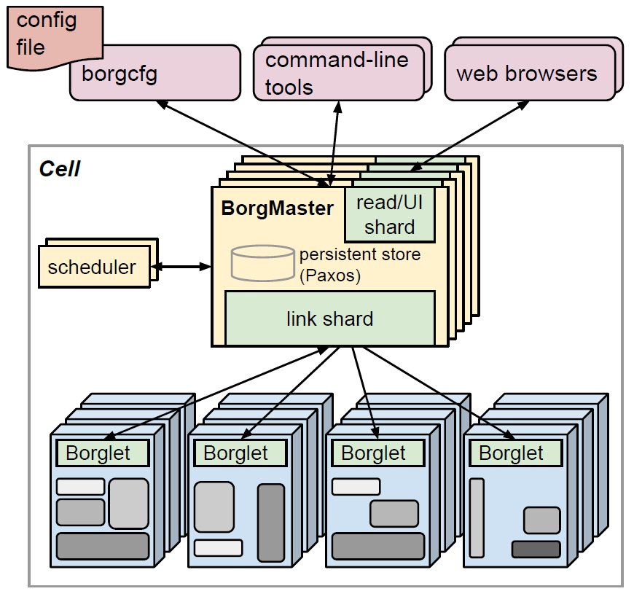
Cells and controllers and agents, oh my!
“Cell” → A Borg cluster
“Borgmaster” → Cluster controller
“Borglets” → Compute nodes
“Jobs” submitted by users
Split into separately-scheduled “tasks”
A. Verma et al, “Large-scale cluster management at Google with Borg”, 2015.

Slide 6
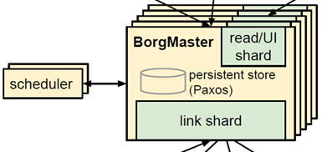
The Borgmaster
Centralized manager
Five replicas run simultaneously
Paxos for state failure tolerance (f=2)
Current leader can mutate state
State periodically checkpointed
Scheduler runs in separate process → performance
A. Verma et al, “Large-scale cluster management at Google with Borg”, 2015.

Slide 7
Borglets
Borglet
Manages tasks running on local system
Includes restarting failed tasks
Manages local resources
Reports status to Borgmaster
Pull-based mechanism (from Borgmaster)
Several status polls missed → machine down
Master reschedules tasks to other borglets
Local task queue
Task 1
Task …
CPU(s)
RAM
Storage
Network
...

Slide 8
Priority, Preemption, and Quota
Band-based priority
E.g., production = [20, 40)
Higher priority can preempt lower priority
Except production preempting production
Exceed memory allocation → highest priority for preemption
Regardless of priority
Is this a good idea? (Discussion time!)
Quota
E.g., 20 TB of RAM at production priority in cell 42 during January
Job rejected in not enough quota for user
monitoring
production
batch
testing (free)
Notes:
Borg is intended to simultaneously run both production and batch jobs on the same machine. Therefore, we need some mechanism to declare which tasks are higher priority than others.
Expedited preemption for exceeding memory allocation even applies to production tasks. Exceeding CPU allocation is less critical, since usage can be throttled.
Quota is how many resources the user is allowed to use during a fixed period of time. The “admission control” system will reject jobs when the user does not have enough remaining quota to run the job.

Slide 9
Scheduling
Feasibility checks (per machine)
“Goodness” scoring (per machine)
Scheduling
Meets task constraints
Presence of task packages
Transfer packages to machine
Has available resources*
# of failure/power domains
Preempt other tasks (if needed)
Mixing task priorities
# of preemptions
User-def. metrics (optional)
* Excludes resource use by lower priority tasks
Notes:
Jobs are split into tasks. Each task is scheduled independently.
The feasibility checking algorithm considers resources in use by lower priority tasks to be free for its purposes
Borg is notable in that it mostly does not consider data locality, only considering the presence of task packages as a factor in its goodness score.
Goodness is not the first scoring mechanism used by Borg. Originally E-PVM was used, which resulted in more even load distribution, but increased fragmentation (“worst fit”). “Best fit” leaves some machines without jobs running and penalizes mis-estimations of resource usage.

Slide 10
Resource Reclamation
“Reclaim” allocated but unused resources
Resource “reservation” is calculated
Decays toward actual resource usage (plus margin)
If usage increases, increases to actual usage
Reclaimed resources only used for non-production tasks

Slide 11
Ensuring Scalability
Borgmaster is resource intensive
10-14 cores
Up to 50 GB of RAM
Scheduler runs in separate process
Uses cached version of state
Suggests task assignments
Controller may reject if no longer correct
Multiple controller threads for read-only RPCs
Borgmaster controls rate of communication with borglets
Polls every few seconds
Sharding: Each replica communicates with subset of borglets
A. Verma et al, “Large-scale cluster management at Google with Borg”, 2015.
Notes:
Having the controller manage communication between itself and the agents prevents the controller from being overloaded by “storms” of requests that may occur in the event of the simultaneous recovery of many agents.
To further increase scalability in the sharding mechanism, Borgmaster replicas will only send state changes on to the primary.

Slide 12
Ensuring Scalability
Goodness only calculated for random subset of borglets
Goodness cached until change in machine/task properties
Equivalence classes
Tasks with same feasibility requirements
Only need to compute goodness score once for each class
Notes:
In experiments, choosing a random subset of nodes to calculate goodness for reduced the cumulative scheduling time from 3 days to O(100) seconds. However, generally takes less than a second to schedule the tasks that are pending at a given moment.

Slide 13
Ensuring Availability
Tasks must handle resiliency of own data
Tasks running on failed machines will be rescheduled
Preempted tasks will be rescheduled
Related tasks spread across failure domains (if possible)
Avoids task→machine pairings (prior failures)
Independence of cells (to avoid failure propagation)
Logsaver to recover intermediate disk data
99.99% availability
Notes:
Rescheduling is rate-limited to prevent a rescheduling cascade (e.g., during widespread machine failures).
If the agent kept on running the tasks after it lost contact with the controller and reestablishes contact with the controller, its tasks will “win” over the restarted tasks.

Slide 14
Isolating Processes
Borglet
chroot jails (security)
cgroup containers (resource utilization)
“Appclasses”
Latency sensitive (LS) vs batch
cgroup container
chroot jail
Task
cgroup container
chroot jail
Task
Notes:
Chroot jails protect the system as well as the task from other tasks on the same system.
High priority latency sensitive tasks are prioritized and can starve batch tasks for instances of multiple seconds. However, this starvation time is limited by adjusting resource caps of greedy LS tasks.
LS can reserve cores against other LS tasks to increase performance
In addition to reserving cores, allocating entire cores to apps with cpuset can be used in apps that require extremely low latency.

Slide 15
Borg and the Improved User Experience
Fine-grained priority and resources requests
Handles complex scheduling and task management, installation
Job/task properties mutable during runtime
Name service and health info → task discovery
Web-based UI → detailed job information
Persistent resource allocations on a machine (“allocs”)
Reserved for future tasks
Associated allocs on multiple machines → “alloc set”
Notes:
Borg’s fine-grained priority systems lets users indicate the relative importance of many tasks against each other. Fine-grained resource requests allow users to use exactly as much of their quota they need to, instead of using too much by forcing tasks into buckets. In addition, the Borg system handles many other complex mechanisms, including scheduling and installing packages.
Job/task property changes will sometimes require that tasks be restarted or rescheduled
Borg name service (BNS) names contain cell name, job name, and task number
Hostname and port are written into highly-available storage (Chubby)

Slide 16
Debugging
Sysadmins:
“Fauxmaster” as a Borgmaster simulator
Reads checkpoints and runs traces to recreate failures
Developers:
Notification of reason for stuck jobs
Rich, verbose logging
Remote debugging on borglets

Slide 17
Implementation
Written in C++
Modified Linux kernel
CFS CPU scheduler for low latency + high frequency
Not many specific details
Likely Google internal!

Slide 18
Evaluation
Q: Does Borg make efficient use of computational resources?
“Cell compaction” - Smallest cell that can fit workload
Combining priorities/users in a cell
Larger vs. smaller cells
Resource requests granularity
Resource reclamation
Notes:
It is difficult to evaluate such a large system quantitatively, so the authors chose to evaluate how efficient Borg was at making use of the computation resources it is in charge of scheduling.
In order to provide realistic input data to their experiments, they used traces from 15 clusters in use at Google, eliminating “small” cells, test cells, and special-purpose cells. They replayed these traces on “Fauxmaster”, a Borgmaster simulator developed for debugging purposes.

Slide 19
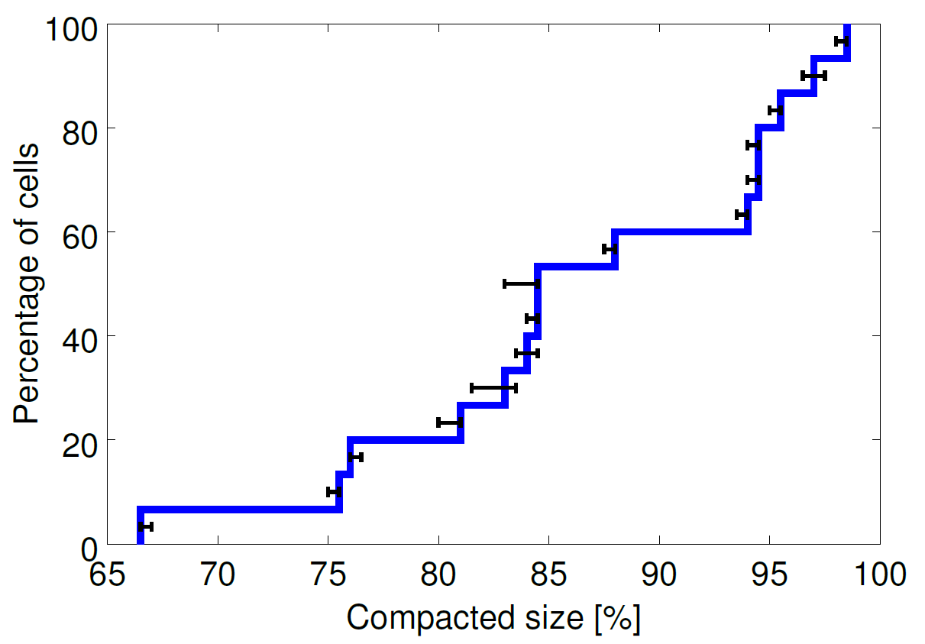
Evaluation – Cell Compaction
A. Verma et al, “Large-scale cluster management at Google with Borg”, 2015.
Notes:
How well does Borg fit tasks into the available computational resources? To evaluate this, they first needed to define a metric. They chose to use “cell compaction”, which refers to the smallest cell that can hold a workload.
To determine this, they removed as many machines from the cell as possible and determine how many were left compared to the original cell size. These results show that many cells in use at Google are significantly larger than they need to be. However, they purposefully leave extra headroom to handle usage spikes.
11 trials

Slide 20
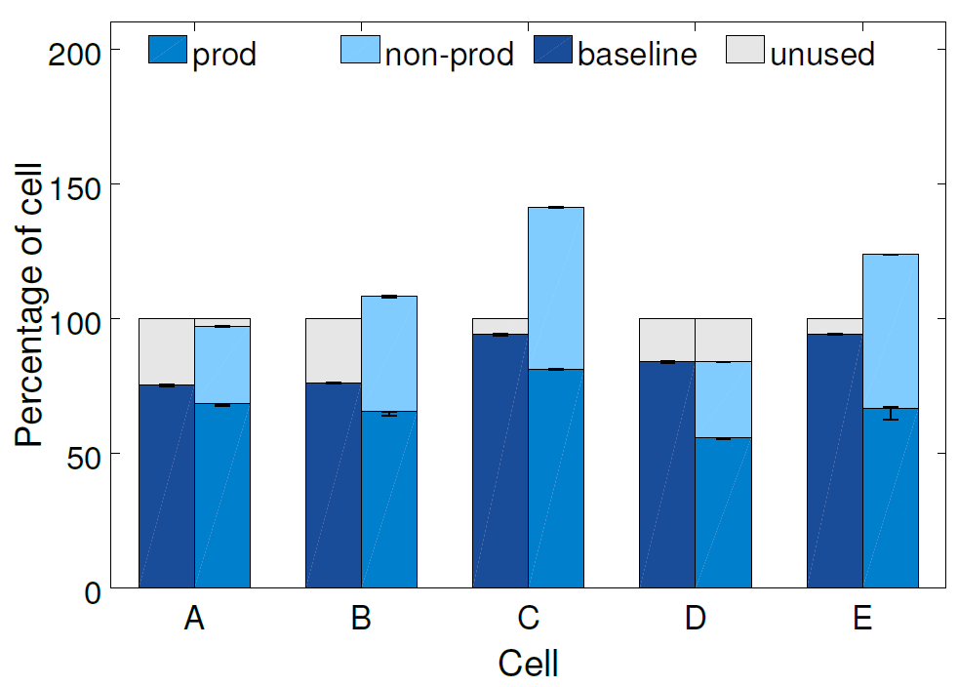
Evaluation – Combining Priorities
A. Verma et al, “Large-scale cluster management at Google with Borg”, 2015.
Notes:
Median of 20-30% more machines needed if prod and non-prod segregated. Because of resource reclamation, fewer resources needed overall.
Left side shows original cell size. Right side shows workload if segregated

Slide 21
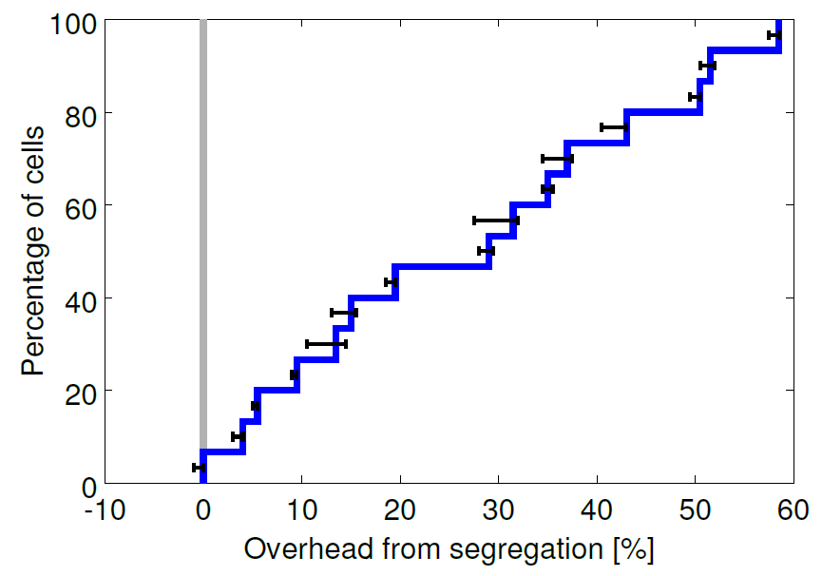
Evaluation – Combining Priorities
A. Verma et al, “Large-scale cluster management at Google with Borg”, 2015.
Notes:
While CPI (cycles per instruction) might be raised slightly, less hardware is needed overall → balance between priorities
Evaluation of all 15 cells. Error bars are 90% confidence intervals.

Slide 22
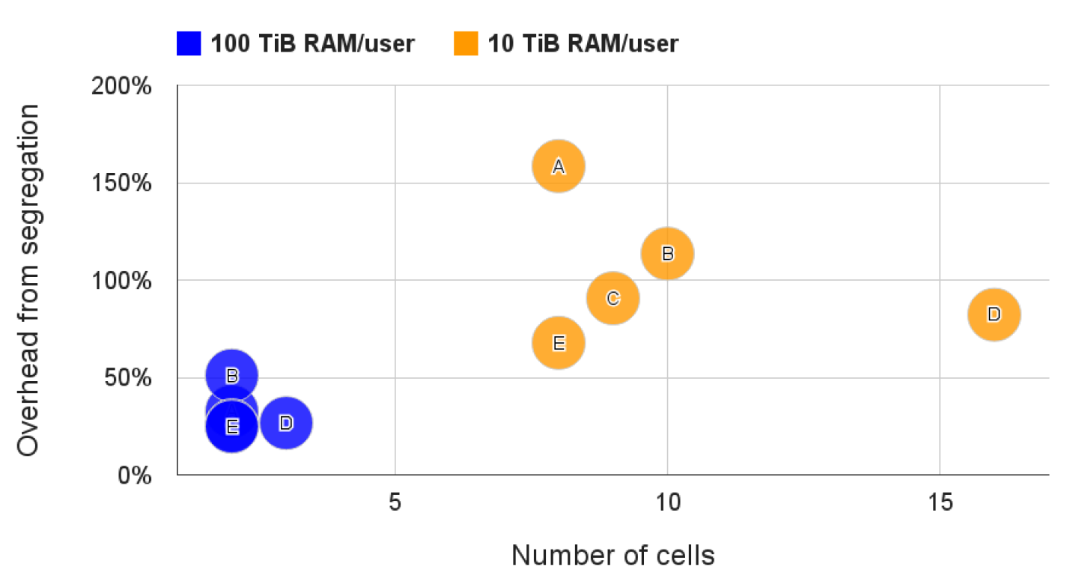
Evaluation – Combining Users
A. Verma et al, “Large-scale cluster management at Google with Borg”, 2015.
Notes:
This measures the additional number of machines needed if users above a certain memory usage threshold were segregated off into their own cell. This shows that pooling resources reduces overhead.E

Slide 23
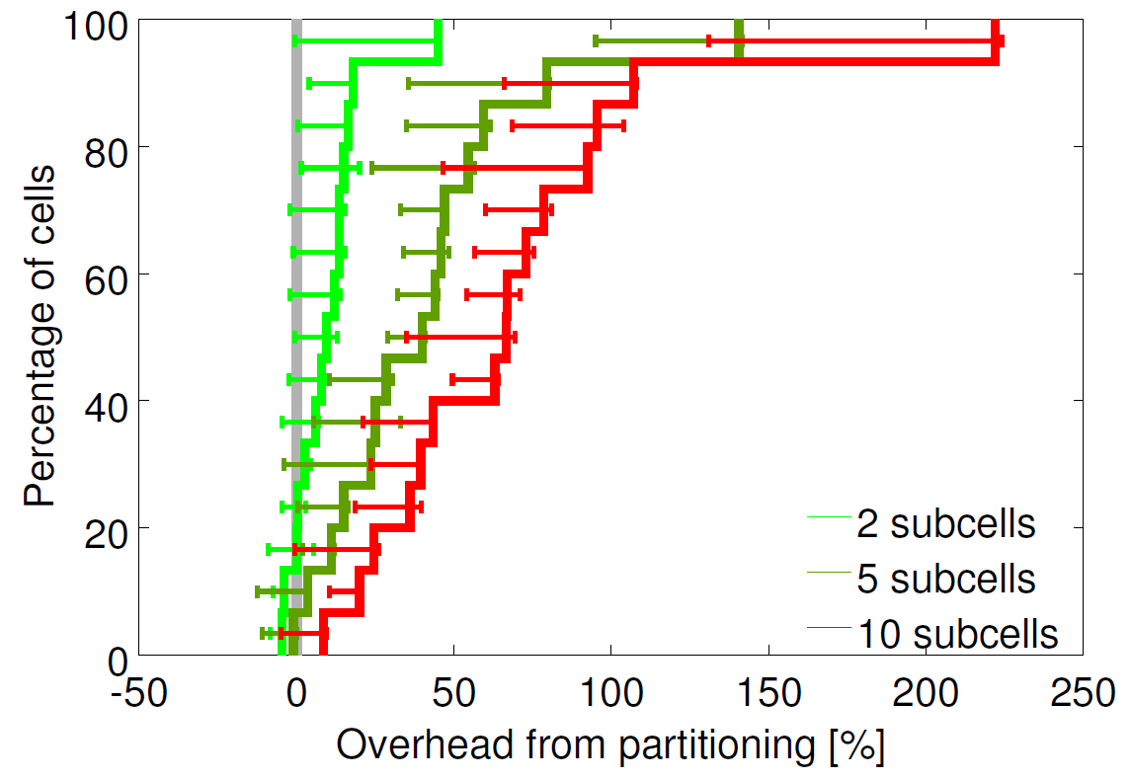
Evaluation – Cell Size
A. Verma et al, “Large-scale cluster management at Google with Borg”, 2015.
Notes:
Reduces resource fragmentation. Not many details given in paper (internal to Google?)

Slide 24
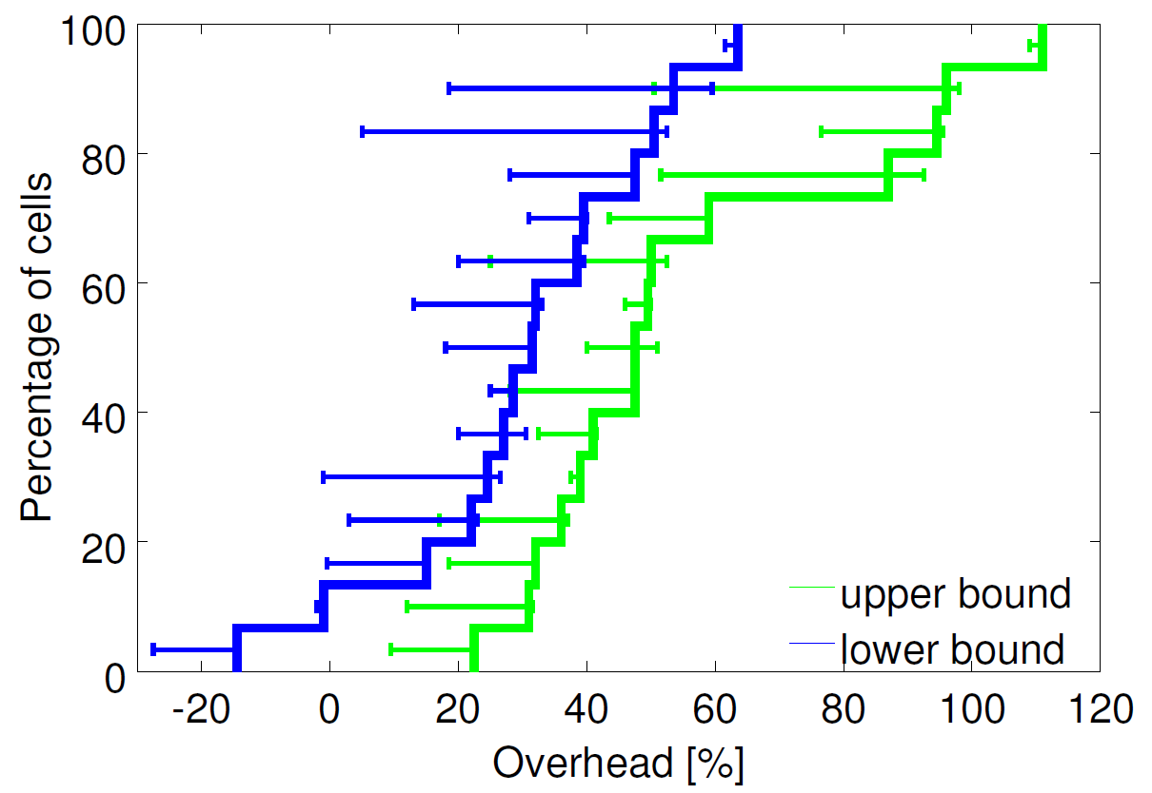
Evaluation – Resource Granularity
A. Verma et al, “Large-scale cluster management at Google with Borg”, 2015.
Notes:
From evaluations, authors found few obvious “sweet spots” to bucket resource requests into.
Found that bucketing resources required a median of 30-50% more resources.
In this figure, rounded up resource request to nearest power of two for CPU cores and RAM (starting at 0.5 cores and 1 GB, respectively).

Slide 25
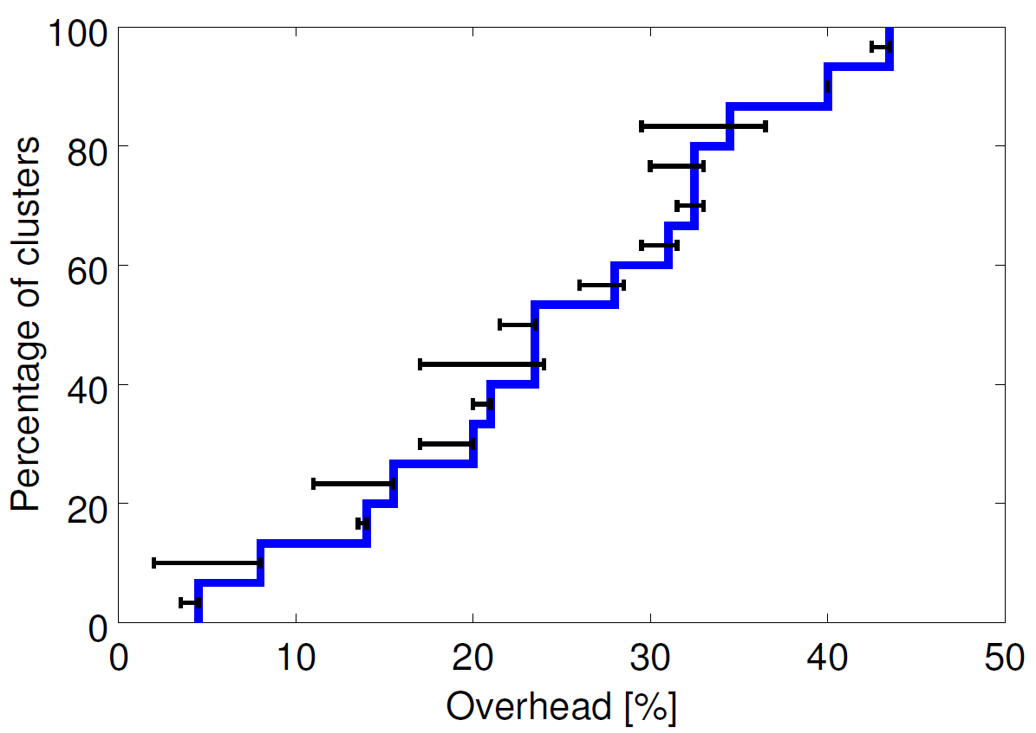
Evaluation – Resource Reclamation
A. Verma et al, “Large-scale cluster management at Google with Borg”, 2015.
Notes:
Results show percentage of additional machines that would be required if resource reclamation were not used. In the average cell, it has been found that 20% of total workload runs in reclaimed resources.

Slide 26
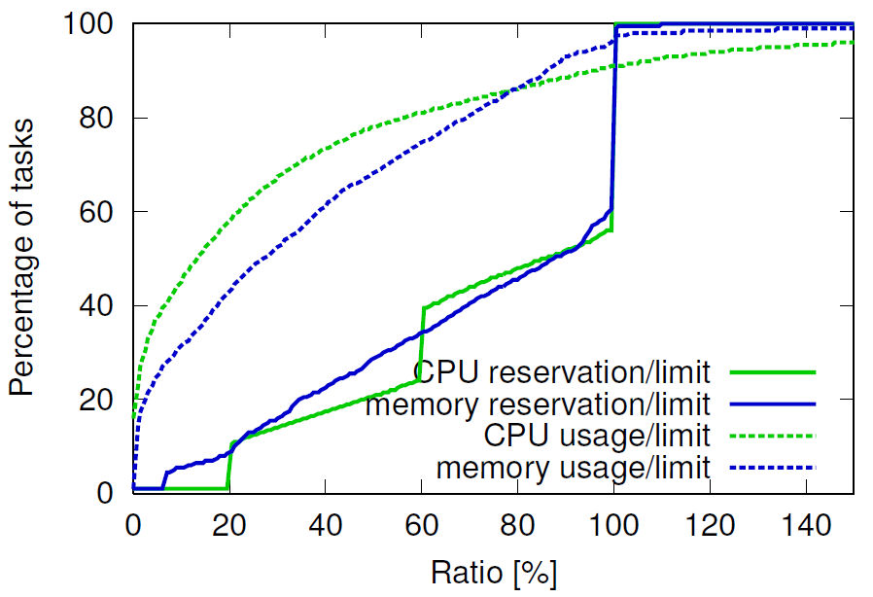
Evaluation – Resource Reclamation
A. Verma et al, “Large-scale cluster management at Google with Borg”, 2015.
Notes:
Results show success of reclamation algorithm at identifying unused resources. Most tasks appear to use significantly less than their limit. Note the gaps between the solid and dashed lines. These indicate unused resources that are unused but not reallocated. After noting this, the authors found that their reclamation algorithm was too conservative and deployed a more aggressive one on their production cells.

Slide 27
What Works Well
Treating cluster as distributed system vs. centralized system
Resource reclamation → more efficient use of resources
“Allocs” – resources available for service when needed
Additional services beyond scheduling
Debugging info for users
Notes:
Many jobs depend on complex services (e.g., naming) and providing them at the cluster level simplifies their development.
Providing debugging info directly to users reduces time sysadmins must spend helping developers resolve errors.

Slide 28
Lessons Learned
Shared use of network resources
Tasks on a compute node must share ports on single IP
Jobs are not a good mechanism to organize related services
How could we do this?
Availability of many advanced features can confuse users
Reduced by automation tools

Slide 29
Ongoing Work (as of writing)
Reducing time between job submission and start
Median of 25 seconds (as of writing)
Scheduling based on hyperthreading, NUMA, and power

Slide 30
Conclusion
Borg is an effective cluster manager
Can scale to clusters of tens of thousands of machines
High availability through redundant controller processes
Efficient resource management through resource reclamation
However, some aspects do not fit all types of jobs:
Difficult to keep track of related jobs
Sharing ports on a single IP
Looking to the future: Omega and Kubernetes

Slide 31
Borg, Omega, and Kubernetes
Brendan Burns, Brian Grant, David Oppenheimer, Eric Brewer, and John Wilkes
Google
Presentation by Eric Newberry, University of Michigan

Slide 32
Borg, Omega, and Kubernetes
Google’s cluster management history:
Borg → Omega → Kubernetes
Enabled by advances in containerization
Focus has shifted from machines to containerized apps
Many lessons learned on this path

Slide 33
Borg, Omega, and Kubernetes
Borg
Omega
Kubernetes
Manager: Monolithic, Centralized
Manager: Peers
Manager: Peers
State: Centralized
State: Decentralized (Paxos)
State: Decentralized (Paxos)
Manager contains state
Components interact directly with state
Components<->State via API
Services developed separately → disparate APIs
Services developed centrally → similar APIs
Consistent APIs/components
Google internal
Google internal
Open source!
Notes:
Borg was originally developed to enable resources to be shared between high-priority latency-sensitive jobs and lower-priority batch jobs.
Omega makes Borg architecture most consistent by integrating many services into manager from the beginning, instead of letting them being developed separately.
Kubernetes’ goal was to ease the development and management of jobs. “REST API [provides] higher-level versioning, validation, semantics, and policy, in support of a more diverse array of clients”
Borg is mature, but heterogeneous, environment
Omega state: Optimistic concurrency control handles (rare) conflicts
Containers enable the isolation of latency-sensitive jobs and batch jobs, which often require large amount of CPU, but are less sensitive to latency.
Many innovations developed for Omega were later added into Borg
Services developed later for Borg: Job management, load balancing, quota checking, job lifecycle management, …

Slide 34
Containers
Host machine
Container 1
Tasks run in containers
Isolate resources at kernel level
Images → generate once and reuse
Latency-sensitive tasks can claim extra resources to handle load spikes
Even with kernel-level isolation, what interference could still occur between processes? (Discussion time!)
CPU
Memory
Task 1
Container 2
CPU
Memory
Task 2
Container …
CPU
Memory
Task …
Notes:
Isolation cannot prevent interference between processes for resources not managed by the OS, such as: processor caches (L3), memory bandwidth, security attacks (VMs help protect here)
Images built and deployed with Midas Package Manager (MPM) within Google

Slide 35
Nested Containers
Host machine
Outer Container
Google uses nested containers to manage resources
Outer container pools resources
Borg: allocs
Kubernetes: pods
Inner container isolates tasks
Pod may contain entire instance of application (support tasks running in separate inner containers)
Benefits for robustness, modularity, resource isolation within app
CPU
Memory
Inner Container
Inner Container
Task
Task
Outer Container
CPU
Memory
Inner Container
Inner Container
Task
Task
Notes:
Borg still allows tasks to be run outside of an alloc, but Kubernetes does not. In Kubernetes, this may result in many outer contains only containing a single inner container.

Slide 36
Application-Oriented Infrastructure
Containerization changes focus from machines to the apps → Manage the app, not the machine
App devs: don’t worry about machine environment
Same dev and deployment environments
Must include (almost) all dependencies in image to ensure consistency
Borg: statically-linked executables, but shared base image
Sysadmins: don’t worry about apps
OS and HW upgrades (mostly) don’t interfere with apps
Single+uniform API between container and management
Load balance between containers (not machines)
Notes:
Even when including dependencies in image, the system call interface must be external (through the kernel) and may change.
The shared base image in Borg can lead to issues with upgrades to system utilities and libraries (e.g., libc). Docker eliminates host OS dependencies.
Only need to manage the app, not the machine, because the container essentially only runs the app.
API between container and management allow self-healing (restarting unhealthy) containers and communication of resource utilization, among other information.
Logging, etc. – no need to demux signals from different apps. Logs tied to container, not machine

Slide 37
General Services of Cluster Managers
Naming and service discovery
Borg Name Service (BNS)
Electing Paxos masters (Chubby)
Load balancing (app-aware)
Autoscaling
Size of instances (vertical)
Number of instances (horizontal)
Easing app deployment
Workflow analysis
Monitoring tools (e.g., status and alerting)

Slide 38
Kubernetes API
Uniform API for interacting with Kubernetes services
Same API used by internal/external tools + users
ObjectMetadata
Name
Unique ID
Version
Labels
Specification
Desired state of object
Status
Current state of object
Notes:
Having a uniform API simplifies tool development, simplifies the development of cluster manager itself, and provides a better user experience.

Slide 39
Modularity in Kubernetes
Separate development concerns
E.g., autoscaler doesn’t need to know how replication controller creates/deletes pods
Components build on base blocks
Consistent design patterns
E.g., reconciliation controller → increased resiliency
“Choreograpy”-based design
Independent components collaborate to achieve goals
Vs. “orchestration system” (centralized system instructs components)
Notes:
Reconciliation controller checks whether a desired state holds. If not, it takes actions to make this the case. No state machines, so no need to save state to stable storage.
Orchestration systems “[tend] to become brittle and rigid over time”.

Slide 40
Lessons Learned
Assign unique IP address to each pod
SDN works around migration and routing issues
Use well-known ports
Use standard network services and tools, instead of custom
Assign labels (metadata) to containers
“Sets” contain tasks with matching “label selectors” (Boolean query)
Notes:
DNS had major issues with Borg, as clients needed to be kept informed of port changes, name-based redirection systems, tools modified to handle custom ports
Numeric IDs in Borg jobs made this complicated: in the event of failure, had to keep track of both old, failed task and replacement task
Labels can be added, deleted, modified by both users and tools

Slide 41
Lessons Learned
Don’t require single task grouping mechanism
Kubernetes: pod management components own pods (label selectors)
Must ensure selectors do not overlap!
Modularize, modularize, modularize! (but not too much!)
→ Simplifies development and maintenance
No components need to know inner workings of others
Standardize API between components
Still need centralized store for consistency + enforcing invariants, policies, etc.
Notes:
Containers can be “orphaned” and “adopted”

Slide 42
Open Problems
Instance configuration
Where all services not supplied by manager must be implemented
So far, generally use domain-specific config languages
However, must have Turing-complete language to configure apps
Managing dependencies
Often additional services must be started to accompany user’s service
Apps don’t expose dependency info →Difficult to automate deployment
Manually-maintained dependency info can quickly become out-of-date
Notes:
Services often added via application configuration (in Borg) include: release management, specifying image version,
Turing-complete language: have to make new debugging tools, etc.

Slide 43
Conclusion
Kubernetes is a cluster manager developed by Google
Builds on the lessons learned from Borg and Omega
Goal: ease job creation, deployment, and management
Decentralized peer management processes
Centralized state store to enforce invariants and policies
Google still runs Borg on its clusters
Reliable, mature, familiar environment for users
But Kubernetes development is ongoing!
Open source!

Slide 44
References
A. Verma et al, “Large-scale cluster management at Google with Borg,” 2015.
B. Burns et al, “Borg, Omega, and Kubernetes,” 2016.
Original presentation of Borg at EuroSys 2015 (J. Wilkes)
Presentation of Borg by A. Khurana, University of Michigan
Presentation of Borg by X. Pei, University of Michigan
Presentation of Borg by I. Stoica, UC Berkeley

