Slide 1
Global Analytics in the Face of
Bandwidth and Regulatory Constraints
Ashish Vulimiri^{u}, Carlo Curino^{m}, Brighten Godfrey^{u}, Thomas Jungblut^{m}, Jitu Padhye^{u}, George Varghese^{u}
UIUC^{u}, Microsoft^{m} (NSDI’15)
Presented by Hasan Al Maruf, Fan Lai, and Henry Singer
Acknowledgements
Presentation on GEODE at NSDI ’15
Presentation on CLARINET at OSDI ’16
EECS 598 – F17

Slide 2
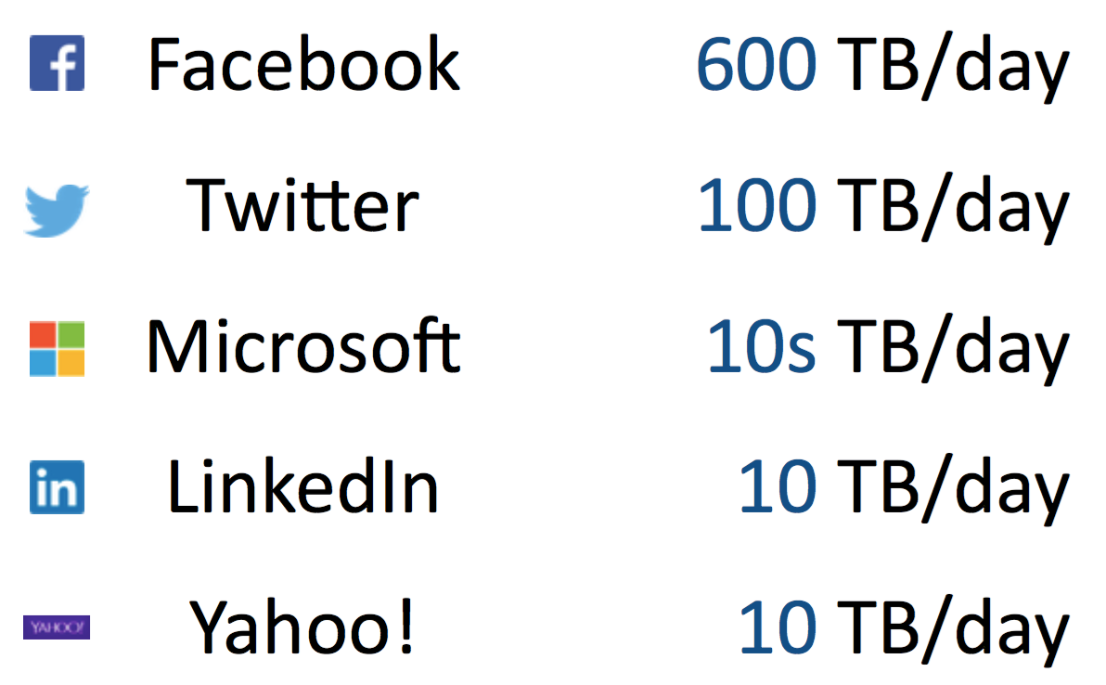
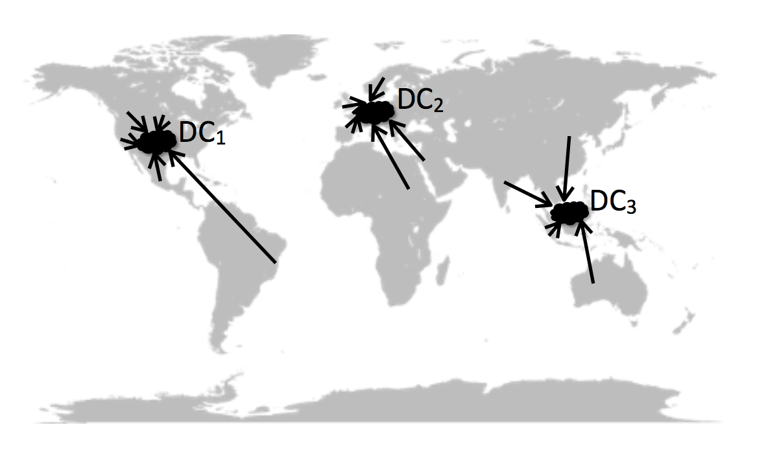
Background
Massive data volumes across geo-distributed data centres
Frequently accessed for insights

Slide 3

Current Solution
Transfer data to a central data centre
Run all analytics there
Limitations
.
.
.
Huge demand for cross-data centre bandwidth
Scarce network Capacity
Sovereignty Constraints
10s - 100s TB/day
up to 10s of DCs

Slide 4
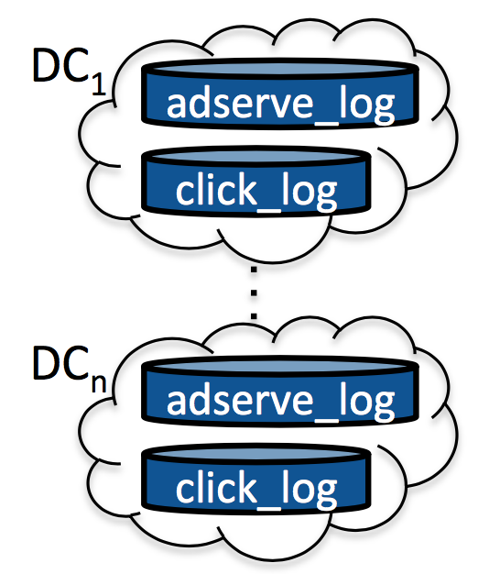
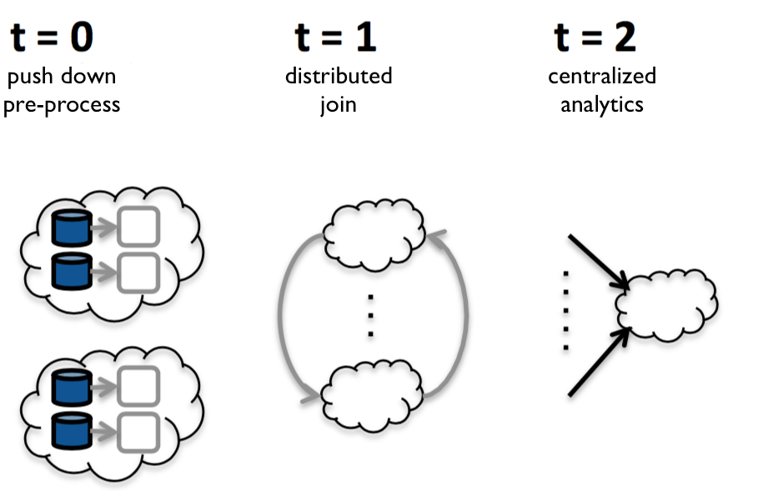
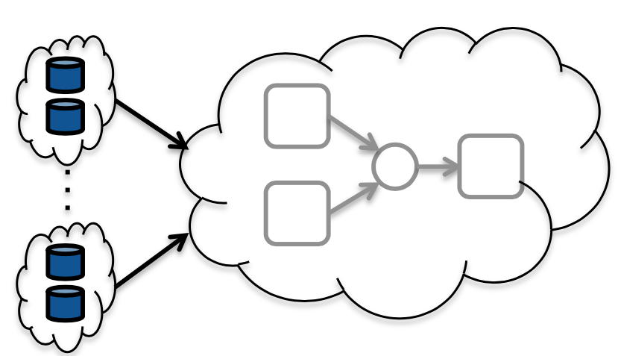
Geo-distributed SQL Analytics
SQL Query
adserve_log
do some
pre-processing
join
run analytics
click_log
do some
pre-processing
Centralized execution
Geo-distributed execution

Slide 5
Challenges
Bandwidth
Fault-Tolerance
Sovereignty
Latency
Consistency
Focuses on batch-analytics paradigm dominant in organizations
Trade-off resources within a data centre for bandwidth reduction

Slide 6
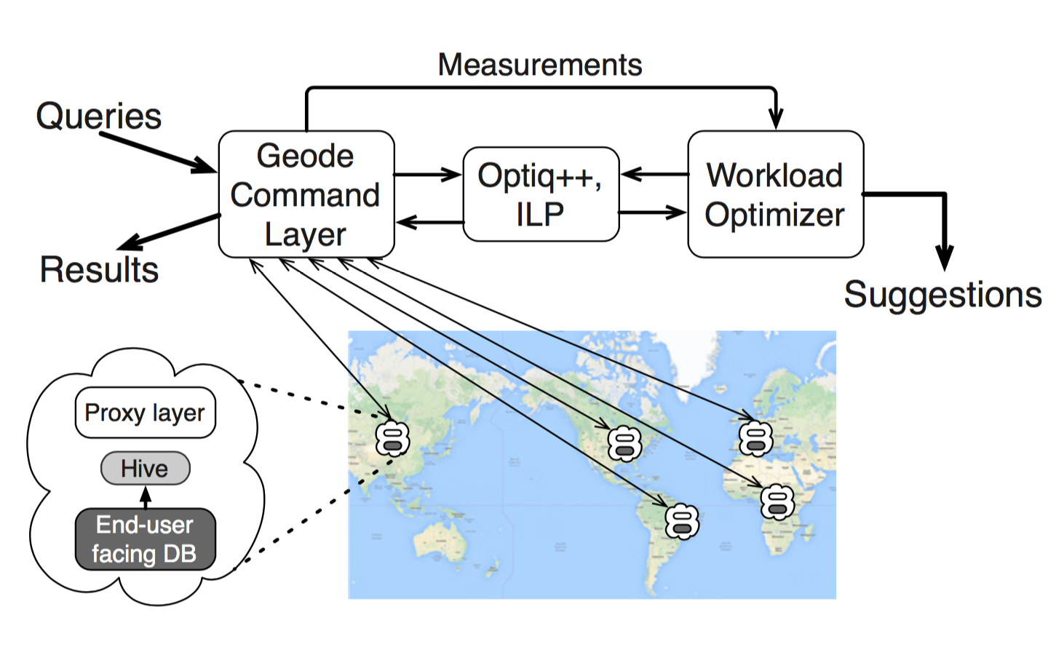
Geode Architecture

Slide 7
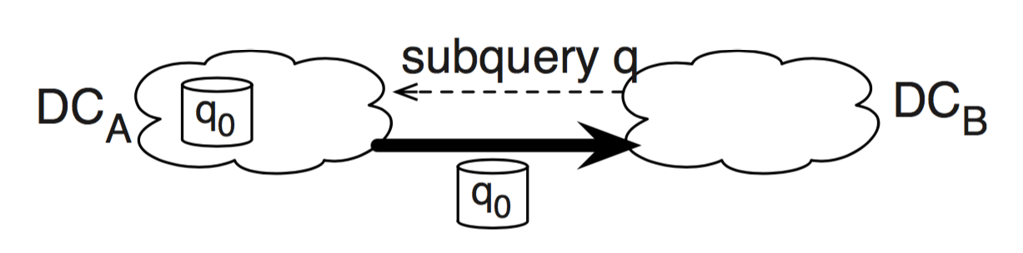
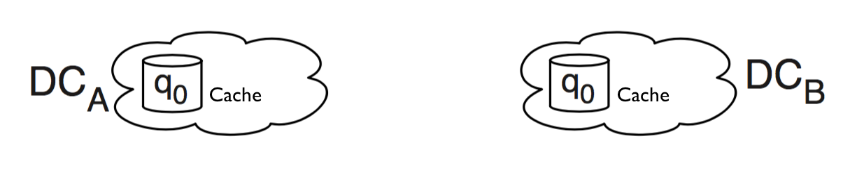
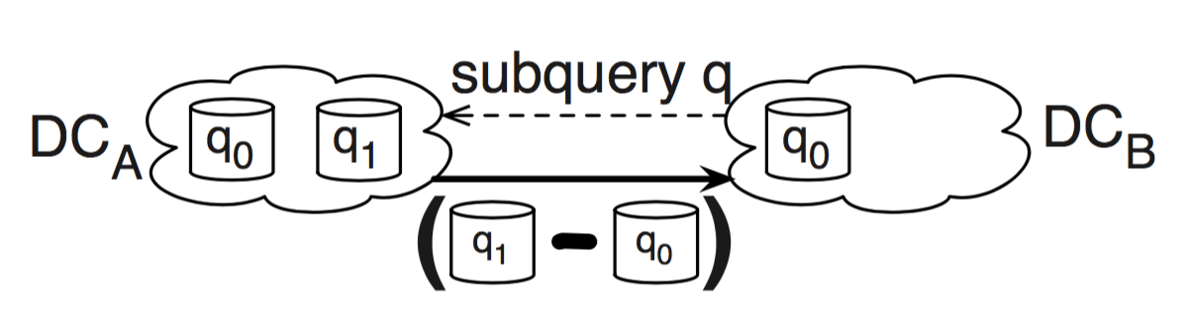
Runtime data transfer optimization
Aggressively caches all intermediate results
At t=0, DCB asks DCA for the output of subquery q
After transfer, DCA and DCB caches the computed output
At t=1, DCB again asks for subquery q’s result.
DCA recomputes q1 from scratch
DCA sends DCB only the difference

Slide 8
Workload optimization
Motivations
Optimize execution plan of each query
Allocate sub-queries to appropriate data centre
Replicate data for performance and/or fault-tolerance
Constrains
Sovereignty
No control over data partitioning
Exponentially large optimization search space

Slide 9
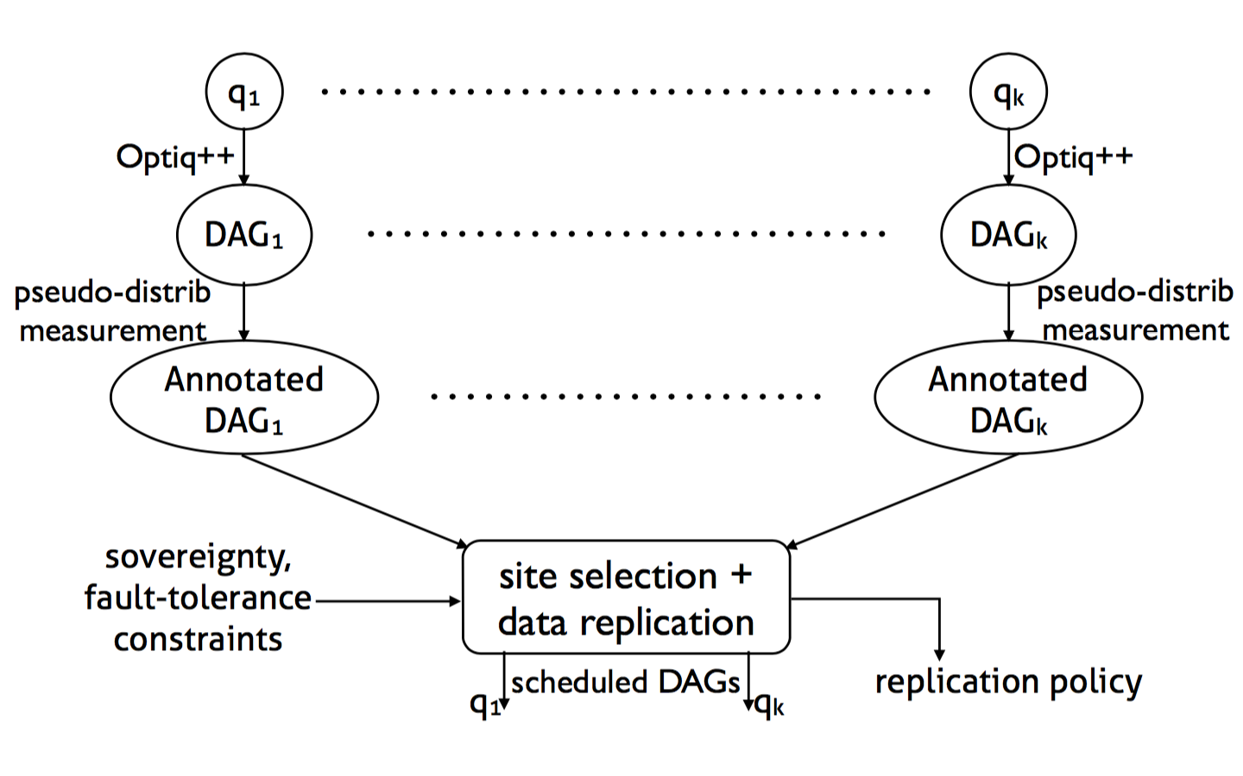
Workload optimization
Figure: Workload optimizer architecture

Slide 10
Command-layer Interface
Supported Queries
Distributed joins with co-located joins, left/right broadcast joins, and left/right semi-joins
Recursive execution of nested queries
User-defined functions
Support via extensible user-implemented optimization functions

Slide 11
Large-Scale Evaluation: Environment
Centralized environment with simulated multi-data-center setup was used for Microsoft data and all experiments larger than 25 GB scale
Distributed deployment across three data centers in US, Europe, Asia

Slide 12
Large-Scale Evaluation: Data
Microsoft production workload - service health/telemetry data
TPC-CH - models DB pf large-scale, Amazon-like retailer
BigBench - models DB of large-scale retailer that collects customer data
Big-data - models DB generated from HTTP server logs
YCSB-getall, YCSB-aggr - author’s benchmarks for best and worst case

Slide 13
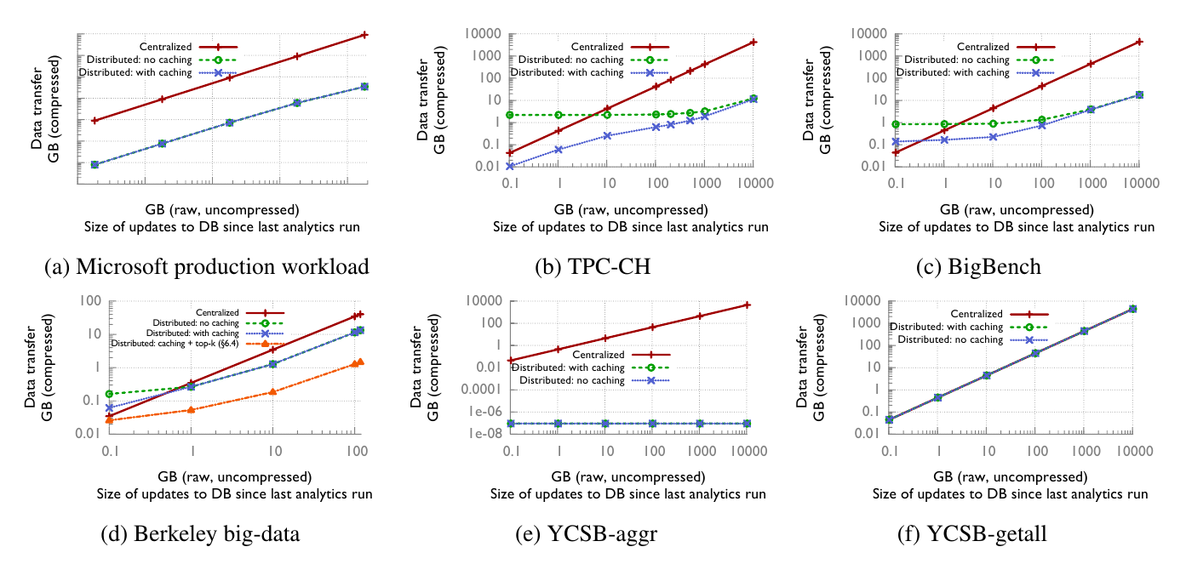
Large-Scale Evaluation: Results

Slide 14
Large-Scale Evaluation: Analysis (Distributed)
Compared to centralized, performed better on frequent, worse on infrequent updates
Out-performed centralized by 150-360x on YCSB-aggr, Microsoft prod., TPC-CH, and BigBench
On Big-Data, out-performed centralized by 3x out-of-the-box, 27x with narrow optimizations
As expected, no improvement on YCSB-getall

Slide 15
Large-Scale Evaluation: Analysis (Caching)
Caching helped significantly for low-update rates on TPC-CH, BigBench, and BigData
Caching did not help with YCSB-aggr or YCSB-getall

Slide 16
Optimizer’s Tradeoff: Set Up
Greedy and exact ILP solutions’ computation time and peformance are compared for two data sets:
the experiments for the large-scale evaluation
randomly generated SQL queries

Slide 17
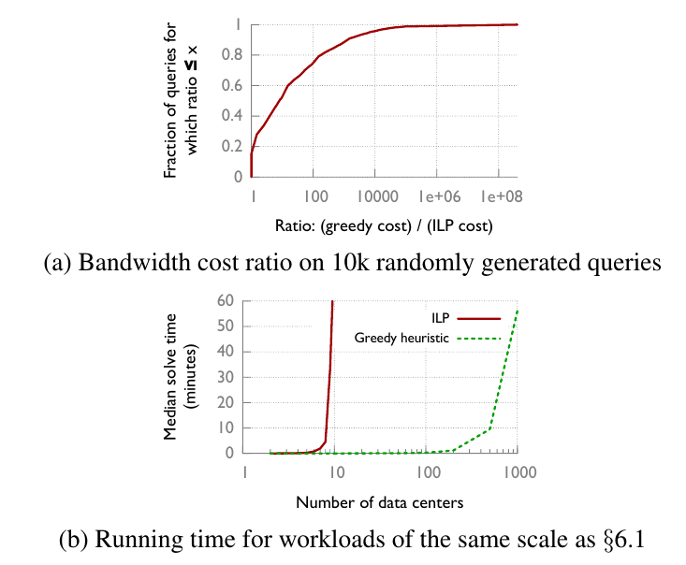
Optimizer’s Tradeoff: Results

Slide 18
Limitations
Does not address latency, only data transfer costs
Only provides eventual consistency
Allows arbitrary queries, so no privacy guarantees
Only focuses on $/byte cost model
Only considers relational data models

Slide 19
Clarinet
Considers WAN network when choosing task placement and scheduling (similar to Geode)
Optimizes jointly over multiple queries to avoid inter-query contention over WAN resource

Slide 20
Environmental Constraints
Similar geo-distributed analytics set-up as given in Geode paper
Assume bandwidth of WAN links is constant for each query’s running time
WAN links have heterogeneous capacity
WAN is slower than intra-DC bandwidth by 1-2 orders of magnitude

Slide 21
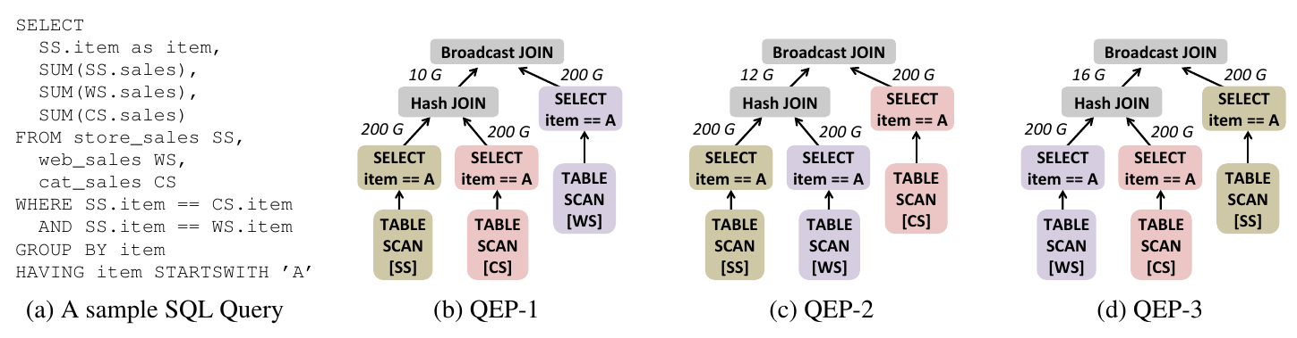
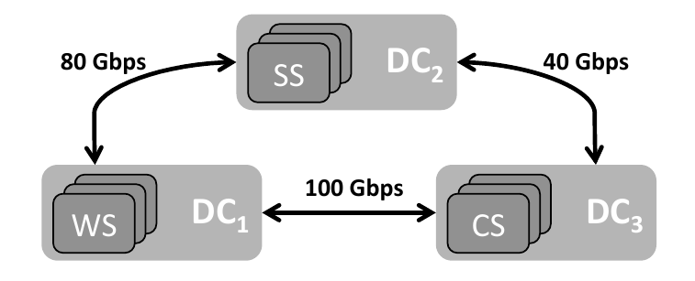
QEP Placement and Scheduling
Similar WAN-awareness argument to Geode

Slide 22
Multi-Query Optimization
If query optimizer is not WAN-aware, it will choose best QEP for each of multiple simultaneously submitted queries
This can result in WAN resource contention if two optimal QEPs are similar
Clarinet considers WAN when selecting QEPs for simultaneous queries, thus minimizing contention and reducing latency

Slide 23
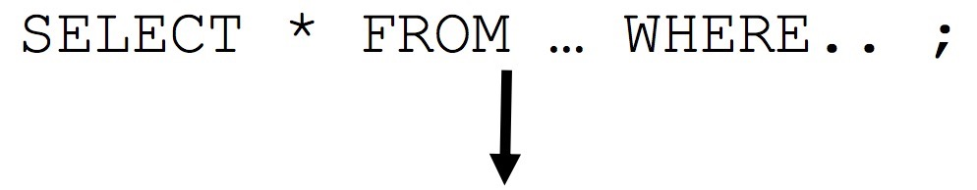
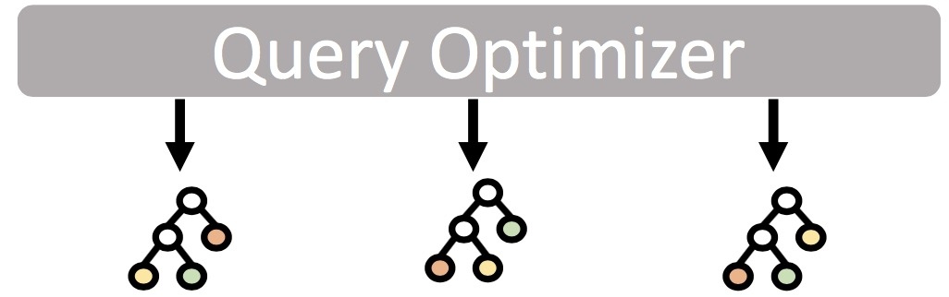
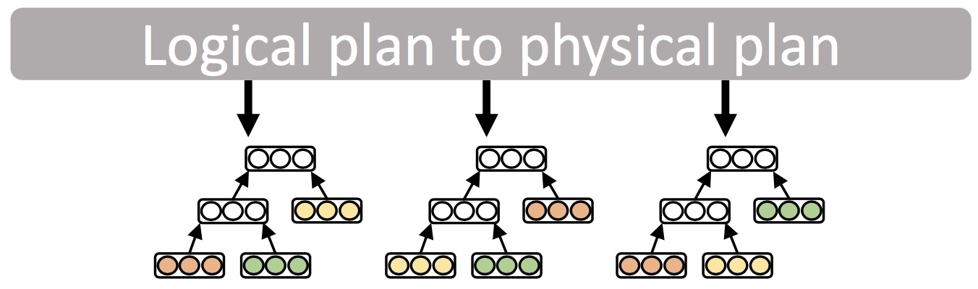

Clarinet’s Design
Multiple query execution plans
(QEP) per query
Assign parallelism for each stage
Network aware task placement and
scheduling for each query plan
Choose plan with smallest run time
for execution
Execution framework
Notes:
Hello, guys! I’m here to give some details about Clarinet. First, when the query arrives, the optimizer will analysis the semantics of it. And give multiple execution plans. Based on these plans, we want to include task placement and scheduling information. And finally choose one with the smallest running time. So how to decide the task placement and scheduling are the key issues.

Slide 24
Network aware placement and scheduling
Task placement for a QEP
Determine the site where tasks are executed
Iteratively for each of stages in topological order
Minimize per stage run time greedily
Scheduling of network transfers
Determine the start time for tasks
Formulate Binary Integer Linear Program to solve scheduling
Notes:
Here, the task placement means we choose a site for task. Actually, if the task has no dependencies with others, we can simply place it in the location of the raw inputs. This way, we can reduce completion time and data traffics. But we have to consider the derived input if they have parents. In this work, they greedily minimize the running time in their dependencies. Similarly, they also use the linear program to solve the placement and scheduling problems. So that’s how they optimize the single query.

Slide 25
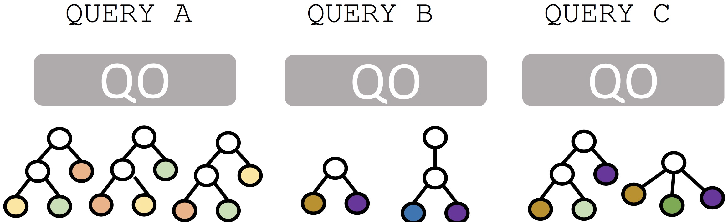
Multiple Contending Queries
How to choose the order of multi-queries with many QEPs?
Computationally intractable to find best combination
Shortest Job First (SJF) performs well in single link
Notes:
Well, All I introduced above are about a single query. I think the most interesting part of this work is how to jointly optimize multiple queries. For example, now we have three queries. i.e, A, B and C. Our goal is to schedule them so that we can reduce the avg completion time. One of the best known solutions is shortest job first. ie, we always choose the query with the shortest running time first. let’s have a taste of it.

Slide 26
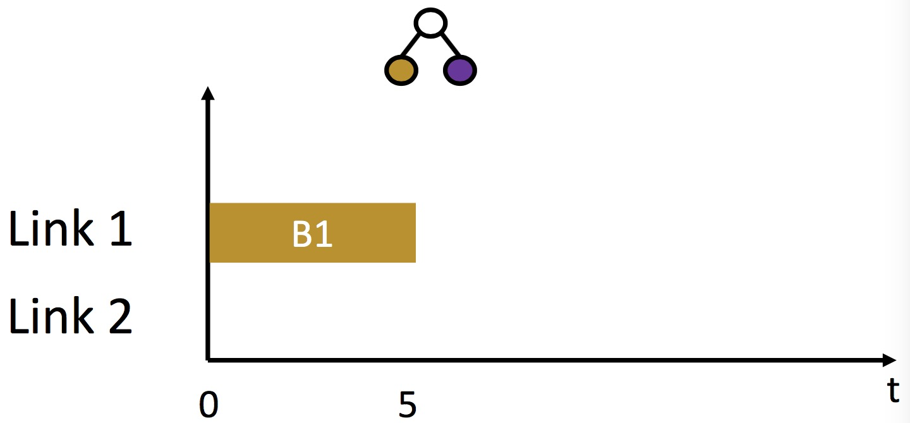
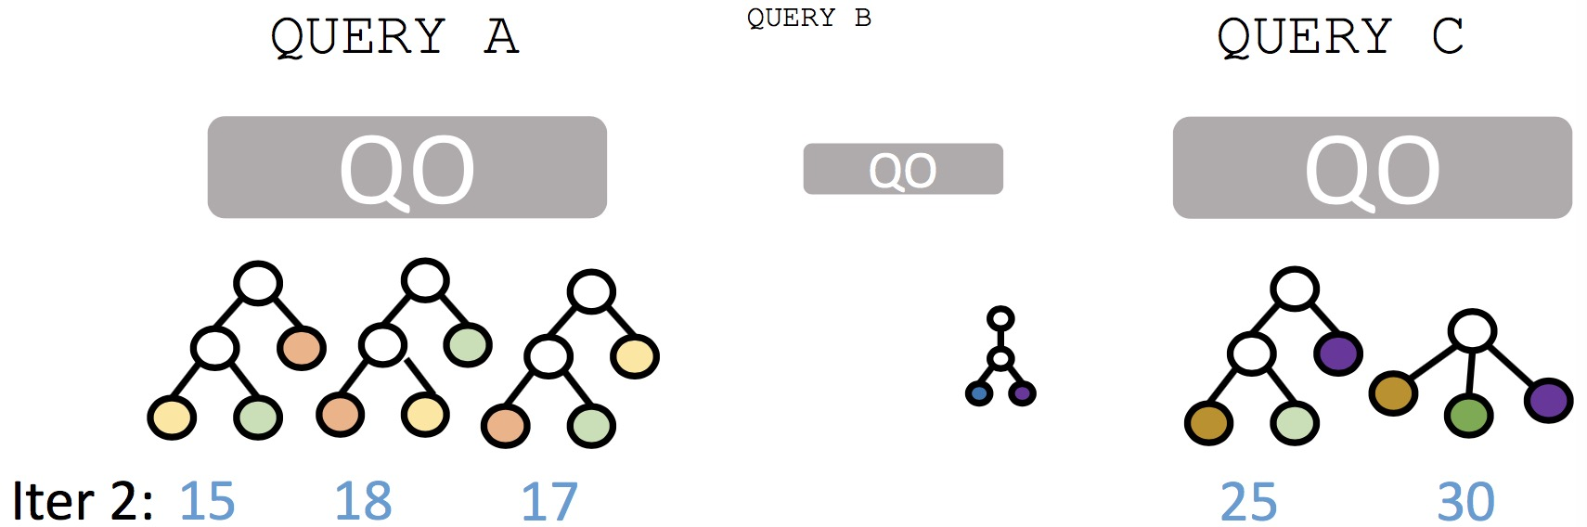
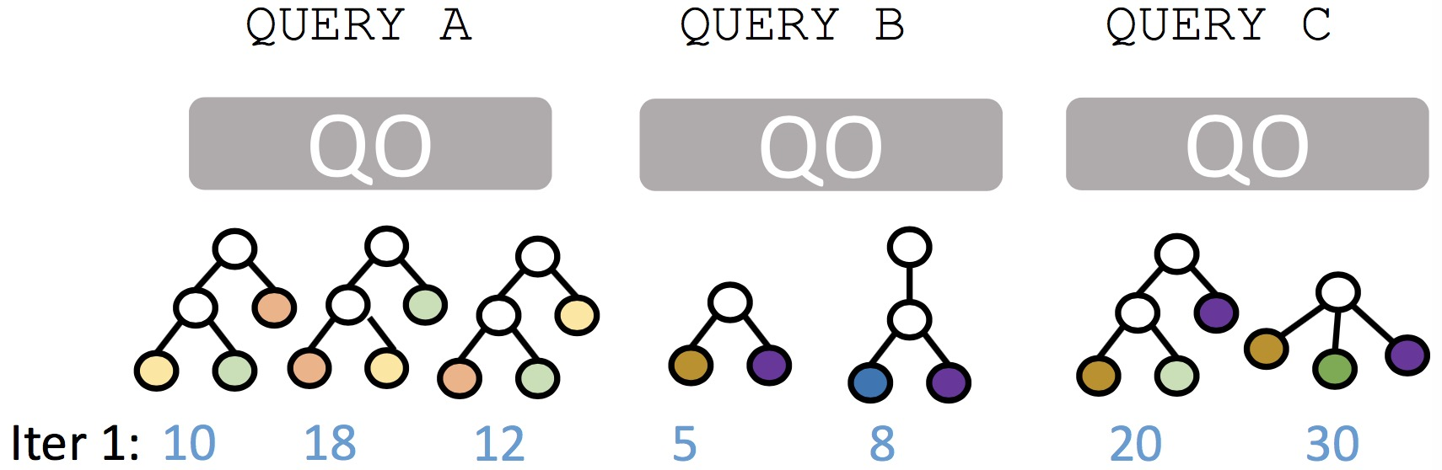
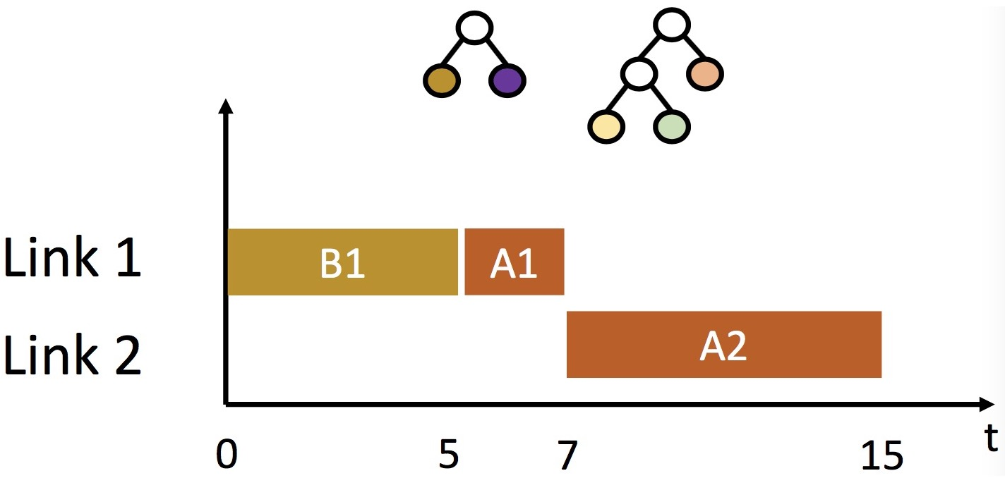
What if iterative SJF ?
Iteratively pick shortest query plan
Reserve BW to guarantee completion time
Notes:
In this case, we pick the shortest plan in all these plans, and reserve link for it after we choose it. Because we want to make sure its running time will not be affected by the rest. In this case, we notice the shortest running time is 5, so we pick it first and reserve link for it. Then, the shortest one is 15, and we choose it ahead of query C. Here we have a problem, we can choose query A first instead of B to make full use of the resource.

Slide 27
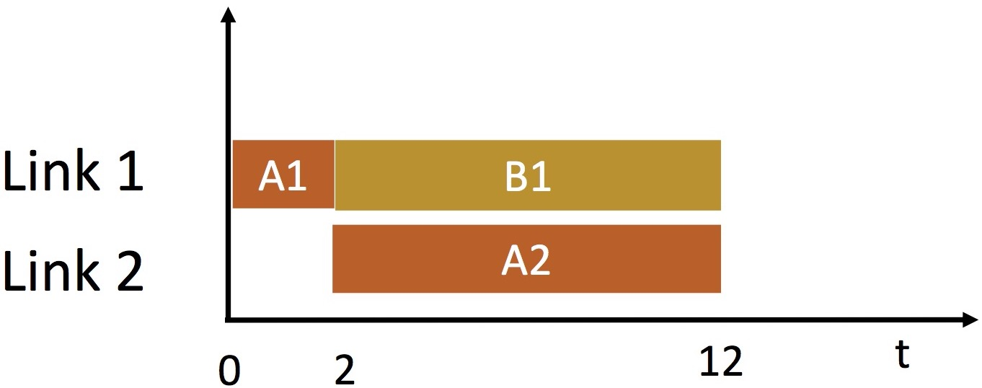
What if iterative SJF ?
Iteratively pick shortest query plan
Reserve BW to guarantee completion time
Resource fragmentation
Due to multiple links, task dependencies
Idle
Notes:
This is the resource fragmentation. Because we consider all the queries share the same link, but they actually travel through different links.

Slide 28
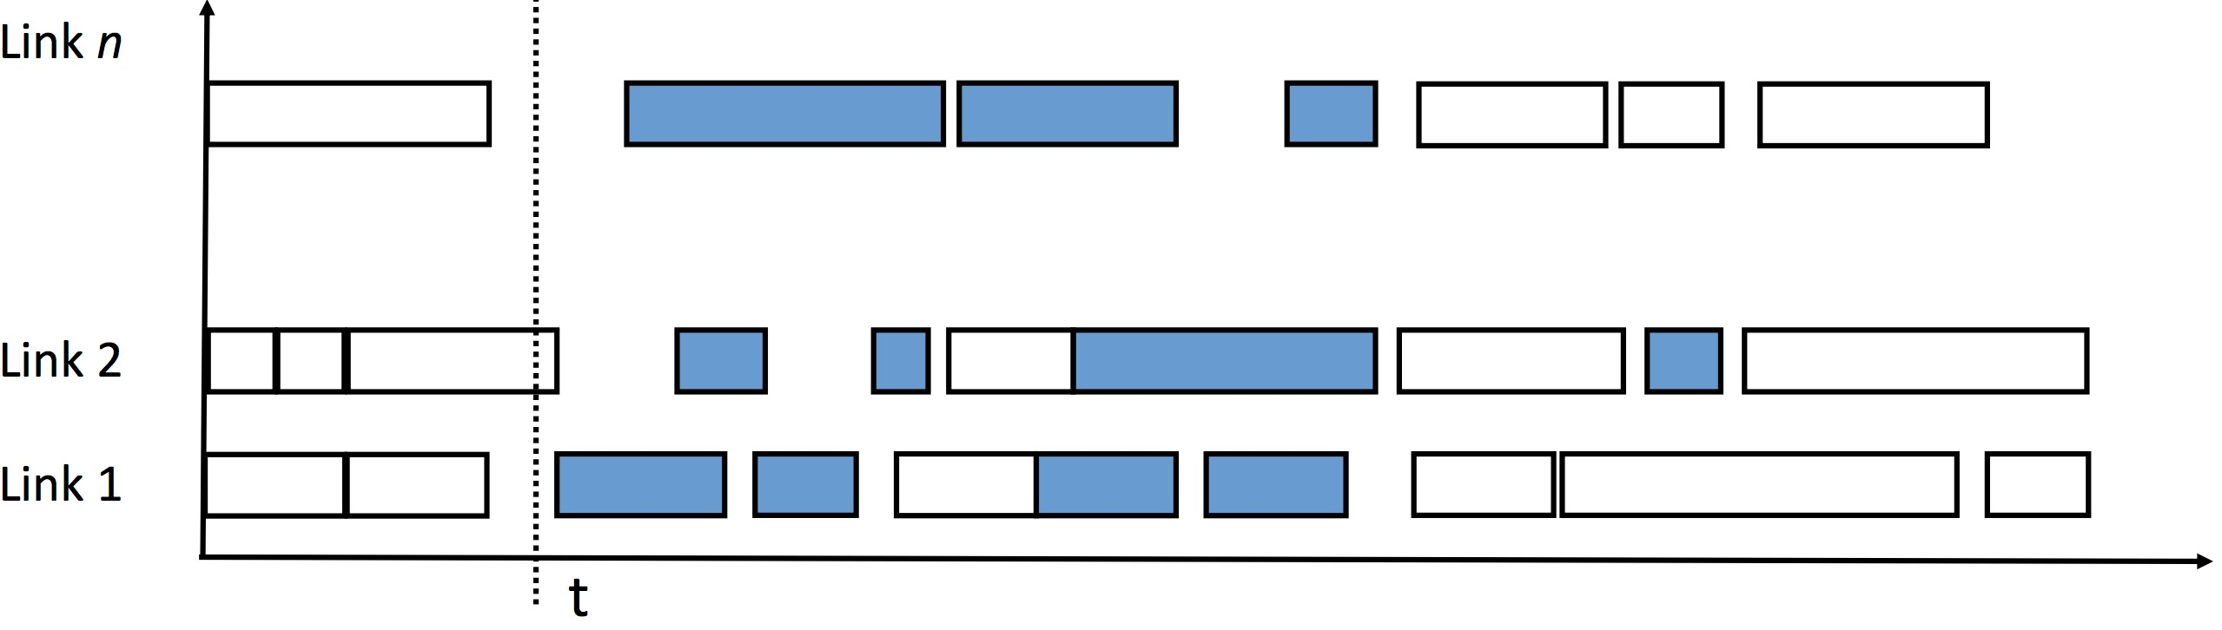
K-Shortest Job First
Identify transfers of k-shortest yet incomplete jobs
Predecessors have completed
Notes:
So in this work, they propose a heuristic solution. we can jointly consider several shortest jobs. For example, we consider K shortest jobs. Here, the predecessors of these selected tasks have already finished. Like the blue chunks show. And this white one is not selected because its parents have not finished yet.

Slide 29
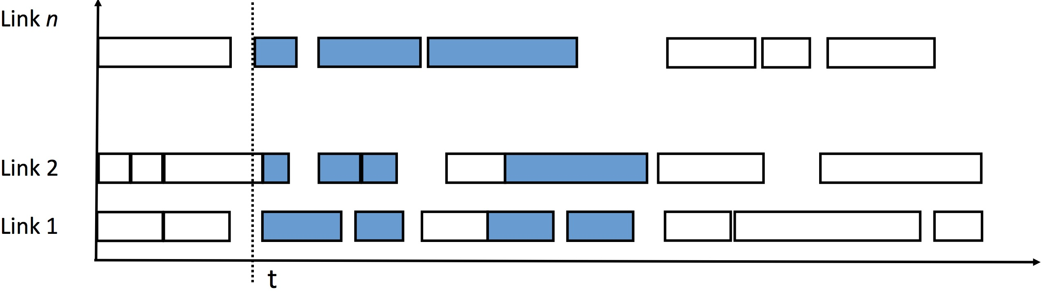
K-Shortest Job First
Identify transfers of k-shortest yet incomplete task
Start as soon as link is free and task is available
If link is free and multiple ones are available, choose them by SJF
Notes:
what we should do now is choose the one with shortest running time if there is available resource. If several ones are available, we still use the shortest job first.

Slide 30
Evaluation
Compare Clarinet with following GDA approaches
Hive: WAN agnostic task placement + scheduling
Hive + Iridium: WAN aware task placement across DCs [SIGCOMM’15]
Geo-Distributed Analytics across 10 EC2 regions
Workload:
30 batches of 12 randomly chosen TPC-DS queries
Notes:
In the experiment, this paper use the default hive and the iridium as baselines. Here the iridium is also a strategy without

Slide 31

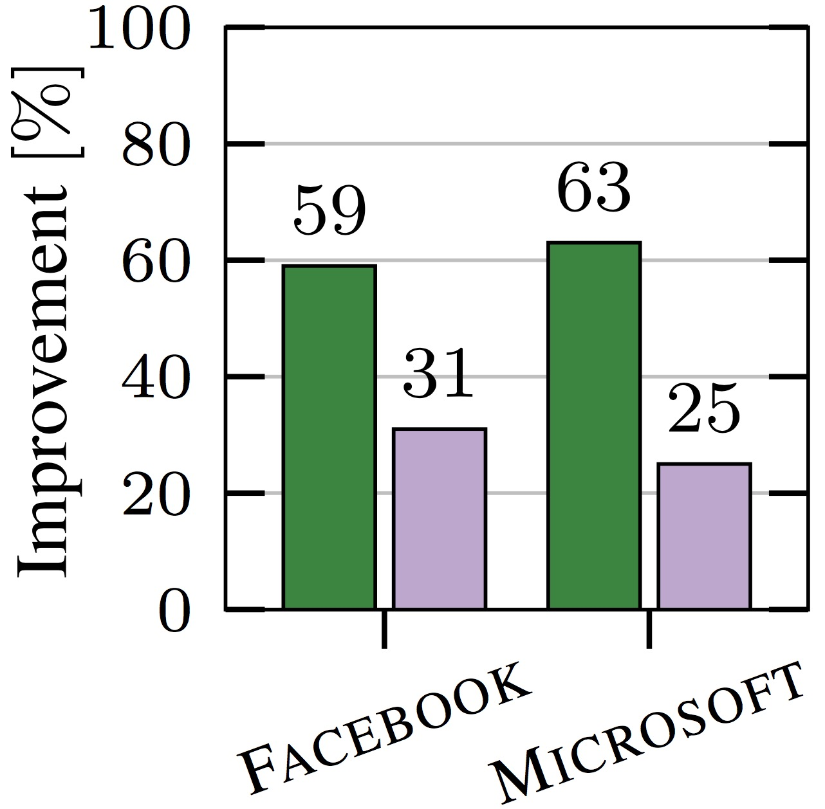
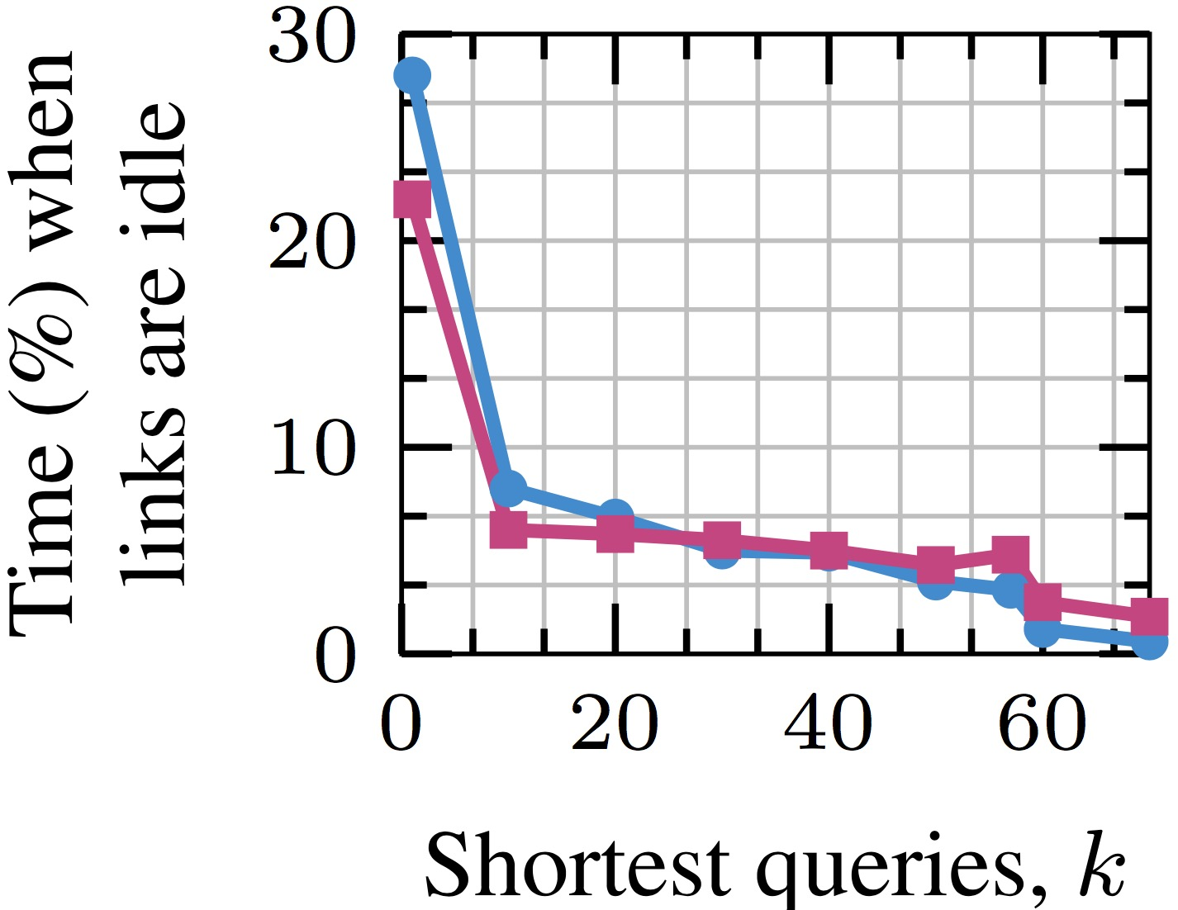
Evaluation results
Reduction in average running time
Reduction in resource fragmentation
Notes:
From the results, we can notice clarinet significantly reduce the average running time, and resource fragmentation by jointly considering several shortest jobs. A small question, since K can reduce the fragmentation, shall we choose a large k?

Slide 32
Thank you for questions!

