Slide 1
Tux²: Distributed Graph Computation for Machine Learning
Authors: Wencong Xiao, Beihang University and Microsoft Research; Jilong Xue, Peking University and Microsoft Research; Youshan Miao, Microsoft Research; Zhen Li, Beihang University and Microsoft Research; Cheng Chen and Ming Wu, Microsoft Research; Wei Li, Beihang University; Lidong Zhou, Microsoft Research
Presenters: William Schmitt, Andrew Levin, Zhao Zhang

Slide 2
Background

Slide 3
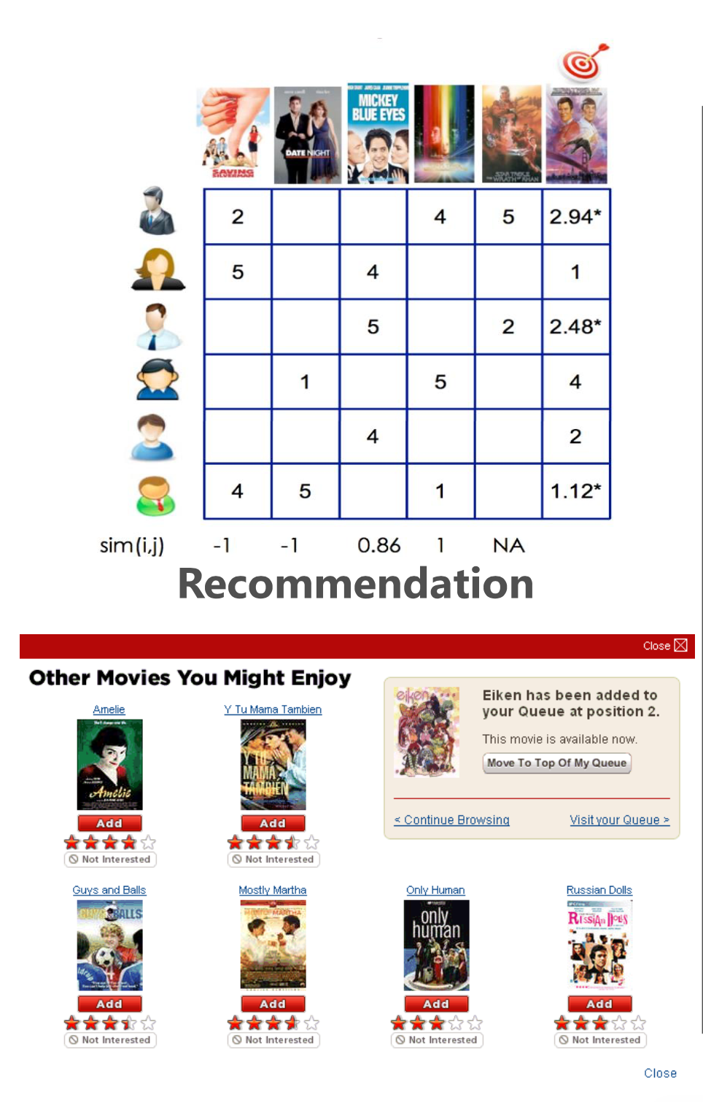
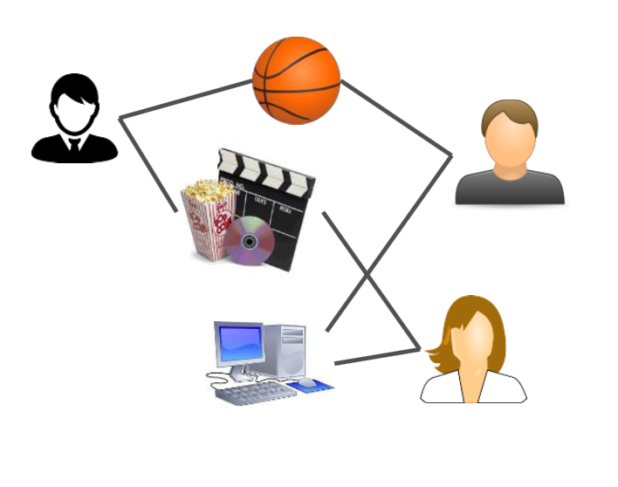
ML in the Wild
App: Movie Recommendation
Problem: Matrix Factorization (MF)
MF as a Graph
Slides adapted from Wencong Xiao, NSDI ‘17
Notes:
A machine learning example:
If we consider a movie recommendation system like Netflix’s
One way netflix is trying to find movies to recommend is to build a matrix that represents the relationships between movies, users, and user ratings by movie
Traditional Matrix Factorization then attempts to solve the “blanks” in these with using some linear algebra
Graph abstraction
Users and items can be considered as vertices in the graphs
Rating behaviour can thus be modelled as the edges between users and items in a graph
Introduce Graph engines

Slide 4
Graph Engines Work Well for ML
Simple programming model
eg. Gather-Apply-Scatter (GAS)
Graph aware optimizations
Data layout, partitioning, etc
Scalability to 3 trillion edges
Slides adapted from Wencong Xiao, NSDI ‘17
Notes:
This means that we can take our machine learning problems and solve them with graph engines like PowerGraph
Graph engines mean simpler interfaces. For exampleGather-Apply-Scatter is a simple abstraction and users only have to specify three functions
Graph engines are able to make graph graph aware optimizations like managing the data layout, partitioning vertices, and more
Graph engines as a result are able to achieve massive scale

Slide 5
Large Scale ML
Large body of research on optimizing graph engines
eg. GraphLab, PowerGraph, PowerLyra
Some research is focused on parameter server
Systems benchmarked against simple algorithms (PageRank)
Slides adapted from Wencong Xiao, NSDI ‘17
Notes:
Introduction
Recent work has focused on the idea machine learning problems can be naturally boiled down to graph problems
PowerGraph and its successor PowerLyra are great example of this: they take the concept of vertex program abstraction to express iterative computation over large scale graphs
A large body of work has been assembled around optimizing the idea of graph engines. Researchers commonly target data layout, partitioning, scheduling and balanced parallelism to achieve massive scalability
Primary problem:
Focusing on optimizing
Audience question:
Does anyone see any problems with benchmarking against something like PageRank
Appendix:
Pregel
Vertex Programs

Slide 6

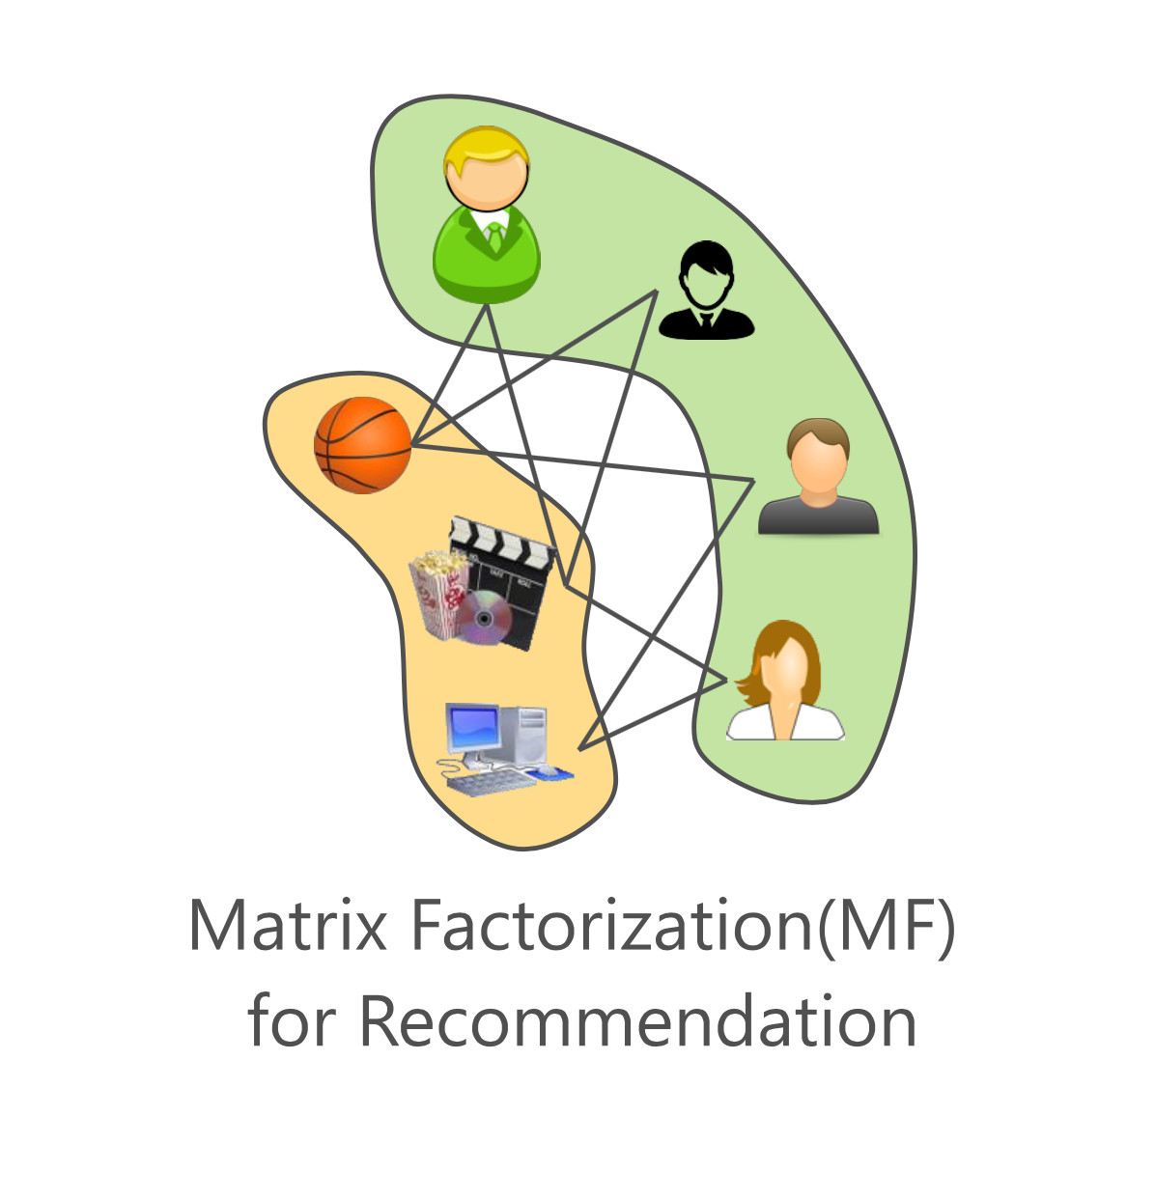
Graph Engines Work Well for ML
Simple programming model
eg. Gather-Apply-Scatter (GAS)
Graph aware optimizations
Data layout, partitioning, etc
Scalability to 3 trillion edges
Graph Engine programming models are too rigid
Homogenous vertices
No support for mini-batches
Strict consistency models
vs.
Slides adapted from Wencong Xiao, NSDI ‘17
Notes:
// Spend more time on gaps of emphasising that Jack will explain how TuX2 solves this gaps
However, graph engines struggle to handle some of the more complex problems in machine learning
Graph engines don’t support for heterogeneous vertices → most will only consider homogeneous vertices, which well for PageRank, however, doesn’t work as well for Matrix Factorization
The graph engine should support mini-batch processing because sometimes in machine learning we just want to use a subset of the training data to update the entire model
Graph engines make strict consistency models: the entire graph is computed all at once. Machine learning algorithms are designed to handle some degree of error and will still converge if we just use the graphs

Slide 7
Solution: TuX²
Bridge graph engines and parameter serves in one framework
Extend graph engines for distributed machine learning
Benchmark against tougher ML problems
Matrix Factorization
LDA
BlockBG

Slide 8
Solution: TuX²
Introduce new flexibility:
Data Model: Heterogeneous Data
Scheduling: Stale Synchronous Parallel Model (SSP)
Programming: Mini-batch, Exchange, GlobalSync, and Apply (MEGA)

Slide 9
TuX² Design

Slide 10
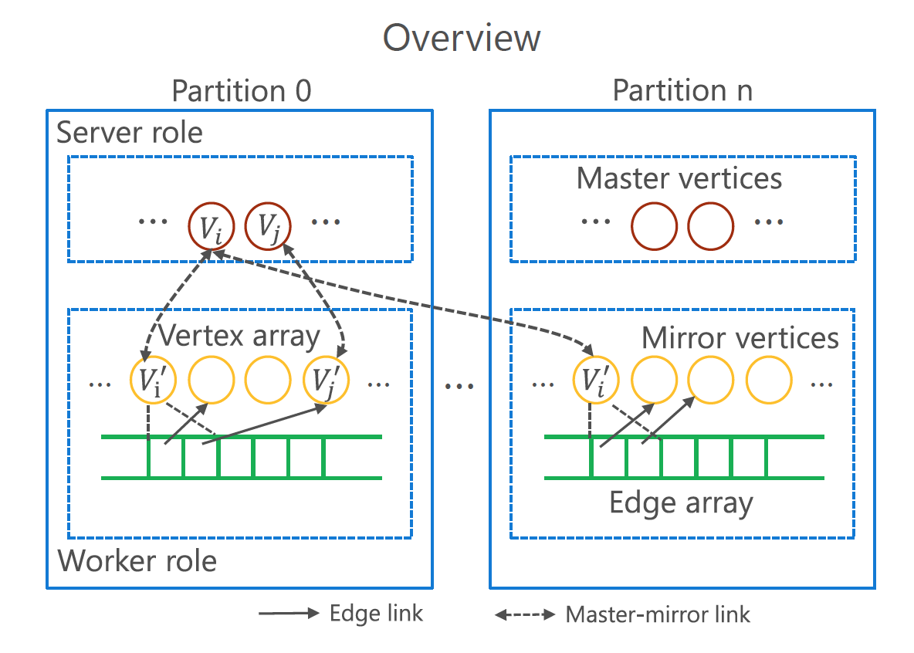
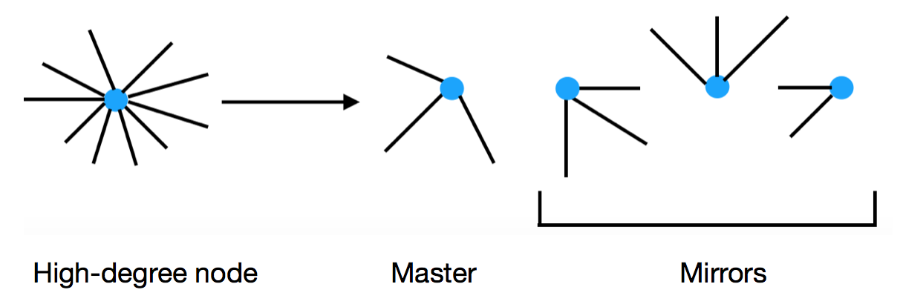
Vertex-cut approach
Partition the high degree vertices into several parts
Each partition maintains 3 arrays:
Edge array -->edges grouped by their source vertices
Master vertices array (one partition may have multiple master vertices)
Mirror vertices array
Each partition is managed by a process playing 2 roles:
a worker role: compute vertices and propagate data along edges
a server role: synchronize states between masters and mirrors
Notes:
Vertex-cut approach
Partition the high degree vertices and their edge sets into several partitions, each maintaining a replica of the vertex
One of the replica is called the master, and maintains the master version of the vertex data
The others of the replica are called the mirrors, with a local cached copy of the vertex data
Benefits:
Effective in handling power-law graphs
Connects naturally to the parameter-server
Audience question:
Does anyone see any problems with benchmarking against something like PageRank
Appendix:
Pregel
Vertex Programs

Slide 11
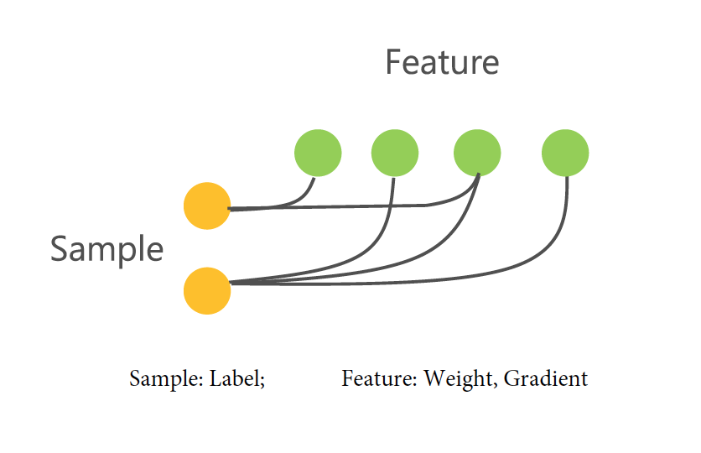
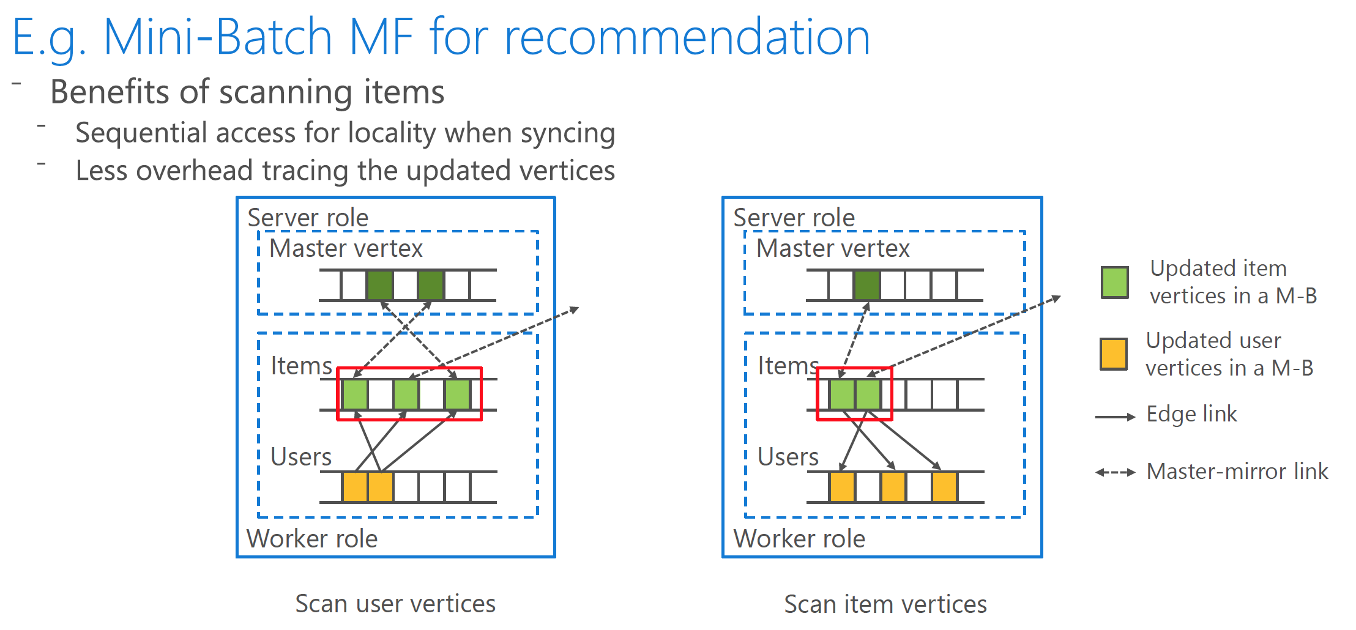
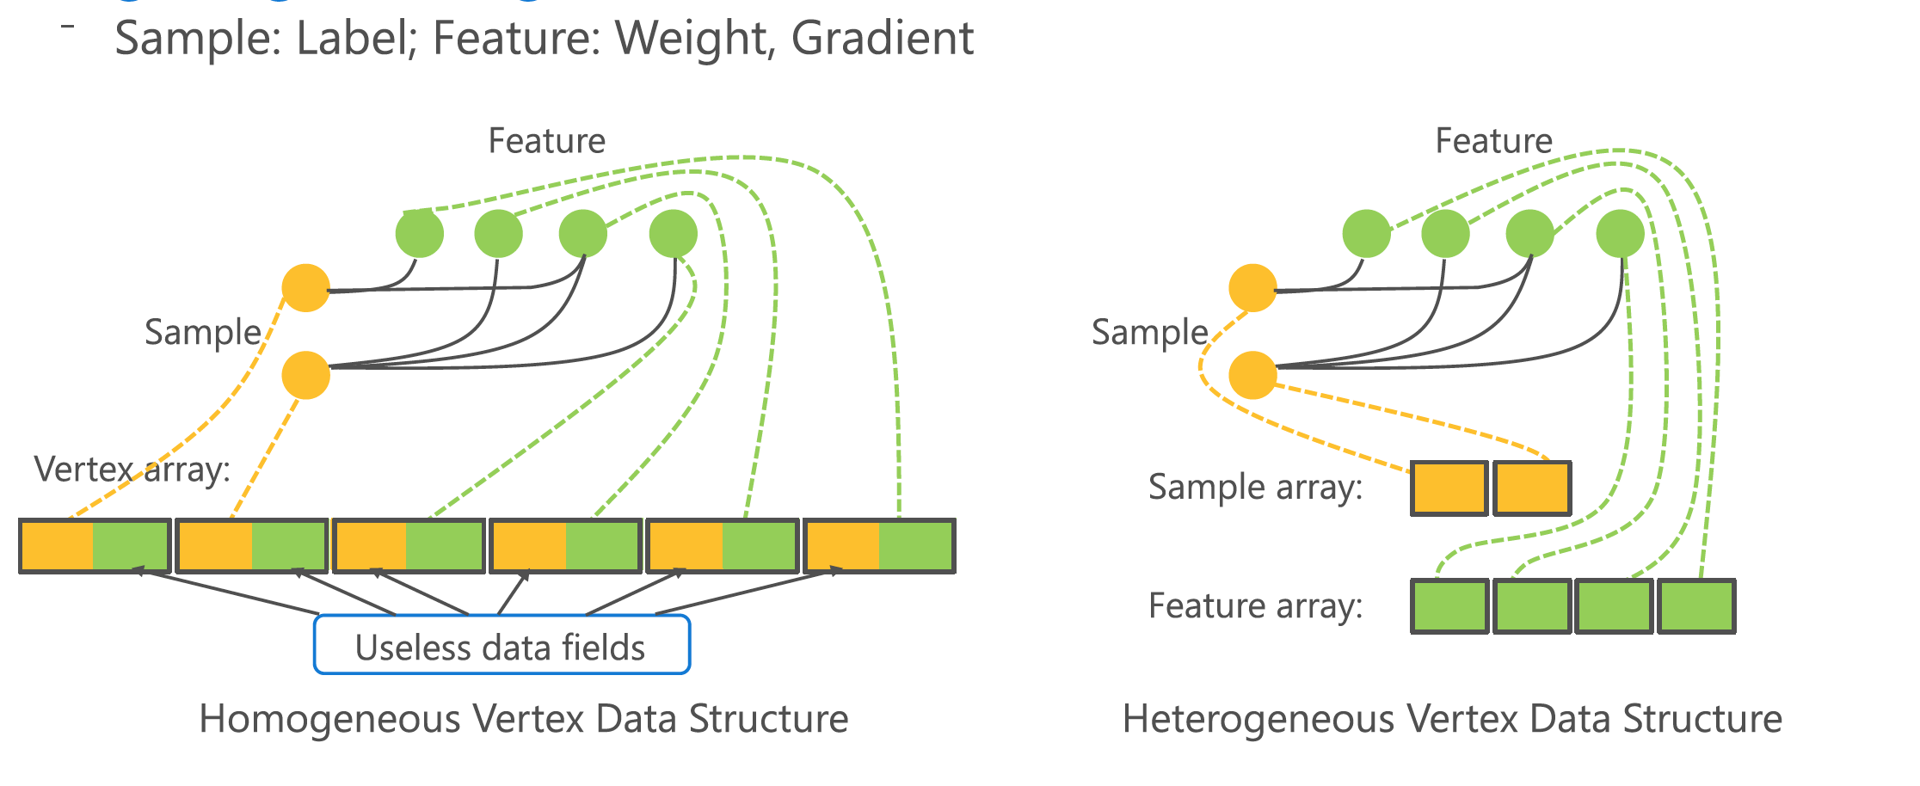
Heterogenous data layout
Heterogeneous vertices
E.g Logistic Regression (Sample and Features vertices)
Matrix Factorization (users and items vertices)
Heterogeneity for compact data structure
Allow users to define different vertex types
And place different types of vertices into separate arrays
Heterogeneity for efficient excecution
Notes:
Heterogeneous vertices (focus on bipartite graphs with two disjoint sets of vertices)
Different type of vertices with different properties and data
Logistic Regression: features and samples
Matrix Factorization: users and items
Heterogeneity for compact data structures:
Tux2 allows users to define different vertex types and places different types of vertex in separate arrays
This leads to a compact data representation
And improves data locality during computation
Heterogeneity for efficient execution:
Using the example of MF algorithm
Item vertices typically have much higher degrees, and we only partition these vertices
When enumerating edges, scanning the vertices with mirrors will be more efficient
If scan the users array, more random access to update the item vertices and sync between master and mirror vertices
In general, scanning the items array will lead a sequential access when sync between master and mirrors
Because the updated item vertices are already aligned contiguous in the array, we save the overhead of tracing them.

Slide 12
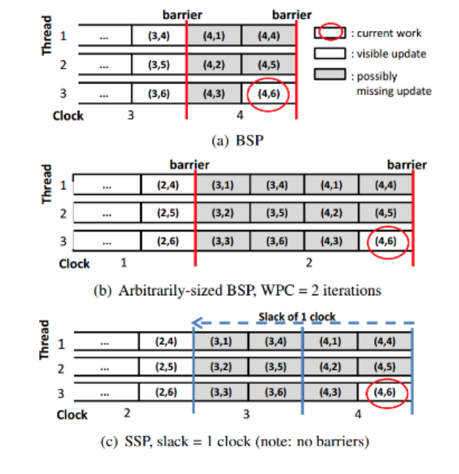
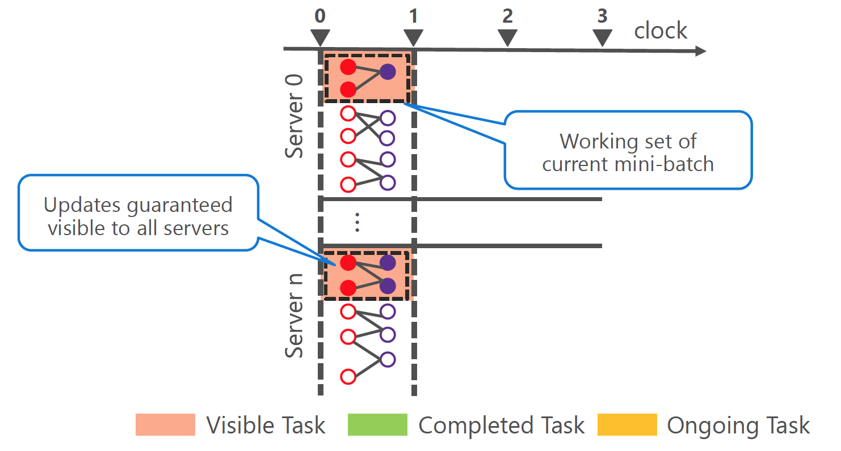
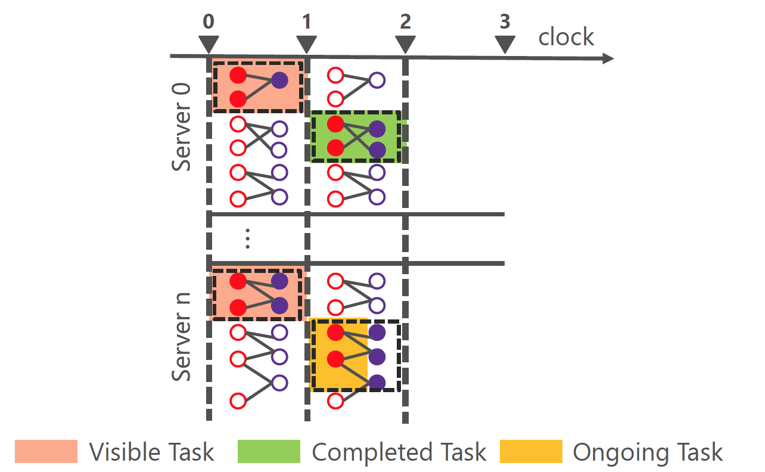
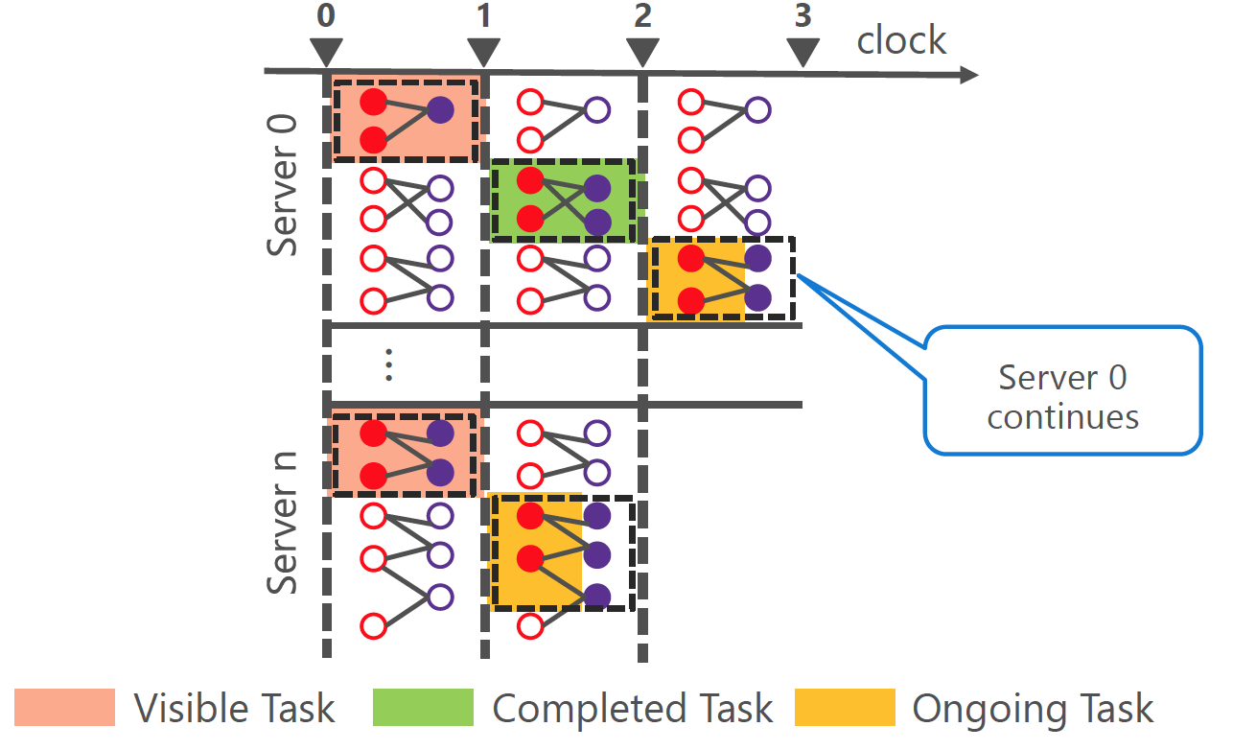
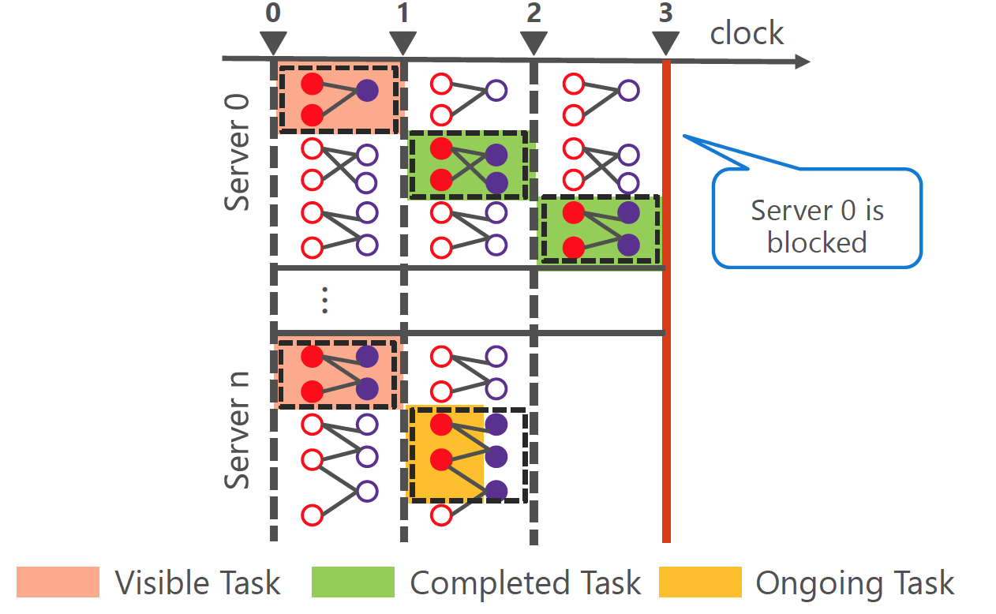
Stale Synchronous Parallel (SSP) based scheduling
Introducing the flexibility for soft barrier mini-batch
A clock — defines the synchronization barriers between tasks
A slack — how many clocks the data that is seen by a worker can be out of date
i.e. how far ahead of the slowest worker that any worker may process
‘Soft’ barrier:
By playing with the slack parameter, every worker can process at its own rhythm while guaranteeing that the data is not out-of-date of more than a certain clock values.
A worker can execute a task at clock t only if it knows that all the clocks up to t-s-1 have completed.
Notes:
SSP Model
A clock : to my understanding it’s like how many iterations to take a sync over a mini-batch executed by a set of concurrent tasks
In contrast with the already well known processing model of Bulk Synchronous Parallel model which refers to the BSP model, SSP introduced a softer barrier scheduling
Examples:
For the beginning, all servers have already finished clock1
Then they continue to clock2, here notice that not all the server finish at the same time, which is very common in the BSP model. With the slack tolerated by the SSP model set to be 1, although server n hasn’t finish clock 2, server0 can continue working on clock3
When server 3 finishes clock3, it is possible that the slowest server, server_n is still working on clock2, now server0 is blocked until server_n finishes clock2

Slide 13
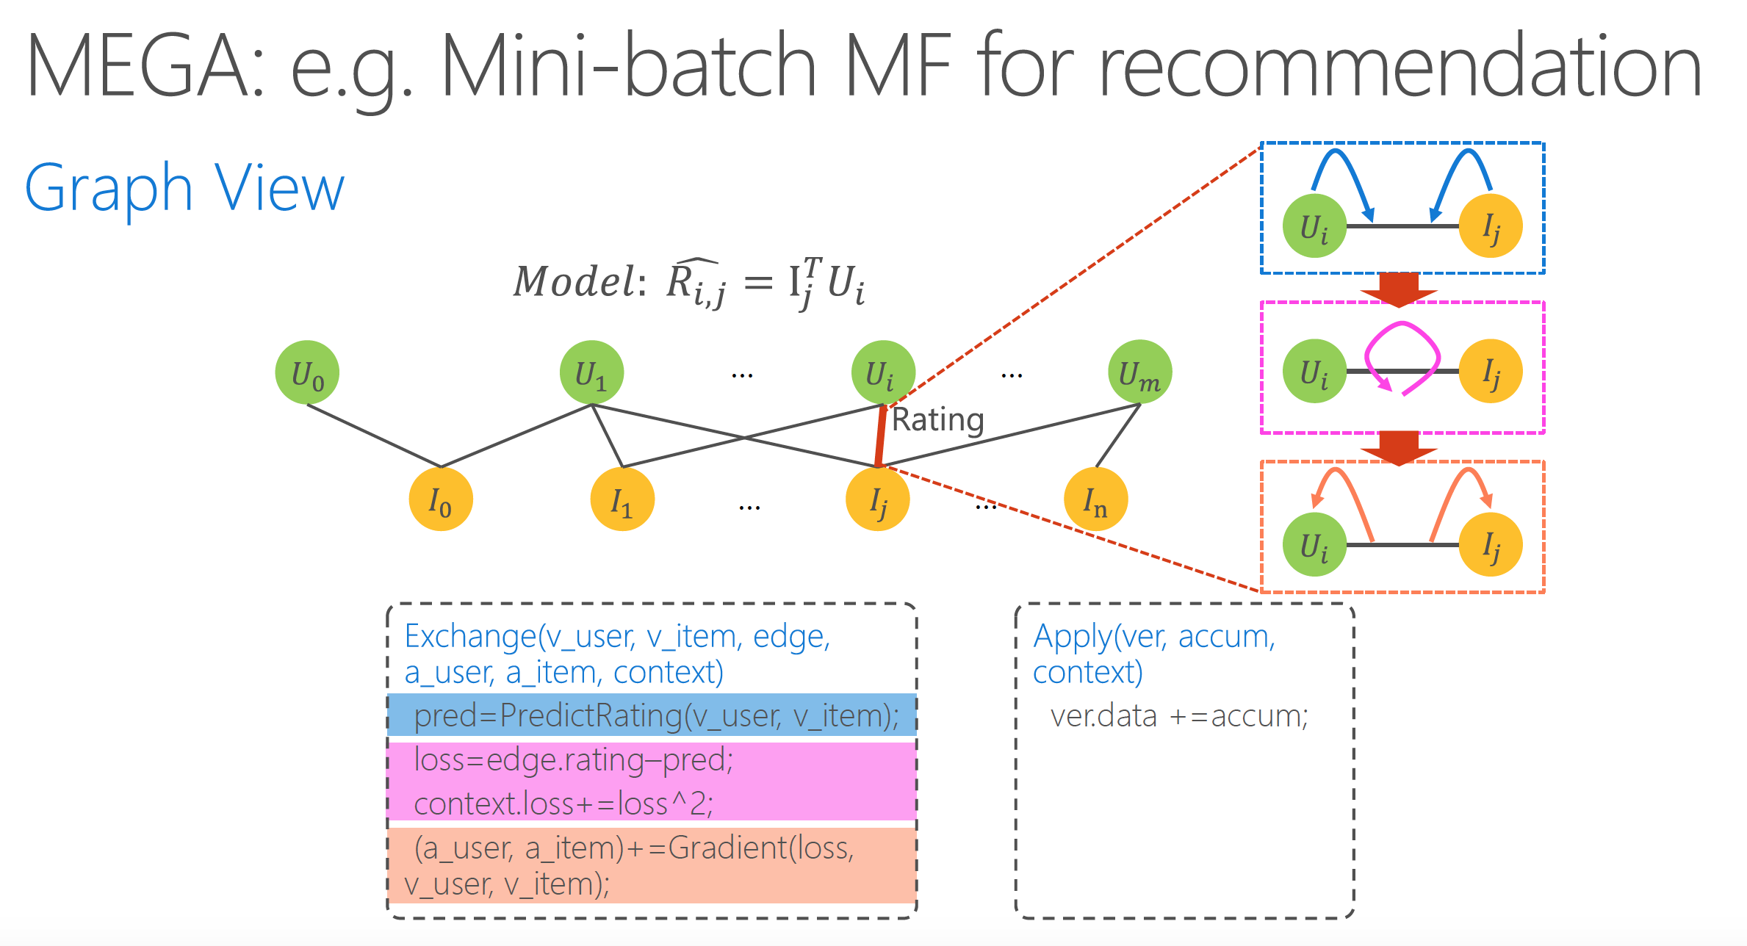
MEGA graph model
Supporting 4 stages:
Mini-Batch(M), Exchange(E), GlobalSync(G), and Apply(A)
Allow users to construct an arbitrary sequence of stages
Exchange:
Can update the states of both vertices connected by one edge
Save unnecessary GAS phase
Apply:
Enumerate a set of vertices and synchronize their masters and mirrors
Notes:
Stage-based MEGA model
A stage -- a computation using user defined function on a set of vertices and their edges
Arbitrary sequence of stages are allowed
Preserves the simplicity of GAS model while improved the deficiency to support machine learning algorithms

Slide 14
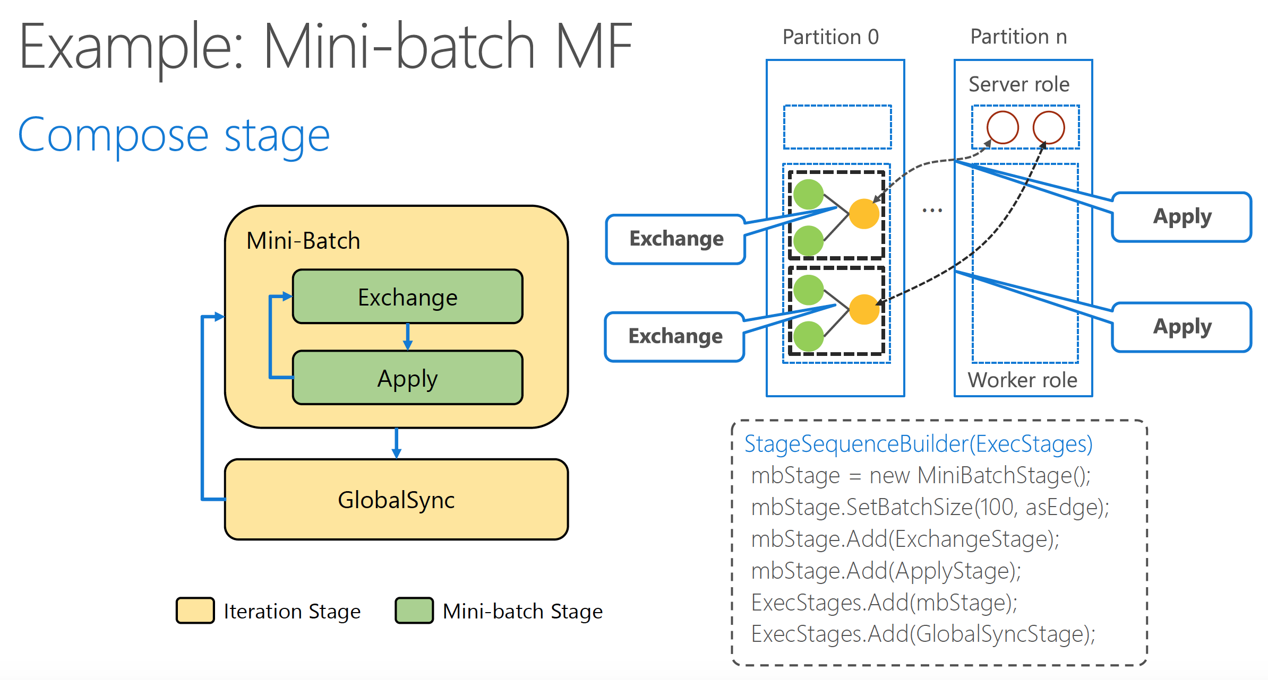
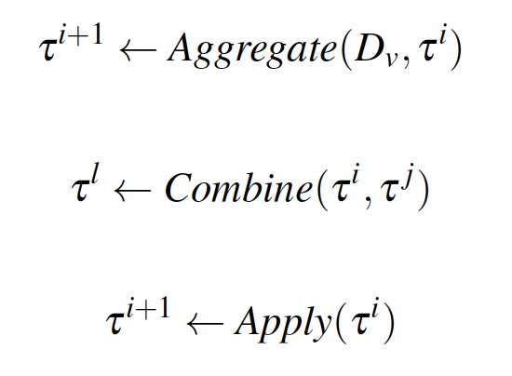
MEGA model cont.
Mini-Batch:
A composite stage containing a sequence of other stages
Defines the stages to be executed iteratively for each mini-batch
GlobalSynch:
Aggregates data across vertices within one worker
combine the user defined context across workers into one
finalize the globally aggregated context and synchronize it back to all the workers

Slide 15
ML Algorithms in TuX²
Notes:
(Section 4: Will)
Cover MF in depth
Do normal closed form MF
Build MF in MEGA
Quick overview of the following LDA and BlockPG

Slide 16
Three Major Algorithms Implemented
Matrix Factorization (MF)
Latent Dirichlet Allocation (LDA)
Block Proximal Gradient (BlockPG)

Slide 17
Matrix Factorization (MF)
What is MF? | Decompose an adjacency matrix of users and items into two matrices
Common Use for MF | Recommendation systems
MF in TuX² (MEGA) | Data Training data is a bipartite graph user and items → (heterogenous) vertices ratings → edges Method Solve with SGD

Slide 18
Matrix Factorization in MEGA
// Batch
void StageSequenceBuilder(ExecStages){
ExecStages.Add(ExchangeStage); ExecStages.Add(ApplyStage); ExecStages.Add(GlobalSyncStage);
}
StageSequenceBuilder() builds the stage sequence for each MF iteration.
Each iteration is then composed of:
ExchangeStage()
ApplyStage()
GlobalSyncStage()

Slide 19
Matrix Factorization (MF) in MEGA
//ExchangeStage:: Exchange(v_user, v_item, edge,a_user, a_item, context){ val pred = PredictRating(v_user,v_item); val loss = pred - edge.rating; context.loss += lossˆ2; (a_user,a_item) += Gradient(loss,v_user,v_item);
}
// ApplyStage:: Apply(ver, accum, ctx){ // Apply accumulated gradients ver.data += accum; }
Exchange()
computes the gradients of the loss function given a user and an item
accumulates the gradients into a user and an item, respectively
Apply()
Accumulated gradient updates each vertex

Slide 20
Matrix Factorization (MF) in MEGA
//GlobalSyncStage::
Combine(ctx1, ctx2){
ctx.loss = ctx1.loss + ctx2.loss; return ctx;
}
Combine()
sums the losses to evaluate convergence
Mini-Batch Version
only ExchangeStage and ApplyStage conducted per mini-batch
GlobalSyncStage conducted per iteration

Slide 21
Reference: Simple MF in Python
for t in xrange(T):
for i in xrange(M):
if i in ratings_by_i:
accum = 0
for j, r in ratings_by_i[i]:
accum += (r - U[i,:].dot(V[:,j]) - C[j] - mu)
B[i] = accum / (1 + reg) / len(ratings_by_i[i])
for i in xrange(M):
if i in ratings_by_i:
matrix = np.zeros((K, K)) + reg*np.eye(K)
vector = np.zeros(K)
for j, r in ratings_by_i[i]:
matrix += np.outer(V[:,j], V[:,j])
vector += (r - B[i] - C[j] - mu)*V[:,j]
U[i,:] = np.linalg.solve(matrix, vector)
# update C
for j in xrange(N):
if j in ratings_by_j:
accum = 0
for i, r in ratings_by_j[j]:
accum += (r - U[i,:].dot(V[:,j]) - B[i] - mu)
C[j] = accum / (1 + reg) / len(ratings_by_j[j])
# update V
for j in xrange(N):
if j in ratings_by_j:
matrix = np.zeros((K, K)) + reg*np.eye(K)
vector = np.zeros(K)
for i, r in ratings_by_j[j]:
matrix += np.outer(U[i,:], U[i,:])
vector += (r - B[i] - C[j] - mu)*U[i,:]
V[:,j] = np.linalg.solve(matrix, vector)

Slide 22
High Level Takeaways
Key ideas:
MEGA model
TuX² programs require less code
TuX² can express modern, complex ML tasks

Slide 23
Implementation & Evaluation

Slide 24
TuX2
12,000 lines C++
Linux and Windows Clusters
Symmetric
All process peers executing same binary
Input: text files
Interprocess communication
RDMA
TCP
Notes:
Each process operates on subset to partition graph in distributed manner
Each partition stored locally
Default is RDMA, TCP used for comparison for fairness

Slide 25
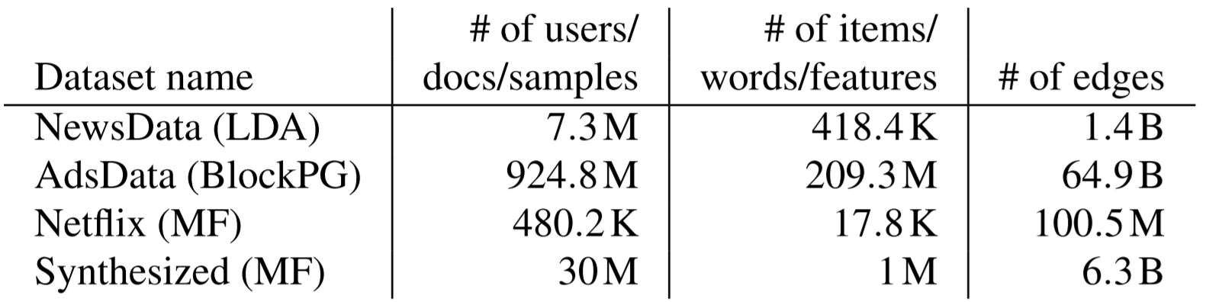
Experimental Setup
TuX2 - RDMA as default
TCP used for comparison
Algorithms
Matrix Factorization (MF)
Latent Dirichlet Allocation (LDA) - Computation Bound
Block Proximal Gradient (BlockPG) - Communication Bound
Notes:
NewsData and AdsData are two real datasets used in production by Microsoft for news and ads
Netflix is largest public dataset available for MF
Create own synthesized dataset
Tested over 100 iteratoins

Slide 26
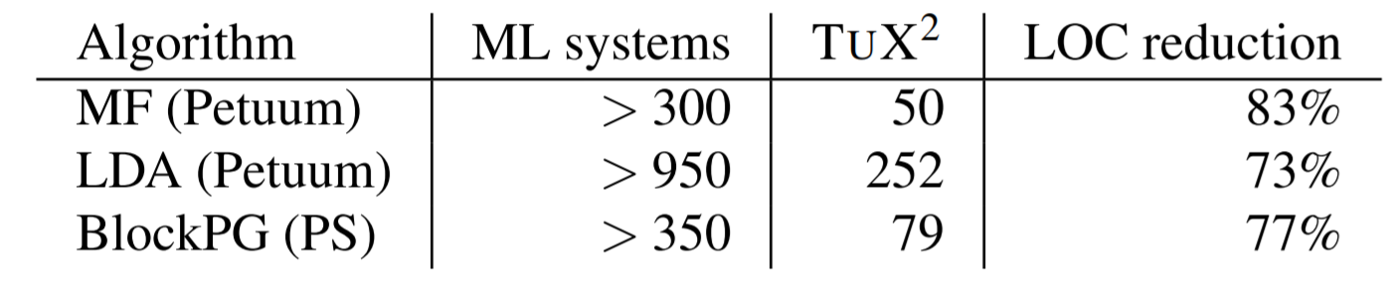
Programmability
MEGA allows developers to ignore
Data organization
Enumeration
Partitioning
Parallelism
Thread Management
Notes:
73-83% reduction in LOC compared to C++ implementations on Petuum or Parameter Server
But LOC comparable to those written with GAS model

Slide 27
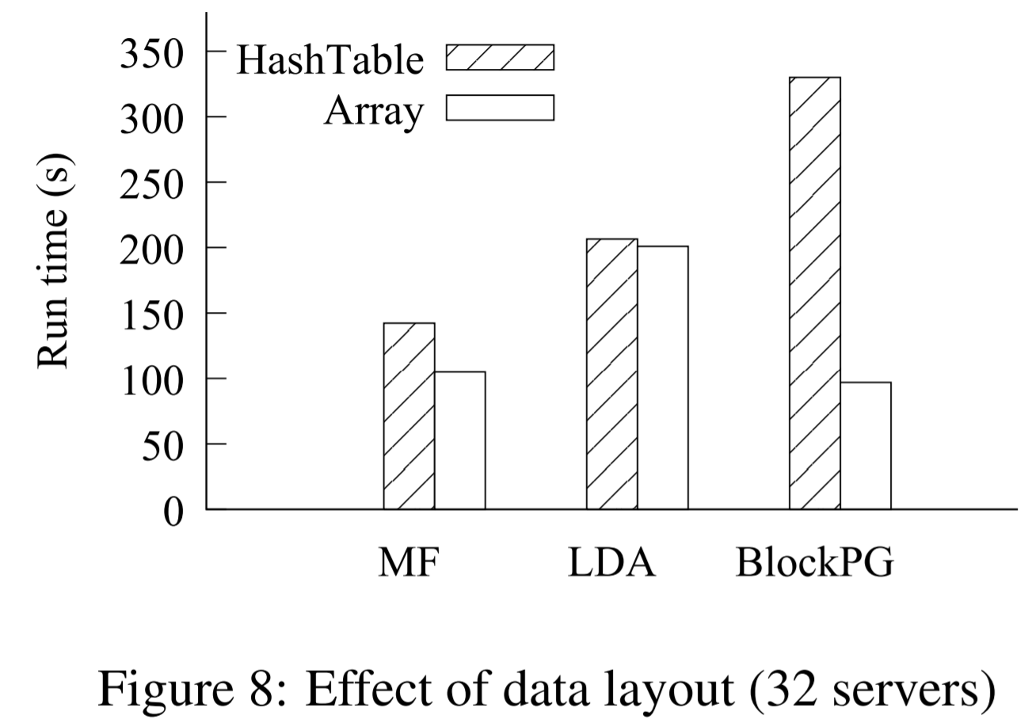
Data Layout
Hashtable used in Parameter-Server
Implemented in TuX2 for comparison
Array-based graph data up to 2.4x better
LDA dominated by floating-point math
Notes:
Hashtable often used in Parameter Server based systems (implemented in TuX2 for comparison)
Y-axis: average run time for one iteration of blockPG and of 10 iterations (just to keep on same scale) for MF and LDA (run 100 times)

Slide 28
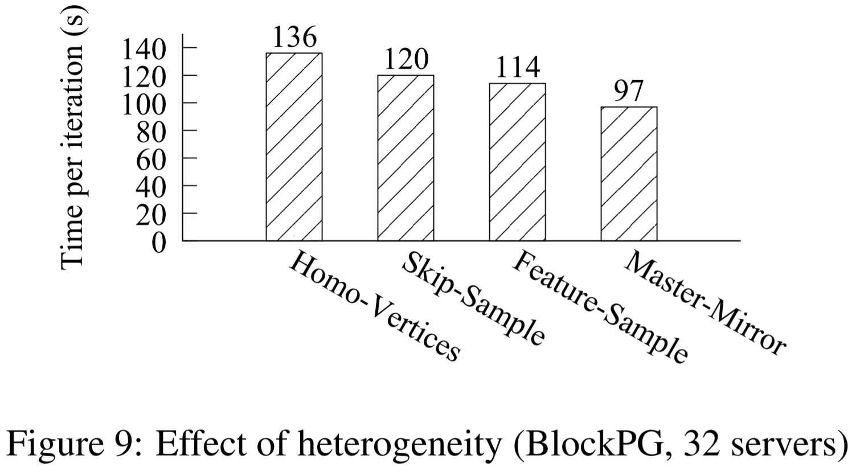
Heterogeneity
Same vertex
BlockPG: only features have mirrors
Enumerate only feature vertices
Feature/Sample different data types
Master/Mirror different data types
40% better than homogenous
Notes:
BlockPG: only feature vertices have mirrors so we can specify to enumerate only feature vertices in each mini-batch and not track whether sample vertices have been updates (because we do not have mirrors to synchronize them with)
Master/Mirror: different data types and indicate which data need to be synchronized

Slide 29
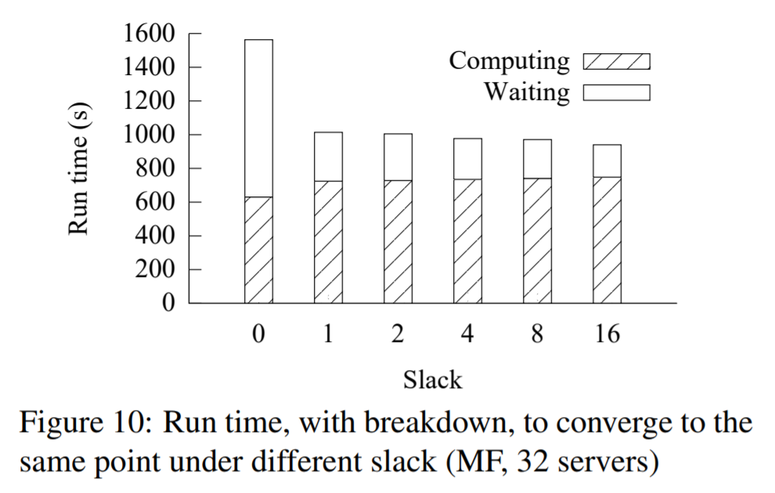
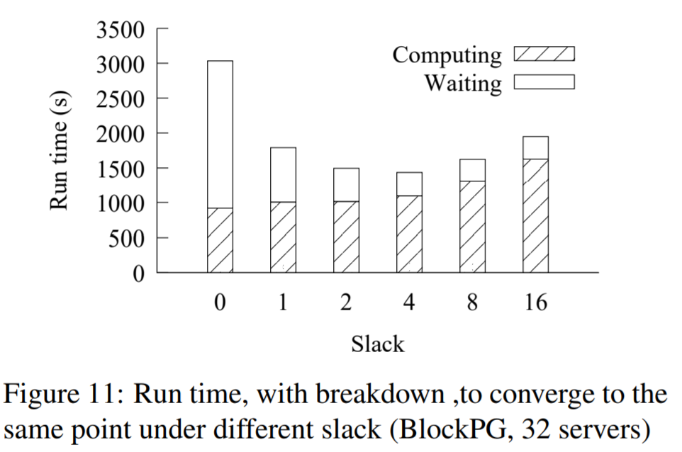
Stale Synchronous Parallel
Configure slack for staleness bound
MF: Increasing slack...
reduces waiting time and…
slightly increases computing time
BlockPG: Increasing slack...
significantly increases computing time
Notes:
Allows users to tune staleness parameter for desirable convergence
Slack value of 4 is optimal for overall convergence time

Slide 30
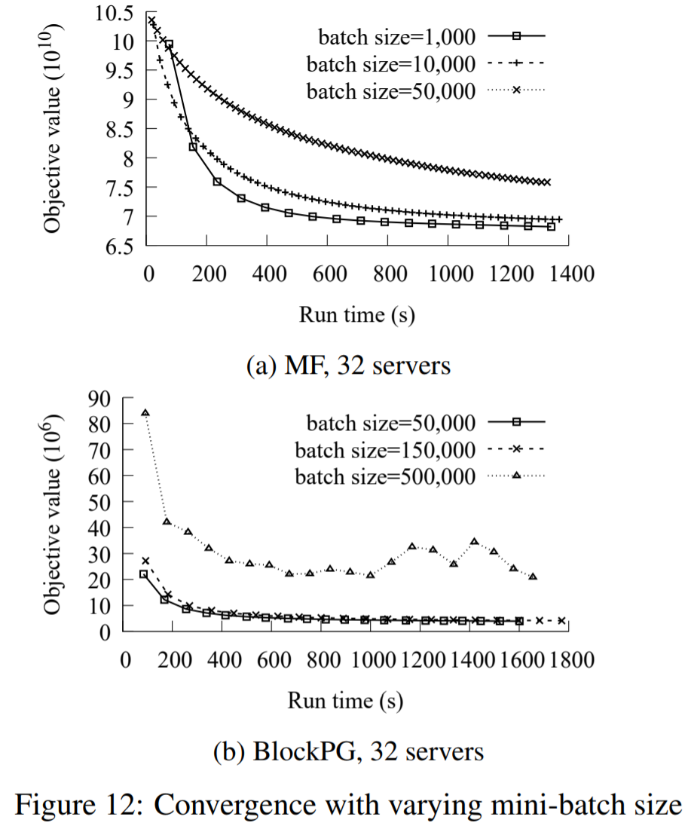
Mini-batch
Smaller size less iterations but…
More frequent communication -> longer iterations
Notes:
Tuned by users
LDA is batch algorithm and does not support mini-batches
More frequent communication -> longer iterations shown by sparse itetaoin points on curce for size 1000, notice for first 180s 10k is beating 1 k
500 k not converging for BlockPG

Slide 31
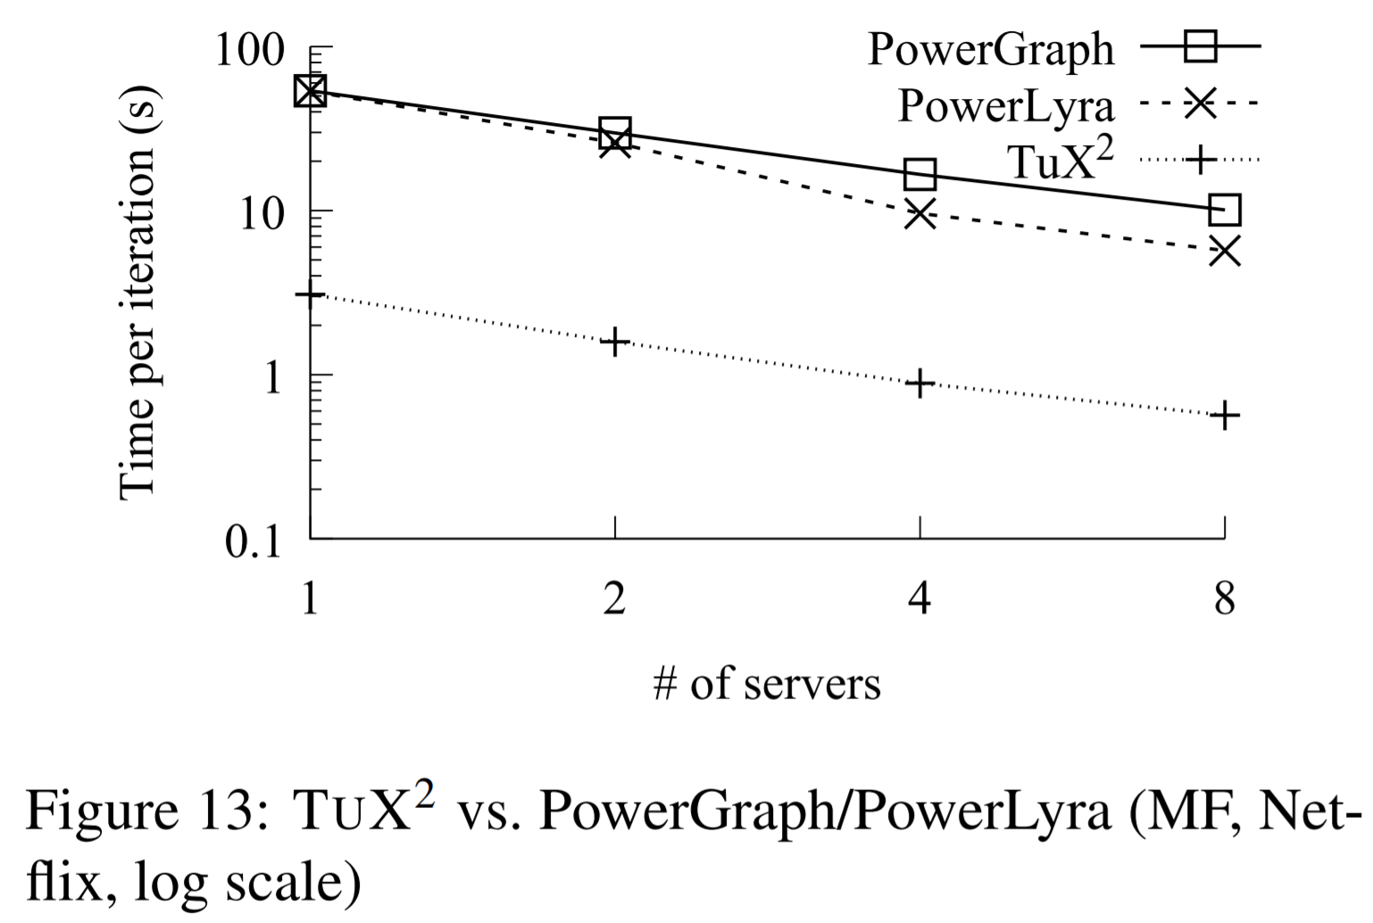
TuX2 vs. PowerGraph and PowerLyra
Support GAS based MF
Two GAS phases per iteration
Synchronization overhead
Do not support SSP so no slack for comparisons
TuX2 > order of magnitude better due to MEGA
TuX2: One ExchangeStage and one ApplyStage per iteration
Exchange (TuX2) takes 0.5 s, Gather takes 1.6s
Due to heterogeneous data layout
GAS two extra scatter phases waste 7.4 s
Notes:
Lyra is 1.6x better than graph
Two phases: one for user vertices and the other for item vertices

Slide 32
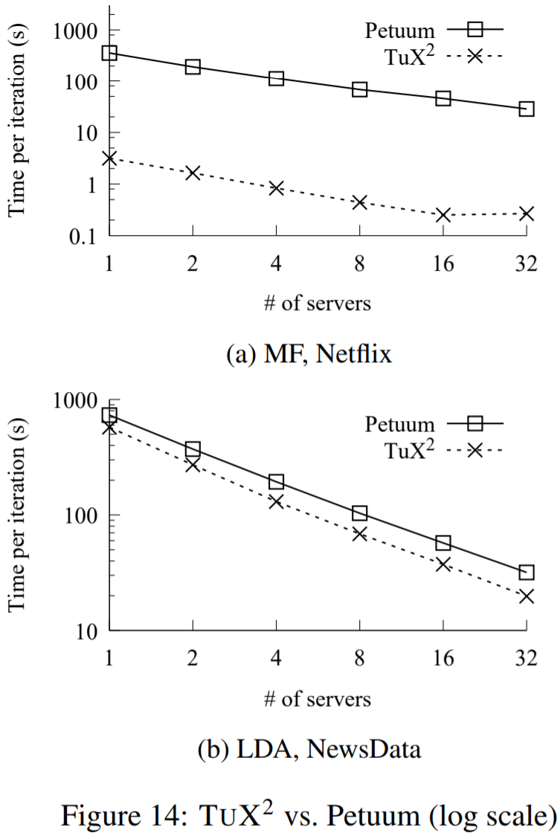
Petuum
Distributed shared memory table (multilayer hash structure)
Fine-grained row-level version tracking
Staleness check for each read/write operation vs check for each iteration/mini-batch start
User and item data stored in parameter server
Communication to update either
TuX2: only item vertices have mirrors -> updating user vertices efficient (no unnecessary communication)
LDA dominated by floating-point math
Notes:
MF: TuX2 two orders of magnitude better
Jump from 16 to 32 for Netflix is because Netflix data is small when divided among 32 servers x 16 threads (only 3 MB per thread) so communication costs dominate
LDA gains limited because dominated by floating point math

Slide 33
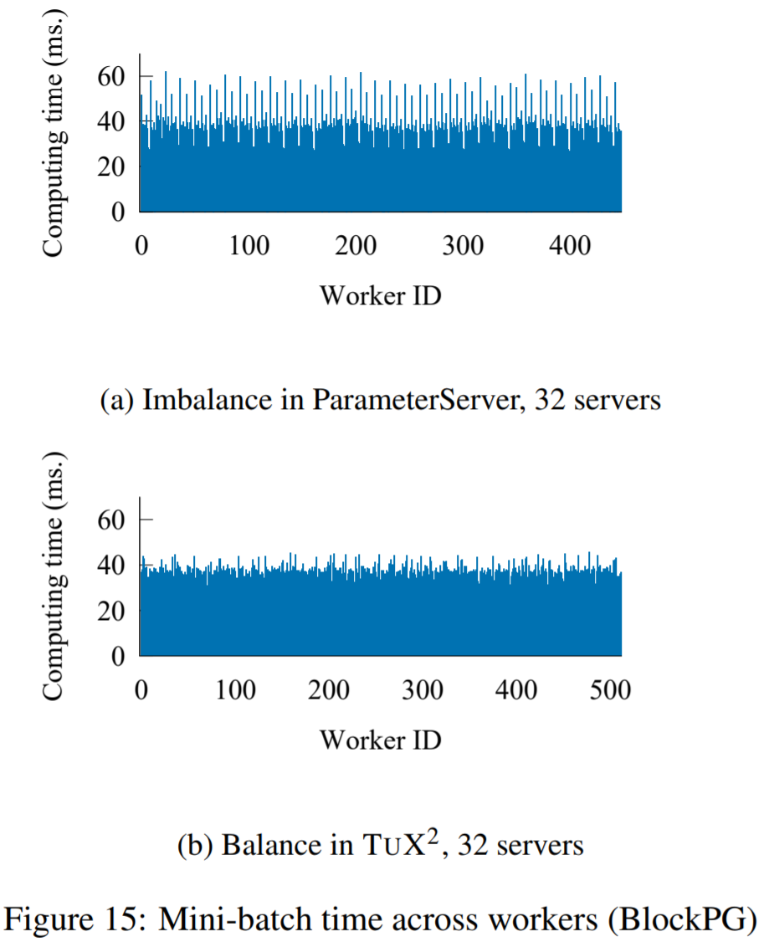
Parameter Server
BlockPG
TuX2: 125 seconds per iteration
PS: 186 seconds per iteration
Data skew imbalance
PS: Few threads work longer, others wait at synchronization points
Tux2: vertex-cut for threads in same process
Notes:
Data skew: some features exist in a large number of samples

Slide 34
Recap

Slide 35
TuX² vs. Everybody
Framework | Goal | Consistency | Programming Paradigm | ML or DL focused? | Industry Use Cases
TuX² | Reduce code needed, improve perf | Relaxed | MEGA | ML | Complex ML
PowerGraph | Improve perf | Strict | GAS | ML | Graph computation
Tensorflow | increase abstraction; improve perf & flexibility | Relaxed | Up to Programmer | DL | DL
SparkML | Use RDDs/Spark in ML apps | Strict | Functional (RDD based) | ML | Fast to develop; Uses same API as Spark

Slide 36
Group Discussion
Questions for group discussion of the paper
Notes:
Whats the etymology of Tux2?
How does this system compare to tensorflow?
What are characteristics of a successful big data machine learning framework?
Compare the success of Tux2, tensorflow, PowerLyra/Power Graph

