Slide 1
Scaling Distributed Machine Learning with the Parameter Server
Mu Liz, David G. Andersen, Jun Woo Park, Alexander J. Smolay, Amr Ahmedy, Vanja Josifovskiy, James Longy, Eugene J. Shekitay, Bor-Yiing Suy
Presenters: Qiyang Lin, Ruying Sun

Slide 2
Large Scale Machine Learning
Dataset size of industry problem:
100 billions samples
10 billions features
1T~1P training data
Keep increasing
Exceed the capacity of a single machine.

Slide 3
Large Scale Machine Learning
Communication cost
Workload distribution
Synchronization
Fault tolerance mechanisms
Notes:
Then when it comes to distributed system for machine learning. There are also many issues we need to consider. LikE 1, 2 3.synchronization between different machines. 4….

Slide 4
Existing Machine Learning Systems
MPI: doesn’t support too large scale data
MapReduce(Mahout, MLI): synchronous iterative communication
GraphLab: lacks the elastic scalability
YahooLDA: eventual model in consistency
3rd generation parameter server

Slide 5
Parameter Server
Efficient communication
Flexible consistency models
Elastic Scalability
Fault Tolerance and Durability
Ease of Use
Notes:
These are the five core properties of PS that help it standing out from other system . Here I just give a brief introduction and I will explain in detail later
The efficient communication is that parameter has many approcahes to reduce the bandwidthi in commucation
The flexible consistency allows us to balance the system efficiency and convergence rate.
Elastic scalability means the we can add and remove server or worker without fully restarting For fault tolerance, It is the only system offering continuous fault tolerance. No need for checkpoint.
And it is very convenient to deal with the vectors and matrices that parameter server have , so it ease of use . Easy

Slide 6
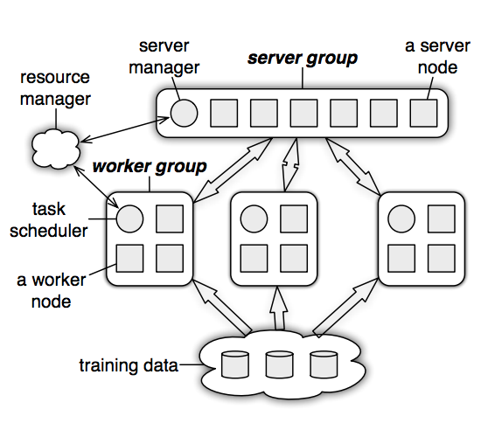
Architecture
Server Node:
Maintain a partition of globally shared parameters
Communicate with each other
Server Manager:
Maintain a view of the metadata(node liveness; assignment of parameter)
Worker Node:
Store a portion of training data to compute local statistics
Communicate only with server nodes
Scheduler:
Assign tasks to workers and monitors progress
Notes:
We have known that the model is the too large, the data is too large. So we distirbute the model to the server machines, and the data distribute to the worker machine
1.Each parameter server node maintains only a part of the parameters, so a whole server group can store the large scale data.
Commucaiontn between server node is mainly for replication and data mitigation for fault tolerance and sacling.
Server manager …. It works when you add or remove some server node.
****
Each worker group runs an application, and they are independent. We can use several worker group to solve the same machine learning problems to realize the parallelization.
Both data and workloads are distributed over worker nodes.
***
Scheduler is some kinds of similar to the server manage. And it will issue task to workers, telling them to load data,

Slide 7
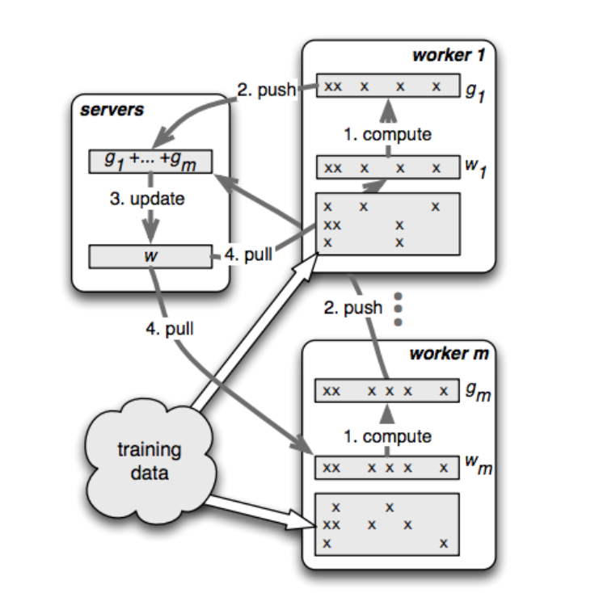
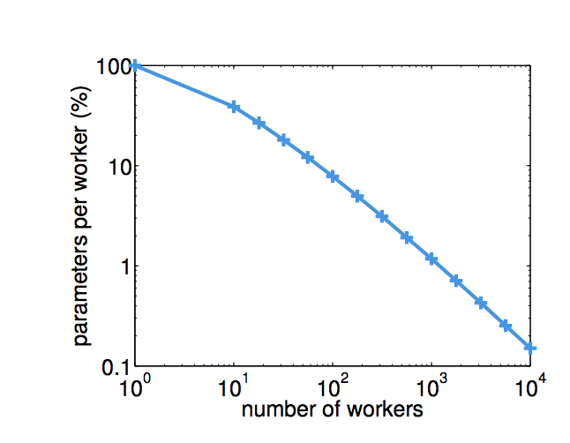
Architecture
A worker can’t cache all parameters.
For billions of features, data is sparse. A worker only need to cache the working set.
Notes:
In this architecture. We can seem it as the whole problem is separating d into many parts with small subset of trainning data
****After fininshing reading
Use a standard distributed gradient descend as example
In the beginning, each worker get a partition of traning data, you can see that the data in the worker 1 have many empty features that do not have value, the worker don’t need to store this, it just need to hold a working set with 5 features
the worker fetch the weight.
Do calculation on its local model
Use send and receive
Server aggregate the gradient
Update the global model than separate and send back to each workers
It is a repeating process and after several iteration we get the answer.
1 worker need to maintain the whole model , with 100 workers you will only need to store about 8% percent of parameters 1f 1000 workers, only need 0.15% parameters

Slide 8
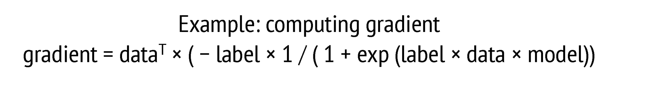
(Key,Value) Vectors
Parameters are represented as Key – Value pairs
(key,value) vectors assume key is ordered
Provide the same functionality as (key,value) abstraction
Facilitate linear algebra operations
Efficient code by leveraging existing libraries
Notes:
Next we will talk about (Key,Value) Vectorss
Read only one line in this
1.
key is the feature identity ,value is the weight of the model.
2. The parameter server express (key,value) pairs in a form of vector and matrices. If the keys doesn’t exist, it just replace it with zero. It is very useful in linear computation in machine learning.
4. linear algebra libraries such as BLAS [16], LAPACK [3], and ATLAS
These all reduces the programming effort to implement algorithms.
*Key values :
Loss minimization problem -> (feature ID, weight)
LDA -> (word ID, topic ID)

Slide 9
Range Push and Pull
Data communication between nodes is captured by two operations, push and pull.
Parameter server optimizes updates for programmer convenience as well as computational and network bandwidth efficiency by supporting range-based push and pull. Eg. w.push(Range, Dest)
Notes:
Read first line
1. Still using the gradient descend example. each worker pushes its entire local gradient into the servers, and then pulls the updated weight back.
We want to batch the communications, if we send one by one, there will be a large delay. Data overhead will be large.
We can realize it in PS using range push and pull （跳过直接到下一章例子）

Slide 10
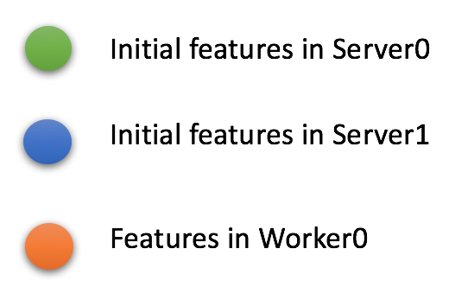
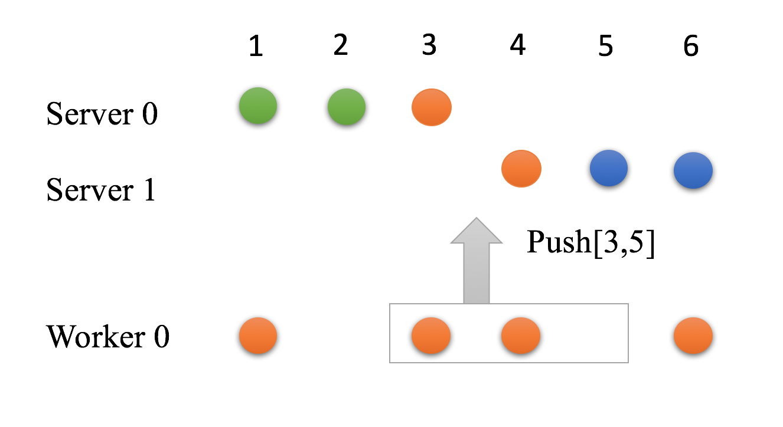
Range Push and Pull
Notes:
6 features total
You can change the range

Slide 11
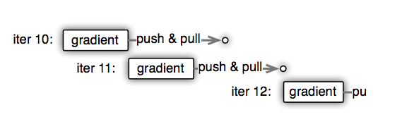
Dependency and Consistency
A piece of workload: Task
Issued by remote procedure
Executed asynchronously
Execute-after-finished dependency

Slide 12
Dependency and Consistency
Trade-off between system efficiency and algorithm convergence rate.
Independent tasks improve system efficiency via parallelizing the use of CPU, disk and network bandwidth.
Asynchronous Tasks may lead to data inconsistency between nodes.
Notes:
Doing task asychronously will slows down the convergence progress fro example , still the picture, the gradient in the iteration 11 may be the same as in the iteration11 because the new parameter hasn’t been pull into the worker, which lead to data inconsistency.
So it is a trade-off procedure.

Slide 13
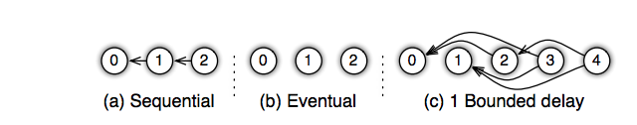
Dependency and Consistency
The parameter server provides the algorithm designer with flexibility in choosing a consistency model via the task dependency graph.
Three models:
Notes:
So a large improvement for compared with previous framework is it support fexible consitency.
A is the strongest
Every one wait the previous iteration
B may be too relax for some algorithm
There is no waiting here, but you can not ganrantee every thing
C is the Bounded delay model. In this model we can set a maximal delay time. Anew task will be blocked until the task before the time we set have been finished.
Like in the picture, the iteration 2
By this model, we can accomplish the best trade-off as I mentioned above.
What the picture showed 1 bounded delay, you can set it to 2,3,4,5 according to different algorithm.

Slide 14
User-defined Filter
Selective communication on key-value pairs
Can be placed at either or both the server machines and worker machines.
Examples:
Significantly modified filter: send entries that have changed for more than an amount.
KKT filter: send entries that are likely to affect the weights on the servers.
Notes:
User-defined filter is used for communication efficiency. We can filter data before we send it to reduce the communication cost. It is selective communication on key-value piars.
******
Over the last iteration, more than 0.00000
KKT: user-defined Karush-Kuhn-Tucker
Random skip filter: randomly drop entries.
You can design differeent filer for differernt algorithm.

Slide 15
Vector clock
Associate with each (key,value) pair for:
Track aggregation status
Reject doubly sent data
Range vector clock:
Many parameters have same timestamps because of range-based communication pattern.
Reduce space complexity from O(nm) to O(nk) (n nodes, m parameters, k unique ranges)
Notes:
In Implementation, there is a
logical clock for each feature, we can use it to identify the version of the data
Due to delays, failures, and lost acknowledgements N may send messages twice.
If we store one vector clock for each node

Slide 16
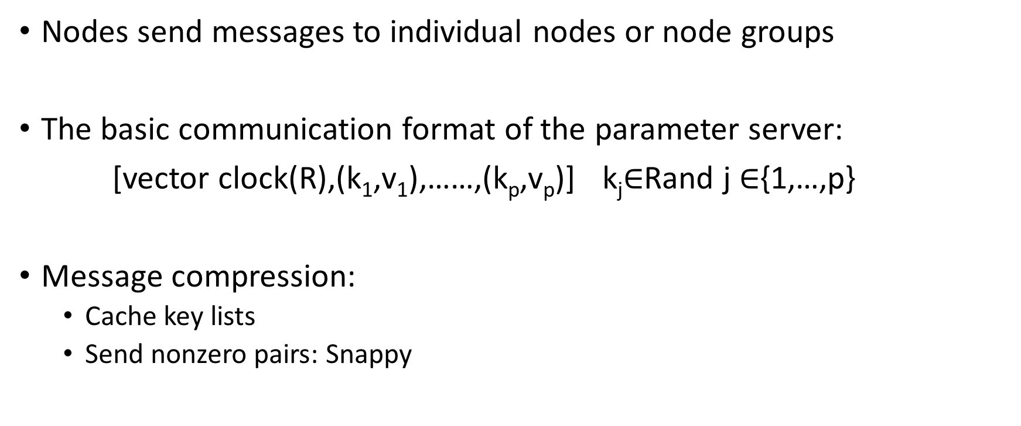
Messages
Nodes send messages to individual nodes or node groups
The basic communication format of the parameter server:
[vector clock(R),(k₁,v₁),……,(k_{p},v_{p})] k_{j}$∈$Rand j $∈${1,…,p}
Message compression:
Cache key lists
Send nonzero pairs: Snappy
Notes:
TCP protocol header
Snappy is a library that compress message almost as fast as one pass of memory

Slide 17
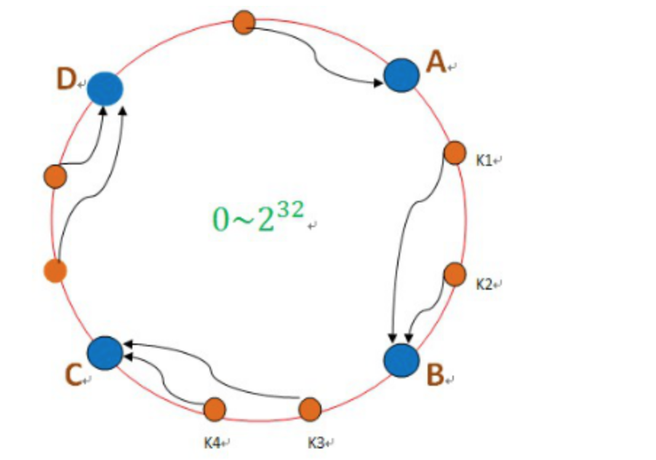
Consistent Hashing
Keys and server node IDs are both inserted into the hash ring.

Slide 18
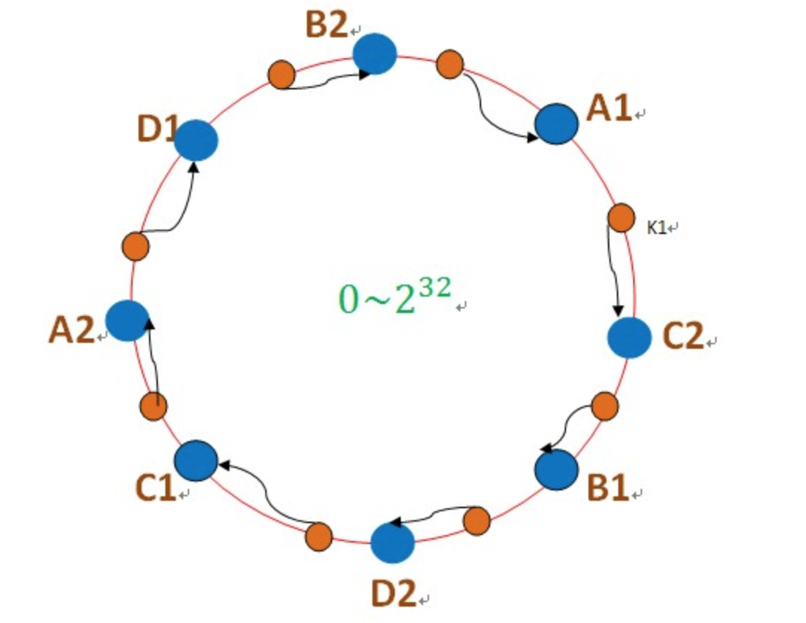
Consistent Hashing
A physical server is often represented in the ring via multiple “virtual” servers to improve load balancing and recovery.

Slide 19
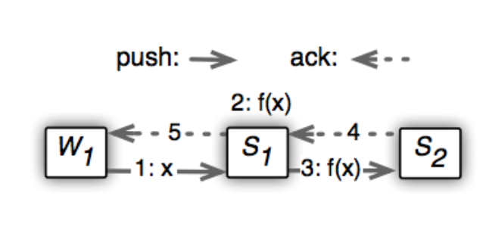
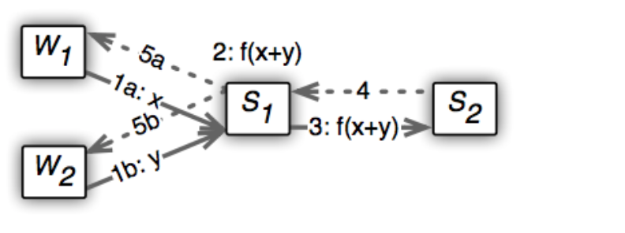
Replication and Consistency
Default replication: Chain replication
Option: Aggregation
Notes:
Now we can come to talk about fault tolerance.
For fault tolerance, the replication is used in PS
The default …..
The process shows the procedure of repliacation
The overhead of communication in Chain replication may be large each time the data from worker is copyed immdiately. If will have k replica, it will increase the traffic by k times.
******
It will significantly reduce the bandwith
Aggregation will cause task delay in worker node. (sequential dependency)
So it is also a trade-off process.

Slide 20
Fault Tolerance & Elastic Scalability
Server nodes store a replica of (Key, value) pairs in k nodes counter clockwise to it.
Example: Server Addition
The server manager assigns the new node a key range to serve as master.
The node fetches the range of data.
The server manager broadcasts the node changes.

Slide 21
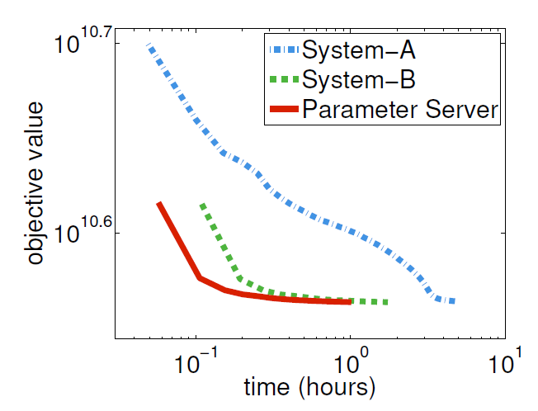
Evaluation(Logistic Regression)
 | method | Consistency
System A | L-BGFS | Sequential
System B | Block PG | Sequential
Parameter Server | Block PG | Bounded delay KKT filter
Reduce the network traffic
Relaxed consistency model

Slide 22
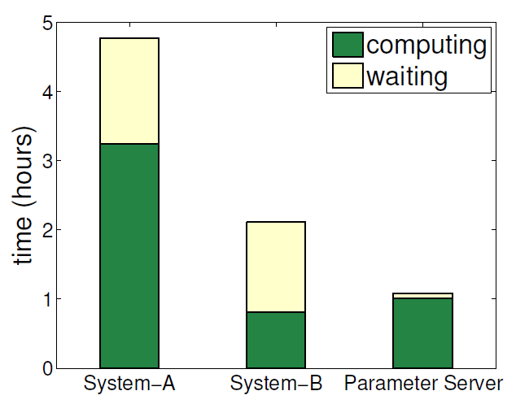
Evaluation (Logistic Regression)
Increase worker node utilization
More CPU
Time per worker spent on computation and waiting during sparse logistic regression.
Notes:
Green one.. Yellow one.. Y-axis..
2. We can figure out that the worker in parameter sever need less waiting time compares to System-A and System-B, but needs a little more computing time compares to System-B.
3. The reason is that ：
（1）Bounded Delay Consistency. Unlike sequential consistency, worker can begin processing the next block without waiting for the previous one to finish.
（2） computing time: Asynchronous updates require more iterations
B optimize gradient calculation

Slide 23
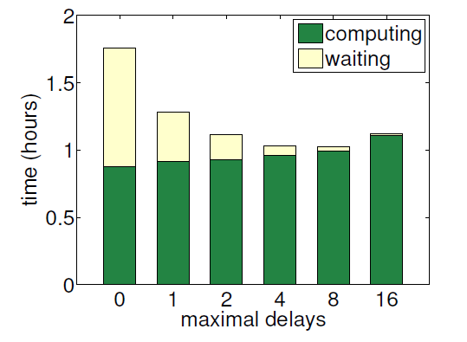
Evaluation (Logistic Regression)
Trade of between algorithm convergence and system performance
Notes:
1.This figure shows the trade of between algorithm convergence and system performance.
2.The x-axis is the maximal delays in the bounded delay consistency model. The y-axis means the time.
3.It shows that as the allowed delay increases, waiting time decreases but computing time increases.
4. So there is a trade of between computing time and waiting time. In this paper, 8 is the best trade off.

Slide 24
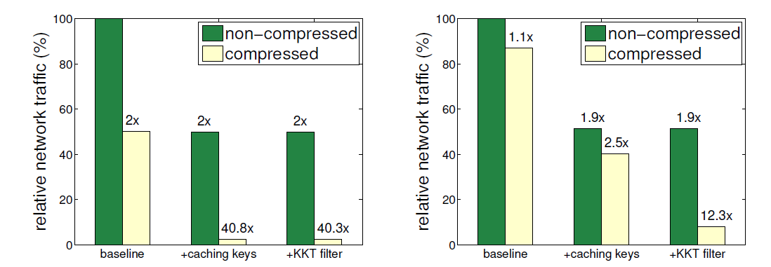
Evaluation (Logistic Regression)
The savings of outgoing network traffic by different components. Left: per server. Right: per worker.

Slide 25
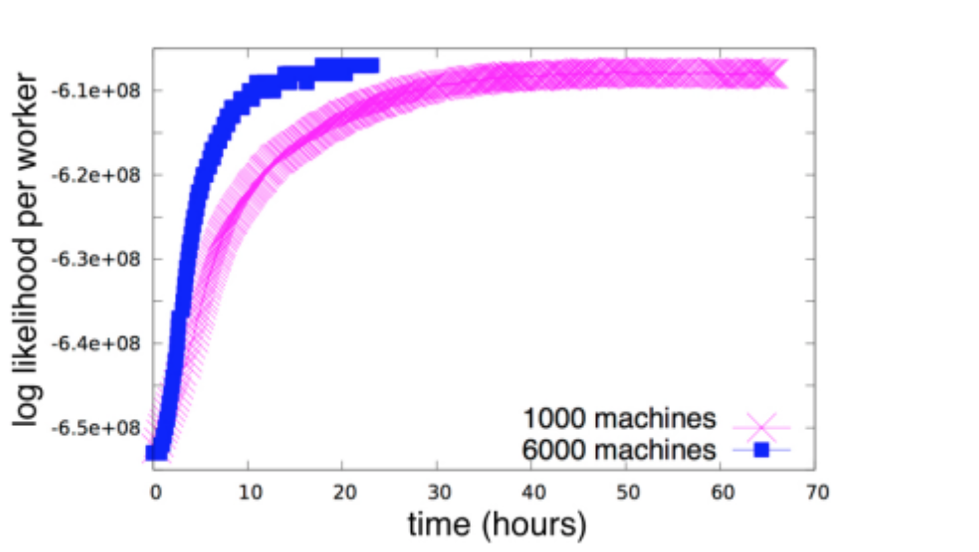
Evaluation(Latent Dirichlet Allocation)
5 billion unique users
5 million URL domains
2000 topics
.
Notes:
nearly fourth times.

Slide 26
Summary
Efficient Communication:
Batching (key,value) pairs in Linear Algebra objects
Filters to reduce unnecessary communication & message compression
Caching keys at worker and server nodes for local access
Flexible Consistency Models:
Can choose between Sequential, Eventual, and Bounded delay consistency models
Elastic Scalability
Node can be added and removed without restarting
Fault Tolerance and Durability:
Replication of data in Servers
Failed workers can restart at the point of failure by using vector clocks
Ease of Use:
Linear Algebra objects allow for intuitive implementation of tasks
Notes:
5 key features.
Efficient Communication:
Batching (key,value) pairs in Linear Algebra objects
Filters to reduce unnecessary communication & message compression
Caching keys at worker and server nodes for local access
Flexible Consistency Models:
Can choose between Sequential, Eventual, and Bounded delay consistency models
Elastic Scalability
Node can be added and removed without restarting
Fault Tolerance and Durability:
Replication of data in Servers
Failed workers can restart at the point of failure by using vector clocks
Ease of Use:
Linear Algebra objects allow for intuitive implementation of tasks

Slide 27
Project Adam: Building an Efficient and Scalable Deep Learning Training System
Trishul Chilimbi, Yutaka Suzue, Johnson Apacible,
and Karthik Kalyanaraman, Microsoft Research
Presenters: Qiyang Lin, Ruying Sun
Notes:
Then let’s have a quick look on the project Adam. It’s designed to solve deep neural network models tasks. A nice character of the deep learning model is that it doesn’t need to construct the appropriate features over the input data. The deep learning model will extract the features by itself. But the deep learning model always require large amount of compute cycles and it means the models are extremely time consuming and have a large number of parameters that have to be trained.

Slide 28
Project Adam
Achieves high efficiency and scalability through whole system co-design that optimizes and balances workload computation and communication.
Demonstrates that system efficiency, scaling, and asynchrony all contribute to improvements in trained model accuracy.
Notes:
Achieves high efficiency and scalability through whole system co-design that optimizes and balances workload computation and communication.
Demonstrates that system efficiency, scaling, and asynchrony all contribute to improvements in trained model accuracy.

Slide 29
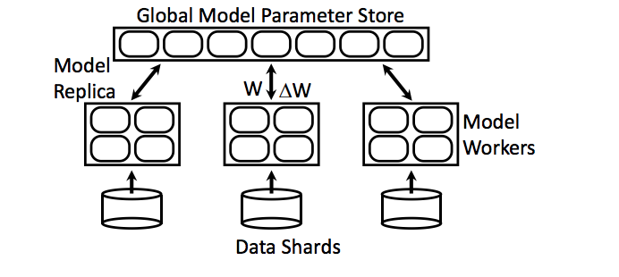
Architecture
Notes:
parameter server.

Slide 30
Adam vs Parameter Server
Similarity:
Both have workers and parameter server. Partition large models across machines.
Use replication of parameters for fault tolerance.
Difference:
Parameter server controller
Data serving machines
Etc.

Slide 31
Model Training
Multi Threaded Training
Weights updated locally without locks
Pass pointers rather than copying data for local communication
Build network library for non local communication
Working sets for the model layers fit in the L3 cache
Allow threads to process multiple images in parallel

Slide 32
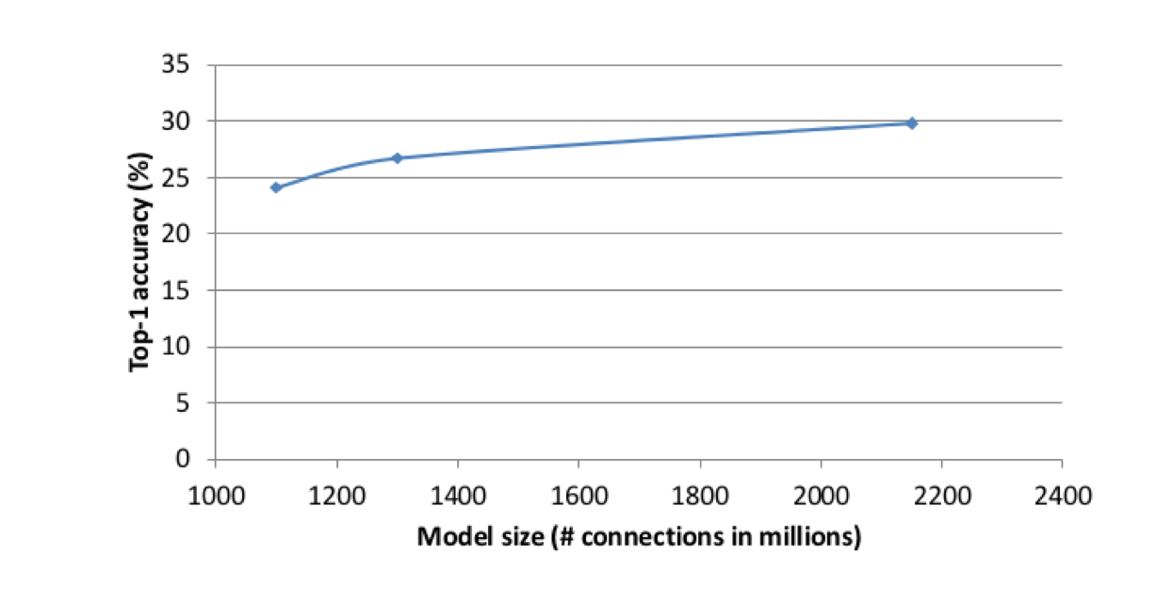
Trained Model Accuracy at Scale

