Slide 1
Realtime Data Processing
at Facebook
Guoqiang Jerry Chen, Janet L. Wiener, Shridhar Iyer, Anshul Jaiswal, Ran Lei
Nikhil Simha, Wei Wang, Kevin Wilfong, Tim Williamson, and Serhat Yilmaz
Facebook, Inc.
Presenter: Tai-Ying Lin, Changfeng Liu, Pei-Xuan Xie

Slide 2
Outline
Introduction
System Overview
Example Application
Design Decisions
Facebook Applications
Lessons Learned
Conclusion
*Build It Yourself

Slide 3
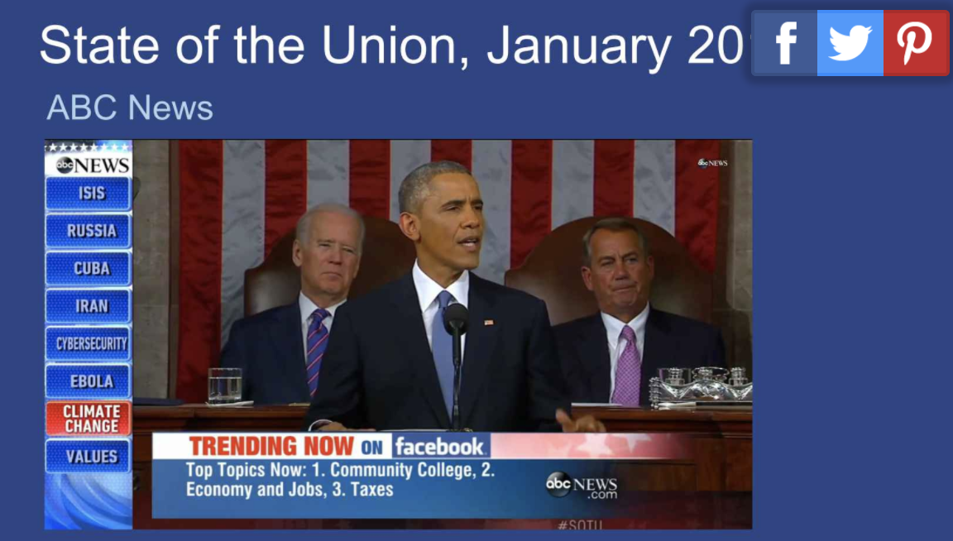
Real-time systems at Facebook
Chorus – aggregate trends
E.g. What are the top 5 topics being discussed for the election today?
Notes:
Source: https://www.infoq.com/presentations/facebook-real-time-conversations

Slide 4
Introduction
Goal:
Main decision: a few seconds of latency meets performance requirements. Present five decisions that must be made while designing a realtime stream processing system and compare alternatives & tradeoffs
Qualities that are important in the design of a real-time data system:
Ease of use
Performance
Fault-tolerance
Scalability
Correctness

Slide 5
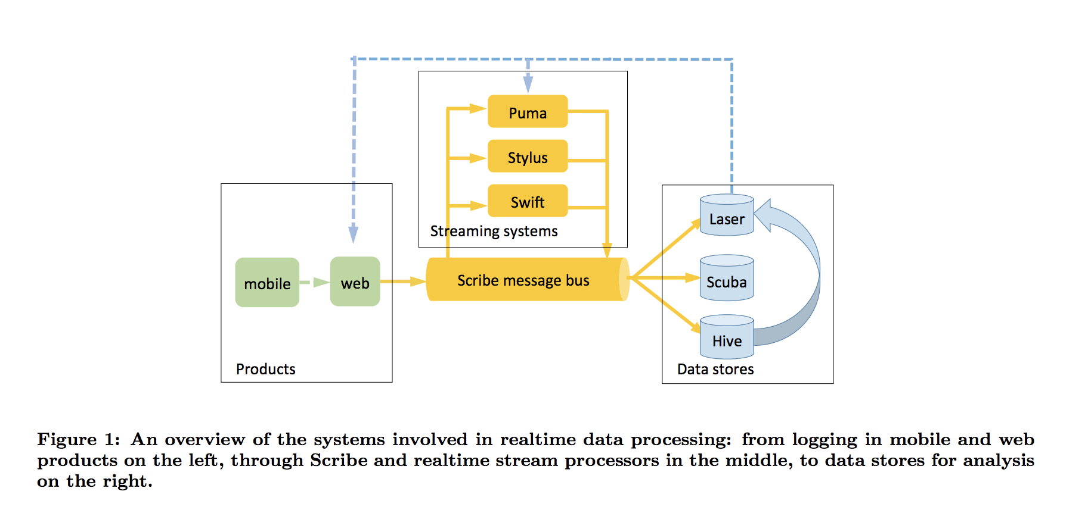
System Overview

Slide 6
System Overview
Scribe:
A persistent, distributed messaging system
A few seconds of latency and high throughput
Transport mechanism
Data :
Category & Bucket

Slide 7
System Overview
Puma
Pre-computed query results
Filtering and processing of Scribe streams
Swift
Provides checkpointing functionalities
Low throughput, stateless processing
Stylus
Handle imperfect ordering
Q : Stylus provides a function to estimate the event time low watermark with a given confidence interval

Slide 8
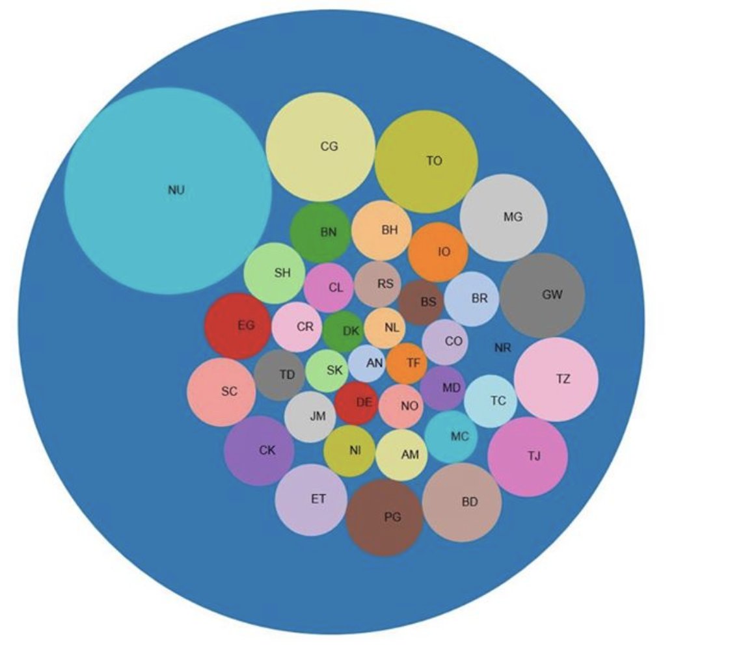
System Overview
Laser
High query throughput, low (millisecond) latency
key-value storage service
Scuba
Provides ad hoc queries with most response times under 1 second.
Hive
Exabyte-scale data warehouse

Slide 9
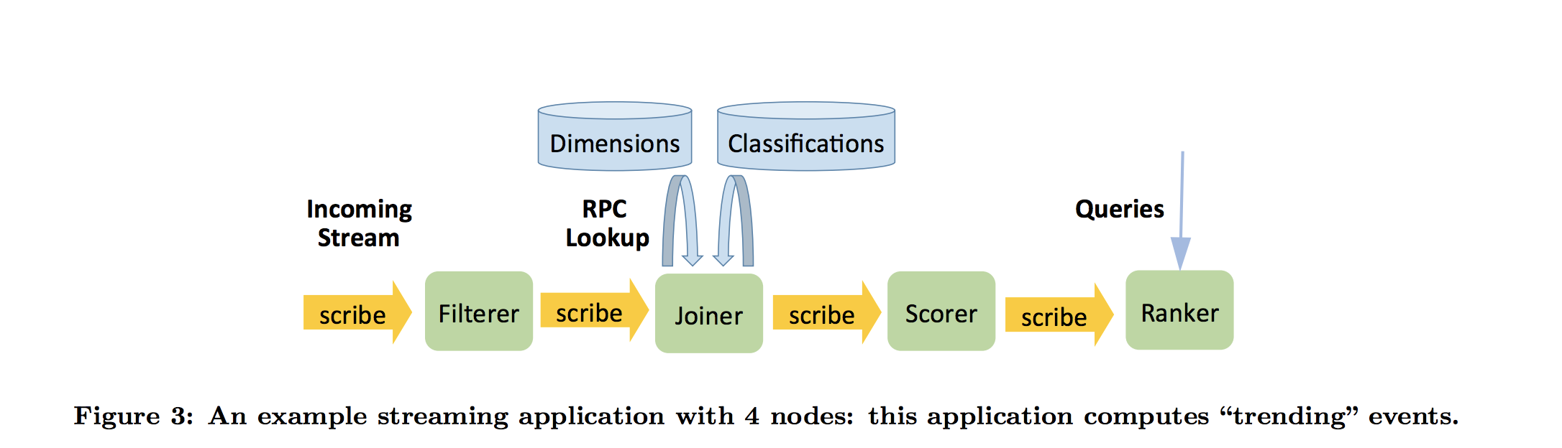
Example Application
Input:
Output:
Ranked list of topics for each 5 mins time bucket
id
type
text
Event

Slide 10
Example Application
Implement:
Processing Nodes
Get Results
Filter
Joiner
Score
Ranker
Client Service
Stateless
Stateful
 | Filter | Joiner | Scorer | Ranker
Stylus | V | V | V | V
Puma | V |  |  | V
Swift | V | V

Slide 11
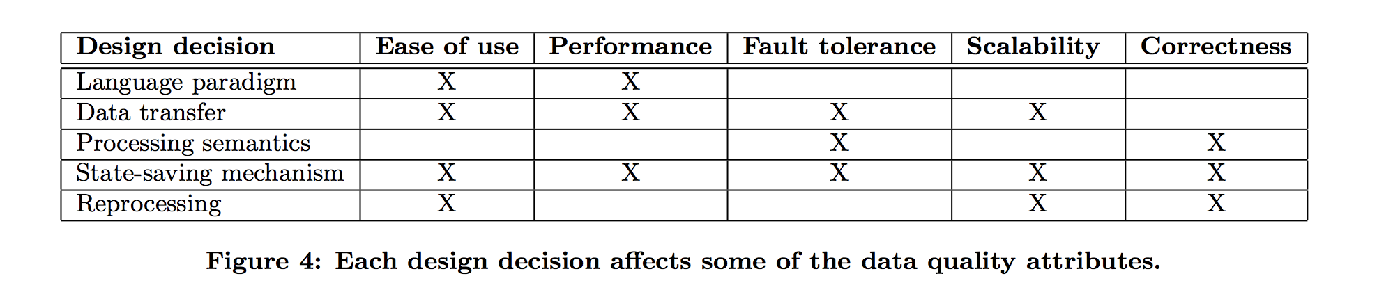
Design Decisions
Present 5 design decisions : alternatives & tradeoff

Slide 12

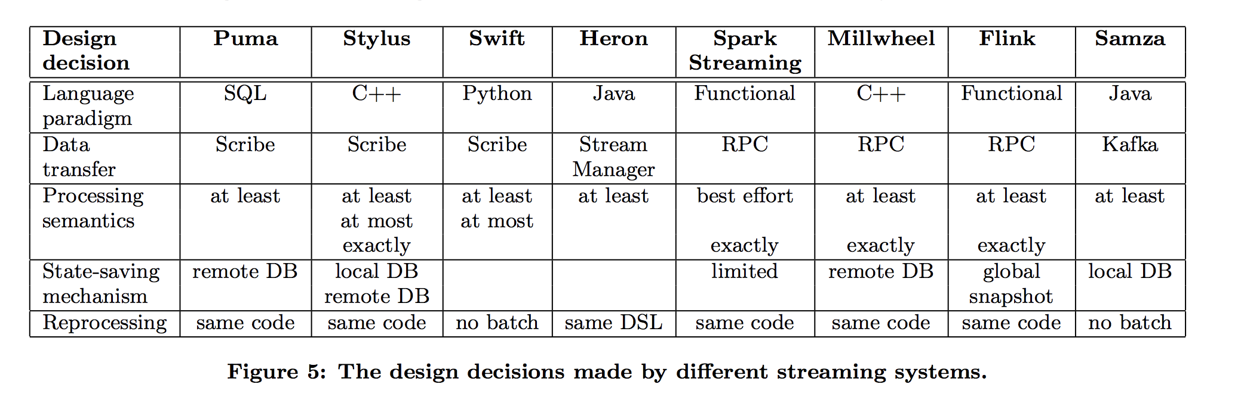
Design Decisions
Present 5 design decisions : alternatives & tradeoff

Slide 13
Design Decisions #1: Language Paradigm
Three common choices:
Declarative (SQL) – easy & limited
Functional (Scala)
Procedural (C++, Java, Python) –
most flexibility,performance, control, Longer dev cycle.
E.g. Storm, Heron
Languages in Facebook:
Puma: SQL
Swift: Python - useful for low-throughput
Stylus: C++ - greatest flexibility

Slide 14
Design Decisions #2: Data Transfer
Direct message transfer (Millwheel, Flink, SparkStreaming)
An RPC or in-memory message queue is used to pass data directly from one process to another.
O: speed
X: failure & persistency
Broker based message transfer (Heron)
A separate broker process that connects stream processing nodes and forwards messages between them.
O: scale better & back pressure
X: overhead
Persistent stream storage (Samza, Kafka’s Stream API)
O: Most reliable, Decouples processors

Slide 15
Design Decisions #2: Data Transfer
Data Transfer at Facebook:
Using Scribe, a persistent message bus, to connect processing nodes.
Limitations:
Imposes a minimum latency of about a second per stream.
Writes to disk => Additional hardware & network bandwidth
Advantages:
Fault tolerance
Performance
Ease of use
Scalability

Slide 16
Design Decisions #3: Processing Semantics
A stream processor does three types of activities.
Process input events
Generate output
Save checkpoints to a database for failure recovery. Three separate items may be saved:
The in-memory state of the processing node.
The current offset in the input stream.
The output value(s).

Slide 17
Design Decisions #3: Processing Semantics
Two kinds of relevant semantics for the implementations of these activities:
State semantics:
can each input event count at-least-once, at-most-once, or exactly-once?
Output semantics:
can a given output value show up in the output stream at-least-once, at-most-once, or exactly-once?
Stateless processors only have output semantics.
Stateful processors have both kinds.

Slide 18
Design Decisions #3: Processing Semantics
The different semantics depend only on the order of saving the offset/checkpoint and saving in-memory state/emitting output.
 | At-least-once | At-most-once | Exactly-once
State semantics | Save the in-memory state ⇒ save the offset. | Save the offset⇒ save the in-memory state. | Save the in-memory state and the offset atomically e.g., in a transaction.
Output semantics | Emit output ⇒ save a checkpoint of the offset and in-memory state. | Save a checkpoint of the offset and in-memory state ⇒ emit output. | Save a checkpoint of the offset and in-memory state and emit output atomically in the same transaction.

Slide 19
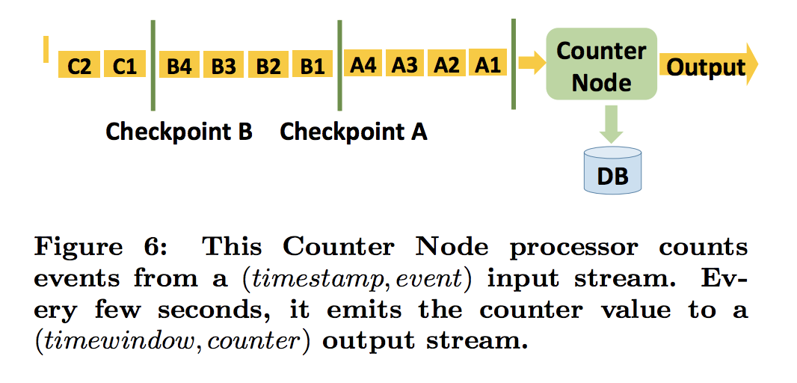
Design Decisions #3: Processing Semantics
Case Study:
Counter Node with different output semantics.
At-least-once ⇒ low latency
At-most-once ⇒ lose > duplication
Exactly-once ⇒ performance penalty

Slide 20
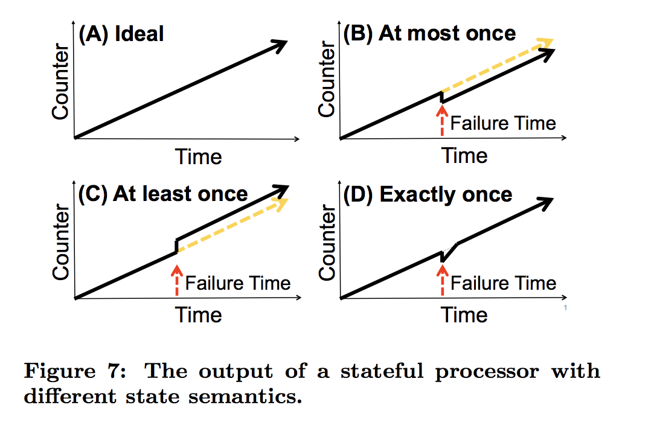
Design Decisions #3: Processing Semantics

Slide 21
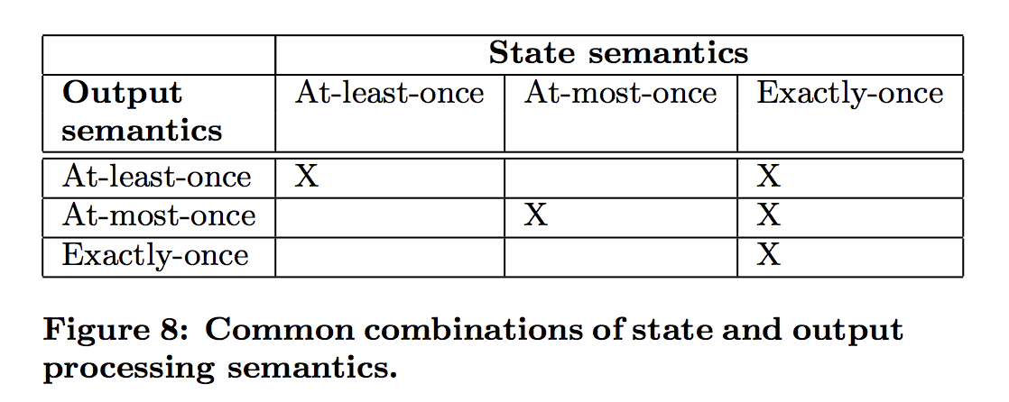
Design Decisions #3: Processing Semantics
Processing semantics used at Facebook :
Ranker writes to idempotent system – at least once
Scuba (stateless) can lose data, but not handle duplicates – at most once
…. Exactly once is REALLY HARD and requires transactions

Slide 22
Design Decisions #4: State-Saving Mechanisms
There are multiple ways to save state during processing and restore it after a failure.
In-memory state with Replication: (Old VoltDB)
X: Requires lots of hardware and network
Local database persistence.(Samza, Kafka Streams API)
Remote database persistence. (Millwheel)
Upstream backup.(i.e. replay everything on failure)
Global consistent snapshot. (Flink)

Slide 23
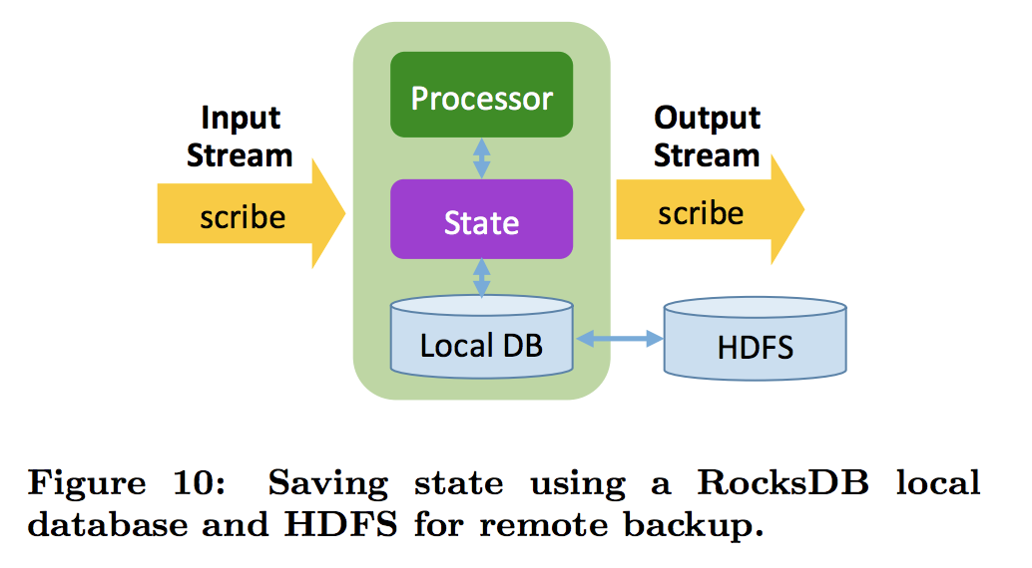
Design Decisions #4: State-Saving Mechanisms
State saving mechanisms at Facebook:
1. general local database implementation

Slide 24
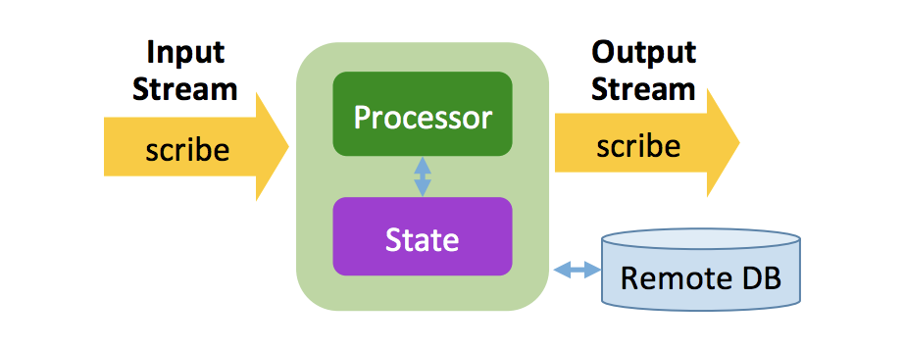
Design Decisions #4: State-Saving Mechanisms
State saving mechanisms at Facebook:
II. remote database model
Save
output & state
Read-Modify-Write ⇒
For Monoid processor: Append-only pattern
( Read-Merge-Write)

Slide 25
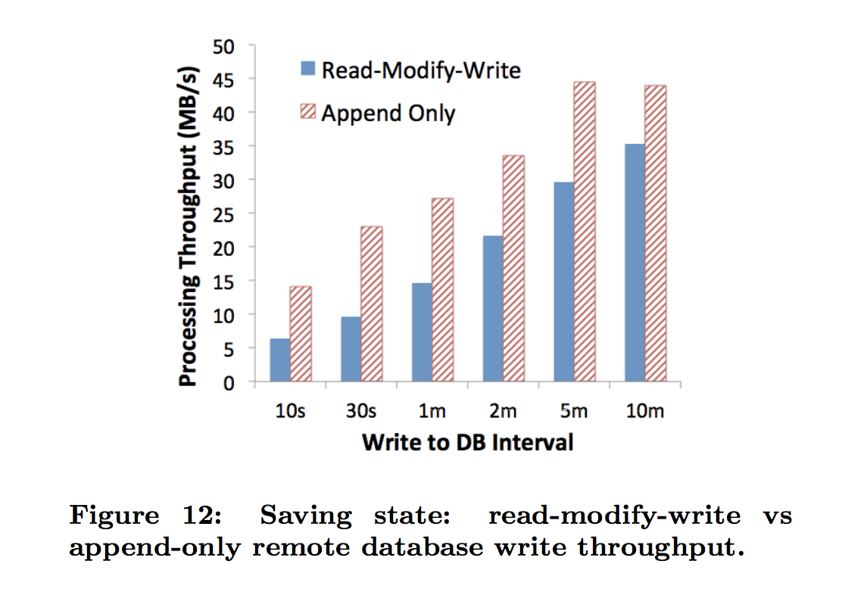
Design Decisions #4: State-Saving Mechanisms
How to efficiently work with state in remote DB?

Slide 26
Design Decisions #5: Backfill processing
Motivations:
Develop a new stream processing application ⇒ test
Add a new metric ⇒ run it against old data to generate historical metric data.
Bug ⇒ we need to reprocess the data for the period with the bug.

Slide 27
Design Decisions #5: Backfill processing
Choices:
Stream only – requires long retention in the stream store
Maintain both batch and stream systems – maintain consistency
Develop systems that can run in streams and batch (Flink, Spark)
Reprocessing data at Facebook
SQL (Puma) runs in both Stream and Batch systems
(Stylus) Compiler generates 2 binaries

Slide 28
Facebook Applications
Chorus
Dashboard queries
Hybrid realtime-batch pipelines

Slide 29

Chorus
From a stream of individual posts to aggregated, anonymized and annotated visual summaries.
New posts added into results in seconds
Example:
2017 UEFA Champions League Final on Facebook and Instagram

Slide 30
Chorus
A mix of Puma and Stylus applications
Lookup joins in Laser
Hive and Scuba as the sink data stores for the results
Data transport via Scribe

Slide 31
Chorus - evolvement
Substantial evolvement
One Puma app to filter posts ->
Laser joins added with custom Python codes ->
Add Stylus app replaced the custom codes
Add or replace one component at a time, and test and deploy incrementally

Slide 32
Lessons learned
It is not enough to only provide a framework for writing applications
Multiple systems help Facebook move fast
Stream replaying makes debugging much easier
Ease of deployment and maintaining
Ease of monitoring and operation
Streaming vs batch processing

Slide 33
Conclusions
Target seconds rather than milliseconds
Ease of use is as important as the other qualities
There is a spectrum of correctness

Slide 34
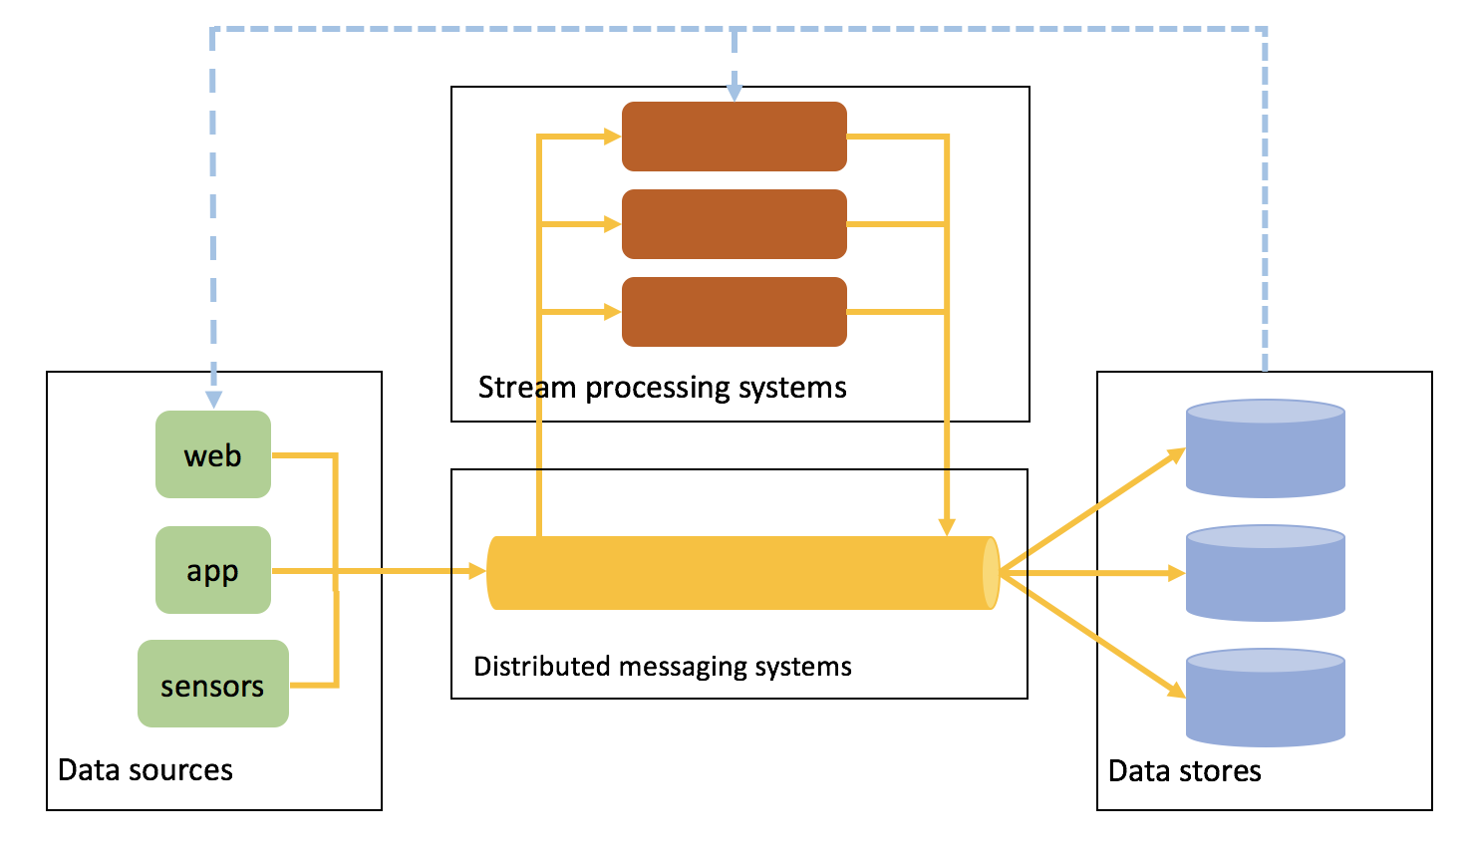
*Realtime Data Processing Pipeline - DIY?
Open-source
Mainstream

Slide 35
Distributed Messaging Systems
Kafka
broker-enabled, persistent, distributed publish-subscribe model
fast, scalable, and highly efficient
RabbitMQ
broker architecture
Easy to use and deploy - routing, load balancing or persistent message queuing
Central node - less scalable and slower
ZeroMQ
Flexible - broker or P2P
Lightweight for high throughput/low latency scenarios
Have to do a lot of implementation - read 80 pages first
ActiveMQ
Kestrel

Slide 36
Stream Processing Systems
Stream-only framework
Storm
Samza
Use Kafka for messaging and Hadoop Yarn for resource negotiation
Bundled with Kafka
Arbitrary number of subscribers, no backpressure problem
At-least-once delivery guarantee
Offers high level abstraction than Storm
Hybrid framework
Spark Streaming
Flink
Heron

Slide 37
Data Stores
Hive
RocksDB
Embeddable persistent key-value store for fast storage
High performance - C++ written engine
Optimized for fast storage - for flash or RAM
Adaptable to different workloads
Advanced database operations - merging and compaction filters
HBase
Random, realtime read/write access
Bigtable-like capabilities on top of Hadoop and HDFS

Slide 38
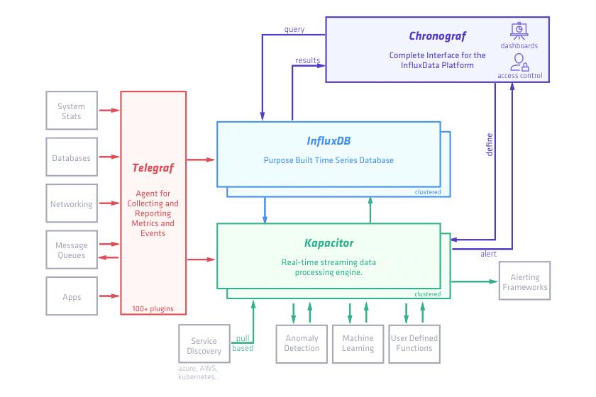
Specific Optimization
Time series data - Influx Data
Telegraf
Plugin-driven server agent
Aim for metrics
Kapacitor
Stream and batch data
User-defined functions
InfluxDB
High throughput ingest, compression and real-time querying
Optimized for time series
What can we do for video stream data?

Slide 39
Twitter Heron:
Stream Processing at Scale
Sanjeev Kulkarni, Nikunj Bhagat, Maosong Fu, Vikas Kedigehalli, Christopher Kellogg,
Sailesh Mittal, Jignesh M. Patel*,1, Karthik Ramasamy, Siddarth Taneja
Twitter, Inc., *University of Wisconsin – Madison

Slide 40
Outline
Introduction
Motivation for Heron
Design Alternatives
System Overview
Evaluation
Conclusion

Slide 41
Introduction
Twitter’s real-time streaming tasks:
Real-time active user counts (RTAC)
Real-time engagement of users
……
Storm engine has many issues in:
Scalability
Debug-ability
Manageability
Efficient resources sharing

Slide 42
Introduction
Goals:
Clean mapping from logical computation units to physical processes
Flexible sharing of cluster resources
Easier management of systems
Efficiency in production
Compatibility with the Storm and Summingbird APIs
Heron - a new system for all the goals above

Slide 43
Motivation for Heron #1:
Limitations of Storm Worker Architecture
Multiple levels of scheduling and complex interaction
Disparate tasks on each worker
Logs from multiple tasks into one file
Assume every worker is homogenous
Running one task per worker is very inefficient
Four threads for data going through a worker process

Slide 44
Motivation for Heron #2:
Issues with the Storm Nimbus
Nimbus component is functionally overloaded
Scheduling, monitoring, distributing JARs...
Scheduler: no resource reservation and isolation
Multiple topologies on one machine: workers interfere with each other
One topology on one machine: waste hardware resources
Zookeeper: bottleneck of number of workers and topologies
A single point of failure

Slide 45
Motivation for Heron #3:
Lack of Backpressure
No backpressure mechanism
Unbounded tuple drops if acknowledgements are disabled
Work done by upstream components is lost
System behavior becomes less predictable

Slide 46
Motivation for Heron #4:
Efficiency
Performance-reduced scenarios
Tuple failures
Tuple replays
Execution lag
Most common causes
Sub-optimal replays
Long Garbage Collection cycles
Queue contention
Have to overprovision more resources

Slide 47
Design Alternatives
1. Fix Storm?
Fundamental issues - require extensive rewrite of the core
Multiple queues for moving data around
inflexible , longer development cycles
2. Choose another existing system? - Apache Samza or Spark Streaming
Issues at Twitter’s scale
Incompatible with Storm’s API
Very long migration
Top stack components fail
3. Develop a new Heron!

Slide 48
Heron Design Goals
Fully API compatible with Storm
Directed acyclic graph
Topologies, Spouts and Bolts
Task isolation
Ease of debug-ability/isolation/profiling
Support for backpressure
Topologies should be self-adjusted
Batching of tuples
Reduce the cost of transferring tuples
Efficiency
Reduce resource consumption

Slide 49
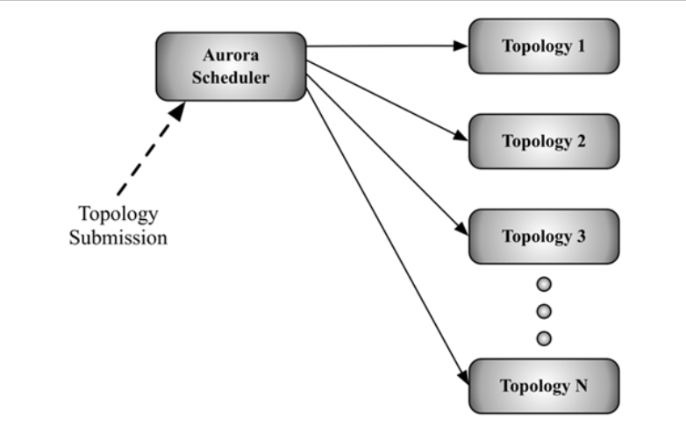
Overall Architecture

Slide 50
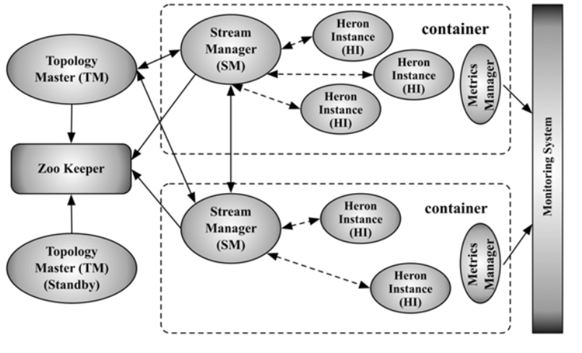
Topology Architecture
Logical plan,
Physical plan,
Execution State

Slide 51
Topology Master (TM)
Monitor containers
Serve as gateway for metrics
Create ephemeral node in Zookeeper
Prevent multiple TM becoming masters
Allow other process to discover TM

Slide 52
Stream Manager (SM)
Route tuples
Implement backpressure
Dynamically adjust the data flow rate
Slow down the upstream stages when a downstream stage runs slow
Manage Acknowledgement
At least once
At most once

Slide 53
Topology Backpressure
TCP backpressure
Receive buffer of HI would start to fill up if the HI runs slow
→ propagates backpressure through SM to other SM and HIs upstream
Often cause the downstream HIs to slow down as well
Spout backpressure
SM clamp down spouts (the most upstream component) to reduce the new data
Advantage: small reaction time for flow rate change
Disadvantage: less optimal, additional message passing overhead
Stage-by-Stage backpressure
Gradually propagate the backpressure stage-by-stage until it reaches the spouts

Slide 54
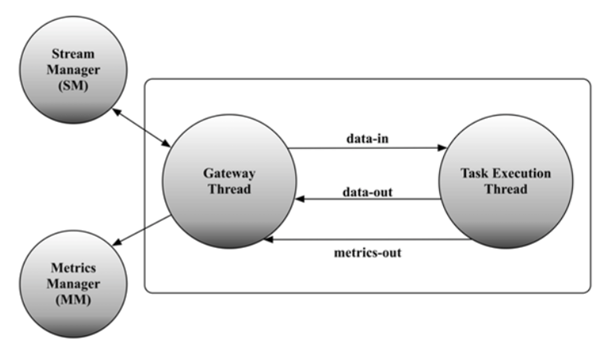
Heron Instance (HI)
Run only one task (spout/bolt)
Exposese Storm and Heron API
Collect several metrics
Gateway thread: maintain TCP connection to SM, receive incoming tuples
Task thread: run user code to process tuples, collect various metrics

Slide 55
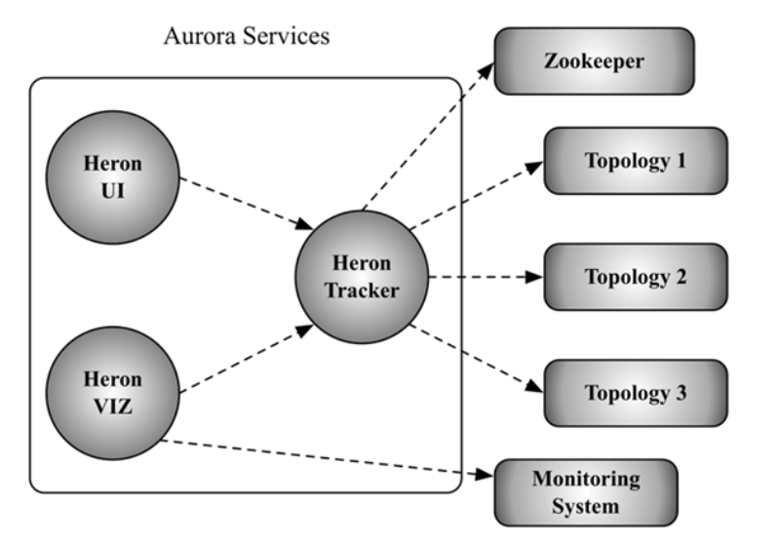
Heron Services for Production

Slide 56
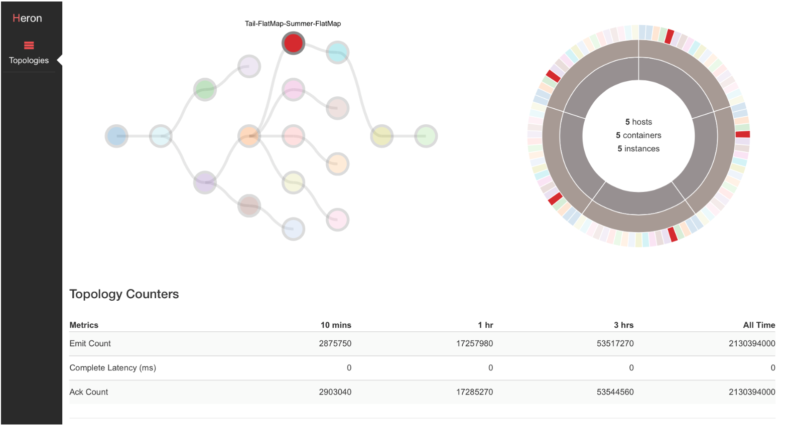
Heron Visualization
Logic plan
Physical plan

Slide 57
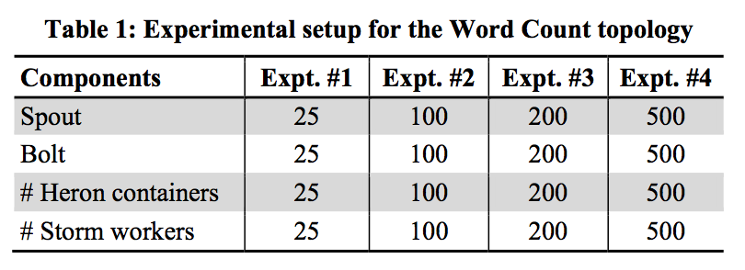
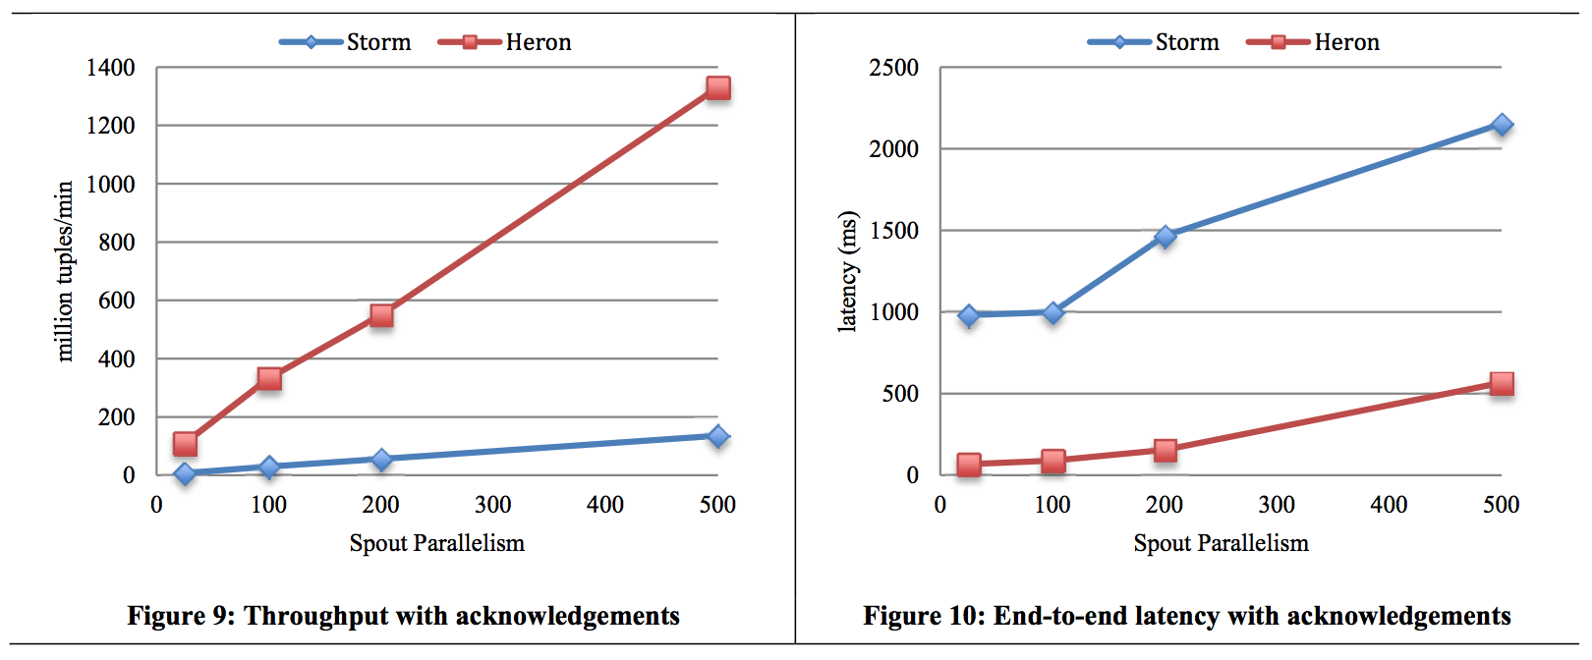
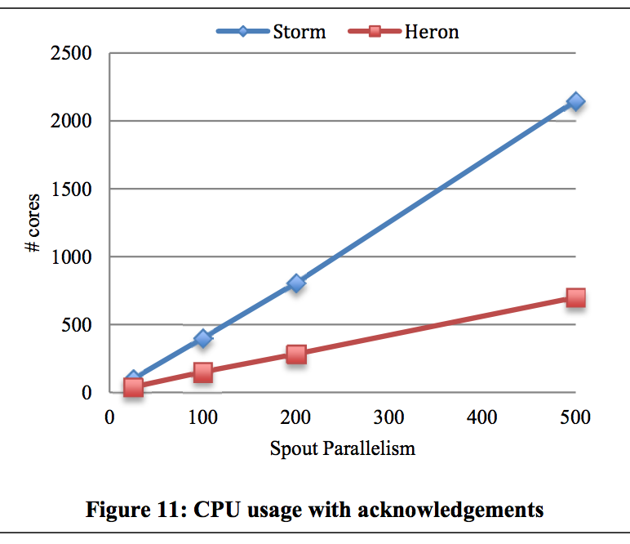
Evaluation - At Least Once
10-14x
5-15x
2-3x

Slide 58
Conclusion
Simplified architecture
Easy to debug/profile/support
Higher performance
6-14x increase in throughput, 5-10x decrease in latency
Efficiency
3-5x decrease in resource usage

Slide 59
Question?

