Slide 1
Machine Learning for Systems
Presented by: Xiangfeng Zhu

Slide 2
Neural Packet Classification
Liang et al., SIGCOMM’ 19

Slide 3
What is Packet Classification?
Goal: Categorize packets by matching it against the highest priority rule
Why classify packets
Firewall/NAT
Quality of Service
Traffic analysis
Flow classification

Slide 4
Packet Classification is hard
Rules have priorities
Hard Time-space tradeoff
Packet
(matching R1 and R4)
R0
R4
R1
R5
Y
R3
R4
X
Credit: Eric Liang

Slide 5
Existing Solutions
Decision tree algorithms
Node cutting
Rule partition

Slide 6
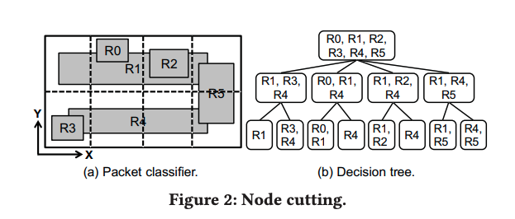
Existing Solutions
Decision tree algorithms
Node cutting
Rule partition

Slide 7
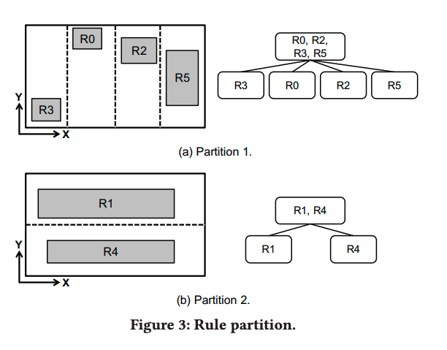
Existing Solutions
Decision tree algorithms
Node cutting
Rule partition

Slide 8
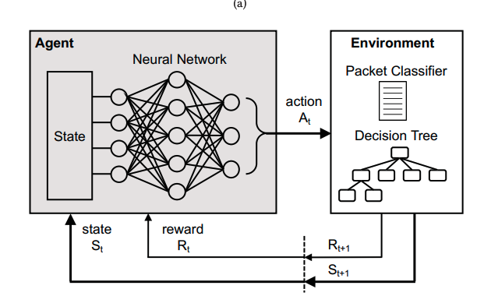
NeuroCuts

Slide 9
NeuroCuts
Branching decision tree process
DFS order of building tree node-by-node
Action: cut or partition the current not

Slide 10
Challenges and solutions
Variable state size
Key insight: Node state are independent of parent nodes

Slide 11
Challenges and solutions
Variable state size
Key insight: Node state are independent of parent nodes
Sparse, delayed rewards
Calculate rewards by agg. across tree branches
N2
done (reward = -1)
N0
N3
done (reward = -1)
N1
reward
= min(r_{child}) - 1
= -3
N4
done (reward = -1)
reward
= min(r_{child}) - 1
= -2
N5
done (reward = -1)
Credit: Eric Liang

Slide 12
Encoded current node:
N = 01….10
Sample an action ; Update tree;
Repeat
Neural Network
Action Distribution π(a|s)
dim=[0.3, 0.1, 0.2, ...]
num=[0.05, 0.7, 0.1, ...]
type=[0.1, 0.9]

Slide 13
Training
Goal: Learn an optimized policy
Actor-Critic Algorithm
Traverse the tree nodes in DFS order
Training steps
Start from an initial policy
Evaluate using multiple rollouts
Update based on the rewards
Repeat until converge

Slide 14
Evaluation
ClassBench, a standard benchmark for packet classifier performance
Metrics
Classification time(tree depth)
Memory footprint

Slide 15
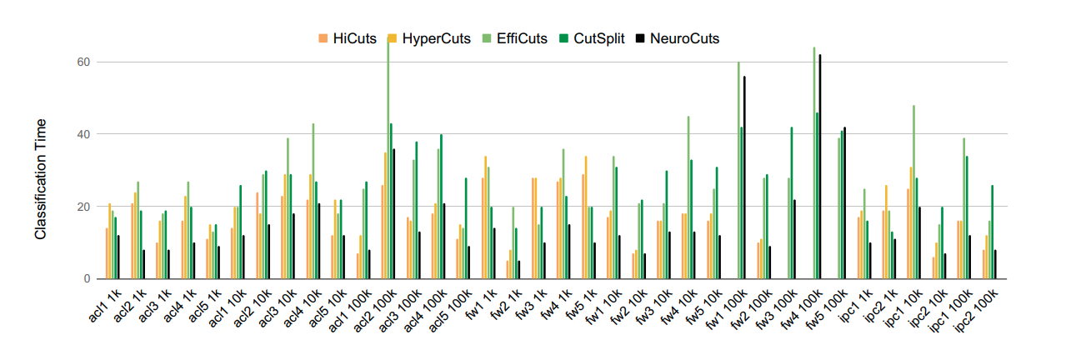
Classification time(tree depth)

Slide 16
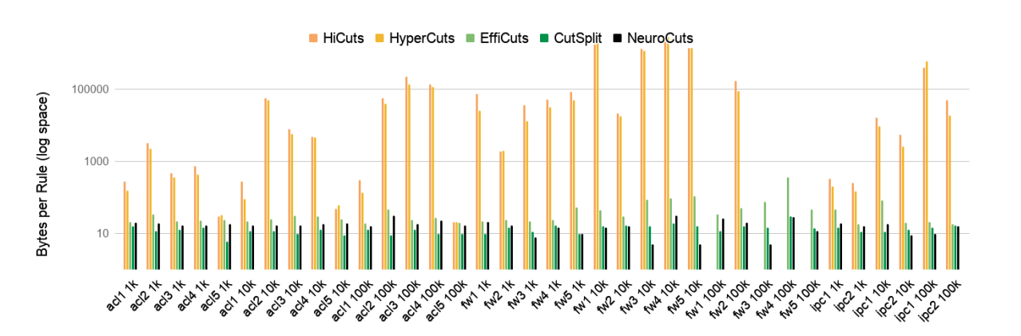
Memory footprint
3x better memory consumption

Slide 17
Are there anything that could be improved from the system perspective?
Can NeuroCuts handles variable sized attributes?

Slide 18
Learning Scheduling Algorithms for Data Processing Clusters
Mao et al., SIGCOMM’ 19

Slide 19
Designing Optimal Schedulers is Hard
Job dependency structure
Degree of parallelism

Slide 20
Decima
Goal: Learn a workload-specific scheduling algorithm for jobs with dependencies
Encoded as DAGs
Vertex: stages and Edge: dependency

Slide 21
Decima

Slide 22
Challenge #1
Neural networks require fixed-sized vectors as inputs
But the cluster can have arbitrary number of jobs

Slide 23
Challenge #1
Neural networks require fixed-sized vectors as inputs
But the cluster can have arbitrary number of jobs
Graph Neural Network
Encodes(’embeds’) state into embedding vectors

Slide 24
Challenge #2
Assigning all executors to jobs stages leads to large action spaces
Solution: Decima only decides which stage to run next and its degree of parallelism

Slide 25
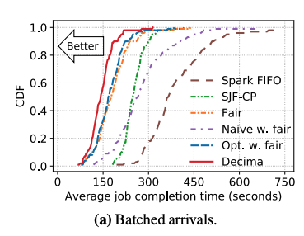
Evaluation
TPC-H queries
Input size: 2 – 100 GB
Decima trained on simulators

Slide 26
Evaluation
Alibaba Trace
20,000 jobs from production cluster

Slide 27
Questions?
Can we apply the idea of Decima to other framework like Tensorflow?
Device Placement Optimization with Reinforcement Learning – Mirhoseini et al., ICML’ 17
Does Decima consider data locality?

Slide 28
What else could we use learning?
Computer System are filled with heuristics
Not adapted to actual pattern of usage
Do not take account available context
Examples:
Networking: TCP Window size decisions, back off for retransmits, data compression
OS: process scheduling, buffer cache insertion, prefetching

Slide 29
Additional Reading
The case for learned index structures - Kraska et al., SIGMOD’ 18
Replace hand-engineered data structure with a learned model
Learning-based Memory Allocation for C++ Server Workloads - Maas et al, ASPLOS’ 20
Use language model to predict the lifetimes
Neural Adaptive Video Streaming with Pensieve – Mao et al., SIGCOMM’ 18
Learn ABR algorithms using RL
Neural Adaptive Content-aware Internet Video Delivery – Yeo et al., OSDI’ 18
Use DNN to enhance the video quality

Slide 30
Do they always work?
Learn then deploy
Use ML to produce an artifact and deploy it

Slide 31
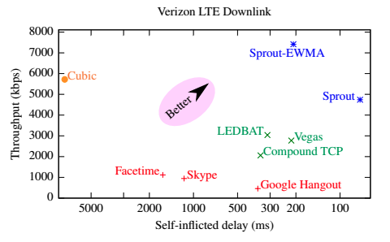
Sprout (NSDI’ 13)

Slide 32
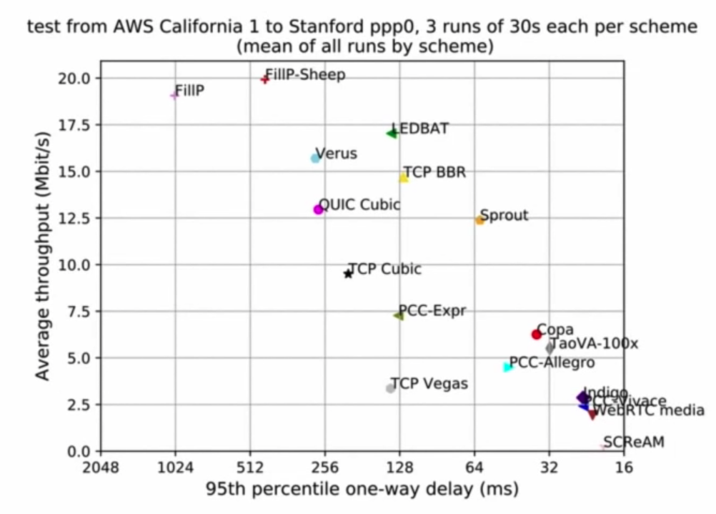
Sprout(NSDI’ 13)
Stanford Pantheon result(2018)

Slide 33
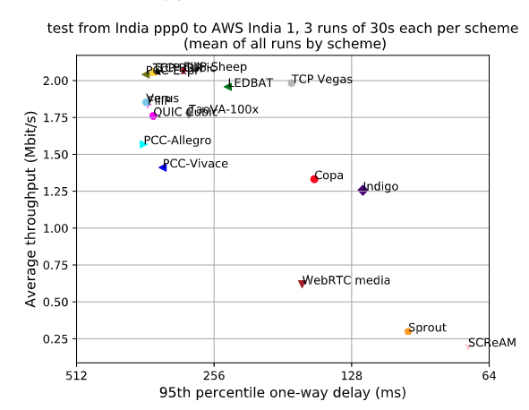
Sprout(NSDI’ 13)
Stanford Pantheon result(2018)

Slide 34
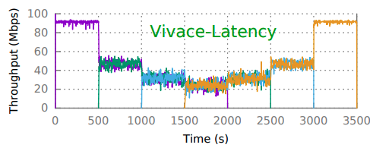
PCC Vivace(NSDI’ 18)
Stanford Pantheon result(2018)

Slide 35
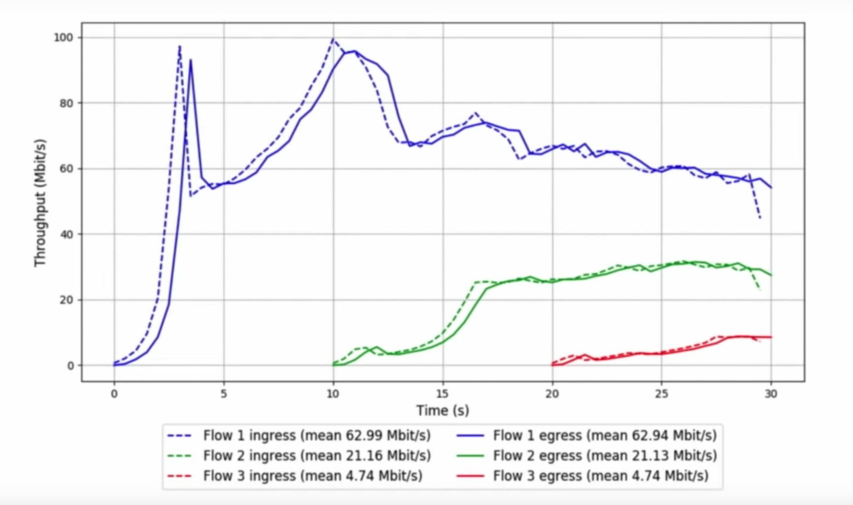
PCC Vivace(NSDI’ 18)
Stanford Pantheon result(2018)

Slide 36
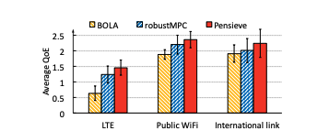
Pensieve(SIGCOMM’ 17)
Neural Adaptive Video Streaming with Pensieve – Mao et al., 2017

Slide 37
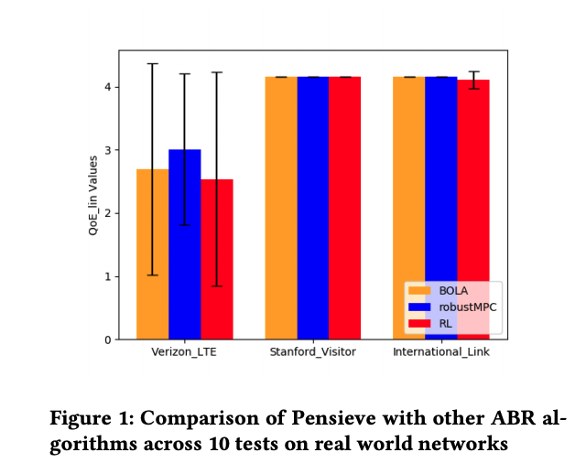
Pensieve(SIGCOMM’ 17)
CS 244: Recreating and Extending Pensieve – Crews et al., 2018

Slide 38
Learning in situ: a randomized experiment in video streaming – Yan et al., NSDI’ 20
A simple ABR algorithm performs better than expected
Outperform existing schemes is learning in situ
We don’t know how to faithfully simulate the Internet

Slide 39
Acknowledgement
Some slides are adapted from authors’ SIGCOMM presentation and Keith Winston’s presentation at Microsoft

