Slide 1
In-Datacenter Performance Analysis of a Tensor Processing Unit
Presented by Mihir Patil, Adam Stautberg

Slide 2
Motivation
A performance analysis of Google’s TPU architecture by Google
TPU Motivation:
Cost/performance improvements in NN inference domain through domain specific hardware
Inference demands strict latency requirements because of its user focused nature
GPUs are optimized for throughput which lends to training
CPUs have none of the advantages of domain specific architecture

Slide 3
High level idea
The TPU is single threaded and minimalistic compared to CPUs and GPUs
It has no caches, branch prediction, out of order execution, multiprocessing etc
More deterministic execution
Leverages minimalism of domain specific architecture to meet stringent application latency requirements
Maximize throughput per host interaction

Slide 4
Details/ tech implementation / innovation
Goal is to keep the Matrix Multiply unit busy
Reading large SRAM is expensive so matrix unit uses systolic execution to reduce reads/writes of the Unified Buffer
*Throughput measured in TOPS (TeraOps/second)
Designed to plug directly into existing servers akin to GPUs
Despite having a much smaller and lower power chip, the TPU has 25 times as many MACs(Multiplier Adder Accumulator ) and 3.5 times as much on chip memory as the K80 GPU

Slide 5
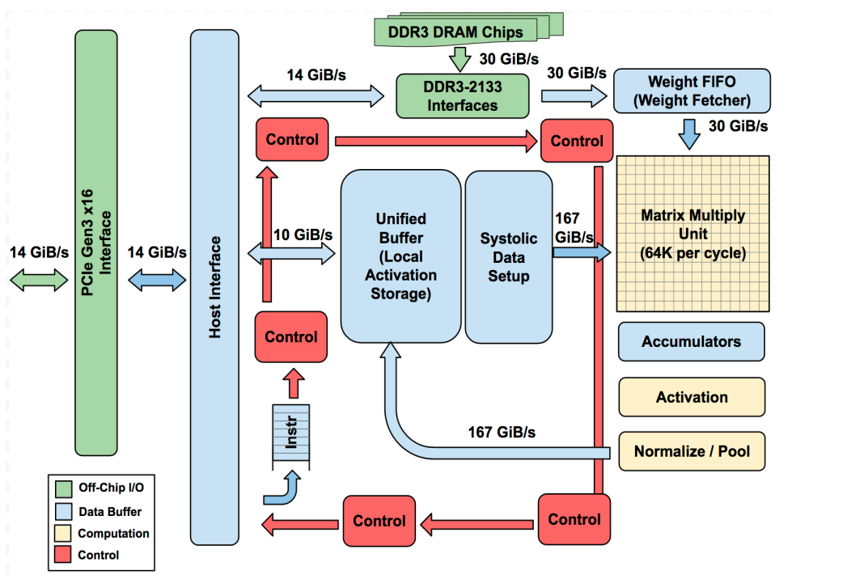
TPU block Diagram
Matrix Multiply unit does the heavy lifting
Performs 8-bit multiply and adds
16 bit products collected in 4 MiB of 32-bit accumulators
The matrix unit produces one 256 element partial sum per clock cycle
Accumulator supports double buffering
Designed for dense matrices
Matrix weights staged through on-chip Weight FIFO that reads from 8GiB off-chip DRAM
Choices determined/influenced by existing architecture/manufacturing/workloads and convenience

Slide 6
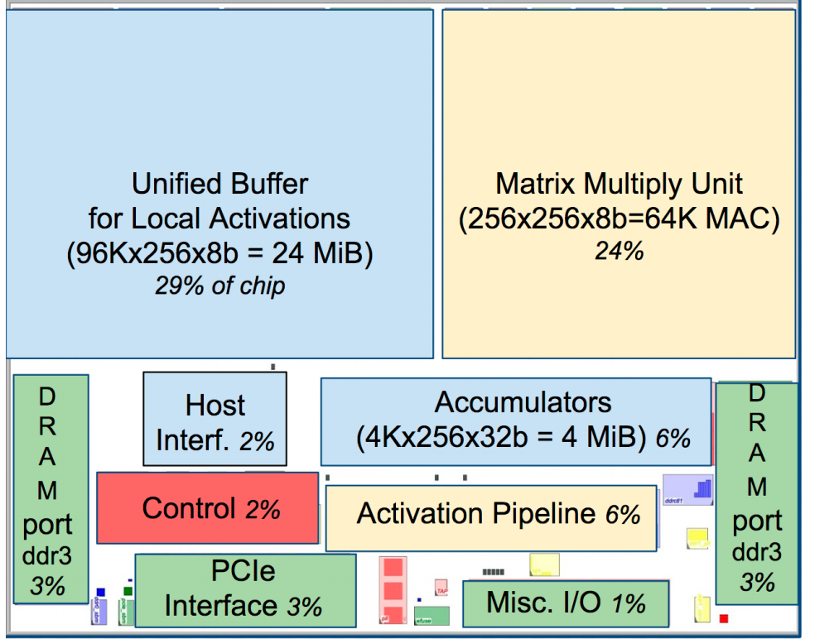
Floorplan of TPU die
The data path is nearly two-thirds of the die
Minimal area devoted to control
Instructions are sent over PCIe following CISC tradition

Slide 7
Five key instructions:
1. Read_Host_Memory = reads data from the CPU host memory into the Unified Buffer (UB)
2. Read_Weights - reads weights from Weight Memory into the Weight FIFO as input to the Matrix Unit.
MatrixMultiply/Convolve - Matrix Unit performs a matrix multiply or convolution from the Unified Buffer into the Accumulators. Size B*256 input, 256x256 constant weight input, giving B*256 output, taking B pipelined cycles to complete
Activate performs the nonlinear function of the artificial neuron, with options for ReLU, Sigmoid, etc. Inputs are the Accumulators, and output is the Unified Buffer.
5. Write_Host_Memory writes data from the Unified Buffer into the CPU host memory.

Slide 8
Performance analysis/benchmarking
Adapted Roofline Performance model:
Applications are limited by either computation or memory bandwidth
Y-axis is FLOPS/sec
X-axis is FLOPS/(DRAM byte accessed) (Operational intensity)

Slide 9
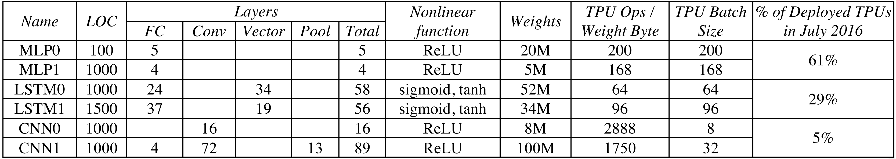
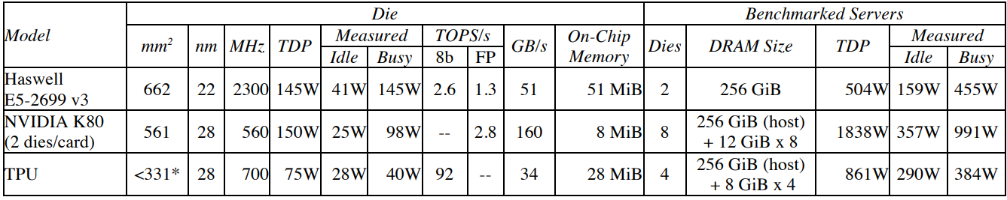
Networks and hardware used for benchmarking
Note that number of dies per server varies, so results are normalized per die

Slide 10
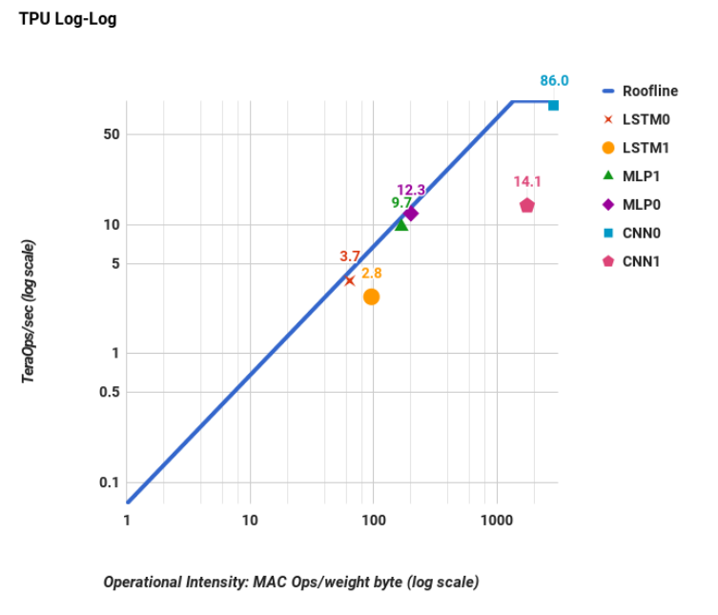
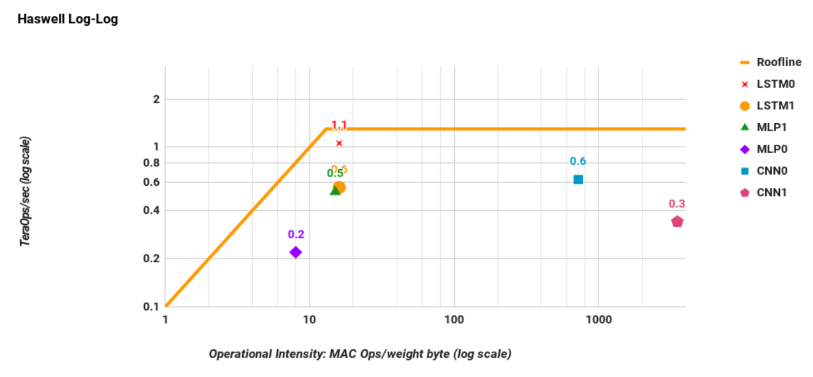

Slide 11
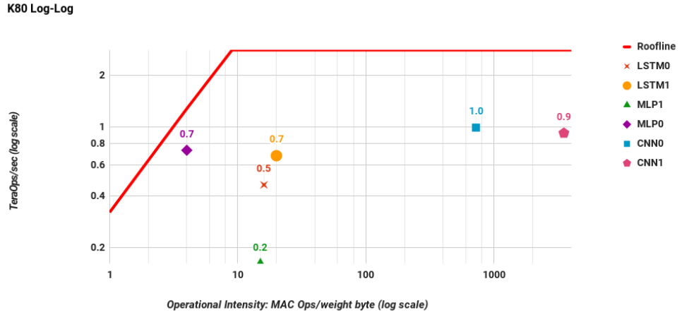

Slide 12
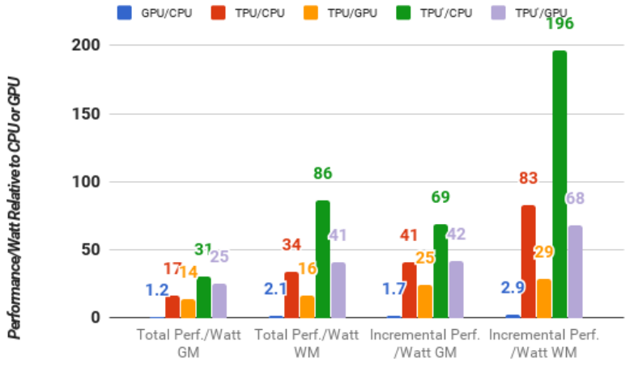
Cost-Performance
Ratio of performance/watt between pairs of processors
Incremental subtracts power used by host server
* using TDP

Slide 13
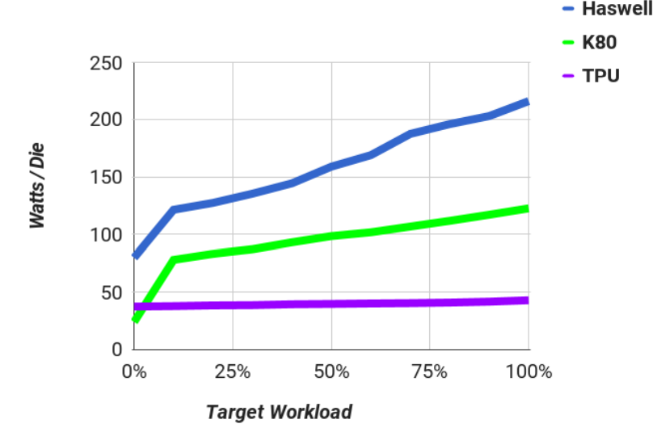
Energy proportionality under load
TPU has minimal optimizations for saving cost energy savings

Slide 14
Related work/improvements
Performance of TPU is expected to scale 3x as memory bandwidth scales to 4x
Replacing DDR3 Weight Memory with GDDR5(used in GPUs) increases theoretical performance between 2x to 4x
Would double memory channels but allow a smaller Unified Buffer
Catapult is a contemporary but is still at least an order of magnitude slower than the TPU
Lots of room for improvement/optimization since it was developed in a 15 month timeframe
2nd Generation, and 3rd generation out, also Edge TPU
2nd Generation increases memory/bandwidth performance, 3rd is twice as fast
Not limited to 8 bit, so can be used for inference as well

Slide 15
Questions
CISC repeat field? CISC vs RISC
Systolic execution(model parallelism?)
Decoupled access/execute

Slide 16
Serving DNNs in Real Time at Datacenter Scale with Project Brainwave
By Adam Stautberg and Mihir Patil

Slide 17
Motivation
Cloud service providers deploy DNN-infused applications that ingest live data streams such as search queries and videos
Computational demands of DNNs are outpacing performance growth of traditional CPUS
Specific example: Bing’s intelligent search feature
There is a clear need for low latency and high throughput
Specialized hardware can improve efficiency and performance

Slide 18
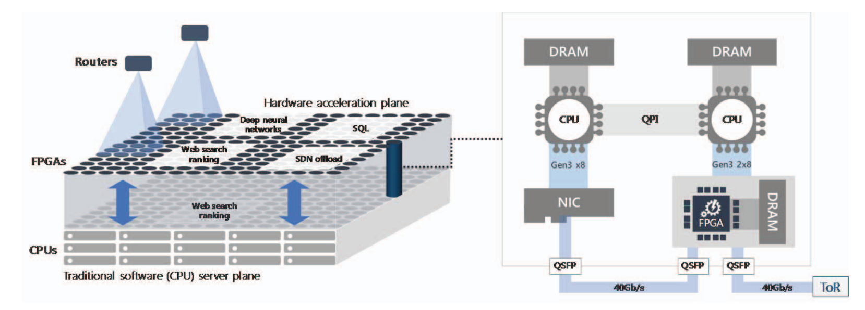
FPGAs
FPGA – field-programmable gate array
Parallelism targeted for a specific algorithm
Reprogrammable
Multiple can be allocated as a shared hardware microservice

Slide 19
Brainwave Architecture Overview
Model parallelism and on-chip pinning
Splits DNN models into sub graphs and pins to FPGAs
This is why the hardware microservice & cloud elasticity is important

Slide 20
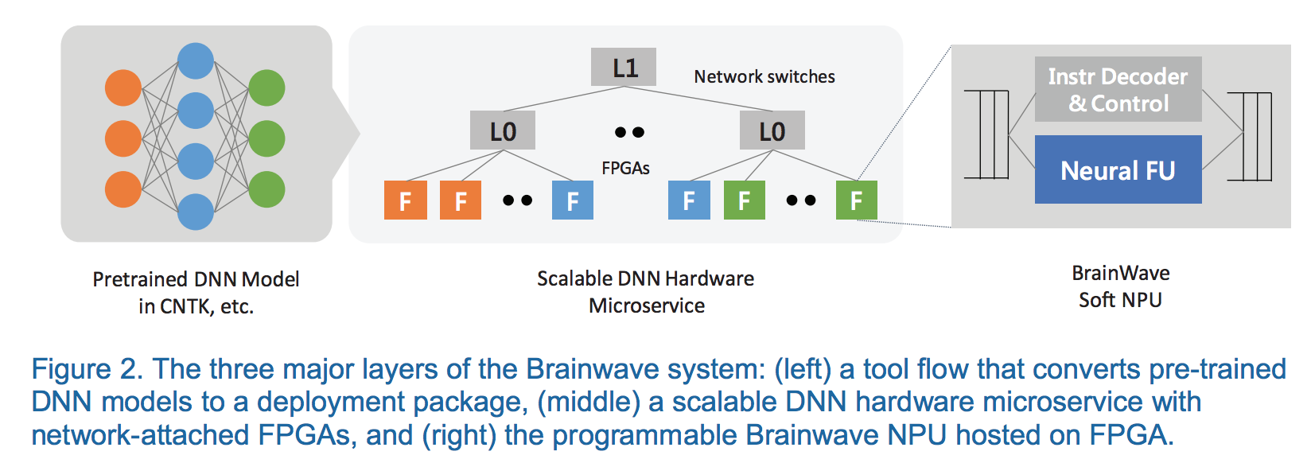
Brainwave Stack Overview

Slide 21
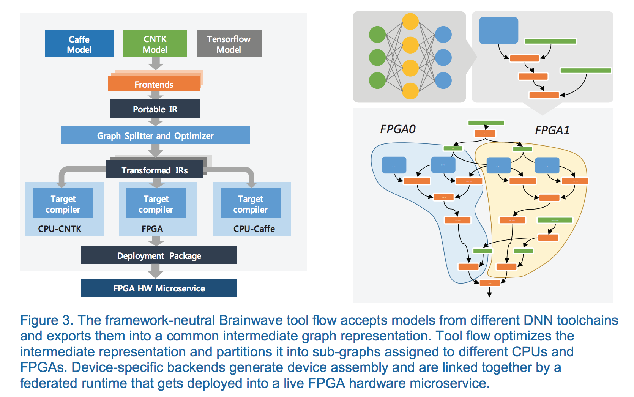
Tool Flow
CNNs high intensity mapped to single FGPA
Weights of bandwidth-limited RNNs pinned greedily
Unsupported or not profitable operators assigned to CPUs

Slide 22
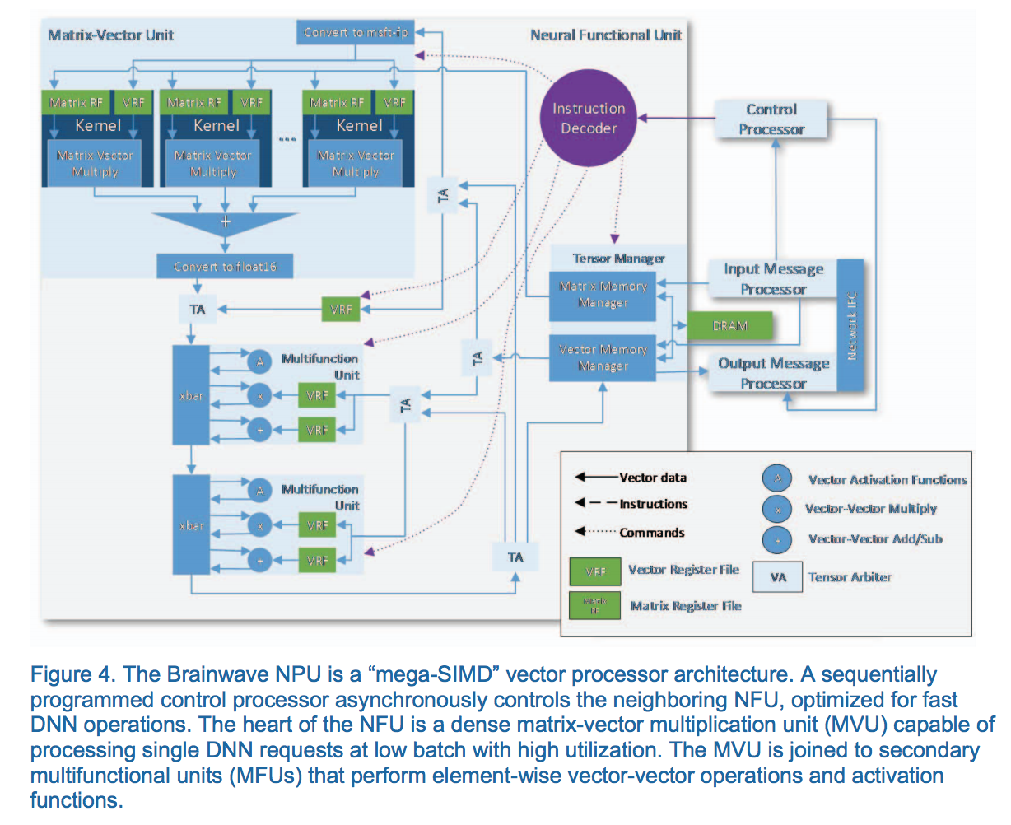
Brainwave NPU
Compile-time narrow precision data types
Simple, single-threaded programming model with an extensible ISA
Scalable microarchitecture that maximizes hardware efficiency at low batch sizes

Slide 23
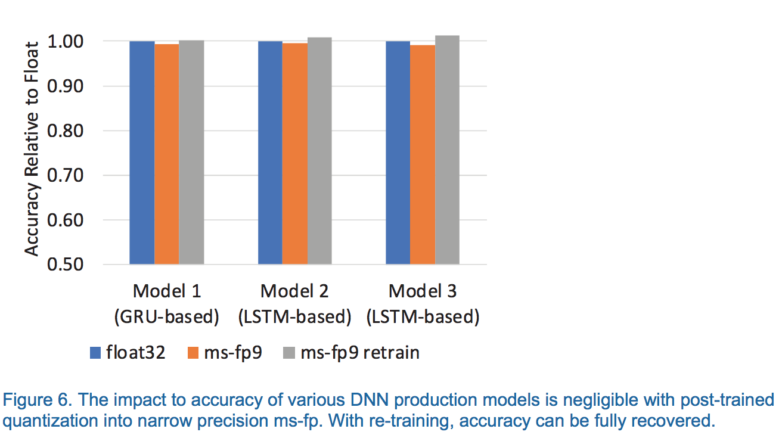
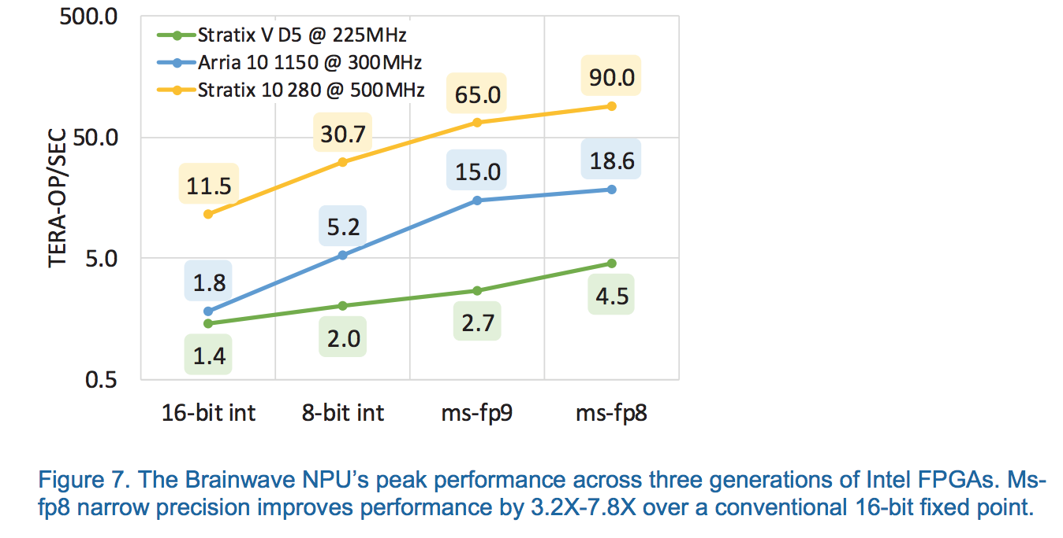
Narrow Precision
Proprietary ‘neural’-optimized data formats
ms-fp8 and ms-fp9
Mantissa trimmed to 2 or 3 bits

Slide 24
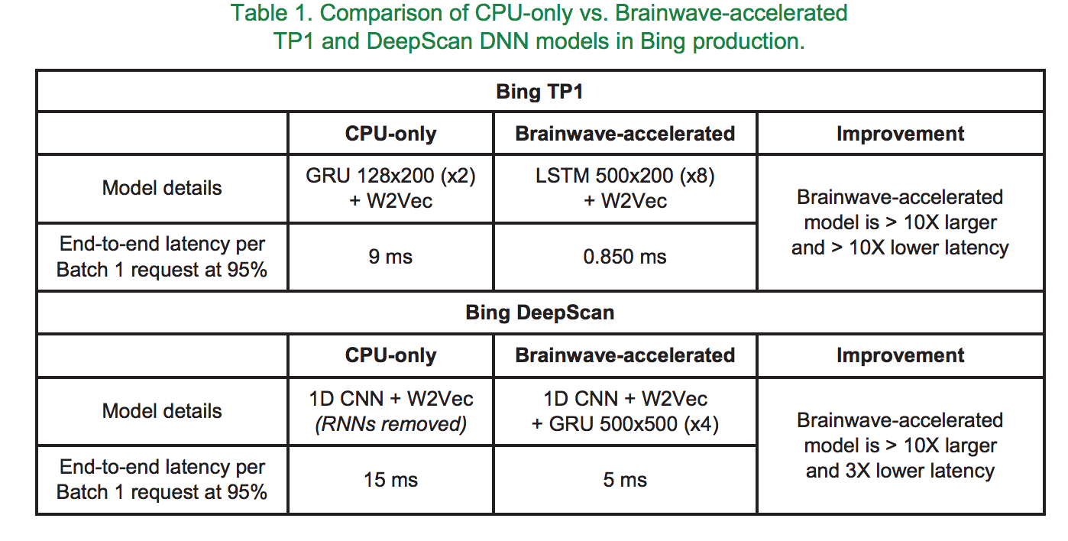
Results

Slide 25
Results Continued
Brainwave NPU scaled up to run on a pre-production Intel Stratix 10 280 FPGA
This engine can serve a Batch-1 high-dimensional 3,200x2,400 GRU with 480 timesteps in under 1 ms
5X that of ResNet-50 and about 25X that of AlexNet

Slide 26
Conclusion
Key takeaway: Using configurable hardware at scale, a system can be designed without an adversarial tradeoff between latency and throughput (batching)
In Brainwave, the system and the soft NPU are co-architected in mind for each other, exploiting datacenter-scale pinning of models in on-chip memories that scale elastically beyond single-chip solutions
Narrow precision quantization is a viable approach for production DNN models. This is a large part of what allows Brainwave to compete in performance and energy efficiency without trading accuracy

