Slide 1
Disaggregated Storage: FDS + EC-Cache
Mosharaf Chowdhury

Slide 2
Flat Datacenter Storage
OSDI’10

Slide 3
Disk Locality
Assumption: Network is bottlenecked
Move compute to data
Programming models like MapReduce and Spark
Good
Decrease bandwidth usage → faster task completions
Bad
Constraints on where a task can run → resource underutilization

Slide 4
Full Bisection Bandwidth Networks
Remember VL2?
From any machine to any other machine we have the same bandwidth
With balanced placement, there is no difference where something is located
As long as we are reading from the disk (why?)
FDS relies on a full bisection bandwidth network (VL2) to flatten the data placement problem
FDS read/write performance exceeds 2 GB/s, can recover 92GB of lost data in 6.2 seconds, and broke a world record in sorting in 2012.

Slide 5
FDS Design: Blobs and Tracts
Data is stored in logical blobs
Sequence of bytes with a unique GUID
Divided into constant sized (8MB) tracts
Both blobs and tracts are mutable
Each disk is managed by a tractserver process
Tracts are written directly to disk instead of going through a file system
All tract meta-data are kept in memory

Slide 6
API
Reads and writes not guaranteed to appear in the order they are issued
Read and writes are atomic
Happens completely or doesn’t happen
API is non-blocking (why?)
Applications have to register a call-back function to be notified
Performance improves: many requests can be issued in parallel, and FDS can pipeline disk reads with network reads

Slide 7
Deterministic Tract Placement
Tractservers can be found deterministically using a Tract Locator Table (TLT)
TLT is distributed to clients using a centralized metadata server
TLT is constructed by concatenating m random permutations of the tract- server list
Find tract i in blob with GUID g at
Tract_Locator = (SHA-1(g) + i) mod TLT_Length
Deterministic function
Hashing the GUID randomizes the first tracts placement

Slide 8
Replication
Each TLT entry is k-way (k > 2)
Writes go to all k replicas; reads pick a random entry
Metadata updates are serialized by a primary replica
Then shared with secondaries using a two-phase commit protocol

Slide 9
Per-Blob Metadata
FDS stores a blob’s metadata in each blob’s special metadata tract (“tract −1”)
Blobs are extended using API calls, all of which has to access the metadata tract
The extend API is functionally equivalent to the Google File System’s “atomic append”

Slide 10
Dynamic Work Allocation
Instead of scheduling task to process on a specific piece of data, work can be assigned to already running workers in FDS (why?)
Data is always equidistant
Whichever worker is done can start doing more work
Fine-grained work distribution

Slide 11
Failure Recovery
TLT carries a version number for each row
Upon failure
Metadata server detects failure by heartbeat
Current TLT is invalidated by incrementing version
Random tractservers are picked to fill gaps in TLT after failure
tractservers ACK new assignment, replicate data
Clients with stale TLTs request new ones from metadata server

Slide 12
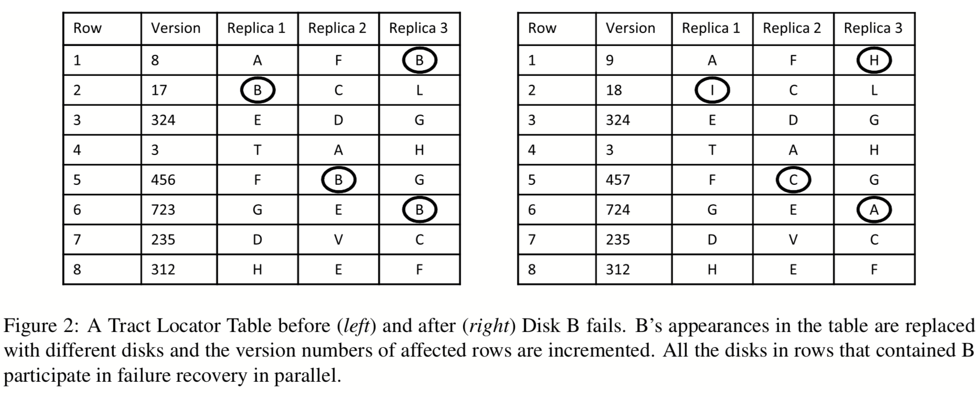
Failure Recovery

Slide 13
Fault Recovery Guarantees
Weak Consistency
trackservers may be inconsistent during failure, or if client fails after a write to a subset of replicas
Availability
Clients will block until TLT is updated
Network failure?

Slide 14
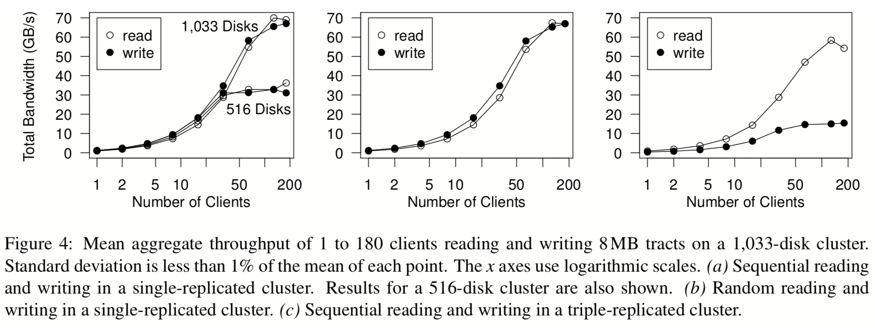
Read & Write Performance
Sequential
Replication=1
Random
Replication=1
Sequential
Replication=3

Slide 15
Comparison
FDS
GFS

Slide 16
Takeaways
If network is not the bottleneck, then disk locality is irrelevant
Do we ignore locality completely?
Memory locality
Memory disaggregation

Slide 17
Break!

Slide 18
Announcements
Paper assignment is finalized
Presenters: MUST send me a copy of the slides a day before
20% of the grade!
Next class: FRIDAY, Jan 25 @ 1200 EECS from NOON
Pop QUIZ: https://goo.gl/forms/hQbxS2JFivbMrNQo2

Slide 19
EC-Cache
OSDI’16

Slide 20
Caching for Data-Intensive Clusters
Data-intensive clusters rely on distributed, in-memory caching for high performance
Reading from memory orders of magnitude faster than from disk/SSD
Example: Alluxio (formerly Tachyon)

Slide 21
Imbalances Prevalent in Clusters
Sources of imbalance
Skew in object popularity
Top 5% of objects 7X more popular than bottom 75%
Background network imbalance
Ratio of maximum-to-average utilization more than 4.5x with >50% utilization
Failures/unavailabilities
Median > 50 machine unavailability events every day in a cluster of several thousand servers

Slide 22
Adverse Effects of Imbalance
Load imbalance
High read latency
Single copy in memory often not sufficient to get good performance
Existing systems rely on replication
Specifically, selective replication → #replicas proportional to popularity

Slide 23
Design Space
“Erasure Coding”
EC-Cache
Read performance
& Load balance
Selective
replication
Single copy
in memory
Memory Overhead

Slide 24
Quick Primer on Erasure Coding
Takes in k data units and creates r “parity” units
Any k of the (k+r) units are sufficient to decode the original k data units

Slide 25


EC-Cache Writes
Put
X
Split
k = 2
Object split into k data units
Encoded to generate r parity units
(k+r) units cached on distinct servers chosen uniformly at random
d1
d2
k = 2
r = 1
Encode
d1
d2
p1
d1
d2
p1
Caching servers

Slide 26

EC-Cache Reads
Caching servers
k = 2
r = 1
d1
d2
p1
Read from (k + Δ) units of the object chosen uniformly at random
“Additional reads”
Use the first k units that arrive
Decode the data units
Combine the decoded units
Δ = 1
k + Δ = 3
Read units
d2
p1
Decode
d1
d2
X
Get X

Slide 27
How Does Erasure Coding Help?
Finer control over memory overhead
Object splitting helps in load balancing
Object splitting reduces median latency but hurts tail latency
Read parallelism
Straggler effect
“Any k out of (k+r)” property helps to reduce tail latency
Δ = 1 often sufficient to reign in tail latency

Slide 28
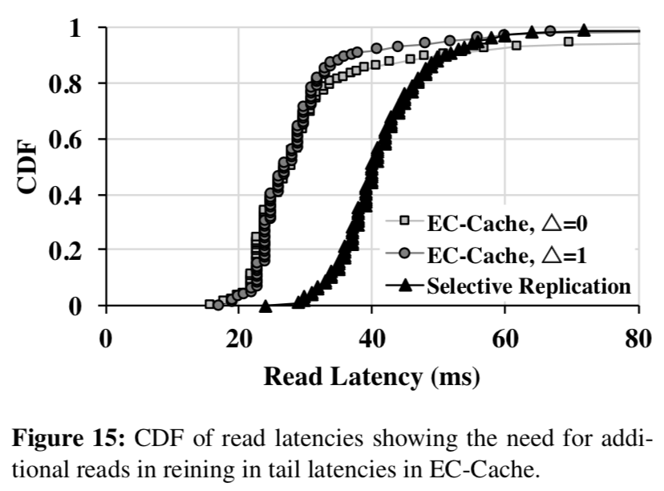
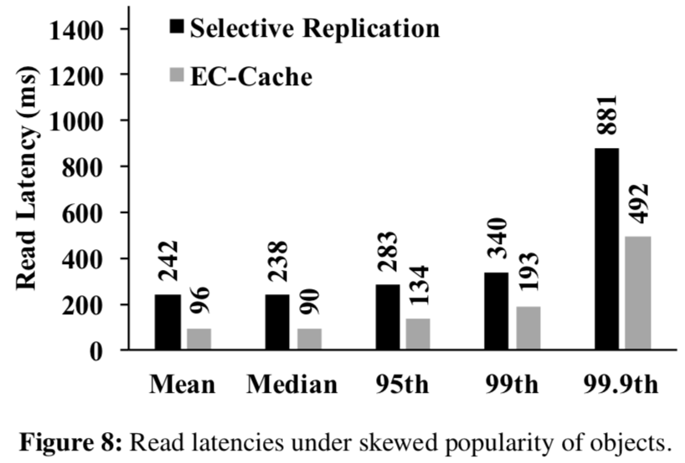
Read Latency

Slide 29
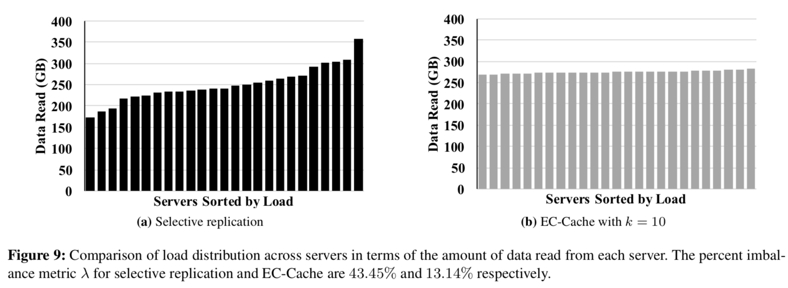
More Balanced Server Load

Slide 30
Takeaways
Erasure coding can improve performance and load balancing in addition to increasing fault tolerance
Must be applied to individual object (why?)
Must be applied to large objects (why?)
Must be used in conjunction with additional reads (why?)

