Slide 1
Resilient Distributed Datasets: A Fault-Tolerant Abstraction for In-Memory Cluster Computing
Matei Zaharia, Mosharaf Chowdhury, Tathagata Das, Ankur Dave, Justin Ma, Murphy McCauley, Michael J. Franklin, Scott Shenker, Ion Stoica
Presented by: Shenghao Lin, Ying Luo, Mengqiu Teng

Slide 2
Motivation & Background
Current Frameworks: MapReduce, Dryad
Pros:
Allowed Parallel Computation without worrying low level details (work distribution, fault tolerance)
Provided a set of high-level operations (map, reduce)
Cons:
Only use on-disk storage, no leverage of distributed memory
Large overhead for reusing data in iterative or interactive tasks (I/O, replication, serialization)

Slide 3
Solution: Resilient Distributed Datasets
Utilize Distributed Memory while providing efficient fault tolerance
Limit operations to coarse-grained transformations (e.g. map, filter)
Provide efficient fault tolerance by logging transformations(lineage)
Allow user control of data persistence and partitioning

Slide 4
RDDs: Overview
Read-only, partitioned collection of records
Created from 1) data in stable storage 2) other RDDs
Transformations define RDD:
Map, filter, flatmap, sample, groupbykey, reducebykey, join, union
Actions return value or export data to storage system
count, collect, save, reduce, lookup

Slide 5
Example: Console Log Mining
lines = spark.textFile("hdfs://...")
errors = lines.filter(_.startsWith("ERROR"))
errors.count()
HDFS File
definition
Base RDD: lines
Transformation: filter
Transformed RDD: errors
Action: count
Number of Logging

Slide 6
RDDs: Fault Tolerance
Key Idea: Limit operations to coarse-grained transformations and only log the transformations instead of replicating data for recovering
Lineage: transformations used to build a dataset
Recover lost partition by applying lineage from corresponding data partition in stable storage

Slide 7



Example
RDD 0
p1
p2
p3
Worker 3
Master
RDD 1a
RDD 1b
p1
p2
p3
p1
p2
p3
Worker 1
Worker 2
RDD 2
p1
p2
p3
Credit: Kevin Yang, University of Michigan
RDD 3
p1
p2
p3
Notes:
RDD 0: initialization (reading from an input file)
RDD 1a/b: some mapping or filtering
RDD 2: some joining
RDD 3: some filtering
What happens when Worker 3 goes down?
All partitions on worker 3 disappear.So we have to rebuild Worker 3’s partitions.
So we have to go back up the lineage and rebuild each partition from each ancestor.

Slide 8
Example
RDD 0
Worker 3
p1
p2
p3
Master
RDD 1a
RDD 1b
Worker 1
p1
p2
p3
p1
p2
p3
Worker 2
RDD 2
p1
p2
p3
Credit: Kevin Yang, University of Michigan
RDD 3
p1
p2
p3
Notes:
RDD 0: initialization (reading from an input file)
RDD 1a/b: some mapping or filtering
RDD 2: some joining
RDD 3: some filtering
What happens when Worker 3 goes down?
All partitions on worker 3 disappear.So we have to rebuild Worker 3’s partitions.
So we have to go back up the lineage and rebuild each partition from each ancestor.

Slide 9
Example
RDD 0
Worker 3
p1
p2
p3
Master
RDD 1a
RDD 1b
p1
p2
p3
p1
p2
p3
Worker 1
Worker 2
RDD 2
p1
p2
p3
RDD 3
Credit: Kevin Yang, University of Michigan
p1
p2
p3
Notes:
RDD 0: initialization (reading from an input file)
RDD 1a/b: some mapping or filtering
RDD 2: some joining
RDD 3: some filtering
What happens when Worker 3 goes down?
All partitions on worker 3 disappear.So we have to rebuild Worker 3’s partitions.
So we have to go back up the lineage and rebuild each partition from each ancestor.

Slide 10
Example
RDD 0
p1
p2
p3
Worker 3
Master
RDD 1a
RDD 1b
p1
p2
p3
p1
p2
p3
Worker 1
Worker 2
RDD 2
p1
p2
p3
RDD 3
Credit: Kevin Yang, University of Michigan
p1
p2
p3
Notes:
RDD 0: initialization (reading from an input file)
RDD 1a/b: some mapping or filtering
RDD 2: some joining
RDD 3: some filtering
What happens when Worker 3 goes down?
All partitions on worker 3 disappear.So we have to rebuild Worker 3’s partitions.
So we have to go back up the lineage and rebuild each partition from each ancestor.

Slide 11
Example
RDD 0
p1
p2
p3
Worker 3
Master
RDD 1a
RDD 1b
p1
p2
p3
p1
p2
p3
Worker 1
Worker 2
RDD 2
p1
p2
p3
RDD 3
Credit: Kevin Yang, University of Michigan
p1
p2
p3
Notes:
RDD 0: initialization (reading from an input file)
RDD 1a/b: some mapping or filtering
RDD 2: some joining
RDD 3: some filtering
What happens when Worker 3 goes down?
All partitions on worker 3 disappear.So we have to rebuild Worker 3’s partitions.
So we have to go back up the lineage and rebuild each partition from each ancestor.

Slide 12
Example
RDD 0
p1
p2
p3
Worker 3
Master
RDD 1a
RDD 1b
p1
p2
p3
p1
p2
p3
Worker 1
Worker 2
RDD 2
p1
p2
p3
RDD 3
Credit: Kevin Yang, University of Michigan
p1
p2
p3
Notes:
RDD 0: initialization (reading from an input file)
RDD 1a/b: some mapping or filtering
RDD 2: some joining
RDD 3: some filtering
What happens when Worker 3 goes down?
All partitions on worker 3 disappear.So we have to rebuild Worker 3’s partitions.
So we have to go back up the lineage and rebuild each partition from each ancestor.

Slide 13
RDDs:
User control of:
Persistence: indicate storage strategy (e.g. in-memory)
Partitioning: placement optimization (e.g. hash partitioning)
EECS 598 – W19

Slide 14
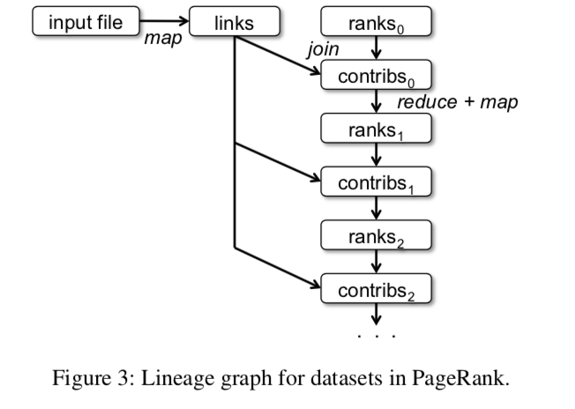
Example : PageRank
val links = spark.textFile(...).map(...).persist()
Partition rank and corresponding links on the same machine to eliminate communication
EECS 598 – W19
Notes:
locality

Slide 15
Example : PageRank
facebook.com
google.com
umich.edu
facebook.com
google.com
umich.edu
facebook.com
google.com
umich.edu
facebook.com
google.com
umich.edu
facebook.com
google.com
umich.edu
PageRank with hash partitioning
PageRank without partitioning
Credit: Kevin Yang, University of Michigan
EECS 598 – W19

Slide 16
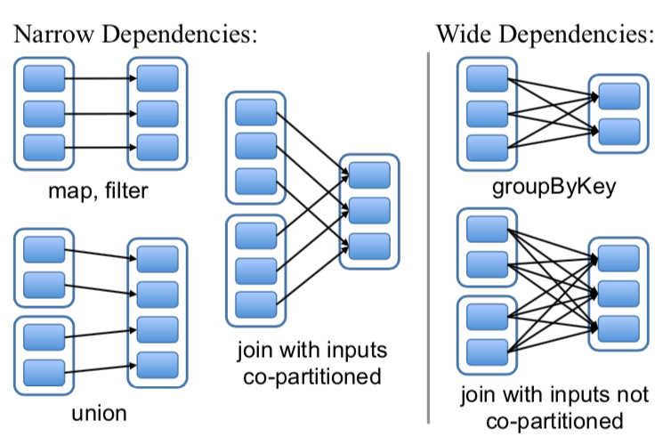
RDD Representation
Partitions: atomic pieces of the RDD
Dependencies: relations with parent RDDs
Narrow Dependencies: A parent RDD partition is used by at most one child partition (e.g. map, filter)
Wide Dependencies: A parent RDD partition is used by multiple child partitions (e.g. join, groupByKey)
EECS 598 – W19
Notes:
narrow dependencies: each partition of the parent RDD is used by at most one partition of the child RDD,
wide dependencies: multiple child partitions may depend on one parent RDD.
Narrow: pipelined execution on one node, efficient, as only the lost parent partitions need to be recomputed in parallel on different nodes.
Wide: need internode communication

Slide 17
RDD Representation
Function: computing dataset based on its parents
Metadata:
Partition scheme
Data placement
EECS 598 – W19
Notes:
narrow dependencies, where each partition of the parent RDD is used by at most one partition of the child RDD,
wide dependencies, where multiple child partitions may depend on one parent RDD.
For example, map leads to a narrow dependency, while join leads to to wide dependencies

Slide 18
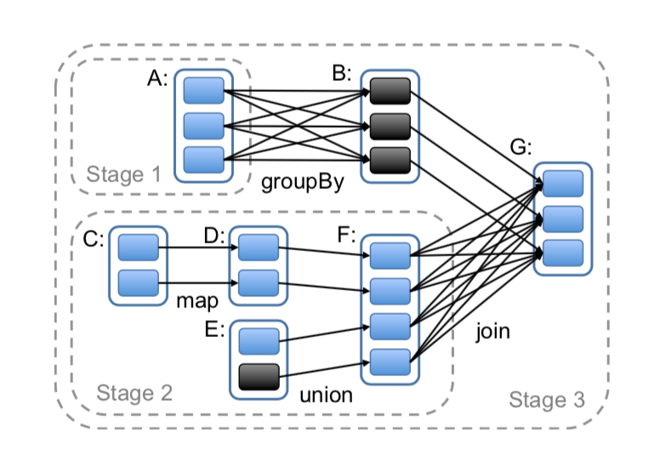
Implementation: Job Scheduling
Build DAG of stages to execute
Each stage contains as much as possible pipelined transformations with narrow dependencies
Stages are linked by wide dependencies
Assign tasks based on data locality
EECS 598 – W19
Notes:
2 co-locate data and computation
Group narrow dependencies into a stage, which can be pipelined on 1 node.

Slide 19
Implementation: Fault Tolerance
Task failures:
Stage’s parents available: rerun on another node
Some stages unavailable: resubmit tasks to compute missing partitions in parallel
Do not currently tolerate scheduler failures
Solution: Lineage graph replication
EECS 598 – W19
19

Slide 20
Implementation: Memory Management
Three storage strategy: In-memory storage as deserialized Java objects, in-memory storage as serialized data, and on-disk storage
LRU policy for eviction at RDD level when there is no enough RAM
Or, use user-specified “persistence priority” for eviction
EECS 598 – W19
Notes:
The first option provides the fastest performance, because the JVM can access each RDD element natively. The second option lets users choose a more memory-efficient representation than Java object graphs when space is limited, at the cost of lower performance. The third option is useful for RDDs that are too large to keep in RAM but costly to recompute on each use.

Slide 21
Implementation: Checkpointing
What if there is a long lineage chain with wide dependencies, which would be too costly to derive lost data from beginning?
Use checkpoints for RDDs
PageRank
EECS 598 – W19

Slide 22
Comparison Between Related Work
Utilize memory (MapReduce, Ciel, Dryad)
High-level programming interface (Piccolo, DSM, Relational Database)
Lineage-based recovery strategy (Piccolo, DSM: checkpoint, rollback)
Can share data across queries (DryadLINQ, FlumeJava)
General abstraction (Twister, Haloop: specific applications)
In-memory caching, explicit control over data (Nectar, Ciel, FlumeJava)
Persist lineage information: MapReduce, Dryad
EECS 598 – W19

Slide 23
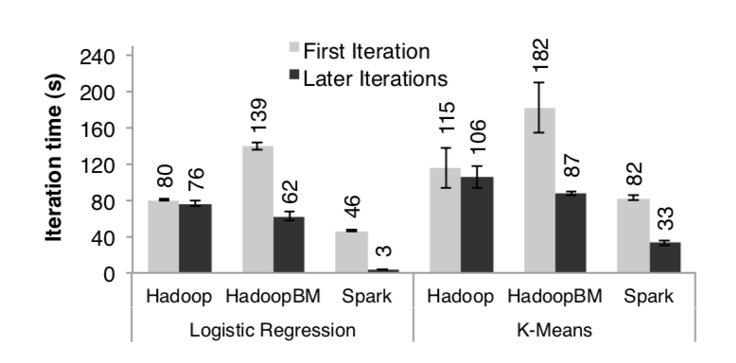
Performance: Iterative Machine Learning
K-Means and Logistic Regression
Experiment Setup:
10 iterations
10GB datasets
25-100 machines
EECS 598 – W19

Slide 24
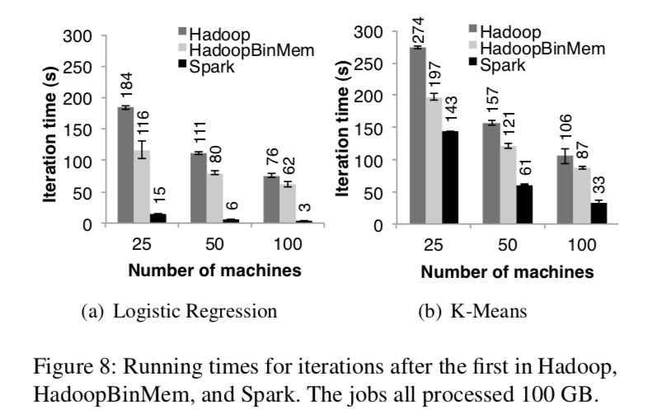
Performance: Iterative Machine Learning
EECS 598 – W19
Notes:
Outperforms HadoopBinMemory
1. Minimum overhead of the Hadoop software stack
2. Overhead of HDFS while serving data
3. Deserialization cost to convert binary records to us- able in-memory Java objects.

Slide 25
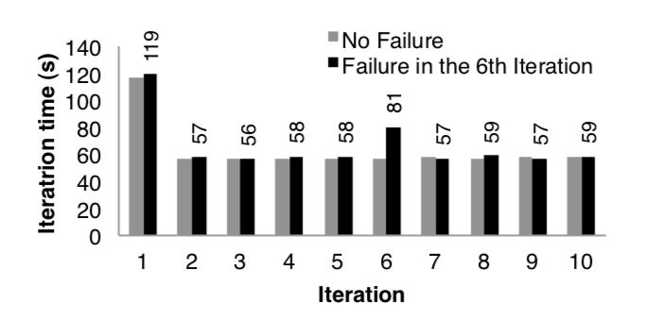
Performance: Fault Recovery
Experiment Setup:
10 iterations
100GB datasets
75 machines
A machine killed in 6th iteration
EECS 598 – W19

Slide 26
CIEL: a universal execution engine for distributed data-flow computing
Derek G. Murray, Malte Schwarzkopf, Christopher Smowton, Steven Smith, Anil Madhavapeddy, Steven Hand

Slide 27
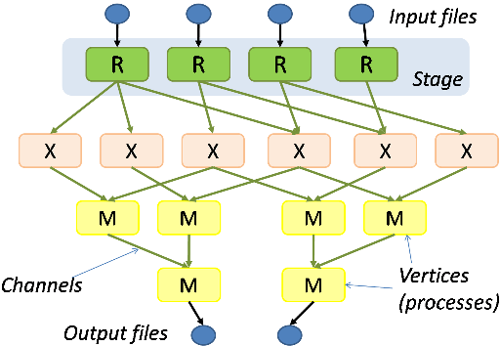
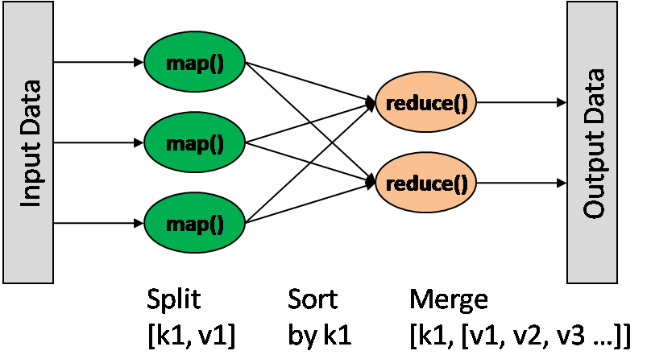
Distributed Computing Models
MapReduce
Dryad
Bipartite Map/Reduce DAG
Arbitrary static DAG
Problem: the graph is fixed!

Slide 28
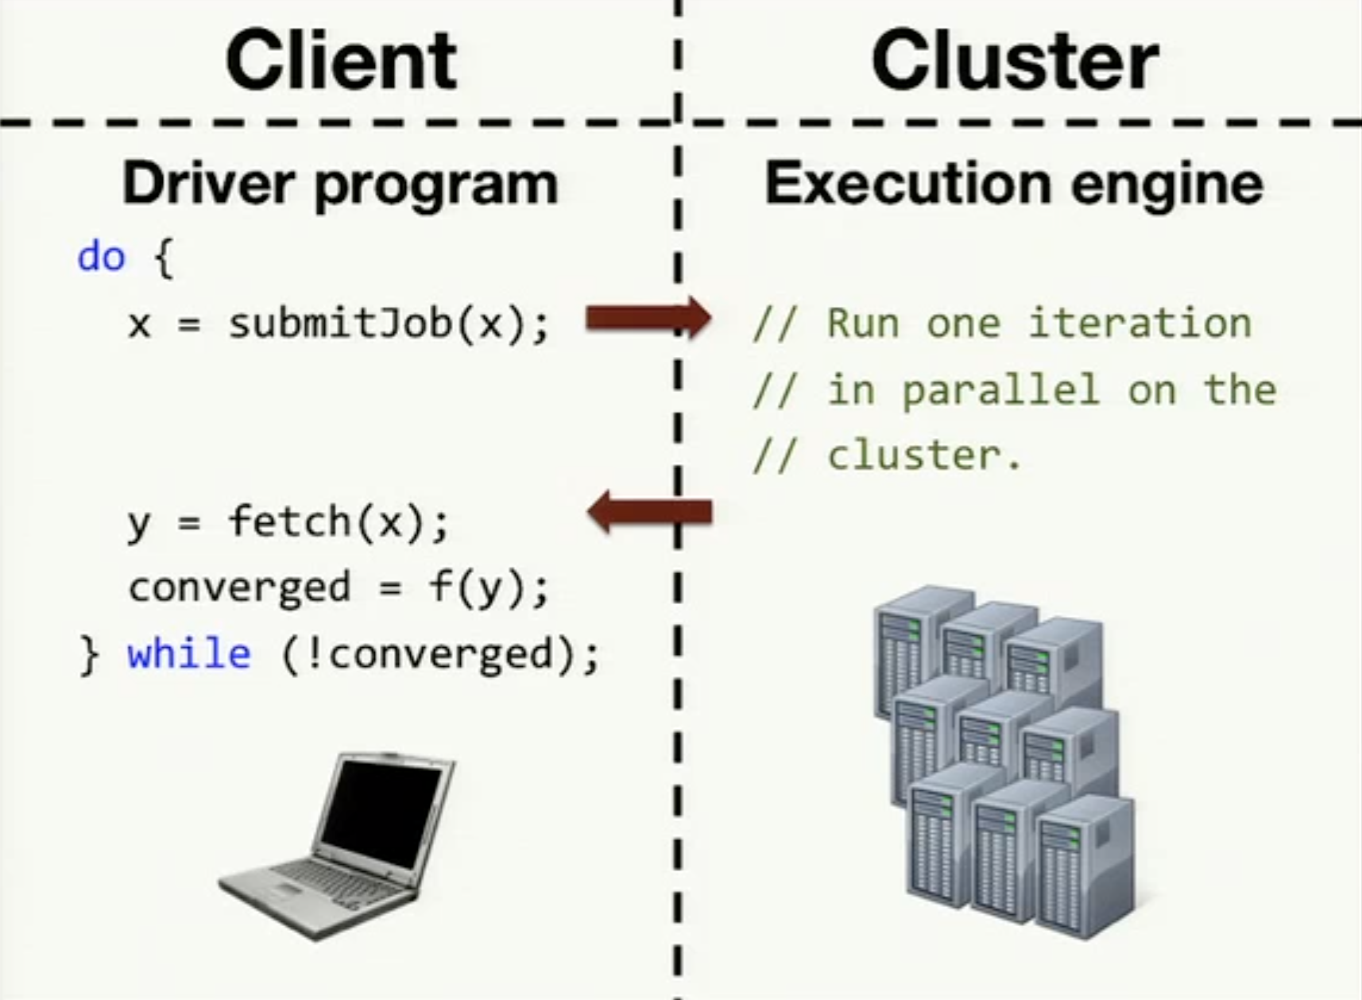
Iterative Distributed Computing Models

Slide 29
Iterative Distributed Computing Models
Rely on driver program on the client side
Per-iteration overhead
Client failure can result in the whole job failure

Slide 30
Motivation
Dynamic Control Flow
Task Dependencies
Transparency (fault tolerance, data locality, scaling)

Slide 31
CIEL: Computational Model
High-level abstraction: Dynamic Task Graphs
A task can choose to produce an output, or more tasks based on current state
Turing-Machine, that’s why it is named as “universal”

Slide 32
CIEL: An Abstract Example
u
A
B
C
w

Slide 33
CIEL: Primitives of the model
Object: an unstructured, finite-length sequence of bytes
Reference: the location where an object is stored
Concrete reference: produced, can be consumed
Future reference: not yet produced
Task: a non-blocking atomic computation that executes completely on a single machine

Slide 34
CIEL: Rules
Dependencies
A task is runnable when all of its dependencies become concrete.
Termination
A task must either publish a concrete reference, or spawn a child task with its expected output name as its output name.
Forming a DAG
A child task must only depend on concrete references, or future references to the outputs of spawned tasks.

Slide 35
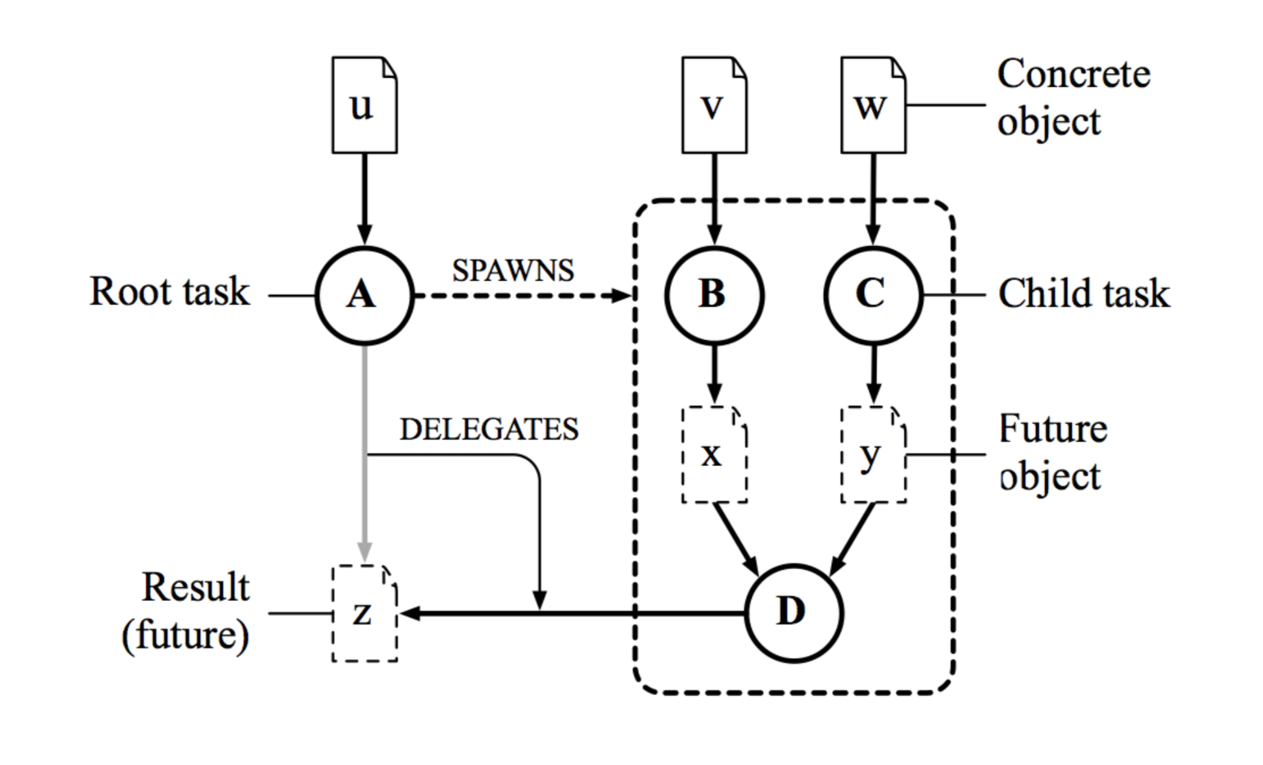
CIEL: A Real Example

Slide 36
CIEL: Evaluating Objects
Eager Evaluation
From inputs/concrete references to tasks
Lazy Evaluation
From outputs to tasks

Slide 37
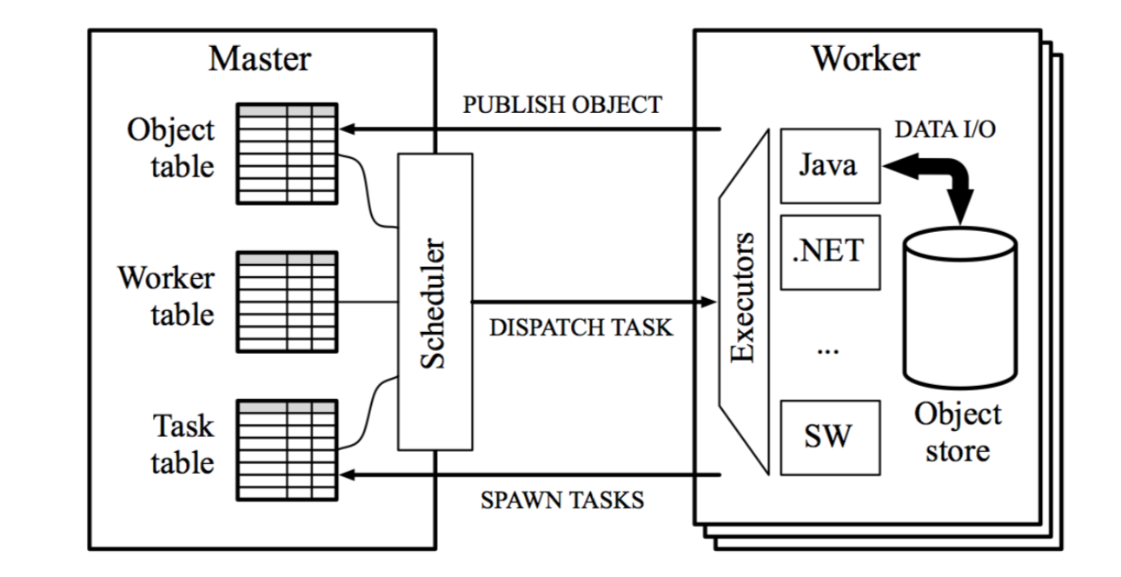
CIEL: System Architecture

Slide 38
CIEL: Master
Object Table
Producers and Locations
Task Table:
Dependencies and Expected Outputs
Worker Table
Scheduler
Dispatch tasks to workers using lazy evaluation, satisfying locality

Slide 39
CIEL: Worker
Executor
Local object storage

Slide 40
Skywriting
Language for expressing task-level parallelism running on top of CIEL
Interpreted, dynamically-typed, C-like syntax
Program state stored as CIEL objects

Slide 41
Fault Tolerance
Client: trivial, the whole job is on server side
Worker: re-execute the task
Master:
Naïve implementation: re-execute the whole job
Persistent logging: the new master can restore the DAG by the log
Secondary master: the primary master asynchronously forwards all task table and object table updates to the secondary
Object table reconstruction: the master pulls the worker’s data objects

Slide 42
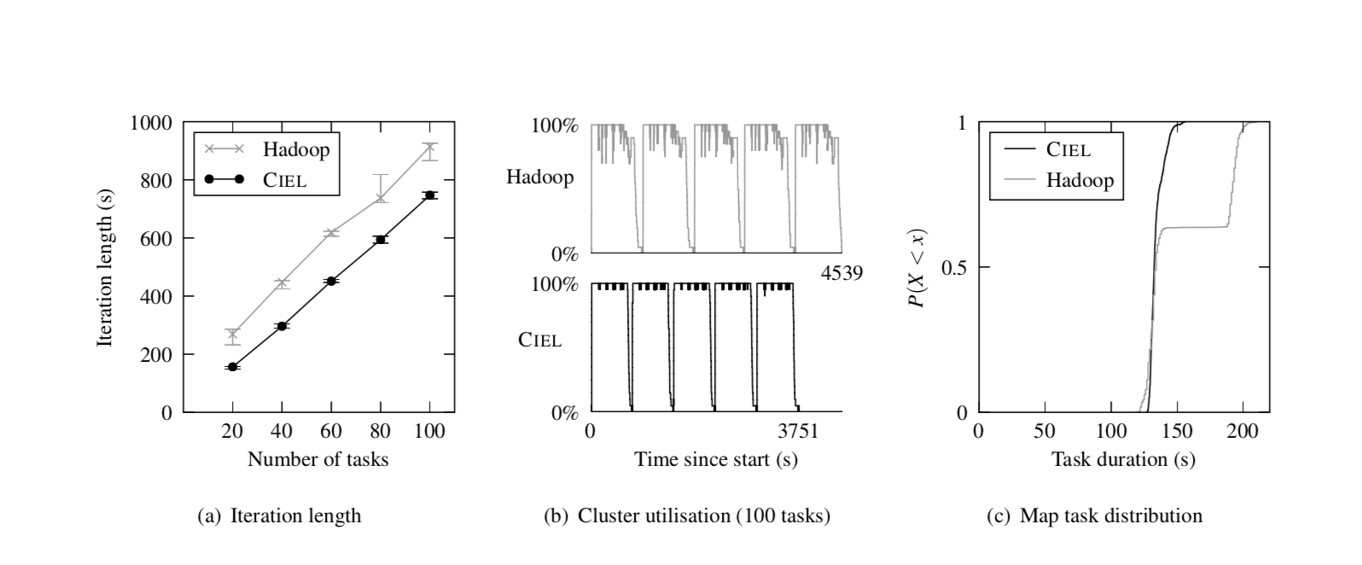
Performance – k-means

Slide 43
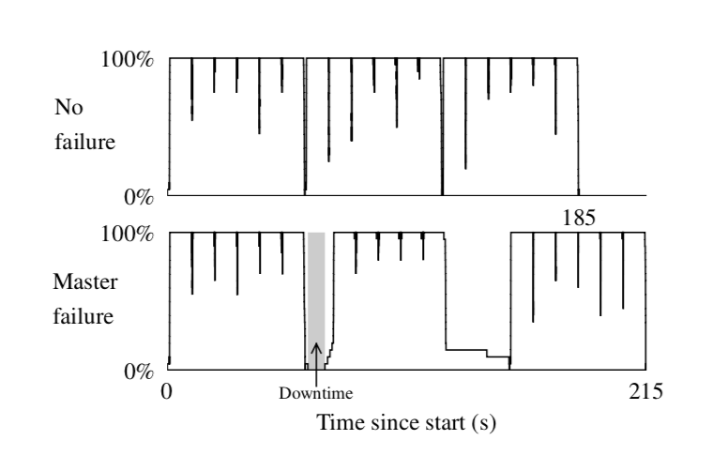
Performance – Fault Recovery

Slide 44
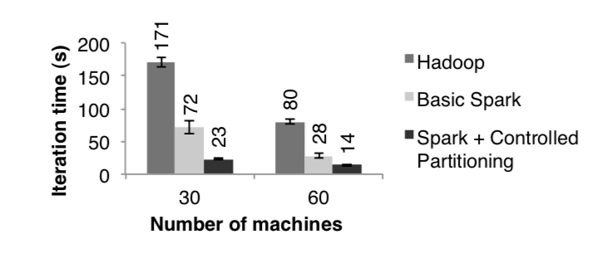
Performance: PageRank
Experiment Setup:
10 iterations
54GB datasets
~4 million articles
EECS 598 – W19

