Slide 1
DeepXplore: Automated Whitebox Testing of Deep Learning Systems
DeepBase: Deep Inspection of Neural Networks
Kexin Pei et al.
Thibault Sellam et al.

Slide 2
DeepXplore: Automated Whitebox Testing of Deep Learning Systems
Kexin Pei et al.

Slide 3
Motivation
Deep learning (DL) systems are increasingly deployed in various domains
Correctness and predictability is of great importance
In safety- and security-critical domains
Self-driving cars
Malware detection
Testing DL systems!
Notes:
In recent years, ….. including ……
…
incorrect behaviors can lead to very bad consequences such as a fatal collision of a self-driving car. I bet you have heard that A Tesla car in autopilot crashed into a trailer because the autopilot system failed to recognize the trailer as an obstacle due to its “white color against a brightly lit sky” and the “high ride height”.
Often time, there are corner cases that the testing data fails to cover.

Slide 4
Current Solution
Rely on manually labeled test data
Manual effort can be costly
Rely on synthetic data
Use simulation to generate synthetic data
Data generation process not tailored for a particular DL
E.g. rotate images
Adversary Deep Learning
Perturbations limited to tiny invisible changes
Cover a small part of DL system’s logic and corner cases
Notes:
The key idea is to create synthetic images such that they get classified by DL models differently than the original picture but still look the same to the human eye.
none of them can hope to cover more than a tiny fraction of all possible corner cases.

Slide 5
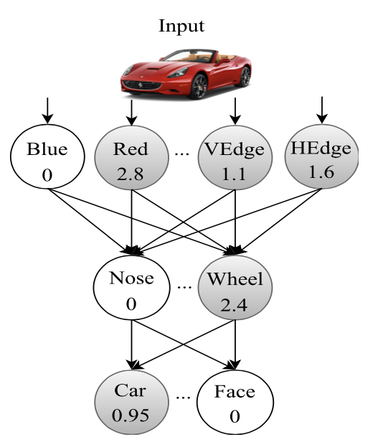

DeepXplore
Common metric: code coverage
New metric:
Neuron Coverage
A neuron in a DL model is considered activated
if the output of the neuron is above a customizable threshold
Notes:
But in DL systems, what usually happens is that inputs go through all the layers of a model therefore leading very high code coverage.
The intuition here is that if the output of a neuron is very small, close to 0, then it makes very little contribution to the final output of the model. And that neuron is considered turned off for that input. In this case, whatever the weight of the edges connecting to these 3 neurons, it doesn’t matter. So basically these weight are not verified by this input.
The percentage of the neurons that are activated by at least one input in the test set.
This is one of the several ways that DeepXplore adopts in the hope of discovering more corner cases.

Slide 6
DeepXplore
How to get rid of manual labeling?
Use other DL systems!
Imagine we have 3 different DL models for identify cars
Take the majority decision as the label
Generates synthetic data that maximize differential behavior

Slide 7
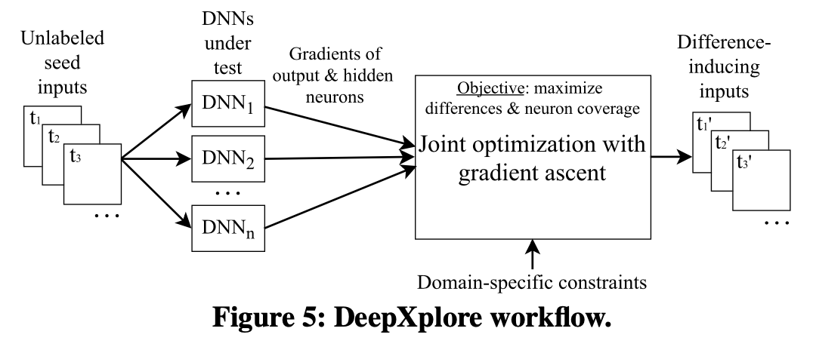
DeepXplore Implementation
Inputs:
A set of test inputs as the seeds
Several DNNs: F1, F2, F3, …., Fn

Slide 8
DeepXplore Implementation
Gradient Descent
In training: w = w + step* 𝜗OBJ/𝜗w
In DeepXplore: fix the weights, modify the inputs.
x = x + step* 𝜗OBJ/𝜗x
Notes:
iteratively perform gradient ascent to modify the test input toward maximizing differential behavior and neuron coverage.

Slide 9
DeepXplore Implementation
Maximize differential behavior
Denote Fk (x)[c] be the probability that Fk predicts x to be class c
Randomly selects one DL, let’s say Fj
Notes:
The first objective of the optimization problem is to generate test inputs that can induce different behaviors.
tries to make it predict different from the remaining DL models by setting the objective function to be this, which is basically ….

Slide 10
DeepXplore Implementation
Maximize neuron coverage
Select one inactive neuron for each DNN in each iteration
Let’s say we want to maximize the output of a neuron n
Notes:
The second objective is to generate inputs that maximize neuron coverage
We achieve this goal by iteratively picking inactivated neurons and modifying the input such that output of that neuron increases.

Slide 11

DeepXplore Implementation
Joint optimization
Notes:
λ2 is a parameter for balancing between the two objectives of the joint optimization process

Slide 12
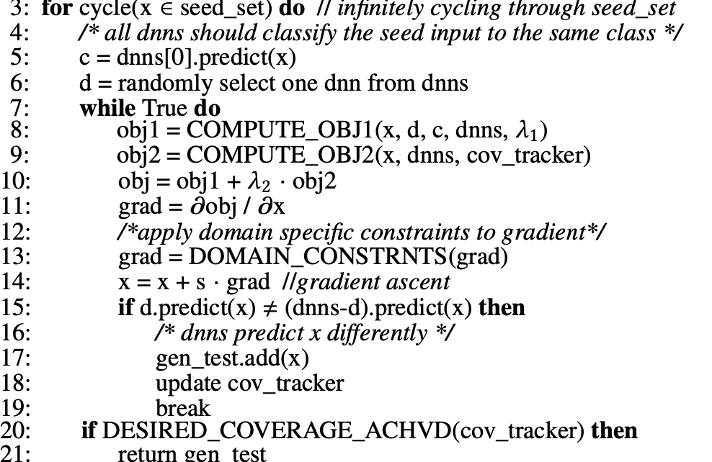

Slide 13
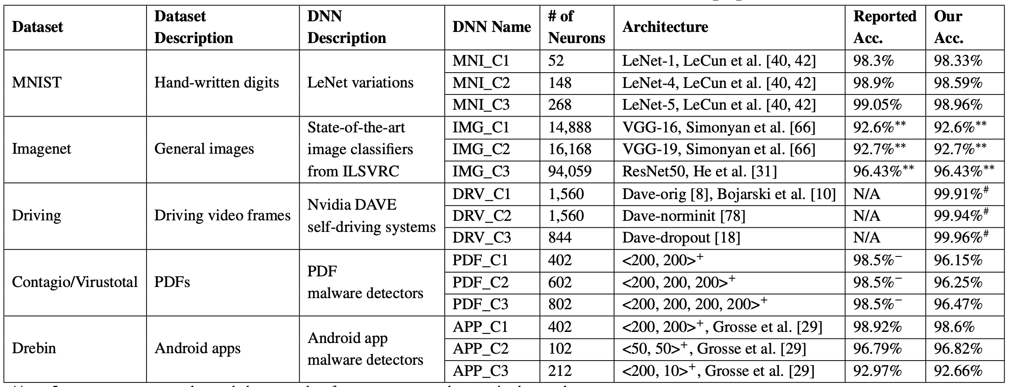
Experiments

Slide 14
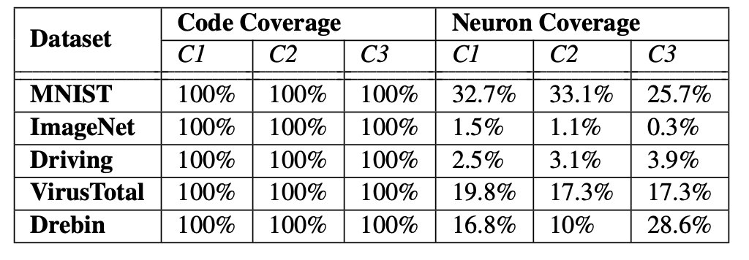
Benefits of Neuron Coverage
Neuron coverage vs. code coverage
Notes:
They compare both code and neuron coverages achieved by the same number of inputs by evaluating the test DNNs on ten randomly picked testing samples.
Even 10 randomly picked inputs result in 100% code coverage for all DNNs while the neuron coverage never goes above 34% for any of the DNNs.

Slide 15
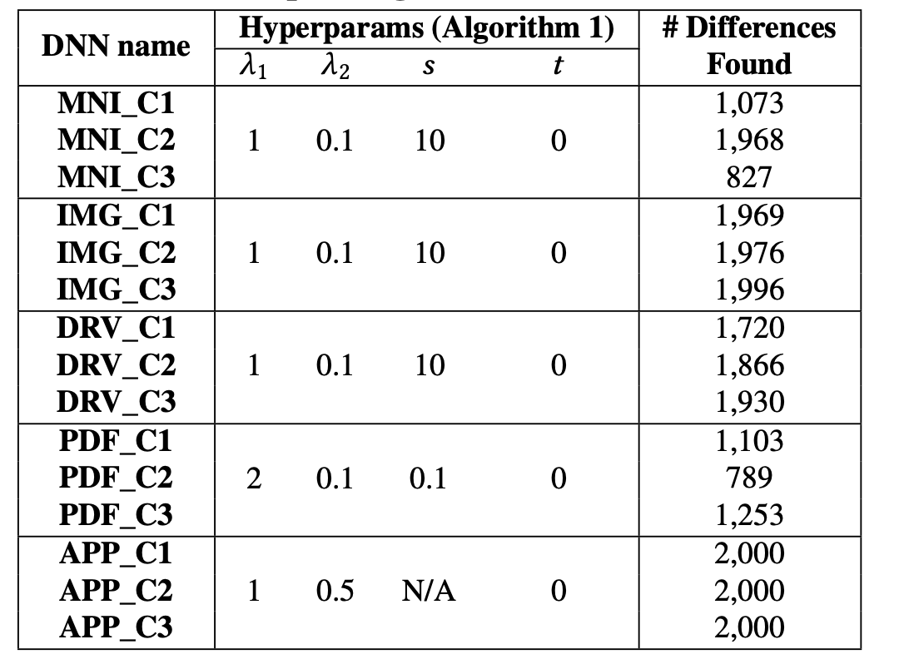
Difference-inducing Inputs
Notes:
Table 2 summarizes the numbers of erroneous behaviors found by DeepXplore for each tested DNN while using 2,000 randomly selected seed inputs from the corresponding test sets.

Slide 16
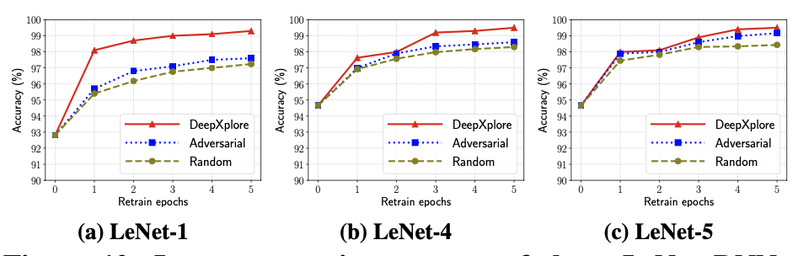
Improving DNNs with DeepXplore
Improve DNN with generated data
Notes:
In this experiment, augmenting training set and then improve DNN’s accuracy
we train LeNet-1, LeNet-4, and LeNet-5 as shown with 60, 000 original samples. We further augment the training data by adding 100 new error- inducing samples and retrain the DNNs by 5 epochs.
The results show that DeepXplore achieved 1–3% more average accuracy improvement over adversarial and random augmentation.

Slide 17
Discussion
When setting the threshold for a neuron to be active, should we consider the distribution of the output?
Introducing more parameters
Needs to be trained
Can DeepXplore be applied to other tasks such nlp?
Can we compute 𝜗F/𝜗x, where F is the output of each neuron in the DNN?
Notes:
There are a few questions that I think are interesting from piazza to discuss here.

Slide 18
Conclusion
The first whitebox system for
systematically testing DL systems
automatically identify erroneous behaviors without manual labels
Introduces a new metric, neuron coverage, for measuring how many rules in a DNN are exercised by a set of inputs
Performs gradient ascent to solve a joint optimization problem that maximizes both neuron coverage and the number of potentially erroneous behaviors discovered
Notes:
λ2 is a parameter for balancing between the two objectives of the joint optimization process

Slide 19
DeepBase: Deep Inspection of Neural Networks
Thibault Sellam et al.

Slide 20
Overview
Motivation
API Overview
System Design
Baseline Design
Naïve DeepBase Design
Optimizations
Evaluation
Related work
Notes:
I’ll give the talk in the steps of first introduce the motivation of DeepBase, followed by an declarative API design of DeepBase
Then, from the system design perspective, I’ll talk about the Baseline system, the naive design of DeepBase and how the authors perform optimizations on DeepBase

Slide 21
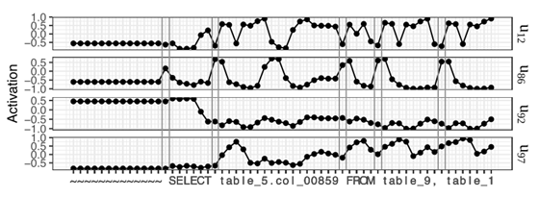
Motivation
Deep Learning are unknowingly effective
DNN decompose a task into sub-tasks?
Memorize training examples?
Deep Neural Inspection
Similarities between hidden units and user-defined hypothesis
Could be computationally heavily (Hypothesis×Hidden Units×Scores)

Slide 22
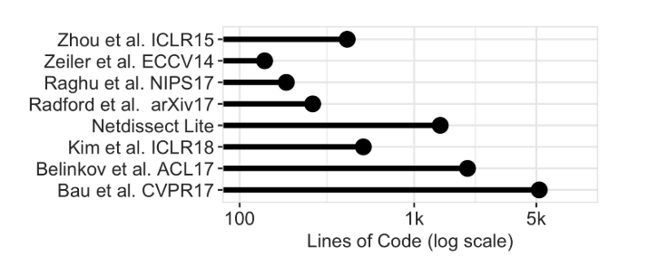
Motivation
Software which supports DNI is limited
Also ad-hoc to certain paper

Slide 23
Motivation
What does DeepBase do?
Providing declarative interface
End2end DNI analysis system
Performance optimization
Trained Model
Python func encoding hypothesis logic
DeepBase
Scores qualify similarity between
hypothesis vs. hidden units
Test Dataset
Affinity score

Slide 24
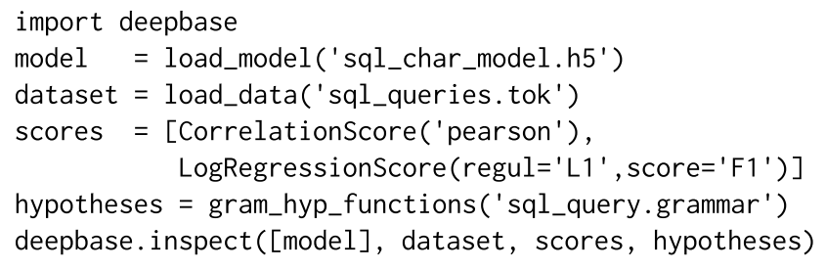
API Overview
Python API
Pandas DataFrame

Slide 25
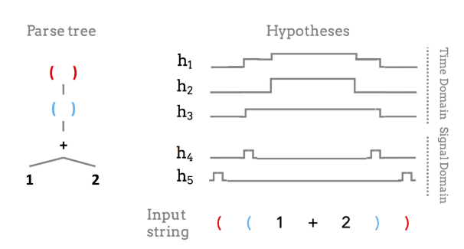
API Overview
Hypotheses generation
Some hypotheses don’t fit into function abstractions
Annotations
Manually annotated (bounding boxes, etc). Similar to node in parse tree

Slide 26

System Design
Baseline designs
DB-oriented. E.g. MADLib, PostgreSQL extensions
Easy for user to load dataset / post process behaviors (activations)

Slide 27
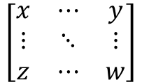
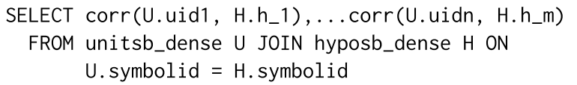
System Design
Baseline designs
Computationally inefficient
DL framework output (dense):
DB table schema1 (Sparse)
DB table schema2 (Dense)
units
Unitid/ hypoid | SymbolId | behavior
… | … | …
SymbolId | unit1 | unit2 | …
… | … | … | …
records
Easily > max # clauses of DB expression
Multiple scans of table
Transformation from dense to sparse

Slide 28
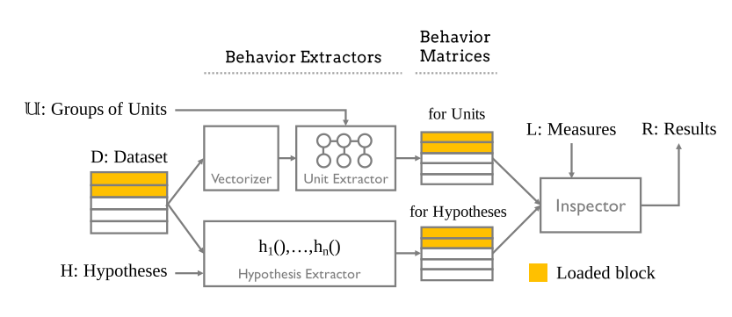
System Design
Naïve Deepbase
Generate behaviors for each unit/hypothesis
Use GPU to extract unit activations

Slide 29
System Design
Optimizations
Shared Computation
Put multiple measures/hypotheses into a single Keras computation graph
Utilize Keras’s graph optimization
Minimize global loss = Minimized each hypothesis model’s loss
Early stopping
Stop when the score has converged (error less than preset bound)
Stop materializing more data when early stopped
Streaming Behavior Extraction
Extract & Materialize behaviors in an online fashion

Slide 30
Evaluation
Scalability & Ability to generalize DNI score
Evaluate on SQL auto-completion & NMT
Predict on the next char
English to German translation
Hypotheses
Parse Tree, Logistic Regression Classifier
Part-of-Speech tagger

Slide 31
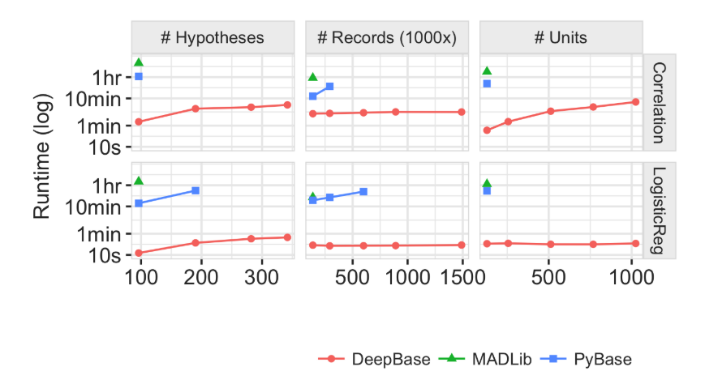
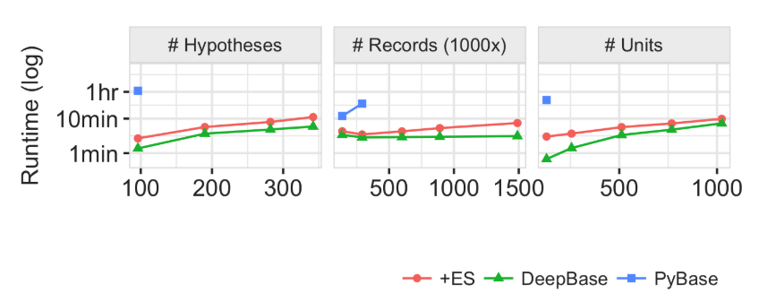
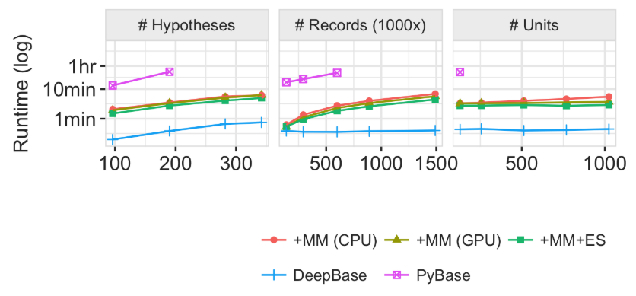
Evaluation
Scalability (SQL auto-completion)
29696 records, 512 hidden units, 142 grammar rules 🡪 190 hypos

Slide 32
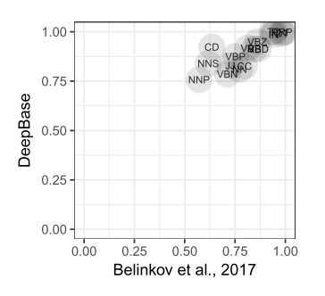
Evaluation
Ability to generalize (NMT)
Compare consistency with Belinkov et al.
Replicate their study on seq-2-seq
Make environment as close as possible

Slide 33
Related work
Interpreting DL Models
Visualization methods
Saliency analysis (Symbols have large “effect”)
Statistical NN inspection
Visualize NN tools
ML augmentation with interpretation
Databases and Models
Integrating ML to DB (MADLib, ModelDB, Modelhub)

Slide 34
Conclusion
DL models require more understanding
Automation required instead of manual work
DeepBase is an end2end system for DNI
Declarative API
Greatly improves the analysis runtime by:
Merging Models / Hypothesis
Early-stopping
Streaming extraction
Can be generalized to many tasks

Slide 35
Questions from Piazza
In section 2.2 Statistical Analysis, how does deep base deal with datasets that are not annotated, which I think is the reason of using deep learning instead of tradition model. How could deepbase express these hypotheses and formally test them at scale?
Can DeepBase be used to help ML researcher improve or prune their model?
Use hypothesis to replace part to unit to speed up. (Could be useful in RNN)
Given the large search space (combination between hidden units), how does deep base make inspection scalable?
Algorithm perspective: Consider choices of units, scores, etc… as hyperparameters and perform local search?
System perspective: Affinity scores are computed pairwise, can be run in the distributed fashion (MapReduce).

Slide 36
Discussion
DeepBase
Inspection of cascaded (groups of ) units? (fully-connected/conv). Now the input is activations of previous units instead of symbols.
Run DNI in a distributed fashion? (store records in the key-value pair, compute pairwise affinity on different nodes, etc)
Is is possible to replace some units with hypothesis to speed up inference speed (especially on RNN)

Slide 37
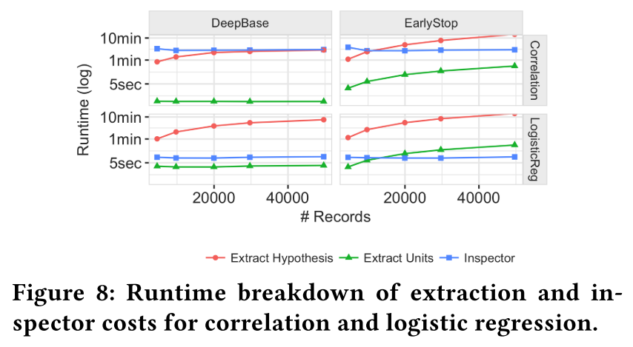
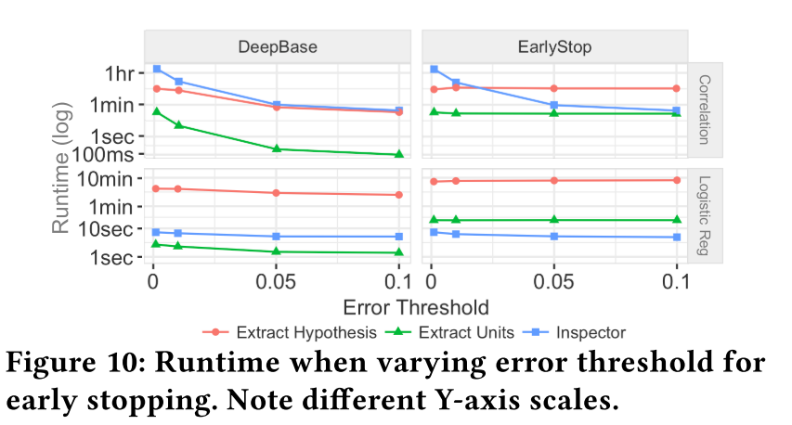
Evaluation
Scalability (SQL auto-completion)
More Inspections

Slide 38
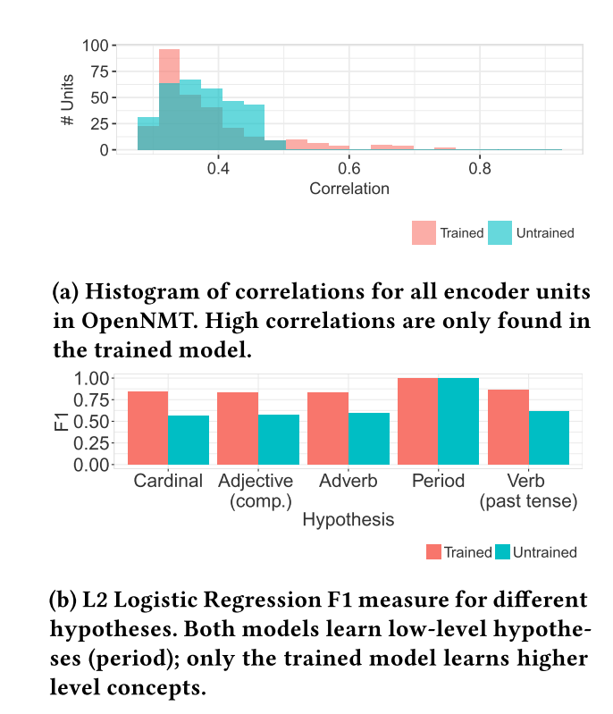
Evaluation
Ability to generalize (NMT)
Additional results than previous study
Unit are interpretable at word level
Models have more high affinity to high level hypos after trained

