Slide 1

A Brief Introduction to RDMA
Yiwen Zhang

Slide 2
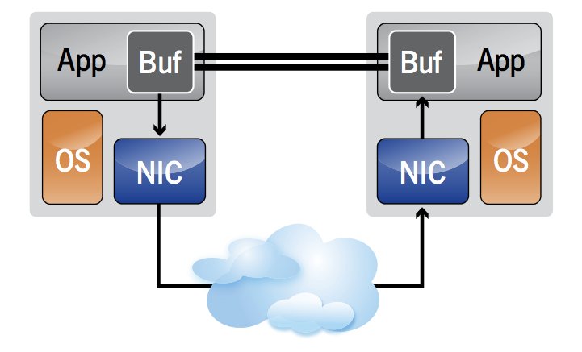
What is RDMA?
Remote Direct Memory Access
Kernel-Bypass & Zero-Copy
Low CPU overhead
High bandwidth (100Gbps)
Low latency (~2us)
RDMA-providing networks:
InfiniBand
RoCE (RDMA over Converged Ethernet)
iWARP (Internet Wide Area RDMA Protocol)
Notes:
RDMA is a network feature that allows direct access to the memory of a remote machine. By using RDMA, …

Slide 3
Queue Pairs
Endpoints of Communication
A Send Queue & A Receive Queue
Applications have direct access to QPs; OS not involved
Handle Work Requests
A Work Request represents a single quantum of work that the application wants to perform.
Work Requests are posted using RDMA verbs

Slide 4
Memory Region
Memory has to be registered to allow RDMA device to read and write data.
Region is associated with a protection domain.
Registration will take some time.
Accessed by Local Key and Remote Key.

Slide 5
RDMA Verbs
Describes how the data is transferred.
One-sided verbs vs. two-sided verbs
One-sided verbs
WRITE
READ
ATOMIC_FETCH_AND_ADD
ATOMIC_CMP_AND_SWAP
Two-sided verbs
SEND/RECV
WRITE_WITH_IMM
SEND_WITH_IMM

Slide 6
Work Completion
Signals completion of a verb
The requester’s RNIC send a Completion Queue Entry via DMA to a Completion Queue (CQ) associated with the QP.
Applications are responsible to poll from the Completion Queue by themselves
For a send request, this signaling can be turned off.
Polling Mechanism:
Busy polling
Event-triggered polling

Slide 7
Transport Type
Reliable Connected (RC)
One RC QP is connected to exactly one remote RC QP.
Guaranteed delivery; at most once, in order, & no corruption.
Unreliable Connected (UC)
One UC QP is connected to exactly one remote UC QP.
No delivery guarantee as the RC case.
Unreliable Datagram (UD)
One UD QP to one or many remote UD QP.
No delivery guarantee; message size limited by maximum path MTU.

Slide 8
Transport Type
Verb | RC | UC | UD
SEND (w/o immediate) | ✔ | ✔ | ✔
Write (w/o immediate) | ✔ | ✔ | ✘
Read | ✔ | ✘ | ✘
Atomic operations | ✔ | ✘ | ✘

Slide 9
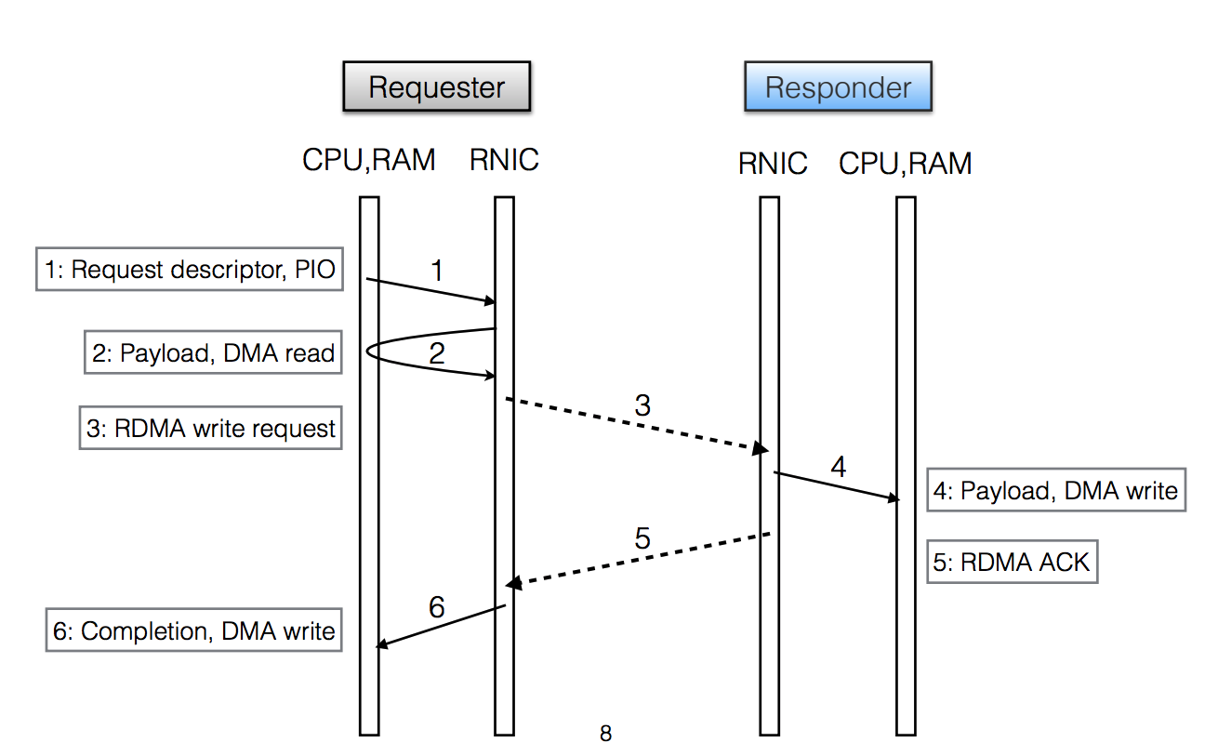
Life of RDMA WRITE
Source of image: https://conferences.sigcomm.org/sigcomm/2014/doc/slides/51.pdf

