Slide 1
Spark SQL: Relational Data Processing in Spark
Michael Armbrust†, Reynold S. Xin†, Cheng Lian†, Yin Huai†, Davies Liu†, Joseph K. Bradley†, Xiangrui Meng†, Tomer Kaftan‡, Michael J. Franklin†‡, Ali Ghodsi†, Matei Zaharia†∗
†Databricks Inc. ∗MIT CSAIL ‡AMPLab, UC Berkeley
Presenter: Chung-Wen Liao, Bor-Kae Hwang, Hongyu Pang

Slide 2
Background
Relational interface (e.g. declarative queries)
Why? Procedural interface is onerous and require manual optimization to achieve high performance.
Challenges:
Performed to and from various semi- or unstructured data sources
Advanced analytics are difficult to express in relational systems
Relational and procedural systems are disjoint
Shark
Previous relational system on Spark
Challenges
Not useful for relational queries on data inside a Spark program (ex. RDD)
Difficult to extend and add new features

Slide 3
Goals
Relational processing within Spark and on external data sources
High performance
Support new data sources
Extension with advanced analytics algorithms

Slide 4
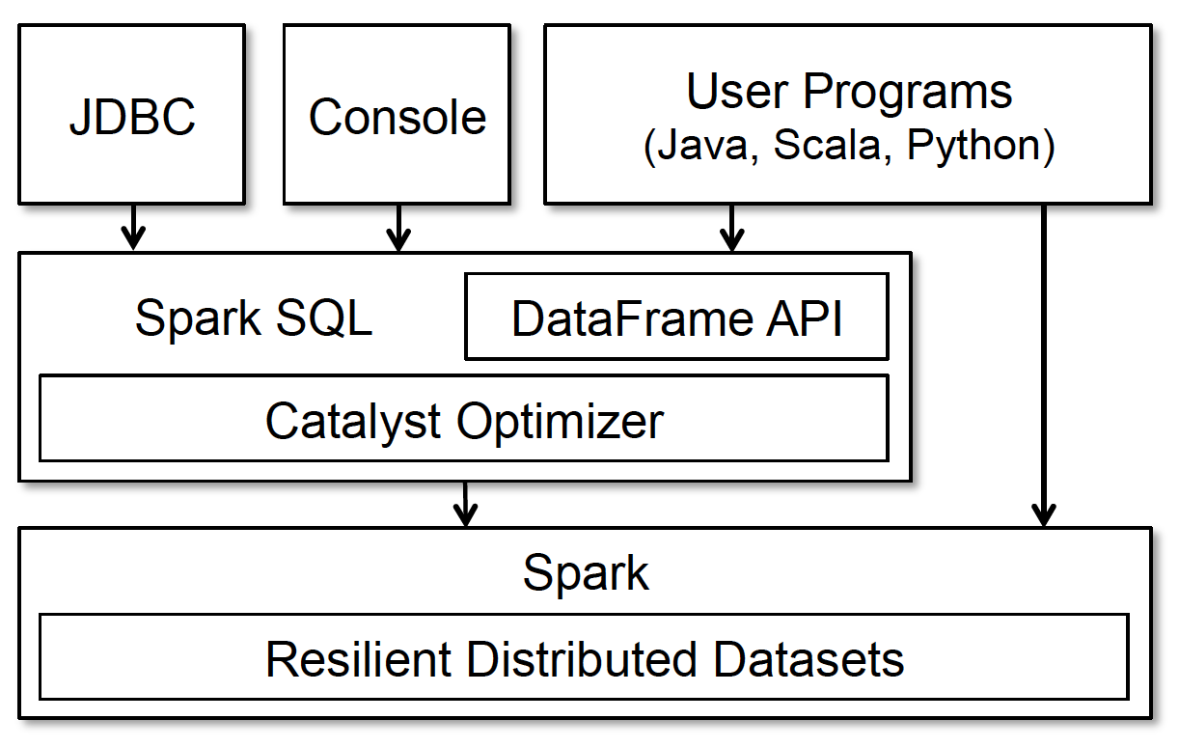
Programming Interface
Spark SQL can be access through
JDBC/ODBC
Command-line console
DataFrame API

Slide 5
DataFrame
Can be manipulated in similar ways to RDDs
Keep track of their schema
Support various relational operations
Constructed from
Table in a system catalog
Existing RDDs of native Java/Python objects
Call procedural Spark API

Slide 6
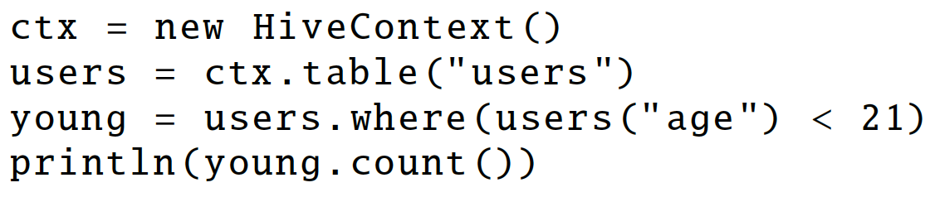
DataFrame API
Spark DataFrames are lazy
Represent a logical plan to compute a dataset
No execution occurs until output operation being called
users and young are DataFrames (logical plan)
count() (physical plan)

Slide 7
Data Model
Spark SQL uses a nested data model
Spark SQL supports all major SQL data types
boolean, integer, double, decimal, string, date, and timestamp
structs, arrays, maps, and unions
First-class support for complex data types
Also support user-defined types

Slide 8
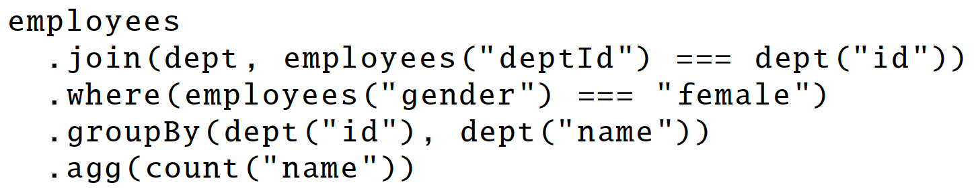
DataFrame Operations
Support relational operations (projection, filter, join, aggregations, …)
Build up an abstract syntax tree (AST), pass to Catalyst for optimization
DataFrame is concise and declarative like SQL

Slide 9
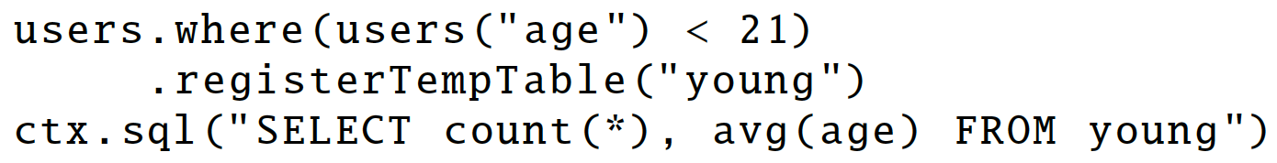
DataFrame Operations
Be temporary tables in system catalog and queried using SQL
SQL sometimes convenient for multiple aggregates
Unmaterialized
Users can name intermediate results for DataFrames

Slide 10
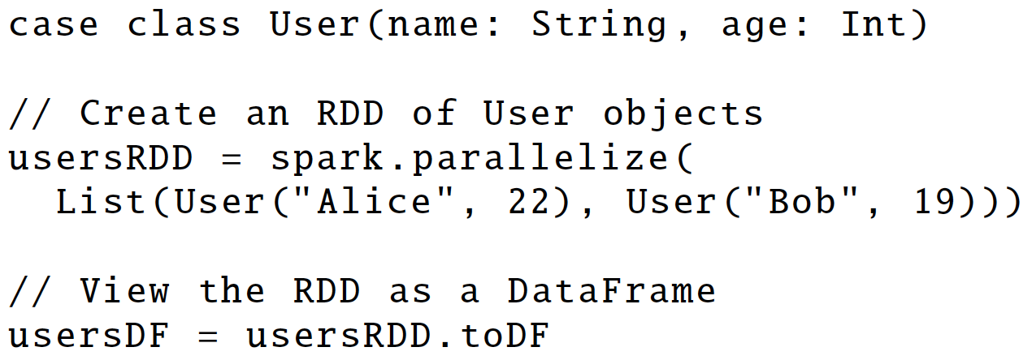
Querying Native Datasets
Construct DataFrame directly against RDDs
Combine RDDs with external structured data

Slide 11
In-memory Caching
DataFrame can be materialized using columnar storage
Dictionary encoding
Run-length encoding
Calling cache()

Slide 12
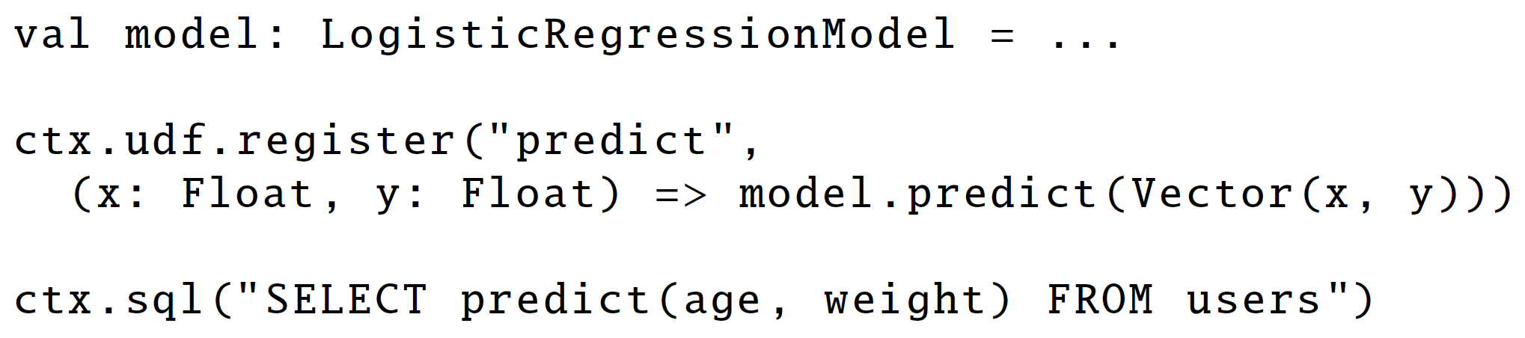
User-Defined Functions
DataFrame API supports inline definition of UDFs
UDFs can be registered inline by passing Scala, Java or Python functions

Slide 13
What is Catalyst
Catalyst is an extensible query optimizer.
Query in DataFrame API / SQL → Java bytecode to run on spark
Techniques for big data
I/O bounded , CPU bounded, what to do?
How to deal with variety of data sources

Slide 14
Wishlist
Easy to introduce new data type to deal with semi-structured data, perform advanced analytics, etc
Easy to add new optimization rules for new data type
Deal with external storage
Be able to push predicate to external data source
Performance: speed up code execution
Most datasets are in-memory, where processing is CPU bound
Takeaway: find the bottleneck

Slide 15
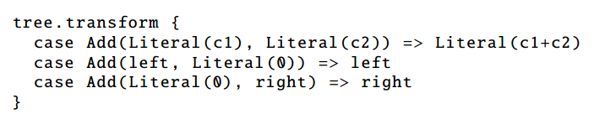
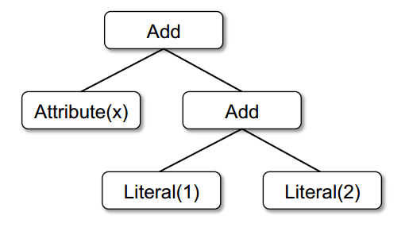
Base Library
Use Syntax tree to represent expression, use rules to transform trees
X+(1+2)
X+3

Slide 16
Difference From RDBM
Catalyst uses pattern-matching, a feature of Scala, to express composable rules in a Turing complete language
Pattern matching allows subtrees transformation
Rules do not need to be modified when there are new data types
Easy to write, debug and potential parallelization

Slide 17
Pipeline
Physical planning
Input:
Unresolved Logical Plan
Resolved Plan
Optimized Query Plan
Physical Plan
Code For RDD
Code generation
Logical optimization

Slide 18
Important Details: Logical Optimization
Simple to add new rule: add arbitrary rules in scala, a general purpose language
There is a compiler hidden in Catalyst
Important Detail: Physical Planning
Generate multiple plans, and use a cost model to select one
Rule based vs cost based models
predicate push down(ppd) also happens here

Slide 19
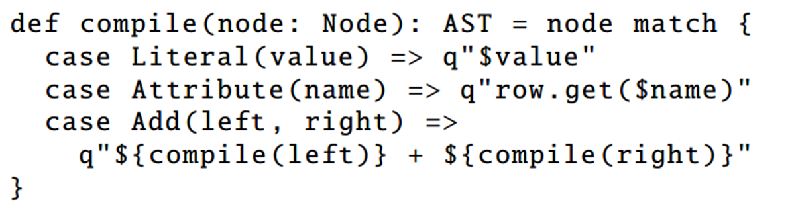
Important Detail: Code Generation
Expression Evaluation Takes Time
Avoid using scala parser on an SQL expression tree at runtime, turn an SQL expression tree into a scala Abstract Syntax Tree, compiler can take AST to do optimization
Constructing an AST from expression tree is enabled by a feature of scala called quosiquotes
Add(Literal(1), Attribute("x")) → 1+row.get("x“) -> scala compiler

Slide 20
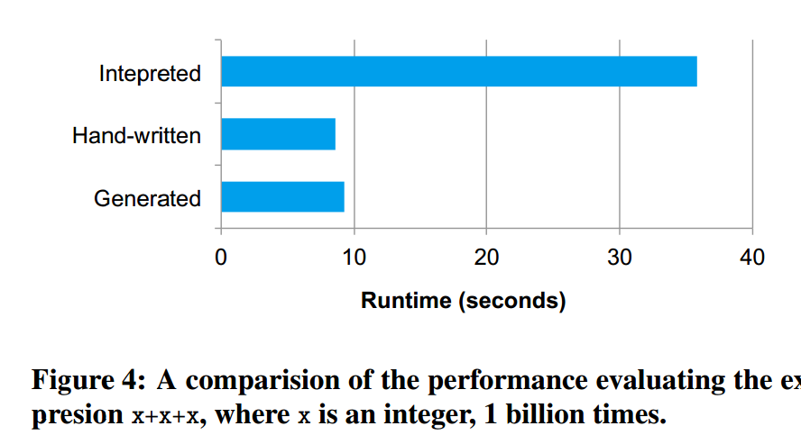
Why Code Generation
Any CPU level optimization inside compiler? Vectorized Execution
Without code generation, expression must be parse at runtime
With Compiled code, compiler does further optimization
Takeaway
I/O bound: in-memory, ppd, and many more(Hive)
CPU bound: code generation, and many more(Hive)

Slide 21
Data Source Variety: Data Virtualization
External data source
CSV file, JSON, Parquet, etc
We want:
Data source have API, where we can push our filters, so we need a standard
Data source meta information: network locality
Even more:
partitioning : good technique for improving reading performance
Columnar: at least when brought in memory
example: Hive ORC
Spark SQL allows an application to cache data in an in-memory columnar format from any data source.

Slide 22
Catalyst Extension Point
Build a data programming model, Set up a unified interface
All data source must implement a createRelation function and return a BaseRelation object
BaseRelation can implement many interfaces
Return RDD objects : TableScan
Running predicates: PrunedFilteredScan
Data Virtualization
build a unified abstraction for processing heterogeneous data source
RDD is a good data programming model with many nice features
SparkSQL build a unified interface so other data source can use and benefit
How does MapReduce support external data source

Slide 23
Evaluation
Compare SQL query processing performance against other big data SQL engines
Compare DataFrame API to native Spark APIs
Pipelining computation across relational and procedural code

Slide 24
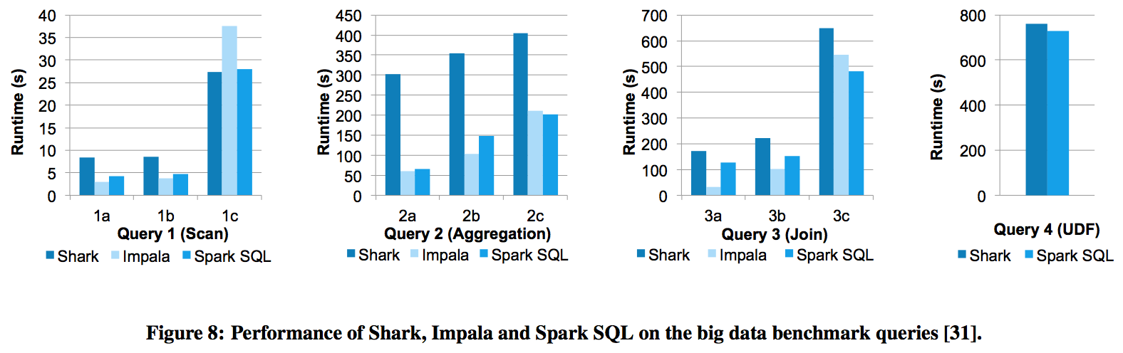
SQL Performance

Slide 25
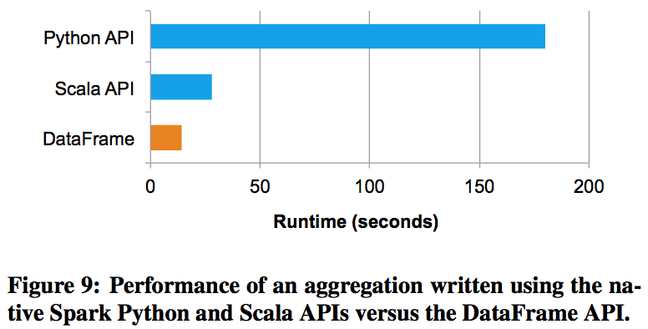
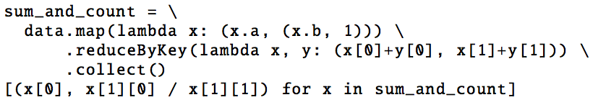

Spark SQL vs. Native Spark Code
Python API
DataFrame API

Slide 26
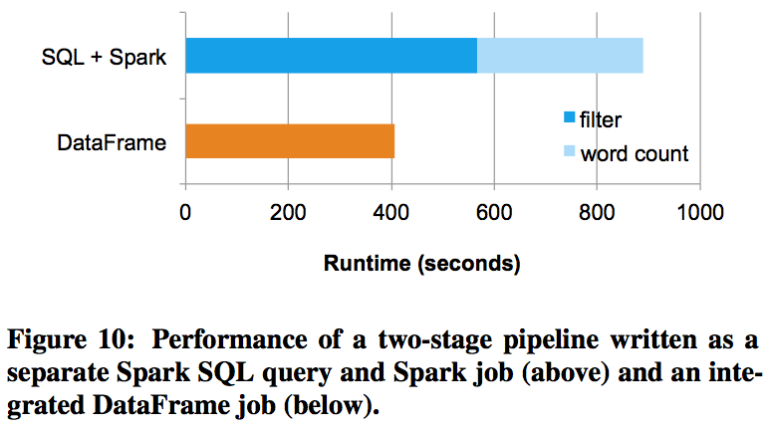
Pipeline Performance
Filter: select a subset of messages (relational processing)
Word count: computes the most frequent words (procedural processing)

Slide 27
Conclusion
DataFrame API allows relational processing
Catalyst: an extensible optimizer that makes it easy to add optimization rules, data sources, and data types
Data pipelines that mix relational and procedural processing

Slide 28
Major Technical Advancements in Apache Hive
Yin Huai¹ Ashutosh Chauhan² Alan Gates² Gunther Hagleitner² Eric N. Hanson³ Owen O’Malley² Jitendra Pandey² Yuan Yuan¹ Rubao Lee¹ Xiaodong Zhang¹
¹The Ohio State University ²Hortonworks Inc. ³Microsoft
¹{huai, yuanyu, liru, zhang}@cse.ohio-state.edu ²{ashutosh, gates, ghagleitner, owen, jitendra}@hortonworks.com ³ehans@microsoft.com

Slide 29
Background
Hive
A translation layer on top of Hadoop MapReduce
Efficient data storage
Optimized query plans and query execution model

Slide 30
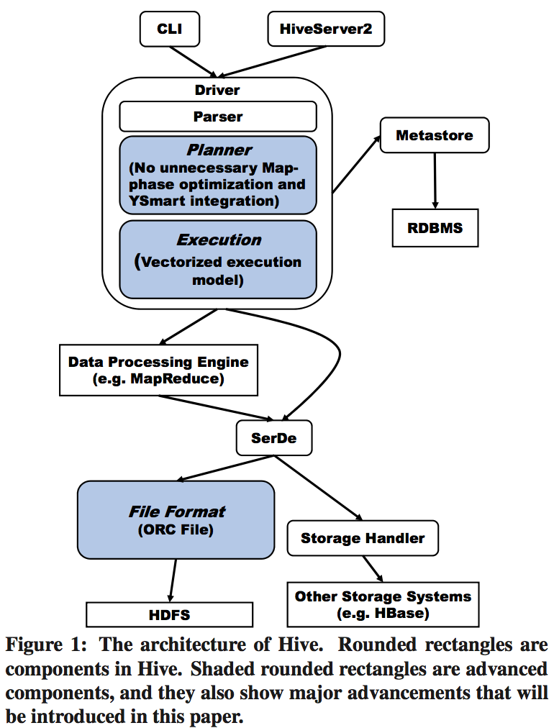
Hive Architecture
Query planner
Vectorized execution model
File format (ORC File)

Slide 31
Shortcomings of Hive
Storage efficiency
File format component
Query planner
Query execution component

Slide 32
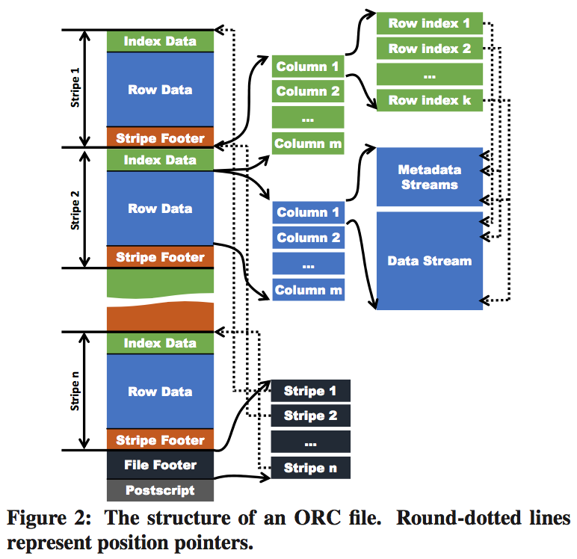
Optimized Record Columnar File (ORC File)
The Table Placement Method
Larger default stripe size

Slide 33
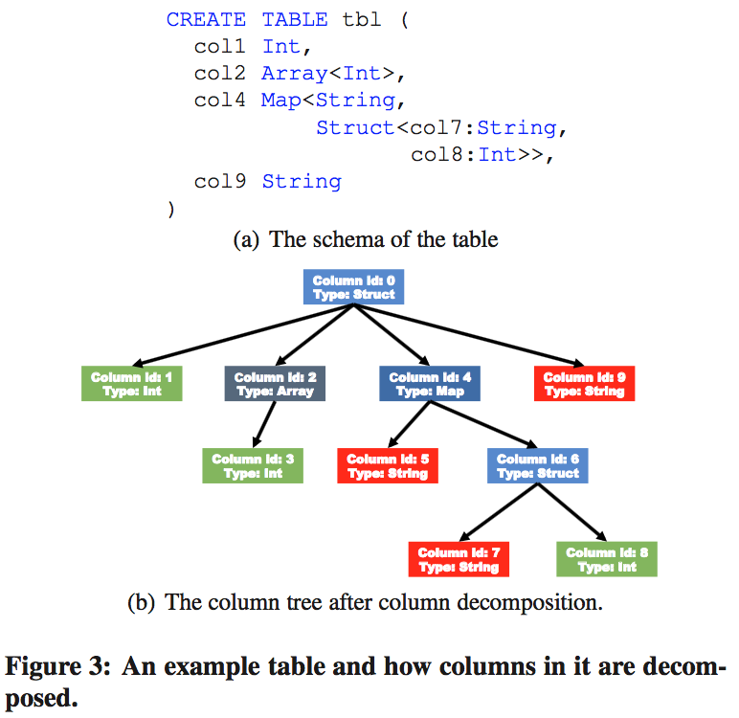
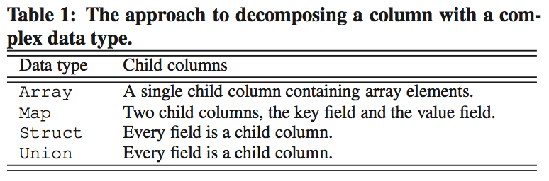
Optimized Record Columnar File (ORC File)
The Table Placement Method
Larger default stripe size
Decompose a column with complex data type to multiple child columns
Able to align stripe boundaries with HDFS block boundaries

Slide 34
Optimized Record Columnar File (ORC File)
Indexes
Data statistics
Position pointers
Starting point in Metadata and Data Stream
Starting point of a stripe in a HDFS block
Memory Manager
Bound the memory consumption of concurrent writers

Slide 35
Query Optimization: compare With Catalyst
Catalyst query plan optimization
We want to make programmer’s life easier. They use simple DataFrame API, query optimization happens inside Catalyst.
Hive query plan optimization
most issue comes from the way map reduce jobs execute. Optimization Specific to MapReduce Framework

Slide 36
Identify issues
Observation: each mapreduce job can only shuffle data once, so the query plan is partitioned in a different job whenever a data partitioning is needed
Unnecessary mapping
Unnecessary data loading
Unnecessary data repartitioning

Slide 37
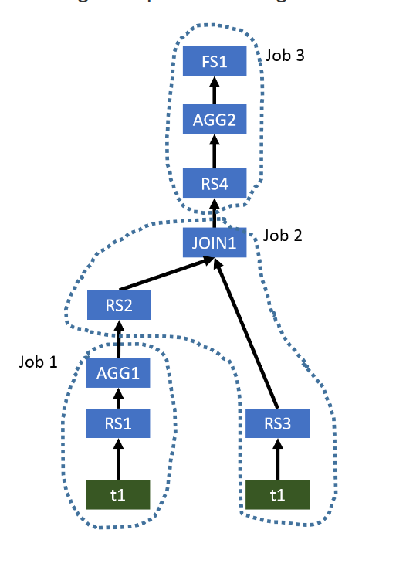
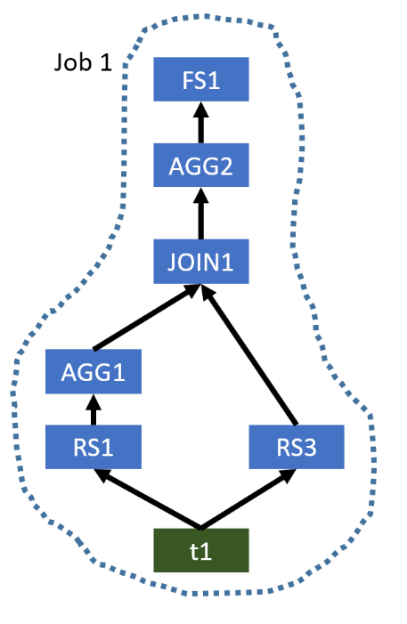
Illustration

Slide 38
Solution(complicated , read paper for detail)
Merge Map only jobs to its child job
Introduced Correlation Detection In Optimizer
A very complicated optimizer that can analyze whether a major operation really needs repartitioning
Operator Coordinator
Make sure the optimized query plan is executable

Slide 39
Discussion
It all comes from MapReduce framework! So, does Spark suffer from such problem? If no, why? If yes, how to improve?
How Spark runs a query?
Create DAG of task stages, group tasks into stages using shuffling boundaries
RDD are in-memory, but first operation reads data from disk
Spark uses share-nothing architecture, tasks are separate
RDD are columnar and partitioned (nice abstraction of ORC)
Spark SQL faces CPU as a bottleneck, what about Hive?
=> Query Execution Optimization In Hive

Slide 40
Vectorized Query Execution
Modern CPU
Multistaged pipelines with large number of stages, and superscalar architectures contain more than one such pipelines
Avoid unnecessary branches in the instructions
The higher the data independence, the more parallelism can be achieved
processing rows in a one-row-at-a-time model causes poor cache performance
Dataset is represented as batches of rows
Fit the entire batch in the processor cache

Slide 41
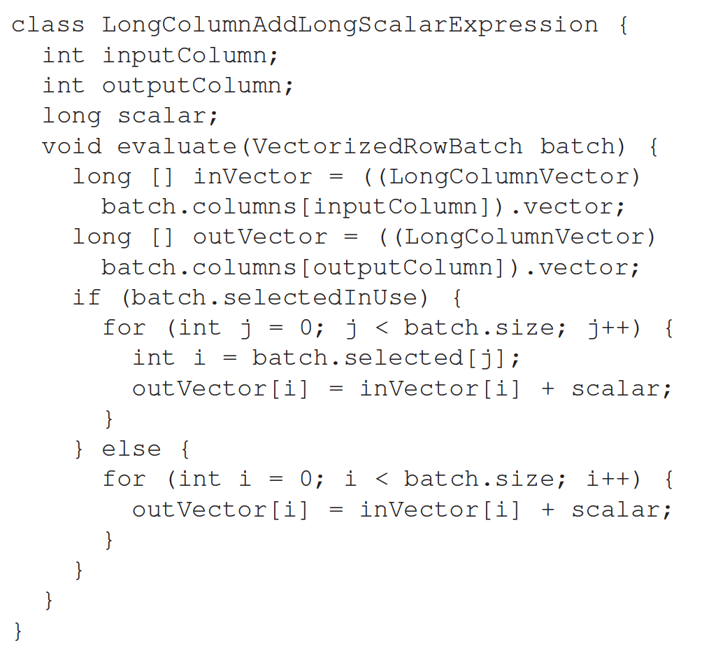
Vectorized Expressions
Process column vectors in a tight loop, minimize branching and method calls
Iterations are completely independent of each other
More optimizations
No-null flag
Is-repeating flag

Slide 42
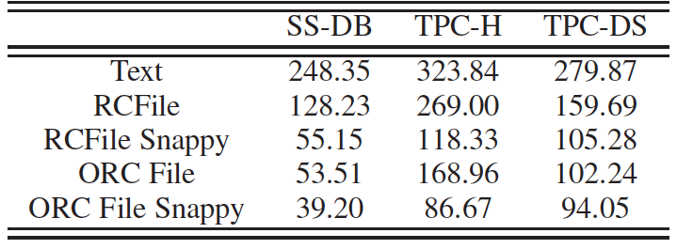
Performance Evaluation (size of datasets)
Without Snappy compression, datasets of SS-DB and TPC-DS have already had smaller sizes than RCFile with Snappy
For datasets of SS-DB and TPC-DS, this further reduction on sizes is not as significant as that shown in the dataset of TPC-H
Unit: GB
Smaller is better

Slide 43
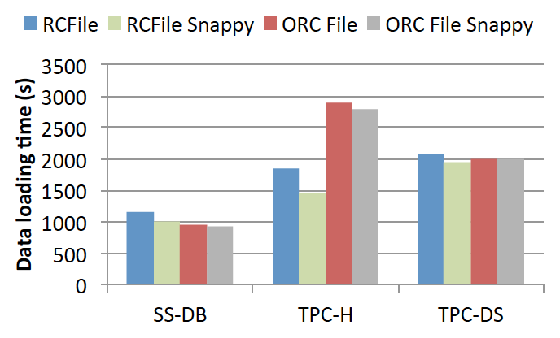
Performance Evaluation (data loading time)
For datasets of SS-DB and TPC-DS, the time taken to load a dataset to ORC File was about the same with RCFile
Data loading time taken to store the TPC-H dataset in ORC File was around two times as long as that taken to store the dataset in RCFile
Unit: second
Smaller is better

Slide 44
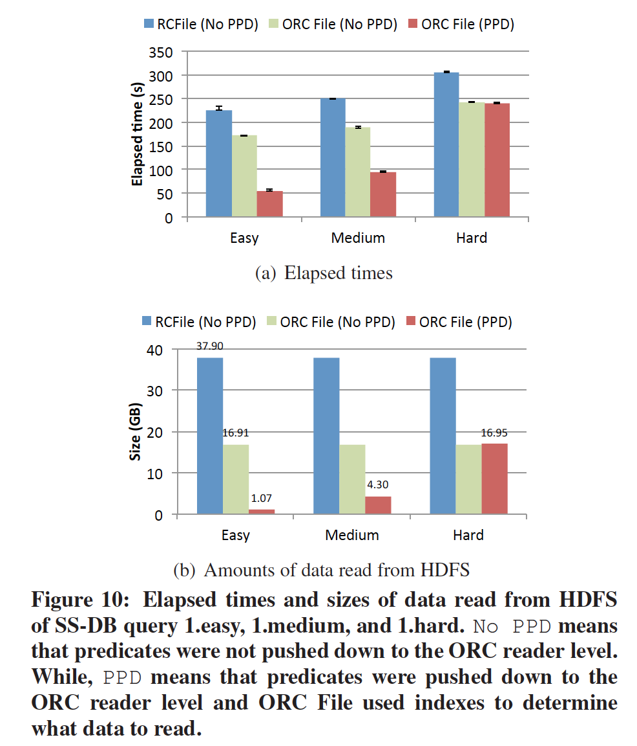
Performance Evaluation (data reading efficiency)
Unit: second
Smaller is better
Unit: GB
Smaller is better
The overhead of using indexes is low (indexes are useless 1.hard)

Slide 45
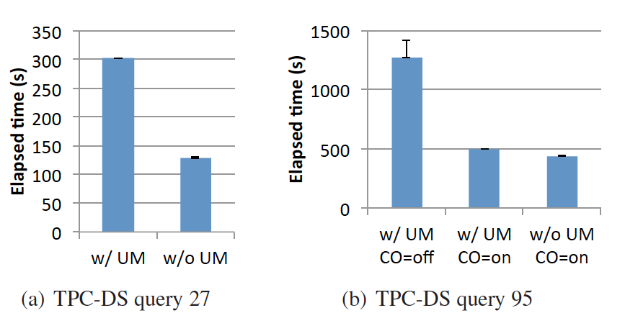
Performance Evaluation (query planning)
 | Map-only | MapReduce
W/ UM CO=off | 3 | 5
W/ UM CO=on | 3 | 2
W/o UM CO=on | None | 2
Unit: second
Smaller is better
Removing unnecessary Map phases
Correlation Optimizer

Slide 46
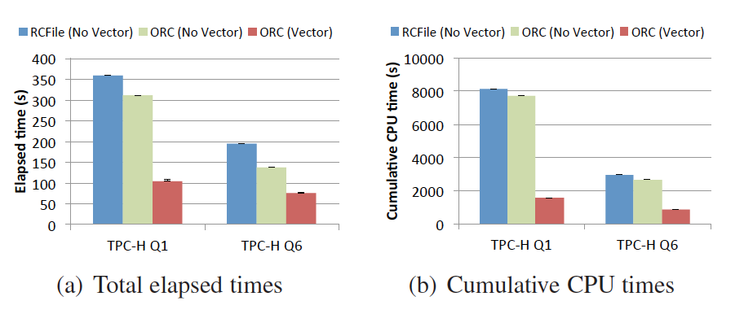
Performance Evaluation (query execution)
The TPC-H query 1 has one predicate and eight aggregations
The TPC-H query 6 has four predicates and one aggregation
Unit: second
Smaller is better

Slide 47
Conclusion
A highly efficient file format, ORC File
Eliminating unnecessary Map phases and exploiting correlations
A new vectorized query execution engine (better utilizing modern CPUs)

