Slide 1
FaRM: Fast Remote Memory
Aleksandar Dragojevic ́, Dushyanth Narayanan, Orion Hodson, Miguel Castro
Microsoft Research
Presenters: Qiyang Lin, Ruying Sun

Slide 2
Background
Decreasing DRAM prices have made it cost effective to build commodity servers with hundreds of gigabytes of DRAM
With 128GB of memory per machine, 32 machines can store 4TB of data in RAM
Frequently, a modest sized cluster can fit the entire working set of an application in memory

Slide 3
FaRM
A new main memory distributed computing platform that exploits RDMA to improve performance
Two mechanisms: Lock-free reads over RDMA; Collocating objects
Provide distributed transactions with strict serializability.
Duality and efficient fault tolerance during transaction

Slide 4
FaRM
RDMA is 23x slower than local memory
Locality first, then RDMA

Slide 5
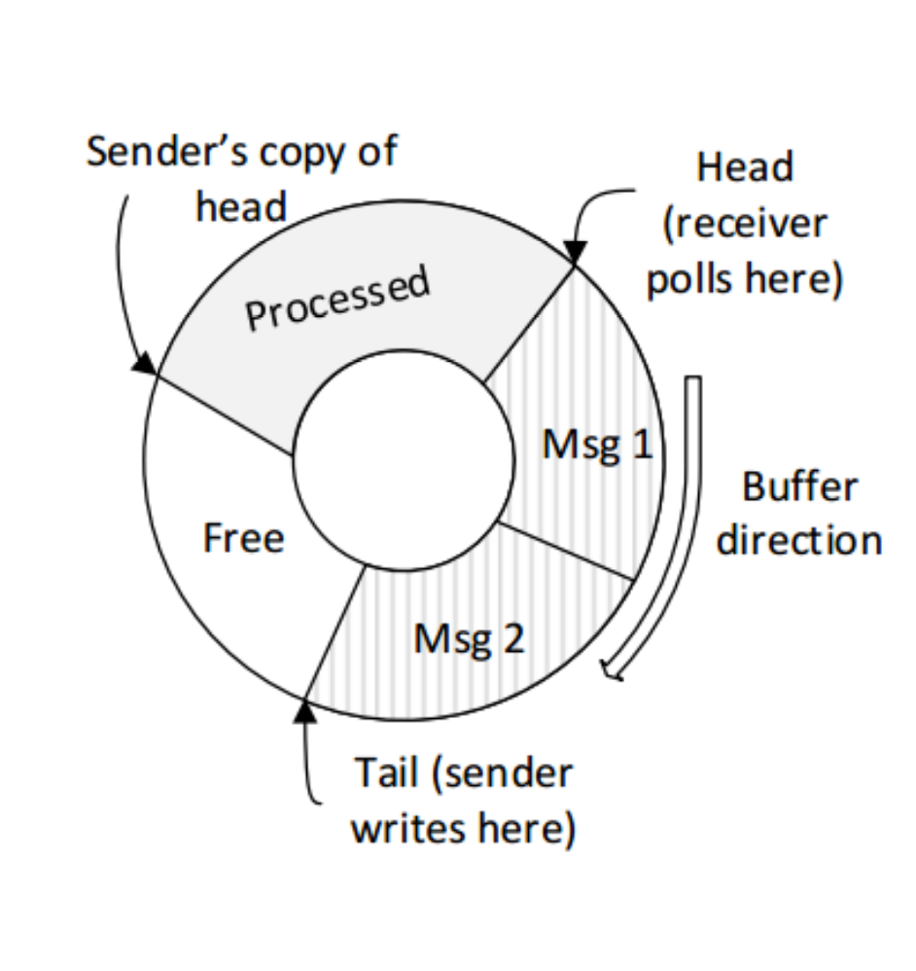
Communication primitives
One-sided RDMA reads & RDMA writes
Circular buffer on the receiver
Polls message at the head
Writes message at the tail
The receiver makes the processed space available lazily by sender’s copy of head.

Slide 6
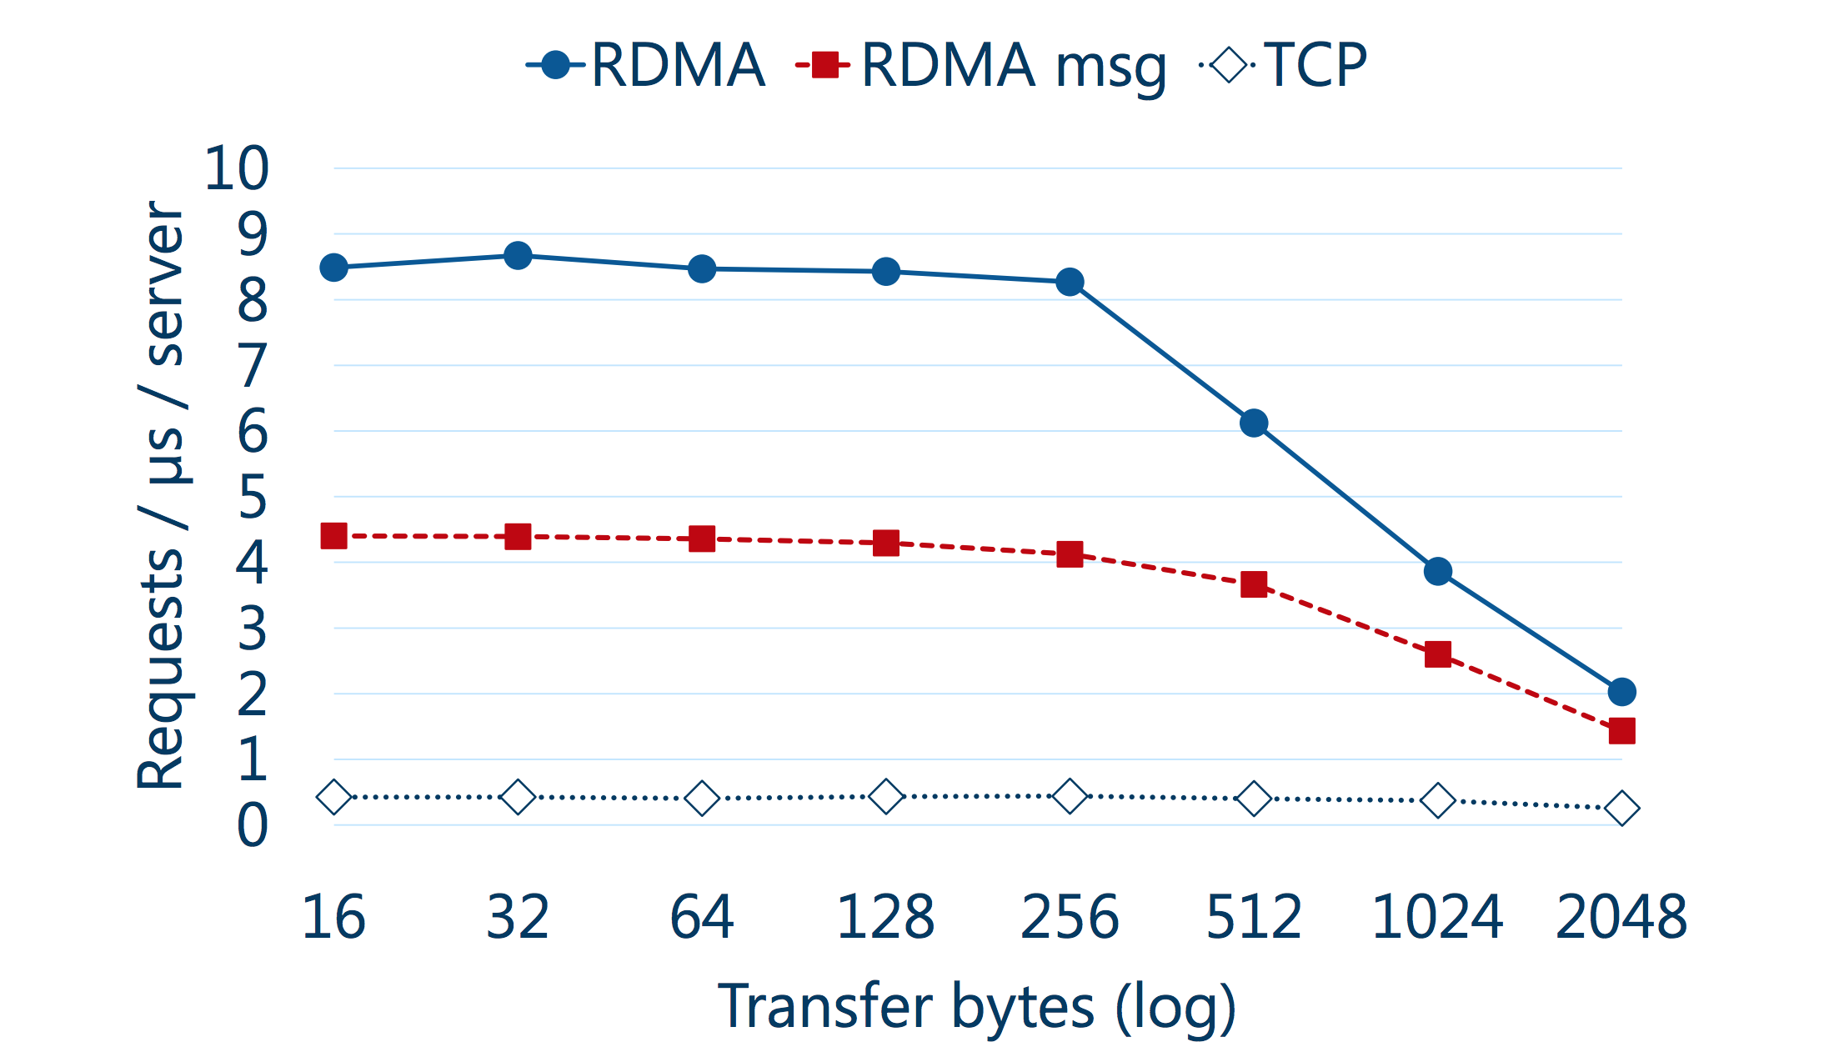

Slide 7
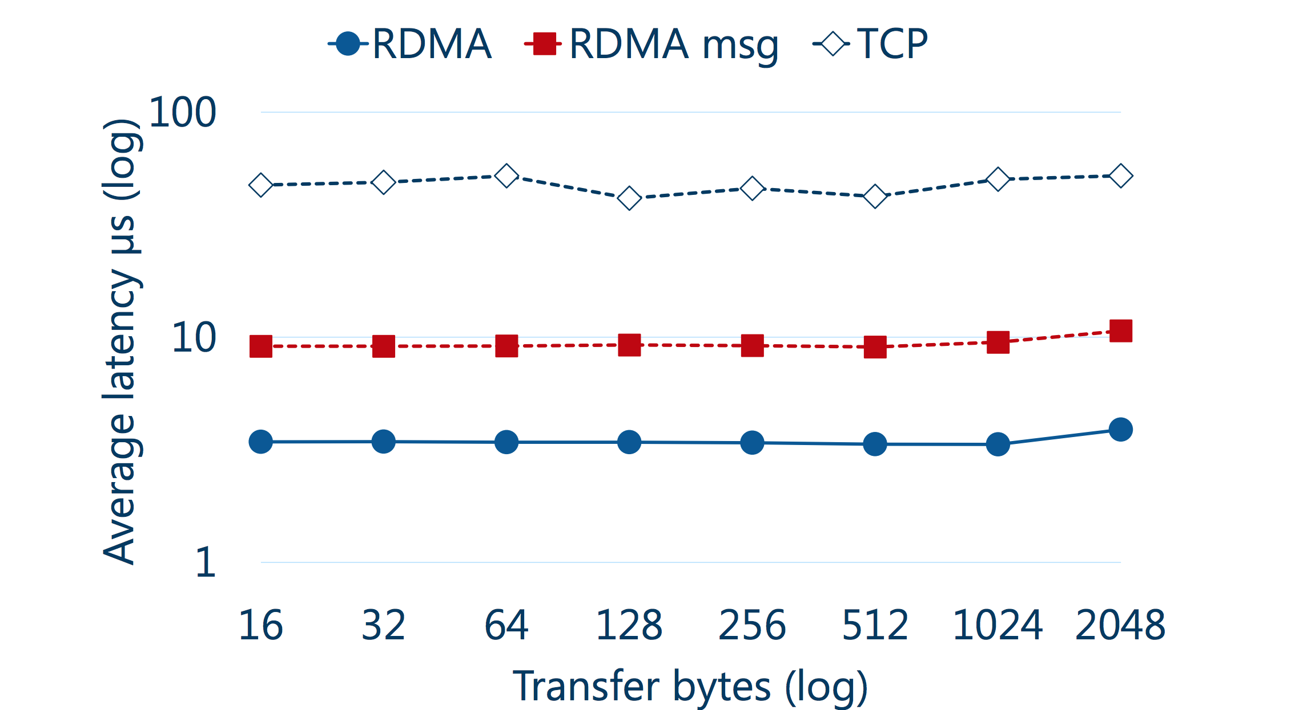

Slide 8
More optimization
NIC page table is too small to store large number of page
—— larger page by Phyco (2GB)
NIC can’t cache message queues
—— using a single connection between a thread and each remote machine

Slide 9
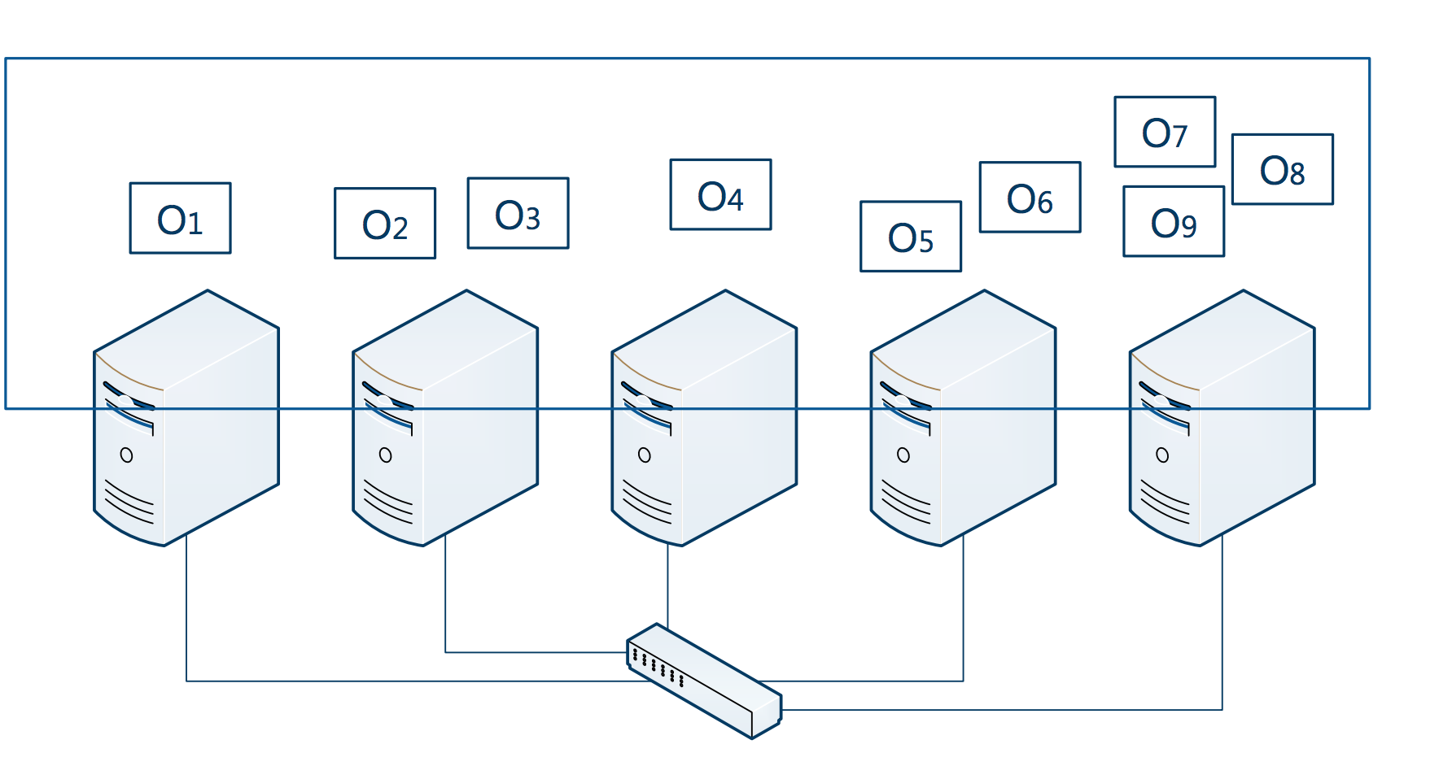
Distributed Memory Management
Shared address space

Slide 10
Distributed Memory Management
Objects are stored in 2GB regions, distributed across cluster
High bits are region ID and low bits are offset
Regions are located using a consistent hashing scheme for remote objects.

Slide 11
Consistent Hashing
Allow multiple regions to be recovered in parallel
Improve load balancing

Slide 12
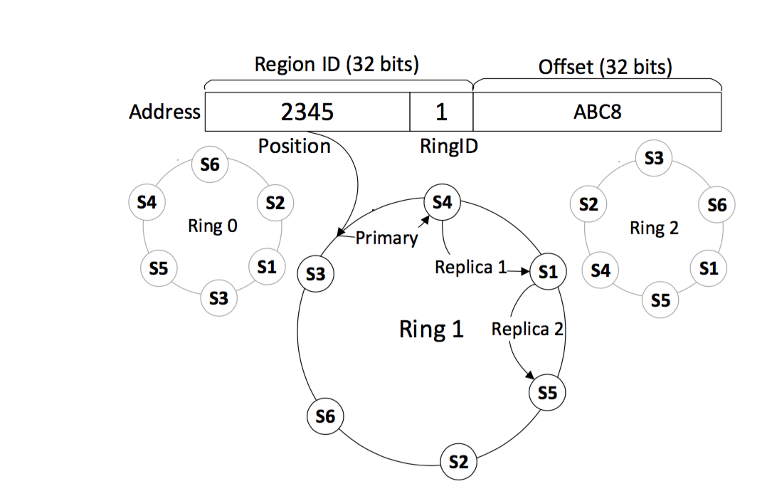
Consistent Hashing

Slide 13
Memory Allocation
Three level allocation
Region
Block
Slab
Supply a location hint: collocating the objects.

Slide 14
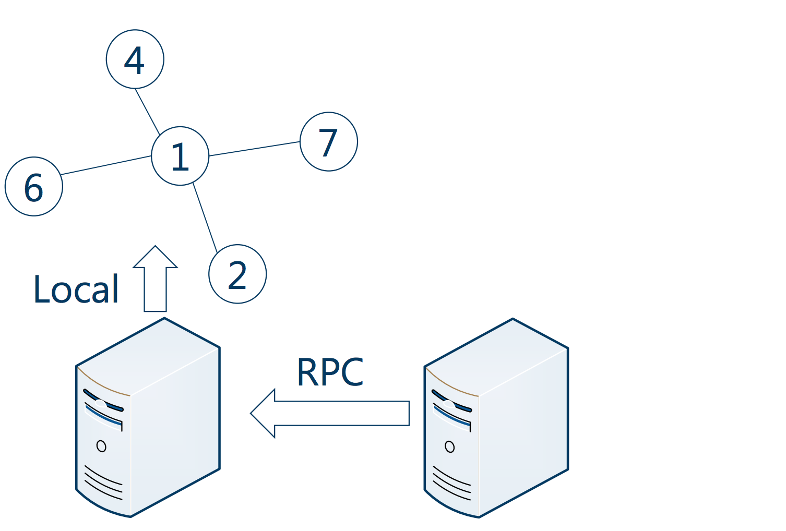

Slide 15
Transactions
Two-phase commit
Single machine transaction
Lock-free read-only operations

Slide 16
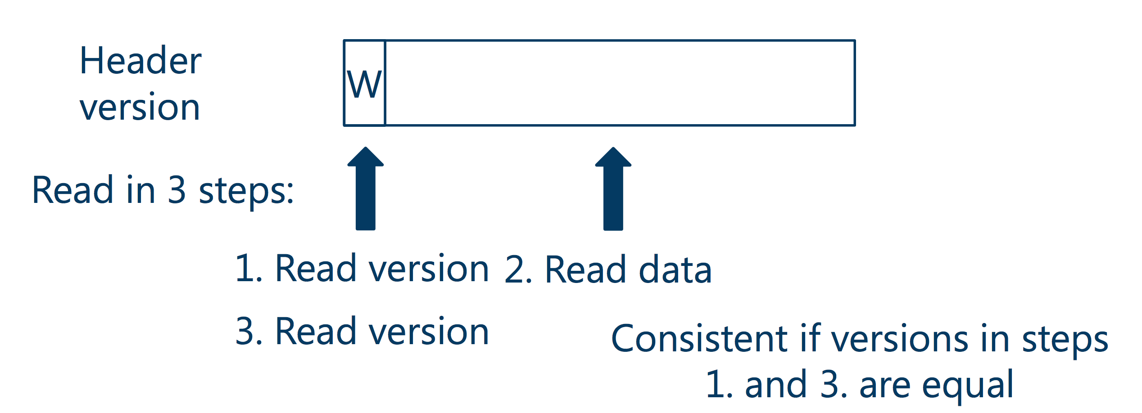
Lock-free Operations

Slide 17
Lock-free Operations
FaRM provides lock-free reads that are serializable with transactions and are performed using a single RDMA
A lockFreeRead reads the object with RDMA and checks if the header version is unlocked and matches all the cache line versions.

Slide 18
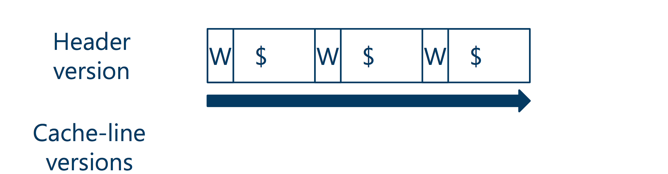
Lock-free Operations

Slide 19
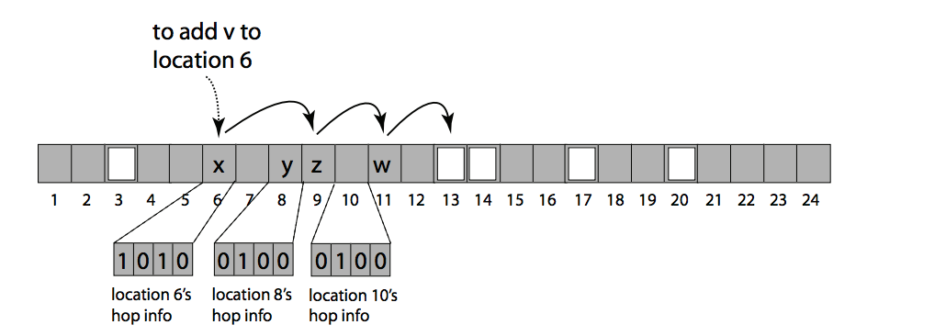
Hash Table
Chained hopscotch hashing: achieves a good balance between space efficiency and the size and number of RDMAs

Slide 20
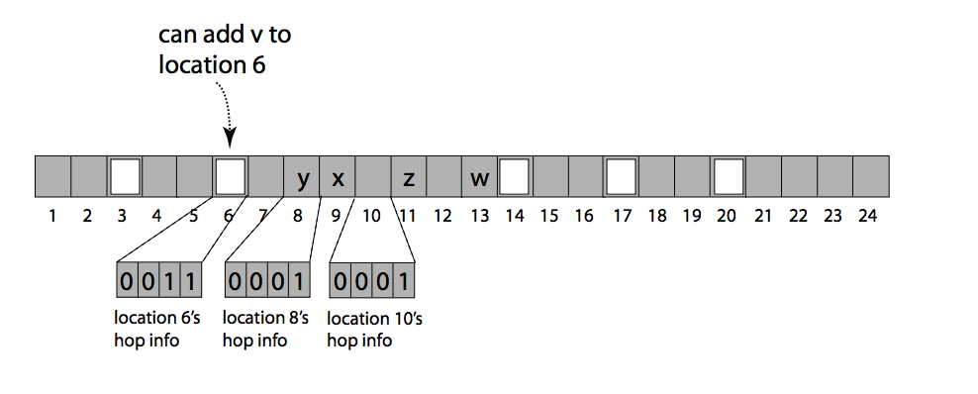
Hash Table
Chained hopscotch hashing
Notes:
】

Slide 21
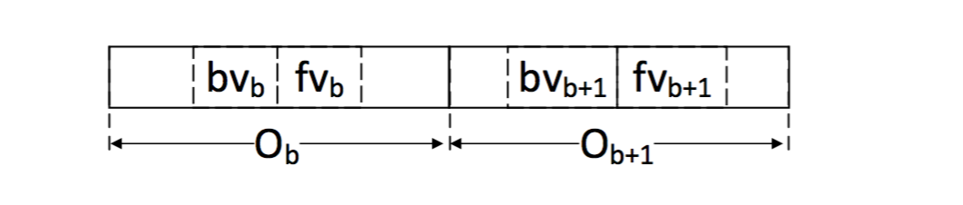
Hash Table
Associativity: Each bucket is a FaRM object with H/2 slots. It amortize the space overhead of chaining

Slide 22
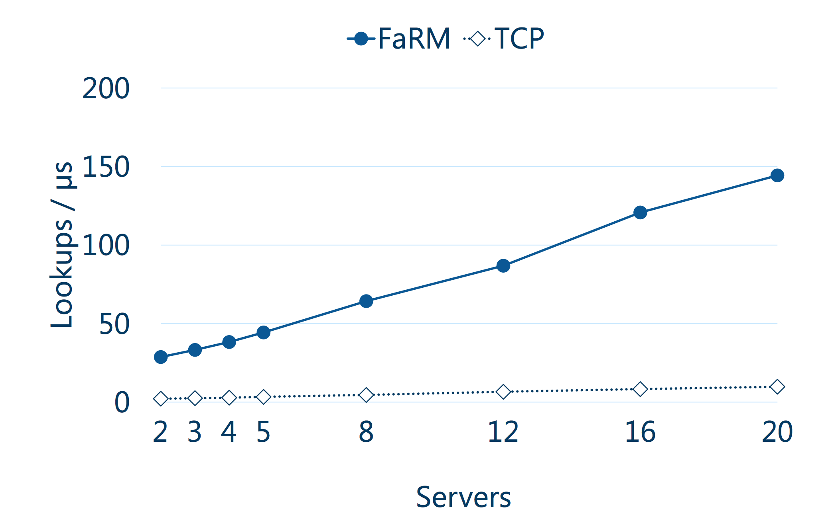
Evaluation

Slide 23
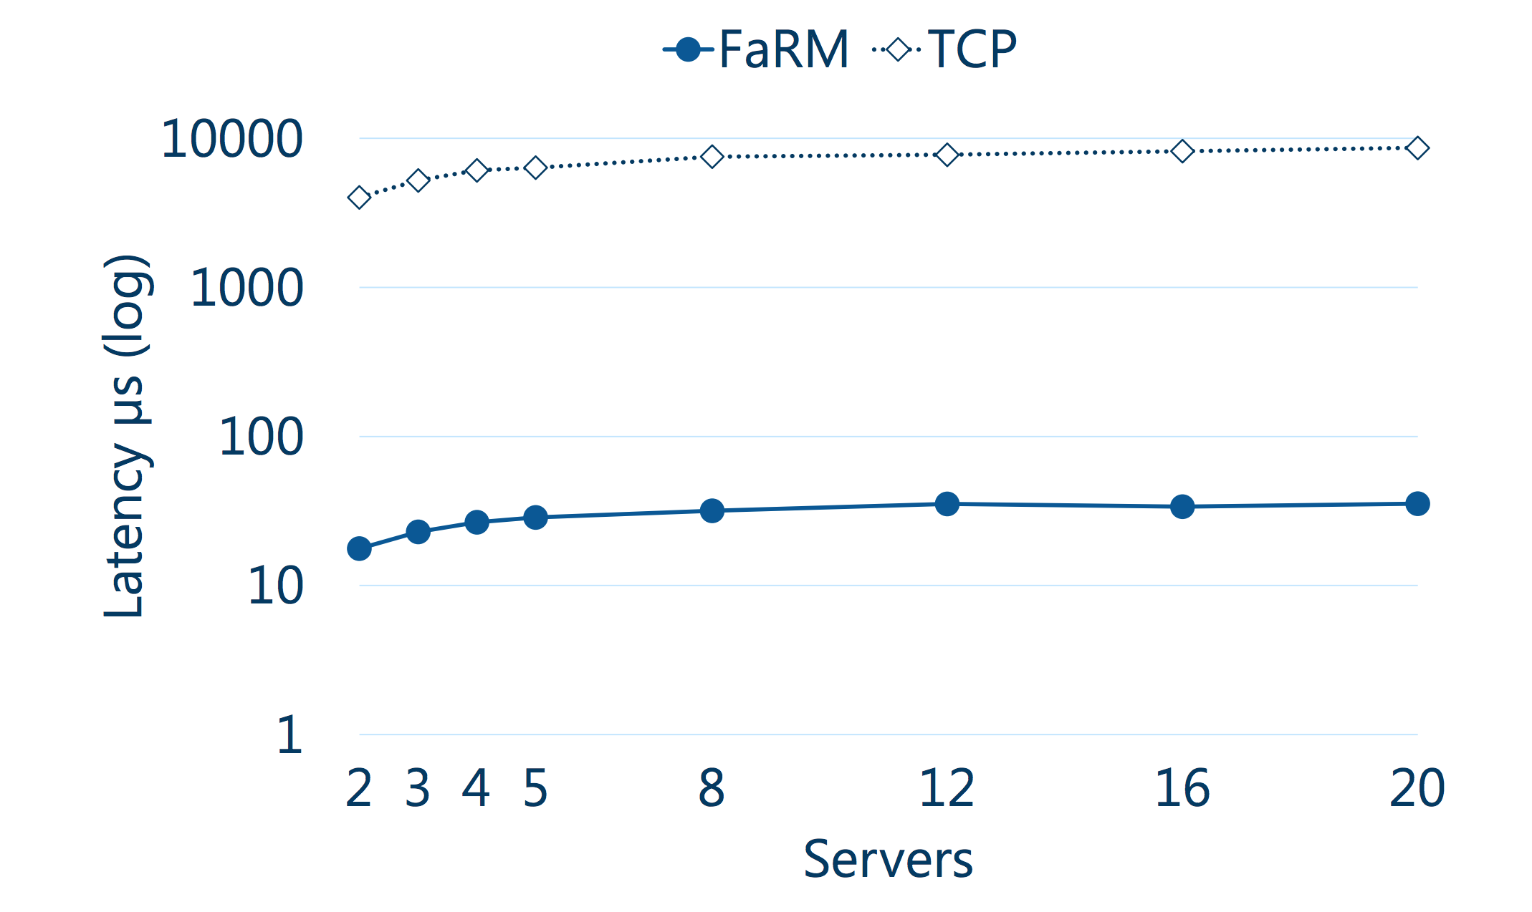

Slide 24
No compromises: distributed transactions with consistency, availability, and performance
Aleksandar Dragojevi´c, Dushyanth Narayanan, Edmund B. Nightingale,
Matthew Renzelmann, Alex Shamis, Anirudh Badam, Miguel Castro
Microsoft Research
Presenters: Qiyang Lin, Ruying Sun

Slide 25
Goal
Strictly serializable transactions
High throughput
Low latency
High availability
New protocols in transaction, replication, and recovery phases.

Slide 26
High performance
One-sided operations
Read objects
Log updates
Reduce message counts
Primary-backup replication
Optimistic concurrency control
Access objects only on primaries
Notes:
.

Slide 27
Two phase commit
Prepare
Commit
C
P1
B1
P2
B2

Slide 28
FaRM commit
Lock
Validate
Replicate
Update and unlock
C
P1
B1
P2
B2

Slide 29
One-sided operations
Complicate recovery
CPU does not process remote accesses
Cannot rely on CPU rejecting messages
Changes:
Configuration change: Precise membership
Recovery: Drain logs before recovering

Slide 30
Failure recovery steps
Detect failure
Change configuration
Recover transactions
Recover data

Slide 31
Transaction recovery
Use parallelism
All message logs in parallel (Draining)
All regions in parallel (Find recovery transactions, Lock, Replicate log)
All recovering transactions in parallel (Vote and Decide)

Slide 32
Data recovery
Parallelize data replication
Done in background

