Slide 1
Clipper: A Low-Latency Online Prediction Serving System
Yifu Jin, Bochang Wang, Junding Wang

Slide 2
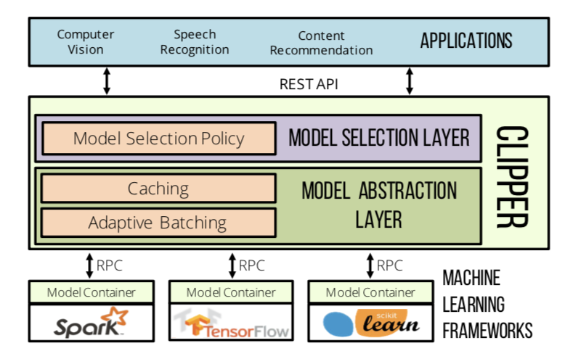
Introduction
Low latencies
High throughputs
Improved accuracy
Notes:
Machine learning is being deployed in a growing number of applications.
It demands real-time, accurate, and robust predictions under heavy query load. However, most machine learning frameworks and systems only address model training, but not deployment.
it is acceptable for training to take hours to days to complete, but inference must run in real-time, eg, movie recommend, through cookie.
To address these challenges, we propose Clipper, a layered architecture system. pic...
it achieves three propertie: low latencies, high throughputs, and improved accuracy.

Slide 3
Introduction
Model Abstraction Layer
Model Selection Layer
Notes:
Clipper is divided into two layers: (1) the model abstraction layer, and (2) the model selection layer.
details later.
[[The the model abstraction layer exposes a common API that abstracts away the heterogeneity of existing ML frameworks and models. So models can be modified or swapped transparently to the application.
The model selection layer sits above the model abstraction layer and dynamically selects and combines predictions across competing models to provide more accurate and robust predictions.]]
Clipper provides support for many widely used machine learning frameworks, like ……
It is widely used in CV, SR…...

Slide 4
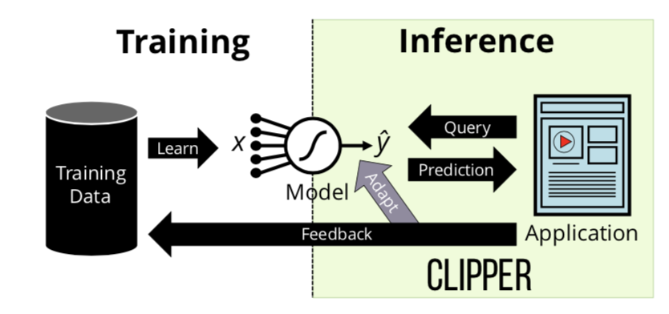
Machine Learning Lifecycle
Training
Inference
Notes:
Training is often computationally expensive, it requires many large datasets and can take hours or even days to complete.
inference does not involve complex algorithms, so it is generally assumed to be easy. As a consequence, there is little research studying the process of inference.
In this paper we focus on the less studied but increasingly important challenges of inference.

Slide 5
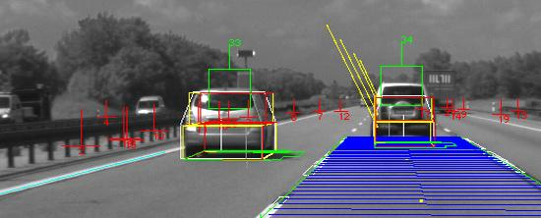
Application Workloads
Object Recognition
Automatic Speech Recognition
Notes:
This paper describes two real-world applications of machine learning:
the task of identifying and labeling the objects in a picture, used in self-driving cars. eg.
A speech recognition model is a function from a spoken audio signal to the corresponding sequence of words. eg. siri cortana

Slide 6
Challenges
Complexity of Deploying Machine Learning
Prediction Latency and Throughput
Model Selection
Notes:
machine learning frameworks are often developed by machine learning experts, and they are heavily optimized towards model development, so they paid little attention to the deployment. So, application developers are forced to accept reduced accuracy.
The prediction latency is the time it takes to get a prediction given a query. In many cases accuracy can be improved by combining models but it will increase latency.
The computational cost of complicated models can impact prediction throughput, For example, a relatively fast neural network which can get 100 predictions per second is still slower than a modern web-server.
developers must decide which of these models to deploy based on offline or online evaluation. But these tests are very inefficient.

Slide 7
Solution
Introduce model abstraction layer and common prediction interface
Batch prediction requests
Adaptive online model selection and ensembling techniques
Notes:
Clipper introduces a model abstraction layer and common prediction interface, it can isolate applications from variability in machine learning frameworks, and simplifies the process of deploying a new model or framework to a running application.
Clipper can automatically batch prediction requests to maximize the use of batch-oriented system optimizations in machine learning frameworks, and at the same time, the prediction latency is still met.
Clipper leverages adaptive online model selection and ensembling techniques to incorporate feedback, and it can automatically select and combine predictions from models.

Slide 8
Architecture
Model Abstraction Layer
Model Selection Layer
Notes:
Clipper is divided into model selection and model abstraction layers (see Figure 1).
The model abstraction layer is responsible for providing a common prediction interface, ensuring resource isolation, and optimizing the query workload for batch oriented machine learning frameworks.
The model selection layer is responsible for dispatching queries to one or more models, and combining their predictions based on feedback to improve accuracy, estimate uncertainty, and provide robust predictions.
[[the path of a prediction request through the system:
Applications issue prediction requests to Clipper through application facing REST or RPC APIs. Prediction requests are first processed by the model selection layer. Based on properties of the prediction request and recent feedback, the model selection layer dispatches the prediction request to one or more of the models through the model abstraction layer.]]
model abstraction layer first checks the prediction cache for the query before assigning the query to an adaptive batching queue.
The adaptive batching queue constructs batches of queries that are suitable for the machine learning framework.
send batch of queries to a model container hosting the model in its native machine learning framework.
After evaluating the model on the batch of queries, the predictions are sent back to the model abstraction layer.
returns the results to the model selection layer.
The model selection layer then combines one or more of the predictions to get a final prediction and confidence estimate.
The prediction and confidence estimate are then returned to the application.
if feedback, Any feedback the application collects about the quality of the predictions is sent back to the model selection layer.
[REST Representational state transfer]

Slide 9
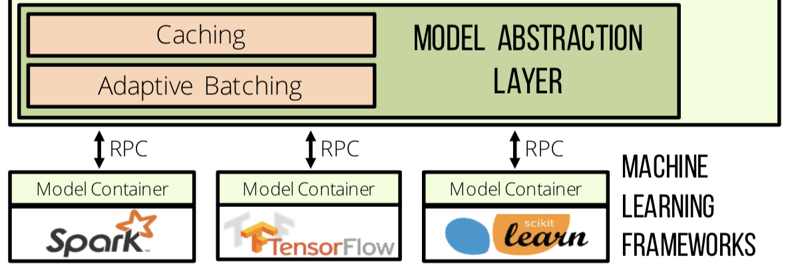
Model Abstraction Layer
Notes:
The Model Abstraction Layer provides a common interface across machine learning frameworks.
It is composed of a prediction cache, an adaptive query-batching component, and a set of model containers connected to Clipper via a RPC system.
At the top of the model abstraction layer is the prediction cache. The prediction caches provides a mechanism for frequent queries, and it can accelerate the model selection.
The batching component sits below the prediction cache, it aggregates point queries into mini-batches that are dynamically resized for each model container to maximize throughput.
Models deployed in Clipper are each encapsulated ML frameworks, communicating with Clipper.
[RPC, Remote procedure call],

Slide 10
Caching
Serves frequent queries without evaluating the model
Serves an important role in model selection
Notes:
For many applications (e.g., content recommendation),some predictions are requested frequently. By maintaining a prediction cache, Clipper can serve these frequent queries without evaluating the model. This reduces latency and system load by eliminating the additional cost of model evaluation.
In addition, caching serves an important role in model selection. Clipper needs to join the original predictions with feedback it receives. So queries can benefit from caching.

Slide 11
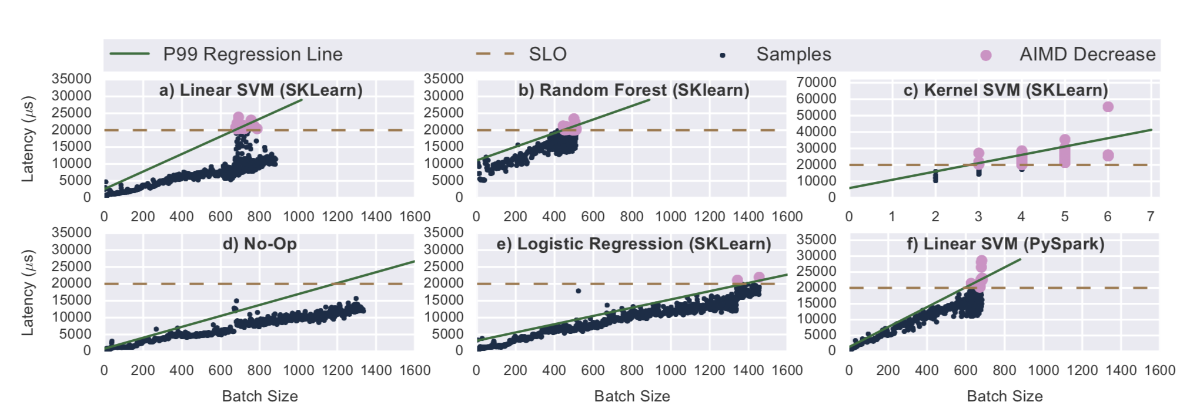
Batching
Increase throughput
Increase latency
Notes:
The Clipper batching transforms the prediction queries into batches that more closely match the workload assumptions made by machine learning frameworks.
Batching increases throughput via two mechanisms. First, batching amortizes the cost of RPC calls and internal framework overheads such as copying inputs to GPU memory. Second, batching enables machine learning frameworks to exploit existing data-parallel optimizations
pic...
But if we increase throughput, the latency will also become higher. So we set SLO, it means the latency that the users can accept.

Slide 12
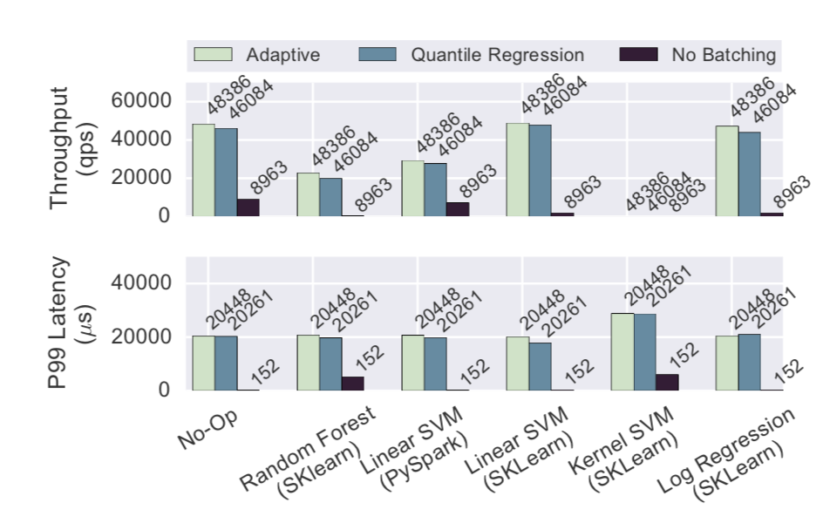
Dynamic Batch Size
Additive-increase-multiplicative-decrease (AIMD) scheme
Reduce the batch size by 10%
Notes:
To find the optimal maximum batch size, we employ an (AIMD) scheme. Under this scheme, we additively increase the batch size by a fixed amount until the latency exceeds the SLO. At this point, They reducing the batch size by 10%.
pic…...

Slide 13
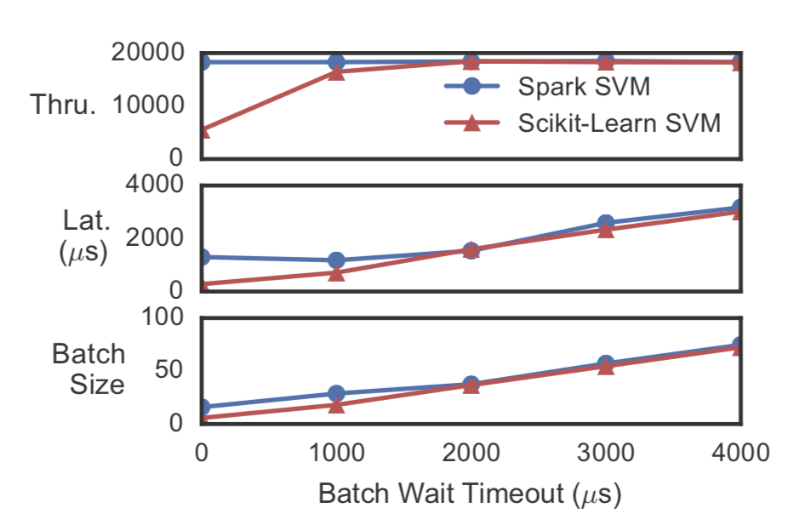
Delayed Batching
Delay the dispatch to allow more queries
Improve throughput significantly
Notes:
Sometimes, the batching queue may contain less queries than the maximum batch size when the next batch is ready to be dispatched. For some models, briefly delaying the dispatch to allow more queries to arrive can significantly improve throughput.
pic...

Slide 14
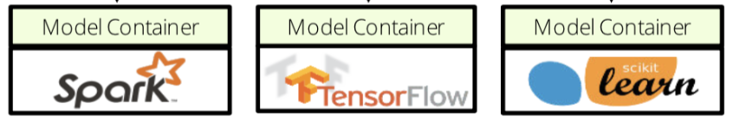
Model Containers
Encapsulate the diversity of machine learning frameworks and model implementations
Process isolation
Notes:
Model containers encapsulate the diversity of machine learning frameworks and model implementations. To add a new type of model to Clipper, model builders only need to implement the standard interface.
To achieve process isolation, each model is managed in a separate container. By placing models in separate containers, we ensure that variability in performance and stability of immature machine learning frameworks does not interfere with the overall availability of Clipper.

Slide 15
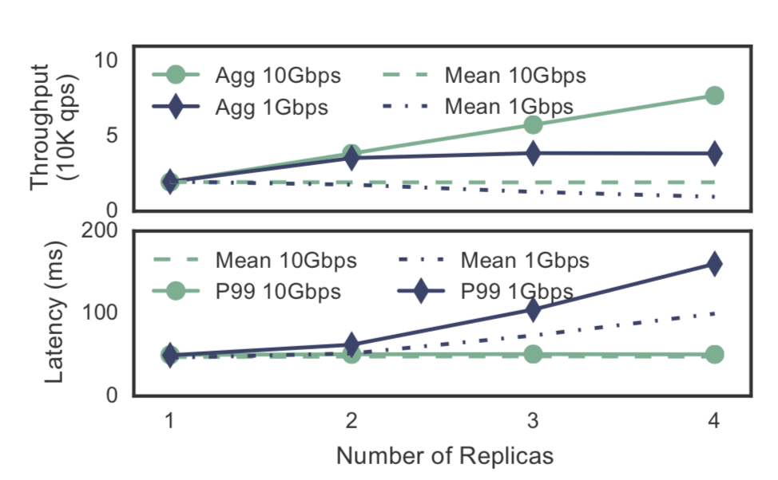
Container Replica Scaling
Improve prediction throughput
Leverage additional hardware accelerators
Notes:
Clipper supports replicating model containers to improve throughput. Because different replicas can have different performance characteristics, particularly when spread across a cluster, Clipper performs adaptive batching independently for each replica.
pic..
bottleneck: GPU speed, network.

Slide 16
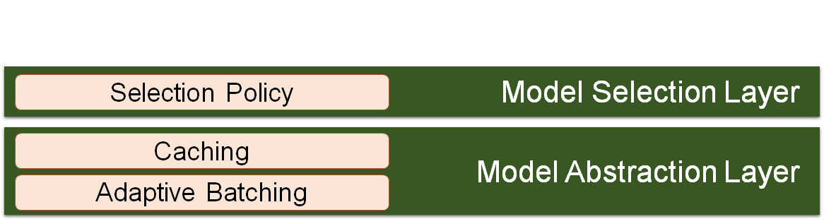
Model Selection Layer
Notes:
Model selection layer sits above Model abstraction layer
Query request are processed by the selection layer

Slide 17
Model Selection Layer
Goal
Maximize accuracy through bandits and ensembles, online learning and personalization
incorporate feedback in real-time to achieve:
robust prediction by combining different models and frameworks
onlines learning and personalization by selecting and personalizing predictions in response to feedback
Notes:
Get higher accuracy. Reduce bias and variance.
Doing jobs like real-time personalized prediction/recommendation

Slide 18
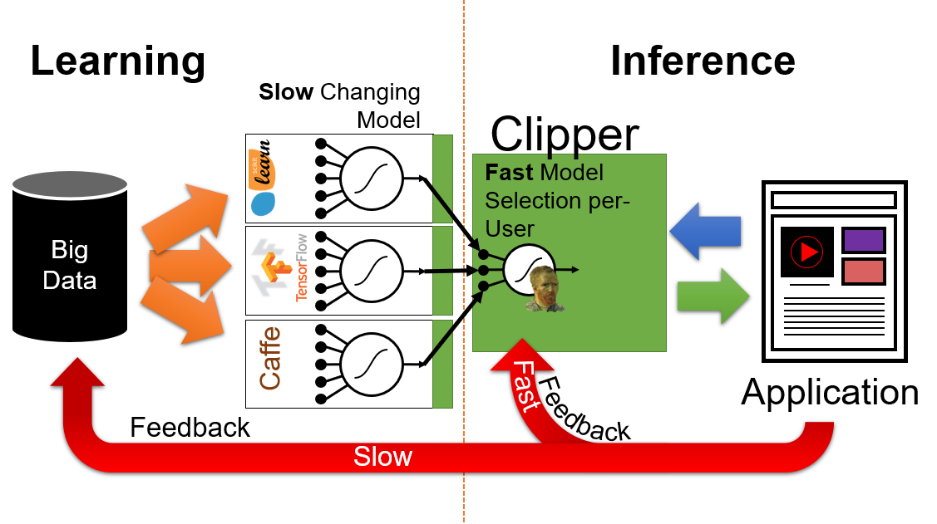
Model Selection Layer
Notes:
Clipper is the bridge between learning part (models) and inference part (application side)
Fast feedback asks clipper to quickly adjust to user’s preference and give prediction/recommendation accordingly
Low feedback -- user’s feedback could in long term become the “new part” of training data, thus changing the resulting model on those data
Clipper have to act swift, and keep accuracy

Slide 19
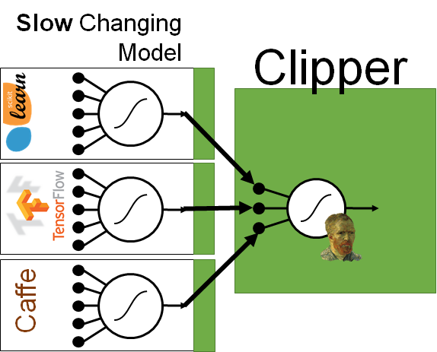
Model Selection Policy
Prediction Accuracy Improvement:
incorporate real-time feedback
estimate confidence of prediction
determine prediction combination strategy
single or ensemble model

Slide 20
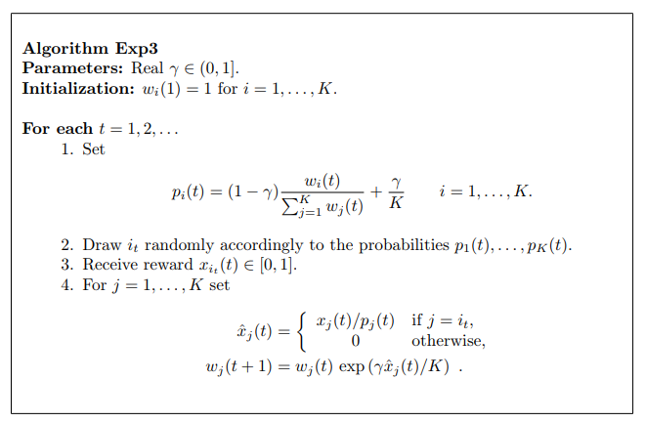
Model Selection Policy
Single Model Selection
multi-armed bandit problem
lightweight
robust
theoretical guarantee for fast convergence to optimal solution

Slide 21
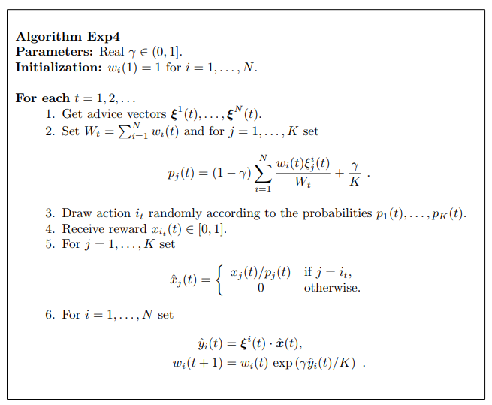
Model Selection Policy
Ensemble Model Selection
Ensemble weights estimating
bandit formulation

Slide 22
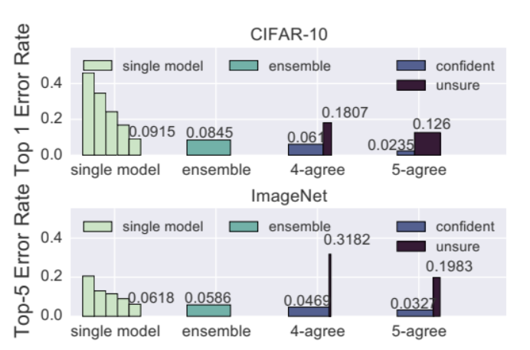
Model Selection Policy
Prediction Accuracy Improvement:
Knowing the confidence
robust prediction
Notes:
Two matrice
Using confidence will increase accuracy, “unsure” part could use the default action.
what’s the meaning of “agree” ? No idea Could be something like “within p% of the prediction result”

Slide 23
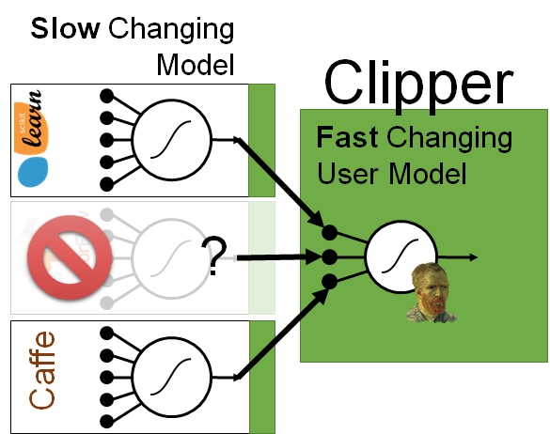
Cost of Ensembles
Stragglers
Solutions:
Selection policy must select/combine from available predictions
built-in ensemble policy like substitutes expected value

Slide 24
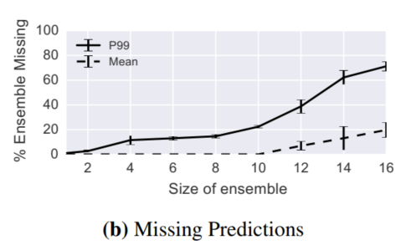
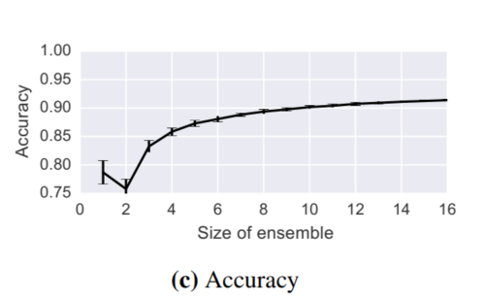
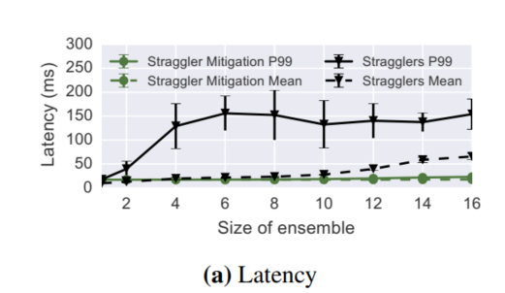
Cost of Ensembles
Stragglers
Straggler Mitigation
Steady and acceptable latency
Reduced ensemble size
High accuracy

Slide 25
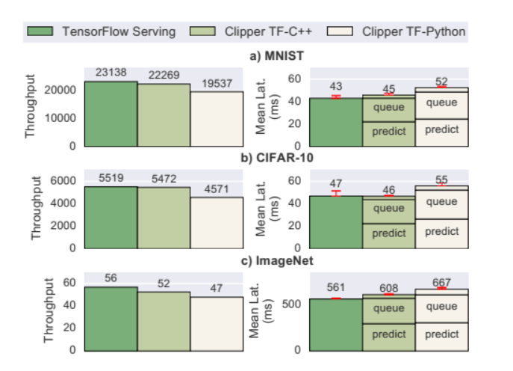
Clipper v.s. TensorFlow
Notes:
TensorFlow : static batch size, manually tune to achieve prediction latency objects

Slide 26
Limitation of Clipper
Clipper does not address offline model retraining
By treating deployed models as black boxes, Clipper forgoes the opportunity to optimize prediction execution of the models themselves or share computation between models
Only performs coarse-grained tradeoffs of accuracy, robustness, and performance.

Slide 27
Q&A
Questions?

Slide 28
DeepCPU: Serving RNN-based Deep Learning Models 10x Faster
Yifu Jin, Bochang Wang, Junding Wang

Slide 29
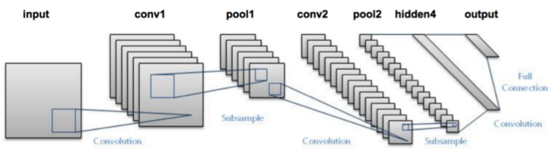
CNN structure

Slide 30
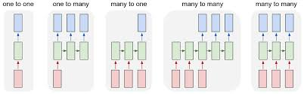
RNN structure

Slide 31
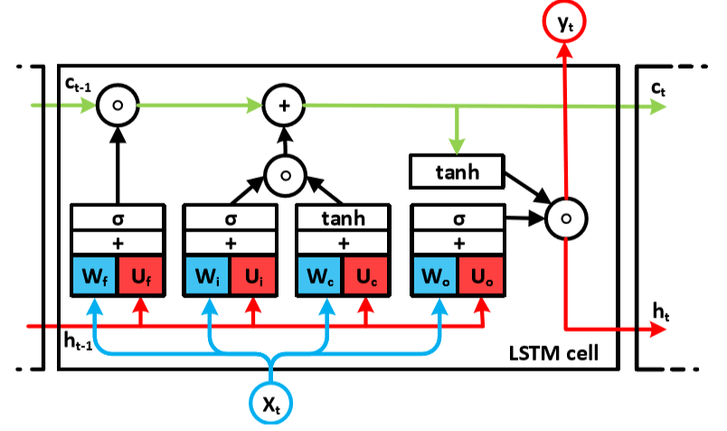
LSTM structure

Slide 32
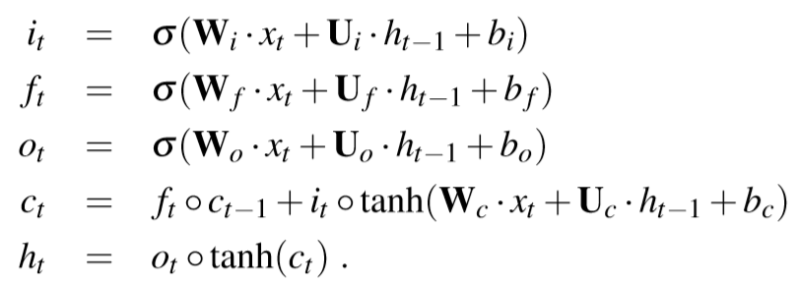
Performance Characteristics
The total computation is dominated by Matrix Multiplications (MMs).
Notes:
Typically the total number of ops in MMs is two to three orders of magnitude larger than the rest combined.

Slide 33
Data reuse
Definition : the number of computational ops that can be executed per data load/store at that level of memory hierarchy.
Notes:
Before we go a step further, we need to realize that for a serving system, input data is pretty small. So, the computation could not hide the time for data movement. For example, we may just have a sentence as input. Different from training system, we need to consider the time for data movement.

Slide 34
Goal
Find an efficient search strategy to optimize data reuse within RNN-based models as a serving system.

Slide 35
DeepCPU novel techniques
MM-DAG
MM-DAG scheduling
Fusion of MMs
Reuse-aware parallelism generator
Private-cache-aware partitioning
Weight-centric streamlining

Slide 36
MM-DAG

Slide 37
MM-DAG scheduling
A MM-DAG could be scheduled into different order of phases, such that all the MMs in the same phase are independent.
Notes:
partition the whole graph into several phases such that the MMs in each phase are independent.

Slide 38
Fusion of MMs
B1
C1
[B1, B2]
[C1, C2]
A
A
B2
C2
Notes:
Two MMs can be fused into a single MM if they share a common input matrix.

Slide 39
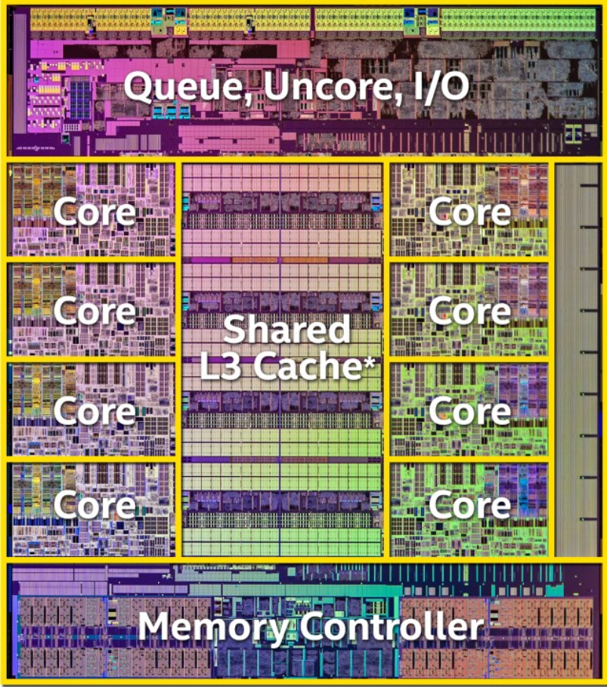
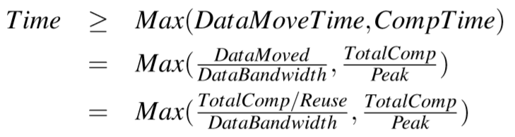
Reuse-aware parallelism generator
Notes:
As the parallelism increases, either the input or output must be replicated acrossmultipleL2privatecaches,thusincreasingthetotaldatamovement.
Find the best number of cores to parallel so that we could balance computation time and data movement time.

Slide 40
Private-cache-aware partitioning
Maximize data reuse within a phase
A estimation function for data reuse based on size of L2 cache and size of MMs within this phase.
Notes:
Find the best partition based on the cache size and input & output size of MM operatiotions
For a given MM with parallelism degree P, we show PCP produces a P-partitioning of the computation space such that the total data movement between L3 and L2 cache is minimized.

Slide 41
Weight-centric streamlining
Improve data reuse across phases
Keep the same thread computing with the same weights
Save the time to open and close parallel region during each step.
Notes:
Maximize data-reuse across phases (Weights are the same for each iteration).
Idea is really simple, use the unique ID of thread so that the weights are cached.

Slide 42
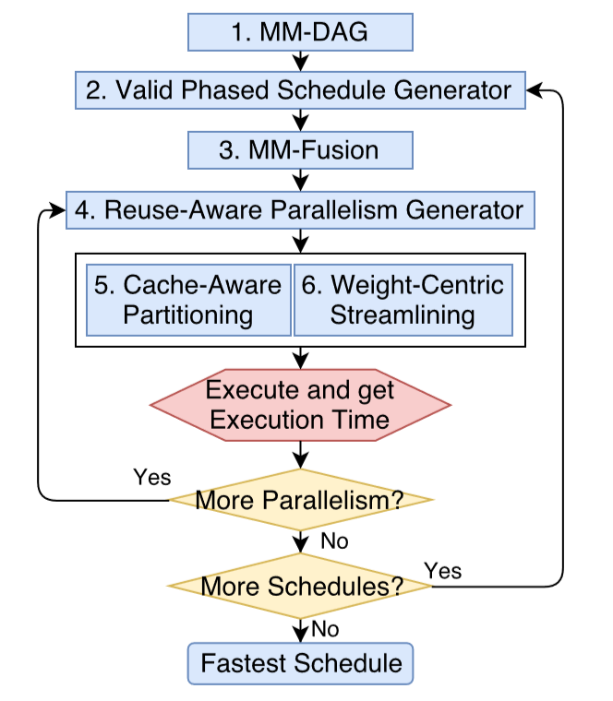
DeepCPU optimization structure

Slide 43
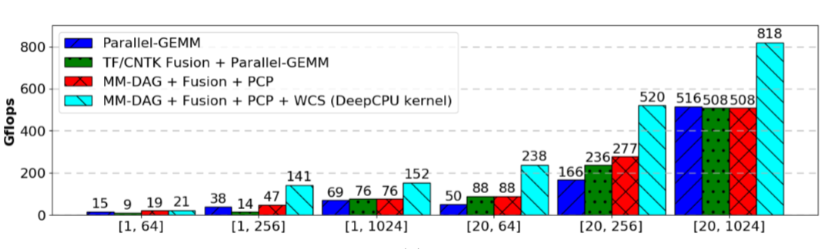
Performance of LSTM
Notes:
Gigaflops is a unit of measurement used to measure the performance of a computer's floating point unit, commonly referred to as the FPU. One gigaflops is one billion (1,000,000,000) FLOPS, or floating point operations, per second.
[batchsize,input/hiddendimension]

Slide 44
Discussion

