Slide 1
BlinkDB: Queries with Bounded Errors and Bounded Response Times on Very Large Data
Sameer Agarwal, Barzan Mozafari○, Aurojit Panda, Henry Milner, Samuel Madden○, Ion Stoica
By Zerihun Bekele

Slide 2
Approximation systems
Problem: How can we compute queries on big data with an interactive response times?
Previous techniques: sampling, sketches and aggregation
trading accuracy for response time and space.
Sampling and sketches
Low space & time complexity, but make strong assumptions about query
Online aggregation
Few assumptions, but highly variable performance

Slide 3
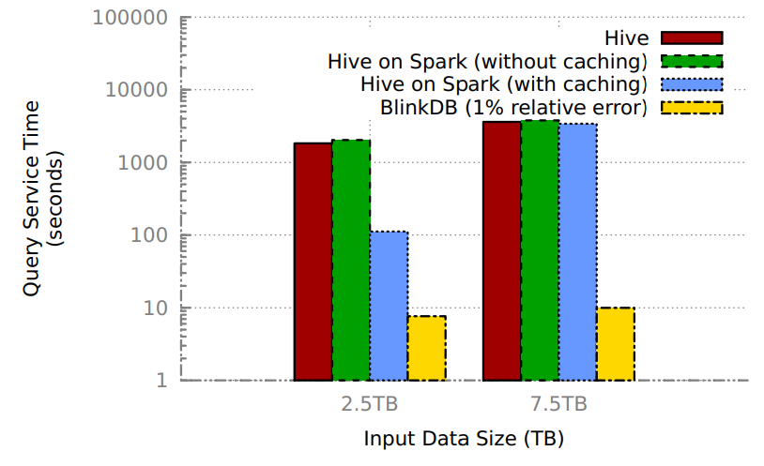
BlinkDB Overview
BlinkDB: a distributed sampling based approximate query processing system by balancing between efficiency and generality.
SQL-based aggregation queries over stored data, along with response time or error bound constraints.
Assumption: sets of columns used by queries in WHERE, GROUP BY, and HAVING clauses are stable over time.
Two modules
Sample creation: stratified samples on frequently
used QCS to minimize storage
Sample selection: pick randomly from subsamples
to satisfy time/error constraints based on
error-latency heuristics
Built on top of Hive/Hadoop/Shark

Slide 4
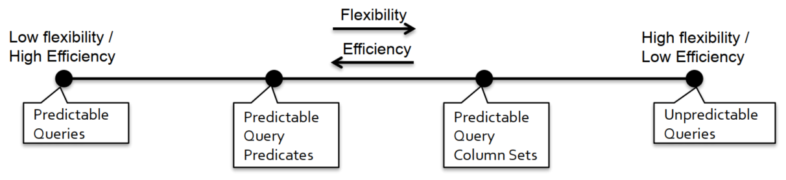
Taxonomy of query workloads
All future queries
group and filter columns & values
Frequencies of column sets
Traditional
systems
STRAT
SciBORQ
BlinkDB
AQUA
OLA

Slide 5
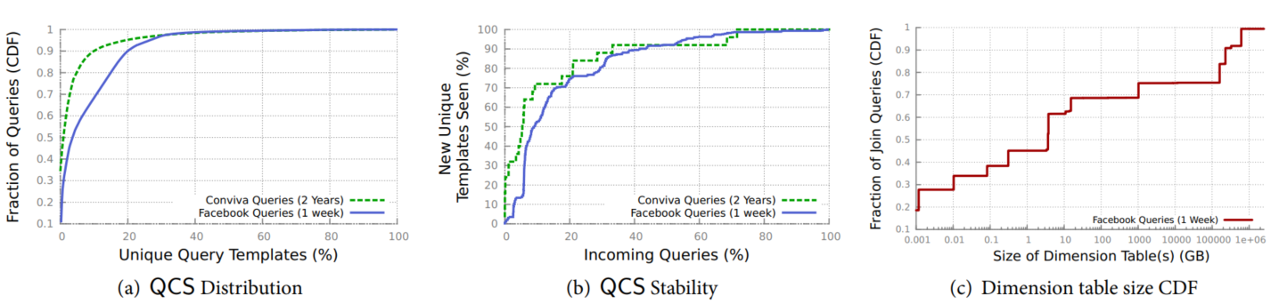

Query Patterns in a Production Cluster
QCSs are relatively stable overtime!

Slide 6
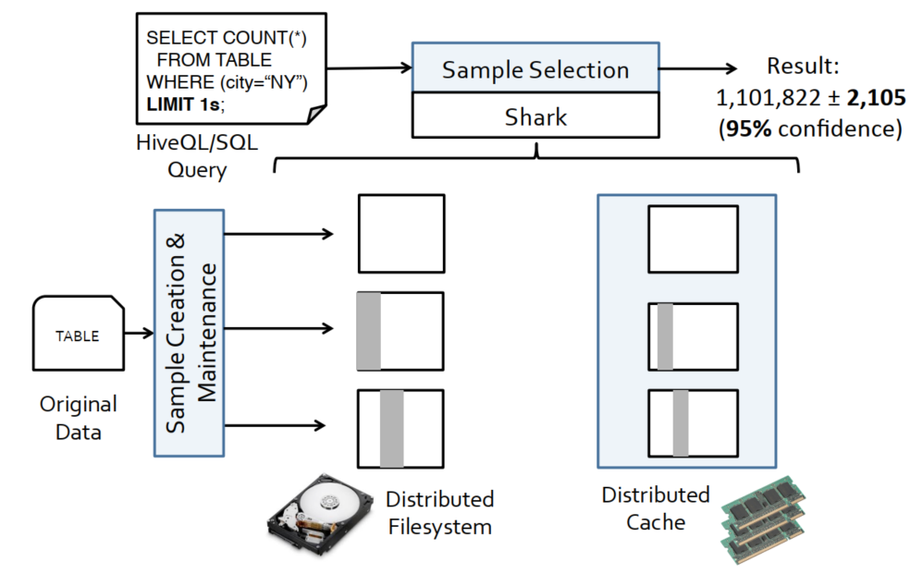
BlinkDB architecture
Runtime
Supports standard SQL aggregate queries involving COUNT, AVG, SUM and QUANTILE.
Joins if it fits memory
Offline

Slide 7
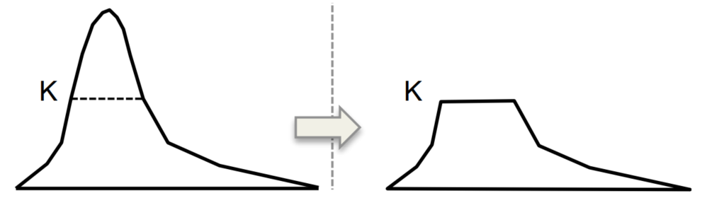
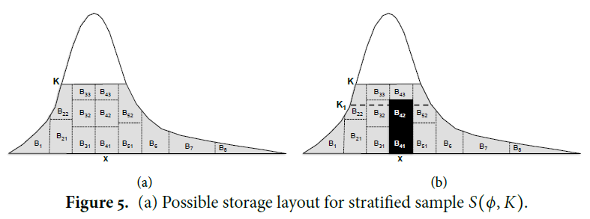
Optimizing a stratified sample for a single query
Random uniform sampling doesn’t work
Poor on filtered or grouped queries
Under representing rare groups
Best choice is assign equal sample size: stratified sampling
Compute group count
Take samples
Uniformly at random without replacement
Sampling from a stratified sample

Slide 8

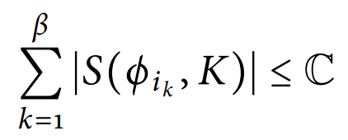
Optimization framework for multiple samples
To determine the subset of columns with minimum storage cost
Three factors
Data sparsity = → no. of groups
Workload: QCSs have historical multinomial distribution
p_{j} is simply the frequency of queries with QCS q_{j} in past queries
Storage cost =

Slide 9
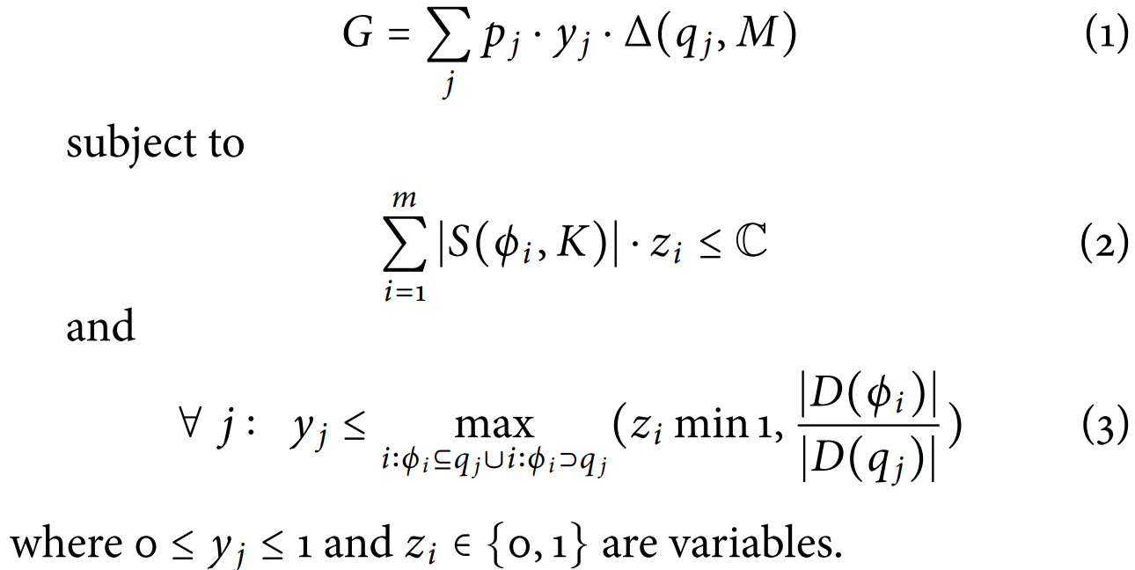
Optimization framework
Maximize the following mixed integer linear program (MILP) in which j indexes over all queries and i indexes over all possible column sets:
Coverage probability

Slide 10
BlinkDB runtime
Given a query Q, select one (or more) sample(s) at run-time that meet the specified time or error constraints
Strategy: executing the query on a subsample of one or more samples and gathering statistics on query’s selectivity, complexity and the underlying placement & distribution of its inputs.
Sample selection: If q_{j} ⊆ φ_{i} , simply pick φ_{i} with the smallest number of columns, and run the query on S φ_{i}, K). Otherwise, run Q in parallel on subsets of all sample, and select the one with high selectivity
Sample Size: Construct Error Latency Profile (ELP) of the query for each sample, assuming different subset sizes.
Used to predict sample size that satisfies error bound
Notes:
Selection depends on columns in Q, selectivity, and data distribution in cluster
Sample size depends on physical location on cluster, time/error bound, computation complexity, & cluster availability
selectivity is defied as the ratio of (i) the number of rows selected by Q, to (ii) the number of rows read by Q (i.e., number of rows in that sample)

Slide 11
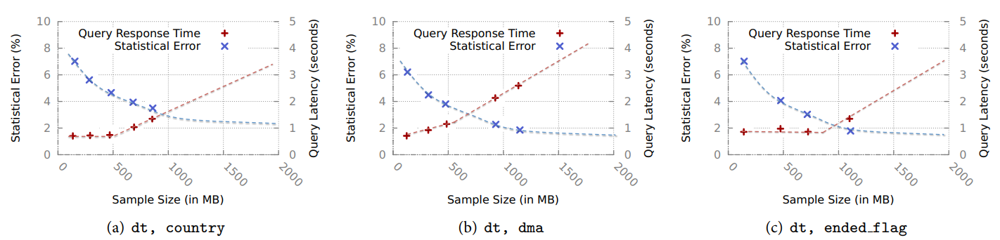
Error Latency Profile
Error profile: Uses closed-form formulas
variance ∼ 1/n, and standard deviation (statistical error) ∼ 1/√n
where n is the number of rows from a sample of size N that match Q’s filter predicates.
Selectivity, s_{q} of the query = n selected/N read
Latency profile: select n rows within the time bound specified
Assumes linearity
Notes:
the value of n depends on the physical placement of input data (disk vs. memory), the query structure and complexity, and the degree of parallelism
BlinkDB simply predicts n by assuming that latency scales linearly with input size,

Slide 12
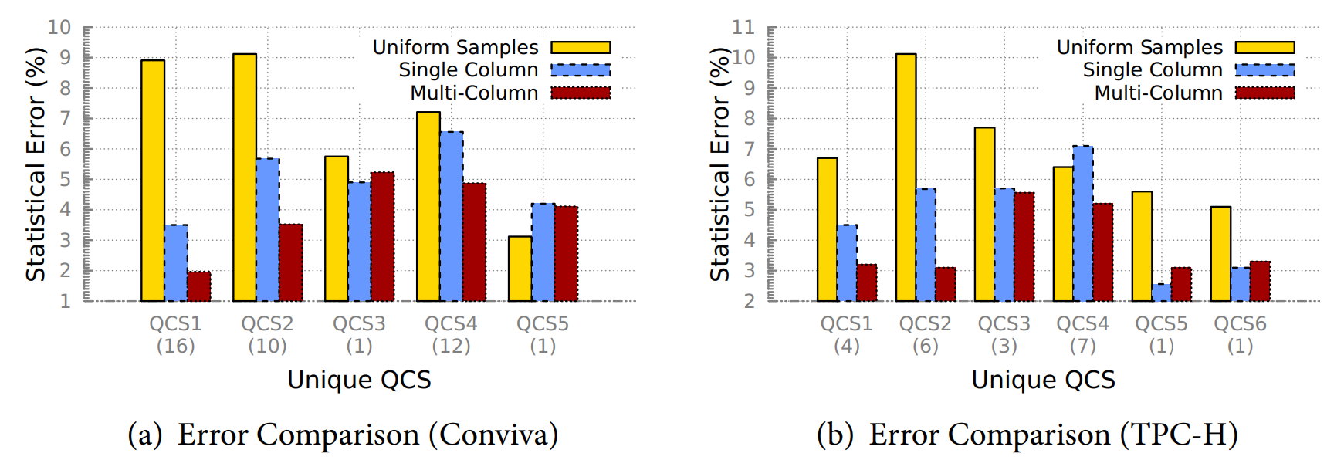
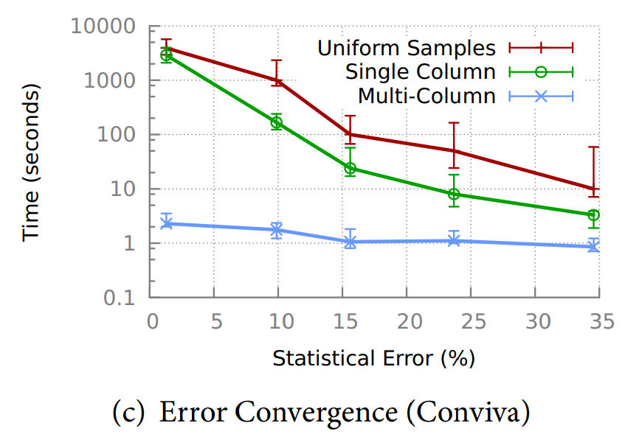
Multi-Dimensional Stratified Sampling
Uniform Samples. 50% of the entire data, chosen uniformly at random.
Single-Dimensional Stratified Samples.
Multi-Dimensional (3) Stratified Samples.
Using BlinkDB’s
optimization framework
Notes:
The optimization framework attempts to minimize expected error, rather than per-query errors, and therefore for some QCS single-dimensional stratied samples behave better than
multi-dimensional samples.

Slide 13
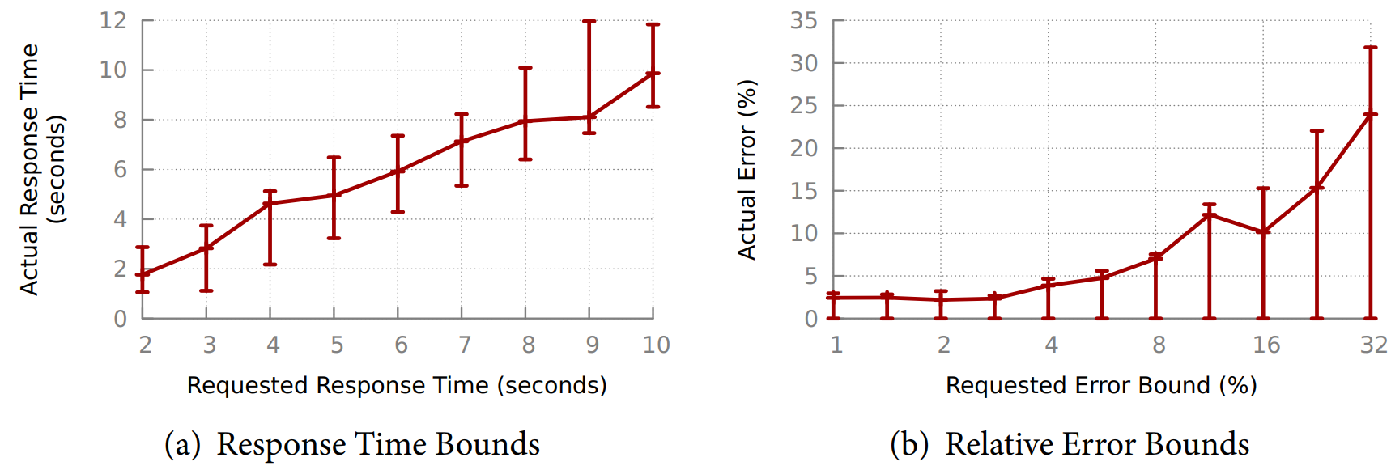
Error and latency guarantee
Notes:
For larger error bound request, the results error bound also increase because sample size required to it decreases

Slide 14
Related works
Using more resources to decrease latency: Spark, Dremel and Shark
Approximate Query Processing in relational database systems
Sampling approaches
STRAT: minimize error assuming future tuple sets are fixed
SciBORQ: tuples based on past query results and provides time bound only
AQUA: single stratified sample & considers the sizes of groups of all subsets
Babcock et al: uses multiple single stratified columns and joins result
Olston et al: interactive data analysis, but uses new sample for each query
Online aggregation: answers are constantly refined during execution. Streams data at random imposing I/O overhead
Materialized views, Data cubes, Wavelets, Synopses, Sketches, Histograms
Work for specific sets of queries

Slide 15
Thank you!

Slide 16
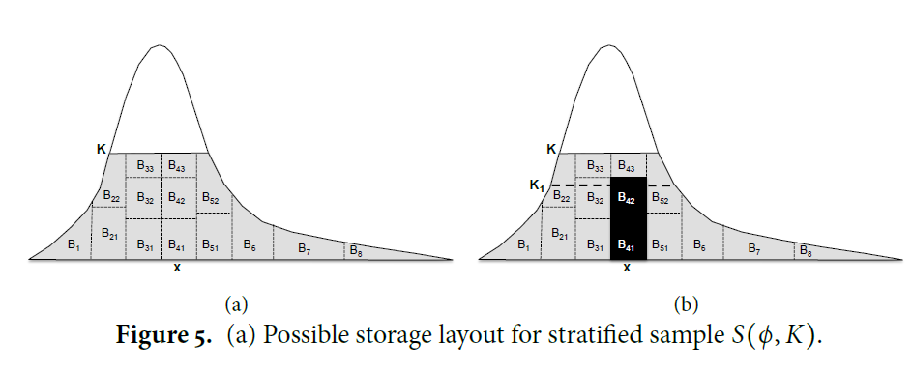

Slide 17
BlinkDB vs no sampling

Slide 18
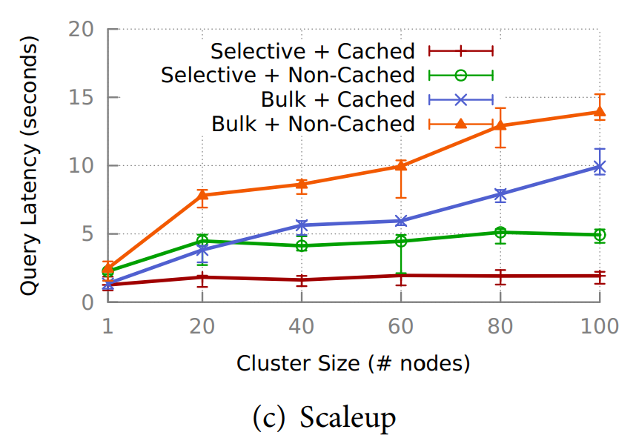
Scaling Up

Slide 19
BlinkML: Efficient Maximum Likelihood Estimation with Probabilistic Guarantees
Yongjoo Park, Jingyi Qing, Xiaoyang Shen, Barzan Mozafari

Slide 20
Background – Sampling for ML
In literature
Sampling has been extensively studied for a specific type of model, such as linear regression, logistic regression
too specific to be generalized or does not offer error guarantees
In practice
Sampling is used extensively to help analysts explore model in early stage
Ad-hoc not well-understand how sampling may affect the model
Not optimized or reusable

Slide 21
Background – Hyperparameter tuning
Current auto-hyperparameter-tuning mostly focus on how to find an optimal sequence of hyper-parameters to test
Sampling instead tries to minimize the data-size to speed up exploration stage

Slide 22
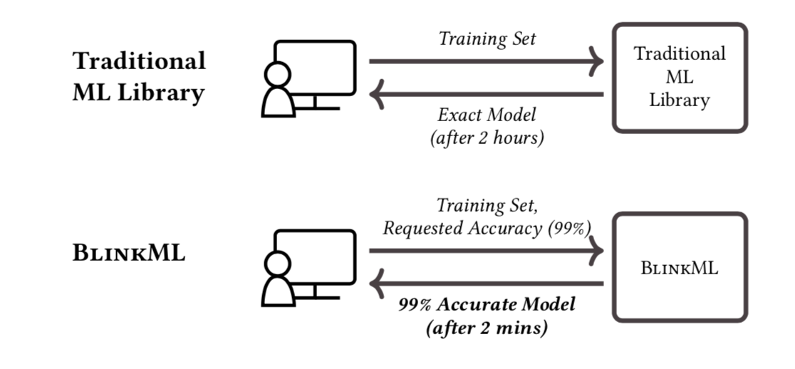
Goal
A system that helps analysts to request error-computation trade-offs for several ML models.
To bound the deviation of the approximate model’s prediction from full model given sample size
To predict the minimum sample size to achieve the required prediction error

Slide 23
Challenges
Difference with BlinkDB
To estimate the error without training multiple model.
To bound the deviation as tight as possible.
Not to optimize a sampling strategy to cover various queries
Not to select a suitable sample during run time to speed up data retrieving process

Slide 24
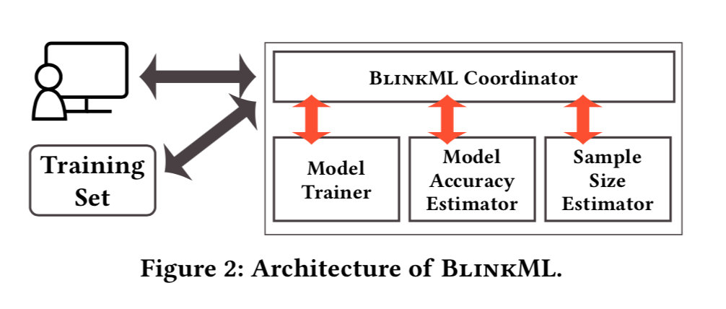
System - Architecture
Model Trainer
to train a initial model on a sample of size n
Model Accuracy Estimator
to estimate the deviation of initial model’s error from the full model
Sample Size Estimator
to predict the minimum sample size satisfied the user requirement

Slide 25
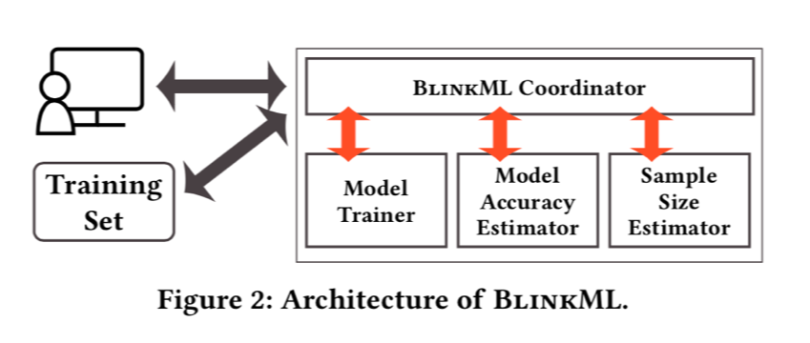
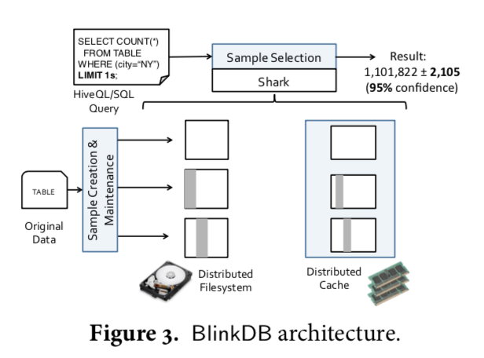
Architecture Comparison
All run-time modules | Offline sampling module + run-time sampling selection module
Focus on error constraint | Support both time-constraint and error constraint

Slide 26
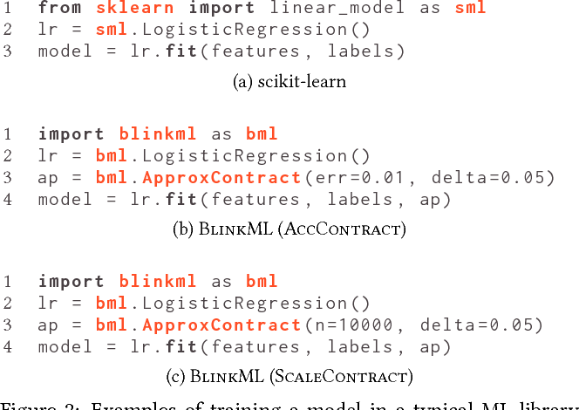
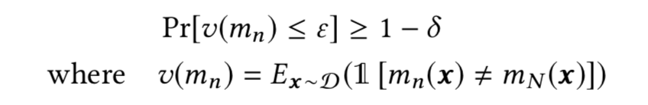
System - User Interface
BlinkML needs to specified an error bound and a confidence level in addition to the input of traditional ML tools.
BlinkML returns a model that satisfies user-specified or default error constraints in probability
Fig. BlinkML API
Fig. Model Objectives

Slide 27
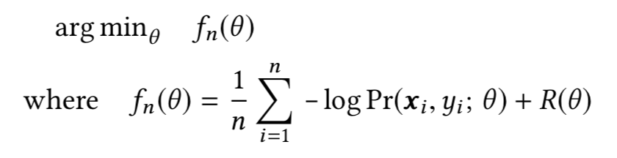
System - Supported Model
BlinkML supports any models that can be trained by solving the following convex optimization problem, i.e. by using maximum likelihood estimation

Slide 28
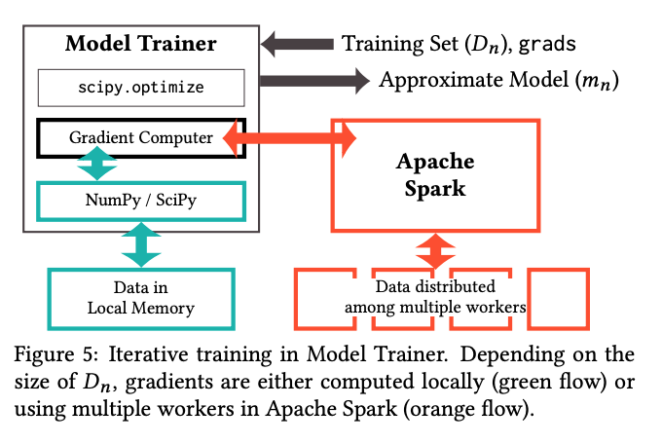
Model Trainer
BlinkML trains model at most two times (initial model + final model)
It is designed to train a model both locally or using system Apache Spark.

Slide 29
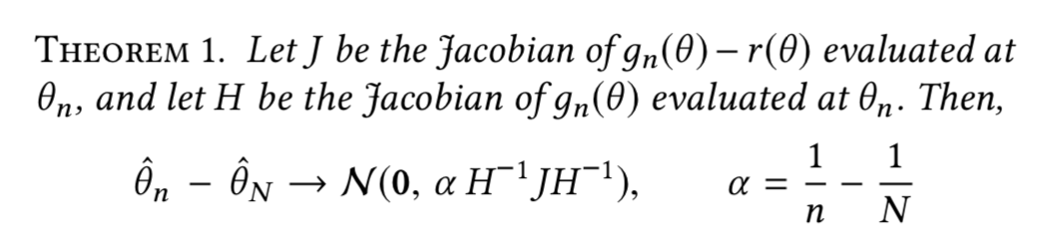
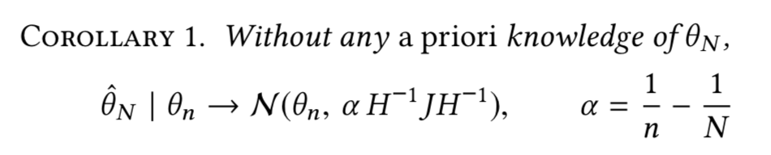
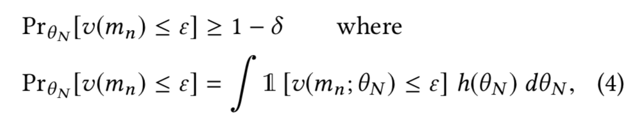
Model Accuracy Estimator
Model Accuracy Estimator estimates the accuracy of an approximate model
To estimate the accuracy without training the full model, we have to understand the distribution

Slide 30
Model Accuracy Estimator
Computing Necessary Statistics
Closed Form
Analytically derive the formula from the optimization model
Accurate but computation heavy and only applied to certain case
Inverse Gradients
Taylor expansion
ObservedFisher (Default)
Information matrix equality (covariance matrix of grads is approximate J)

Slide 31
Model Accuracy Estimator
Model Accuracy Estimator
m₀
Select Statistics Computer
Apache Spark
Numpy / Scipy
Local data
Distributed data

Slide 32
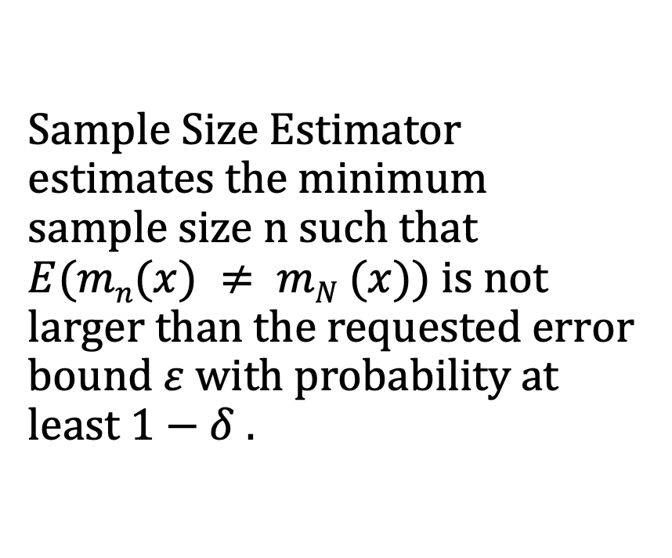
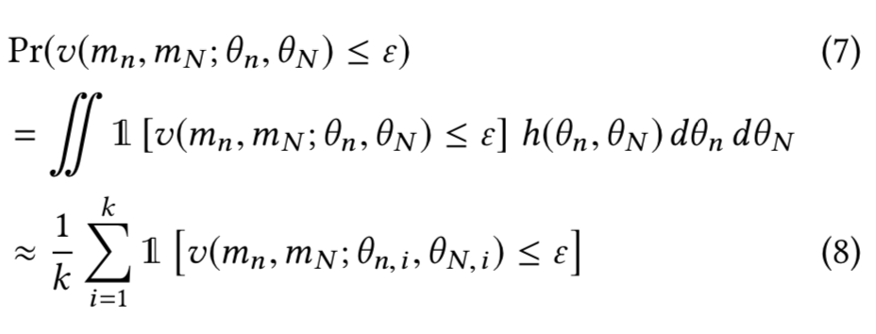

Sample Size Estimator

Slide 33
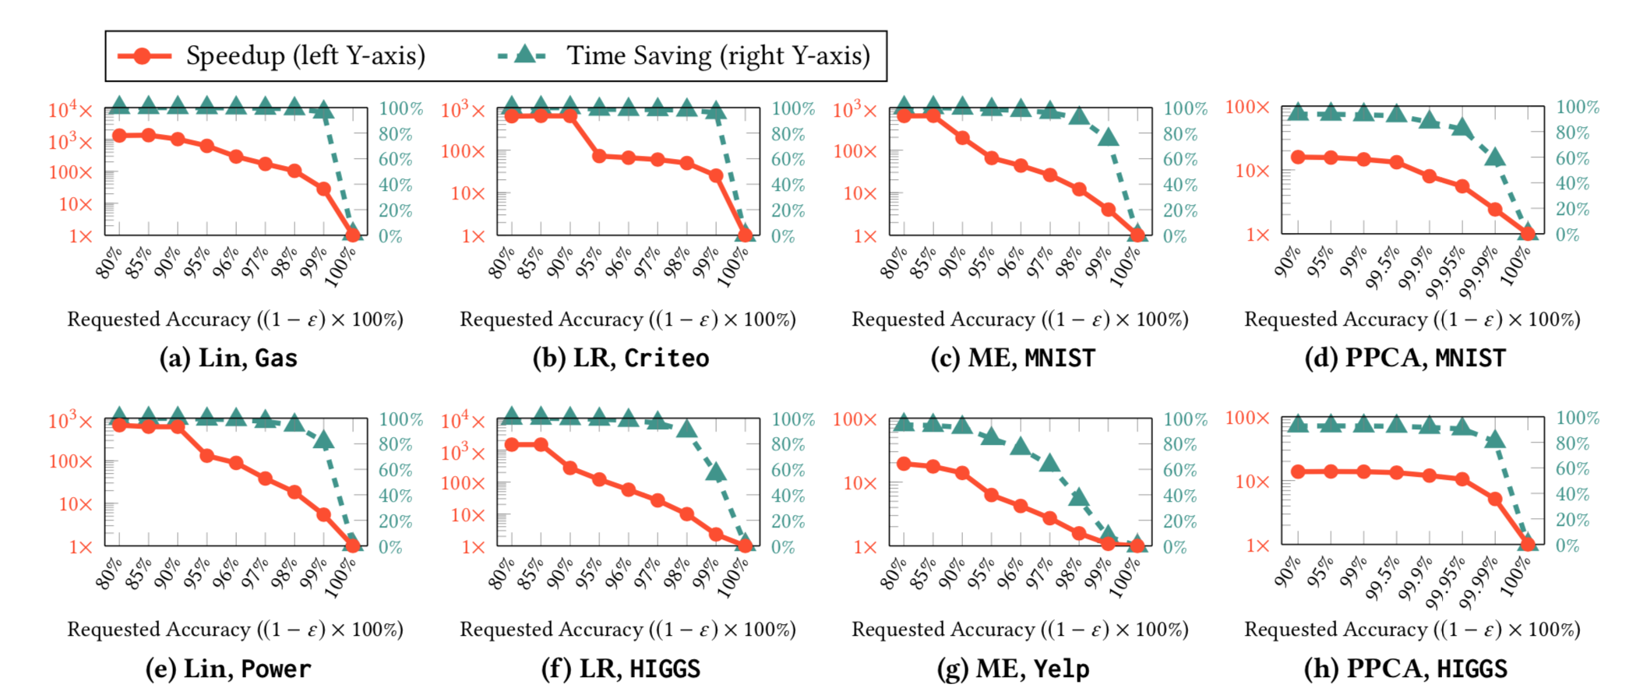
Experiments - Training Time Savings

Slide 34
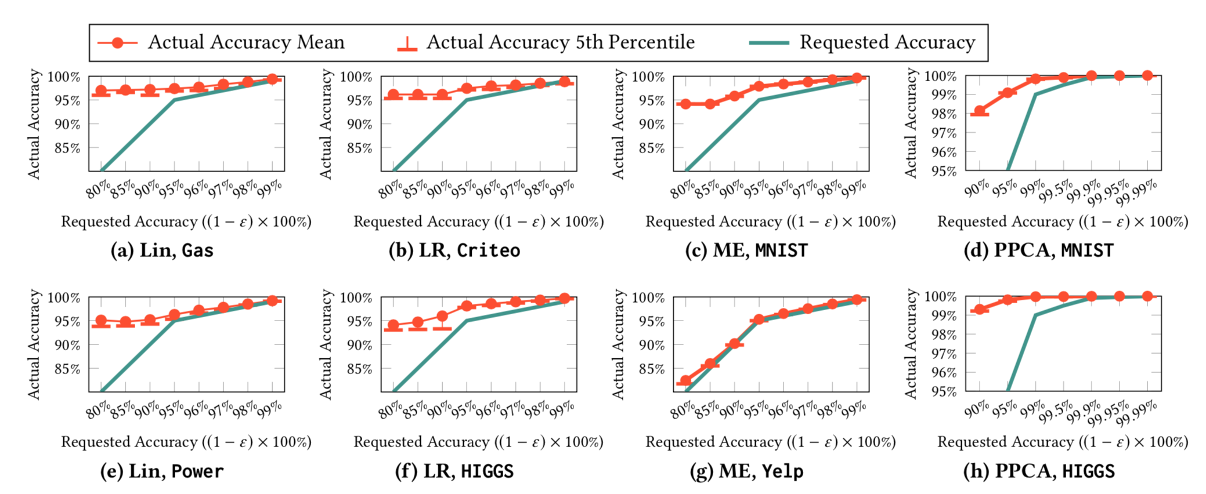
Experiments - Accuracy Guarantees

Slide 35
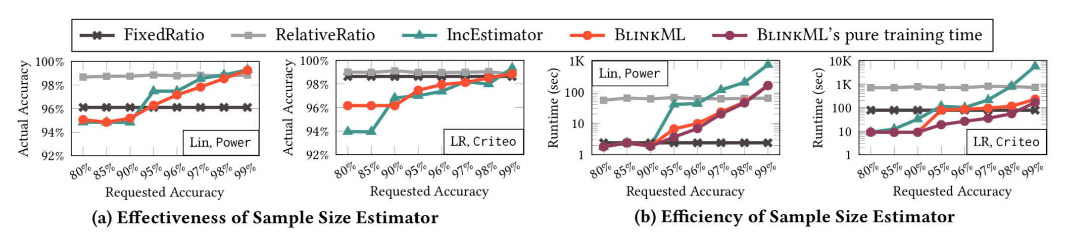
Experiments – Sample Size Estimation

Slide 36
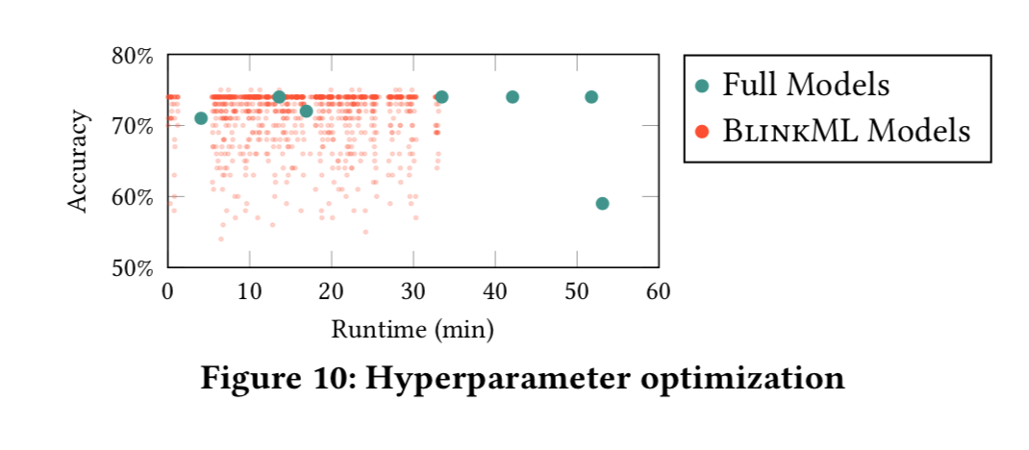
Experiments - Hyperparameter Optimization

