Slide 1
YARN: Yet Another Resource Negotiator
Vinod Kumar Vavilapalli et al.
Hortonworks, Yahoo, Microsoft, Inmobi and Facebook
[SoCC’13]
Presented by Matthew Furlong, Ayush Goel, HyunJong (Joseph) Lee

Slide 2
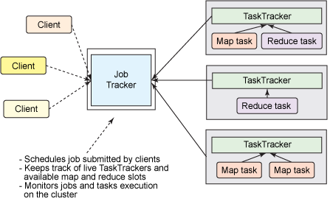
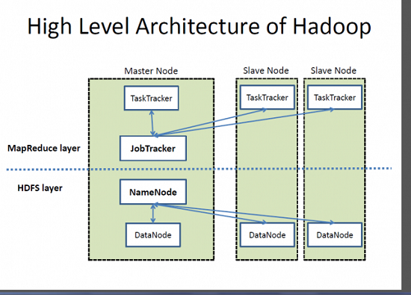
Background: Hadoop 1.0
JobTracker (JT)
Single master
Manages …
TaskTracker (TT)
Executes jobs
User submits MapReduce jobs to JTs
Notes:
Start talking about the state of the art.
Hadoop 1.0 being used for mr for web crawls. However as the size and the complexitiy of the web increased
Major shortcomings - tight coupling, leading to abuse of mapreduce apis. Clever workarounds, sidestep apis.
Centralized handling of jobs’ control flow.

Slide 3
Job Tracker Responsibilities
Admission control
Tracking the liveness of TTs
Launching tasks speculatively for slower nodes
Reporting job status to users
Recording audit logs
Aggregate audit statistics
Authenticating users

Slide 4
Requirements of YARN
Scalability
Notes:
Scalability was a requirement with Hadoop and continues to be of the utmost importance to YARN as well. The system must be able to scale out as you add more nodes in order to be an effective solution for large datacenters with commodity hardware. So can someone explain the difference between scaling up vs scaling out?

Slide 5
Requirements of YARN
Scalability
Multi-Tenancy
Notes:
The second requirement, which also was met by Hadoop and needed to be continued in YARN, was to provide Multi-Tenancy. Multi-Tenancy is the ability for multiple jobs to run on the same node. This allows for increased utilization of every computing resource, similar to renting out all of the rooms in an apartment so that the space can be maximized effectively.

Slide 6
Requirements of YARN
Scalability
Multi-Tenancy
Serviceability
Notes:
Serviceability is the decoupling of upgrade dependencies on the system. For example, being able to migrate a mini-cluster, or a cluster within a cluster, from Hadoop 1.0 to Hadoop 2.0 without having service delays or any critical changes in the architecture itself.
Developers at Yahoo used multiple tools including Torque and Maui to create Hadoop on Demand, which allowed for users to set up their own mini clusters for every job, and thus use older versions of Hadoop.

Slide 7
Requirements of YARN
Scalability
Multi-Tenancy
Serviceability
Difficult to run multiple versions of Hadoop within a single cluster.
Impossible to update Hadoop without taking cluster down.
Notes:
By default, Hadoop does not allow for upgrades to the system without downtime, and most systems were using a single version of Hadoop throughout the cluster, thus increasing the workload on the user who must account for these version changes and downtime.
Developers at Yahoo overcame this by using multiple tools including Torque and Maui to create Hadoop on Demand, which allowed for users to set up their own mini clusters for every job, and thus use older versions of Hadoop. However, this led to problems in Locality Awareness.

Slide 8
Requirements of YARN
Scalability
Multi-Tenancy
Serviceability
Locality Awareness
Notes:
Note that this is not a shortcoming of Hadoop, but rather the full system that Yahoo was attempting to build.

Slide 9
Requirements of YARN
Scalability
Multi-Tenancy
Serviceability
Locality Awareness
Yahoo’s Hadoop on Demand used Torque, which does not account for locality when allocating nodes.
Notes:
While Hadoop provided Locality Awareness, with the Job Tracker being aware of the locale of the data and assigning computation to this data, when Yahoo built Hadoop on Demand, Torque was no longer ware of the location of the data and thus they lost the ability to bring the computation to the data.

Slide 10
Requirements of YARN
Scalability
Multi-Tenancy
Serviceability
Locality Awareness
High Cluster Utilization
Notes:
Users at Yahoo had little knowledge of how many nodes there jobs required, and so they would ask for multiples of 10 to their natural intuition to ensure their jobs ran. Think about it, how can we assume that people will be altruistic and not hog all of the resources for their own jobs?

Slide 11
Requirements of YARN
Scalability
Multi-Tenancy
Serviceability
Locality Awareness
High Cluster Utilization
Jobs used many more nodes than required.
Notes:
Users at Yahoo had little knowledge of how many nodes there jobs required, and so they would ask for multiples of 10 to their natural intuition to ensure their jobs ran. Think about it, how can we assume that people will be altruistic and not hog all of the resources for their own jobs?

Slide 12
Requirements of YARN
Scalability
Multi-Tenancy
Serviceability
Locality Awareness
High Cluster Utilization
Reliability/Availability
Notes:
Fault tolerance is critical to any big data system, and Hadoop and YARN are no different. However, the fault tolerance that was built into Hadoop also caused performance problems, and thus it was important that YARN provided efficient fault tolerance.

Slide 13
Requirements of YARN
Scalability
Multi-Tenancy
Serviceability
Locality Awareness
High Cluster Utilization
Reliability/Availability
JT potentially delays allocation of cluster resources.
Notes:
The reason that Hadoop had performance issues is that the Job Tracker has strict admission control logic to safeguard its own availability, which delays allocating free cluster resources when it begins to be overwhelmed from client requests.

Slide 14
Requirements of YARN
Scalability
Multi-Tenancy
Serviceability
Locality Awareness
High Cluster Utilization
Reliability/Availability
Secure and Auditable Operations
Notes:
While Hadoop also had these characteristics, it is important that YARN must be secure to support multi-tenant clusters and also auditable to assist in debugging.

Slide 15
Requirements of YARN
Scalability
Multi-Tenancy
Serviceability
Locality Awareness
High Cluster Utilization
Reliability/Availability
Secure and Auditable Operations
Support for Programming Model Diversity
Notes:
While MapReduce is efficient for many jobs, it is not an end all solution for big data programs. However, Hadoop users were bound to use MapReduce jobs because this was the only programming framework that it supported.

Slide 16
Requirements of YARN
Scalability
Multi-Tenancy
Serviceability
Locality Awareness
High Cluster Utilization
Reliability/Availability
Secure and Auditable Operations
Support for Programming Model Diversity
Hadoop is tied to the MapReduce framework.
Notes:
Users often abused the system, for example, with machine learning algorithms that required multiple passes over the dataset or when graph algorithms that would work better with message passing to communicate between vertices were expressed as map-only jobs even though they radically different resource requirement. This caused poor utilization.

Slide 17
Requirements of YARN
Scalability
Multi-Tenancy
Serviceability
Locality Awareness
High Cluster Utilization
Reliability/Availability
Secure and Auditable Operations
Support for Programming Model Diversity
Flexible Resource Model
Notes:
By statically partitioning Map and Reduce tasks, full utilization is not reached because when a map task completes, this fallow node will not be used for reduce tasks. Therefore, no configuration will ever be perfectly balanced.

Slide 18
Requirements of YARN
Scalability
Multi-Tenancy
Serviceability
Locality Awareness
High Cluster Utilization
Reliability/Availability
Secure and Auditable Operations
Support for Programming Model Diversity
Flexible Resource Model
Hadoop statically partitions Map and Reduce tasks.
Notes:
By statically partitioning Map and Reduce tasks, full utilization is not reached because when a map task completes, this fallow node will not be used for reduce tasks. Therefore, no configuration will ever be perfectly balanced.

Slide 19
Requirements of YARN
Scalability
Multi-Tenancy
Serviceability
Locality Awareness
High Cluster Utilization
Reliability/Availability
Secure and Auditable Operations
Support for Programming Model Diversity
Flexible Resource Model
Backward Compatibility
Notes:
It was important to the developers of YARN to ensure that their system was backwards compatible with Hadoop to ensure that old jobs that run on Hadoop were still able to be executed on YARN. This avoided what the authors refer to as “second system syndrome”.

Slide 20
YARN Design Principles
Decouples programming languages from resource management
Per-cluster Resource Manager
Tracks resource usage, node liveness, allocation invariants
Application Master
Head of the job
Prepares a logical, physical and execution plan for every job
NodeManager
Tracks resources per nodes and communicates the information to the RM
Notes:
The RM was totally ignorant about the semantics of the job
And the AM was totally ignorant about the resource management.

Slide 21
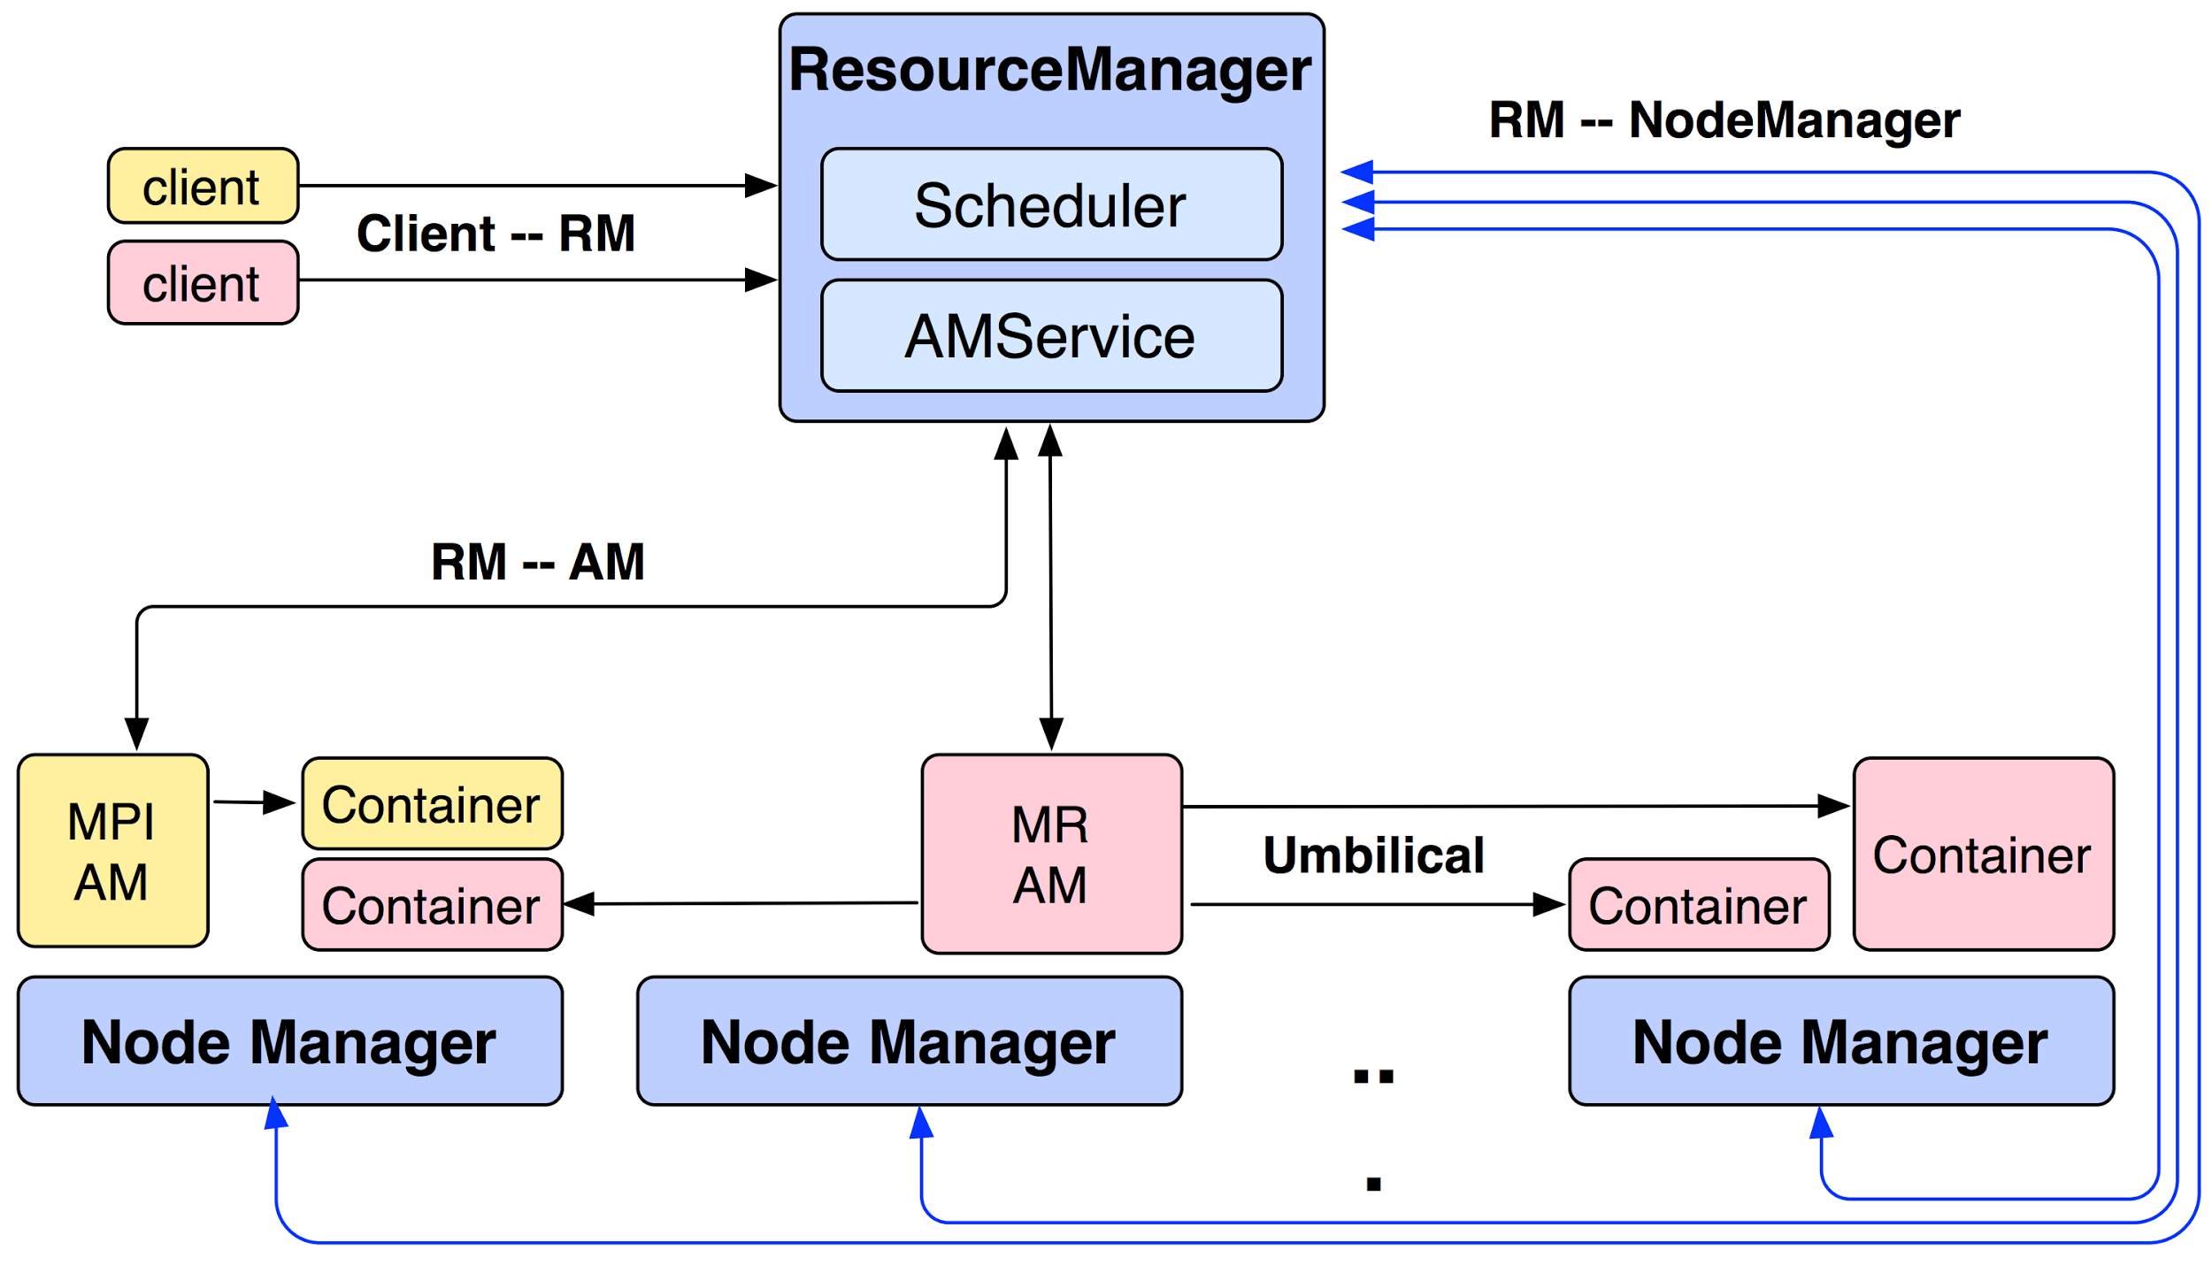
YARN Architecture
Notes:
RM had two public APIs, one for client, one for AM dynamically negotiating access to resources. RM has a global view of all the resources in the cluster. NM monitors the health of the node. The NM can also provide a number of auxillary tasks like being able to aggregrate logs and run certain log analysis tasks.

Slide 22
Contrast with Mesos
How they approach scheduling?
Mesos incorporates 2 level scheduling
Determines resources available, and sends them as offers to application scheduler
Offers can be accepted or rejected
Yarn determines the available resources, and then schedules the job itself accordingly.
Notes:
I’d like to quickly contrast yarn with mesos. Primary difference lies in their design and how they approach scheduling.
Both enables support for multiple frameworks on shared clusters. Also note, that yarn was specifically designed to run mapreduce jobs which are more like batch jobs. However interesting even though they kind of target the same space, they can be made to work together.

Slide 23
Contrast with Omega
Developed by Google
Focuses on cluster scheduling architecture
Parallelism, shared state, optimistic concurrency control.
No external resource manager
Notes:
No external RM as every scheduler has direct access to the resources, and every scheduler has a copy of the cluster state. Google first started with Borg and then moved to Omega.

Slide 24
Yarn | Mesos | Omega | Kubernetes
Built with different intentions
Targeting different space
Can be made to work with each other
Myriad
Kubernetes on Yarn
Notes:
Myriad: both a Mesos framework and a YARN scheduler that enables Mesos to manage YARN resource requests. When a job comes into YARN, it will schedule it via the Myriad Scheduler, which will match the request to incoming Mesos resource offers. Mesos, in turn, will pass it on to the Mesos worker nodes.
Kubernetes Master allocating resources (to run Docker containers) from YARN.

Slide 25
What did YARN solve by decoupling?

Slide 26
Support for Programming Model Flexibility
Hadoop is tied to the MapReduce framework.
The AM allows for various programming frameworks to be used in YARN.
Notes:
This is the most important aspect of YARN in our opinion (the decoupling of programming paradigms and the resource manager).
The Application Manager manages application-specific semantics to allow various programming frameworks to run on YARN (MapReduce, Dryad, Tex, Reef, Spark, etc.)
The AM can run arbitrary user code, written in any programming language, which allows the user full control of the application’s framework.

Slide 27
Locality Awareness
Torque in Hadoop on Demand (HoD)
⇒ no locality accounted during a node allocation
AMs codify locality preference in ResourceRequests
⇒ locality among map tasks with identical resource requirements
Global Resource Manager provides knowledge of locality across nodes
Notes:
In terms of locality awareness, torque in Hadoop on Demand does not have a notion of locality and does not account for data locality in a node allocation stage.
That means, an input data of map task can be arbitrarily scheduled on any node.
One of YARN’s requirements were exposing locality awareness, under an assumption that
“Application wants tasks to be scheduled on container which is closer to its input data in HDFS”.
In YARN, application masters can express locality preference when resource requests are sent to resource manager.
This allows locality among map tasks with identical resource requirements.
Locality is achieved by a global resource manager that has notion of locality across distributed nodes.
Prior system called Mesos also schedules tasks based on data locality.
Mesos uses delay scheduling to get locality, by waiting a short time to acquire data-local nodes, instead of placing tasks randomly.

Slide 28
Serviceability
Difficult to run multiple versions of Hadoop within a single cluster
Impossible to update Hadoop without taking cluster down
Application specifics are managed by the AM, allowing for simplified upgrading
Notes:
Moving to serviceability, Hadoop v1 was very difficult to run multiple versions of Hadoop in a single cluster.
Also, it was nearly impossible to update the framework without taking cluster down.
That means, availability is significantly decreased in Hadoop v1.
On the other hands, YARN allows users to update the application master without taking down the entire cluster.
This enables various frameworks to run concurrently and to be upgraded without hurting availability.

Slide 29
Flexible Resource Model
Statically partitioned resources for MR tasks
⇒ waits for Map job to progress to Reduce stage
Mapping b/w logical and physical resources
⇒ no guarantee of requested physical resources
Preemption allows app-level tasks’ prioritization
⇒ AM is responsible for the recovery
Notes:
In Hadoop, statically partitioned resources for map and reduce tasks were a bottleneck in resource utilization. Especially, when a map tasks complete, the fallow node will not be used for reduce tasks.
Therefore, no configuration will ever be perfectly balanced.
In YARN, the authors show the need for the resource can be dynamic depending on the tasks progress.
This is enabled by mapping between logical and physical resources.
Application masters “requests” for resources and Resource manager returns available resources.
That means, there is no absolute guarantee of requested physical resources.
Also, preemption is handled at application master level.
This gives application to prioritize tasks based on diverse heuristics.
However, Application Master is responsible for bringing back the tasks that were preempted.

Slide 30
Flexible Resource Model
Mesos: Resource offers
»Offer available resources to frameworks, let them pick which resources to use
+ Keeps Mesos simple, lets it support future frameworks
- Decentralized decisions might not be optimal
Notes:
Similar to YARN, Mesos points out that Hadoop does not scale out because of statically partitioned resources for map-reduce tasks.
As Ayush mentioned, Mesos is designed with a consideration of flexible resource model.
In the paper, the authors use the term “elasticity”.
Mesos is designed as “Small microkernel-like core that pushes scheduling logic to frameworks” to meet the elasticity.
The key difference is “resource offers” instead of resource request.
Mesos offers available resources to frameworks and let them choose which resources to use.
This is very important difference between YARN and Mesos.
In YARN, applications “request” desired resources and take lease whereas Mesos offers resources to the frameworks, treating frameworks like customers.
Mesos supports “filter” functionality, which somewhat functions like resource requests at coarse-grained manner.

Slide 31
Fault-Tolerance
MR task runs on distributed commodity clusters
⇒ frequent hardware/software failure
YARN approach
⇒ AM is responsible for reacting to node failures, re-run tasks.
Mesos approach
⇒ master has only soft state: list of currently running frameworks and tasks
⇒ Rebuild when frameworks and slaves re-register with new master after a failure
Notes:
Many map-reduce job runs on distributed commodity clusters.
That means hardware and software failure is frequent.
YARN’s approach to have fault-tolerance is by isolating each application master to be responsible for restoring.
Upon failure, resource manager simply restarts application masters.
For failure in the cluster level, a record of the accepted application is written to persistent storage and recovered in case of resource manager restart or failure.
Similarly, in Mesos, master maintains soft state, which is a list of currently running frameworks and tasks.
Master simply rebuilds the states when frameworks and slaves re-register with a new master.

Slide 32
Scalability (scale-out)
In Hadoop
Max cluster: 4K nodes
Max concurrent tasks: 40K
JT limits scalability
In YARN
Max cluster: 7K nodes
Max concurrent tasks: ?
AM is responsible for
Flow execution
Recovery
Computation skew
Resource consumption
Notes:
Next is scalability.
In Hadoop v1, JobTracker can be overloaded and results in a single point of failure.
Also, due to overloaded JobTracker, Hadoop v1 could not run on more than 4000 nodes, with max of 40000 concurrent tasks.
In YARN, the Application Master manages the application’s execution in the cluster, and can be customized from user provided code.
YARN delegates many responsibilities to the Application Master.
Resource consumption management
Flow execution
Handling faults
Computation skew
Communication messages via heartbeat and scheduler state are made compact.
This results in running more than 7000 nodes.

Slide 33
High Cluster Utilization
In Hadoop
max busy cores: 2.5K
Jobs used more nodes than required
JT infers resource needs
In YARN
max busy cores: 7K
AM explicitly declares resource needs:
resources / container
locality preference
priority within app.

Slide 34
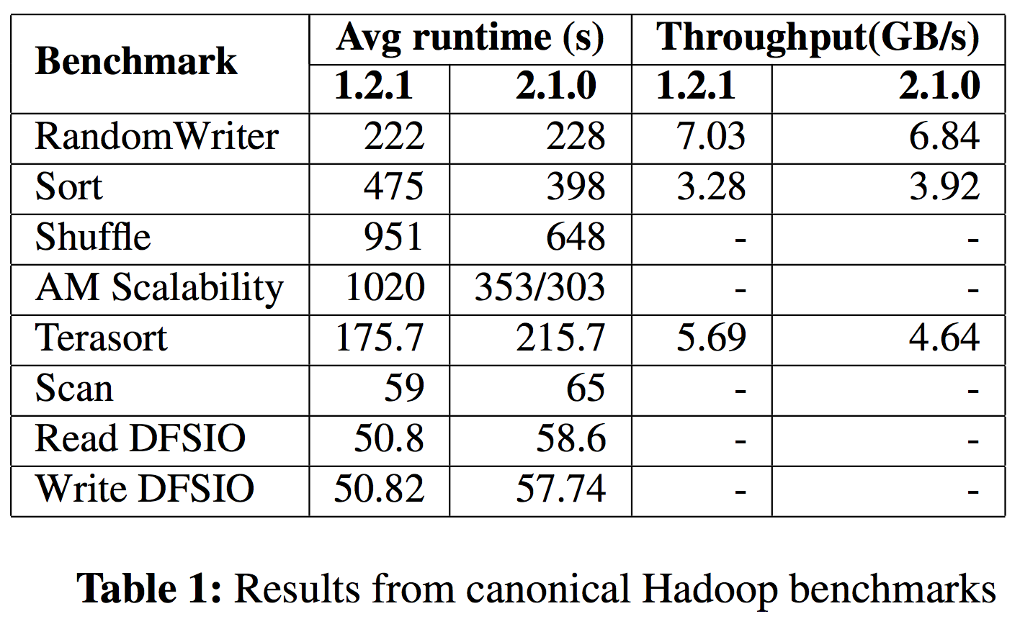
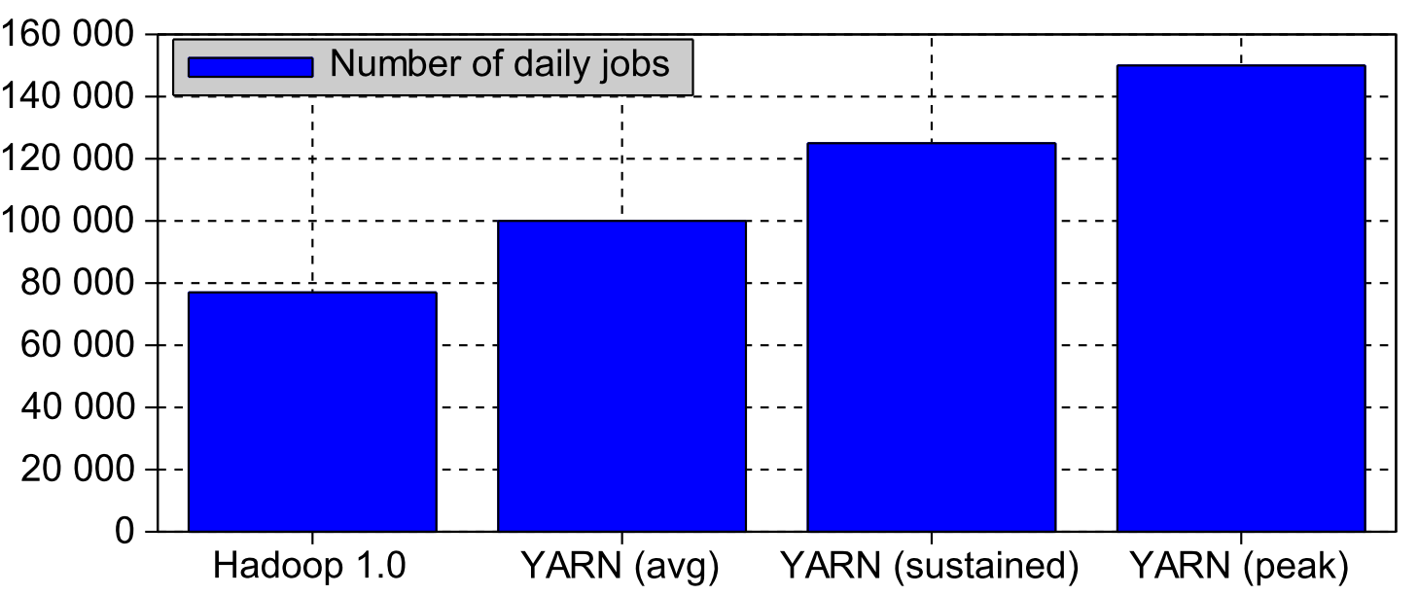
Evaluation: scalability
AM becomes scalable
Some benchmarks’ performance degrades

Slide 35
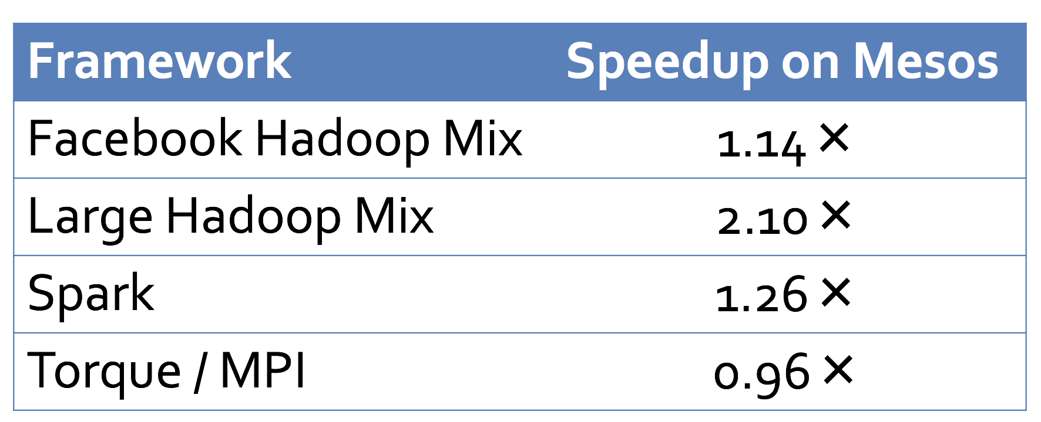
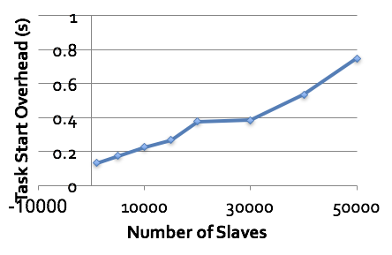
Evaluation: scalability in Mesos
Notes:
You can see where most of the frameworks are able to finish their jobs sooner when run on Mesos since they can occasionally get more than their fair share of the CPU. Torque, on the other hand, doesn’t accept more resources once it has reached its Safe Allocation
Mesos only performs inter-framework scheduling (e.g. fair sharing), which is easier than intra-framework scheduling.
Mesos scales up to 50000 nodes with 100K tasks.

Slide 36
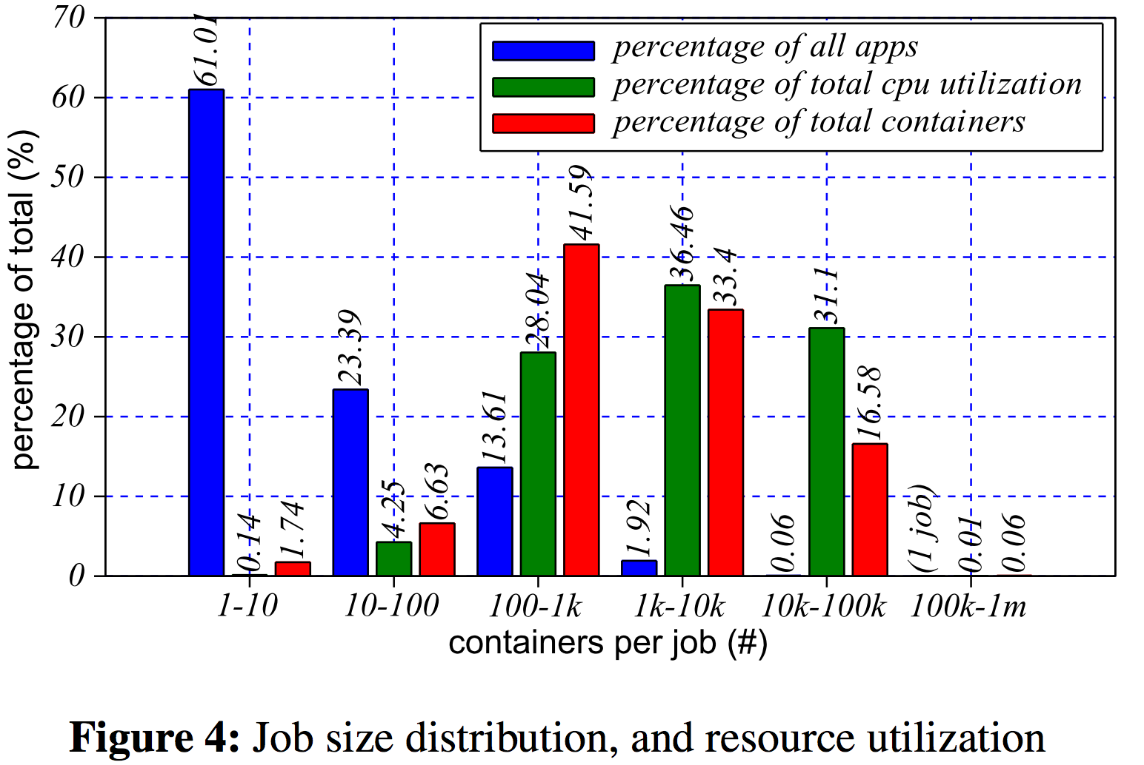
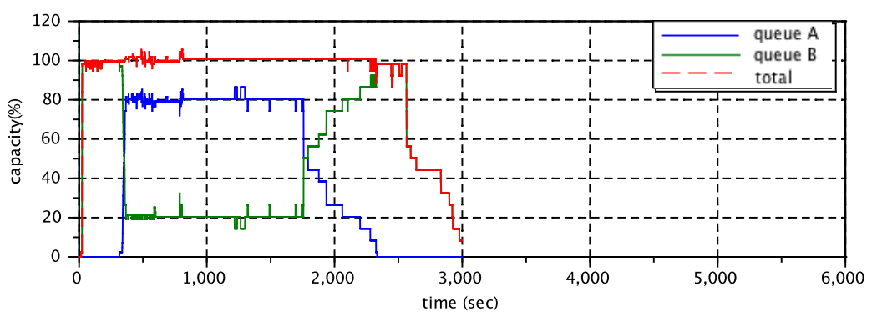
Evaluation: resource utilization
Higher utilization
Even above 100%!

Slide 37
THANK YOU

Slide 38

Questions?

