Slide 1
Scaling Distributed Machine Learning with the Parameter Server
Presented by Yifu Jin, Bochang Wang, Junding Wang

Slide 2
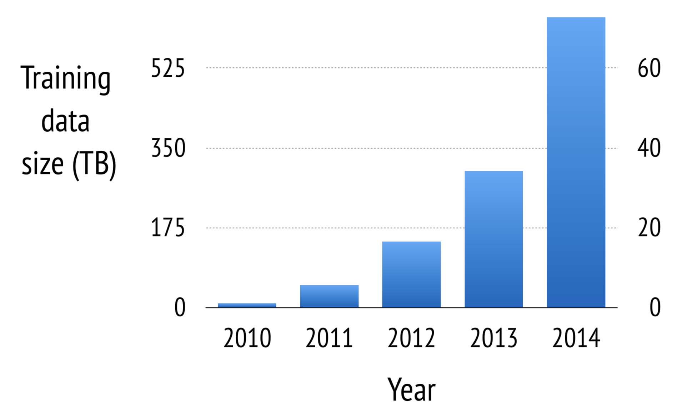
Why Need Parameter Server?
Growth of data and model complexity
--Intensive computational workloads
--Large volume of data communication
Notes:
no single machine could solve these problems sufficiently rapidly
So, we need distributed optimization method for Large Scale Machine Learning problems.
However, implementing an efficient distributed algorithm is not easy

Slide 3
Three Main Challenges
Enormous amount of network bandwidth is required.
Resulting barriers hurt the performance.
Fault tolerance is critical.
Notes:
large amount of training data and parameters
1.Accessing the parameters requires enormous amount of network bandwidth.
2.Many machine Learning algorithms are sequential, so the resulting barriers hurt the performance when the cost of synchronization and machine latency is high.
3.At large scale, fault tolerant is critical. Machines can be unreliable and jobs can be preempted.

Slide 4
Five Key Features
Efficient Communication
Flexible Consistency Models
Elastic Scalability
Fault Tolerance and Durability
Ease of Use
Notes:
1. Efficient communication. (Asynchronous communication model does not block computation & Reduce network traffic and overhead)
2. Flexible consistency models. (Hides synchronization and latency)
3. Elastic scalability. (New nodes can be added without restarting the running network)
4. Fault tolerance and durability. (Recovery from and repair of non-catastrophic machine failure within 1s, without interrupting computation.
5. Ease of use. (The globally shared parameters are represented as vectors and matrices, facilitate development of machine learning applications.

Slide 5
Two Key Engineering Challenges
Communication
Key-value pairs are inefficient.
Overhead of sending each update is high.
Fault tolerance
It must not require a full restart of a long-running computation.

Slide 6
Solution
Communication
At each logical time, a part of the object is updated.
Send a segment of a vector, or an entire row of the matrix.
Batch both the communication of updates and their processing
Fault tolerance
Support hot failover.
Failover and self repair in turn support dynamic scaling.

Slide 7
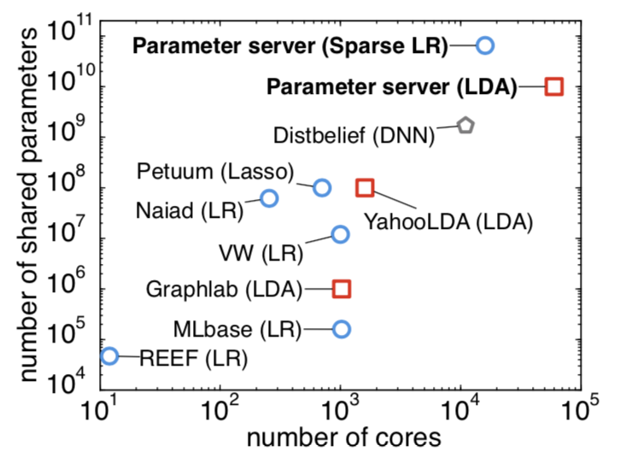
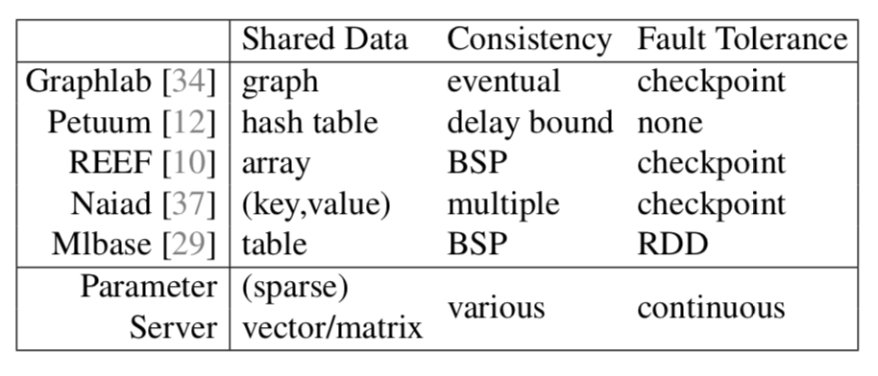
blue circles — sparse logistic regression
red squares — latent variable graphical models
grey pentagons — deep networks
Notes:
BSP: board support package

Slide 8
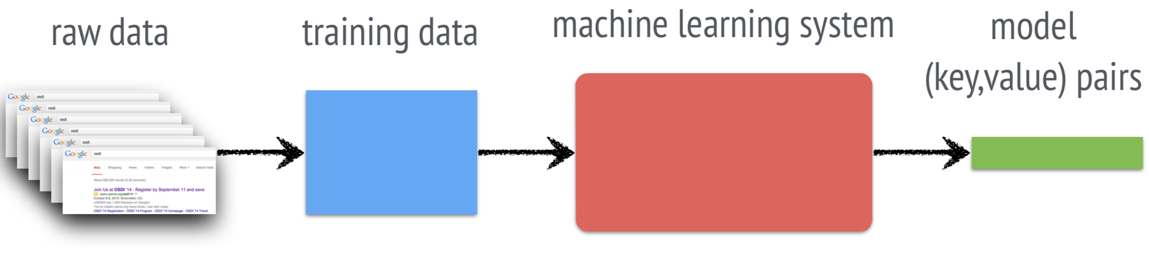
Machine Learning
Feature extraction
Objective function
Learning

Slide 9
Goals
Minimize this objective function to obtain the model
Training data may be extremely large.
Require enormous computing and bandwidth resources

Slide 10
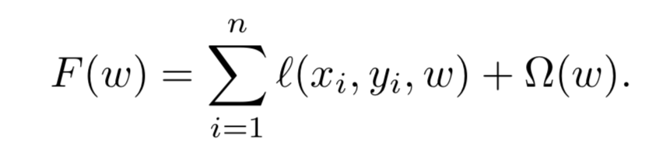
Risk Minimization
Overfit
Fail to capture relevant attributes of the data

Slide 11
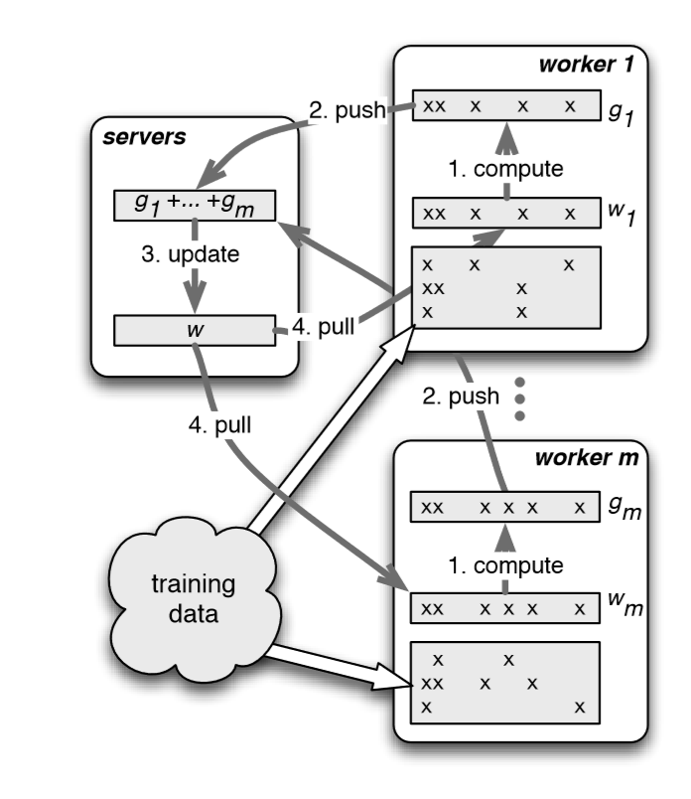
Steps
Training data is partitioned among all of the workers.
Jointly learn the parameter vector w

Slide 12
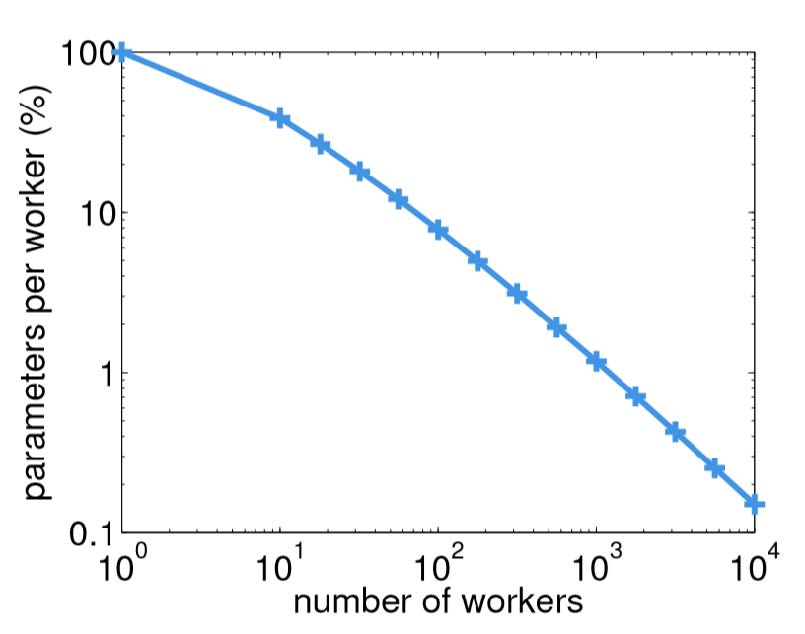
Workload distribution
100 workers, each worker only needs 7.8% of the total parameters
Overlap

Slide 13
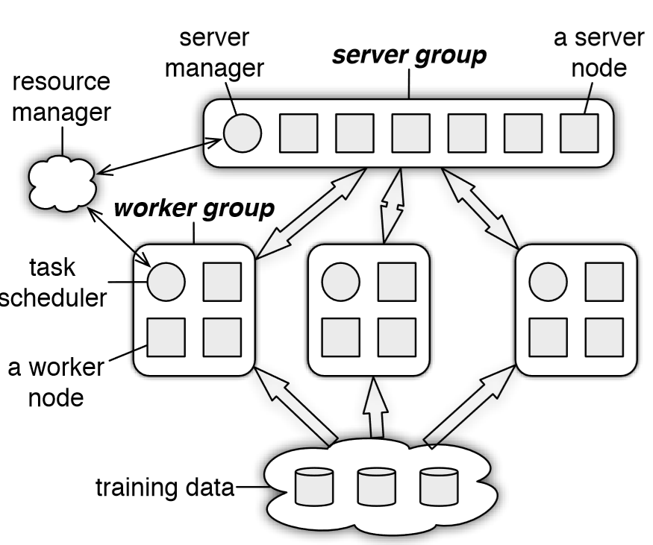
Architecture
server node
server manager node
worker node
scheduler node
Architecture of a parameter server communicating with several groups of workers
Notes:
Parameter server nodes are grouped into a server group and several worker groups.
A server node in the server group maintains a partition of the globally shared parameters.
A server manager node maintains a consistent view of metadata of the servers.(liveness, assignment of parameter partition, etc)
A worker node typically stores a portion of the training data to compute local statistics such as gradient. It only communicates with the server nodes, updating and retrieving the shared parameters.
A scheduler node in each worker group assigns tasks to workers and monitors their progress.
The parameter server supports independent parameter namespaces, as we may use more than one worker group to solve deep learning applications to increase parallelization.

Slide 14
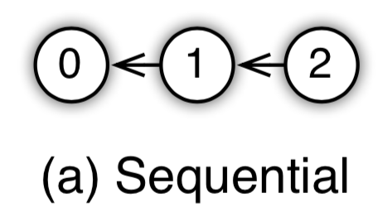
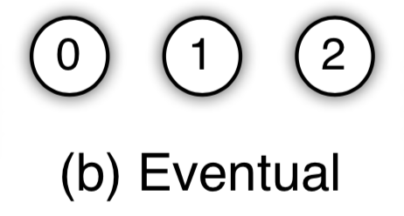
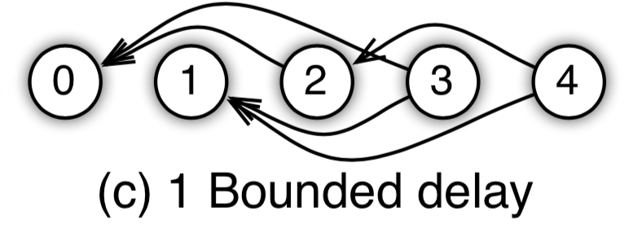
Architecture
(Key,Value) Vectors
Range push and pull
User-defined functions on the server
Asynchronous tasks and dependency
Flexible consistency
User-defined filters
Notes:
key-value vector. The shared parameters are presented as (key,value) vectors to facilitate linear algebra operations.
range push and pull Data is sent between nodes using push and pull operations. The parameter server optimizes these updates for programmer convenience, and computational and network bandwidth efficiency by supporting range- based push and pull. This can help us save memory and also enjoy the optimization.
user-defined functions on the server server nodes can execute user-defined functions. It is beneficial because the server nodes often have more complete or up-to-date information about the shared parameters.
asynchronous tasks and dependency Tasks are executed asynchronously: the caller could compute further immediately after issuing the task. For the dependency, we could place different types of dependency to the tasks, like execute-after-finished.
flexible consistency We need to make the best trade-off between system efficiency and algorithm convergence rate.
In sequential consistency, all tasks are executed one by one. Eventual consistency is the opposite: all tasks may be started simultaneously. For Bounded delay, a new task will be blocked until all previous tasks τ times ago have been finished.
user-defined filters the parameter server supports user-defined filters to selectively synchronize individual (key,value) pairs, allowing fine-grained control of data consistency within a task.

Slide 15
Implementation
Vector Clock
Messages
Consistent Hashing
Replication and Consistency

Slide 16
Implementation
Vector Clock
Naive Implementation
A separate vector clock needed for each parameter in w
W = (w1, w2, …, wm)
Node
Node
VC(w1) = 25
VC(w2) = 12
VC(w3) = 25
VC(w4) = 25
VC(w5) = 12
…
VC(wm) = 43
Node
O(mn)
n nodes
Notes:
VC generates a partial ordering of events in a distributed system and detecting causality violations
Here it can used to track the status of aggregation and reject duplicate messages
Every Work node will maintain a record of VC for its own purpose
This is a example of a naive way of implementation, where server node has a VC for all wi in W, which is space consuming and could take more time in communication
There is an example of VC(w) , example will be used later
Parameter Vector are long
The space needed in each node is O(m) and total space consumption is O(mn)

Slide 17
Implementation
Vector Clock
Optimized Implementation
A separate vector clock used for all parameters in one key range R
R1, R2, R3… Rk
R1 = (w1, w3, w4)
Node
Node
VC(R1) = 25
VC(R2) = 12
VC(R3) = 43
Node
O(nk)
Notes:
Since parameters are organized with key range, we thereby use VC of Key Range to represent VC of parameters
The example shows VC(R1)
Complexity has been reduced

Slide 18

Implementation
Messages
Key Range based message
A message can be split by the key range
Key Range
Key : Value
Key : Value
Key : Value
Key : Value
Key : Value
Notes:
Key range based trans
Example of a message in parameter server

Slide 19
Implementation
Messages
Key Range based message
A message can be split by the key range
Key Range
Key : Value
Key : Value
Key : Value
Key Range
Key : Value
Key : Value
Notes:
How to split the ranges? A range could be split into at most 3

Slide 20
Implementation
Messages
Cache key list
receiver node to cache the key lists
Receiver
Node
Key Range
key
list
Notes:
A long key list brings problem. If it’s million parameters long then we use too much bandwidth to communicate

Slide 21
Implementation
Messages
Cache key list
receiver node to cache the key lists
Receiver
Node
Key Range
hash
hash
map
Notes:
Use a hash to make life easier

Slide 22
Implementation
Messages
Send impactful values only
Zero values could be the majority in a parameter vector
Only non-zero values will be sent to receiver
User-defined filters could help
Key : Value
Key : Value
Key : Value
Sent
Key : 0
Key : 0
Key : 0
Key : 0
Ignored
Key : 0
Key : 0
Key : 0
Key : 0
Key : 0
Notes:
L1 norm could make parameters sparse. Karush–Kuhn–Tucker (KKT) first derivative test
Values could become and remain zero ever after a few iterations, or become stable and will not affect on model update

Slide 23
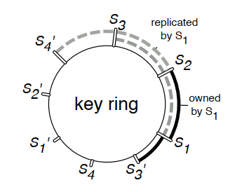
Implementation
Consistent Hashing
hash ring
Each server node manages the key range starting with its insertion point to the next point by other nodes in the counter-clockwise direction
Each server node stores a replica of the k counterclockwise neighbor key ranges relative to the one it owns
Notes:
Some topics about distributed hash table (DHT)
How is the hash ring used? Use circle to represent key ranges
Why ring? Adding or deleting a node doesn’t hurt much
S1 is the master of s1-s2, and is the slave of s2-s3 and s3-s4’
A key range is replicated k times. Not replicating server here

Slide 24
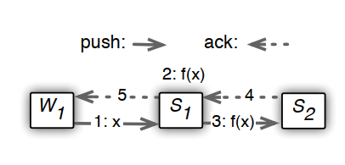
Implementation
Replication
Replication among servers
modification on the master is chain-replicated with its timestamp to the slaves synchronously
Notes:
sync replication, which is slow. When # of parameters grows, the chain replication could be the bottleneck

Slide 25
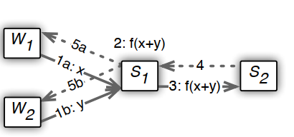
Implementation
Replication
Replication among servers
modification on the master is chain-replicated with its timestamp to the slaves synchronously
replication functions are called after aggregation
Notes:
To accelerate replication, only replicate after aggregation. If server will update N parameters in one iteration and replicate N times originally , then it will need to use chain replication only one time.

Slide 26
Implementation
Server Management
Server Addition
The server manager assigns the new node a key range to serve as master. This may cause another key range to split or be removed from a terminated node.
The node fetches the range of data to maintains as master and k additional ranges to keep as slave.
The server manager broadcasts the node changes. The recipients of the message may shrink their own data based on key ranges they no longer hold and to resubmit unfinished tasks to the new node
Notes:
How to insert node

Slide 27
Implementation
Worker Management
Worker Addition
The task scheduler assigns W a range of data.
This node loads the range of training data from a network file system or existing workers. Training data is often read-only, so there is no two-phase fetch. Next, W pulls the shared parameters from servers.
The task scheduler broadcasts the change, possibly causing other workers to free some training data

Slide 28
Implementation
Worker Management
Worker Removal
The task scheduler may start a replacement
The task scheduler may not do the replacement
recovering a work node is expensive due to data amount
losing a small amount of data doesn’t matter much
- The indifferent scheduler could even cruelly murder slowest worker

Slide 29
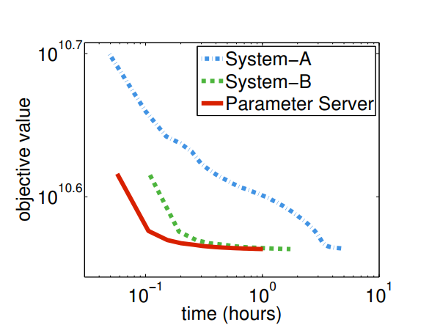
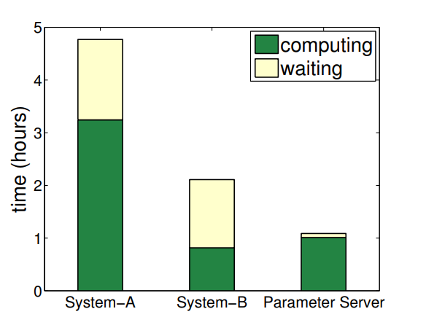
Evaluation
Sparse Logistic Regression
Faster convergence and higher utilization
636T data, 170 billions of example, 65 billions of features
Notes:
High utilization and fast convergence:
accelerate convergence time
increase utilization

Slide 30
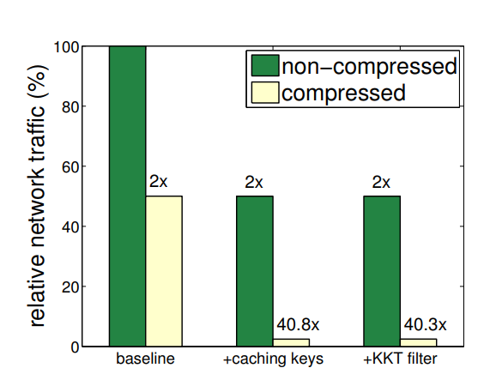
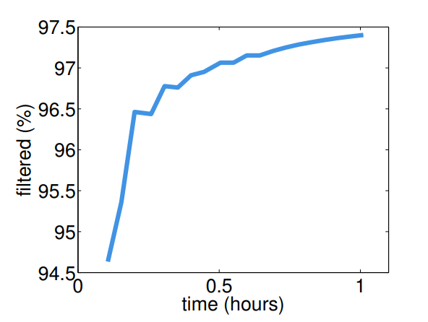
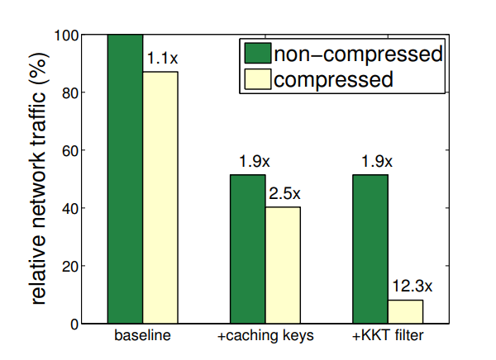
Evaluation
Sparse Logistic Regression
Reduced network traffic
Server
Worker
Notes:
most of parameters are filtered by KKT, thus improving performance
Caching keys also have effect on traffic

Slide 31
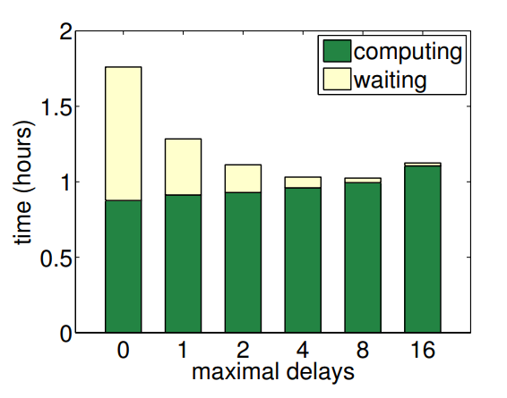
Evaluation
Sparse Logistic Regression
Effect of relaxed consistency
Notes:
trade off between high utilization and convergence rate

Slide 32
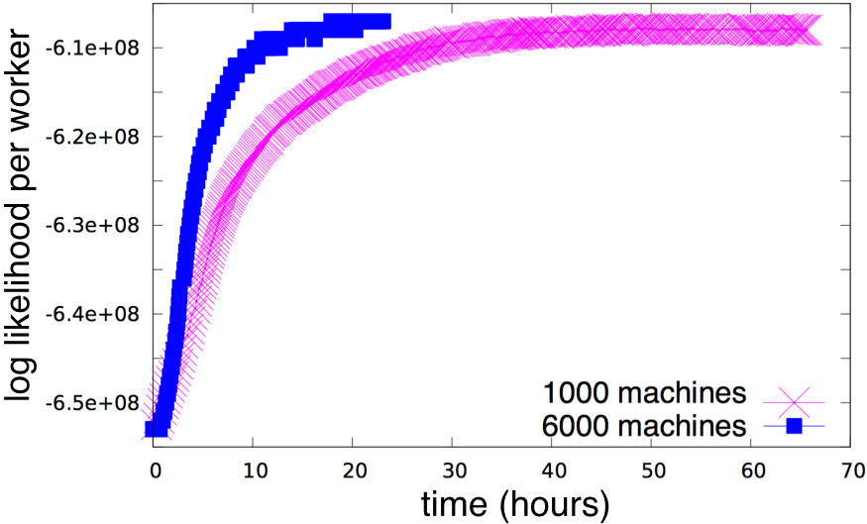
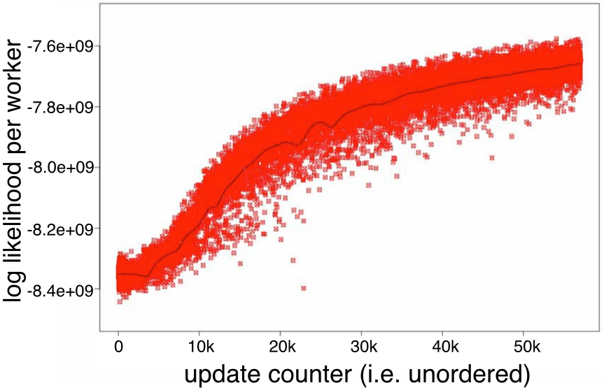
Evaluation
Latent Dirichlet Allocation
Nice speedup
4x faster when scaling 1000 machines to 6000

Slide 33
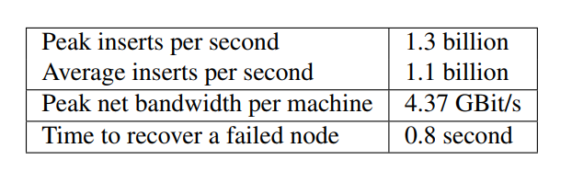
Evaluation
Sketches
High insert rates and fast recovery

Slide 34
Q&A
Any more questions?

Slide 35
STRADS: A Distributed Framework for Scheduled Model Parallel Machine Learning
Yifu Jin, Bochang Wang, Junding Wang

Slide 36
Model parallelism vs Data parallelism
Data parallelism prerequisite:
Most ML algorithms adopt i.i.d assumption on data (independent and identically distributed)
Model parallelism challenges:
The model parameters are not independent
Different model parameters may take different number of iterations to converge

Slide 37
Properties of ML algorithms
Model dependencies
Uneven convergence
Error-Tolerant
Notes:
Error-Tolerant offers us opportunities to partition parameters.

Slide 38
What is Model Parallelism?
A distributed system design for ML algorithms
Partitions the model parameters for non-shared parallel access and updates
Periodically repartitions the parameters to facilitate communication

Slide 39

Idea of Model Parallelism
A model parameters, t refers to current iteration, D input data, delta() the model update function, the schedule Sp() identifies a subset of parameters in A.

Slide 40
Schedule for model-parallel
Schedule affects effectiveness of a model-parallel method
Which parameters are updated in parallel
How they are prioritized

Slide 41
Metrics for effectiveness of ML algorithms
Key factor : convergence time
Progress per iteration
Iteration throughput
Notes:
We need trade-off for progress per iteration and iteration throughput.
Find the optimal schedule need a lot of time and is NP-hard within dependencies.

Slide 42
How to partition the parameters?
Ideal model parallel
Highest progress per iteration, but find ideal schedule(partition of parameters) is expensive
Random model parallel
No cost for finding the schedule, but pretty poor progress per iteration even failure
Approximate model parallel

Slide 43
Strategies for Approximate model parallel
Static Partition
Dynamic Partition
Pipelining (Complimentary)
Prioritization (Complimentary)

Slide 44
Static Partition
Definition : A fixed and hard-codes scheduled partition pre-defined beforehand.
Pros : Little cost to throughput Cons: Progress per iteration depends on how well the schedule matches the ML program’s dependencies.

Slide 45
Dynamic Partition
Definition : Select independent partition schedule via dependencies within a small number of parameters at different iterations.
Pros:
Achieve high progress per iteration
Cons:
Suffer from poor iteration throughput

Slide 46
Pipelining
s is the pipeline depth, A model parameters, t refers to current iteration, D input data, delta() the model update function, the schedule Sp() identifies a subset of parameters in A.
Pipelining allows the next iterations to start before the current one finishes, ensuring that computation is fully utilized.
Notes:
A complementary technique for partitioning
Pipelining allows the next iterations to start before the current one finishes, ensuring that computation is fully utilized.
Pipelining therefore sacrifices some progress per iteration to increase iteration throughput, and is a good way to raise the throughput of dynamic partition.
iterative convergence ML algorithms are self-correctness as they are robust with data-hazard.

Slide 47
Prioritization
Idea: modify schedule to prefer parameters that will yield the most convergence progress, while avoiding parameters that are already converged.
Metrics for potential progress :
cheap-but-effective approximations or heuristics to estimate the potential progress
Notes:
Prioritization thus improve progress per iteration at a small cost to iteration throughput.

Slide 48
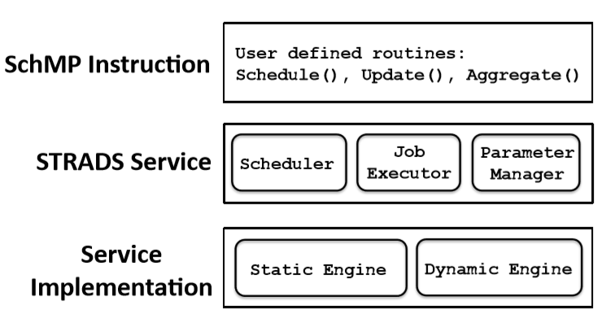
STRADS
Definition : STRADS is a framework to realize Scheduled Model Parallelism for ML algorithms

Slide 49
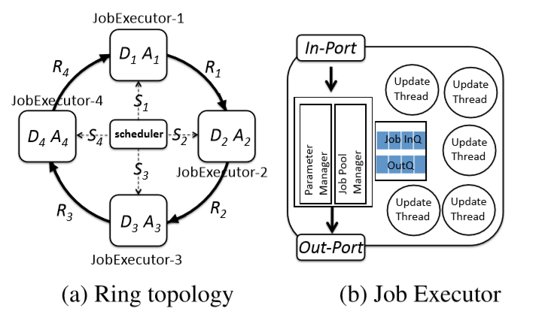
Static Engine

Slide 50
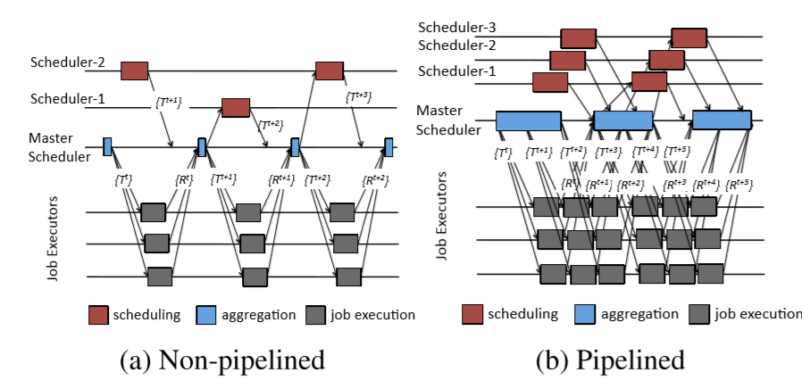
Dynamic Engine

Slide 51
Questions

