Slide 1

Spark SQL Relational Data Processing in Spark
Michael Armbrust†, Reynold S. Xin†, Cheng Lian†, Yin Huai†, Davies Liu†, Joseph K. Bradley†, Xiangrui Meng†, Tomer Kaftan‡, Michael J. Franklin†‡, Ali Ghodsi†, Matei Zaharia†∗
†Databricks Inc. ∗MIT CSAIL ‡AMPLab, UC Berkeley
SQL
Presenter: Fan Lai
EECS 598 – W19

Slide 2
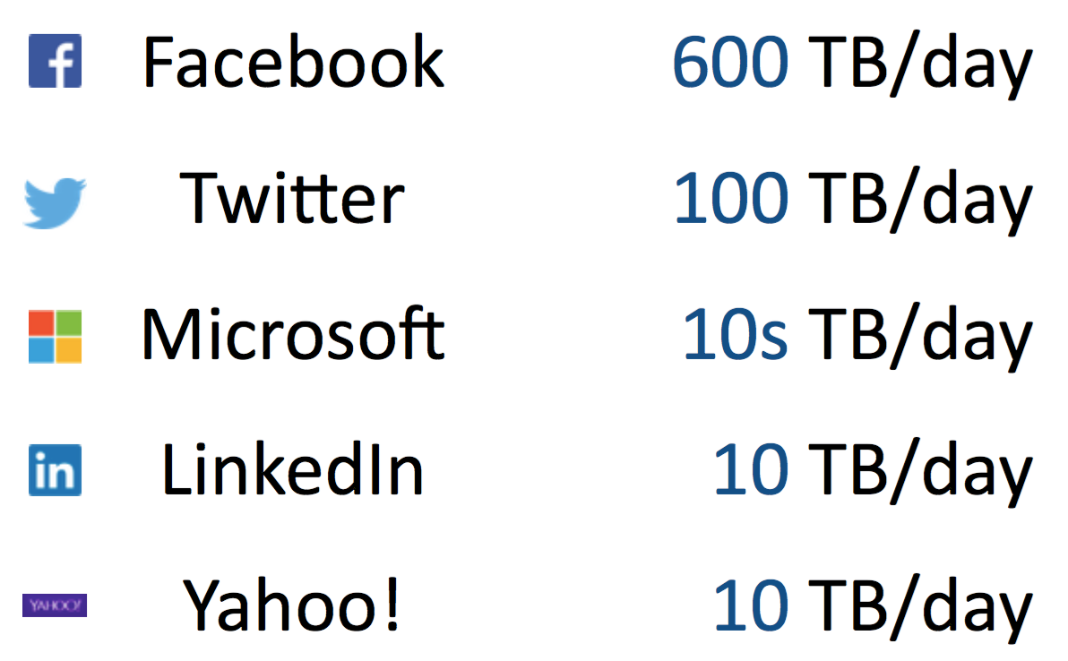
Background
Big data analytics
Massive data every day from IoT devices, cloud datacenters, …
A great variety of data formats
Efficient SQL for companies boosts revenues
Data-parallel processing is important
Fully utilize all the available resource
Avoid single point failures
Often built along Hadoop-based stack

Slide 3
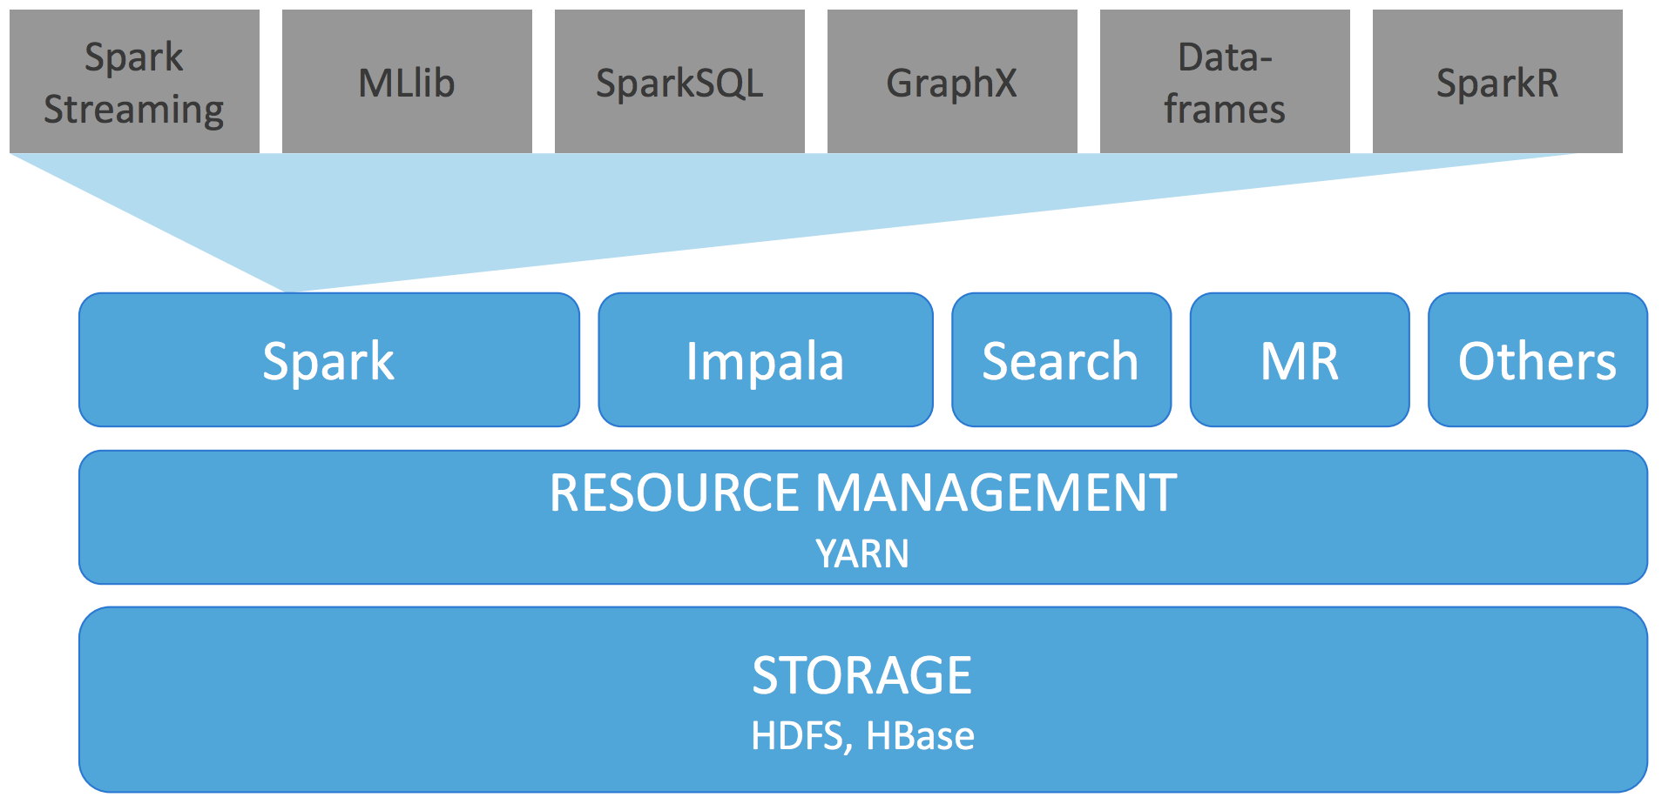
Big Data Stack
Orchestration of multiple layers
Application layer
Execution layer
Resource management layer
Data storage layer

Slide 4
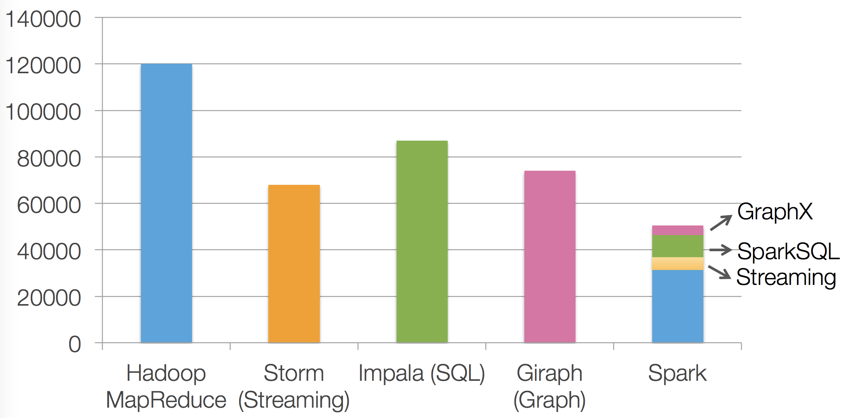

Spark as a Unified Engine
Generic data processing in a single engine to avoid migration cost
Data migration, program migration
Lines of Source Code
Shark: Spark Integration with Hive
Query external data in Hive catalog -> limited data sources, inconvenient
Hive optimizer tailored for MapReduce -> difficult to extend
[1] Adapted from Yin Huai, “Data Source API in Spark”

Slide 5
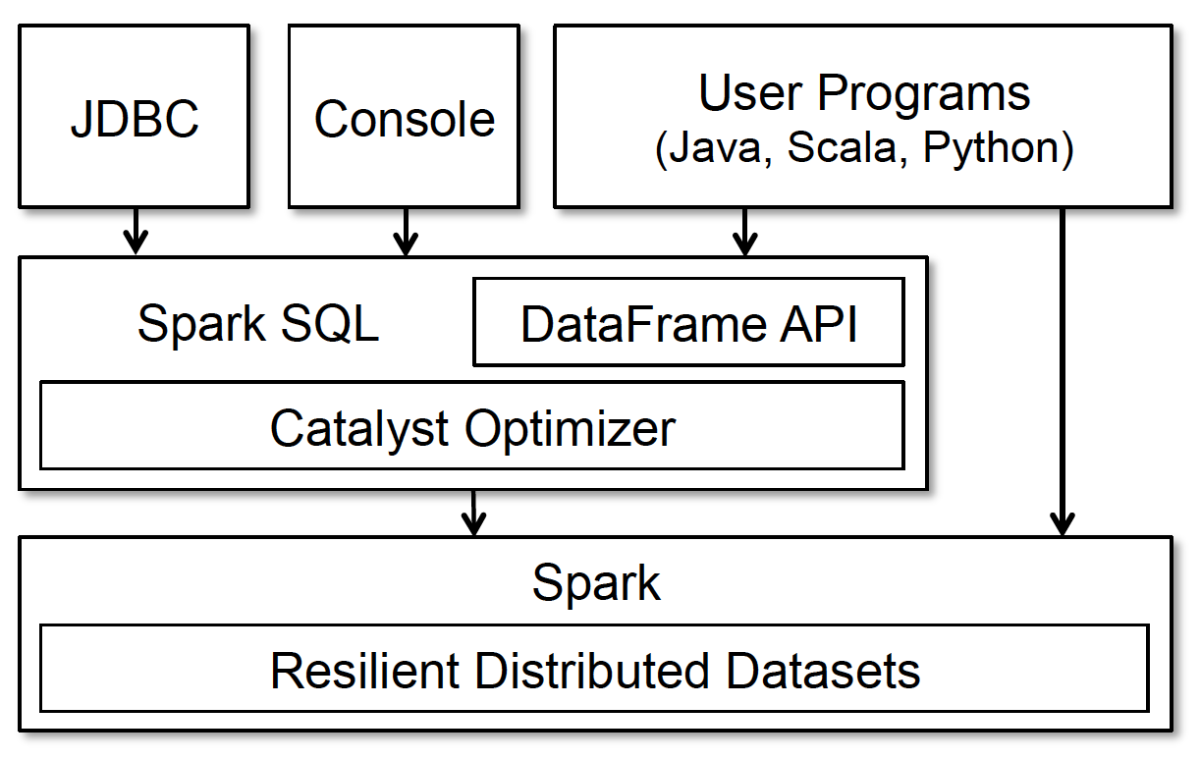
Challenges
Requirements in Design
Perform to and from various data sources
Relational and procedural processing should be compatible
Advanced analytics (e.g., ML) are difficult to express in relational systems
Implement SQL for Spark
In an extensible way
Solution: DataFrame API
In an efficient way
Solution: Catalyst optimizer
Accessible to JDBC/Console/Program

Slide 6
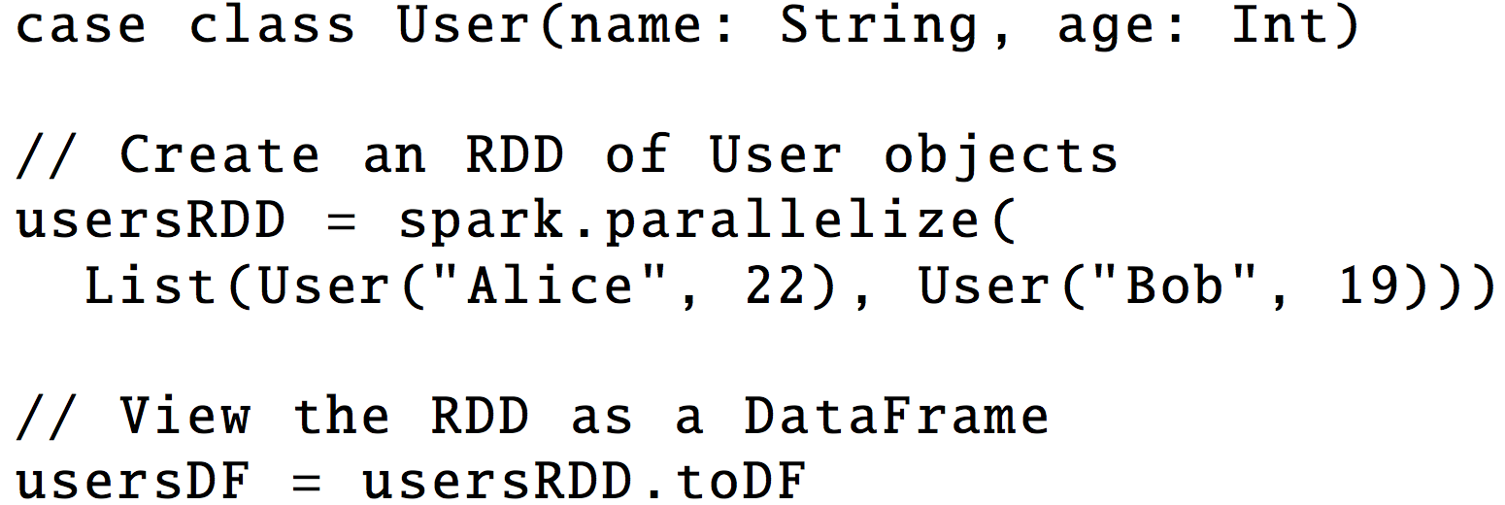
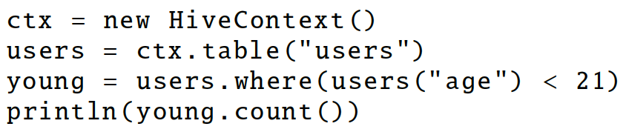
DataFrame (DF) ≈ Table in relational databases
Collections of structured records
Constructed from external tables or RDDs
Support In-memory caching
Support all major SQL data types (e.g., Boolean, Int …)
Evaluated lazily for (runtime) optimizations
No execution until output being called
Represent a logical plan of queries
Analyze logical plans eagerly to report invalid codes
Fig 1. DataFrames
Fig 2: Generate DF from RDDs

Slide 7
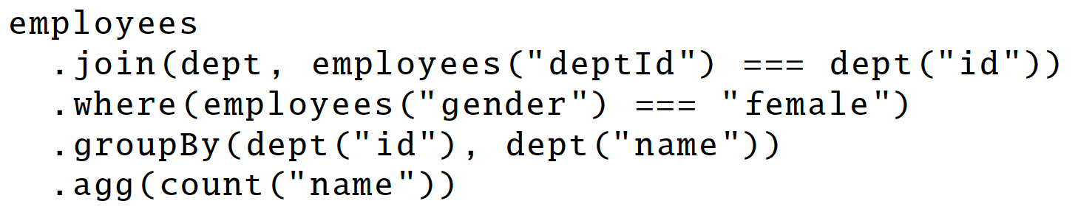
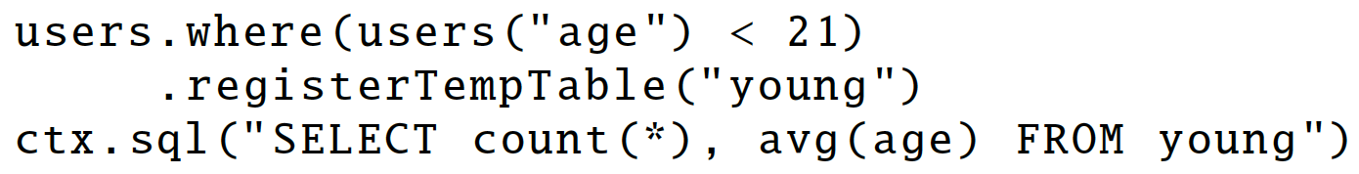
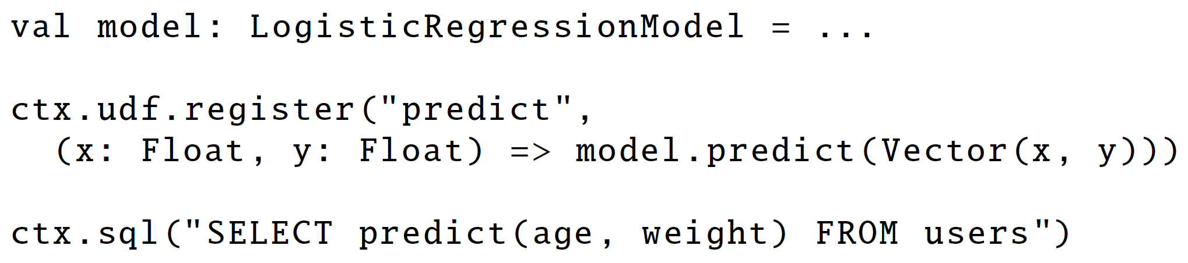
DataFrame (DF) Operations
Build up a abstract syntax tree (AST)
Support relational operations
filter, join, aggregations, …
DF as a temporary table
≈ table in relational databases
DF in advanced analytics
Support inline definition of UDFs
Fig 3
Fig 4
Fig 5

Slide 8
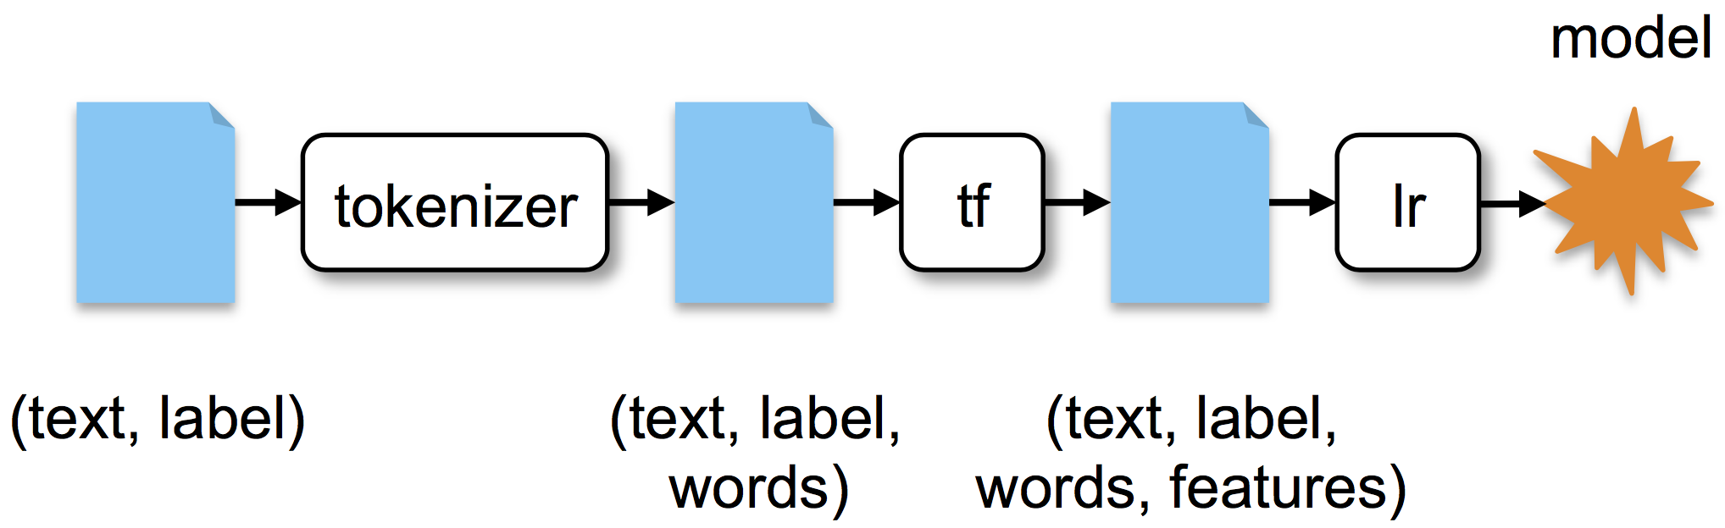
Apply DataFrame in SparkML
df = <DataFrame of (text, label) records> // input as DF
tokenizer = Tokenizer(inputCol="text", outputCol="words”)
hashingTF = HashingTF(inputCol="words", outputCol="features”)
lr = LogisticRegression.setInputCol(“features”)
// Define a Graph of transformation on data
pipeline = Pipeline(stages=[tokenizer, hashingTF, lr])
model = pipeline.fit(df)
Fig 6. A sample ML pipeline
Fig 7. Corresponding Work Flows

Slide 9
Catalyst: An extensible Query Optimizer
Convert logical plan to Java bytecode on spark
DataFrames represent logical plans
Catalyst contains a lib for representing syntax trees and applying rules
Rule-based optimizer and cost-based optimizer
Analysis, logical optimization, physical planning, code generation
Analysis
Logical
Optimization
Physical
Planning
Code
Generation
SQL AST
Unresolved Logical Plan
Optimized Logical Plan
Selected Physical Plan
Logical Plan
Physical Plans
Cost Model
RDDs
DataFrame
Catalog
Fig 8. Phases of query processing

Slide 10
Analysis in Catalyst
Unfold unresolved(unknown) attributes or relations
Catalog tracks the tables in data sources
Catalyst looks up attributes from catalog
Propagate types through expressions
Unresolved Logical Plan
Analysis
Logical Plan
Catalog
Add
x + (1+2)
Attribute(x)
Add
Literal(1)
Literal(2)
Fig 9: Catalyst tree for expression x + (1+2)

Slide 11
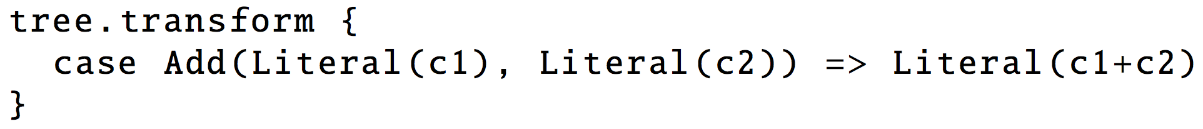
Planning in Catalyst
Logical Optimization
Apply standard rule-based optimizations to logical plans
Iteratively transform subtrees via pattern matching
E.g., constant folding, null propagation, …
Logical
Optimization
Logical Plan
Optimized
Logical Plan
Add
Add
Attribute(x)
Add
Attribute(x)
Literal(3)
Literal(1)
Literal(2)
Fig 9: Catalyst tree for expression x + (1+2)

Slide 12
Physical Planning in Catalyst
Physical Planning
Generate one/more physical plans using physical operators
Select a plan after cost-based optimizations
E.g., optimize join operations
Physical Planning
Optimized Logical Plan
Selected Physical Plan
Physical Plans
Cost Model
Code Generation
Generate Java bytecode to run on machines
Feed the syntax tree to the Scala compiler at runtime
Selected Physical Plan
RDDs
Code
Generation

Slide 13
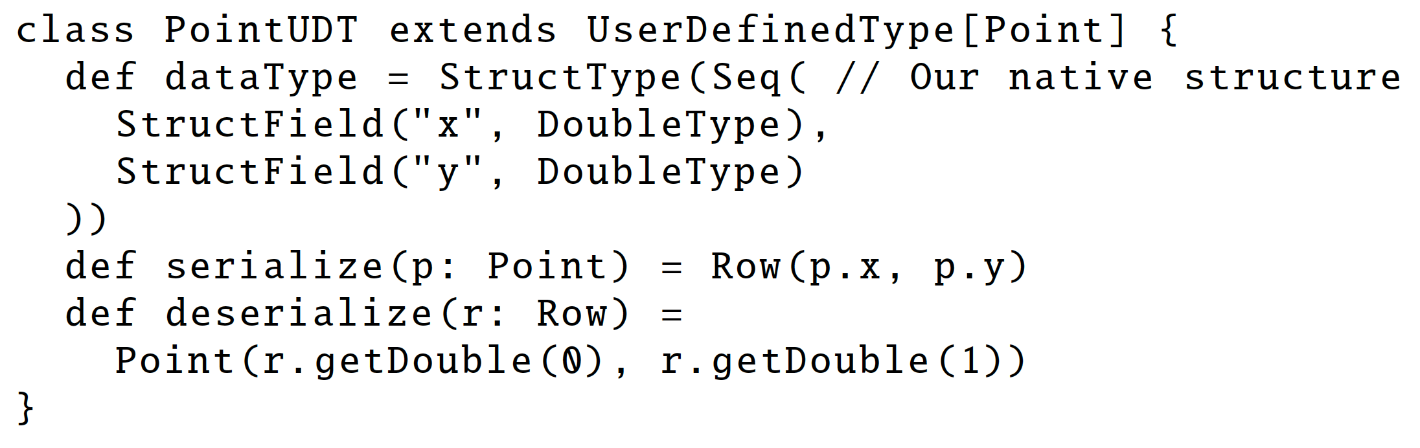
Catalyst’s Support for User-defined Funcs
User-defined Data Sources
Users can define new data sources with APIs
Can expose data locality information
E.g., CSV, Avro, Parquet, JDBC
User-Defined Types
Map user-defined types to structures composed of Catalyst’s built-in types.

Slide 14
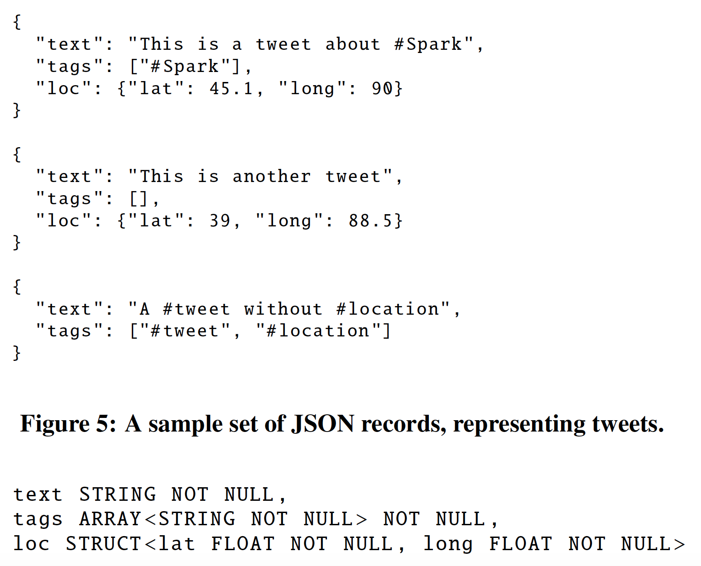
Better Support for Data Sources
Schema inference for semistructured data
Automatically infers schema (data types) from records
Pass over the records, pick the most appropriate type
Schema
Inference
Fig 9. Schema inferred JSON records

Slide 15
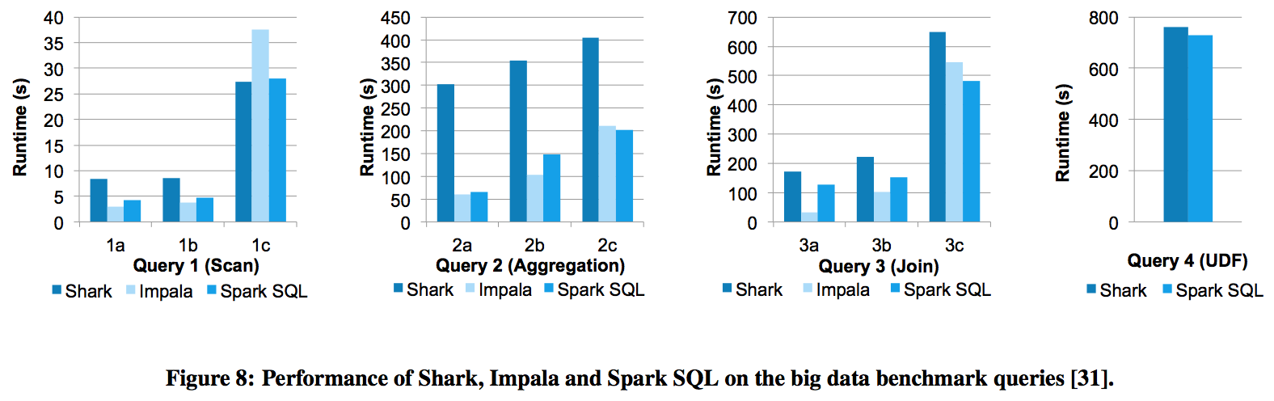
SQL Performance
Setting:
6 nodes
110 GB big data benchmarks
4 Queries
SparkSQL is faster than Shark
Optimizations in Catalyst, DataFrame, …
SparkSQL is competitive with Impala
Query plan matters (3a)

Slide 16
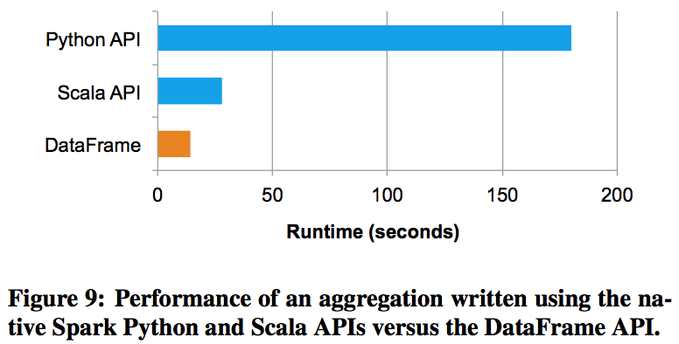
DataFrames (DF) vs. Native Spark Code
Benchmark
Compute the avg (b) for each a in 1 billion (a, b) pairs -> df.groupBy(“a”).avg(“b”)
Python is typically slower than the JVM
DF benefits from code generation to avoid allocations of key-value pairs

Slide 17
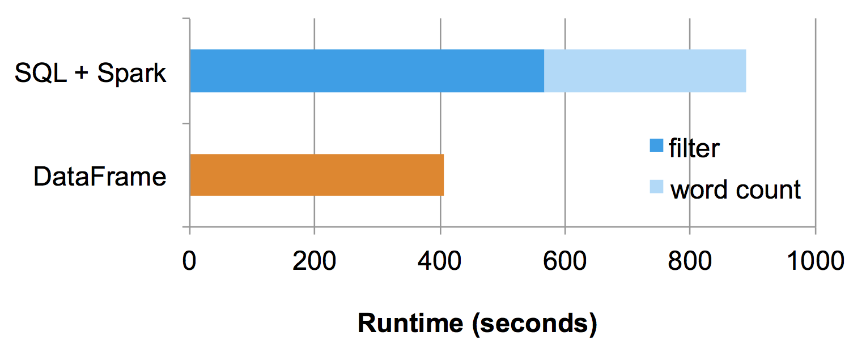
DataFrames in Pipeline Performance
Benchmark: Select a subset of text and compute the word frequency
SQL + Spark: a separate SQL query followed by a Spark job
Filter: relational processing
Word count: procedural processing
DataFrame: avoid the cost of flushing data to HDFS
Pipeline the word count with the rationale operators for the filtering

Slide 18
Discussion
SparkSQL: a SQL service atop the unified execution engine (Spark)
DataFrame API allows relational processing
Data pipelines that mix relational and procedural processing
Cons:
Not many impressive contributions
Evaluations are too thin
Few benchmarks
What’s your opinion?

Slide 19
Impala A Modern, Open-Source SQL Engine for Hadoop (CIDR’15)
Marcel Kornacker, Alexander Behm, Victor Bittorf
Cloudera
Presenter: Fan Lai
EECS 598 – W19
Notes:
Now, let’s turn to another execution engine, impala, which is designed for efficient query processing. This work is from cloudera.

Slide 20
Impala: General-purpose SQL Engine
Fast
Support interactive business service and analytical workloads (ms ~ hours)
Written in Java and C++
Runtime code generation
Flexible to support multiple
Storages (e.g., HDFS, S3)
File formats (e.g., CSV, Avro)
User workloads
Notes:
In the last section, we have discussed spark-sql, an execution framework atop spark engine. Here, impala itself is a new execution engine, which is not based on mr. It targets at efficiency and flexibility. First… .
To achieve great efficiency,

Slide 21
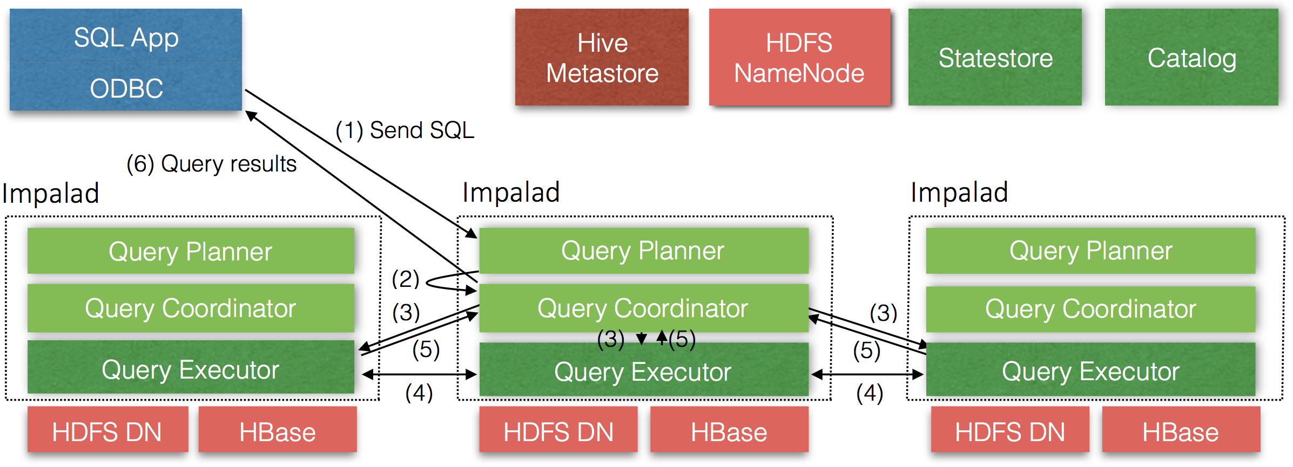
Impala Overview
Impala Daemon: Handle client requests and orchestrate executions
Statestore Daemon: Disseminate cluster-wide metadata to Impala daemons
Catalog Daemon: Manage catalog repository and metadata
Frontend
Notes:
In Impala design, it is a high parallel system, and its design is comprised of three services. Say the impala daemon on each node. A centralized statestore daemon, and a centralized catalog daemon.

Slide 22
Impala Frontend
Frontend is responsible for query optimizations (in Java)
Query parsing, semantic analysis, and query planning/optimization
2 Phases Query Planning
Phase 1: Generate a single node plan
Parse a query into a tree of plan operators (e.g., scan, join)
Phase 2: Convert single node plan into distributed execution plan
Generate plan fragments for distributed execution
Minimize data movements, maximize data locality
Notes:
Now, let’s start with the

Slide 23
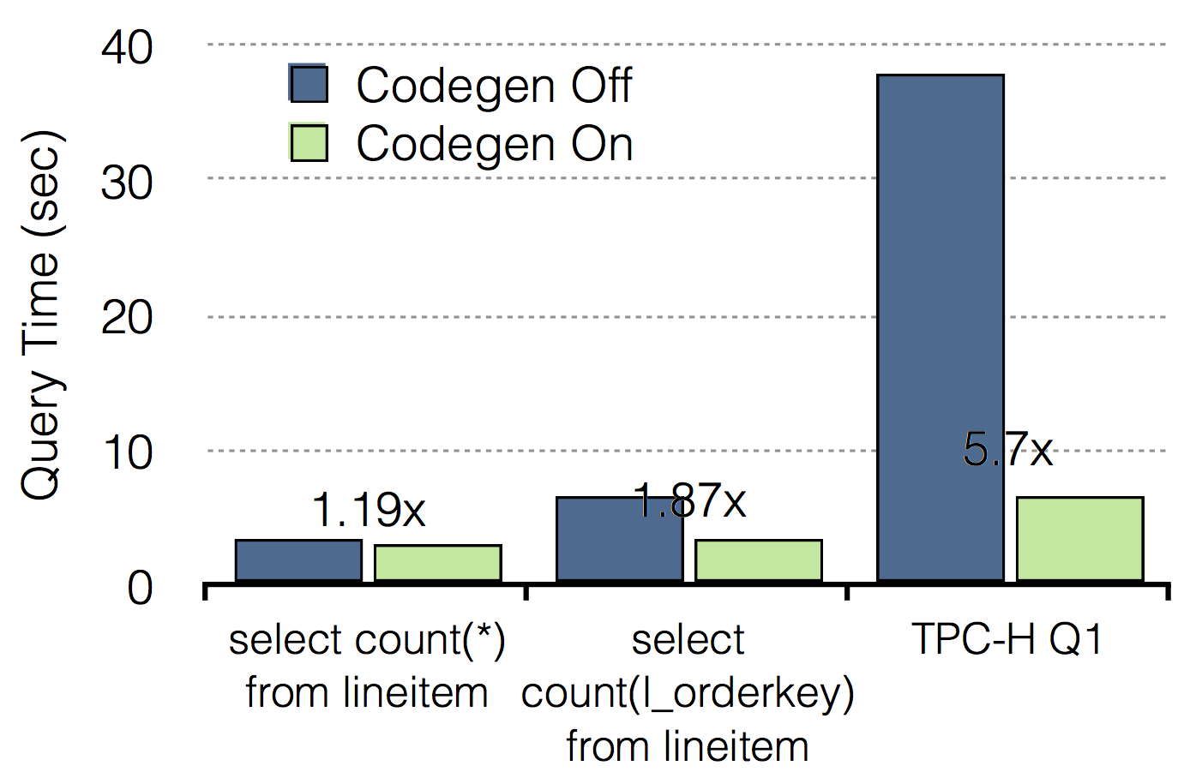
Impala Backend: Distributed In-memory execution
Backend is responsible for the execution of query fragments
Written in C++, not based on MapReduce
Runtime Code Generation
LLVM enables just-in-time compilation w/ runtime information
E.g., eliminate branches, unroll loops,…
Pipelined backend execution
Spill working sets to disk if needed
Notes:
After receiving the plan fragments,

Slide 24
Enhancement of Resource Management
Resource management should be low-latency and scalable
Decentralized admission control on requests
Impala daemons make decentralized admission decisions
Requests are admitted/queued/rejected based on resource-pool limits
Can result in exceeding limits due to asynchronous views
However, state is typically updated faster than non-trivial queries
Llama: to mitigate YARN overhead
Llama caches a resource pool specialized for Impala
Llama isolates resource requirements from mixed workloads (MR, Spark…)
Llama directly allocates resource when having enough cached resource
Notes:
Apart from the optimizations of engines, Impala also tries to improve the resource management to support low-latency and scalable resource scheduling.
Impala introduce a cached resource pool for impala.

Slide 25
Impala as a whole
Optimizations of the execution engine
Highly-parallel Impala daemons
LLVM code generation, C++
Optimizations of the resource management
Decentralized admission control
Llama
Notes:
Apart from the optimizations of engines, Impala also tries to improve the resource management to support low-latency and scalable resource scheduling.
Impala introduce a cached resource pool for impala.

Slide 26
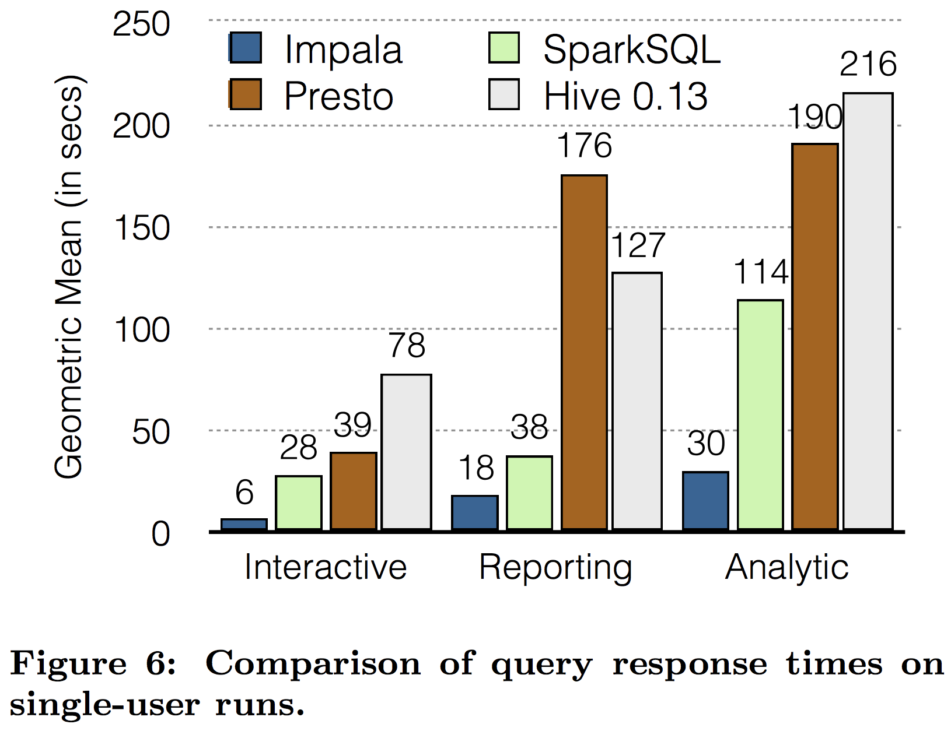
Eval: Single Query Performance
Setting:
21 Nodes, 6 CPUs/node
15 TB TPC-DS
Classify 99 sqls into 3 bins
Interactive, reporting, analytic sqls
Impala has much lower response
9x better than Hive
7.5x better than Presto

Slide 27
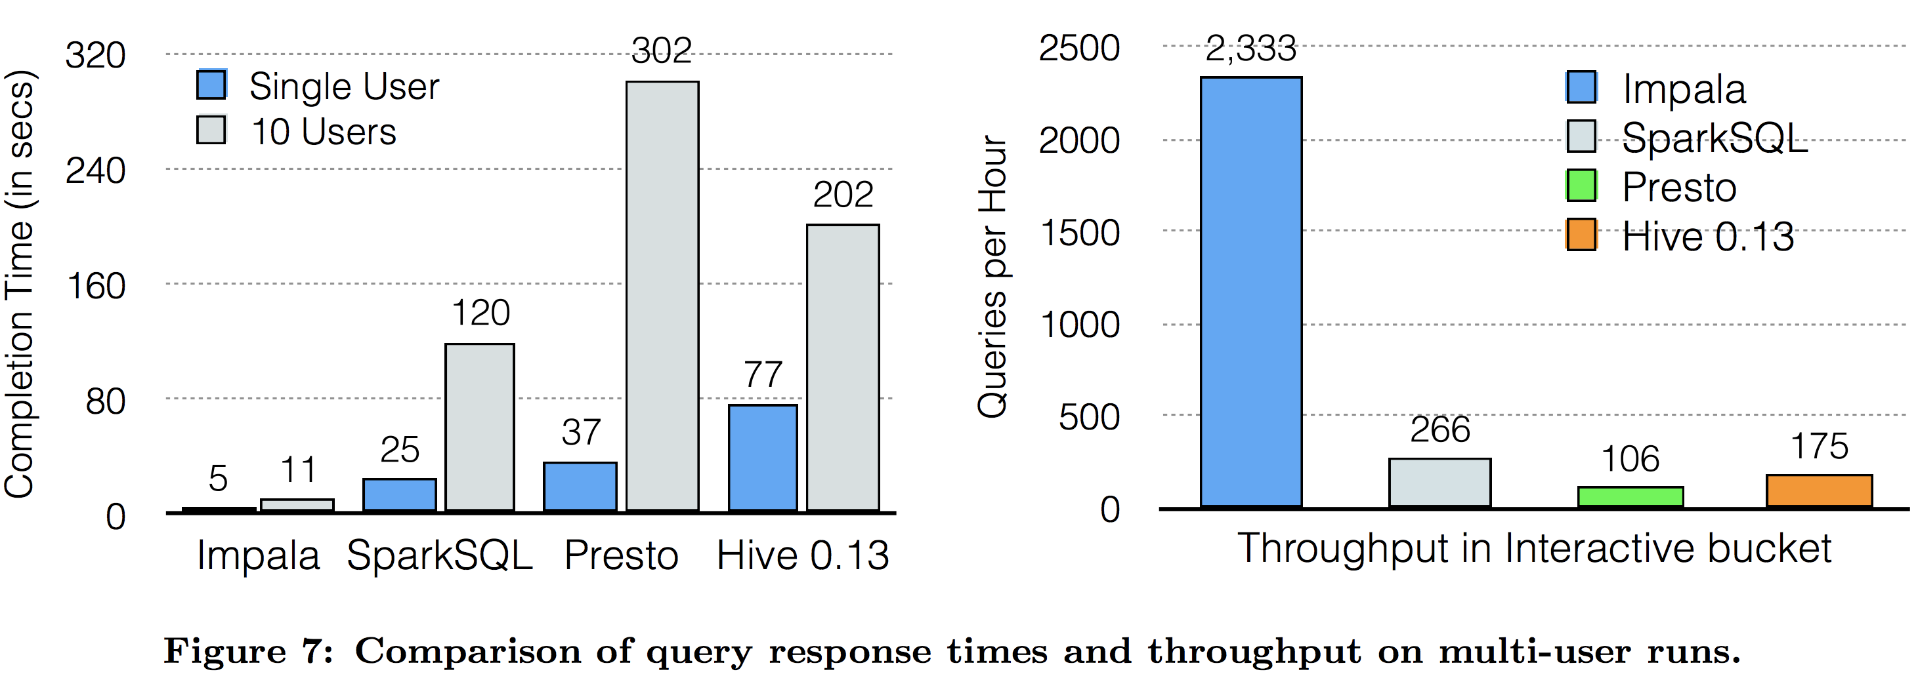
Eval: Mutli-User Performance
10 concurrent users submit interactive queries
Low completion time, high throughput
Notes:
As we know that OpenCL is an open standard for programing heterogeneous computing systems,
and these systems are becoming more and more popular in the Top500 list.
People are putting accelerators like GPU/Xeon PHI into they supercomputers
because these accelerators deliver better performance and energy-efficiency

Slide 28
Discussion
Evaluations are too subjective
SparkSQL is comparable to Impala? Impala is better than SparkSQL?
No breakdown evaluations
Different code generation techniques/query plans/languages (Java vs. C++)!
Any ideas?
Notes:
Now, we have discussed these two execution services.

Slide 29
Discussion
Source: DB-Engines, January 2017 http://db-engines.com/en/ranking
Notes:
Now, we have discussed these two execution services.

Slide 30
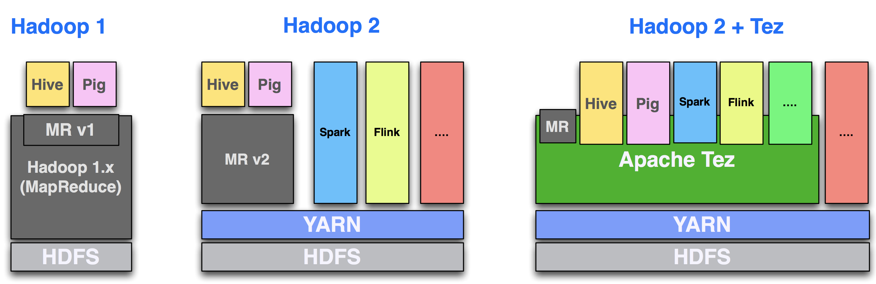
Evolution of Hadoop

Slide 31
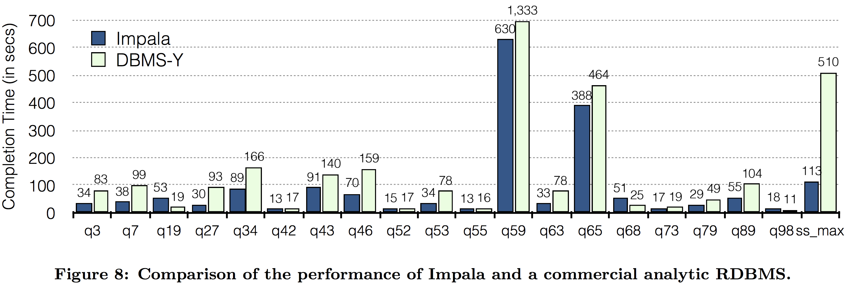
Impala Overview
Notes:
As we know that OpenCL is an open standard for programing heterogeneous computing systems,
and these systems are becoming more and more popular in the Top500 list.
People are putting accelerators like GPU/Xeon PHI into they supercomputers
because these accelerators deliver better performance and energy-efficiency

Slide 32
Catalyst Optimizer
Convert logical plan to physical plan
An extendable scheduler
HiveQL
SparkQL
DataFrame DSL
Hive Parser
Spark Parser
DataFrame
Catalyst
RDD codes
Notes:
As we know that OpenCL is an open standard for programing heterogeneous computing systems,
and these systems are becoming more and more popular in the Top500 list.
People are putting accelerators like GPU/Xeon PHI into they supercomputers
because these accelerators deliver better performance and energy-efficiency

