Slide 1
Big Data Analytics Using GFS and MapReduce
Mosharaf Chowdhury

Slide 2
The Problem
GFS
MapReduce
Store large amounts of data
Efficiently
With fault-tolerance
In a scalable manner
Process large amounts of data
Efficiently
With fault-tolerance
In a scalable manner

Slide 3
Common Assumptions
Failures are the norm
High concurrency is of utmost importance
Batch processing
Throughput is preferred over latency
Co-designing increases flexibility
Allowed to make assumptions impossible in a general solution

Slide 4
Symbiosis Between Storage and Compute
How we store data often dictates how we can operate on them
How we want to interact with data dictates how we store them
But it’s all about the workload!
What type of data
What we do with the data

Slide 5
What was the Workload?
Modest number of huge files
A few million 100 MB or larger files
Files are write-once, mostly appended to
Some are never read again (aka, cold data)
Large streaming reads
High sustained bandwidth (throughput) is favored over low latency
NOT user-facing

Slide 6
File System is the Narrow Waist of the Big Data Stack
Sits between hardware and applications, and connects them
Both hardware and applications can change as long as the file system in between remains the same
or provides the same interface
Similar to the IP protocol in the computer networking stack!

Slide 7
Agenda
GFS
MapReduce

Slide 8
GFS Design Decisions
Files stored as chunks
Fixed size (64 MB)
Reliability through replication
Each chunk is replicated across 3+ chunkservers
Single master to coordinate access and keep metadata
Simple centralized management
No data caching
Little benefit due to large datasets, streaming reads
Familiar interface but customize the API
Snapshot and record append
Notes:
The design decisions we made based on these assumptions:
The files should be stored as large chunks whereas in a regular end user file system. Files may be stored with 4 KB blocks. Google decide to make it 64 MB blocks. So this will make the streaming much easier across whole 64 MB segments
The individual component is going to fail randomly, the way they should make the system reliable is by replicating the data across machines. And each chunk is replicated across at least three machines, which is the chunk server.
They also decided that all of the metadata should be kept in a single master, which will be coordinating the access to individual chunkservers from the clients.
Because the dataset is so large and they are going to be stream reads every time, there is no incentive to allow client-side caching. Because if you cache one file at GB, where is your next file going to go? You probably going to overwrite it anyway.
The interface should be familiar. It should look similar to the POSIX system but there is no incentive to make it exactly POSIX like. They also want to add some functions they found particularly useful. For example there are a lot of writes to the end of the files that occur in the GFS. So they add a particular function called record append, which allow them to atomically append data to the end of the file very quickly. Another function they add is called snapshot
(2:10)

Slide 9
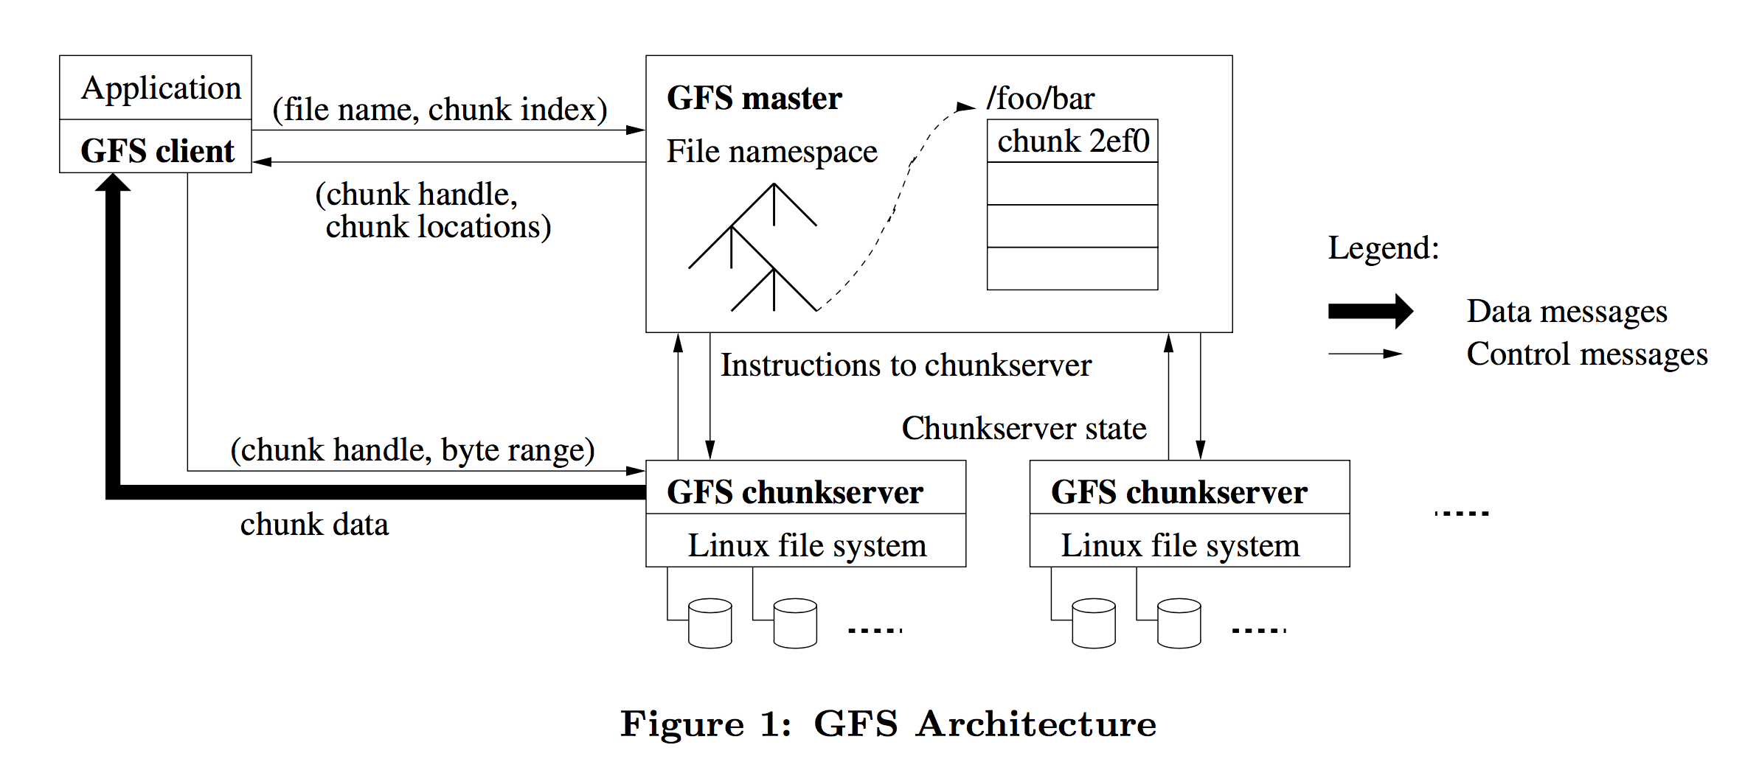
Architecture
Notes:
This is the architecture of the Google file system.
(1) The application first talk to the master server about where to get the data from.
(2) And then the actual bulk of data which is through the thicker line comes directly from the chunkserver itself
(3) The master keeps tracks of of table that maps filename to a set of chunk ids and the servers that have them.
(4) The client will ask the master where is the file and will given them back a set of locations.
(5) The client will then pick one of those locations randomly and give the handle to that chunk
(6) The data come straight back from the chunkservers.
(51)

Slide 10
Single Master Holds Metadata
Problem
Single point of failure
Scalability bottleneck
GFS solutions
Shadow master
Minimize master involvement
Never move data through master, only used for metadata
Large chunk size to decrease metadata
Master delegates authority to primary replicas in data mutations (chunk leases)
Notes:
We know that this is the single point of failure and a scalability bottleneck.
The solution to the single failure problem is to create other machines called shadow masters. Although there is only a master at any time, it periodically sends its metadata to these computers. When the master fails, we still have a pretty recent copy of the file system and we still can map files to chunkservers.
From the scalability point of view, as long as the master do not have to send very much data at a time, it would not be a scalability bottleneck. The chunk is very large, which means that there are very few number of chunks per file. So when accessing a file’s metadata, we are not given a MB long list of chunks. The data mutations are also handled by the chunkservers instead of master itself. So the master involvement is minimized.
(1:11)

Slide 11
Chunkservers Hold the Actual Data
Many chunkservers under one master
Free to join and leave
Stores actual data
Report chunk locations to master
Refresh master on join
Checksums the data for integrity

Slide 12
Metadata
Metadata is stored on the master
File and chunk namespaces
Mapping from files to chunks
Locations of each chunk’s replicas
All in memory (64 bytes per chunk)
Fast
Easily accessible
Notes:
The primary job of master is to store the metadata, which is the file and chunk namespaces and the mapping form files to chunks.
To keep the master’s scalability high. We put every thing in memory. It is only 64 bytes per chunk. You can think about if we have 20 million files or so. That’s going to be only 200 MB. Which can be easily kept in memory in one computer.
(35)

Slide 13
Metadata
Master has an operation log for persistent logging of critical metadata updates
Persistent on local disk
Replicated to the shadow master(s)
Checkpoints for faster recovery
Notes:
The other piece of data that is kept on master computer is the operation log, which is persistent on the disk. This is also replicated through the shadows so that it can be recovered quickly and to ensure consistent data.
Why is it important to log data on the master?
With chunkservers, we have multiple machine holding the data. If one of these machines gets totally corrupted, we are allowed to just give up on that machines because we know we have two other copies somewhere. But we only have one copy of the master, if we are going to do a set of mutations to master,
(49)

Slide 14
Metadata
Master has an operation log for persistent logging of critical metadata updates
Persistent on local disk
Replicated to the shadow master(s)
Checkpoints for faster recovery
START
X
X
Y
Y
END
Notes:
The way we handle this is by having a separate list of things that we are going to write before they are going to actually write it. We will have some log entries. We will have a start entries. We say we are going to write X and Y. And there is a special end token. We first write this log to disk before we actually write the data in. If we crash half way through this process. We can just read the whole log
(40)

Slide 15
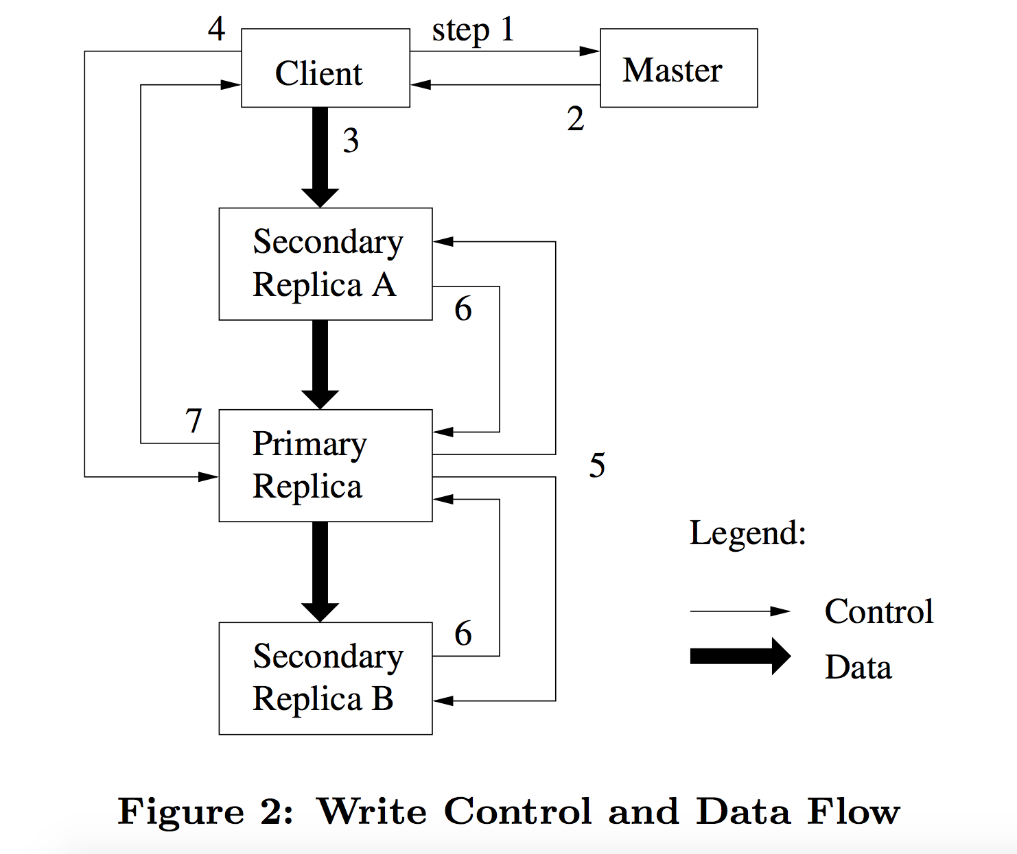
Mutations
Mutation = write or record append
Must be done for all replicas
Goal: minimize master involvement
Lease mechanism
Master picks on replica as primary and gives
it a “lease” for mutations
Primary defines a serial order of mutations
All replicas follows this order
Data flow decoupled from control flow
Notes:
Mutation is the thing that gets complicated to have multiple copies of data lying around. We have a master and it says these chunkservers are with these chunks and if you want to read out of it. It is easy. You just pick one and go because we know that they are all consistent. But how do we keep them consistent if we actually want to change them? We need to change them all at the same time w.r.t other concurrent accesses.
Because we only have one master machine, we need to minimize its involvement in the process. The way they handle this is through lease mechanism.
When we want to write to some files,
Client asks the master for the chunkservers.
The master replies the identity of the location of the primary server and the secondary servers.
The client will push the data to one of the replicas. It does not matter which replica it choose. That replica will figure out the other replicas and pass the data to them
Once all the data are ready on every chunk. The primary will define a serial order of mutations
The primary will pass the list of changes to the secondary replicas.
The secondary will notify primary that the have completed the operations.
The primary will finally notify the client that the write is finished.
(1:48)

Slide 16
Atomic Record Append
GFS appends it to the file atomically at least once
GFS picks the offset
Works for concurrent writers
Used heavily by Google applications
For files that serve as multiple-producer/single consumer queues
Merge results from multiple machines to one file
Notes:
The other mutation they provide is this atomic record append operation. The reason they add this is because rewriting the entire file is not often by a GFS client. What Google file system does for is a lot of logging. There are programs that run on all of the servers that are consistently checking some statistics like the bandwidth, CPU usage. And they write all of these out to the file system. We want to make it convenient to just to write a snippet to a file. Therefore, Google provides record append operation which guarantees that each record is added at least once. The ordering of the record may be different on different replicas.
(56)

Slide 17
Master’s Responsibilities
Metadata storage
Namespace management/locking
Heartbeat with chunkservers
Give instructions, collect state, track cluster health
Chunk creation, re-replication, rebalancing
Balance space utilization and access speed
Re-replicate data if redundancy is lower than threshold
Rebalance data to smooth out storage and request load
Notes:
What are the things that a master server needs to do?
It is responsible for metadata storage.
It is the only machine that has something to do with all of the lockings. We have leases in the chunkservers, the leases is granted through the master. A chunk server cannot promote itself to be a primary.
It is responsible for tracking the health of the chunkservers. It is periodically pinning the chunkservers and making sure that they come back. It also given instructions to the servers.
For example, if one chunk server crashes. Since the master knows all the files on that server, it will start directing other server to make copies to keep the number of replicas above threshold.
Master knows how much reads and writes to each file. If the master start seeing there are many read request through many clients to the same file. It will tell other machines to replicate the file so that we can provide fast throughput to the end user
(1:40)

Slide 18
Master’s Responsibilities
Garbage collection
Simple and reliable in distributed system where failures are common
Master logs the deletion, rename the file to a hidden name
Lazily garbage collect hidden files (three days?)
Stale replica deletion
Detect stale replicas using chunk version numbers
Notes:
Another thing that master do is garbage collection. The way they do file delete is that the file is renamed to a random hidden name. And periodically, when the master is not busy, it will remove the chunks associated with these files.
Failed writes can make regions undefined but consistent. There are old versions of chunks which is left abandoned. All the chunks are given a version number throughout the writing process. Master asks periodically the chunkservers which version of file it has. The stale replicas will be removed and given a new copy of the file.
(52)

Slide 19
Fault Tolerance
High availability
Fast recovery
Master and chunks server can restart in a few seconds
Chunk replication
Default is three replicas
Shadow masters
Data integrity
Checksum every 64 KB block in each chunk
Notes:
They create a very fault tolerant system that manages huge amount of data. They make a very high availability server cluster.
Machines can restart quickly. Individual servers can reboot in a few seconds.
Shadow master can take over the main master in a show amount of time. The applications will only stall for a minute. They can continue to run with a pretty recent backup copy.
Even if two of the three machines dies, assume that the files are distributed uniformly. All of the files should still be available in this case.
They also added an additional layer of reliability on top of the basic hard drives. The chunkservers can check the files they read against the checksum. If a chunkserver detect itself is failing. It can vote itself out of the server and direct other replicas to take over the reponsibilities for the file it has. And make these files available again

Slide 20
Consistency Model
Consistency level
Defined (everyone see the correct data)
Consistent (everyone see the same data, which may or may not be correct)
Inconsistent (everyone do not see the same data)
Implications for applications
Rely on appends rather than overwrites
Checkpoint
Use self-validating, self-identifying records

Slide 21
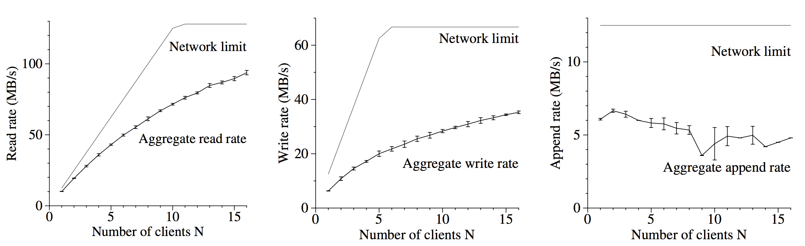
Evaluation: Micro-Benchmarks

Slide 22
Evaluation: Real-World clusters
Cluster A
Research and Development
A few MBs to a few TBs of data
Tasks run up to hours
Cluster B
Production use
Continuously generate and process multi-TB data
Long running tasks

Slide 23
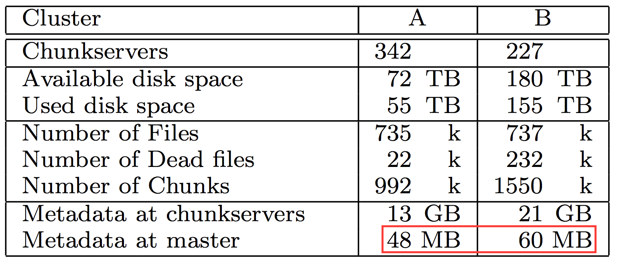
Storage and Metadata

Slide 24
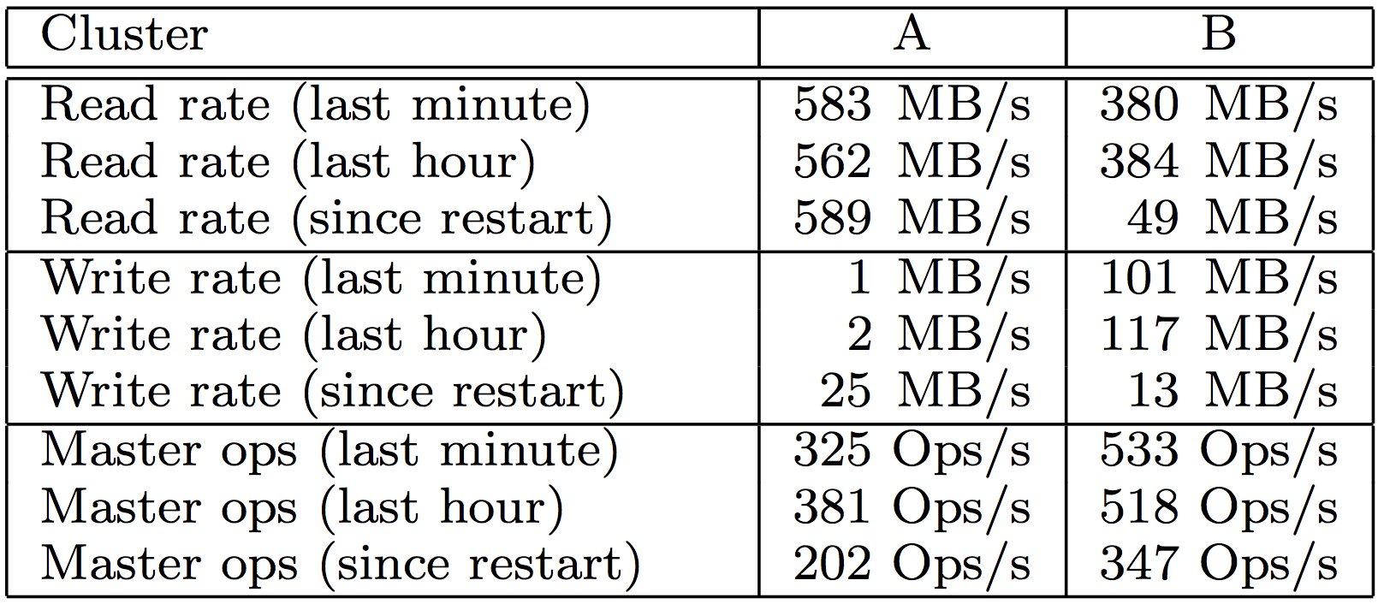
Read/Write Rate

Slide 25
Recovery Time
Kill one chunkserver
15000 chunks containing 600 GB data
All chunks restored in 23.2 mins
Kill two chunkservers
Each with 16000 chunks and 660 GB data
Results in 266 single replicas
Single replicas restored to at least 2x within 2 mins

Slide 26
Break!

Slide 27
Announcements
Paper assignment is (almost) finalized
Please check on the course website tonight
Presenters: MUST send me a copy of the slides a day before
20% of the grade!
Everyone else: MUST read the mandatory paper(s)
Presenters and reviewers must read all papers listed
Pop QUIZ: https://goo.gl/forms/3obXL70Y78syHMSQ2

Slide 28
MapReduce Design Decisions
Simple interface and programming model is often sufficient
Map and Reduce
Fault tolerance and scalability should come without much user efforts
Deterministic work
Rerunning will result in the same output
Level of parallelism dictated primarily by the underlying file system
Each map task works on one chunk of data on GFS
A bit more control over reduce tasks

Slide 29
Programming Model: Word Count
apple banana
Doc 1
banana orange
Doc 2
orange apple
Doc 3

Slide 30
Programming Model: Word Count
apple banana
Doc 1
banana orange
Doc 2
orange apple
Doc 3
(Doc1: apple:1, banana:1) (Doc2: banana:1, orange:1)(Doc3: orange:1, apple:1)

Slide 31
Programming Model: Word Count
apple banana
Doc 1
banana orange
Doc 2
orange apple
Doc 3
(Doc1: apple:1, banana:1) (Doc2: banana:1, orange:1)(Doc3: orange:1, apple:1)
apple: 2, banana: 2, orange: 2

Slide 32
Programming Model: Word Count
apple banana
Doc 1
banana orange
Doc 2
orange apple
Doc 3
(Doc1: apple:1, banana:1) (Doc2: banana:1, orange:1)(Doc3: orange:1, apple:1)
apple: 2, banana: 2, orange: 2
apple banana
apple:1 banana:1
Doc 1
banana orange
banana:1 orange:1
Doc 2
orange apple
orange:1 apple:1
Doc 3

Slide 33
Programming Model: Word Count
apple banana
Doc 1
banana orange
Doc 2
orange apple
Doc 3
(Doc1: apple:1, banana:1) (Doc2: banana:1, orange:1)(Doc3: orange:1, apple:1)
apple: 2, banana: 2, orange: 2
apple banana
apple:1 banana:1
Doc 1
banana orange
banana:1 orange:1
apple 1, apple 1
Doc 2
banana 1, banana 1
orange 1, orange 1
orange apple
orange:1 apple:1
Doc 3

Slide 34
Programming Model: Word Count
apple banana
Doc 1
banana orange
Doc 2
orange apple
Doc 3
(Doc1: apple:1, banana:1) (Doc2: banana:1, orange:1)(Doc3: orange:1, apple:1)
apple: 2, banana: 2, orange: 2
apple banana
apple:1 banana:1
Doc 1
banana orange
banana:1 orange:1
apple 1, apple 1
apple 2
Doc 2
banana 1, banana 1
banana 2
orange 1, orange 1
orange 2
orange apple
orange:1 apple:1
Doc 3

Slide 35
Generalization
apple banana
apple:1 banana:1
Doc 1
banana orange
banana:1 orange:1
apple 1, apple 1
apple 2
Doc 2
banana 1, banana 1
banana 2
orange 1, orange 1
orange 2
orange apple
orange:1 apple:1
Doc 3

Slide 36
Generalization
apple banana
apple:1 banana:1
Doc 1
banana orange
banana:1 orange:1
apple 1, apple 1
apple 2
Doc 2
banana 1, banana 1
banana 2
orange 1, orange 1
orange 2
orange apple
orange:1 apple:1
Doc 3
Partition → Shuffle → Collect
Remapping:
(docID-content) → (word-frequency)
Reduction
Many (word-frequency) → small number of (word-frequency)
Duplicate keys → distinct keys
Notes:
Bring up spark here – narrow dependency

Slide 37
Things to Worry About in a Real System
apple banana
apple:1 banana:1
Doc 1
banana orange
banana:1 orange:1
apple 1, apple 1
apple 2
Doc 2
banana 1, banana 1
banana 2
orange 1, orange 1
orange 2
orange apple
orange:1 apple:1
Doc 3
Granularity:
How many partitions for map and reduce?
Scheduling:
How to assign workers?
How to coordinate between map and reduce workers?
Fault-tolerance:
What if something fails?

Slide 38
The Real MapReduce with Word Count
Input
Split 1
(Doc1: apple banana …)
(Doc2: banana orange…)
(Doc3: orange aplle…)
(Doc4: apple banana …)
(Doc5: banana orange…)
(Doc6: orange apple…)
... ...
(Doc1: apple banana…)
(Doc2: banana orange…)
(Doc3: orange apple…)
apple 1, apple 1
banana 1, banana 1, banana 1, banana1,
Banana 4
banana 1, banana 1
orange 1, orange 1
Split 2
(Doc4: apple banana …)
(Doc5: banana orange…)
(Doc6: orange apple...)
apple 1, apple 1
.
.
.
.
.
.
banana 1, banana 1
orange 1, orange 1
.
.
.
.
.
.

Slide 39
The Real MapReduce with Word Count
Map worker
Reduce worker
Input
Split 1
(Doc1: apple banana …)
(Doc2: banana orange…)
(Doc3: orange aplle…)
(Doc4: apple banana …)
(Doc5: banana orange…)
(Doc6: orange apple…)
... ...
(Doc1: apple banana…)
(Doc2: banana orange…)
(Doc3: orange apple…)
apple 1, apple 1
banana 1, banana 1, banana 1, banana1,
Banana 4
banana 1, banana 1
orange 1, orange 1
Split 2
(Doc4: apple banana …)
(Doc5: banana orange…)
(Doc6: orange apple...)
apple 1, apple 1
.
.
.
.
.
.
banana 1, banana 1
orange 1, orange 1
.
.
.
.
.
.

Slide 40
The Real MapReduce with Word Count
Map worker
Reduce worker
Input
Split 1
(Doc1: apple banana …)
(Doc2: banana orange…)
(Doc3: orange aplle…)
(Doc4: apple banana …)
(Doc5: banana orange…)
(Doc6: orange apple…)
... ...
(Doc1: apple banana…)
(Doc2: banana orange…)
(Doc3: orange apple…)
apple 1, apple 1
banana 1, banana 1, banana 1, banana1,
Banana 4
banana 1, banana 1
orange 1, orange 1
Split 2
(Doc4: apple banana …)
(Doc5: banana orange…)
(Doc6: orange apple...)
apple 1, apple 1
.
.
.
.
.
.
banana 1, banana 1
orange 1, orange 1
.
.
.
.
.
.
M splits
M * R partitions
R outputs

Slide 41
System Overview
Map worker
disk
Reduce worker
Map worker
disk
Reduce worker
Map worker
disk
GFS
Split 1
Split 2
Output 1
Split 3
Output 2
…

Slide 42
System Overview
Map worker
disk
Map Func
Reduce worker
Reduce Func
Map worker
disk
Map Func
Reduce worker
Reduce Func
Map worker
disk
Map Func
GFS
Split 1
Split 2
Output 1
Split 3
Output 2
…

Slide 43
System Overview
Master
Map worker
disk
Map Func
Reduce worker
Reduce Func
Map worker
disk
Map Func
Reduce worker
Reduce Func
Map worker
disk
Map Func
GFS
Split 1
Split 2
Output 1
Split 3
Output 2
…

Slide 44
System Overview
Master
O(M + R) Task status
O(M * R) states (locations)
Map worker
disk
Map Func
Reduce worker
Reduce Func
Map worker
disk
Map Func
Reduce worker
Reduce Func
Map worker
disk
Map Func
GFS
Split 1
Split 2
Output 1
Split 3
Output 2
…

Slide 45
System Overview
Master
O(M + R) Task status
O(M * R) states (locations)
Map worker
disk
Map Func
Reduce worker
Reduce Func
Map worker
disk
Map Func
Reduce worker
Reduce Func
Utilize GFS Locality
Map worker
disk
Map Func
GFS
Split 1
Split 2
Output 1
Split 3
Output 2
…

Slide 46
The Reasoning Behind the Implementation
parallelism
splits
limited bisection bandwidth
Input splits stored in GFS
Master coordination
Intermediate values go over network just once
Master assign new tasks to idle workers
Load balancing
Many more splits than workers
Not too many otherwise would bring too many overheads
No huge tasks
Notes:
System is designed and built on a lot of reasoning, naturally or even intuitively

Slide 47
The Reasoning Behind the Implementation
Map Worker failure(before or after completion)
Stateless/Pure function
Restart map task
Input splits stored in GFS, read from another replica
Reduce worker failure (after completion)
Difficult to track origin
Make output reliable – store in GFS
No need to restart
Master failure
Checkpoint
Still difficult to restore updates after most recent checkpoint
Materializing map outputs
Failure unlikely for one machine
Restart the whole task
No need to rerun map if map worker restarts
Notes:
Reduce worker failure in the middle of writing output – GFS’s atomic rename, partial-output won’t be visible
Reduce worker read some of the intermediate values of failed workers’ intermediate data – depend on determinist map function.
Reduce crash and map crash – need the rerun of map.

Slide 48
Refinement
Performance
Stragglers: backup tasks
Skipping bad records: catch >1 failures on a specific record
Utilities
Sort inside partitions – faster lookup for reduce workers/output consumers
Combiner function – “partial reduce”
Additional output
Status info
Counters
Debugging – local (sequential execution)

Slide 49
Performance: MR_Grep
Locality optimization helps:
1800 machines read 1 TB of data at peak of ~31GB/s
Without this, rack switches would limit to 10 GB/s
Startup overhead is significant for short jobs

Slide 50
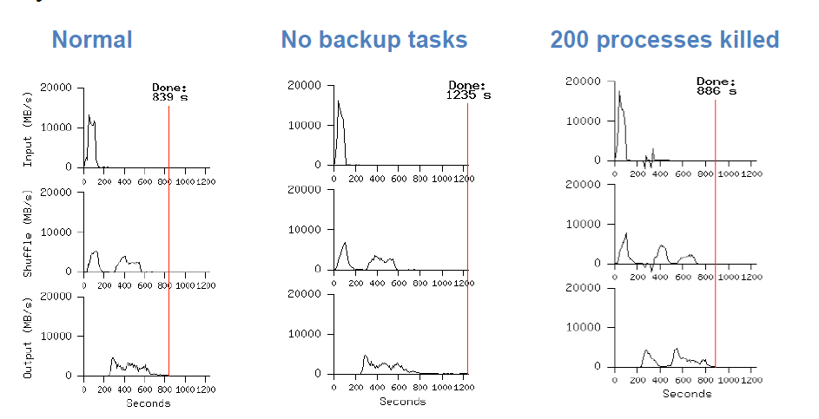
Performance: MR_Sort

Slide 51
Techniques Used
Technique | Used In
Replication | GFS
Erasure coding | GFS
Sharding/partitioning | MapReduce tasks, GFS splits
Load balancing | Automatic due to partitioning
Health checks | MapReduce, GFS
Integrity checks | MapReduce, GFS
Compression | GFS
Eventual consistency | GFS master
Centralized controller | MapReduce and GFS masters
Canaries
Redundant execution | MapReduce

Slide 52
Summary
Use domain knowledge wisely
Strive for simplicity
Fault-tolerance and scalability are not optional

