Slide 1
Refactoring MagnificationCurves and Derivatives

Slide 2
Finite Source Calculations

Slide 3
Part of Model.get_magnification(), but not stored.
Related, but one is in PointLens(), the other is in FitData()
Separate calculation that requires recalculating u.

Slide 4
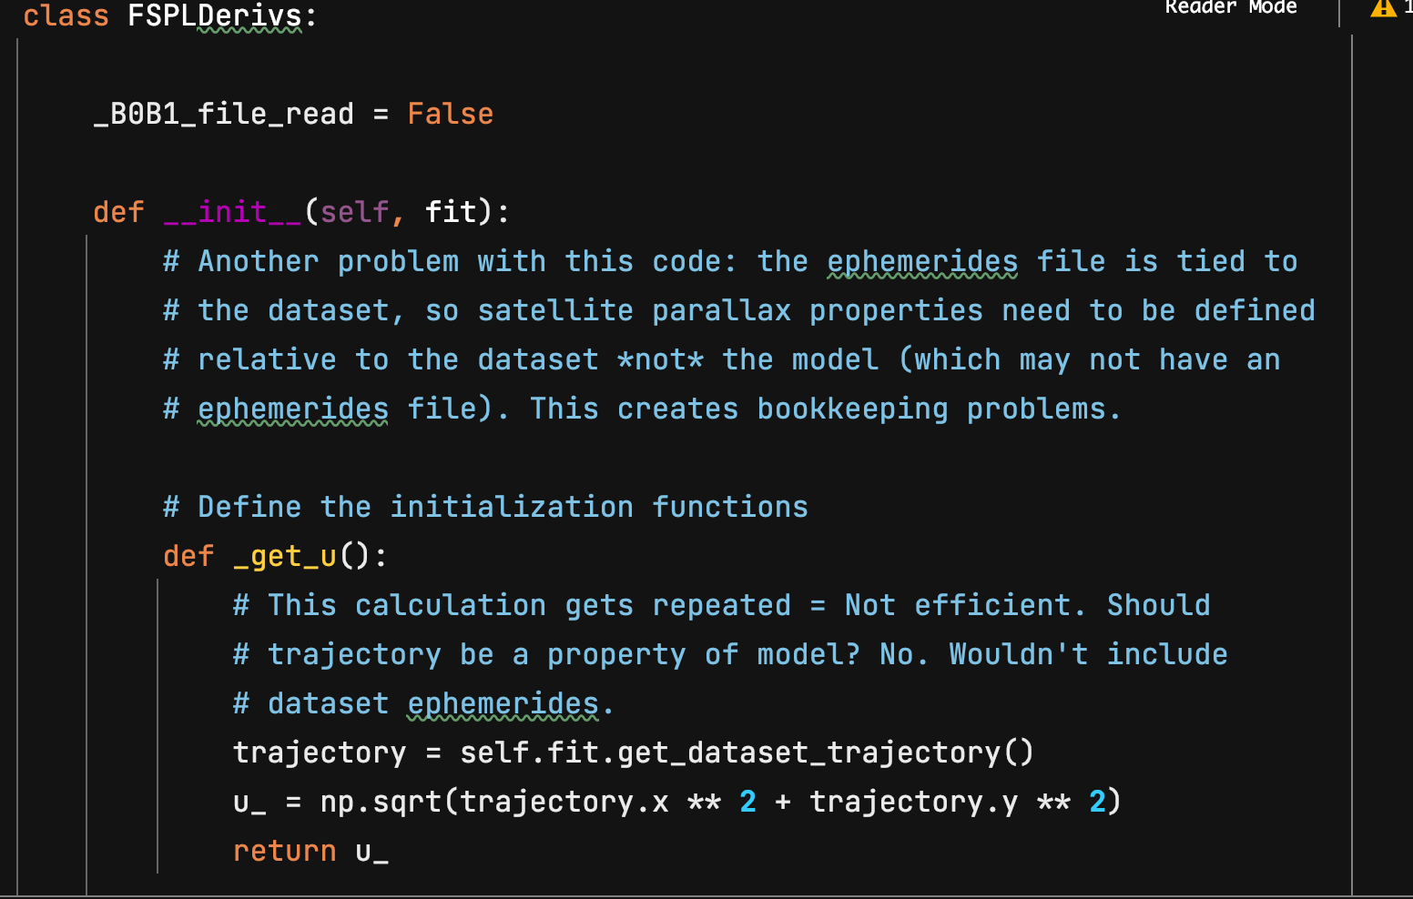

Slide 5
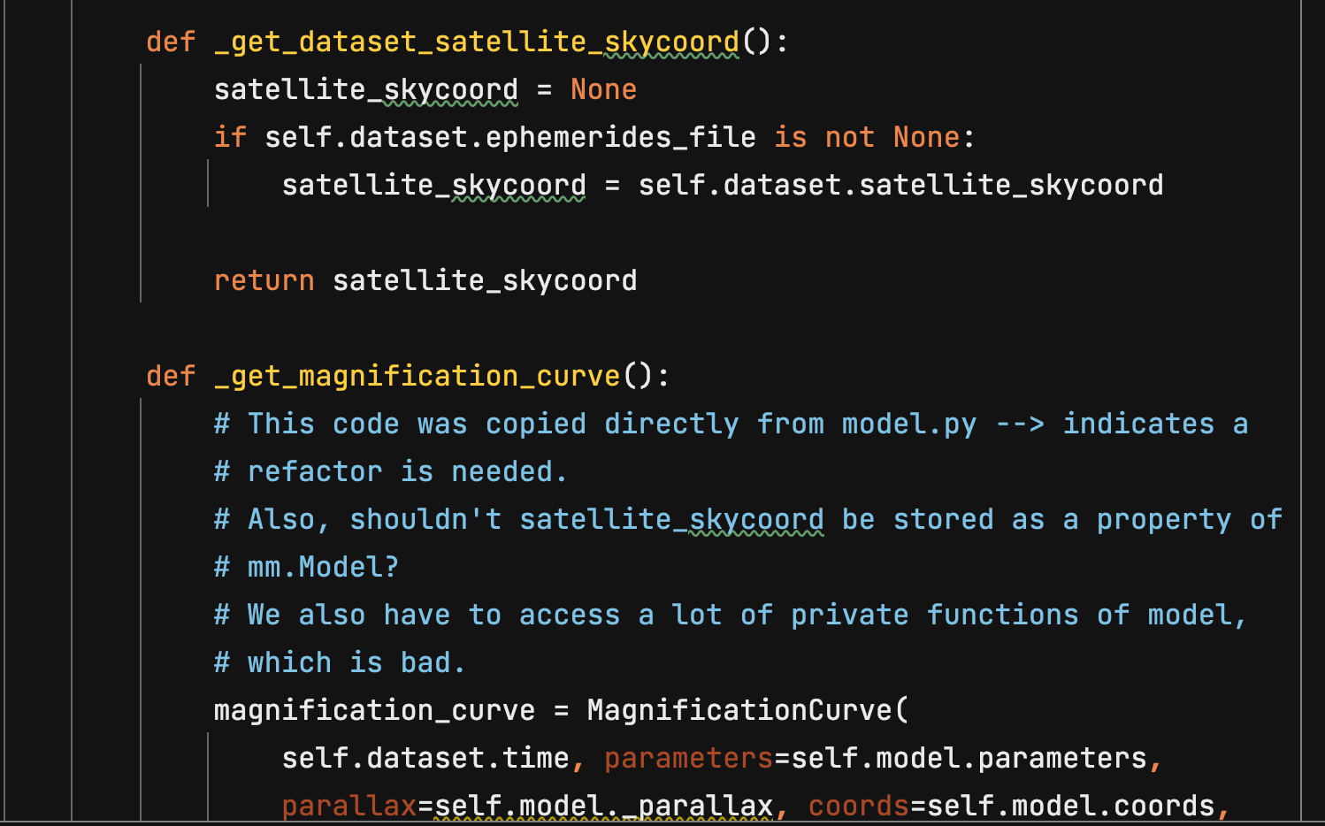

Slide 6
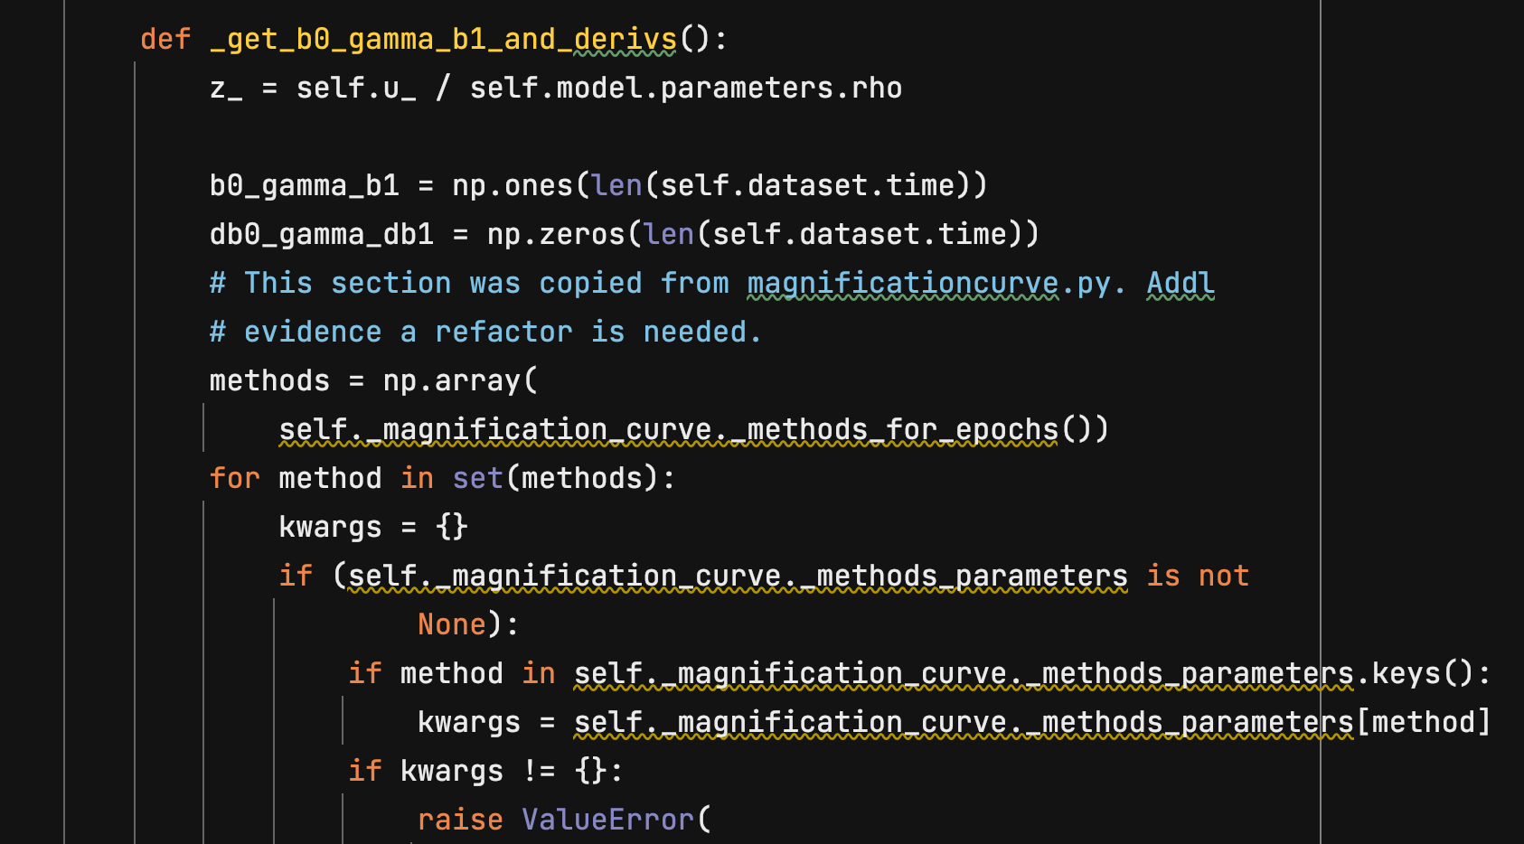

Slide 7
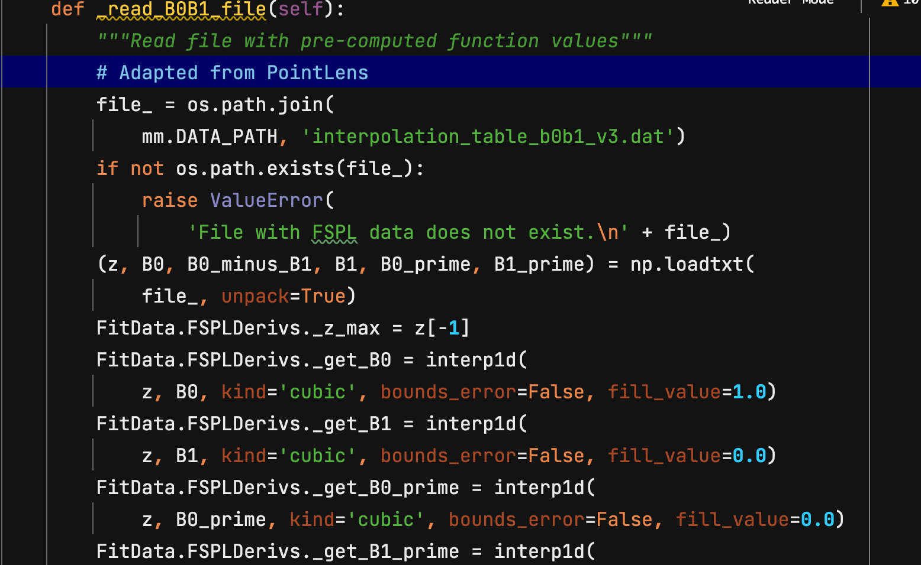

Slide 8
The Problem:
Comes from mm.Model.get_magnification(times, satellite_skycoords, gamma/bandpass)
get_magnification()
_get_magnification()
_magnification_1_source()
MagnificationCurve(times, satellite_skycoords, gamma, parameters, parallax, magnification methods)
MagnificationCurve().get_magnification()

Slide 9
The Problem:
MagnificationCurve().get_magnification()→
Trajectory()
get_point_lens_magnification() →
get_pspl_magnification → pspl_magnification
u
PointLens(parameters) → get_point_lens_limb_darkening_magnification(u, pspl_magnification, gamma)

Slide 10
The Problem:
PointLens.get_point_lens_limb_darkening_magnification(u, pspl_magnification, gamma) →
_read_B0B1_file()
→ PointLens._B0_interpolation(), PointLens._B0_minus_B1_interpolation()

Slide 11
General Constraints
There are multiple methods for calculating the magnification
Different methods may be applied to different parts of the data
The underlying parameter that controls magnification is the source position, which is calculated by Trajectory
Different datasets may have different trajectories
The model needs to be universal and independent of the datasets

Slide 12
Proposed Solution: Create separate classes for each type of magnification curve.

Slide 13
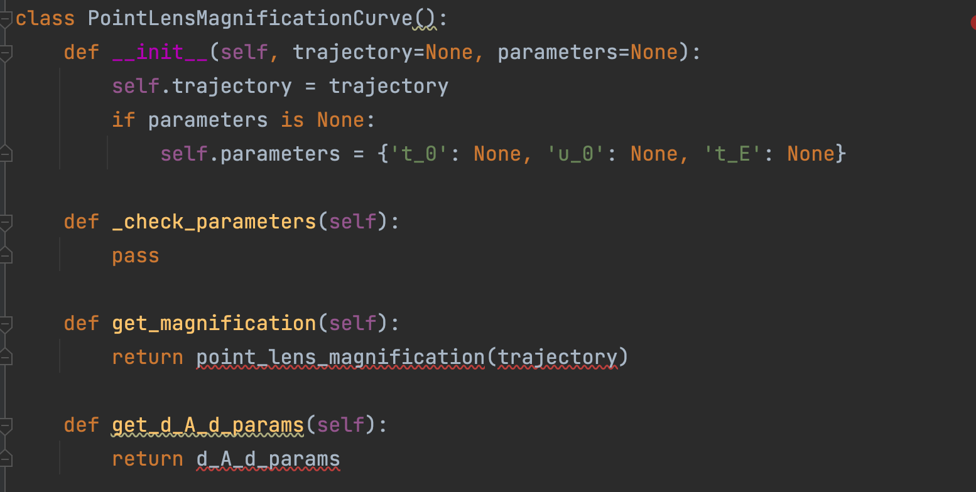

Slide 14
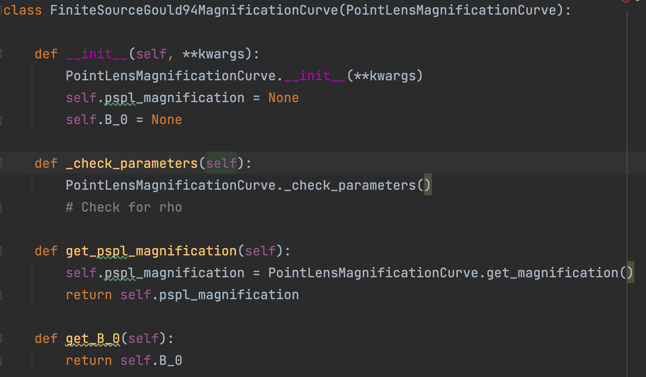
Also contains the read_B0_B1 function…

Slide 15
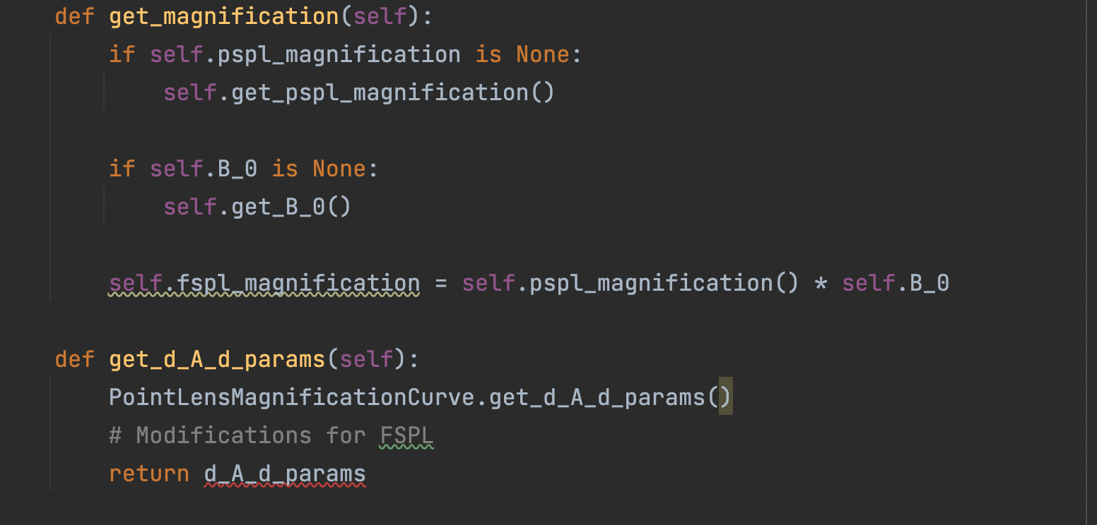

Slide 16
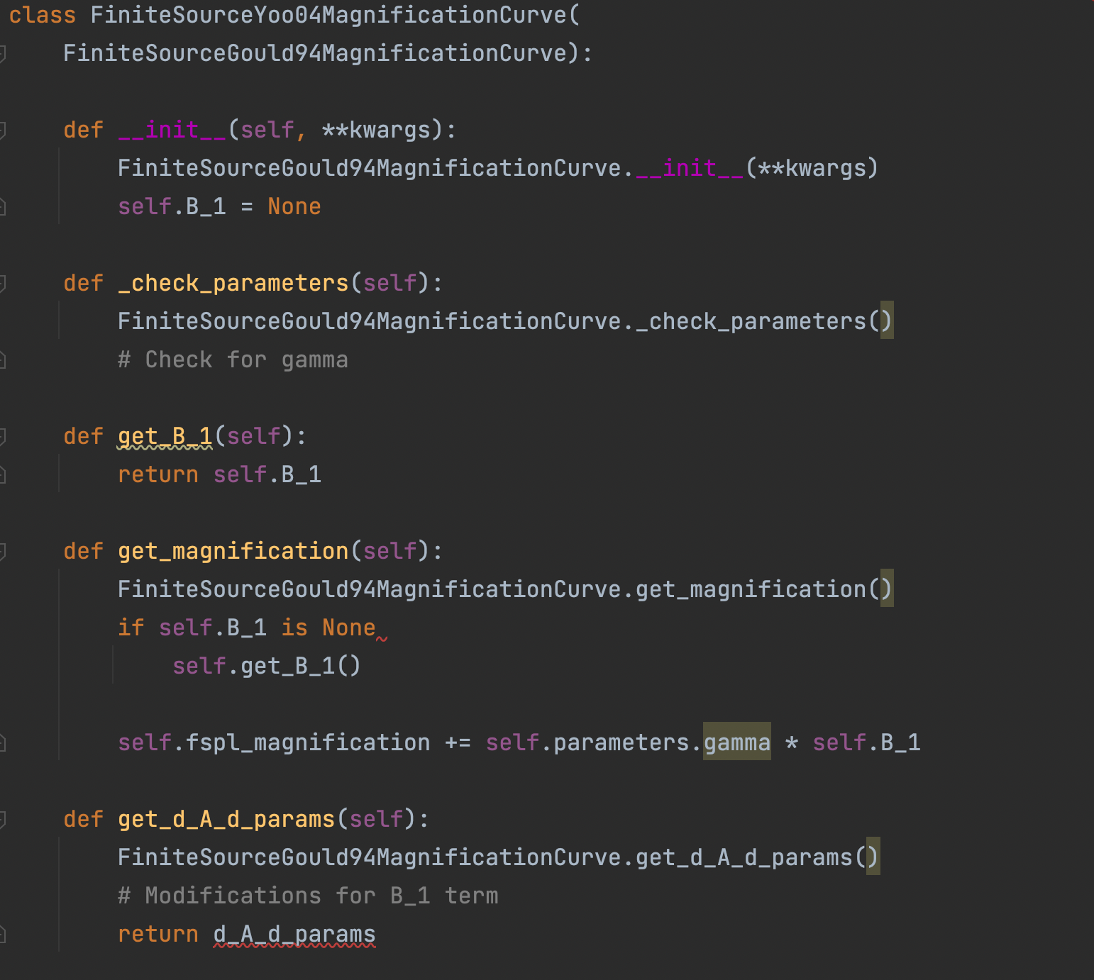

Slide 17
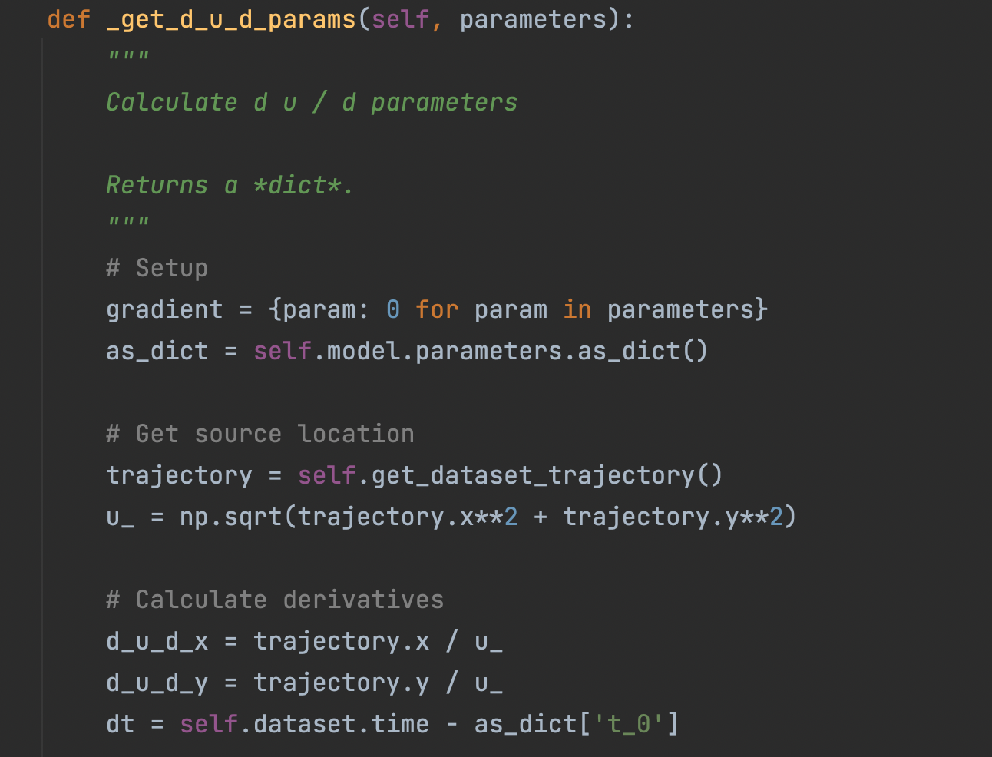
Current FitData method
self.trajectory.
get_du_d_params()

Slide 18
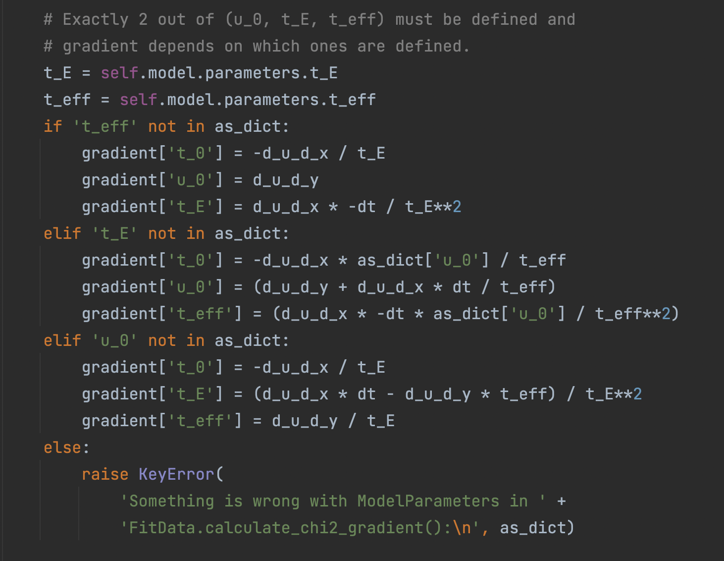
self.PLMC.
get_d_A_d_params

Slide 19
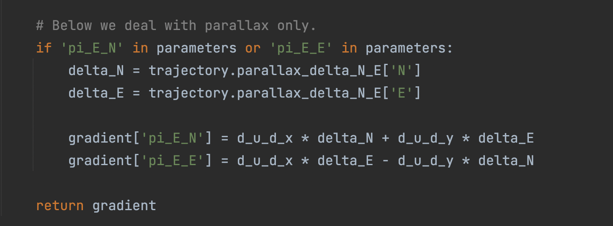
PLMC.get_d_A_d_params():
gradient[piEE,N] =
self.trajectory.d_u_d_x[piEE,N] * self.trajectory.parallax_delta_N_E[E,N]…

Slide 20
Deprecated?
Pointlens().
_get_point_lens_finite_source_magnification()
get_point_lens_limb_darkening_magnification()
get_point_lens_uniform_integrated_magnification()
get_point_lens_LD_integrated_magnification()
Need a property self.direct
FiniteSourceUniformGould94MC()
FiniteSourceLDYoo04MC()
FiniteSourceUniformLee09MC()
FiniteSourceLDLee09MC()
Raise error for d_A_d_params

Slide 21
Open Questions
How do these new classes interface with FitData, Model and MagnificationCurve?
Is MagnificationCurve still needed?
How are different methods applied to different parts of the data?
How do we fix the bookkeeping problem of the ephemerides files (which may be attached to datasets)?

