Slide 1
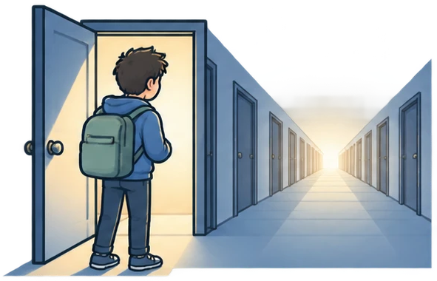
The adversary's case: the claims outrun the evidence
Turzo, Sultana, Bosu · IEEE Transactions on Software Engineering 51(4), 2025
Adversary presentation · after the champions
Notes:
Static title. Transition into slide 2: Fade.
Opening line: the champions showed you what the paper found; I am going to argue that what it claims is larger than what it measured.

Slide 2




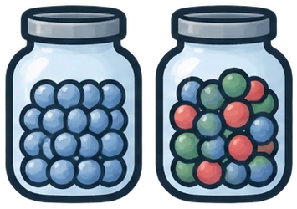
I will grant what holds, raise three threats to validity, and name the experiment that would change my mind
threats to validity
What holds
Construct validity
Internal validity
Conclusion validity
What would change my mind
Notes:
MORPH SOURCE. The five icons are pictures named pt-holds, thr-construct, thr-internal, thr-conclusion, pt-experiment in the Selection Pane; the same pictures with the same names appear on slides 3-9, which is what lets Morph move them.
Animation: click 1 pt-holds Fade with label; click 2 the three threat icons Fly In from bottom in sequence (0.2 s delay) and the bracket Wipe from left; click 3 pt-experiment Fade.
Say: three threats, in the order the paper's own Section VI lists them, minus external validity, which is the paper's strength.

Slide 3



The scale is real, the GFI effect is real, and the finding that no recommendation generalises everywhere is the paper's best contribution
What holds
7 / 8
5.57×
0 / 15
datasets where bug fixes and fewer insertions raise newcomers' acceptance odds · Table XI
acceptance odds for a Good First Issue, newcomers in busy GitHub projects · Table VIII
recommendations supported in all eight datasets · Table XI
Notes:
Transition: Morph (pt-holds flies to the badge, the other four shrink into the strip).
Click 1 first callout Grow & Turn; click 2 second; click 3 third; click 4 green check Fade onto the badge.
Say: credit first. These three numbers survive everything I am about to say.

Slide 4


The title and abstract promise higher odds of becoming a long-term contributor, but the only outcome variable in the paper is whether one patch was accepted
Construct validity
“abandon at non-newcomer status to increase their odds of becoming long-term contributors”
retention · tenure · continued contribution ?
not measured anywhere in the paper
Abstract, final sentence
is_accepted
one patch, one yes/no · Section IV-A-5
long-term contributor
✓
Notes:
Transition: Morph (thr-construct rises to the badge, pt-holds drops to the strip with its check).
Click 1 bubble + sapling Fade; click 2 is_accepted box Wipe from bottom; click 3 dashed box Fade, question mark Pulse; click 4 red arrow Wipe from left; click 5 red cross onto the badge.
Say: the newcomer definition (IV-A-4) ends at the first accepted patch; after that everyone is one control group and the dependent variable is still acceptance of a single patch. 'Long-term contributor' appears in the title, abstract and conclusion and in no variable.
Expected rebuttal: 'acceptance of later patches is a reasonable proxy.' Answer: then the paper should test the proxy, and it has the data to do so (slide 8).

Slide 5





The sign flips behind “abandon these strategies” are explained by who non-newcomers are, since the models control for neither tenure nor affiliation nor author
Internal validity
 | M · NC | M · CT | H · NC | H · CT
R6 low complexity | ✓ | ✗ | ✓ | ✗
R7 documentation | ✓ | ✗ | ✓ | ✗
R9 fewer deletions | ✓ | ✗ | ✓ | ✗
tenure ✗
affiliation ✗
Table XI · M/H = GitHub(M)/GitHub(H) · NC newcomers, CT non-newcomers
author ✗
not in any model · Section IV-A-5
newcomers
non-newcomers
✓
✗
Notes:
Transition: Morph (thr-internal rises, thr-construct drops with its cross).
Click 1 table Fade, then the CT cells Fill Color red one by one; click 2 jars Fade; click 3 characters Fly In from bottom over the jars; click 4 the three missing-covariate boxes Fade with the crosses Pulse. No cross on the badge yet; the point continues on slide 6.
Say: in Android, oVirt and Wikimedia the sponsor's employees are non-newcomers whose complex, non-documentation patches are accepted because they are trusted. Nothing in the model separates trust from task type.
Expected rebuttal: 'Section VI acknowledges non-newcomer diversity.' Answer: acknowledging a confound is not controlling for it; the models have no tenure, affiliation or author terms, no project fixed effects in the pooled GitHub strata, and no clustered standard errors.

Slide 6

Review iterations is the strongest predictor in three of the five Gerrit models and is measured after submission, so the best-explaining variable is an outcome of review rather than a newcomer choice
Internal validity
submit
review rounds · patchsets accumulate
accepted or rejected
✗
the outcome shapes the “predictor”: an abandoned patch has one patchset, an engaged one has many
14.2%
of oVirt's explained deviance comes from iterations; next-best task-selection variable is bug fix at 4.7%
✓
✗
Notes:
Transition: Morph; thr-internal stays in place as the badge, so only the content changes.
Click 1 timeline nodes Wipe from left in sequence; click 2 red arrow Wipe; click 3 chart bars Wipe from bottom one at a time; click 4 callout Grow & Turn; click 5 red cross onto the badge.
Say: iterations is the top predictor in LibreOffice, oVirt and Typo3 (Android: bug fix; Wikimedia: promptness, also post-submission). 'Be patient' is advice derived from a variable the newcomer does not control.
If short on time, cut this slide; it weakens Key Takeaway 4, not the headline.

Slide 7
With 262,013 newcomers in the busiest GitHub stratum, an odds ratio of 0.999 is significant at p < 0.001, explains under 0.2% of deviance, and is still reported as a negative association
Conclusion validity
262,013
0.999***
newcomers, GitHub(H) · Table VI
odds ratio for title length, newcomers · Table VIII
R10 · newcomers | Android | LibreOffice | oVirt | Typo3 | Wikimedia | GitHub(L) | GitHub(M) | GitHub(H)
title length | ✗ | ○ | ○ | ○ | ○ | ✗ | ✗ | ✗
Table XI, row R10 · every ✗ is an odds ratio of 0.999 · ○ = not significant
✓
✗
✗
Notes:
Transition: Morph (thr-conclusion rises, thr-internal drops with its cross).
Click 1 N callout Grow & Turn; click 2 OR callout Grow & Turn; click 3 chart Wipe from bottom (the four tiny bars barely appear, which is the point); click 4 Table XI row Fade then the grey line Wipe across it; click 5 red cross onto the badge.
Say: the paper's own EP column shows these are null effects; the abstract still counts them as 'four significant negative associations'. The honest reading, 'no effect', is more useful to newcomers.
Expected rebuttal: 'EP is reported.' Answer: reported, then not applied in the abstract or Table XI.

Slide 8
Following the same contributors from their second to their tenth patch would separate what stage changes from who the non-newcomers are
What would change my mind
?
same person, patches 2–10
still contributing
at 12 months?
first patch
accepted
complex
simple
complex
simple
complex
simple
complex
simple
complex
Feasible with the paper's own 1.4M Gerrit reviews and 6M GitHub pull requests: compare acceptance of simple vs complex patches within the same early-stage contributor, then test whether the choice predicts activity a year later.
✓
✗
✗
✗
Notes:
Transition: Morph (pt-experiment rises, thr-conclusion drops with its cross).
Click 1 newcomer + first patch + stamp Fade; click 2 patches 2–10 Wipe from left in sequence along the line; click 3 the tile fills alternate (Fill Color) to show the complexity contrast; click 4 sapling + question mark Fade and Pulse; click 5 a slate arrow Fade onto the badge (not a verdict mark).
Say: a within-person design removes the composition problem by construction, and a 12-month activity outcome measures what the title promises. The authors have the data; this is a revision, not a new study.

Slide 9
Three threats leave the patch-acceptance findings standing and the long-term-contributor claim unsupported, so the paper should be reframed as a study of patch acceptance before it is accepted
✓
✗
✗
✗
→
What holds
Construct validity
Internal validity
Conclusion validity
What would change my mind
From First Patch to Long-Term Contributor: Evaluating Onboarding Recommendations for OSS Newcomers
Which patches get accepted: evaluating onboarding recommendations across OSS contexts
reject as written · accept reframed
Notes:
Transition: Morph (all five icons travel back to the agenda row; the strip disappears). The marks are separate shapes named mark-<slug> so they morph too.
Click 1 the three crosses Pulse together; click 2 original title Fade then its strike-through; click 3 reframed title Wipe from left; click 4 small hero Fade.
Close: this paper tells us which patches get accepted, not which newcomers become long-term contributors. Reframed, it is a useful paper; as titled, its central claim is untested.

