Slide 1
Cloud Automation with Ansible
WordPress Deployment on DigitalOcean
Presented by Amber Harrison

Slide 2
Outline
• Project Scope
• Network Diagram
• Lessons Learned
• Live Demo
Notes:
In this presentation, I’ll cover the project scope, explain the system architecture using a network diagram, share a few key lessons learned, and then walk you through a live demo showing the end-to-end deployment process.

Slide 3
Project Scope
• Provisioned two Ubuntu droplets on DigitalOcean
• Used Ansible for automated LAMP stack setup
• Deployed and configured WordPress on both servers
• Used GitHub for version control
• Integrated RESTful API for provisioning
Notes:
This project involved provisioning two droplets on DigitalOcean running Ubuntu. I used Ansible to install and configure Apache, MySQL, and PHP, creating a full LAMP stack on both servers. I then deployed WordPress on each, using automated scripts for consistency. GitHub was used to manage my playbooks, and DigitalOcean’s REST API helped streamline the provisioning process.

Slide 4
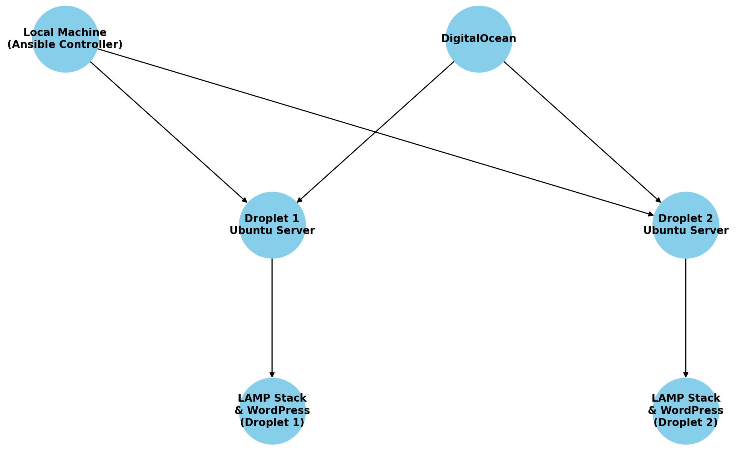
Network Diagram
Notes:
This is the system architecture. We have two droplets acting as independent WordPress hosts, each running a full LAMP stack. Ansible was executed from my local machine to configure both servers identically. While not shown here, this design could be expanded with a load balancer for high availability.

Slide 5
Lessons Learned
• Gained experience with YAML and Ansible automation
• Cloud provisioning through REST API improved deployment speed
• Troubleshooting taught deeper Linux and service management
• GitHub version control helped manage configuration files
• Real-world practice of DevOps principles
Notes:
This project taught me how to use Ansible to automate infrastructure and application deployment. I became more confident with YAML syntax, Linux services, and REST APIs. GitHub was critical for version control, and I now understand how to deploy real-world web applications in a scalable and repeatable way.

