Slide 1

MIDTERM PROJECT
PROJECT: NATURAL LANGUAGE PROCESSING
GROUP :
CAO NGUYEN THAI THUAN – 522H0092
NGUYEN PHAM QUANG HUY – 522H0138
Instructor: Associate Professor, Ph.D. LE ANH CUONG

Slide 2
Outline
Categorize questions about players, leagues and teams in football
Build synthetic datasets using Large Language Models
Common methods of text representation against traditional ML methods
Doc2Vec in action – comparison between pretrained and home-trained

Slide 3
Categorize questions about players, leagues and teams in football
In the field of football, automated question-answering systems and sports chatbots are increasingly being widely applied. One of the critical challenges in this domain is classifying questions into categories such as players, tournaments, and teams. Automatically categorizing questions enhances information retrieval efficiency, improves user experience, and optimizes virtual assistant systems.

Slide 4
Categorize questions about players, leagues and teams in football
The main objectives of this study include:
1.Building a dataset of questions related to players, tournaments, and football teams.
2.Applying machine learning methods to classify questions into predefined categories.
3.Evaluating the performance of each method and proposing an optimal solution.

Slide 5
Categorize questions about players, leagues and teams in football
Benefits of Datasets:
Building a suitable dataset for classifying football-related questions offers several key benefits:
Optimizing search systems: Accurately categorized questions allow systems to quickly provide relevant answers, enabling users to find information more easily.
Improving sports chatbots: Chatbots can better understand question contexts, deliver more precise responses, and enhance user experience.

Slide 6
Categorize questions about players, leagues and teams in football
Benefits of Datasets:
Supporting AI model training: The dataset helps train machine learning models to accurately identify question topics, which can then be applied to other applications like virtual assistants or sports analytics.
Developing sports data analytics applications: AI systems can leverage this data to track search trends, predict popular topics, and generate insights within the football community.

Slide 7
Build synthetic datasets using Large Language Models
Step 1: Define the Dataset Objective
- This dataset is designed to train an NLP model to process football-related questions
- The dataset must be diverse and include various types of questions.

Slide 8
Build synthetic datasets using Large Language Models
Step 2: Identify Main Categories
- We divide the dataset into key categories:
- Football history
- Players and coaches
- Tournaments and clubs
- Football rules
- Statistics and records

Slide 9
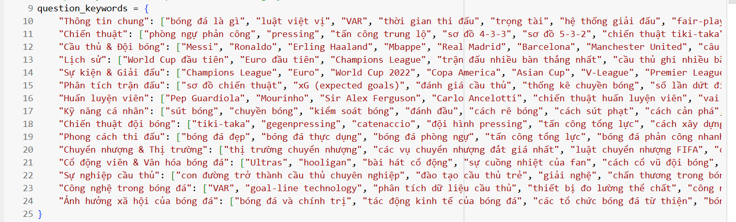
Build synthetic datasets using Large Language Models
Step 3: Build a Keyword List
Create a list of important keywords for each category. Example for "Football History": keywords may include "World Cup," "Euro," "legend," "final," etc.

Slide 10
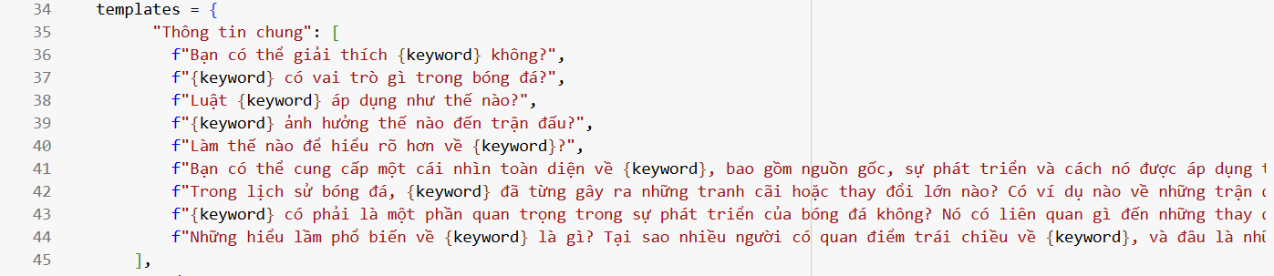
Build synthetic datasets using Large Language Models
Step 4: Construct Question Templates
Develop question templates for each category.

Slide 11
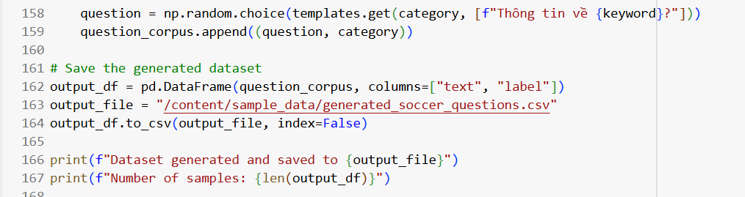
Build synthetic datasets using Large Language Models
Step 5: Generate Data Automatically
Use Python programming to combine keywords and templates into various questions.

Slide 12
Build synthetic datasets using Large Language Models
Step 6: Review and Refine the Data
In this step, we need to achieve:
- Remove duplicate or illogical questions.
- Check grammar and question accuracy.
- Add more keywords to enhance diversity.

Slide 13
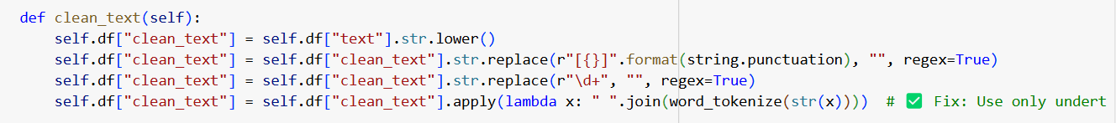
Build synthetic datasets using Large Language Models
Step 7: Data Preprocessing
Convert text to lowercase.
Remove punctuation and numbers.
Tokenize words using NLP techniques.

Slide 14
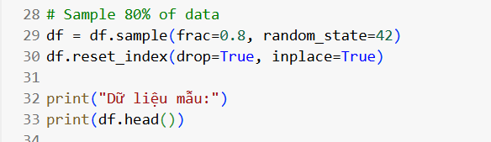
Build synthetic datasets using Large Language Models
2. Data Splitting
Split the dataset into training (80%) and testing (20%) sets.

Slide 15
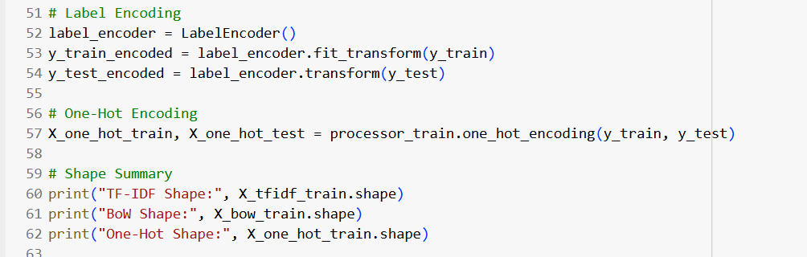
Build synthetic datasets using Large Language Models
3. Text Vectorization and Label Encoding

Slide 16
Common methods of text representation
Three models are trained and evaluated:
Logistic Regression
Naïve Bayes
Decision Tree

Slide 17
Common methods of text representation
Step 1: Encoding the Data
Text data is transformed using BoW, TF-IDF, and One-Hot Encoding.
Labels are encoded using LabelEncoder to fit the data into the models properly.

Slide 18
Common methods of text representation
Step 2: Training and Evaluating Models
Each model is trained on all three text representations.
Accuracy (accuracy_score) and classification reports (classification_report) are recorded.

Slide 19
Common methods of text representation
Step 3: Comparing Results
Accuracy scores for each model and representation method are stored.
A bar chart visualizes model performance.

Slide 20
Common methods of text representation
BoW, TF-IDF and One – hot Encoding
BoW: Maps all unique occurrences of each word from a document.
TF – IDF: Product of the rate of appearance of each term and the logarithmic value of the inverse document’s term rate in the corpus.
One-hot Encoding: a binary vectorization technique where for each present word in the vocab is noted 1 and vice versa.
LabelEncoder:
A vectorization technique where each unique word is a unique integer.

Slide 21
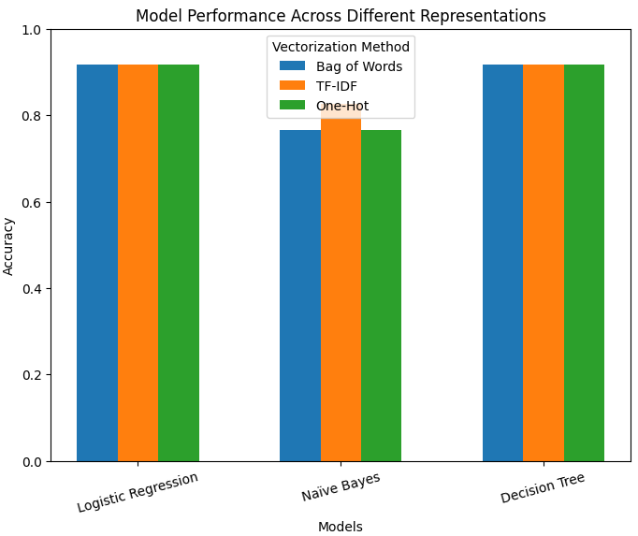
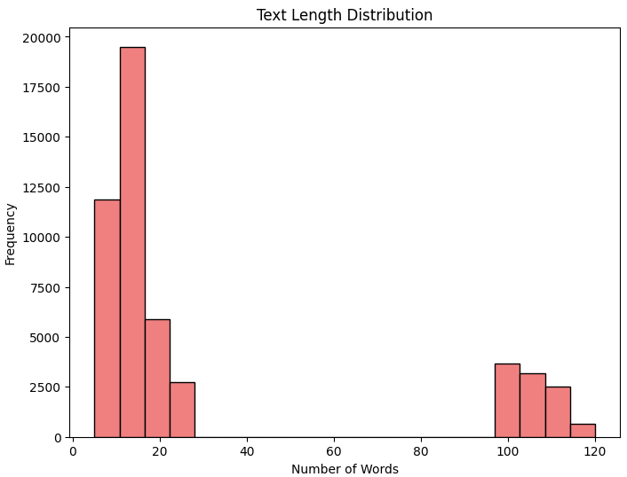
Common methods of text representation
Comparison of accuracies between models(high short – high long):

Slide 22
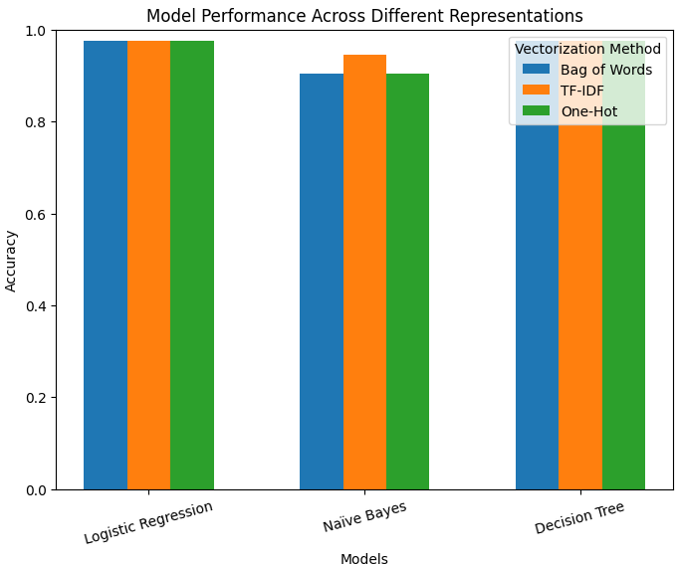
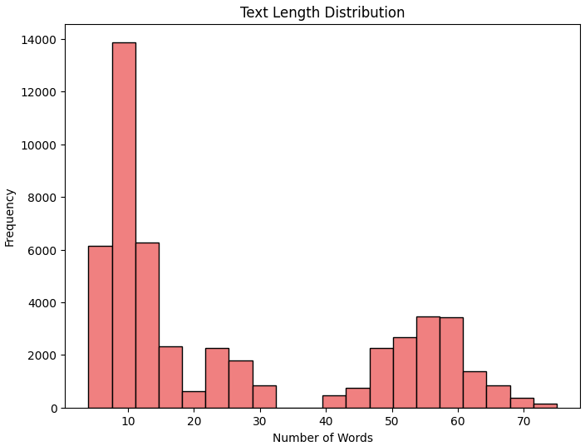
Common methods of text representation
Comparison of accuracies between models(high short – high long – alt dataset):

Slide 23
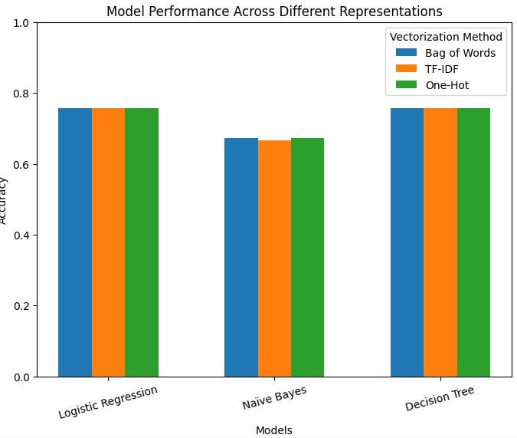
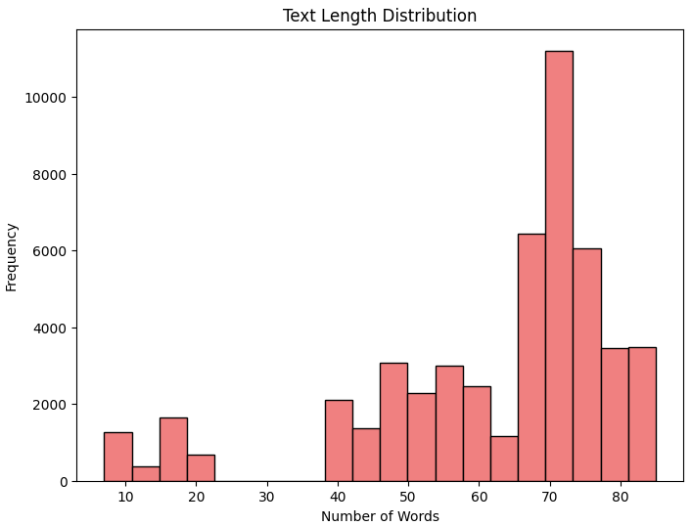
Common methods of text representation
Comparison of accuracies between models(better balanced – alt dataset):

Slide 24
Common methods of text representation
Conclusion:
- These models and vectorization techniques have a harder time at handling longer sentences
- Between topics, templates variability and template length, the template length has the largest impact
- TF – IDF, while being the best vectorization method, also struggles with longer sentences

Slide 25
Doc2Vec
Why not BoW, TF - IDF or One – hot encoding?
- Doesn’t carry order or context
- Calculation resources scales with the size of the corpora
- Struggles with out-of-vocab words

Slide 26
Doc2Vec
The aim of Doc2Vec:
- Reduce high-dimensionality by creating dense, low dimensional vectors that captures meaning and context
- Can handle variable length and new or strange words
- Easier to fine tune

Slide 27
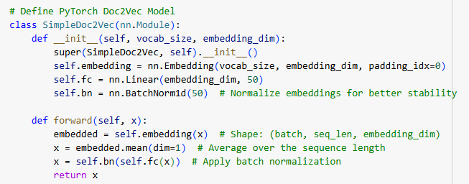

Doc2Vec
Doc2Vec – pretrained vs house-trained

Slide 28
Doc2Vec
Conclusion:
- Very hard to train yourself
- Doc2Vec is a complex but more versatile option for a wider range of problems
- Very dependent on a large corpora for better accuracy

Slide 29
Reference Document
Breiman, L. (2001). Random Forests. Machine Learning, 45(1), 5-32.
Quinlan, J. R. (1986). Induction of Decision Trees. Machine Learning, 1(1), 81-106.
Guyon, I., & Elisseeff, A. (2003). An Introduction to Variable and Feature Selection. Journal of Machine Learning Research, 3, 1157-1182.
Hastie, T., Tibshirani, R., & Friedman, J. (2009). The Elements of Statistical Learning: Data Mining, Inference, and Prediction. Springe

Slide 30
Thanks for your watching This is the end of my group’s report
Subject: Machine Learning

