Slide 1

Advanced Threat Incident Analytics &
Security Visualization Framework
Infosys Springboard 7.0 | Data Analytics Track
Kotla Ambika
Final Review Presentation | Milestones 1 - 4

Slide 2




Project Overview
A Power BI analytics project that tracks cybersecurity incidents end-to-end - starting with descriptive analysis of what happened, extending into geospatial and temporal patterns, and culminating in a predictive, risk-scored view built for executive decision-making.
Milestone 1
Milestone 2
Threat Classification &
Severity Analytics
Geospatial Threat
Intelligence
Built entirely in Power BI using DAX measures, star-schema modeling, Power Query, and native forecasting analytics.
Milestone 3
Milestone 4
Temporal & Incident
Response Analytics
Predictive & Executive
Intelligence
Advanced Threat Incident Analytics and Security Visualization Framework
2

Slide 3
What was built
Built a synthetic cybersecurity dataset in Excel (Security_Incidents, Response_Action, Asset_Inventory, Vulnerability_Data) using real CVE and CVSSv3 identifiers.
Modeled the data using star schema and DAX measures across Power BI.
Milestone 1
Threat Classification &
Severity Analytics
Built an interactive dashboard with KPI cards, category/location breakdowns, severity distribution, monthly trend, and response-time analysis.
Added slicers for Date, Category, Severity, and City.
4
6
4
Data Tables
KPI Cards
Slicers
Advanced Threat Incident Analytics and Security Visualization Framework
3

Slide 4
What was built
Extended the Milestone 1 dashboard with geospatial visuals - bubble map, filled map, and Top 10 Risk Cities.
Added response-time-by-city and threat-concentration analysis.
Milestone 2
Geospatial Threat
Intelligence
Introduced drill-through to a City Details page with dynamic tooltips.
Delivered a 1-page insight report with 3 key insights and 2 business recommendations.
2
1
3
Map Visuals
Drill-through Page
Key Insights
Advanced Threat Incident Analytics and Security Visualization Framework
4

Slide 5
What was built
Added time-based trend analysis - hourly, daily, weekly, monthly, and seasonal.
Built anomaly and activity-spike detection alongside environmental-factor analysis (weather, shift, day type).
Milestone 3
Temporal & Incident
Response Analytics
Added incident response analytics - response/resolution time, team performance, and status distribution.
Delivered two dashboards with 5 key insights and 3 operational recommendations.
2
5
3
Dashboards
Key Insights
Recommendations
Advanced Threat Incident Analytics and Security Visualization Framework
5

Slide 6
Milestone 4
Security Risk Assessment, Predictive Intelligence & Executive Analytics
Part A
Part B
Part C
Part D
Security Risk
Assessment
Predictive
Intelligence
Executive
Intelligence
Dashboard
Interactivity
6

Slide 7
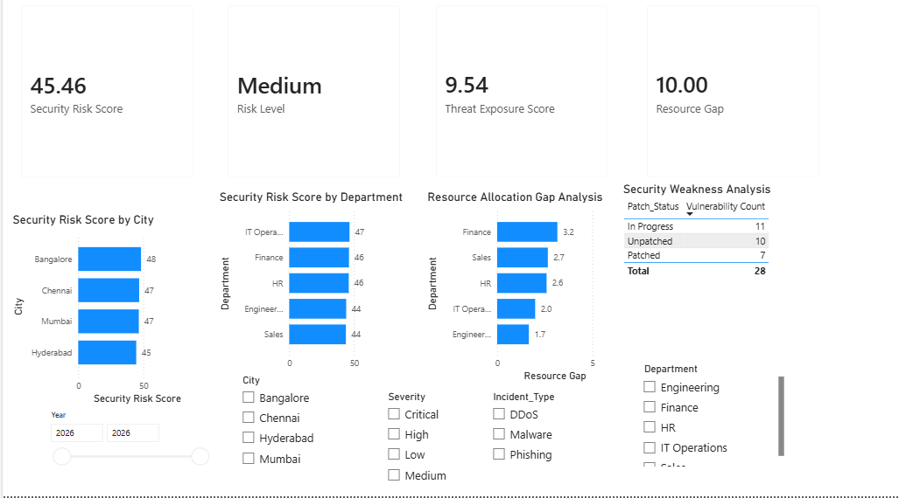
Security Risk Assessment Dashboard
Composite risk scoring by location and department, resource gaps, and vulnerability weaknesses.
45.46
Medium
9.54
10.00
Security Risk Score
Risk Level
Threat Exposure
Resource Gap
7

Slide 8
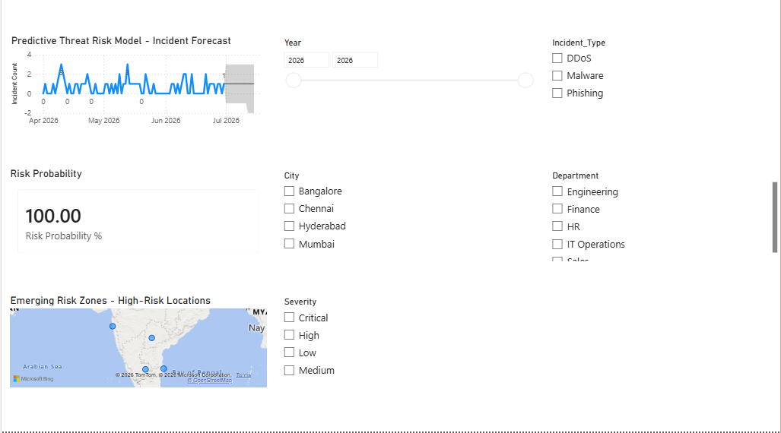
Predictive Intelligence Dashboard
Native Power BI forecasting, risk probability, and emerging high-risk zones.
15-day
100%
95%
Forecast Window
Risk Probability
Confidence Interval
8

Slide 9
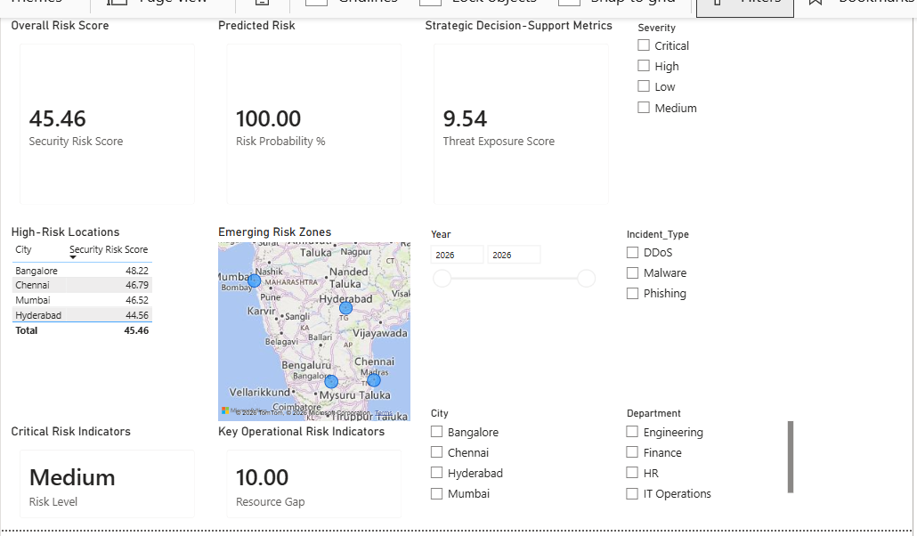
Executive Intelligence Dashboard
A condensed, decision-ready summary built for leadership review.
7
4
5
Executive KPIs
High-Risk Cities Tracked
Synced Slicers
9

Slide 10



Five Key Insights
Overall risk is Medium
Risk is evenly spread across cities
Security Risk Score of 45.46/100 - manageable, but non-trivial.
Bangalore (48), Chennai & Mumbai (47), Hyderabad (45).
Finance & HR are most resource-strained
75% of vulnerabilities are unresolved
Both average 2.0 incidents per analyst; Finance has the worst gap (3.2).
Of 28 tracked: 10 Unpatched, 11 In Progress, only 7 Patched.
IT Operations & Finance carry top risk scores
47 and 46 respectively - the priority departments for action.
10

Slide 11
The Predictive Threat Risk Model uses Power BI's native Forecast analytics on a daily incident-count series, projecting roughly 15 days forward with a 95% confidence band.
Predictive
Findings
Because the dataset spans only 2-3 months, the forecast should be read as an early trend indicator, not a long-range prediction - reflected in its wide confidence band.
Risk Probability % (30-day count vs. 180-day average) is currently at its 100% ceiling - a signal worth flagging, but tempered by the limited historical baseline.
The Emerging Risk Zones map confirms the location findings: Bangalore, Chennai, and Mumbai form the largest risk bubbles and warrant closer monitoring.
11

Slide 12
Three Strategic Recommendations
01
02
03
Prioritize patch remediation
Reallocate analyst capacity
Monitor Bangalore, Chennai & Mumbai jointly
Clear the 10 Unpatched and 11 In-Progress vulnerabilities, starting with Unpatched - the biggest lever on Threat Exposure Score.
Shift capacity toward Finance and HR (2.0 incidents/analyst) from better-resourced teams like Sales and Engineering.
Their risk scores are closely clustered - apply citywide mitigation across all three simultaneously.
12

Slide 13




Tools & Techniques
Power BI Desktop
DAX Measures
Star Schema Modeling
End-to-end dashboard build
Risk scoring, forecasting logic
Relationship-driven data model
Native Forecast Analytics
Geospatial Visuals
Excel & Power Query
Time-series projection
Bubble & filled maps
Synthetic dataset & transforms
13

Slide 14
Thank You
Questions & Discussion
Kotla Ambika | Infosys Springboard 7.0

