Slide 1

Rating Prediction Project
Submitted By:
Ambika Saraf

Slide 2
Introduction
The project is build for a client who wants to introduce ratings feature in their application. They want a model to predict ratings for their pre-existing reviews.
The project consists of two phase:
- Data Collection Phase
- Model Building phase
In first phase we have collected reviews from “amazon.in” and “flipkart.com”
Our goal here is to build a classification model to predict ratings for each review.

Slide 3
Data Set Description
In our scraped data the target variable “Ratings” is categorical variable and has 5 classes whereas, “Reviews” is feature containing text data.
We collected the data from difference e-commerce websites like www.Amazon.in and www.Flipkart.com . The data is scrapped using Web scraping technique and the framework used is Selenium.
We scrapped nearly 52000 of data.
We have created separate data frames for each product and combined all the data frames into a single data frame in the end.
Next we have saved it into a csv file.
Data fetched looks like as shown below:

Slide 4
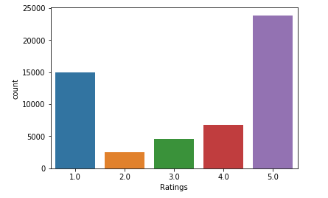
Data Visualizations
Distribution of ratings in data scraped
5.0 : 23857
1.0 : 14995
4.0 : 6786
3.0 : 4551
2.0 : 2556

Slide 5
Data Pre-processing
We have used data cleaning steps involved in NLP and modified data which is not in proper format.
First step is to removed stopwords.
Created another function named “Clean_data” which involves :
Removing ‘\n’ or extra lines.
Removing numbers, HTML tags, websites, unwanted white spaces, etc.
Transforming text into lower case.
Next we have removed remaining small and irrelevant tokens and Lemmatized words using WordsNetLemmatizer().
We know the list of products of which we have scraped reviews so we will remove those product names from reviews.
Functions defined are given in next slide

Slide 6
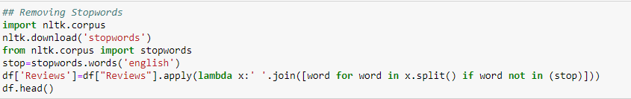
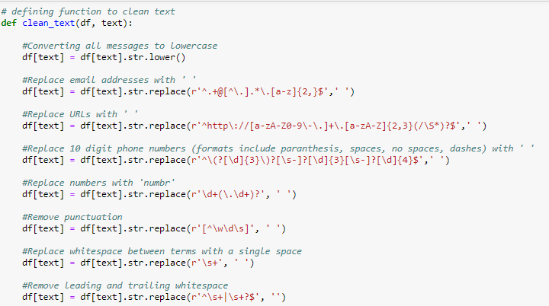
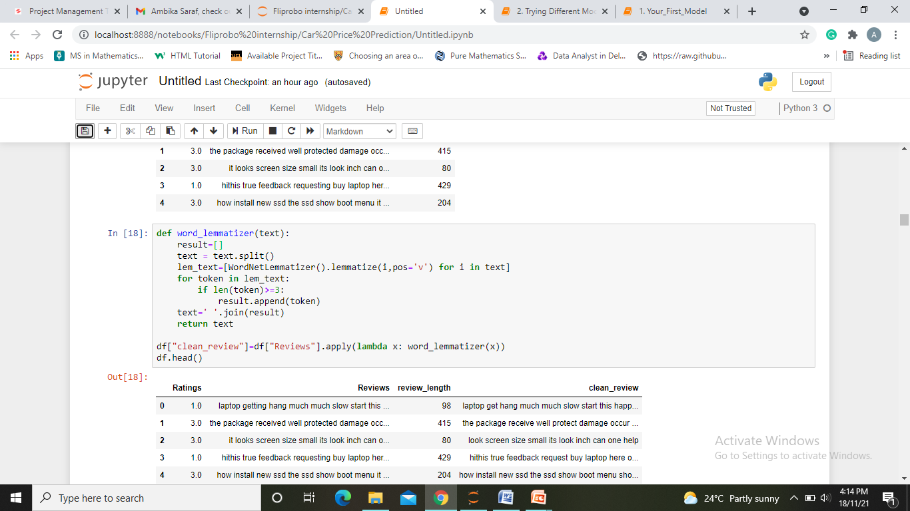

Slide 7
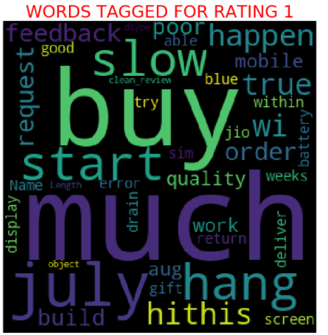
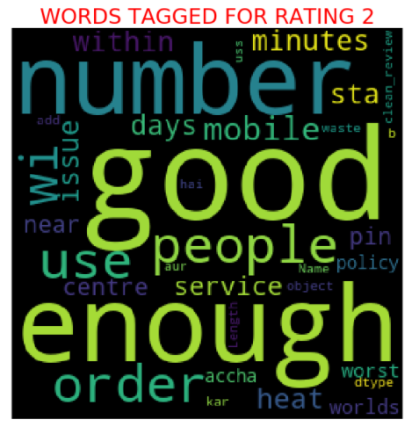
Plotting Wordclouds

Slide 8
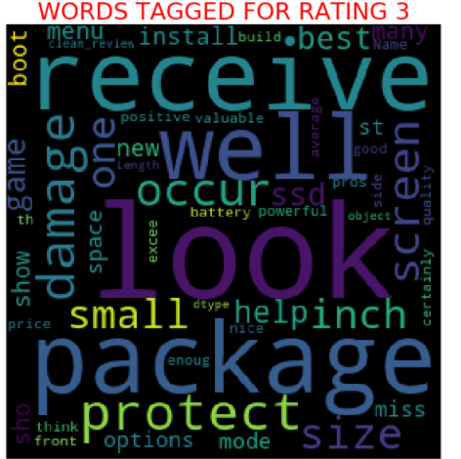
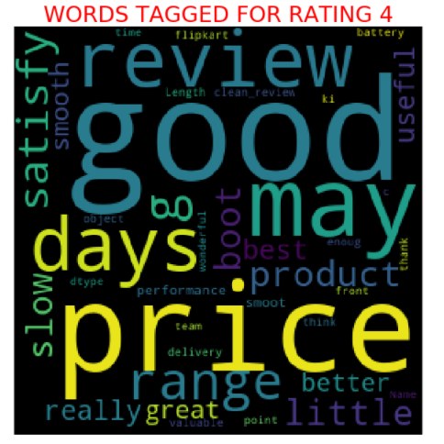
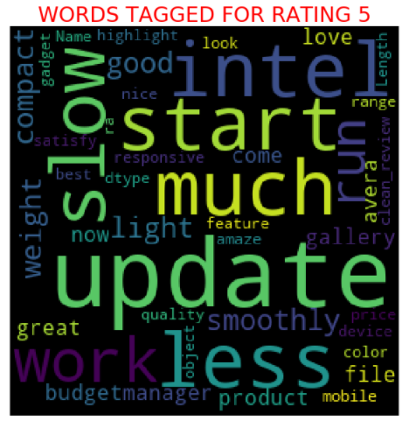

Slide 9
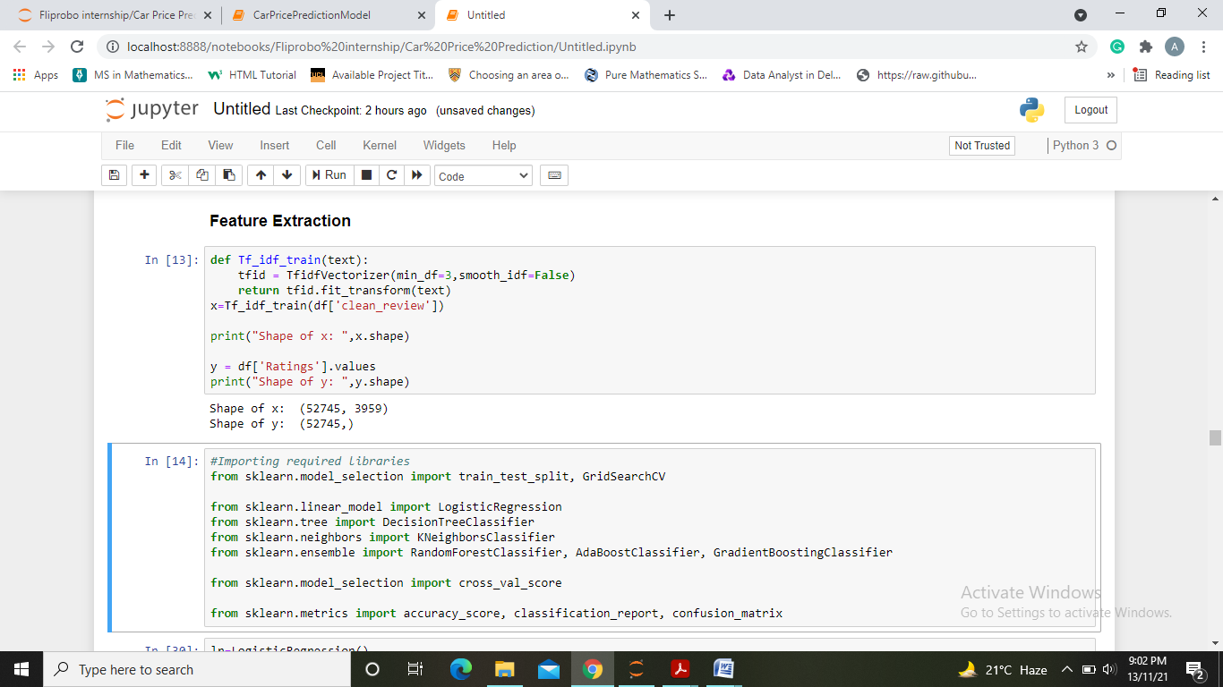
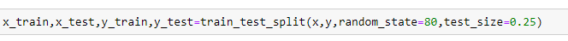
Preparing Data for Modeling
We have first separated data and then converted it to number features using TfidVectorizer. Further split our data into train and test part by determining the best random state for Logistic Regression Algorithm.

Slide 10
Model Building and Evaluation
Algorithms used are:
Logistic Regression
Decision Tree Classifier
KNeighbors Classifier
Random Forest Classifier
Gradient Boosting Classifier
AdaBoostClassifier

Slide 11
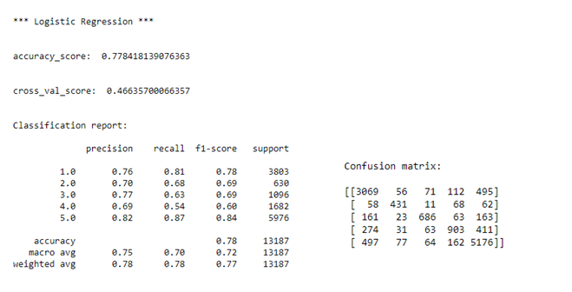
Logistic Regression

Slide 12
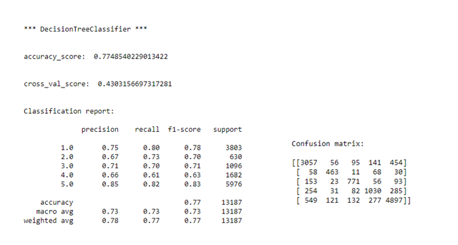
DecisionTree Classifier

Slide 13
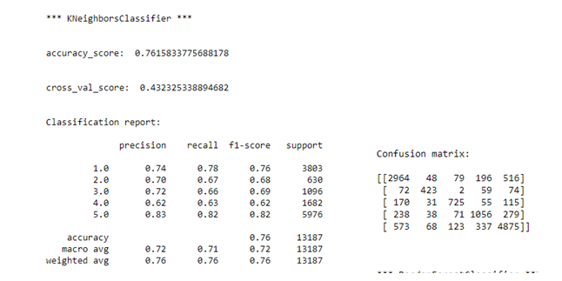
Kneighbors Classifiers

Slide 14
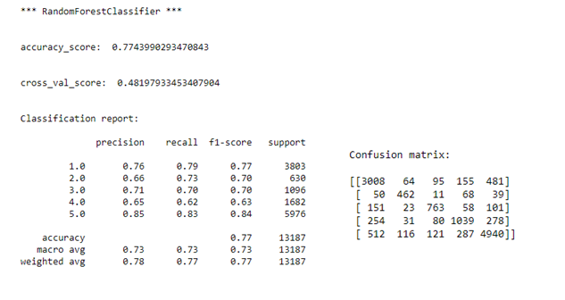
Random Forest Classifiers

Slide 15
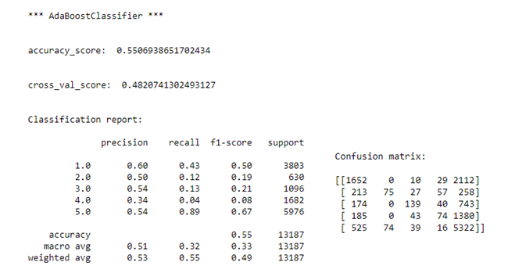
AdaBoost Classifier

Slide 16
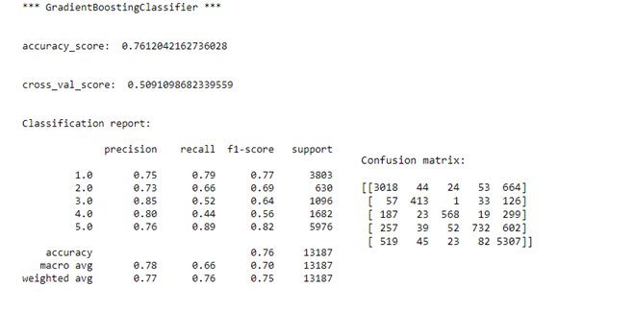
Gradient Boosting Classifier

Slide 17
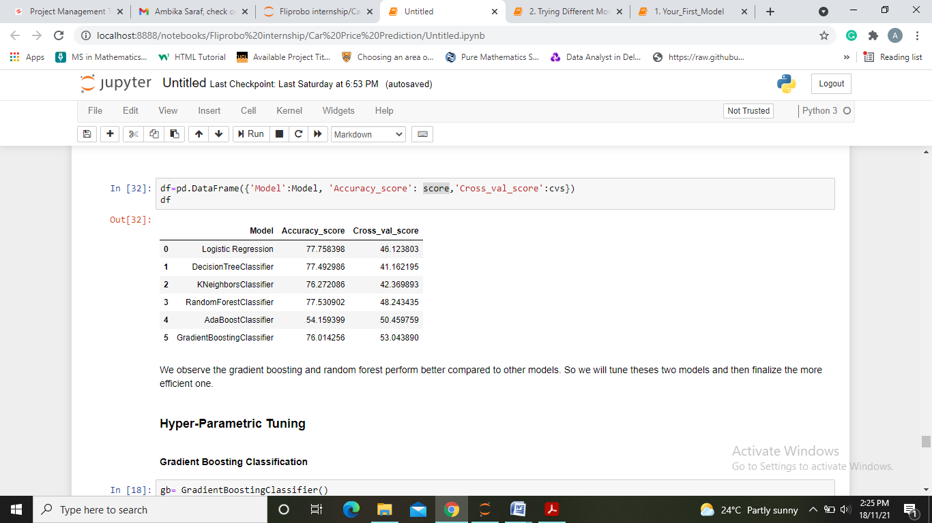
Data Frame below shows the algorithms used and the accuracy scores and CV scores obtained
Looking the various metrics we conclude the gradient boosting and random forest perform better compared to other models. So we will tune theses two models and then finalize the more efficient one.

Slide 18
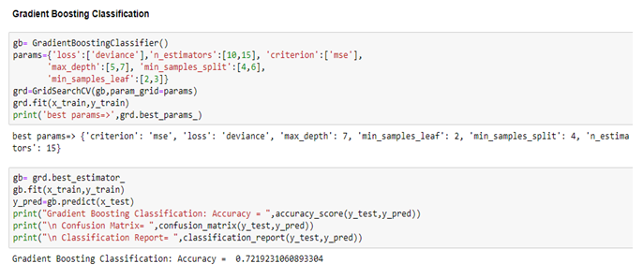
HYPER-PARAMETRIC TUNING

Slide 19
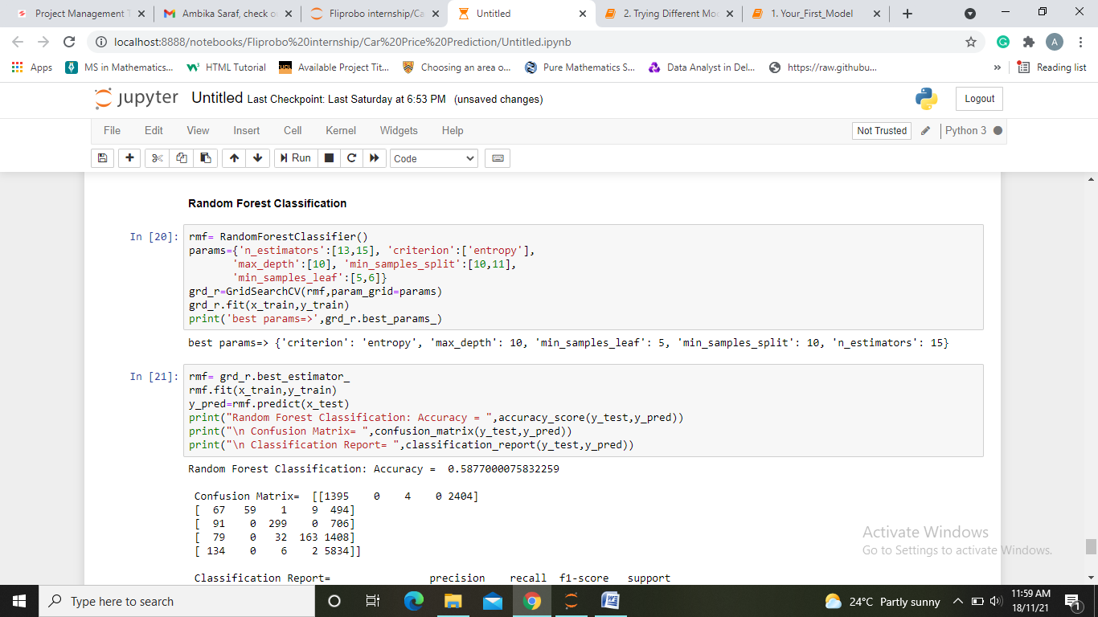

Slide 20
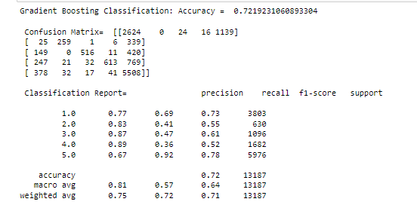
After applying hyper-parameter tuning we can see that Gradient Boosting classifier gives an accuracy of 72.19% and Random Forest Classifier gives an accuracy of 58.77%. Therefore we will finalize Gradient Boosting Model as our final model and save it using pickle for future use.

Slide 21
Conclusion
KEY FINDINGS AND CONCLUSIONS OF THE STUDY
First, we collected the reviews and ratings data from different e-commerce websites like Amazon and Flipkart and it was done by using Webscraping (Selenium).
We collected almost 52000 of data which contained the ratings from 1.0 to 5.0 and their reviews. Then we combined it into a single dataframe and saved it to a csv file.
We have used NLP to pre-process and clean data following steps were performed:
Removing punctuations, e-mails, numbers, white spaces, etc.
Removing stopwords
Lemmatizing and removing words with length less than 3
After looking at various metrics and parametric tuning we concluded gradient boosting model with accuracy 72.19% as our best model and saved it using pickle.

Slide 22
LEARNING OUTCOMES OF THE STUDY IN RESPECT OF DATA SCIENCE
After the completion of this project, we got an insight of how to collect data, pre-processing the data, analyzing the data and building a model. We have used NLP techniques to clean data. Also it helped me in exploring different algorithms and metrics to get the best output.
LIMITATIONS OF THIS WORK AND SCOPE FOR FUTURE WORK
More time consumption during hyperparameter tuning for both models, as the data was large and less number of parameters were used during tuning. This project is done with limited resources and can be made more efficient in future.

Slide 23
Thank you

