Slide 1

A Project Presentation on Development and Performance Evaluation of An Application for News Article Summarization, Classification and Sentiment Analysis Using Deep Learning models
BHEEMA INSTITUTE OF TECHNOLOGY & SCIENCE
ALUR ROAD, ADONI-518301, KURNOOL DIST, A.P.
Submitted by
𝐉 𝐀𝐌𝐁𝐈𝐊𝐀 - 𝟐𝟏𝟐𝐊𝟏𝐀𝟎𝟓𝟏𝟓
𝐒 𝐁 𝐇𝐈𝐌𝐀𝐂𝐇𝐀𝐍𝐃𝐑𝐈 - 𝟐𝟏𝟐𝐊𝟏𝐀𝟎𝟓𝟒𝟕 || 𝐒𝐇𝐀𝐌𝐒𝐇𝐔𝐃𝐃𝐈𝐍 𝐌 𝐆 𝐌 - 𝟐𝟏𝟐𝐊𝟏𝐀𝟎𝟓𝟓𝟐 𝐒 𝐕𝐄𝐍𝐊𝐀𝐓𝐄𝐒𝐇 - 𝟐𝟏𝟐𝐊𝟏𝐀𝟎𝟓𝟒𝟒 || 𝐍 𝐒𝐇𝐀𝐈𝐊𝐒𝐇𝐀𝐕𝐀𝐋𝐈 - 𝟐𝟏𝟐𝐊𝟏𝐀𝟎𝟓𝟑𝟔
Under the guidance of
Sri K. ARJUN M. Tech., (Ph. D.)
Associate Professor, Department of CSE, BITS-Adoni.

Slide 2
CONTENTS
Abstract
Introduction
Literature Survey
Existing System
Disadvantages of Existing System
Proposed System
Advantages of Proposed System
System Requirements
System Architecture
UML Diagrams
Module Overview
Technology Description
Transformers
Evaluation Metrics
Output Screens
Conclusion
Future Enhancements
References

Slide 3
ABSTRACT
The project "Development and Performance Evaluation of an Application for News Article Summarization, Classification, and Sentiment Analysis using Deep Learning Models" uses NLP techniques with DistilBERT to generate concise summaries and categorize news articles.
In this study, we evaluated the performance of DistilBERT in resource-constrained environments.
The project Implemented in Python with Streamlit, it leverages Pandas, NLTK, and Transformers for processing.
Performance is evaluated using ROUGE score and classification accuracy metrics.
This solution tackles information overload.

Slide 4
INTRODUCTION
In today’s digital world, an overwhelming amount of news is published daily, making it difficult to process and understand all the information efficiently.Our project, " Development and Performance Evaluation of an Application for News Article Summarization, Classification, and Sentiment Analysis using Deep Learning Models " solves this challenge using Natural Language Processing (NLP) to automatically summarize and categorize news articles.
Uses DistilBERT for accurate, concise news processing.
This project empirically evaluates DistilBERT’s real-world performance in a news analysis system, highlighting its usability for summarization, classification, and sentiment analysis in resource-constrained environments.
Built with Python, Streamlit, Pandas, Transformers, and Torch.
Kaggle dataset (THESTAR) used for training & evaluation.

Slide 5
LITERATURE SURVEY
Problem statement: Big language models like BERT work really well but need a lot of computing power. A smaller model called DistilBERT is faster, but we still don’t know how well it works for tasks like analyzing news articles, especially on devices with
limited resources.
Project Contribution: Our approach is based on the foundational work detailed in DistilBERT: A distilled version of BERT (Sanh et al., 2019), which serves as the main base paper for this project and demonstrates how a model can retain 97% of BERT’s performance while being 40% smaller and 60% faster.
Key Differentiator:
Unlike prior work focused solely on model design, this project emphasizes performance evaluation and real-world usability in resource-constrained environments.

Slide 6
EXISTING SYSTEM
Over time, different techniques have been used for news article summarization and classification, evolving from basic rule-based methods to advanced AI models like Transformers.
Rule-Based Systems: Used TF-IDF, lacked context & flexibility.
ML-Based Systems: Needed feature engineering, struggled with meaning.
RNN & Seq2Seq: High computation cost, long training time.

Slide 7
DISADVANTAGES OF EXISTING SYSTEM
Rule-Based Systems (e.g., TF-IDF)
Ignored word context and semantics
Poor performance on complex sentences
Machine Learning-Based Systems
Required manual feature engineering
Performance highly dependent on data quality
RNN / Seq2Seq Models
High computational cost
Long training and inference times
Struggled with long-range dependencies in text

Slide 8
PROPOSED SYSTEM
Our proposed system improves news summarization and classification by using a unified model architecture based on DistilBERT. This allows shared contextual learning, enhancing output accuracy.
Transformer-Based Systems (BERT, GPT, DistilBERT)
Self-attention mechanisms enable deep contextual understanding, producing more accurate and meaningful summaries.
Benefits: Better generalization, improved efficiency and works well with real-time applications.

Slide 9
KEY IMPROVEMENTS
✅ Unified Transformer-Based Architecture
Uses DistilBERT for shared contextual learning
✅ Deep Contextual Understanding
Powered by self-attention mechanisms
Captures meaning beyond individual words - better comprehension of full text.
✅ Improved Performance
More accurate summaries and classifications
Better generalization across various types of news articles
✅ Efficient and Lightweight
Faster inference with lower resource usage
Suitable for real-time applications and resource-constrained environments.

Slide 10
HARDWARE & SOFTWARE REQUIREMENTS
Hardware :
Processor : Intel Core I5 Or AMD Ryzen 5
Memory : A Minimum of 8GB RAM
Graphics Processing Unit : A Mid-range GPU
Storage : At Least 6GB Of SSD Storage
Connectivity : A Stable Internet Connection Is Necessary
Software :
Operating System : Operating Systems Including Windows, Macos, And Linux
Programming Language : Python 3.7
Libraries And Frameworks : Transformers, Torch, Pandas, Numpy, Streamlit,
Beautifulsoup4, Requests, Openpyxl, Wordcloud , Matplotlib, NLTK And Summarizer.

Slide 11
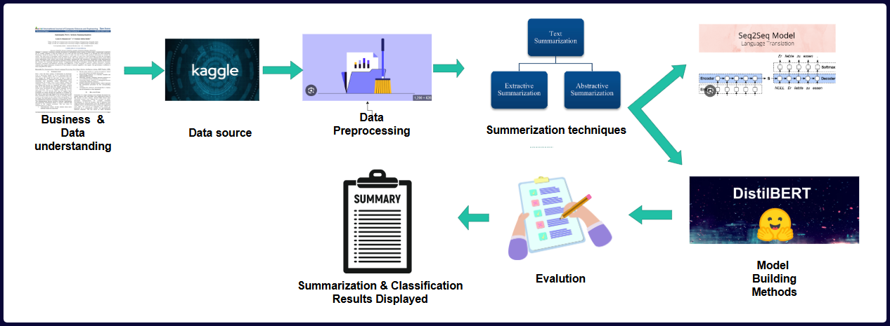
PROJECT ARCHITECTURE
Fig 1:Project Architecture

Slide 12
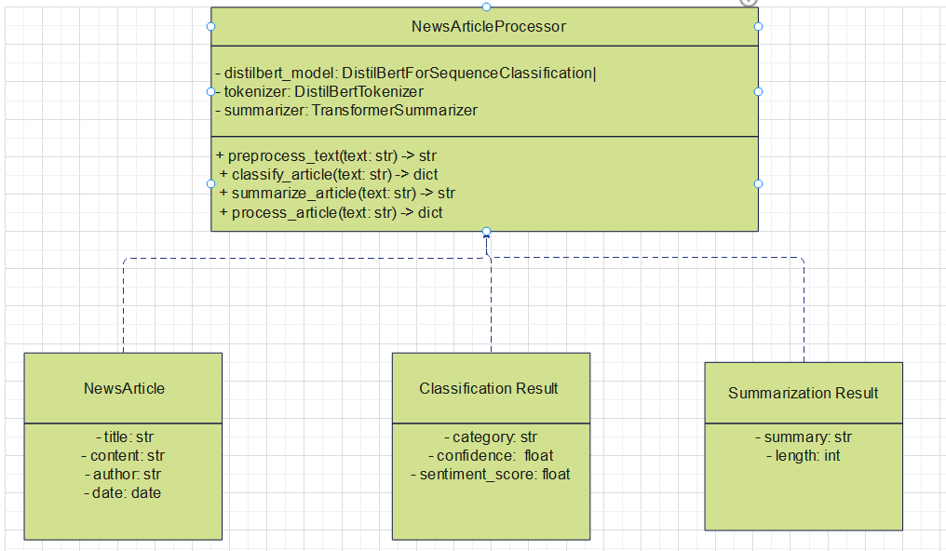
UML Diagrams
Fig 1: Class Diagram

Slide 13
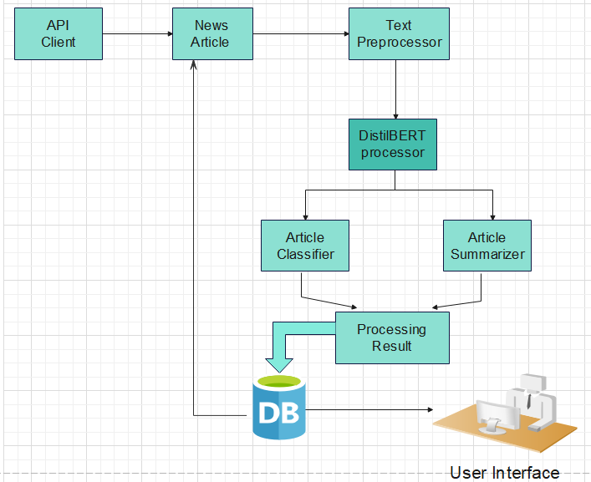
UML Diagrams
Fig 2: DataFlow Diagram

Slide 14
MODULE OVERVIEW
Summarization Module: Extractive & abstractive techniques.
Classification Module: Categorizes articles.
Sentiment Analysis: Sentiment analysis identifies and categorizes emotions in text as positive, negative, or neutral.

Slide 15
TECHNOLOGY DESCRIPTION
Python: Simplicity & Extensive NLP Support.
Libraries: Pandas, Numpy, Transformers, NLTK, Summarizer, Torch.
Data Processing: Web Scraping, Text Cleaning, Dataset Management.
Summarization & Classification: Extractive & Abstractive Techniques.
Visualization: Streamlit-Ui, Word-Cloud, Matplotlib.

Slide 16
TRANSFORMERS
What is a Transformer?
A Transformer is a deep learning model designed to process and understand text by using a mechanism called self-attention. It helps the model focus on important words in a sentence and understand the context—no matter how far apart the words are.
Why Transformers Matter
They understand full sentence meaning, not just individual words.
Enable powerful models like BERT, GPT, and DistilBERT.
Provide faster training and better performance than older models like RNNs.

Slide 17
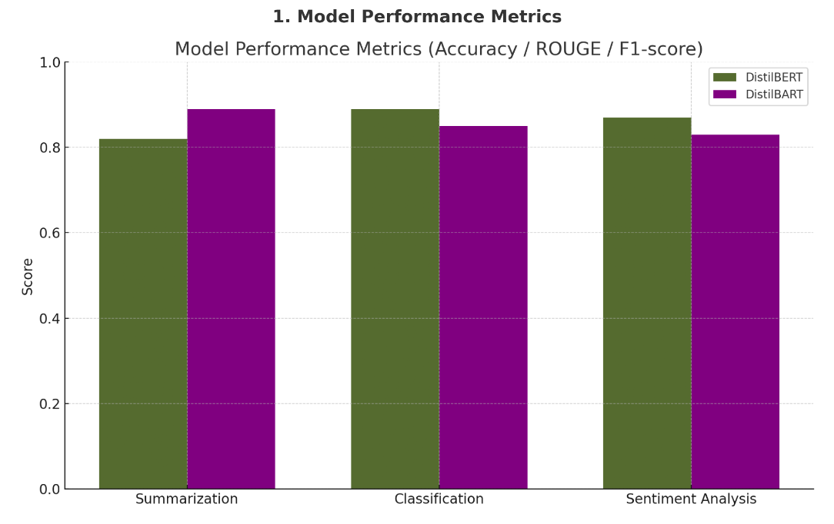
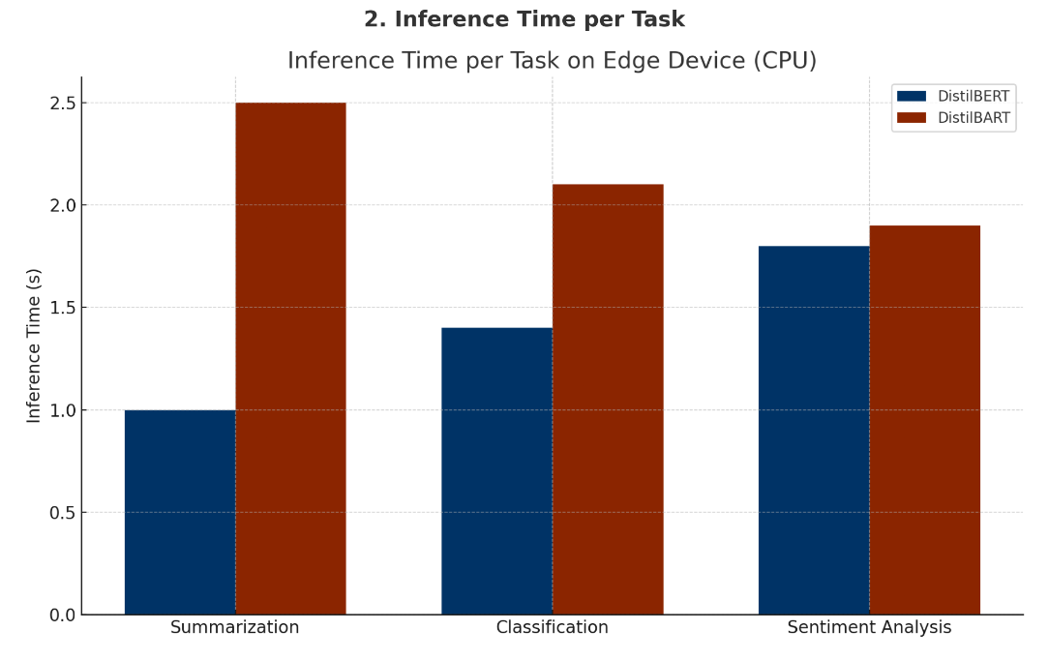
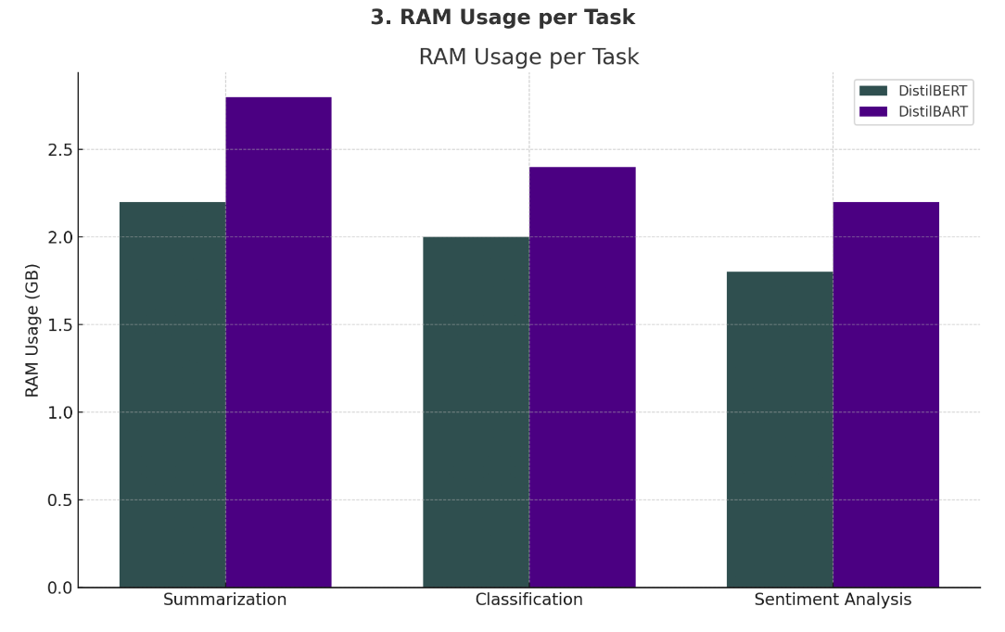
EVALUATION METRICS
Fig 1: Model Performance Metrics
Fig 2: Inference Time per Task
Fig 3: Ram Usage per Task
DistilBART slightly outperforms DistilBERT in summarization, while DistilBERT shows better performance in classification and sentiment analysis, suggesting greater versatility.
DistilBERT achieves consistently faster inference times than DistilBART across all tasks on an edge device using CPU, indicating better efficiency.
DistilBERT uses less RAM than DistilBART across all tasks, making it more suitable for deployment on resource-constrained devices.

Slide 18
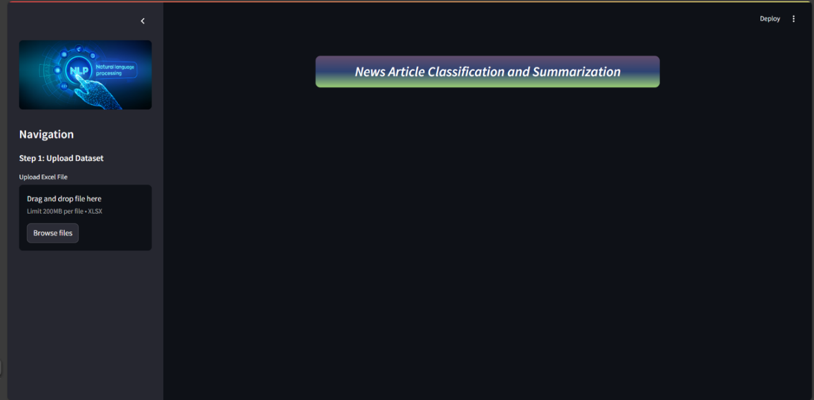
OUTPUT SCREENSHOTS
Fig 1: Web UI Landing Page

Slide 19
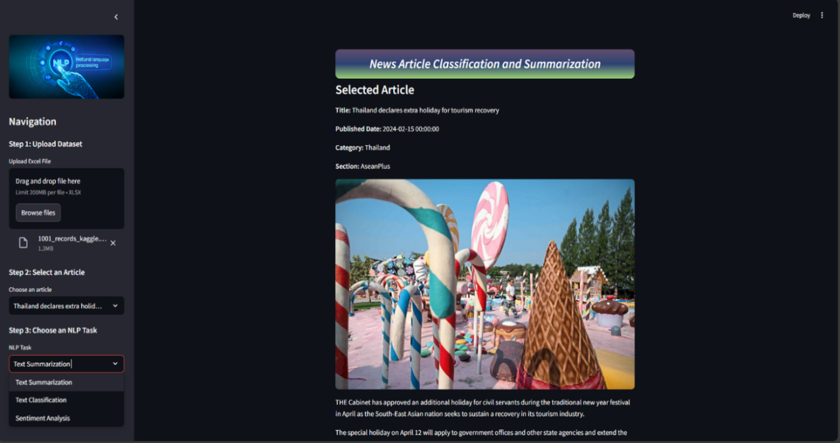
Fig 2: A News Article is Loaded from The Dataset

Slide 20
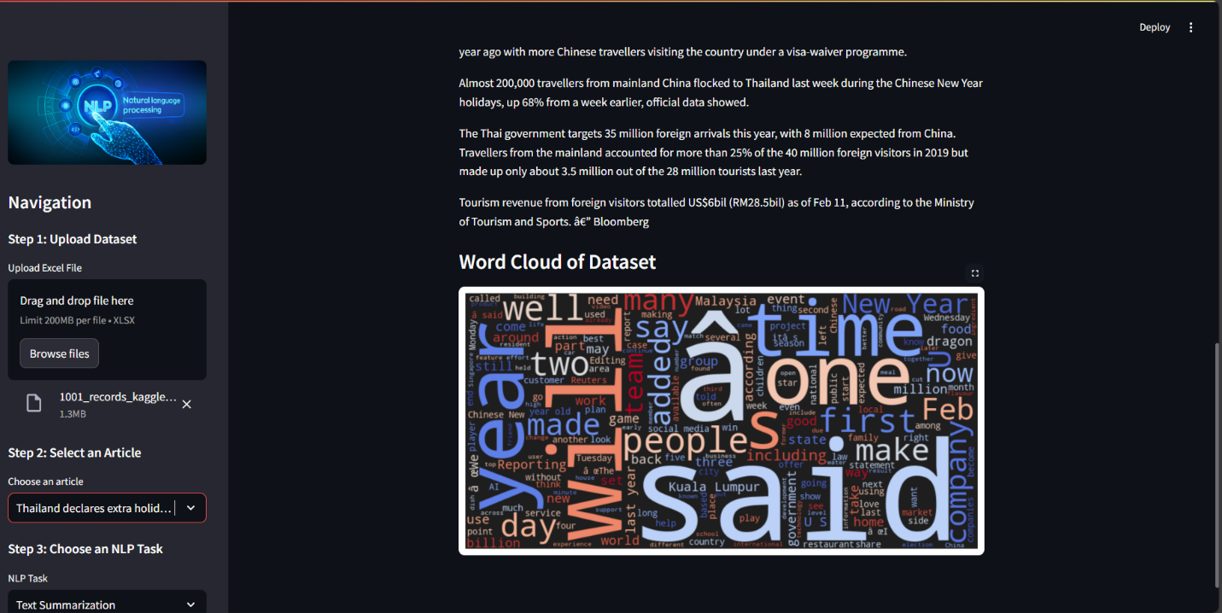
Fig 3: Displaying the Word Cloud

Slide 21
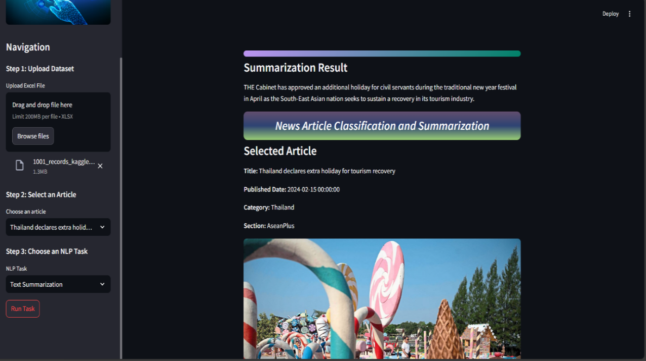
Fig 4: Displaying Text Summarization Results

Slide 22
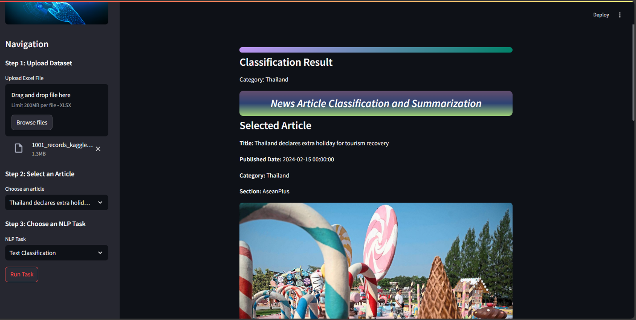
Fig 5: Displaying Text Classification Results

Slide 23
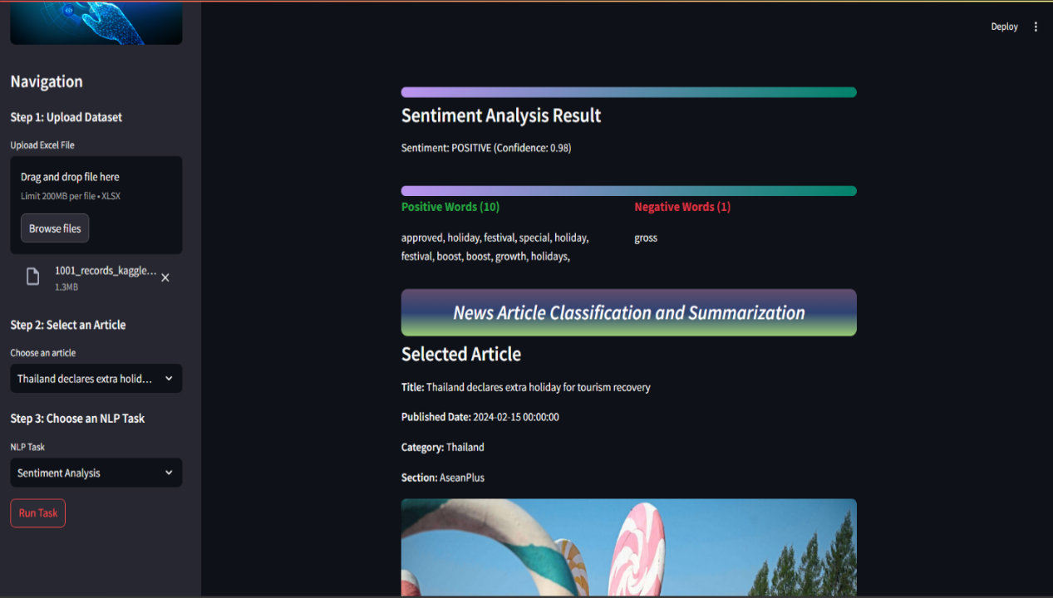
Fig 6: Displaying Sentimental Analysis Results

Slide 24
CONCLUSION
Successfully summarizes & classifies news using DistilBERT.
Hybrid summarization ensures coherent summaries.
Achieved high classification accuracy with user-friendly UI.
Addressed challenges like data quality & scalability.
System is adaptable for future NLP advancements.

Slide 25
FUTURE ENHANCEMENTS
Further Fine-Tuning: Fine-tune DistillBERT on domain-specific datasets to
enhance classification accuracy.
Cloud & Containerization: Deploying the system using Docker & cloud platforms (AWS, Google Cloud) for better scalability.
Interactive Summarization & Classification: Allow real-time adjustments to summary length or classification settings using an interactive UI.

Slide 26

THANK YOU

