Slide 1

FINAL PROJECT group -7
Big Data Analytics: Georgian College
BDAT1001:Information Encoding Standards
Nital Shah
April 10,2023

Slide 2
PROJECT SUMMARY
The Contact Manager project is an ASP.NET Core web application that uses user authentication and authorization to secure user data.
The app allows registered users to create, view, edit, and delete their own contact information, which is protected by authorization.
The app provides secure access to contact data, ensuring that only authorized users can view and modify the data.
The app has three security groups: Registered Users, Managers, and Administrators, each with specific permissions and roles.
Registered Users
Registered Users can view all approved data and edit or delete their own data.
Managers
Managers approve/reject contacts and only approved ones are visible to users. They manage a list of pending contacts for approval.
Administrators
Administrators have complete control over contact data, allowing them to manage the entire data set.

Slide 3
Group Members
AMBILI RATHI: 200543432
(Master of Computer Application)
ARYA SREEKUMAR: 200543435
(Master of Computer Application)
JISNA JOHN: 200512388
(Masters in Space Science and Technology)

Slide 4
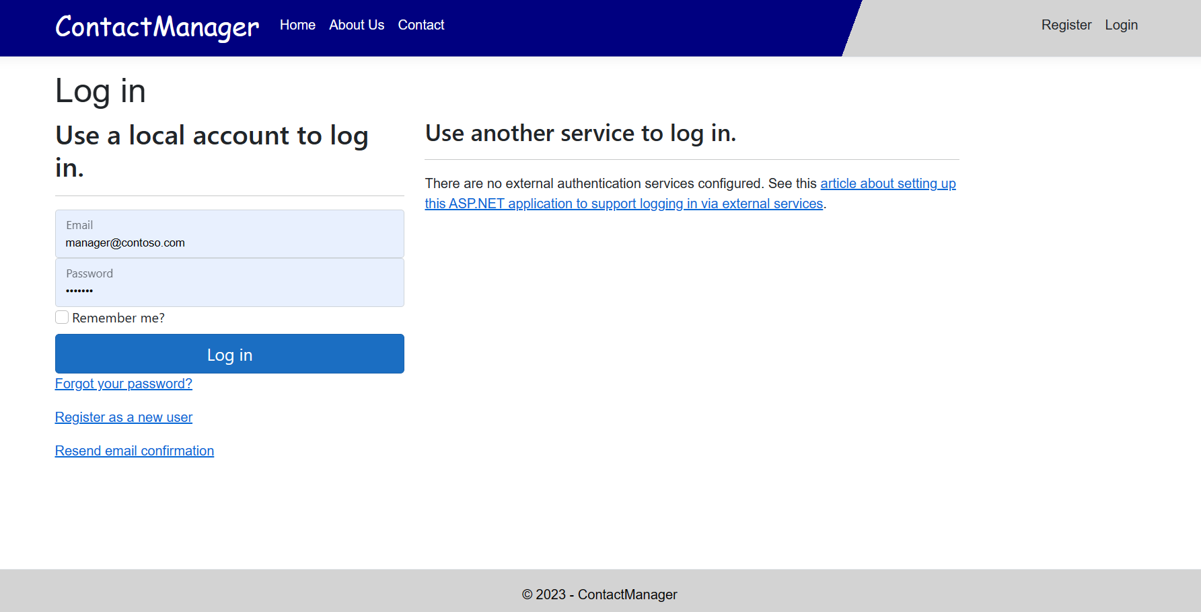
Part 1 User Data Protected By Authorization
Login Page

Slide 5
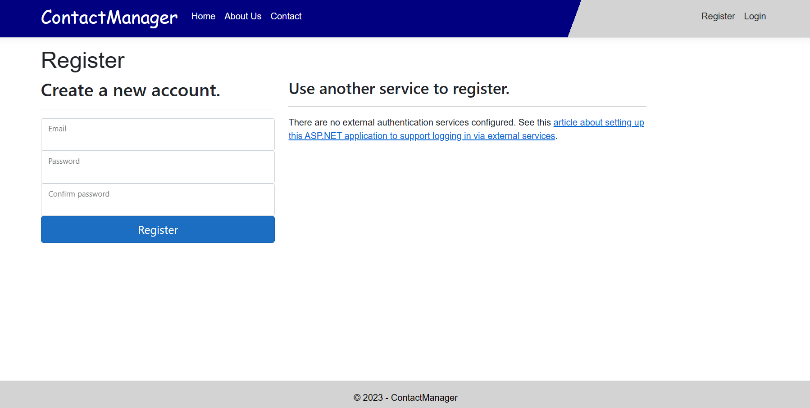
Register page

Slide 6
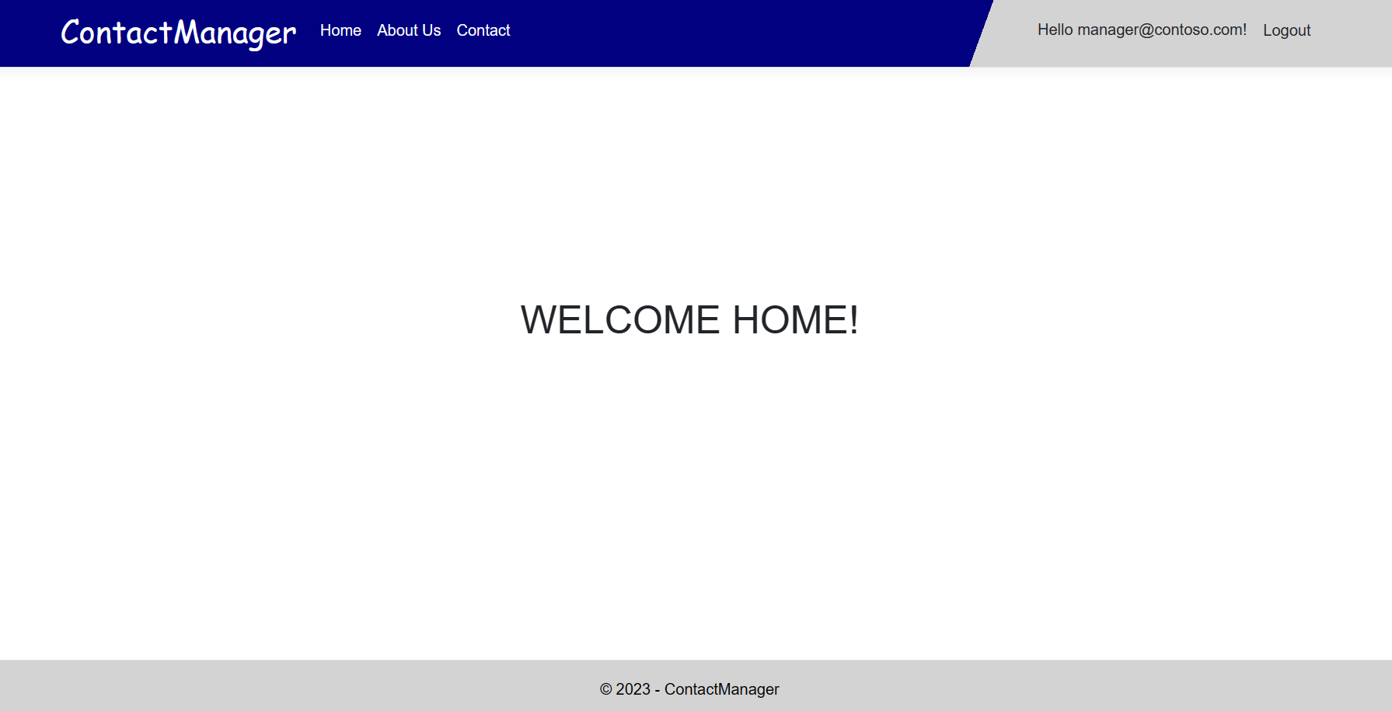
Manager Homepage

Slide 7
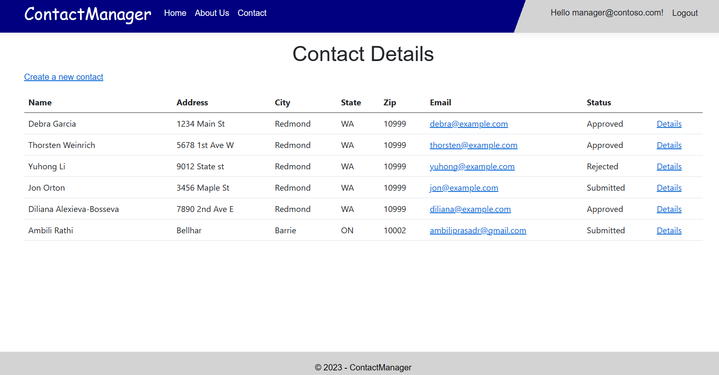

Slide 8
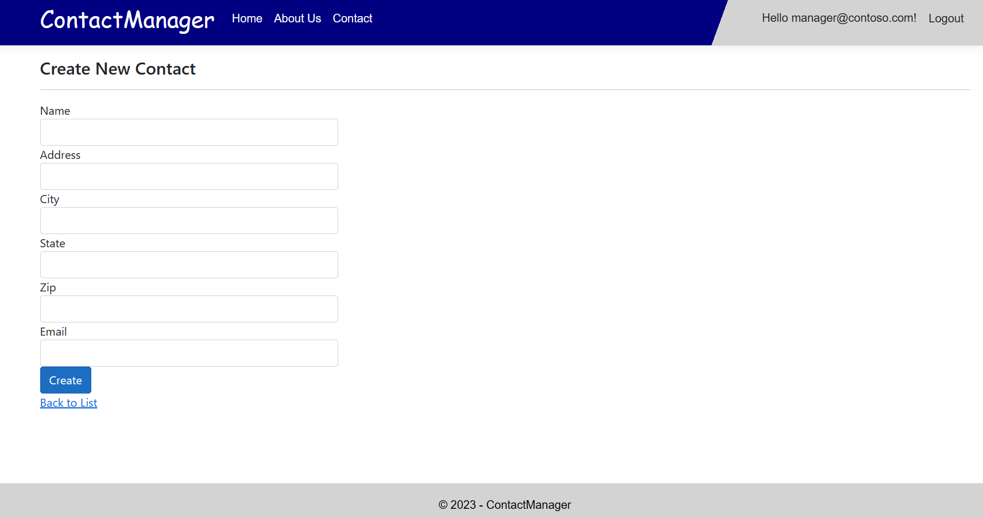

Slide 9
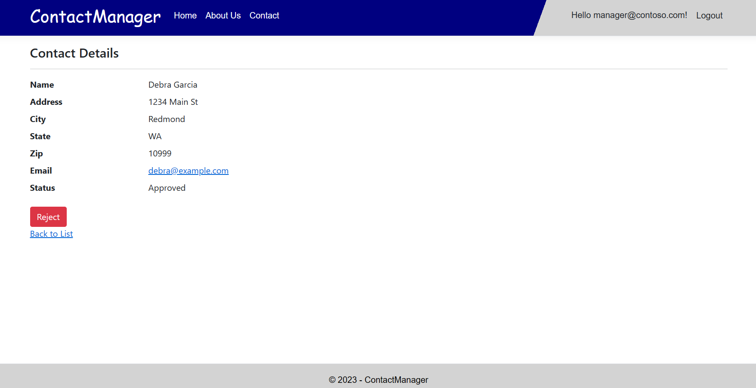

Slide 10
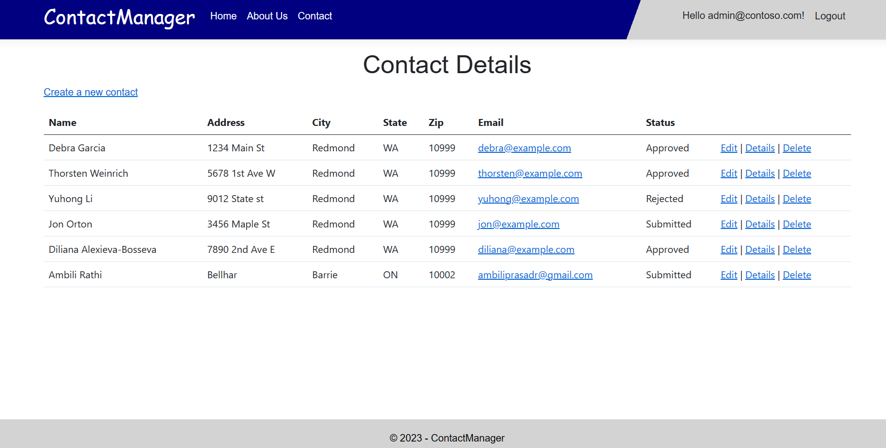
Admin-Contact page

Slide 11
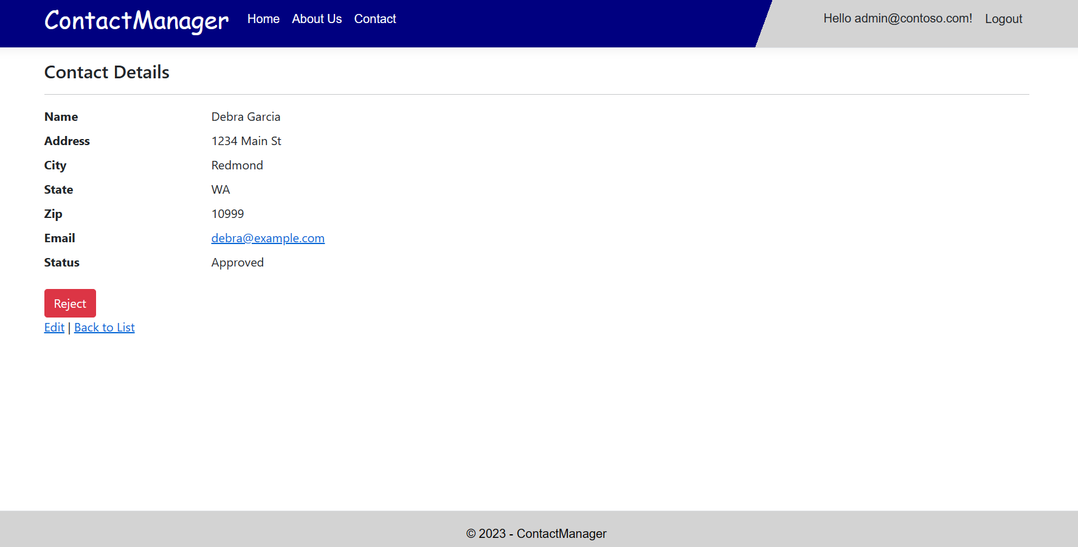
Admin-Contact Details

Slide 12
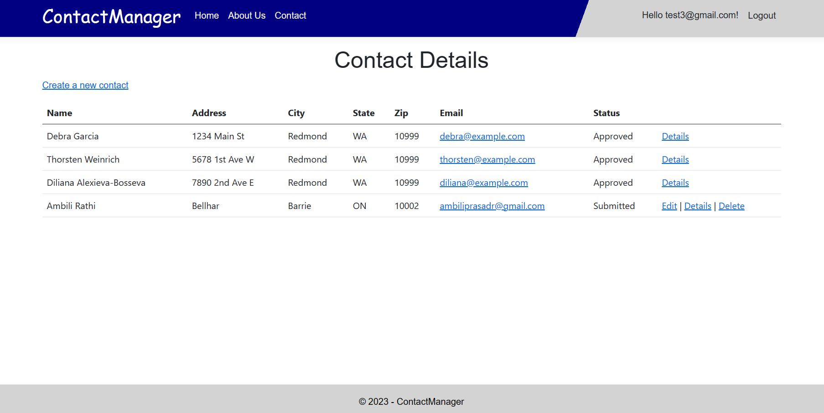
Registered-Contact List

Slide 13
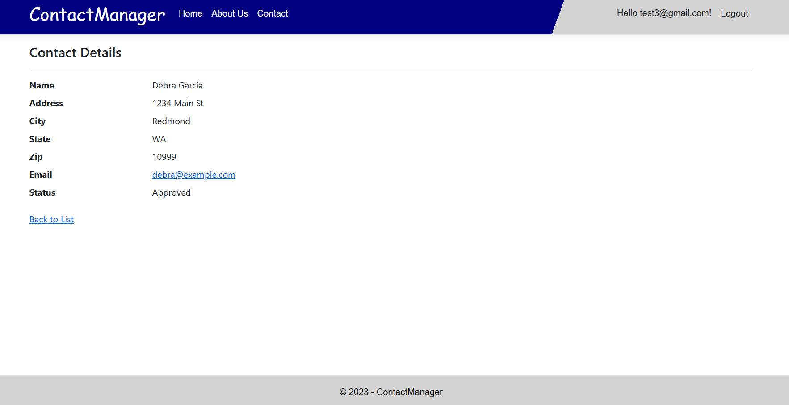
Registered User-Contact Details

Slide 14
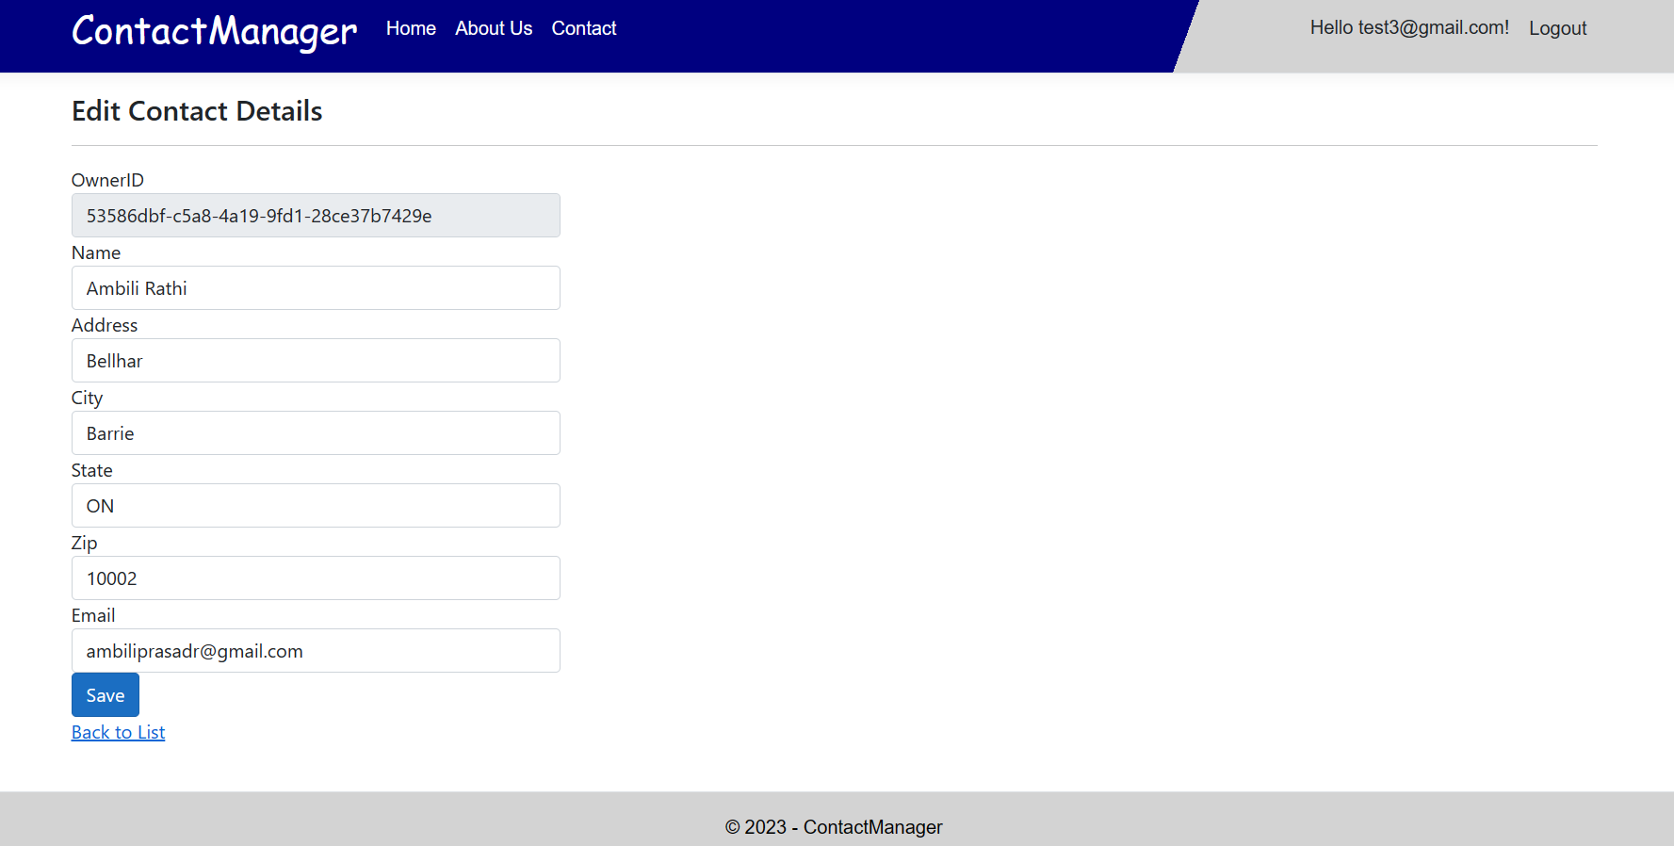
Registered user-Edit Contact Details

Slide 15
Part 2 Security Technologies Recommendations
How can we transfer personal data securely within their network?
1. Data Encryption:
Encrypt sensitive personal data before transferring it over the network.
Four effective encryption techniques are AES, RSA, Triple DES, and Blowfish.
2. Access Control for Secure Information:
Limit data access to authorized employees.
Identify who needs access and implement authentication procedures, user rights, and access control methods like multi-factor authentication, attribute-based access control, or role-based access control.

Slide 16
3. Virtual Private Network (VPN):
Use a VPN to securely transfer data within your company's network.
A VPN creates an encrypted tunnel between two endpoints for secure data transfer.
4. Effective Communication Strategy:
Establish clear communication channels among team members involved in the data transfer process.
Share knowledge of the data, its structure, and how it moves between systems to prevent interruptions that could lead to data loss.
5. Ethical Concerns:
Personal data should be protected and not misused.
Consider the ethical implications of collecting, storing, and transferring personal data and ensure compliance with regulations like GDPR, CCPA, or HIPAA.

Slide 17
What security protocol is best for transferring personal files?
1. FTPS (File Transfer Protocol Over SSL)
Uses SSL/TLS to make FTP secure
Certificates are used to verify user identity and prevent unauthorized access
Requires two ports on the client server, which may be challenging to obtain
across a firewall
2. SFTP (SSH File Transfer Protocol)
Based on Secure Shell cryptography and uses encryption to transfer data
Allows the use of key pairs and host-based authentication
Encryption often results in faster transmission speeds than FTP

Slide 18
3. HTTPS (Hypertext Transfer Protocol Secure)
Encrypts data with TLS/SSL as it travels over the Internet
Widely supported by web browsers and frequently used for secure web-based
file transmission
4. SCP (Secure Copy)
Uses the SSH protocol to transfer data securely between computers
Frequently used for secure file transfers between Unix-based computers

Slide 19
Can we encode and encrypt images?
Images can be sent securely via encryption to protect sensitive information.
Encoding is the process of changing data's format to one that is more suitable for transmission or storage.
Base64 encoding technique is often used to transform binary data, such as photos, into ASCII text.
Data encryption involves turning data into a secret code that can only be deciphered with a key or password.
Encryption protects sensitive data from unauthorized access and interception.
Encrypted images cannot be accessed or viewed without the correct decryption key.
There are two ways to encrypt an image: at the pixel level or at the block level.
Pixel-level encryption involves encrypting each pixel value separately.
Block-level encryption involves encrypting a collection of pixels all at once.
The goal of image encryption is to obtain a high-quality concealed image to protect information.

Slide 20
Our database cannot be moved from the site and we need to be able to access it externally using a secure API. Can you explain the architecture of a secure API?
1. Authentication
Verifies client identity
API keys, OAuth, or JSON Web Tokens (JWTs) can be used
2. Authorization
Determines what operations clients can carry out
Based on role, permissions, or other variables
3. API Gateway
Provides a single access point for clients
Enforces authentication and authorization rules
Sends requests to backend services

Slide 21
4. Transport Layer Security (TLS)
Encrypts data in transit
Ensures secure communication over the internet
5. Input Validation
Validates and cleans input data
Prevents common security flaws
6. Output Encoding
Transforms special characters into HTML entities
Prevents cross-site scripting (XSS) attacks
7. Rate Limiting
Restricts number of queries within a specific time frame
Maintains API responsiveness
Mitigates denial-of-service (DoS) attacks

Slide 22
Can you recommend a secure framework for coding an API?
1. Spring Boot
Popular Java-based framework for creating APIs
Offers CORS compatibility to prevent attacks like cross-site request forgery
Strong security features including authentication and authorization
Large community support and documentation
2. Django Rest Framework
Robust framework for creating APIs using the Django web framework
Comes with security features such as authentication and CSRF protection out of the box
Strong and thriving community support
Enables easy serialization of Django models
3. Express.js
Widely used Node.js framework for creating secure APIs
Includes middleware to handle cross-site scripting (XSS) protection and avoid SQL injection threats
Lightweight and enables quick development of APIs
Offers scalability with a modular architecture

Slide 23
What data interchange format should we use while transferring data between locations?
JSON (JavaScript Object Notation): This lightweight data interchange format is easy to read and write for humans, and simple to parse and generate for machines. It is widely used in web applications and RESTful APIs.
XML (Extensible Markup Language): XML is a markup language that is readable by humans and machines. It is widely used for transferring data over the internet, particularly in SOAP web services.
CSV (Comma Separated Values): CSV is a simple text-based format that is widely used for exchanging data between different software applications, particularly in spreadsheets.
YAML (YAML Ain't Markup Language): YAML is a human-readable data serialization format that is often used for configuration files and data exchange between programming languages.
Protocol Buffers: Protocol Buffers is a language-agnostic binary serialization format developed by Google. It is designed to be smaller, faster, and simpler than XML and JSON, making it ideal for transferring large amounts of data.
Avro: Avro is a data serialization system that is designed to be compact, fast, and extensible. It is often used in big data processing systems like Apache Hadoop.

Slide 24
How should we store our data in our many locations?
1. Distributed database:
Maintains data across several databases that are spread out geographically
Offers better scalability and performance than a centralized database
Can be more difficult to manage and control
Reduces the risk of a single point of failure
2. Centralized database:
Stores all data in a single database
Easy to administer and maintain
Can lead to performance issues and a single point of failure
Suitable for smaller-scale operations

Slide 25
3. Cloud-based storage:
Stores data in various locations across the globe using cloud-based services
Offers flexibility, scalability, and accessibility
May be more expensive than other methods
Suitable for businesses that require easy access to data from different locations
4. Hybrid approach:
Combines centralized, distributed, and cloud-based storage methods
Offers the benefits of each approach while mitigating the drawbacks
Can be the most difficult to manage
Suitable for businesses with complex storage needs that require high scalability and performance.

Slide 26
What are the ethical concerns related to the transmission of personal data?
1. Privacy: Personal data transfer can lead to privacy concerns, especially if it is done without the individual's knowledge or consent.
2. Security: Personal information is vulnerable to theft or misuse by hackers during transmission. This can result in identity theft, financial loss, and other negative outcomes.
3. Fairness: The transfer of personal information can give rise to concerns about fairness, particularly if the information is used to discriminate against specific individuals or groups.
4. Transparency: There are concerns regarding transparency with the transfer of personal data. People need to know what information is being collected about them, how it is used, and who has access to it.
5. Accountability: Businesses must take responsibility for their actions when transmitting personal information. They should have clear policies and procedures in place to handle any violations or lapses in those policies.

Slide 27
THANK YOU

