Slide 1

Congestion Control in Datacenter Based on Both RTT and ECN
Liang Junpeng, 2014050690
Supervisor: Cui Lin

Slide 2
01
TCP Problems in Datacenter
02
Existing Congestion Control Algorithm for Datacenter Network
CONTENTS
03
Introduction to T-DCTCP
04
Performance of T-DCTCP
05
Conclusion

Slide 3
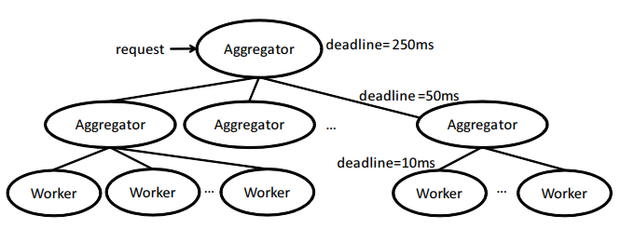
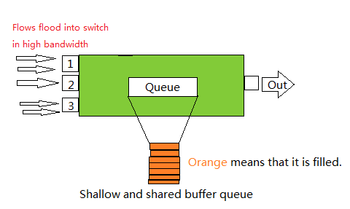
01
TCP Problems in Datacenter
The sources of incompatibility between TCP and Datacenter
Distributed computation model:
Partition/Aggregate
Using switches with shallow buffer
Using shared-buffer switches

Slide 4
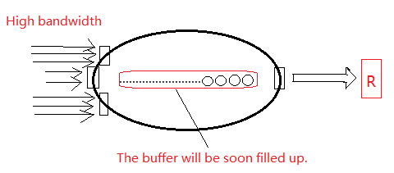
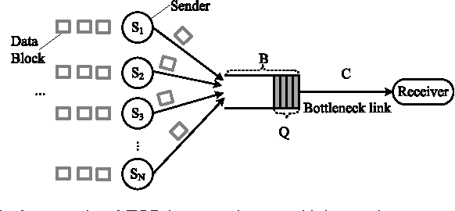
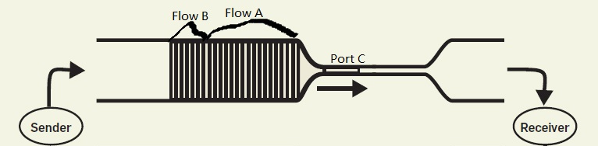
01
TCP Problems in Datacenter
The incompatible issues between TCP and Datacenter
TCP incast issue
These two issues can have great harm to network performance, like decreasing throughput and increasing latency.
TCP outcast issue (queue buildup)

Slide 5
02
Existing Congestion Control Algorithm for Datacenter Network
Congestion Control based on ECN
Congestion Control based on RTT
DCTCP (SIGCOMM 2010);
MCP (ACM HotNets-XII 2013);
DT-DCTCP (IEEE ICDCS 2013);
TCP-FITDC (ICNC 2013);
NewTCP (IEEE ICC 2014);
TIMELY (SIGCOMM 2015);
DX (USENIX 2015);
Congestion Control based on other indicator
Deadline-aware congestion control: D²TCP (SIGCOMM 2012)
Congestion control based on window size notification: TCP-CWR (ITC 2013)

Slide 6
03
Introduction to T-DCTCP
Motivation of choosing both ECN and RTT
Drawback
ECN is single-bit congestion signal.
Bad handle on packet burst.
RTT is not precise enough at controlling congestion window.
Poor performance in congestion window adjustment.
EAR
Modification on switches.
We would like T-DCTCP can just modify senders and receivers instead of switch

Slide 7
03
Introduction to T-DCTCP
Eight situations for modifying congestion window
Alpha is calculated from the fraction of the ACKed packets with ECN flag
normalized_gradient equals to the difference of RTTs divided by minimum RTT to remove its unit. It reveals the trend of RTT.
alpha_factor is a self-defined parameter
New RTT is less than Tlow
1. cwnd increases by addstep
2. cwnd decreases slightly according to alpha
1
alpha is less than alpha_factor
New RTT is greater than Thigh
S
1. cwnd decreases according to the value exceeding Thigh and the value of alpha
2. cwnd decreases by half
2
alpha is greater than alpha_factor
RTT is decreasing
1. cwnd increases by addstep
2. cwnd decreases slightly according to alpha
RTT is increasing
1. cwnd decreases according to the value of normalized_gradient
2. cwnd decreases according to alpha

Slide 8
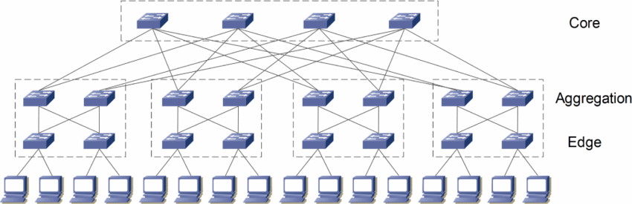
04
Performance of T-DCTCP
Network Experiment Topology
Mininet
Incast simulation
Use iperf to simulate incast issue
Use curl to simulate incast issue with various flow sizes in different qunanities

Slide 9
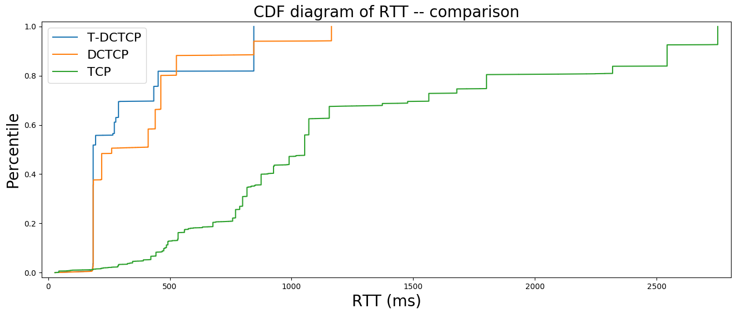
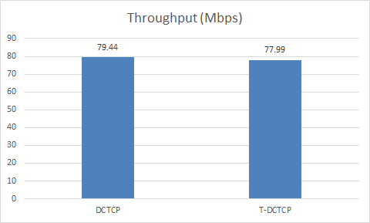
04
Performance of T-DCTCP
Comparing throughput
CDF diagram of RTT
The throughputs of T-DCTCP and DCTCP are close.
The throughput of T-DCTCP is 2% smaller than that of DCTCP
The average RTT of T-DCTCP is 9.4% smaller than the average RTT of DCTCP, and is 143.2% smaller than that of TCP with CUBIC.
As for 99th percentile RTT, T-DCTCP drops it by 37.7% and 123.2% comparing to DCTCP and TCP with CUBIC.

Slide 10
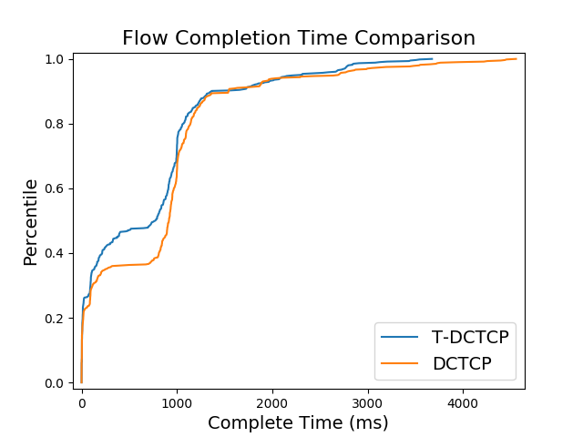
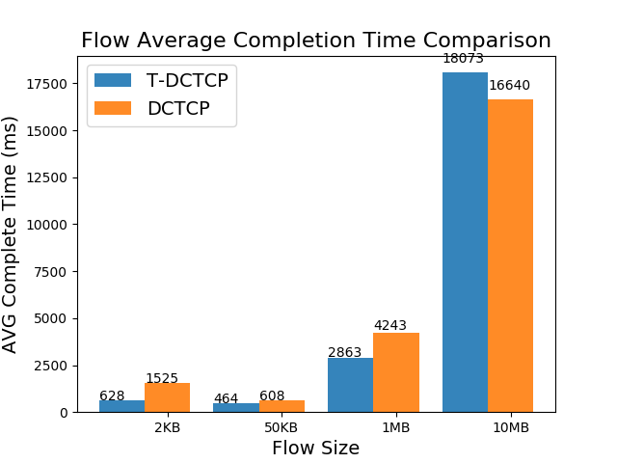
04
Performance of T-DCTCP
CDF diagram of FCT
Bar diagram of FCT
The blue curve represents T-DCTCP and it rises faster than the orange one.
In 80th percentile, FCT of T-DCTCP is 10% smaller than that of DCTCP.
FCT of 2KB flow is 1.4X smaller.
FCT of 50KB flow reduces by 31%.
FCT of 1MB flow drops by 48.2%.
FCT of 10MB flow increases slightly.

Slide 11
05
Conclusion
T-DCTCP does reduce RTT without decrease on throughput.
T-DCTCP does improve FCT of small flows.
T-DCTCP reveals the feasibility of using both RTT and ECN as congestion indicators to control congestion level.
Future work: We can try to improve RTT measurement accuracy and find a better way to describe congestion and a better scheme to control cwnd.

Slide 12
That’s all of my presentation
Expecting your advice on T-DCTCP

