Slide 1
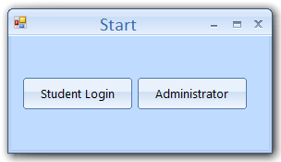
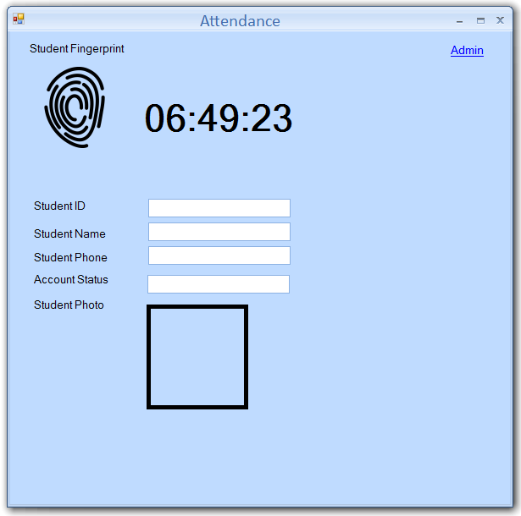
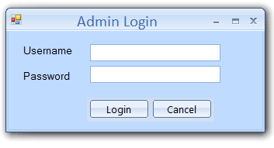
Application Start
Admin will double click on the application
Display form with 2 Buttons
See next slide
Student will place their finger on the reader and automatically Detect fingerprints and login the student and display a message “You’re logged in” this form will be maximized on the screen
The task of this form is to wait for student to login will be open all the time

Slide 2
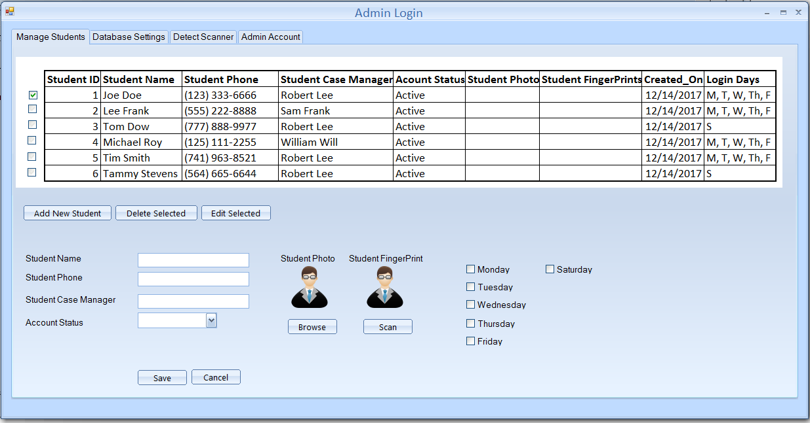
Select Student and Click on Edit, it will load the selected student data and allow admin to edit student data then save it
Select number of Student then Click on Delete selected it will delete all the selected students
If admin username & password OK allow login and display the admin form to manager students database connection detect scanner, admin accounts
Student can login
Monday to Friday
Or
Saturday only

Slide 3
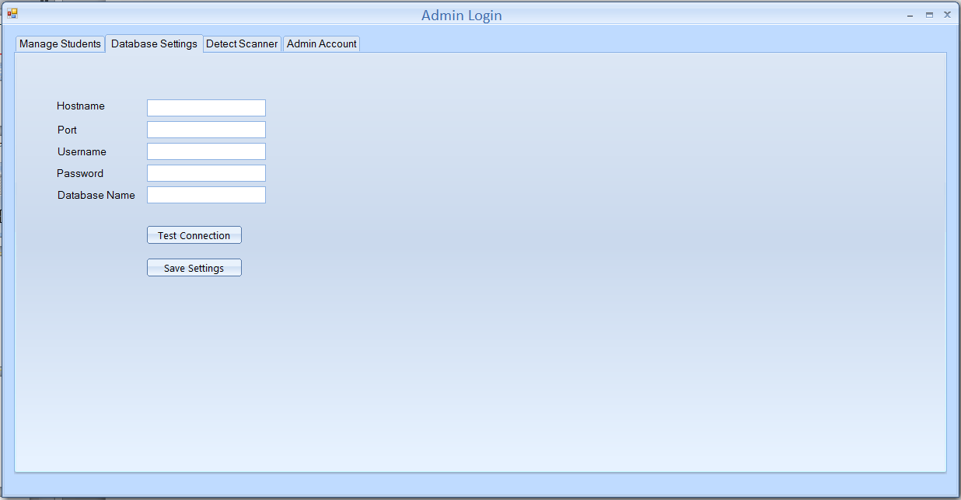
Allow admin to setup the database connect
IP Address, Port, Username, Password, and Database name

Slide 4
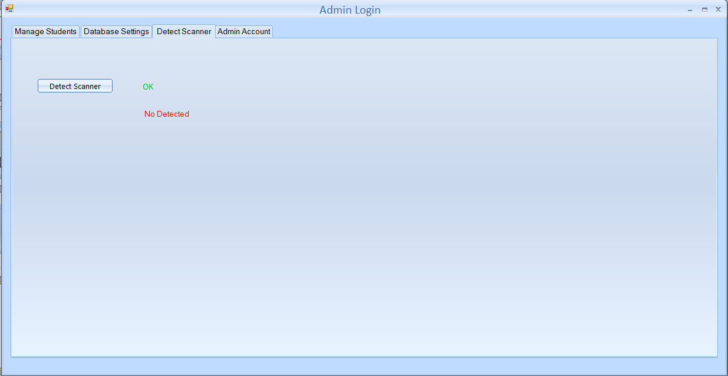
Allow admin to check if fingerprint scanner is connected or no and display
Message Ok in green color, not detected in red color

Slide 5
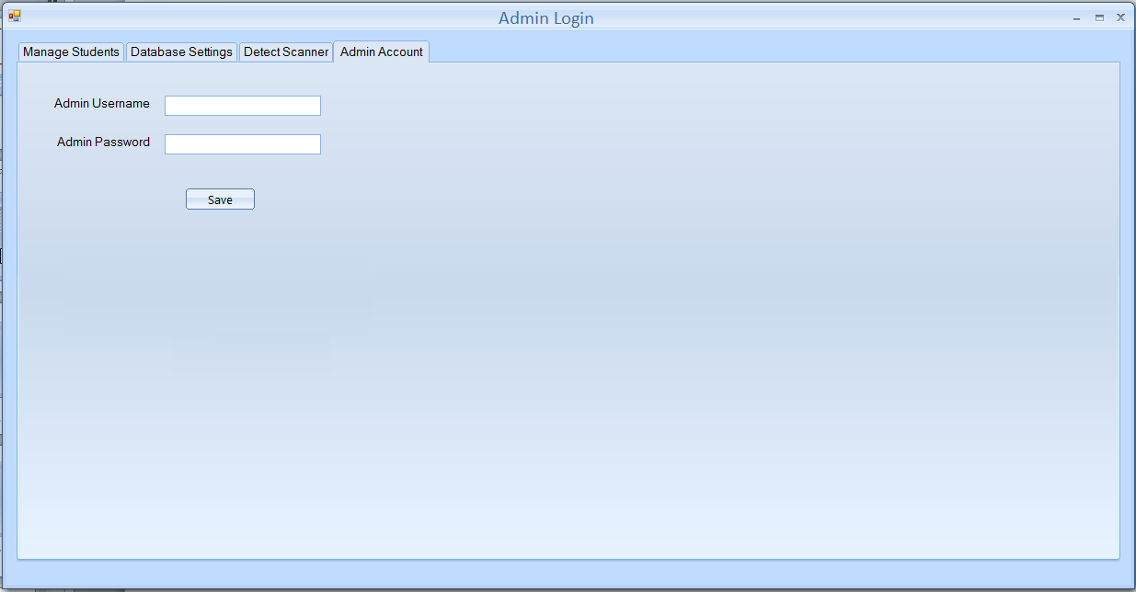
Allow admin to set the admin username and password

Slide 6
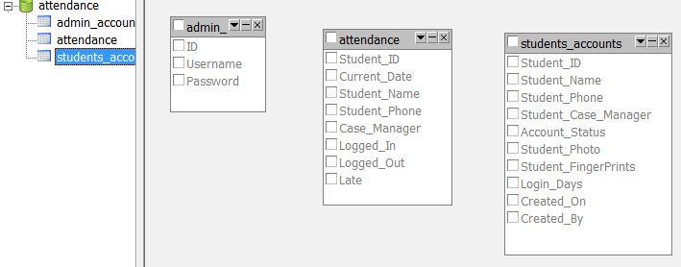
Where Admin Username & Password will be Saved
Students Account
Where daily login data will be saved

