Slide 1
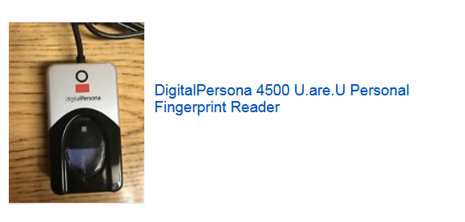
Project Budget: $200.00
Looking for an application for students attendance with finger prints
C sharp 2010 and MySQL with Setup built with the project
Admin mode: Add, Edit, Delete, and disable students account
Attendance mode: where students use their fingerprints.
Data collected: student name, date, time, fingerprints
Config mode: for admin only protected with username and password
Allow admin add edit delete, disable student and set the scanner (Detect the scanner)
Student_ID: Auto Generate
Date: MM/DD/YYYY
Student_Name: Full name of the student
Student_Phone: Phone number of the student
Case_Manager: will be a full name
Logged_In: Time HH:MM:SS
Logged_Out: Time HH:MM:SS
Late: Yes or No (if after 7:00 am set late = Yes)
I will be using this Fingerprint reader

Slide 2
If you are the winner
I will create milestone with full amount
You start working
Send me a demo
If all ok
Send me source code
I will release the milestone
If not ok
keep working and fix it
No down payment
If you have problem with these conditions do not bid

Slide 3
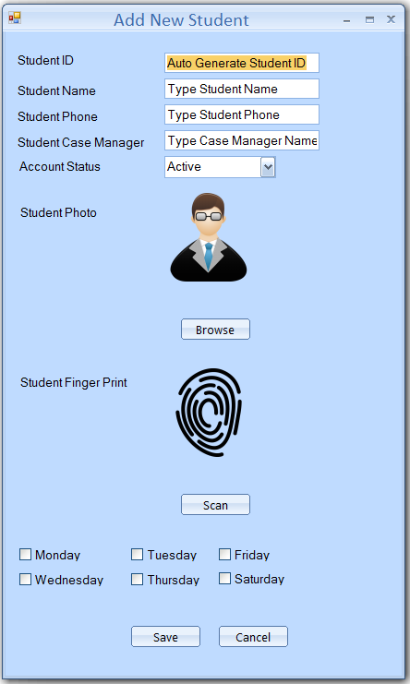
Add New Student
Account Student is Active when adding new student
Active, Disabled
Admin will select which day of the week will the student logging in
If week days is selected = student can only login during the week day
If Saturday = the student can only login on saturday
Admin will browse and select student picture (is not required)
Student will place his finger on the scanner and the admin will click on Scan to capture the fingerprint
Admin will click on save to add student data to the database (MySQL) or Click on Cancel to cancel the entry

Slide 4
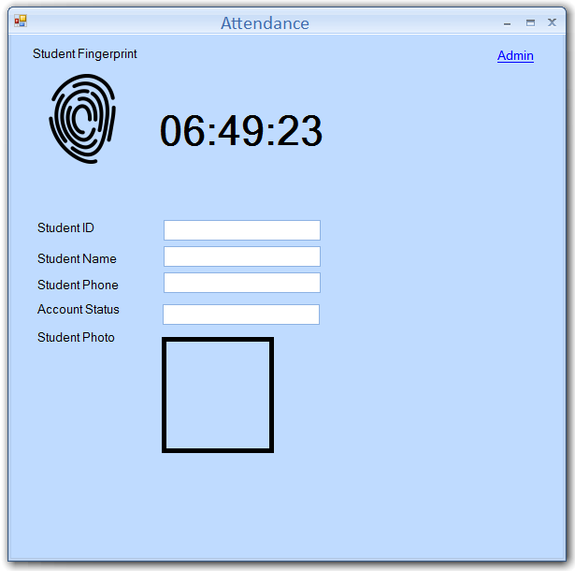
The form must be maximized on the screen so student can not use the computer
Student Placer his finger on the scanner
Auto detect will be used
To detect finger prints presence
The finger print is captured
The information of the student will be displayed
And he will be logged in
Display Message Mr. you’re logged in or Logged Out
If student try to login after 7:05 am Admin must validate using his (Admin) finger print
Otherwise no logged in
This rule can be enabled or disabled

Slide 5
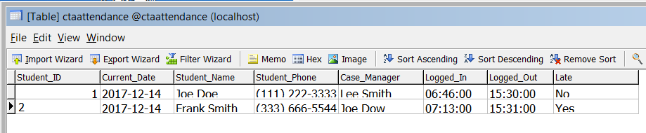
This is how the data will be saved in the table
Student_ID
Current_Date
Student_Name
Student_Phone
Case_Manager
Logged_In
Logged_Out
Late: Yes or No (if after 7:00 am set late = Yes)

