Slide 1


SkyPulse : Beating Delays Before They Start
A real-time flight difficulty detection framework powered by data-driven insights.
Team Name:Neutrinos
MEMBERS :- Abhilash(22102069) & Rajveer(22102072)

Slide 2
Business Problem
The Challenge: Certain flights are operationally complex due to tight ground times, high baggage volumes, and specific passenger needs, making on-time departures a challenge.
Current State: Identifying high-difficulty flights relies on manual experience, which is inconsistent and not scalable.
Goal: Develop a systematic, data-driven "Flight Difficulty Score" to quantify flight complexity and enable proactive resource planning at Chicago O'Hare (ORD).

Slide 3
Project Roadmap
Data Cleaning & Preparation
Exploratory Data Analysis (EDA)
Feature Engineering
Difficulty Score Development
Post-Analysis & Recommendations
Standardized and cleaned five datasets by removing duplicates, correcting data types, and handling missing values to create a reliable foundation for analysis.
Performed an in-depth analysis to understand the key characteristics of the data and identify the primary factors, like Special Service Requests, that correlate with operational difficulty.
Created new, insightful variables from the raw data, such as 'Ground Time Pressure' and 'Baggage Complexity Ratio', to serve as inputs for our scoring model..
Developed a daily, weighted scoring model that combines key features to systematically quantify flight complexity, resulting in a final rank and classification ('Easy', 'Medium', 'Difficult').
.Analyzed the score's output to identify high-risk destinations and their root causes, translating these data-driven findings into actionable operational recommendations.

Slide 4
Data Cleaning & Preparation
Ensuring a Reliable Foundation for Analysis.
Outlined the key cleaning steps performed on the five datasets.
Key Actions:
Removed 293 duplicate baggage records.
Converted all date/time columns to the correct datetime format.
Standardized categorical and boolean columns (e.g., 'Y'/'N' to 1/0).

Slide 5
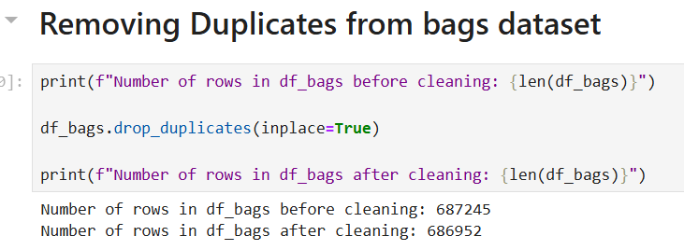
Removing Duplicates
The bags data set was found to have 293 duplicate data points. It was removed from the dataset as i could skew our analysis.

Slide 6
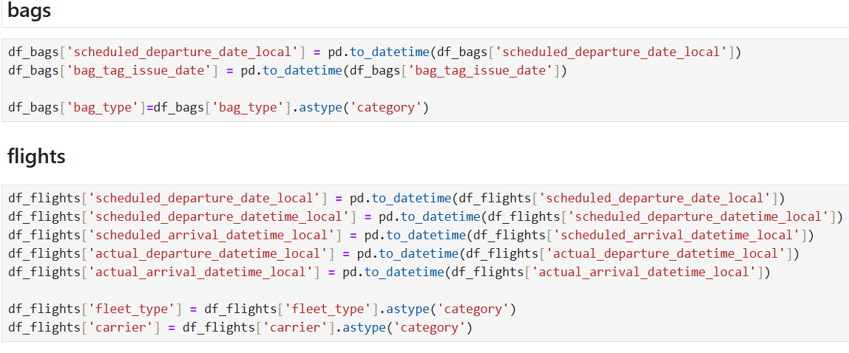
Converting into correct data-types
Various columns across different datasets were converted into a more useful data-type. For example, dates columns were converted from object to date-time format.

Slide 7
Standardizing Categorical Columns
Categorical columns such as “is_child” and “is _stroller_user” were standardized and converted from yes/no to 0/1. This step made further analysis easier and helped us during Feature Engineering.

Slide 8
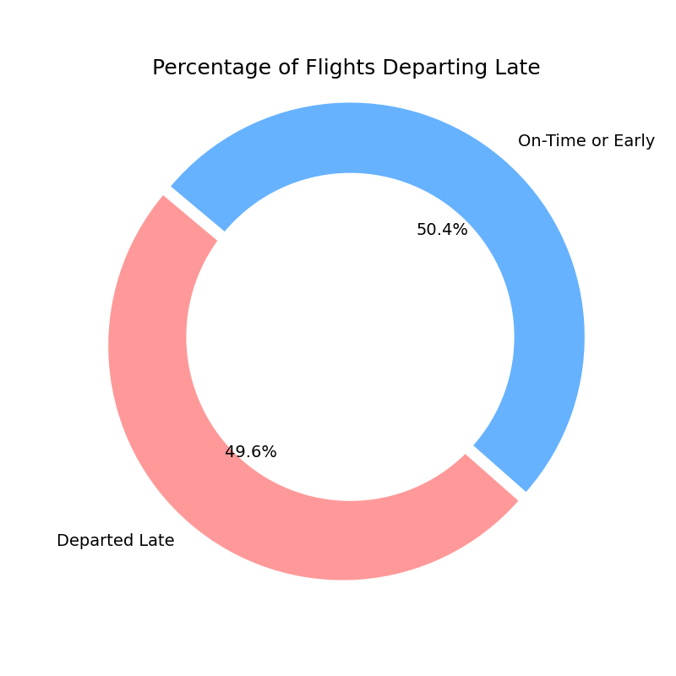
Exploratory Data Analysis
1.) Delays are Frequent & Significant
Question: What is the average delay and what percentage of flights depart late?
Finding: Nearly half (49.6%) of all flights depart late, and those that do are delayed by an average of 47 minutes.

Slide 9
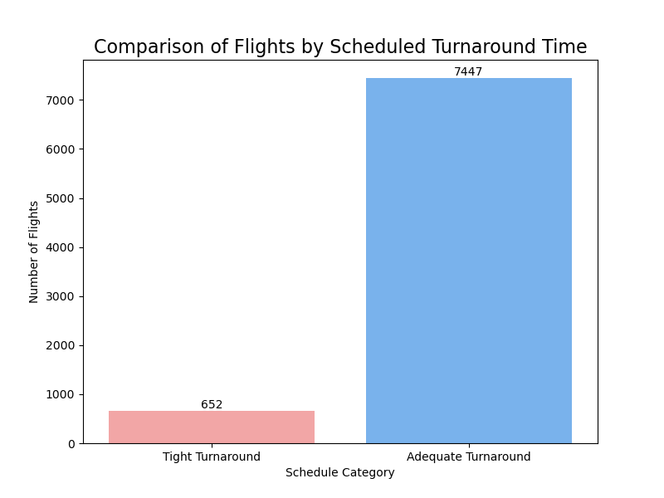
Exploratory Data Analysis
2.) The Pressure of Tight Schedules
Question: How many flights have scheduled ground time below the minimum?
Finding: A significant 8.05% of flights are scheduled with tight turnarounds, creating inherent operational risk before the day even begins.

Slide 10
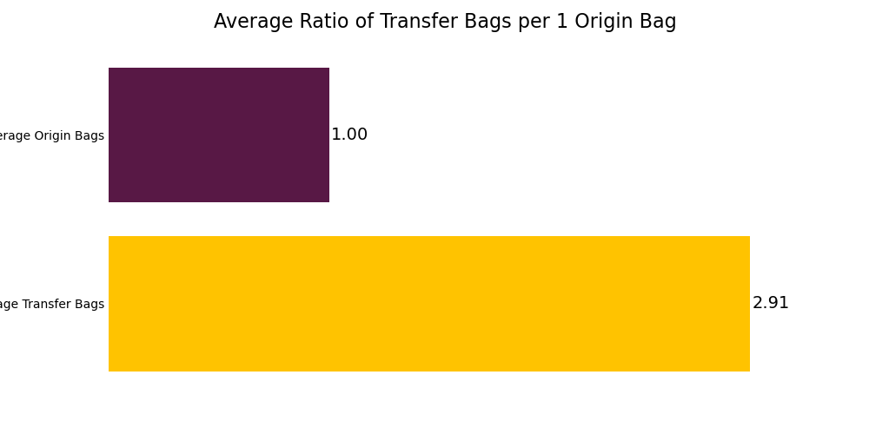
Exploratory Data Analysis
3.) The Complexity of Baggage Handling
Question: How many flights have scheduled ground time below the minimum?
Finding: A significant 8.05% of flights are scheduled with tight turnarounds, creating inherent operational risk before the day even begins.

Slide 11
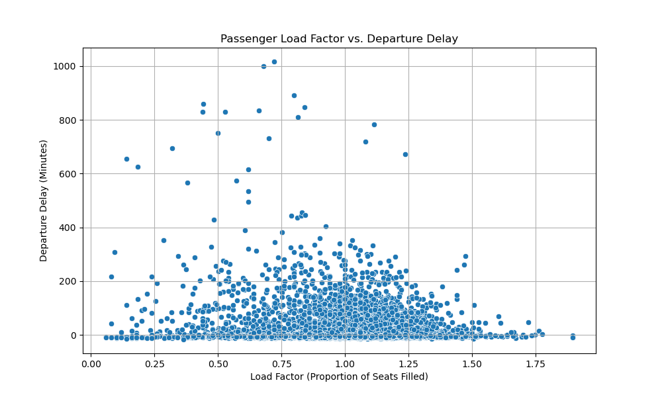
Exploratory Data Analysis
4.) Passenger Load Factor Distribution
Question: How do passenger loads compare across flights?
Finding: Most flights operate at a high capacity, with a significant number of flights even exceeding 100% load factor due to lap infants.

Slide 12
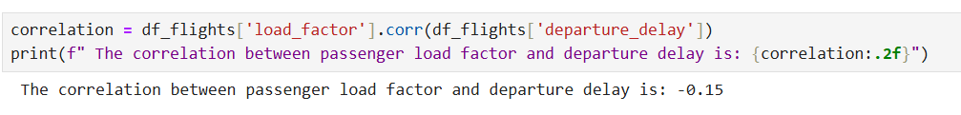
Exploratory Data Analysis
4.) Passenger Load Factor Distribution
Question: How do passenger loads compare across flights?
Finding: Most flights operate at a high capacity, with a significant number of flights even exceeding 100% load factor due to lap infants.
Observation: A correlation of -0.15 is considered very weak. It suggests that there is almost no linear relationship between how full a flight is and how delayed it is.

Slide 13
Exploratory Data Analysis
5.) The Impact of Special Service Requests (SSRs)
Question: Are high SSR flights also high-delay after controlling for load?
Finding: Yes. Our analysis proves that a high volume of SSRs is an independent driver of delays, regardless of how full the flight is.
Observation: As "High" SSR bar is consistently taller than the "Low" SSR bar within each load factor category ('Low', 'Medium', and 'High'), it provides strong evidence that a high number of special service requests does contribute to departure delays, regardless of how full the flight is.

Slide 14
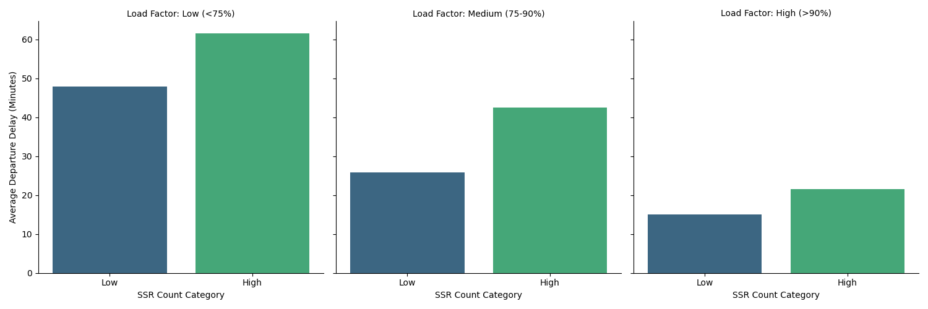
Exploratory Data Analysis
5.) The Impact of Special Service Requests (SSRs)

Slide 15
The Flight Difficulty Score
Feature Engineering
Translating Raw Data into Indicators of Difficulty.
We created several key features to serve as inputs for our model.
List of Features:
Ground Time Pressure: minimum_turn_minutes- scheduled_ground_time_minutes
Baggage Complexity: transfer_to_origin_ratio, count of Hot Transfer bags
Passenger Complexity: ssr_count, lap_child_count
Flight Fullness: load_factor

Slide 16
The Flight Difficulty Score
Scoring Logic - A Weighted Approach
A Daily, Relative Scoring System
Normalization: To ensure fairness, all features were scaled from 0 to 1 for each day independently. We used MinMaxScaler for this purpose.
Weighting: We assigned weights based on the impact observed during EDA. SSRs and Ground Time Pressure were identified as the most critical factors.

Slide 17
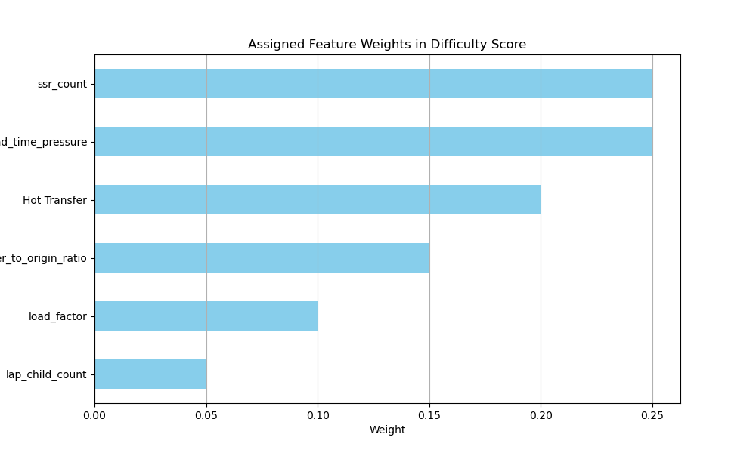
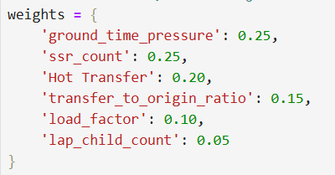
The Flight Difficulty Score
Scoring Logic - A Weighted Approach

Slide 18
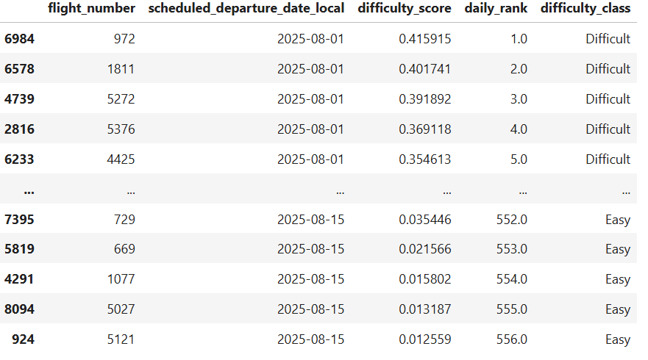
The Flight Difficulty Score
We successfully calculated the difficulty scores and grouped them on the basis of difficulty_class(easy, medium and difficult).
We grouped by day and then ranked the scores in descending order.

Slide 19
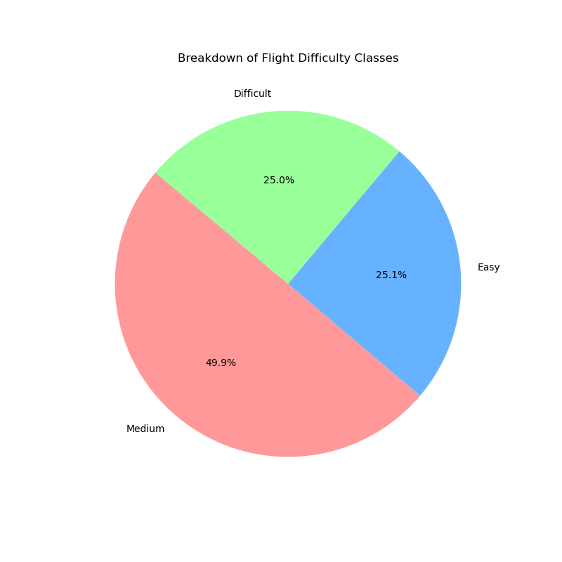
Results & Analysis
Daily Flight Ranking & Classification
The model produces a daily ranked list and classifies each flight as 'Easy', 'Medium', or 'Difficult'.

Slide 20
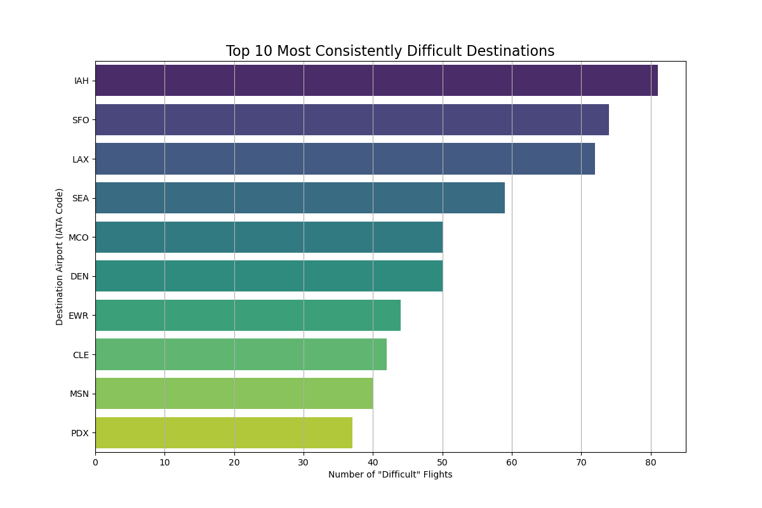
Results & Analysis
Pinpointing Difficult Destinations
Our analysis revealed that a small number of destinations consistently account for a large portion of "Difficult" flights.

Slide 21
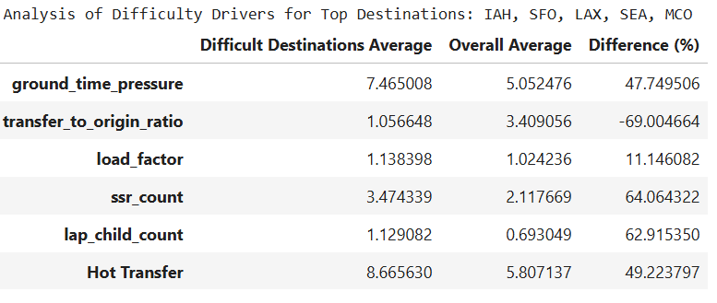
Results & Analysis
The Drivers of Difficulty
Why are those destinations so difficult?
Flights to these top destinations exhibit significantly higher complexity across multiple factors compared to the average flight.

Slide 22
Conclusion & Recommendations
Actionable Recommendations
Recommendation 1 (Passenger Focus): Proactive Staffing. For flights flagged as "Difficult" to high-risk airports (IAH, SFO), pre-allocate an extra gate agent to manage complex boarding and SSR needs.
Recommendation 2 (Baggage Focus): Priority Handling. Automatically flag "Difficult" flights in the baggage system to ensure transfer crews are ready for the high volume of "Hot Transfer" bags.
Recommendation 3 (Scheduling Focus): Strategic Review. The operations team should review consistently high-ranked flights to see if adding a 10-15 minute buffer to their ground time is feasible.

Slide 23
Conclusion & Recommendations
Actionable Recommendations
Recommendation 4: Pre-Flight "Difficulty Huddle." For the top 3-5 flights ranked "Difficult" each morning, the operations manager should hold a brief huddle with the gate, ramp, and cabin crew leads.
Recommendation 5: System-Wide Turnaround Time Review. Initiate a review of all flight schedules that fall below the recommended minimum turn time plus a 10-minute buffer.
Recommendation 6: Enhanced Gate Information Displays. For flights flagged as "Difficult," the system should push key complexity metrics to the gate crew's information displays.

Slide 24
Conclusion & Recommendations
Conclusion
Summary: The Flight Difficulty Score provides a simple, data-driven, and scalable tool to help United's frontline teams anticipate challenges, allocate resources more effectively, and improve on-time performance.

Slide 25
Thank You

