Slide 1
BANKING Software using java
Name: Abhishek. Amble
Usn: 2GI20EE001

Slide 2
INTRODUCTION
1)JDBC- Java Database Connectivity:
JDBC stands for Java Database Connectivity, which is a standard Java API for database-independent connectivity between the Java programming language and a wide range of databases.
2)MYSQL –RDBMS(Relational DataBase Management System)
MySQL is a fast, easy-to-use RDBMS being used for many small and big businesses. MySQL is developed, marketed and supported by MySQL AB, which is a Swedish company. MySQL is becoming so popular because of many good reasons .

Slide 3
METHODOLOGY
Software Used:
MySQL
IntelliJ IDEA Community Edition 2022.3.3
In any Bank Transaction, there are several parties involved to process transaction like a merchant, bank, receiver, etc. so there are several numbers reasons that transaction may get failed, declined,

Slide 4
METHODOLOGY
so to handle a transaction in Java, there is a JDBC (Java Database Connectivity) which provides us an API to connect, execute, fetch data from any databases. It provides the language Java database connectivity standards. It is used to write programs required to access databases.
In this Mini Banking Application, to handle a transaction, we are using JDBC Transaction to make transactions consistent. This Application Provides Menu-Driven Console Interface to a User Using that User can perform functions like create Account, Login, View Balance And Transfer Money To The Other Customer.

Slide 5
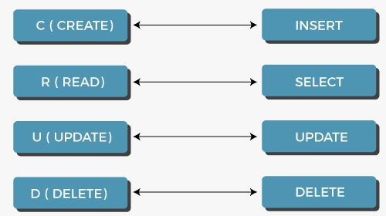
Crud operations :

Slide 6
IMPLEMENTATION DETAILS
Step 1) Database Setup:
Step 2)Intellij Project Setup:
Step 3) Create a Connection class in the banking package:
Step 4) CRUD Operations in SQL:
Step 5)Loading the Main Class
Please refer report for brief description of all steps implementations

Slide 7
Banking Software Details:
My Banking Software allows to perform various features such as :
1)Creating Account and Logging in
2)Transfer Amount
3)Deposit Amount
4)Withdraw Amount
5)View Balance
6)Change Password
7)Log Out

Slide 8
Conclusion:
By use of Java programming Language ,JDBC and MYSQL database using CRUD method Bank Software was successfully Implemented and tested Successfully.In which we able to run various processes like any normal banking application.

Slide 9
THANK YOU!

