Slide 1
Hands On—How to Use Machine Learning for Medical Images
Bradley J Erickson, MD PhD
Zeynettin Akkus, PhD
Timothy Kline, PhD
Panagiotis Korfiatis, PhD
Mayo Clinic Radiology Informatics Lab
Sunday 4-5:30

Slide 2
Disclosures
Lab is funded by CA160045, NIDDK and NIBIB HHSN
BJE has relationships with Vital Images, Visage, OneMedNet, VoiceIT

Slide 3
What is Machine Learning
Part of Artificial Intelligence that focuses on computers recognizing patterns
Classes of Machine Learning
Supervised (have data with right answer)
Classification
Regression
Unsupervised (are there groups or clumps in data)
Augmented (use unlabeled data to help refine supervised learned classes)

Slide 4
Supervised Learning
This is what nearly all CAD systems try to do
Systems can be sensitive to unique traits of data used to train it

Slide 5
Classification Regression Clustering
Classification Regression Clustering
Notes:
Classification could be tumor / not tumor. Lung, liver, heart, vessels, muscle, etc.
Regression is: higher rCBV means higher grade tumor

Slide 6
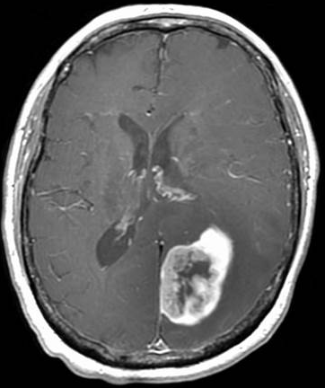
Features
Feature = data that are computed as input
In medical, might be CT density, MR pixel value, edge strength, patient age, etc.
Mean Value: 232

Slide 7
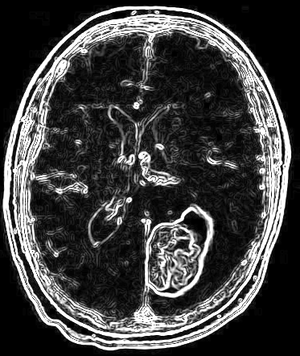
Features
Feature = data that are computed as input
In medical, might be CT density, MR pixel value, edge strength, patient age, etc.
Mean Value: 232
Edge Strength: 0.82

Slide 8

Features
Feature = data that are computed as input
In medical, might be CT density, MR pixel value, edge strength, patient age, etc.
Mean Value: 232
Edge Strength: 0.82
Enhancing Volume: 142mm³

Slide 9
Feature Selection
Keep (only) the features that are relevant
Keep the unique features

Slide 10
Underfitting
If there is not enough information, or there is not enough sophistication in model, computer may not be able to identify the ‘rules’ to classify data.

Slide 11
Overfitting
If there is enough power, the system could learn each example in the training set
E.g. the 12th pixel in each of the training sets is unique, so learn it as predictor
Unlikely that this will have any value as predictor for future/real world data sets
Regularization is a technique to reduce complexity to avoid overfitting

Slide 12
Training Data
For most cases, available data is split into:
Training data (actively used to adjust parameters)
Test (measure accuracy of ML and further update)
Validation (Completely separate set of data used only after ML is ‘fully trained’)
Test/Validation names sometimes used other way around

Slide 13
Cross Validation
Split data into train/test. E.g. 5-fold takes 80% for training and 20% for test.
Extreme case is Leave One Out (LOO) where training happens on all but 1 example. Then classify that one example. Then leave out next example/train/test on that example. Repeat until each sample has been left out.

Slide 14
Models
The model is the framework that the computer uses to fit training examples to data
Can embody known properties of the problem
E.g. the relationship between feature and class is an exponential

Slide 15
Optimization
Most Machine Learning Methods Search “Parameter Space”
Parameter Space = best combination of Feature weights
Requires an error metric be computed for parameters
Simple approach: Change 1 weight at a time in each direction and see causes greatest error reduction
Repeat until little improvement in error

Slide 16
Local vs Global Minima
As one adjusts weights, it is possible that the search will find a ‘local minimum’
Not the best solution!

Slide 17
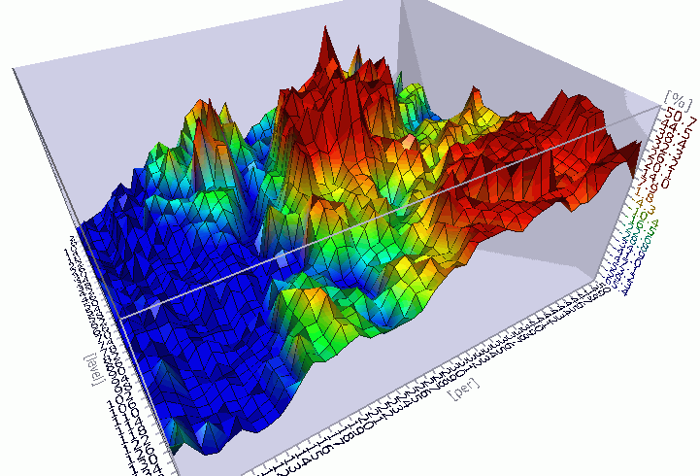
Options
Start with ‘many’ different starting points and use best found
Grid search—pick regularly spaced samples throughout parameter space
Random Search—pick randomly located samples

Slide 18
When Has Computer Learned It?
In most cases, there is no way to know the ‘Perfectly Right’ model
Most ML methods are iterative
Keep trying to improve
Stop when no <significant> improvement
Stop when certain amount of time elapsed

Slide 19
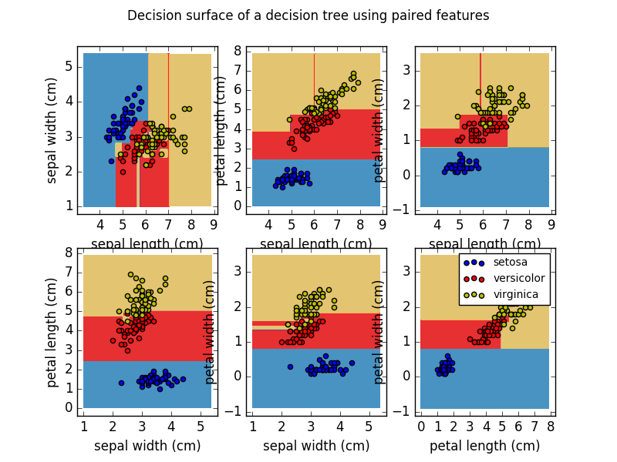
Decision Tree Parameters
How Deep to Search
When to stop splitting (e.g. < 10 samples)
Split criteria
http://scikit-learn.org/stable/auto_examples/tree/plot_iris.html#sphx-glr-auto-examples-tree-plot-iris-py

Slide 20
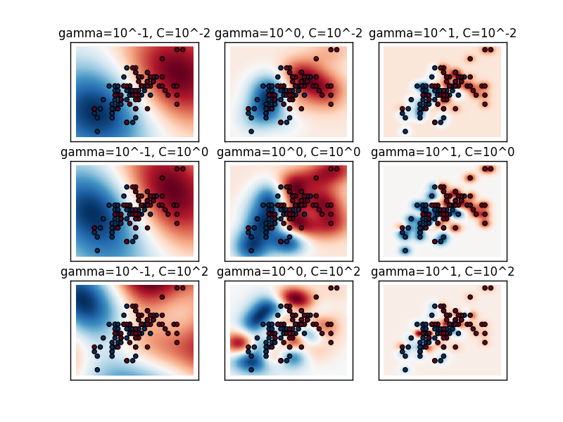
SVM Parameters
C—penalty for ‘complex’ decision boundary.
Gamma—impact of an example
Basis function
Linear
Radial
http://scikit-learn.org/stable/auto_examples/svm/plot_rbf_parameters.html

Slide 21
Performance Metrics
Precision=PPV = TP / (TP + FP)
Recall=Sens = TP / (TP + FN)
F1=harmonic mean of Precision + Recall = 2*TP / (2*TP + FP + FN)

Slide 22
Resources
Code and slides are at: http://github.com/slowvak/MachineLearningForMedicalImages
Books:
Machine Learning by Flach
Python Machine Learning by Raschka
Radiographics article in March

Slide 23
Questions

Slide 24
Starting Your Session
Guide …

