Slide 1

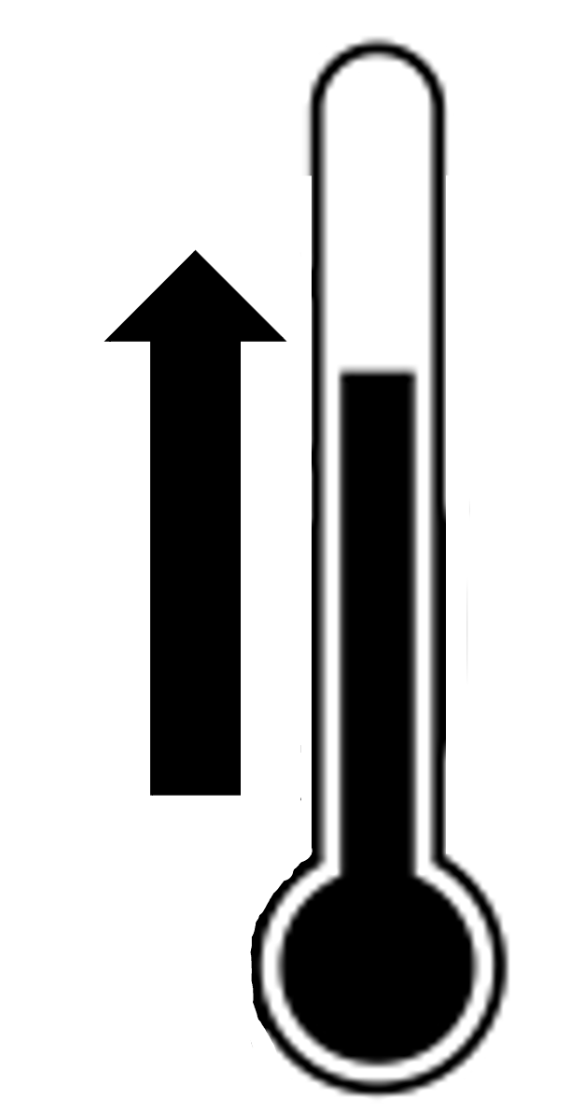
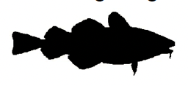

Western Baltic cod collapse
S-AS scientific advice
SE-AS recreational
PE-AS abiotic
O₂
Baglimits were too high
Temperature increase,
oxygen depletion, and
eutrophication
ICES advice overestimates
stock abundance
Recreational catches higher
than commercial catches
TACs were
too high
Predation
S-AS mismanagement
SE-AS harvesting
E-AS predation
Depletion
Non-recovery
Notes:
Harvesting, scientific advice, ecosystem degradation are dominant action situations driving collapse.
Harvesting: fishing & recreational
Scientific advice: overestimation of stock
Ecosystem degradation: eutrophication, oxygen depletion & temperature increase
Predators (might hinder recovery)

Slide 2
S-AS scientific advice
SE-AS recreational
PE-AS abiotic
O₂
Baglimits were too high
Temperature increase and oxygen depletion
hinder recovery
ICES advice overestimates
stock abundance
Recreational catches higher
than commercial catches
TACs were
too high
Predation hinders
recovery
S-AS mismanagement
SE-AS harvesting
E-AS predation
Notes:
Harvesting, scientific advice, ecosystem degradation are dominant action situations driving collapse.
Harvesting: fishing & recreational
Scientific advice: overestimation of stock
Ecosystem degradation: eutrophication, oxygen depletion & temperature increase
Predators (might hinder recovery)

Slide 3
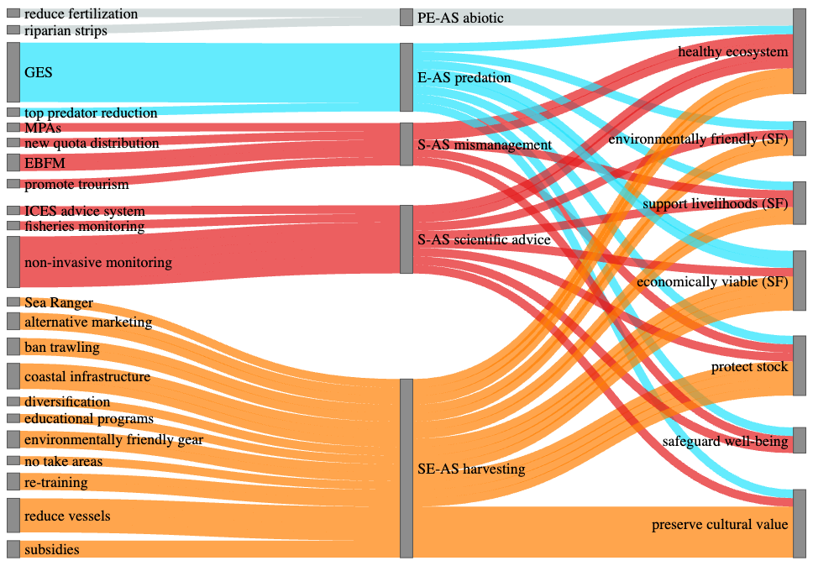
Old sankey

Slide 4
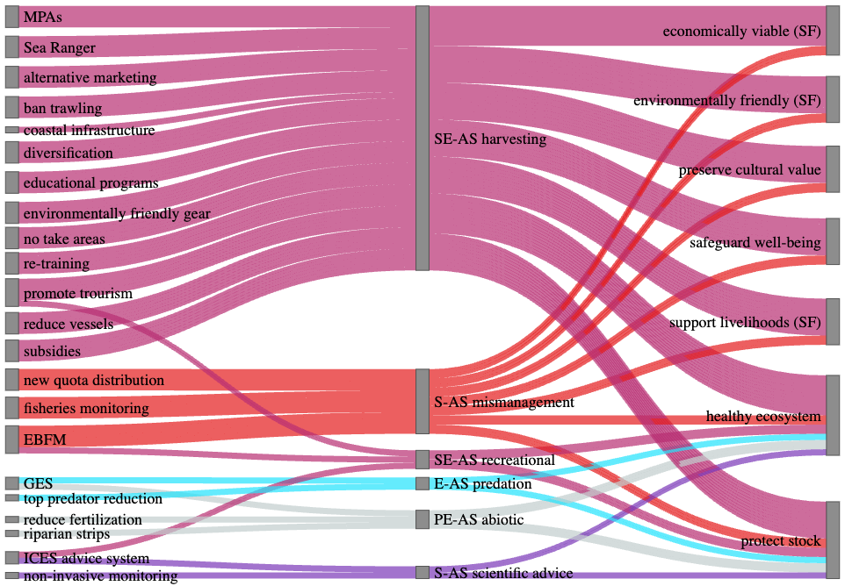

Slide 5
Scientific
exchange
STECF
WGBFAS
ACOM
ICES
ICES
advice
EU
Comission
Data
Regulations
Cod
EU
Parliament
EU
Council
Regulations
EU
Quotas
Fisheries
Regional
level
Federal
German
Government
Quotas
Quotas
Recreational
fisheries
Notes:
Governance system

Slide 6
Economic entities
Cooperation
owned
store
Baltic Sea
Advisory
Council
Restaurants
Auctions
End
consumer
Producer
organizations
Fisheries
cooperations
Fisheries
ICES
eNGO
Supermarkets
Fishers &
families
Fishery
associations
Cod
Fishing
community
Recreational
fisheries
Community identity
Social entities
Community identity through fish species
Notes:
Socio-economic system

Slide 7
Predators
Recruitment
Temperature
Climate
change
Salinity
Cod
Oxygen
Parasites
Baltic Sea
fish
community
Prey
availability
Pollution
Biological entities
Physical entities

Slide 8
Western Baltic cod collapse
1. SES analysis
2. Alternative management
a. Literature review
a. PrOACT
Problem
Objectives
Alternatives
Consequences
Trade-offs
b. Network of social, ecological and physical entities
c. Classification of Action Situations
b. Objective – action pathways
d. Aggregation
into major
Action Situations
Objective 1
Objective 2
Objective 3
e. Integrated
SES
Objective 4
3. Measures
in
SES
Objective 5
Measures in
SES
Objective 7
Objective 8

Slide 9
Average
Environmentally friendly gear
Coastal infrastructure
Non-invasive monitoring
Alternative marketing
Ban trawling
Reduce vessels
GES
EBFM
Re-training
Subsidies
Riparian strips
ICES advice system
MPAs
Healthy ecosystem
Reduce fertilization
Fisheries monitoring
No-take areas
Weighting
Protect stock
Promote tourism
Safeguard well-being
Quota distribution
Support livelihoods (SF)
Searanger
Diversification
Educational programs
Preserve cultural value
5 %
Top predator reduction
Economically viable (SF)
5 %
Environmentally friendly (SF)
5 %
Ability score
Notes:
AVERAGE

Slide 10
Team A
Environmentally friendly gear
Non-invasive monitoring
Coastal infrastructure
Alternative marketing
Ban trawling
Re-training
Reduce vessels
Subsidies
GES
EBFM
Riparian strips
ICES advice system
MPAs
Healthy ecosystem
Reduce fertilization
Fisheries monitoring
No-take areas
Protect stock
Weighting
Quota distribution
Support livelihoods (SF)
Promote tourism
Safeguard well-being
5 %
Searanger
Diversification
Educational programs
Preserve cultural value
5 %
Top predator reduction
Economically viable (SF)
5 %
Environmentally friendly (SF)
5 %
Ability score
Notes:
Team A

Slide 11
Team B
Environmentally friendly gear
Non-invasive monitoring
Coastal infrastructure
Reduce vessels
Alternative marketing
Re-training
Ban trawling
Subsidies
GES
EBFM
Riparian strips
ICES advice system
MPAs
Healthy ecosystem
Reduce fertilization
Promote tourism
Safeguard well-being
Weighting
Fisheries monitoring
No-take areas
Protect stock
Quota distribution
Support livelihoods (SF)
5 %
Searanger
Educational programs
Diversification
Preserve cultural value
5 %
Top predator reduction
Economically viable (SF)
5 %
Environmentally friendly (SF)
5 %
Ability score
Notes:
Team B

