Slide 1



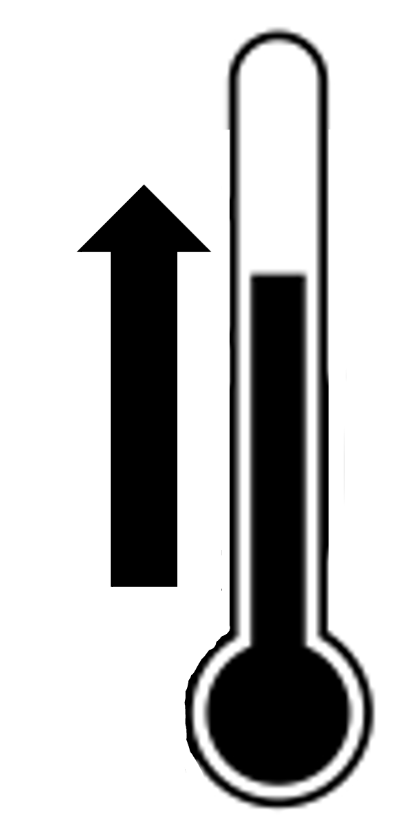
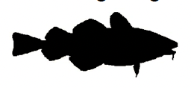
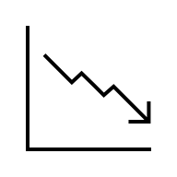


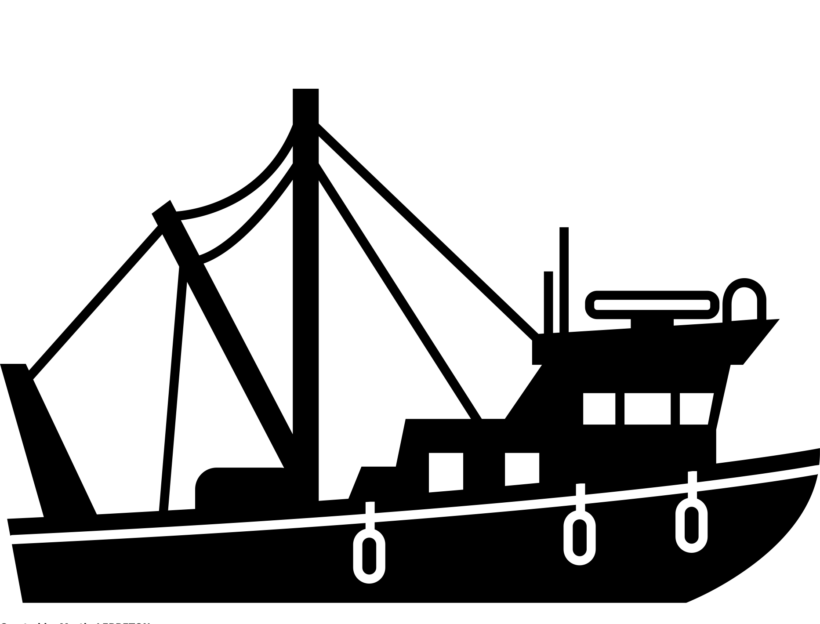


Western Baltic cod collapse
S-AS scientific advice
SE-AS recreational
PE-AS abiotic
O₂
Baglimits were too high
Temperature increase,
oxygen depletion, and
eutrophication
ICES advice overestimates
stock abundance
Recreational catches higher
than commercial catches
TACs were
too high
Predation
S-AS mismanagement
SE-AS harvesting
E-AS predation
Depletion
Non-recovery
Notes:
Harvesting, scientific advice, ecosystem degradation are dominant action situations driving collapse.
Harvesting: fishing & recreational
Scientific advice: overestimation of stock
Ecosystem degradation: eutrophication, oxygen depletion & temperature increase
Predators (might hinder recovery)

Slide 2
S-AS scientific advice
SE-AS recreational
PE-AS abiotic
O₂
Baglimits were too high
Temperature increase and oxygen depletion
hinder recovery
ICES advice overestimates
stock abundance
Recreational catches higher
than commercial catches
TACs were
too high
Predation hinders
recovery
S-AS mismanagement
SE-AS harvesting
E-AS predation
Notes:
Harvesting, scientific advice, ecosystem degradation are dominant action situations driving collapse.
Harvesting: fishing & recreational
Scientific advice: overestimation of stock
Ecosystem degradation: eutrophication, oxygen depletion & temperature increase
Predators (might hinder recovery)

