Slide 1
StudyBuddy
Find study partners - build study groups - track progress
A Human-Computer Interaction (HCI) Semester Project
Design, Implementation & Usability Evaluation Findings
Group Members:
Areeba Fatima
Umer Farooque Soomro
Sameea Majeed
Ambreen Naeem
Sadaf Fatima

Slide 2
CONTENTS
Agenda
Project overview & users
Task analysis, design & HCI
1
2
Heuristic evaluation findings
Usability testing & SUS
3
4
Statistical analysis of results
Final redesign & impact
5
6

Slide 3
SECTION 1
Project Overview
The problem
Objectives
Students struggle to find compatible study partners.
Syllabi are unstructured; progress is invisible; deadlines slip.
Existing tools are generic (chat / to-do), not study-centred.
Auto-match students into study groups by subject / semester / skill.
Break a syllabus into weekly topics automatically.
Track completion %, weekly targets and a study streak.
Plan tasks & deadlines (weekly / monthly).
Apply AND verify major HCI usability principles throughout.
Generic apps were not built for the way students actually study together.

Slide 4
USER RESEARCH
Target Users & Personas
A
D
M
Aisha
Daniel
Maria
Organised high-achiever
Struggling first-year
Part-time / working student
Wants efficiency, shortcuts and a clear progress overview.
Needs guidance, low cognitive load and gentle feedback.
Needs flexible scheduling and forgiving deadlines.

Slide 5
PHASE 2 - TASK ANALYSIS
Hierarchical Task Analysis (HTA)
Goal 0 - Find & join a study group
1 Choose how to find
2 Set match criteria
3 Review & join
Browse recommended on dashboard
or open Find Groups
Pick subject & semester
pick skill level
Compare match %
send join request
Plan 0 (the defining feature of HTA)
Do 1, then 2, then 3. If a suitable open group appears during step 1, skip 2. Repeat steps 2-3 until a group is joined.

Slide 6
PHASE 3 - COMPETITIVE ANALYSIS
Existing System Analysis
Capability | Quizlet | Discord | Notion | Classroom | StudyBuddy
Partner / group matching | Part | No | No | No | Yes
Study groups + discussion | Part | Yes | Part | Part | Yes
Syllabus -> weekly topics | No | No | Part | Part | Yes
Progress % / study streak | Part | No | Part | No | Yes
Planner / deadlines | No | No | Yes | Yes | Yes
Accessibility / dark mode | Yes | Yes | Yes | Part | Yes
Student-focused & free | Yes | Part | Part | Yes | Yes
Gap: no single tool offers syllabus-aware partner matching + progress tracking in one student-focused, free app - StudyBuddy's niche.

Slide 7
THE PRODUCT
Key Features & Architecture
Features
3-Tier Architecture
Smart study-group matching + join requests
Study groups: discussion board, group progress, admin tools
Syllabus breakdown -> Week 1 / Topic A, Week 2 / Topic B ...
Progress tracking: %, bars, weekly targets, study streak
Planner: tasks & deadlines (weekly / monthly)
Dashboard + notifications
React SPA
Vite + Tailwind + Router
v
Flask REST API
JWT auth + Blueprints
v
SQLite
SQLAlchemy ORM, 11 tables

Slide 8
SYSTEM DESIGN
Database & Use Cases
Database - 11 tables (3NF)
Actors & key use cases
Users
Subjects
StudyGroups
GroupMembers
GroupJoinRequests
Syllabus
Topics
Progress
Tasks
Notifications
DiscussionPosts
Actors: Student - Group Admin - System
Register / login / manage profile
Find, match & join a study group
Create & administer a group (add/remove, accept/reject)
Add subject & auto-generate weekly topics
Mark topics complete & track progress
Plan tasks & deadlines; receive notifications
Relationships: 1:N (User -> Subjects), M:N (Users <-> Groups via GroupMembers), self-referencing DiscussionPosts for threaded replies.

Slide 9
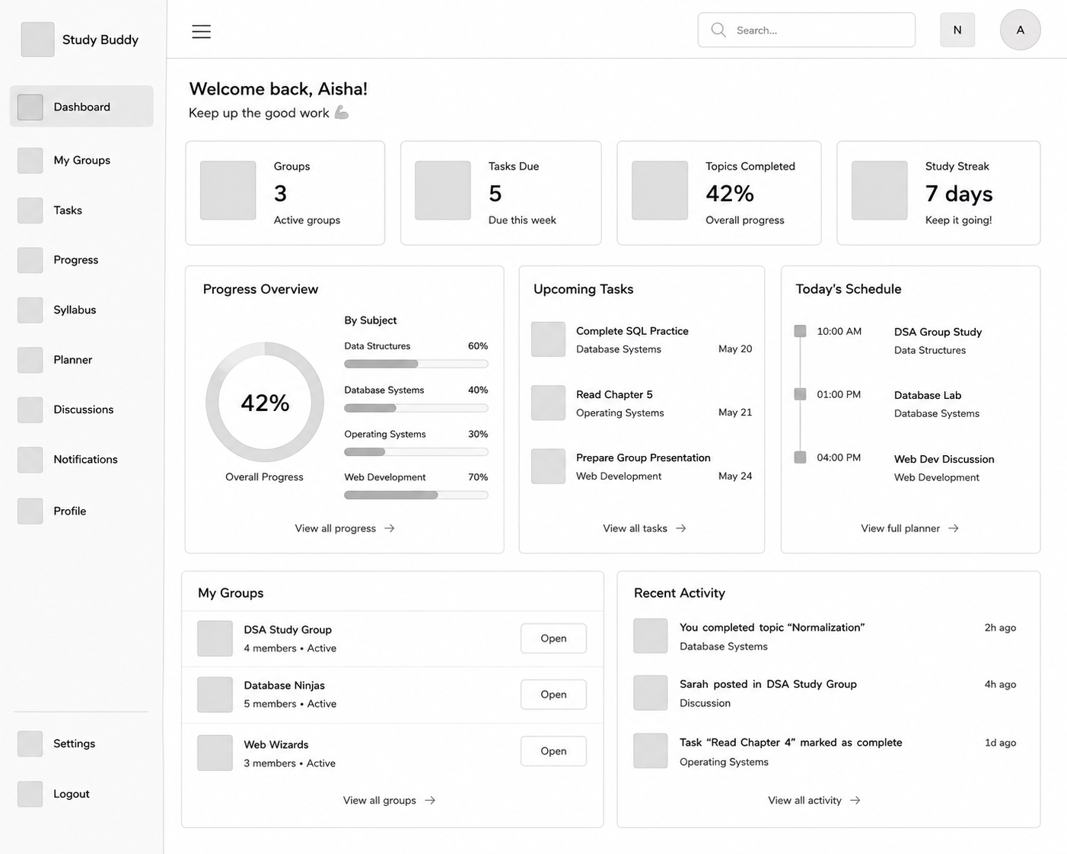
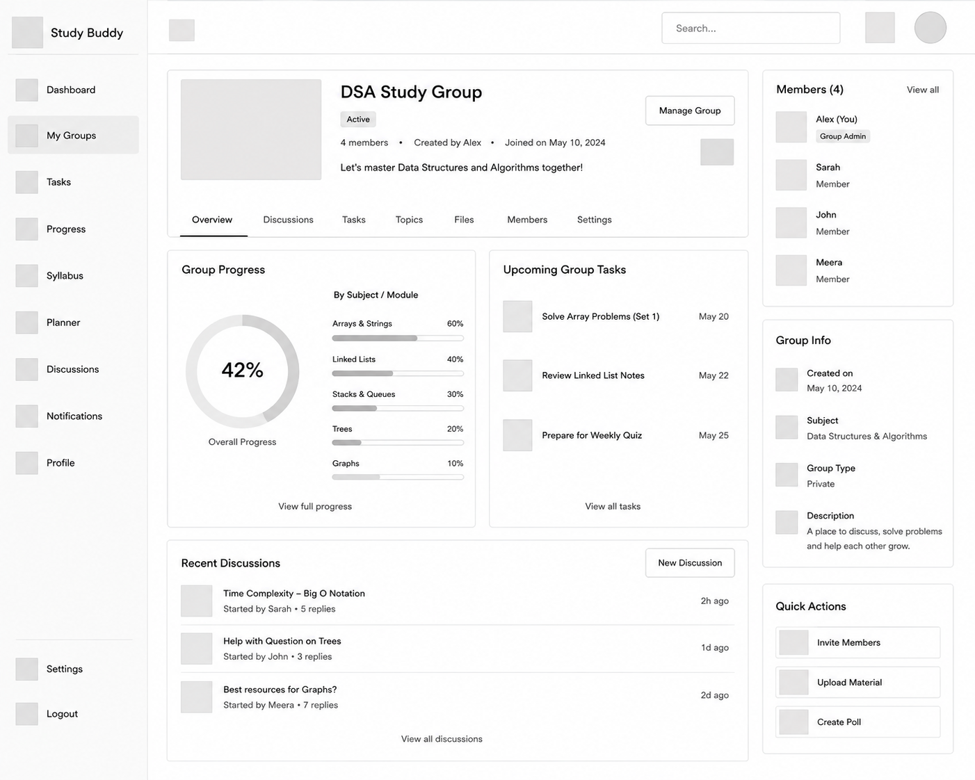
PHASE 4 - WIREFRAMING
Low-Fidelity Wireframes
Dashboard
Study Group page
Low-fidelity sketches define layout & hierarchy before visual design - full set in the wireframes document.

Slide 10
PHASE 5 - HIGH-FIDELITY PROTOTYPE
UI Design System
Colour palette
Typography & components
Inter / system font, clear type scale (h1-h6, body, caption)
Components: buttons, inputs, cards, modals, toasts, progress bars
Rounded-2xl glassy cards, gradient accents, soft shadows
Light & dark themes (WCAG AA, colour-blind safe)
Primary
Secondary
Success
#2563EB
#7C3AED
#16A34A
Warning
Error
Neutral
#D97706
#DC2626
#1E293B
The working React app is the high-fidelity prototype - real, interactive, themeable.

Slide 11
SECTION 2
HCI Principles Applied
Nielsen's 10 Heuristics
Shneiderman's 8 Golden Rules
Status visibility, error prevention, consistency, recognition over recall, minimalist design ...
Consistency, shortcuts, informative feedback, closure, reversible actions, user control ...
Accessibility
UX Principles
Semantic HTML + ARIA, full keyboard nav, focus rings, colour-blind safe, WCAG AA, dark mode.
User-centred design, simple navigation, clear feedback, low cognitive load, visual hierarchy.

Slide 12
EVALUATION & FINDINGS
How usable is StudyBuddy?
Heuristic evaluation - usability testing - statistical analysis - content analysis

Slide 13
FINDINGS
Evaluation Methodology
1
2
3
4
Heuristic Evaluation
Usability Testing
Statistical Analysis
Content Analysis
Expert inspection vs Nielsen's 10 heuristics, scored 0-4 severity.
Moderated, task-based testing with 5-8 students; 12 task scenarios.
t-test, Mann-Whitney, Wilcoxon, correlation, chi-square on study data.
Open feedback coded into themes and frequencies (triangulation).

Slide 14
HEURISTIC EVALUATION
Severity Scorecard
0
6
24
24
Catastrophic (S4)
Major (S3)
Minor (S2)
Cosmetic (S1)
Verdict
No blocking (catastrophic) issues.
Strongest: consistency, visibility, accessibility.
Weakest: help & documentation (onboarding).
Overall usability rated: GOOD.

Slide 15
HEURISTIC EVALUATION
Top Findings (Major)
ID | Finding | Heuristic | Severity
H4-1 | Removing a group member fires with no confirmation dialog | Consistency / Error prevention | Major
H5-1 | Login has no client-side validation (blank fields hit API) | Error prevention | Major
H3-1 | No undo for destructive actions (delete group/task/member) | User control & freedom | Major
H9-1 | No React error boundary - a render error crashes the page | Error recovery | Major
H1-1 | No 'session expired' warning before 401 redirect | Visibility of status | Major
H10-1 | No onboarding / help for first-time users | Help & documentation | Major
Every finding is cited to a specific screen / component; full list and P0 fix plan in the report.

Slide 16
USABILITY TESTING
Study Setup
Participants
Method
5-8 university students matching the personas
Moderated, task-based testing + think-aloud
Scenarios
Metrics
12 real tasks with success criteria & time limits
Task success rate, time on task, error rate, SUS

Slide 17
USABILITY TESTING
System Usability Scale (SUS)
+23.6
SUS points gained
What it means
Crossed from 'OK / marginal' to 'good' on the SUS adjective scale.
All 8 retested users improved (no regressions).
Wilcoxon signed-ranks: z = -2.52, p = .012 (significant).

Slide 18
STATISTICAL ANALYSIS
Did the Redesign Work? (Difference Tests)
t(28) = 8.91
Independent t-test - p < .001 - d = 3.25
U = 1
p = .012
Mann-Whitney p < .001
Wilcoxon (SUS)
~32% faster task completion - statistically significant AND a very large effect.

Slide 19
STATISTICAL ANALYSIS
Correlation & Categorical Findings
rho = -0.89
Comfort vs speed (Spearman) - p < .001
Chi-square findings
Task success depends on UI: 14/15 vs 8/15, chi2(1)=6.14, p=.013.
Theme preference: Dark leads (11/20) but p=.086 - not significant.
So we ship a toggle, not a forced theme.

Slide 20
FINDINGS
Content Analysis of Open Feedback
Triangulation
Qualitative themes echo the quantitative results - speed, reliability and dark mode - and independently confirm the heuristic 'onboarding' and 'undo' gaps.

Slide 21
RESPONSE
Final Redesign & Impact
From findings to a measurably better product

Slide 22
FINAL REDESIGN
Feedback to Change
Finding | Change made | Status
Notifications never marked read | Call correct endpoint; bind to isRead | Done
Planner checkboxes didn't persist | Bind completion to backend status field | Done
Dashboard / progress showed empty data | Global camelCase<->snake_case API bridge | Done
UI felt flat; users wanted dark mode | Vibrant refresh + persistent light/dark toggle | Done
No confirm / undo / onboarding (heuristic) | Confirm dialogs, undo, help page | Backlog (P0)

Slide 23
FINAL REDESIGN
Measured Impact
-32%
56 -> 80
8/15 -> 14/15
Task completion time
SUS usability score
Syllabus task success
Bottom line
Every headline improvement is statistically significant (p < .05) AND a large effect.
Critical data-flow defects fixed at their architectural root, not patched per screen.
Accessible dark/light theming shipped; remaining P0 items scoped for the next iteration.

Slide 24
Conclusion
1
Complete A working, study-focused web app - frontend, backend and database.
2
Principled Major HCI principles applied AND verified, not merely claimed.
3
Proven Significant, large gains in speed, success rate and satisfaction.
4
Accessible Responsive, keyboard-friendly, colour-blind safe, light & dark.

Slide 25
NEXT ITERATION
Future Work
Onboarding tour + in-app help (top usability gap).
Undo + confirmation on all destructive actions.
Real-time notifications (WebSocket) & calendar sync.
Native mobile apps and offline mode.
Larger-sample usability study to settle the theme-preference question.

Slide 26
Thank You
Questions & Discussion
StudyBuddy - Human-Computer Interaction Project

