Slide 1
UofT SCS FinTech Book Camp
Project 1 – Team 1 Presentation
Ambreen Simon, George Barbuc, Katie Gouinlock, Keiran Gugula
Thursday November 12, 2020

Slide 2
Motivation
Hypothesis: payment for investment management and related services provides negligible returns over those cultivated from a “passive” strategy
Is a unique portfolio management strategy worth additional fees?
Findings: portfolio’s with explicit investment strategies outperformed, more research necessary, caveats to analysis

Slide 3
Summary
Is a unique portfolio management strategy worth additional fees?
For this project we will examine three different possible portfolio management strategies that an investor would potentially pay for when choosing an investment product, and compare the result of those strategies over time as to a simple strategy that simply owns the S&P 500 (US equities), as a means of determining whether the different strategy is worth the fee paid by an investor.
We have defined our scope of study as the following three hypothetical portfolios:
Base Case | S&P 500 (SPY ETF)
Portfolio 1 | Low Volatility (i.e. low Beta)
Portfolio 2 | High Volatility (i.e. high Beta)
Portfolio 3 | Randomly select 50 stocks
*Each portfolio contained 50 securities

Slide 4
Questions & Data
Questions | Objective | Data Required | Where is was found
Is a unique portfolio management strategy worth additional fees? How does a randomly selected portfolio perform? What does the performance of a high volatility vs. low volatility look like? | Evaluate performance of the different portfolios using MC simulation | Historical stock market data from relevant securities Tickers included in chosen index to pass into call for historical data | Yahoo Finance (yfinance)

Slide 5
Data Cleanup and Exploration
Confirm data sources
Format & Organize Data
Standard data cleaning procedure
Import data
Confirm data
sources
Format and organize data
Standard cleaning procedure performed

Slide 7

Data Analysis
Once the data was cleaned and formatted properly…
Convert closing prices into daily returns
Calculate Beta’s for each ticker
Attach Beta numbers to original data frame
Construct portfolio’s based on predefined metrics (e.g. low beta = securities with 50 smallest betas)
Pass portfolio’s through MC and visualize

Slide 8
Creating a function to calculate the betas of our df and save it into a dictionary

Slide 9
Concatenating ‘Beta’ information onto df with historical
stock prices

Slide 10
Portfolio construction – high volatility and low volatility

Slide 11
Discussion
Findings:
portfolios with explicit investment strategy outperformed slightly, however, we don’t believe results can be generalized due to limitations in research conducted
Conclusions:
Directing investments towards a ‘theme’ may yield higher returns (i.e. low volatility index, emerging markets, dividend portfolio)
Not clear if active strategies are worth their weight in terms of the additional basis points paid in commission (limitations to research conducted)

Slide 12
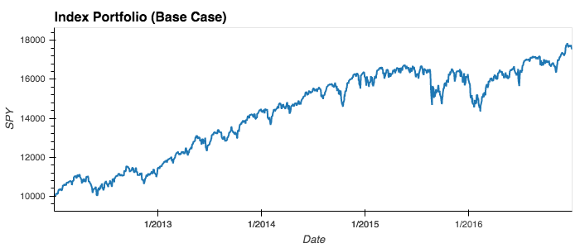
Results:

Slide 13
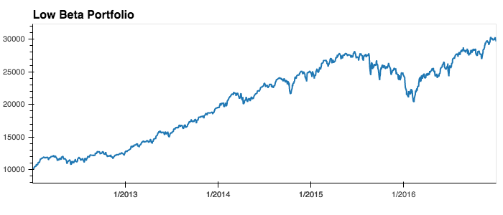
Results:

Slide 14
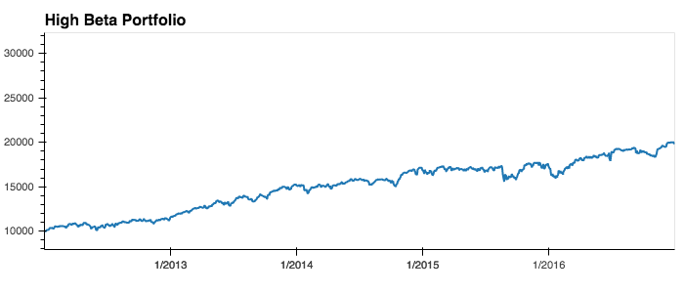
Results:

Slide 15
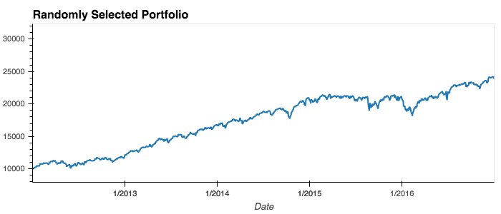
Results:

Slide 16
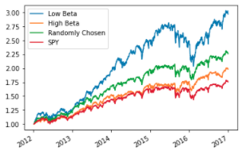
Relative portfolio performance:

Slide 17
Reflection on Analysis
Difficulties | Limitations | Caveats
Integrity of data from original source (AlpacaAPI) led to our group switching data sources very late | Returns data did not take into account dividends that could have been reinvested Did not have the time or resources to collect data from multiple stock exchanges MC simulation forecasts results retrospectively | Portfolios with “unique” investment strategies were not really active in nature (i.e. no rebalancing or changes made to the portfolio during the forecast period) During the years that the historical data was collected stock market returns we’re abnormally strong

Slide 18
Reflection on Analysis
What would you research next if you had two more weeks?
Same concept, but would apply machine learning algorithms to better reflect reality of “active” investment strategies, and so that historical returns data was not just forecast into the future

Slide 19
Q&A Thanks for listening!

