Slide 1

NextLead AI
AI Powered CRM Lead Management Platform
Project Presentation
Made By: Ambreesh Shukla

Slide 2




Problem Statement & Objectives
Problems with Manual Lead Management
Project Objectives
Build an AI-assisted CSV import that auto-maps fields to CRM schema
Sales teams waste hours manually entering leads from CSV files
Provide a real-time dashboard with lead analytics and status tracking
Inconsistent field naming across CSV exports causes data loss
Deliver a fully containerized, deployable CRM platform
No intelligent mapping — wrong data ends up in wrong fields

Slide 3






Technology Stack
A modern, production-grade stack powering every layer of NextLead AI.
Next.js
TypeScript
React-based framework for fast, server-rendered UI with seamless routing
Type-safe development across both frontend and backend codebases
Node.js + Express
Google Gemini AI
RESTful backend API handling all business logic and data operations
Powers intelligent CSV field extraction and automatic column mapping
Docker
Vercel + Render
Containerized deployment ensuring consistent environments everywhere
Cloud deployment platform hosting the live production application

Slide 4

System Architecture
Layer Breakdown
01
User (Browser)
Interacts via Next.js frontend at nextlead-ai.vercel.app
02
Frontend Layer
User Browser
Express Backend
Data Storage
Next.js handles routing, UI, CSV preview, and dashboard rendering
Interact via browser
API and routing layer
Persist logs and records
03
Backend API
Next.js Frontend
Express.js processes uploads, manages leads, and calls AI services
Gemini AI
UI at nextlead-ai.vercel.app
Process and enrich requests
04
Five-layer architecture from browser to data storage, with AI processing embedded in the backend pipeline.
AI Processing
Gemini AI extracts and maps CSV fields to CRM schema automatically
05
Data Layer
Leads, analytics, and user data stored and served via API

Slide 5
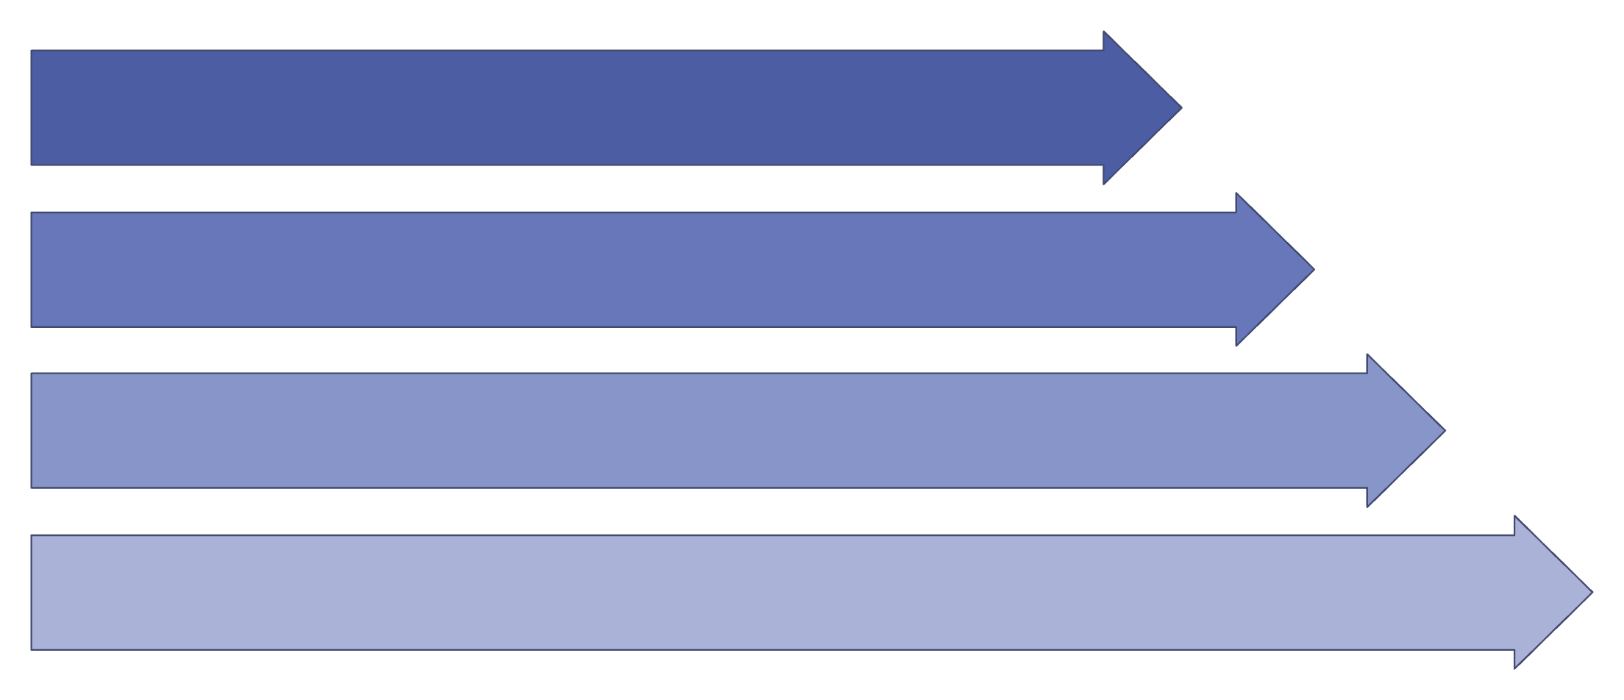
Project Workflow
From raw CSV upload to live dashboard — six intelligent steps powered by Gemini AI.
Upload CSV
AI Extraction
Field Mapping
Preview & Confirm
① Upload CSV
② AI Extraction
User selects a CSV file on the Import Leads page
Gemini AI reads raw columns and detects field intent
③ Field Mapping
④ Preview & Confirm
AI maps CSV columns → CRM fields (name, phone, email, city, remarks)
User reviews mapped data before finalizing the import
⑤ Leads Generated
⑥ Dashboard Updates
Confirmed leads are saved and appear in the Leads page
Analytics, status breakdown, and lead sources refresh automatically

Slide 6







Features Implemented
Dashboard
Import Leads
Leads over time chart, status breakdown donut, top lead sources
CSV upload with 4-step wizard — Upload → AI Extract → Preview → Confirm
AI Field Mapping
Leads Management
Gemini AI auto-maps any CSV layout to CRM schema intelligently
View, search, and manage all imported leads in one place
Analytics Page
Settings
Lead status breakdown, source breakdown, leads over time
Profile update, avatar, theme toggle (light/dark), email notifications
Skipped Rows Detection: Rows with missing contact info are automatically flagged during import — no data loss goes unnoticed.

Slide 7
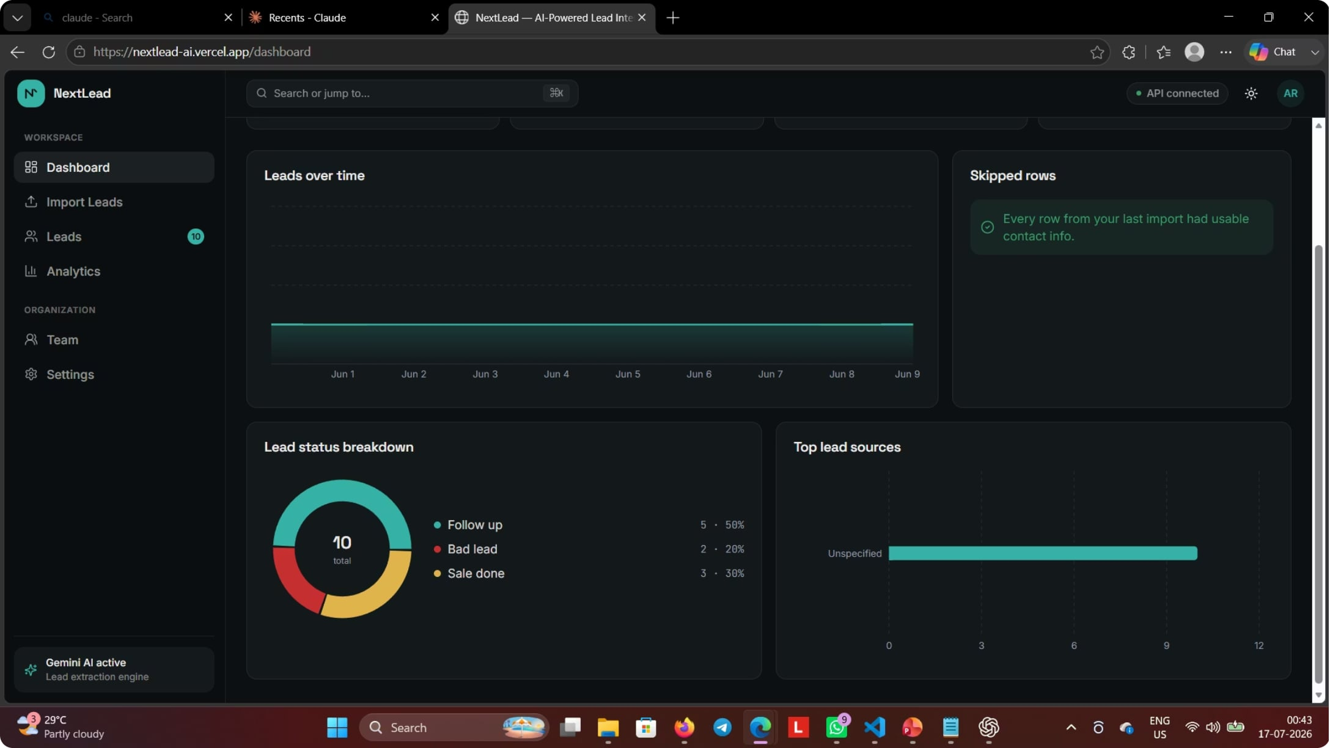
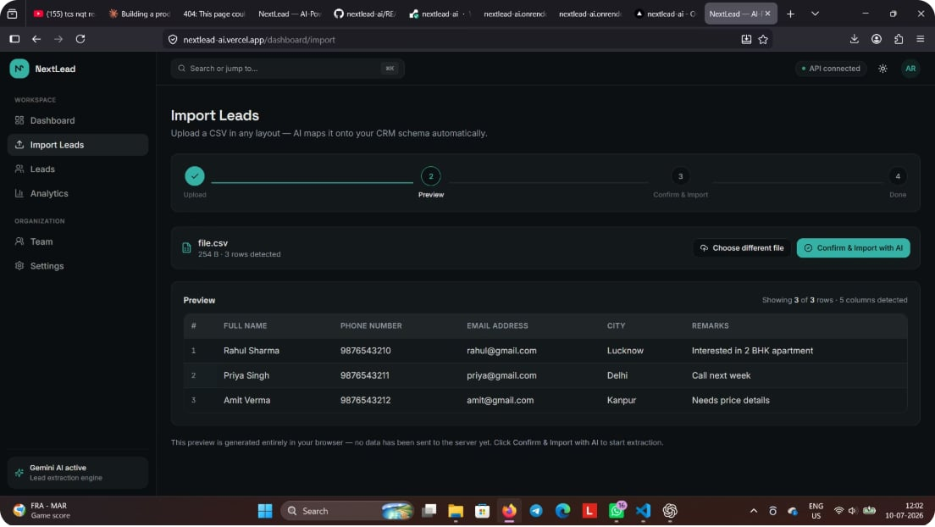
Project Screenshots
AI-Powered CSV Import — Gemini auto-maps columns to CRM fields
Live Dashboard — Leads over time, status breakdown & source analytics

Slide 8
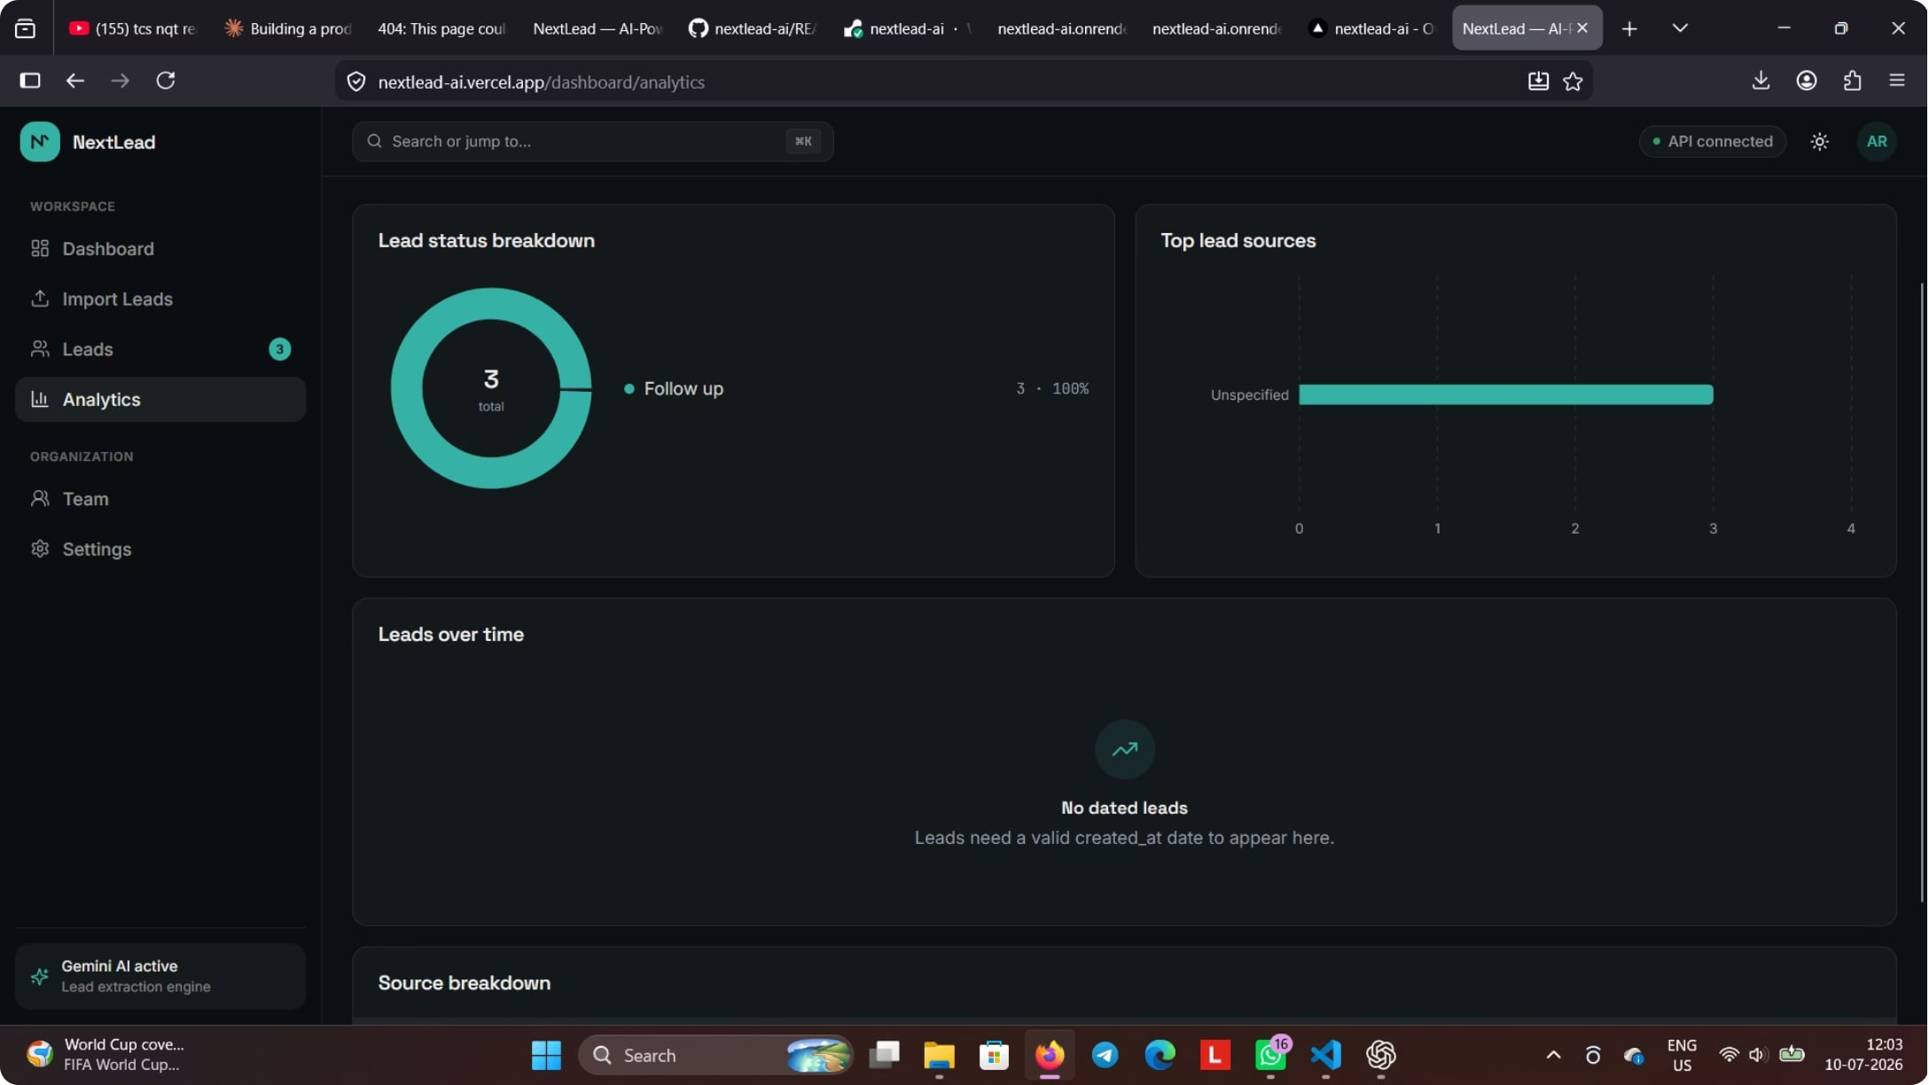
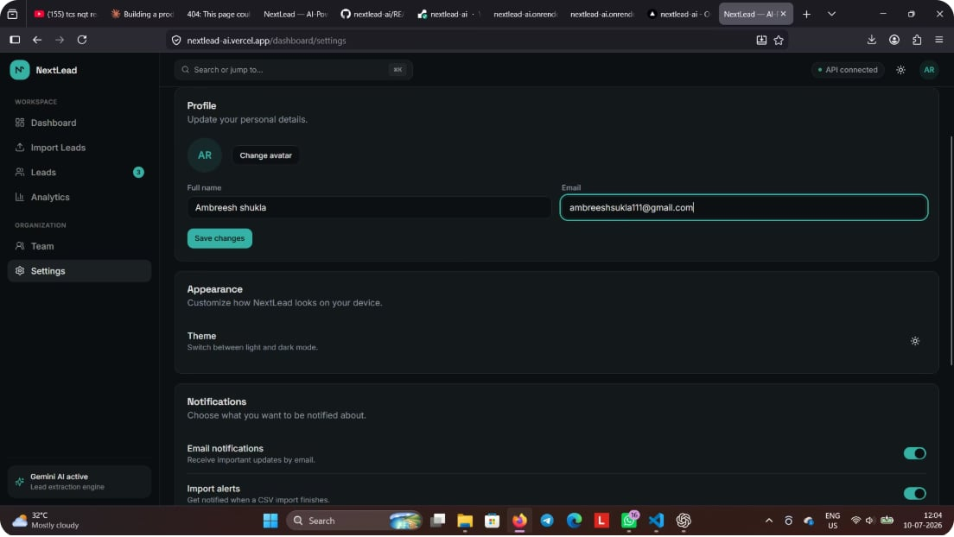
Analytics & Settings
User Settings — Profile, avatar, theme toggle & notification controls
Analytics Page — Status breakdown, source distribution & lead trends

Slide 9

Docker Implementation
Backend: Express API
Frontend: Next.js
Why Docker?
Container Architecture
Container 1: Next.js Frontend — deployed on Vercel
Container 2: Express Backend API — deployed on Render
docker-compose
A single docker-compose up command spins up the entire full-stack environment locally.
🚫 No "Works on My Machine"
📦 Isolated Containers
☁️ Cloud Ready
Identical environment across dev, staging, and production
Frontend and Backend run independently with clean separation
Simplifies deployment to any cloud provider or server in minutes

Slide 10

Challenges, Learnings & Conclusion
Challenges Faced
Key Learnings
AI Integration
CSV Parsing
NextLead AI successfully delivers an intelligent, end-to-end CRM lead management platform — from AI-powered CSV import to live analytics — built and deployed as a containerized full-stack application.
Crafting reliable prompts for Gemini to map arbitrary CSV columns consistently
Handling varied formats, encodings, and missing/skipped rows gracefully
Thank You! — Made By: Ambreesh Shukla
Docker Networking
Real-time Analytics
Configuring multi-container networking between frontend and backend services
Keeping dashboard charts in sync automatically after each import
Full-Stack Mastery
AI Prompt Engineering
DevOps with Docker
Production-like development with Next.js + Express end-to-end
Practical experience with Google Gemini API in a real product
Containerization and deployment using Docker Compose

Slide 11
Sources
Screenshot 2026-07-17 004353.png
Screenshot 2026-07-10 120257.png
Screenshot 2026-07-10 120354.png
Screenshot 2026-07-10 120454.png

